Slide 1
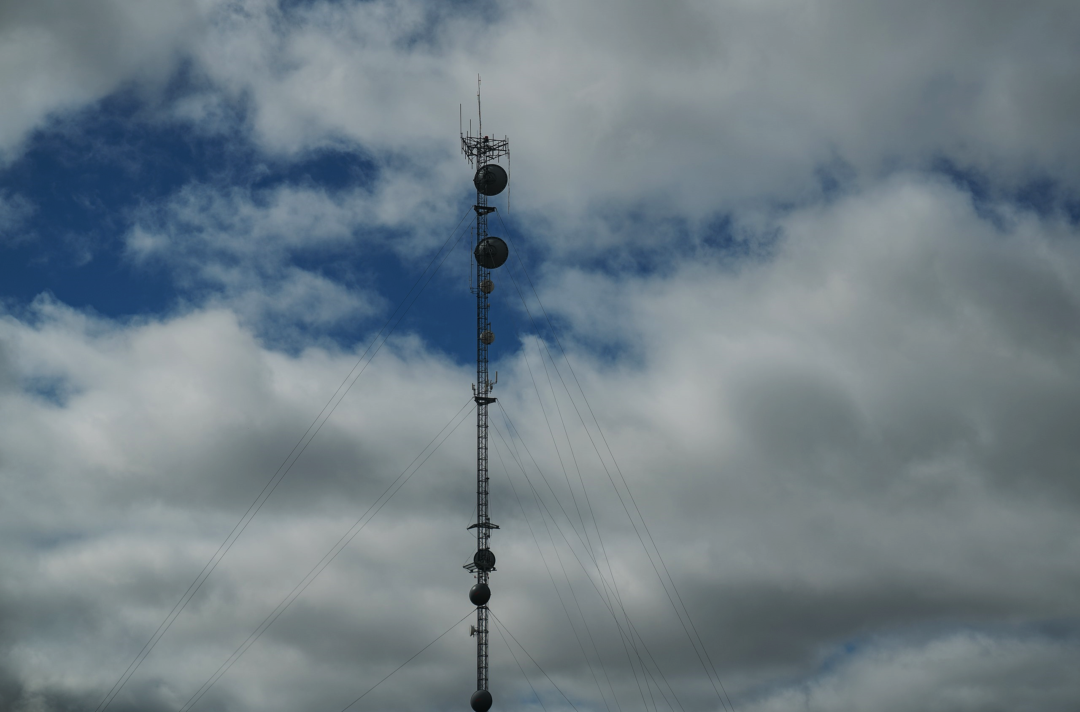
A Flexible Architecture for Monitoring Public Safety Communications using GNU Radio, RFNoC, and Python
Aaron Rossetto

Slide 2
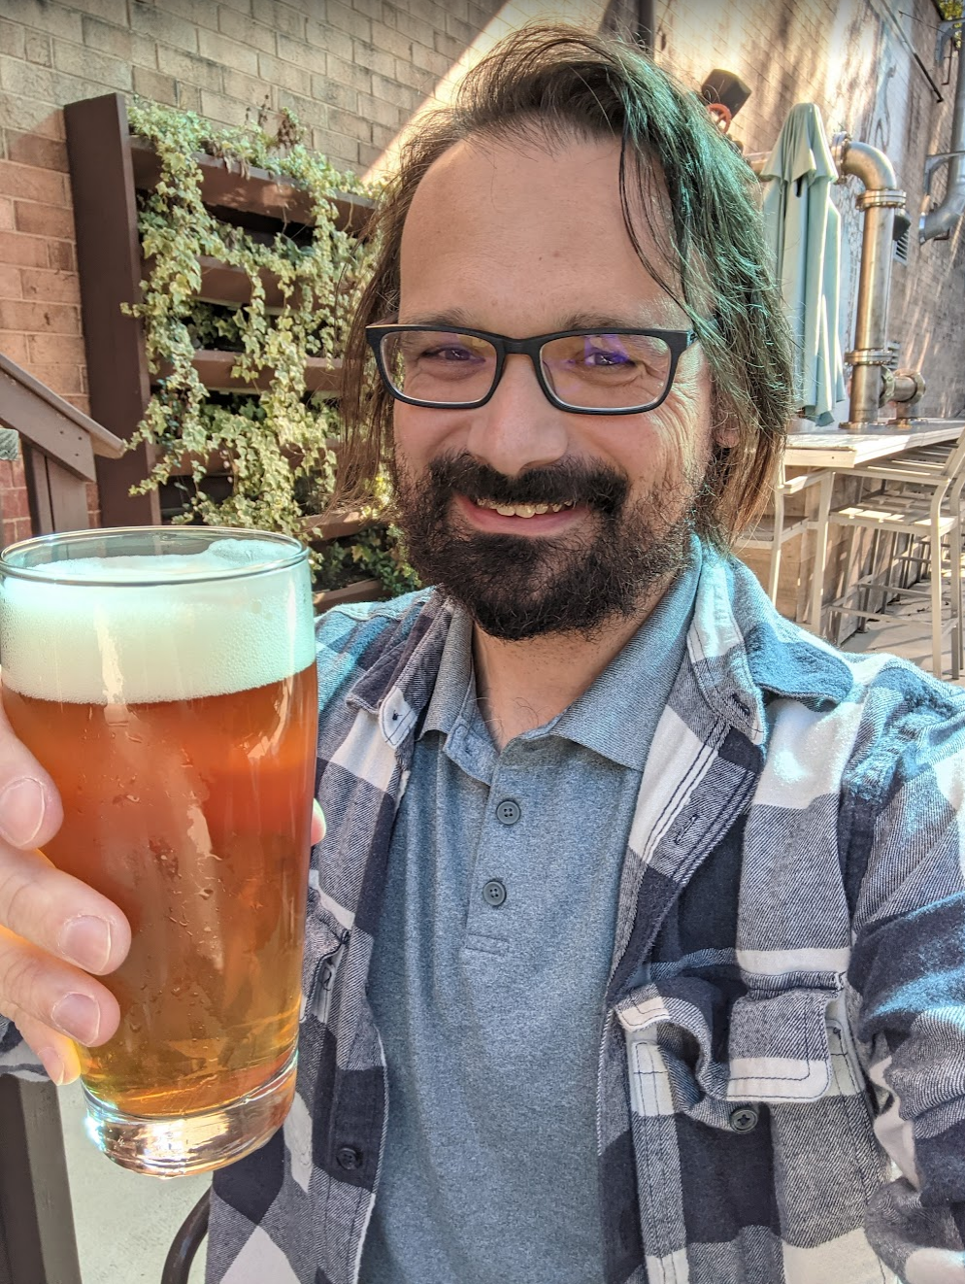
About Me
Former NI/Ettus employee and UHD maintainer
GRCon presentations
Exploring RFNoC with the UHD Python API
Meet the Family: RFNoC Blocks in UHD
Amateur Radio Meetup: A Look at Project 25 Digital Radio
Long-time SDR and public safety monitoring enthusiast
Notes:
What do I mean by public safety monitoring enthusiast? What exactly does that entail?

Slide 3
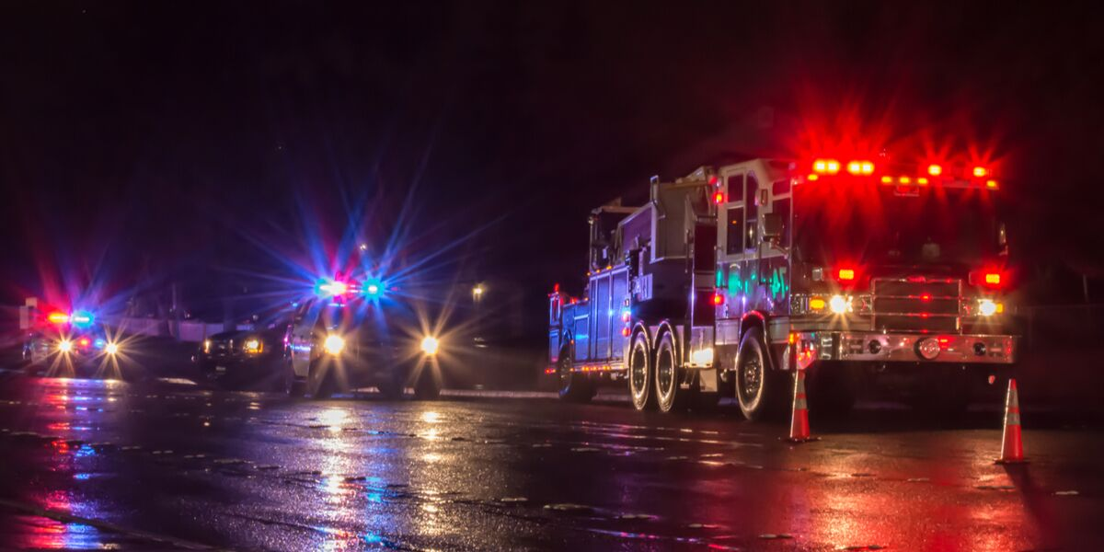
Public Safety Monitoring
Listening to the radio communications of first responders, local, state, and federal agencies, and other governmental and community organizations as they respond to emergent situations, and the equipment and techniques used to do so
Notes:
This can be for any number of reasons: entertainment, information, governmental oversight, etc.

Slide 4
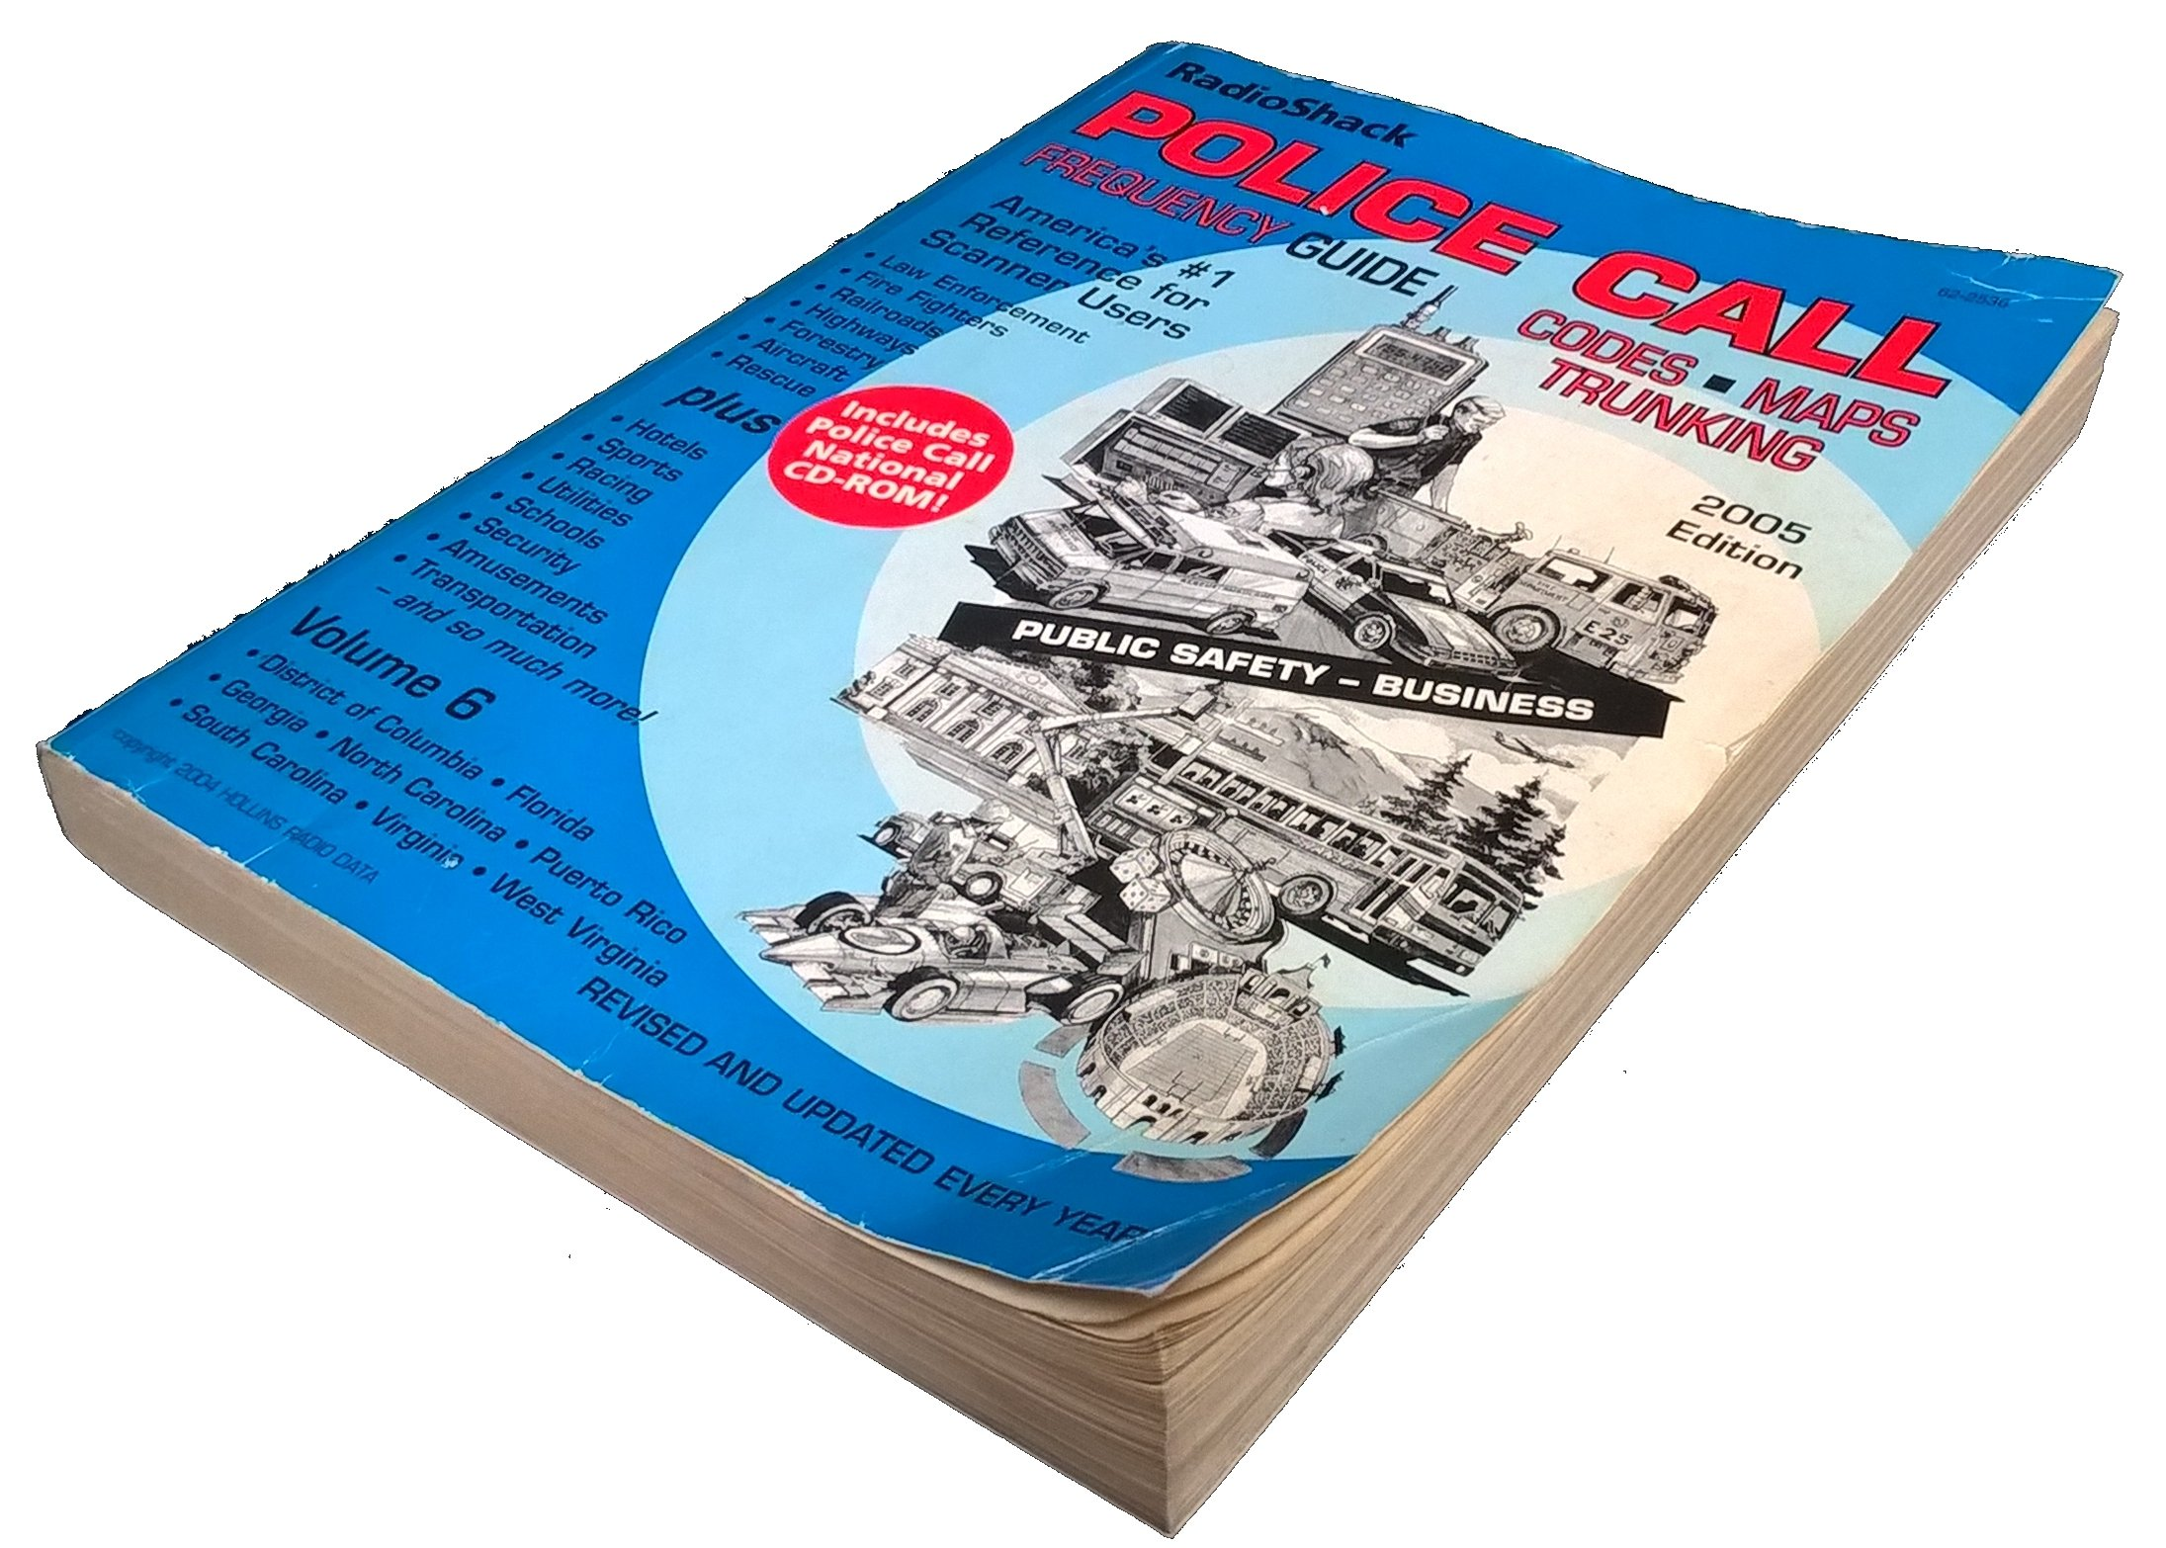
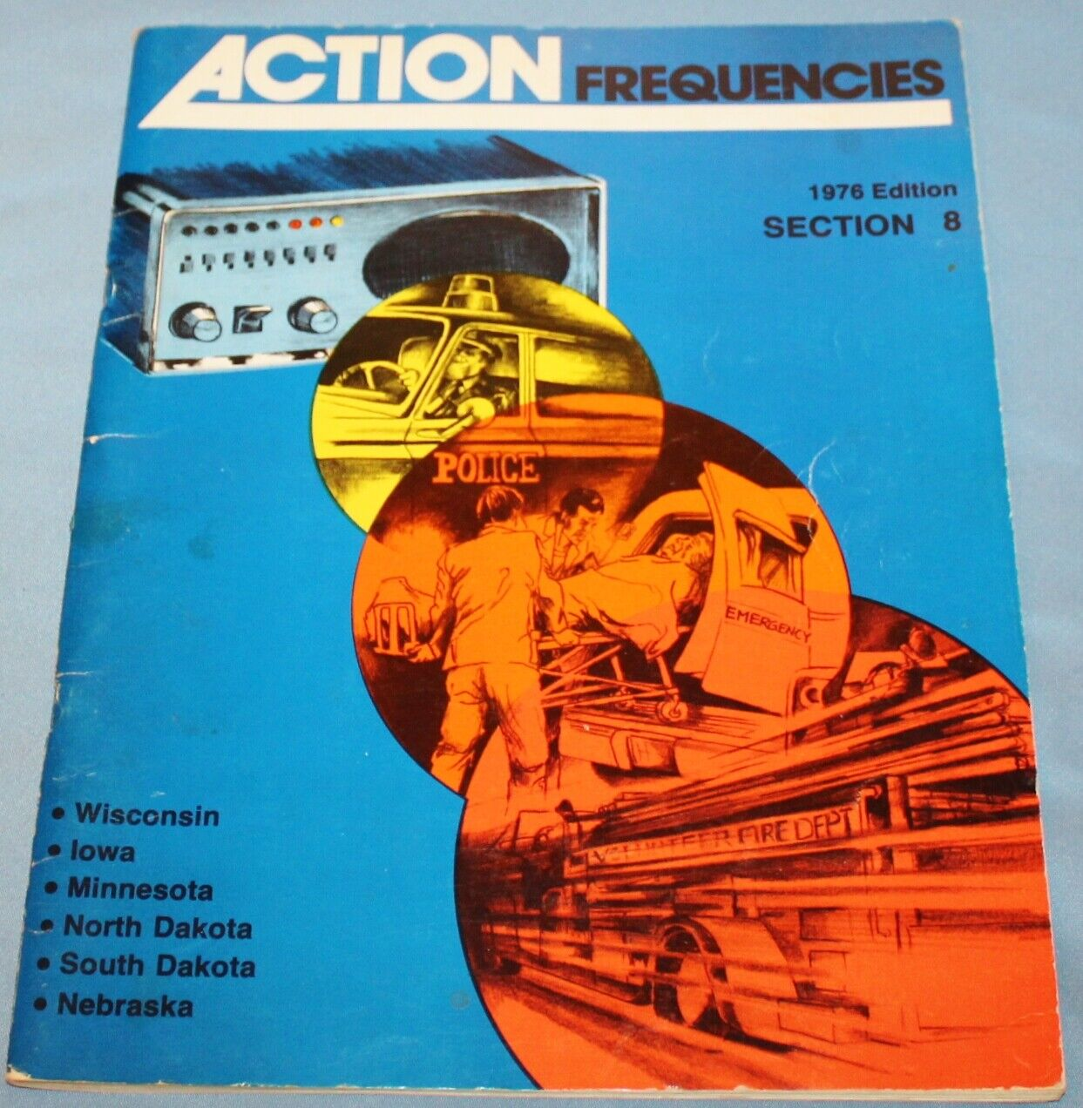
Public Safety Monitoring
Notes:
First, you need to know how to tune into the radio communications of the agencies of interest. Back in the day, you’d get a copy of a publication like Police Call or Action Frequencies for your area and look up the frequencies they used. These days, online databases like Radio Reference provide quick, searchable access to frequencies worldwide.
But listening to public safety communications is a little different that tuning in your favorite rock ‘n’ roll or news stations and keeping the dial there. Agencies have their own unique frequencies which they use and it’s simply impossible for a human to jog a tuning knob between more than just a few channels. Thus, specialized receivers known as ‘scanners’ were created to do just that.

Slide 5
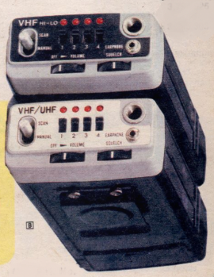
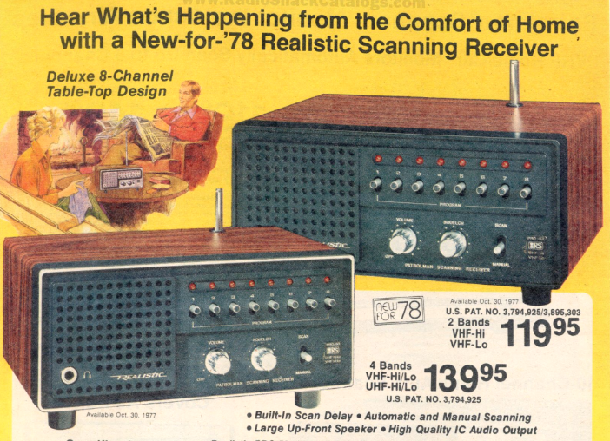
Scanners
Notes:
The scanner gets its name because it is can quickly and automatically tune to a set of frequencies very quickly in succession, looking for the presence of a signal above a certain strength (the squelch threshold) that would indicate communications happening on that frequency. When the frequency is in use, it unmutes the speaker and plays the communications, then returns to scanning once the communication is over. Here are some classic examples from the 70s, which used crystals to tune each frequency. You’d go down to your local Radio Shack (remember them?) and order crystals for the frequencies of the agencies you’d want to monitor, pop them in the scanner, and you’re good to go.

Slide 6
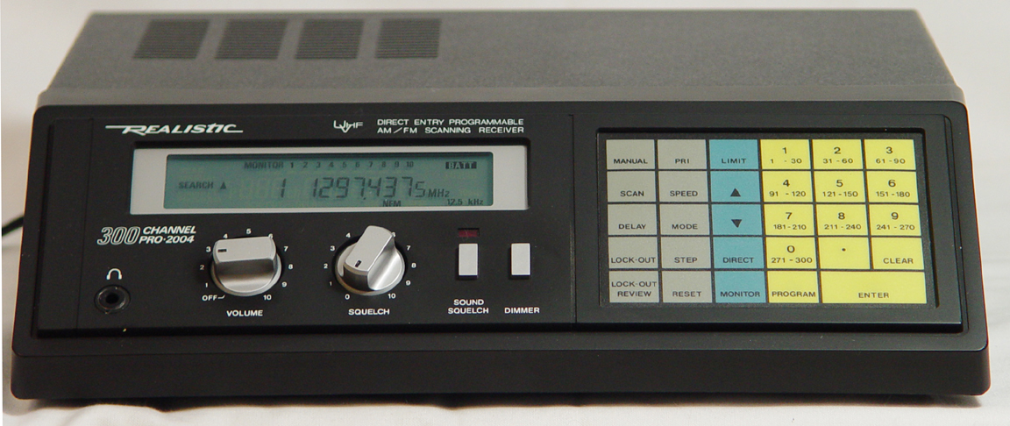
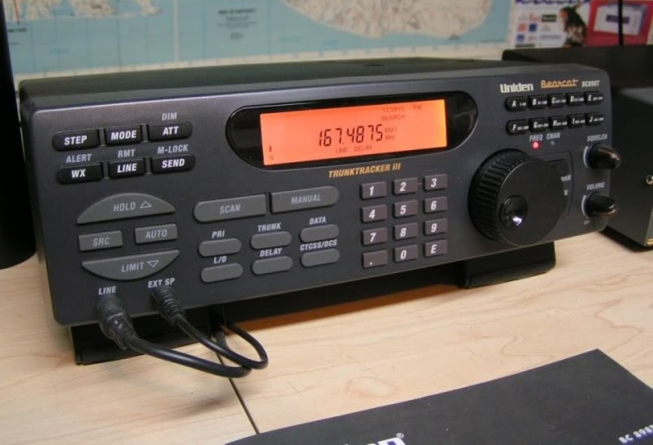
Scanners
Notes:
By the 80s, most scanners had microprocessors and digital synthesizers that allowed for faster scanning speeds and direct keypad entries of frequencies. They also began to incorporate interfaces for computer command and control of scanning operations. Scanner manufacturers also began to build capabilities for monitoring trunked radio systems, where many agencies share a pool of frequencies and a computer arbitrates the assignment of frequencies to users dynamically by sending messages to a digital control channel that all radios tune and constantly monitor.

Slide 7
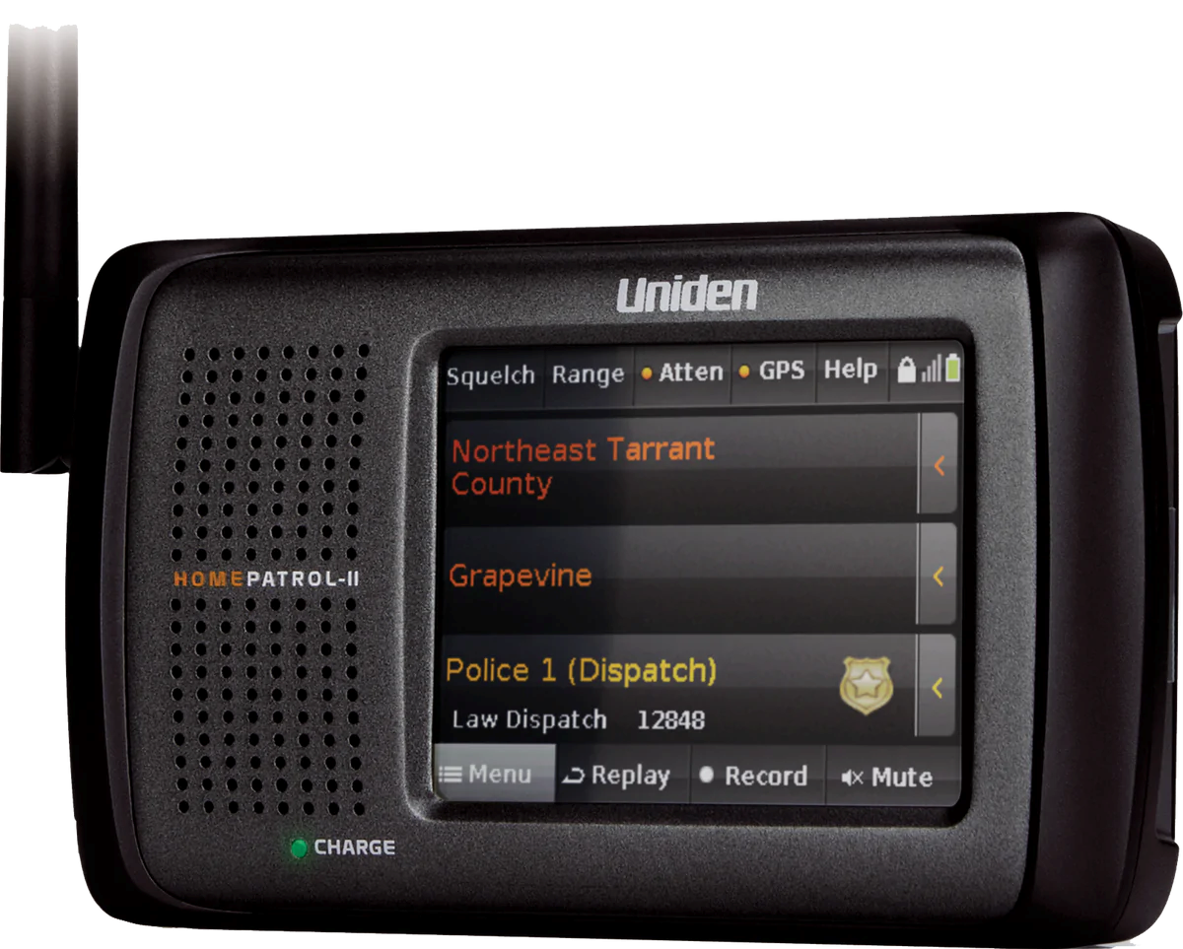
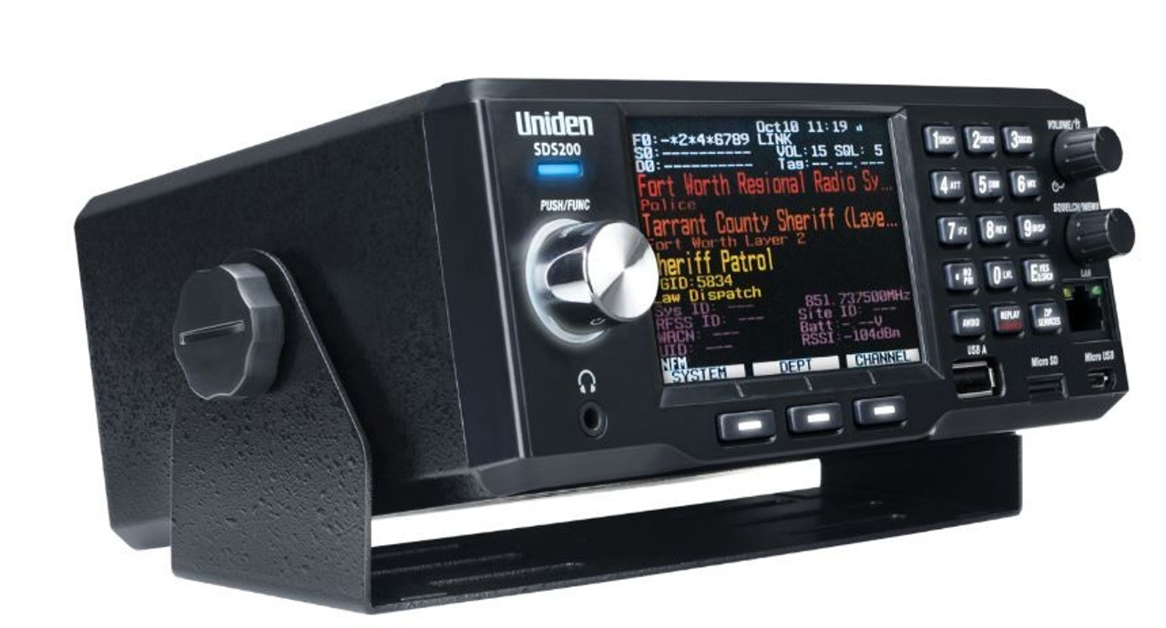
Scanners
Notes:
The state of the art includes touch screens and information-rich displays sourced from databases such as Radio Reference, and incorporates modern radio receiver techniques like software-defined radio to allow monitoring of trunked systems which use digital data streams to convey voice and control information.

Slide 8
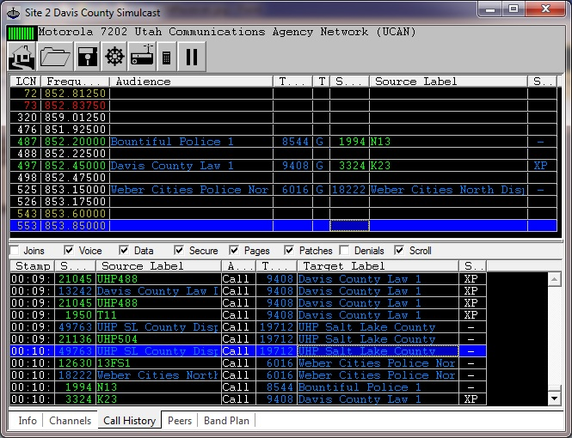
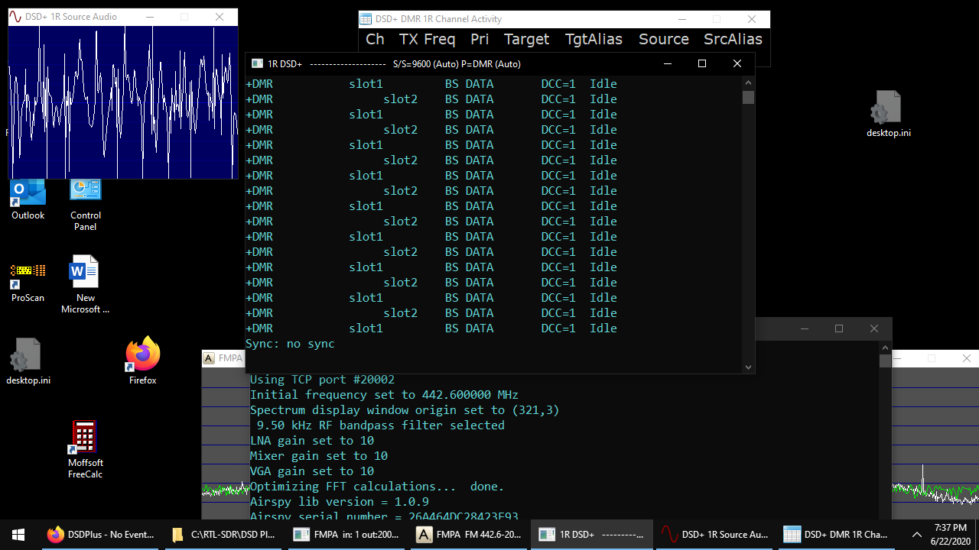
Computer-Based Solutions
Notes:
Of course, for the more adventurous and tech-savvy public safety communications monitor, there are excellent computer-based solutions like UniTrunker and DSD Plus.

Slide 9
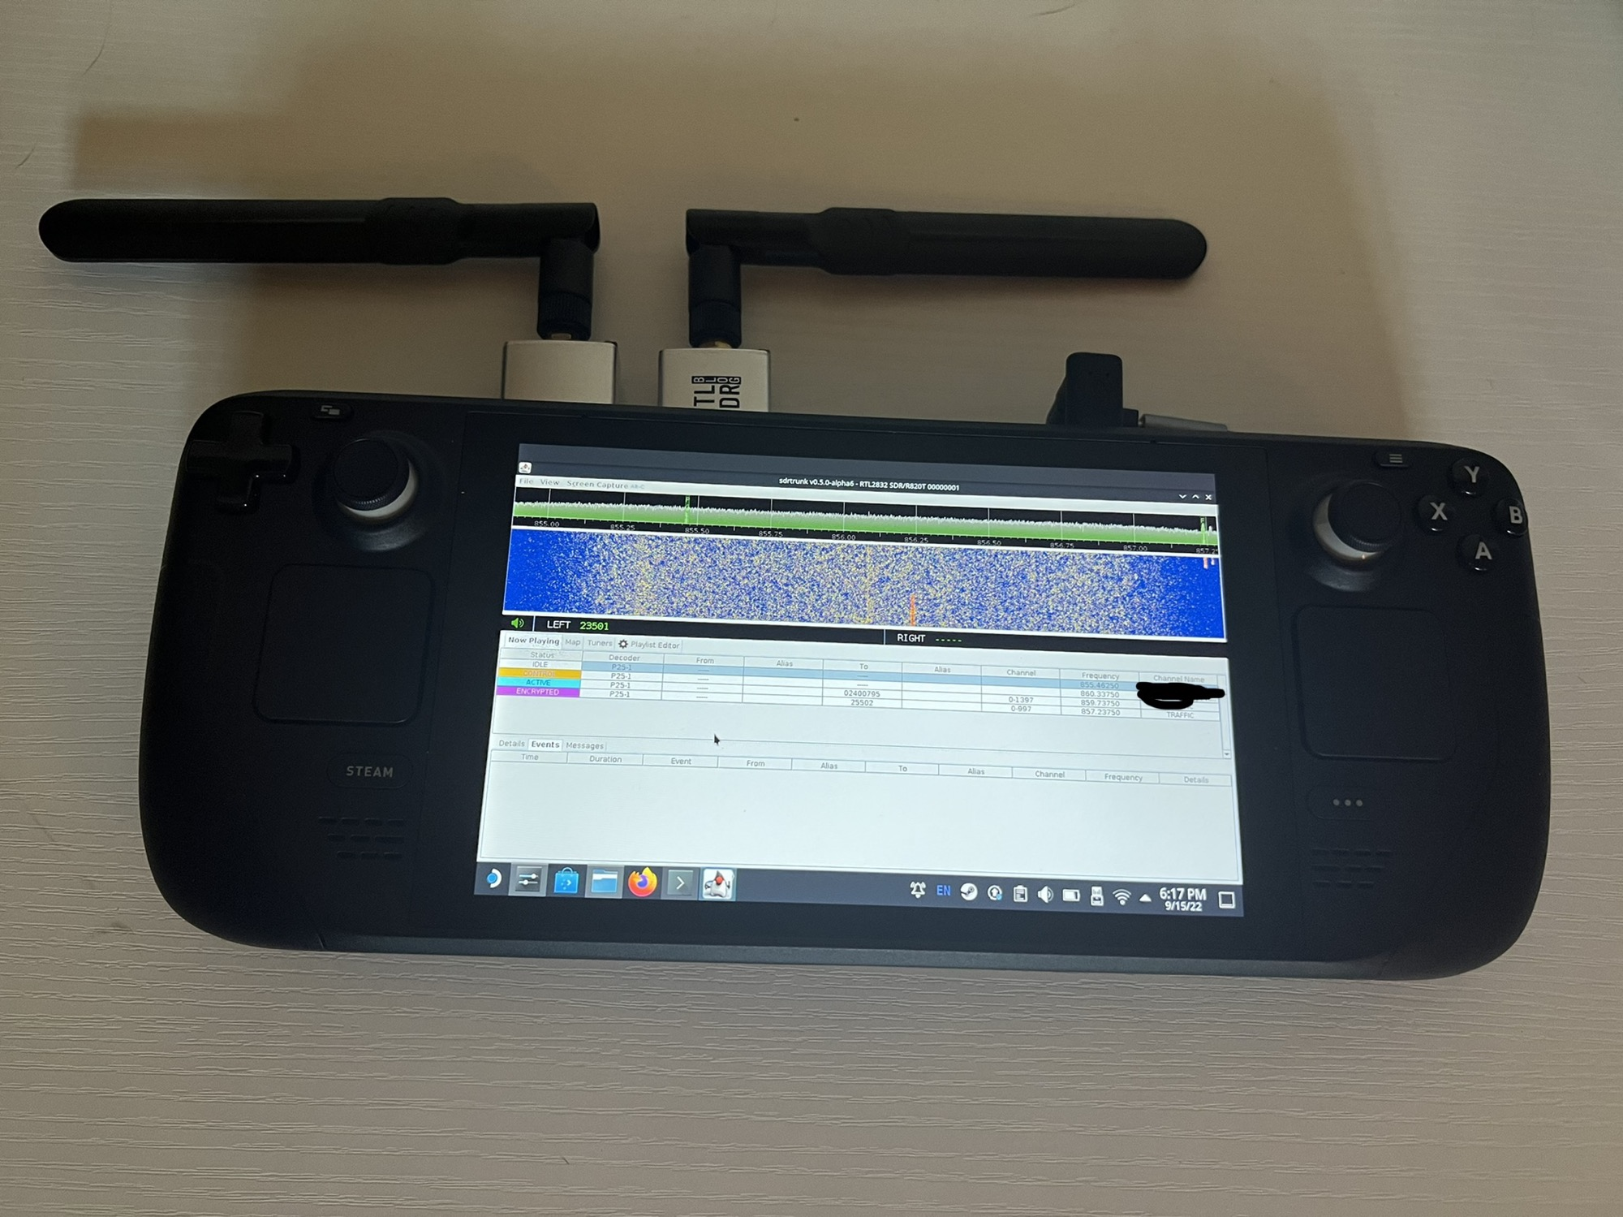
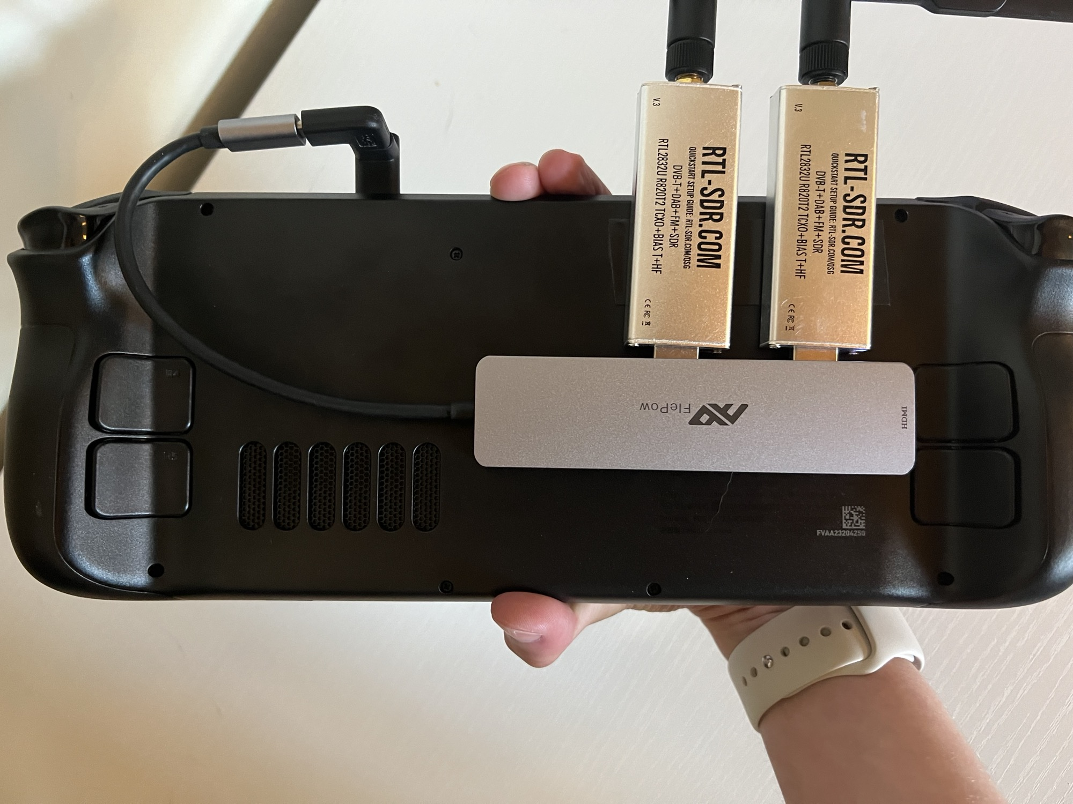
Gaming Platform-Based Solutions
https://old.reddit.com/r/RTLSDR/comments/xf9v16/steam_deck_portable_trunking_setup_using_sdrtrunk/
Notes:
And taken to the ridiculous extreme…

Slide 10
scanner

Slide 11
Monitoring Option Deficiencies
Scanners
Made for broad audiences and common use cases
No or only limited customization possible
Typically have a single tuner
Inscrutable UI/UX design choices
Computer-Based Scanners
Often difficult for novices to use/configure
Require dedicated compute resources
Customization possible with specific knowledge and/or toolset
Inscrutable UI/UX design choices
Notes:
Don’t get me wrong, I’m a big fan of scanners. I’ve been listening since the late 80s and have owned probably seven or eight different units since then. But with both scanners and computer-based scanners, there are some deficiencies, especially as it pertains to creating a custom experience around monitoring. I’ve always longed to have a monitoring solution that meets my personal needs and feature list. Like, I want to be able to create lists of channel groups of interest that can be switched between quickly for different incident types. So if I hear sirens from the firehouse about a quarter mile from my house, I want to select a group with Firecom North, Medcom North, the sheriff’s office, and other channels where the action is likely to be heard.

Slide 12
Notes:
This is a slide I presented as part of my A Look at P25 Digital Radio Systems presentations that I mentioned in my intro. It’s something I’ve always wanted to do, and in the six and a half free minutes I get per day as the father of two kids under the age of 5, I’ve been trying to take small steps in this direction. And what better way to force action than to submit a GRCon abstract!

Slide 13
DIY Scanner Goals
Flexibility above all
Front end flexibility (radio, channel selection, demodulation)
Back end flexibility (the ‘business logic’)
Leverage modern SDR techniques/hardware and software packages
Simplify back end development (the ‘user experience’ bits)
Decouple from and abstract away front end
Insulate implementer as much as possible from communications protocol
Accelerate development via interpreted language and a rich library ecosystem for building monitoring applications
Notes:
I have nothing against GNU Radio Companion and the code it generates, but I want only to have to use GRC if I need to modify the front end. The goal of separating the front and back ends as much as possible is to allow me to make changes to the back end without having to regenerate the GRC code each time. In that vein, another goal was to make the front end code complete without the need for modifications to the generated Python.

Slide 14
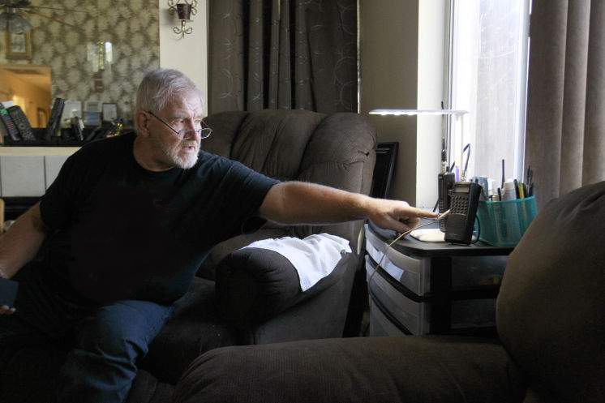
Introducing gr-scanner!
A GNU Radio module to simplify the creation of customized listener-oriented monitoring solutions focusing on P25 trunked public safety radio systems
Notes:
‘gr’ stands for ‘GNU Radio’, not ‘grandpa’, as you might infer from this image…
I will readily admit that while the framework has as a goal to be as flexible as possible as it pertains to communication types, whether conventional analog, trunked analog (Motorola Type 2, EDACS, etc.), or P25, I have but limited resources to work on this, and so I’ve been focusing mainly on capabilities that I want to build custom monitoring solutions that meet my needs.

Slide 15
gr-scanner Overview
Front end
GNU Radio flowgraph for signal acquisition, channel selection, 4FSK demodulation, and P25 message framing
Designed to support multiple simultaneous channel acquisition (e.g., a control channel and a separate traffic channel)
Back end
Python module implementing the ‘business logic’ of the monitoring application
Designed to be decoupled from GNU Radio and front end flowgraph
Data exchange accomplished via lingua franca of JSON messages

Slide 16
Credit Where Credit Is Due
Credit to OP25 project authors and contributors from which I based much of the P25 framer code
gr-op25 uses many similar techniques
Supports more than P25 phase 1 Max H. Parke, KA1RBI Pavel Yazev Jonathan Naylor, G4KLX Hard Consulting Corporation Michael Ossmann <+YOU OR YOUR COMPANY+>
And all the other contributors to GR, UHD, cmake, etc. 👍
Notes:
Credit where credit is due.

Slide 17
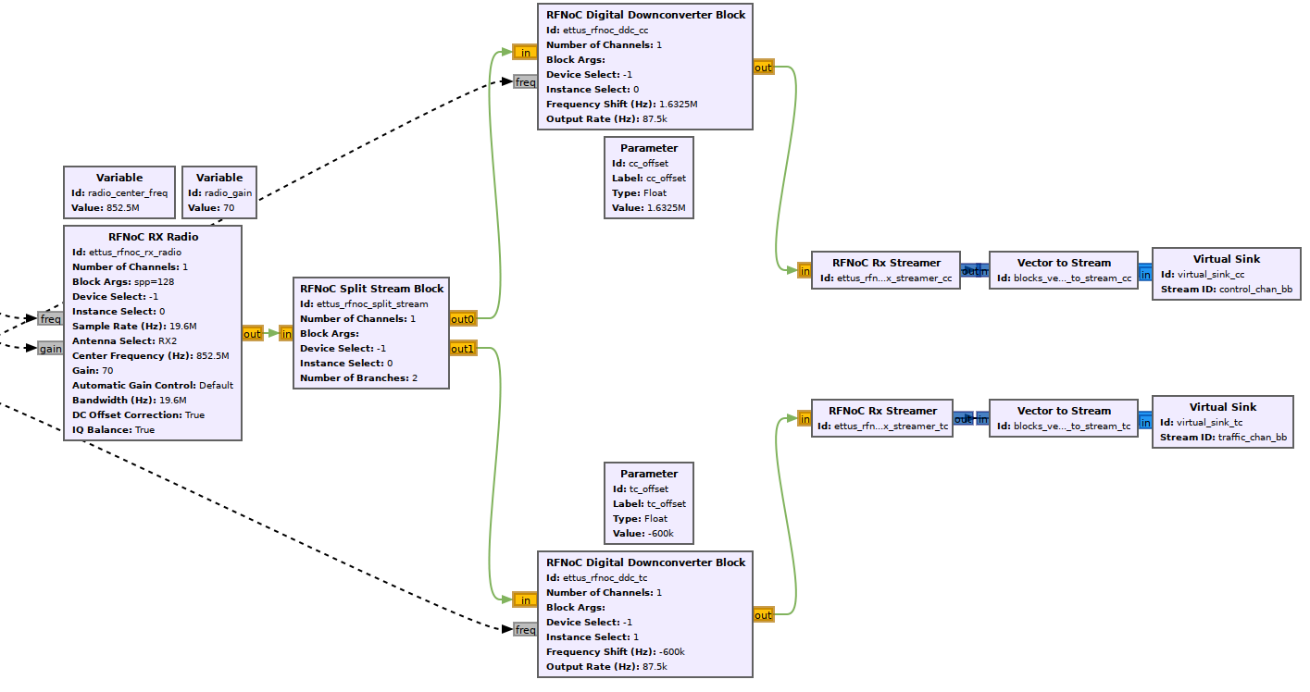
RFNoC Domain
GNU Radio Domain
Notes:
This is a look at the acquisition part of the front end. It’s a pretty wide diagram, so I’ve split it into two.
RFNoC domain: This portion of the flowgraph runs in the E310 and its FPGA using the RFNoC framework. See some of my other GRCon presentations for more information on this. The radio tunes 10 MHz worth of spectrum, then splits the I/Q data into two streams, both of which go through a separate DDC block which downconverts part of that spectrum to about 88 kHz of baseband centered around a given frequency.
While only a small part of the overall graph lives in the RFNoC domain, that’s primarily because the E310 has a relatively modestly sized FPGA, and the end application is simple. But the concept is what’s important here, though. You can imagine that with more FPGA fabric resources, like you might find on the N3xx or X410, you could put more capabilities into the FPGA, such as a polyphase channelizer, quadrature decoder, and a 4FSK demodulator, and output a stream of dibits per radio system channel. That would free up the compute resources for the remainder of the application, and unlocks some incredible abilities.
The streamer acts the bridge between the RFNoC domain and the rest of the GNU Radio flowgraph, where the remainder of the processing takes place.

Slide 18
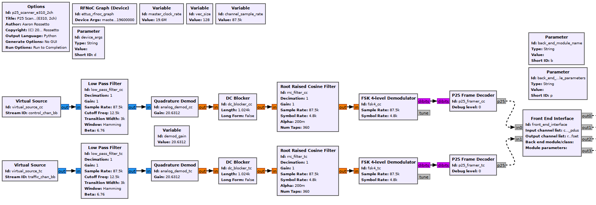
gr-scanner modules
GNU Radio Domain
Notes:
The other half rest of the GNU Radio front end is pretty standard. It is written to perform quadrature demodulation on both channel streams, perform RRC filtering, 4FSK demodulation, then passes the data to a custom GR C++ block which performs P25 frame decoding. That said, there’s nothing preventing this diagram from being modified to do FM demodulation, or Motorola trunked system control channel framing; it’s just set up for a P25 Phase I use case. Also, I used an E310 because I had access to one, but the front end could be rewritten for any supported device with enough tuning range and bandwidth to support the use case.
The FSK 4-level demodulator and P25 frame decoder are based heavily on the gr-op25 implementations of each and were used as a starting point because that code already had P25 framing, error checking and correcting, and IMBE vocoding abilities.
The results of the frame decoder, in the form of PDU messages, go to the unimaginatively named ‘front end interface’ block, but it’s really the lynchpin to how this all should come together.

Slide 19
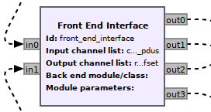
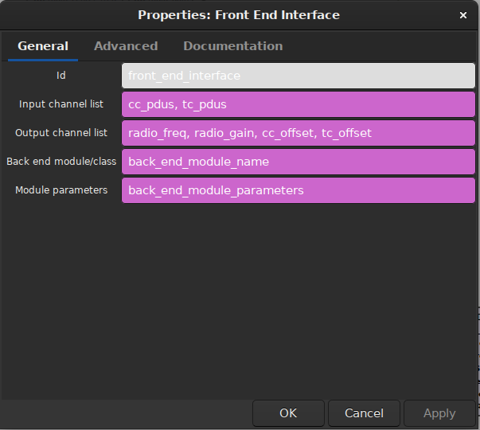
Front End Interface
GNU Radio Python block connecting front and back ends
Loads Python module and instantiates named class with given parameters
Accepts PDUs from input ports and proxies to receive_pdu() on class
Outputs PDUs on output ports from back end via send_pdu() method
Maps inN and outN ports to names provided in input and output channel lists
Notes:
The parameters that get passed to the back end module, in the case of my front end flowgraph, come from the command-line parameters passed to it. So when invoking the front-end code via the command line, it’s possible to switch out back ends and pass it band end-specific parameters based on the application needs.

Slide 20
Front End Interface in P25 Scanner Front End
radio_freq
PDUs (floats) to RFNoC Rx Radio block
PDUs (JSON strings) from P25 framer #1
cc_pdus
radio_gain
cc_offset
PDUs (floats) to RFNoC DDC block
PDUs (JSON strings) from P25 framer #2
tc_pdus
tc_offset
back_end_class.receive_pdu(‘cc_pdus’,
{‘p25_du’: {‘nac’: ‘0x137’, ‘duid’: ‘0x7’,
‘tsbk’: ‘90005235FAE30A5761E1C01264’, ‘ok’: 1}}
send_pdu_fn(‘tc_offset’,
{‘type’: ‘float’,
‘value’: ‘-161500’})

Slide 21
Back End: P25 Scanner
REASONABLY
IDIOMATIC
PYTHON!
Tuning instructions to radio
TSBKs from control channel
LDUs from traffic channel
Python module; no GR dependencies
Base class handling common P25 trunked system decoding tasks
Configures front end radio for trunked system reception
Interprets trunked control channel messages and calls user-defined functions
Decodes digital voice packets on traffic channels to PCM data
Parses trunked system data files from Radio Reference database and provides access via dictionaries
Intended to be subclassed to implement application-specific behaviors
P25 Scanner
Site info Talkgroup info
receive_pdu()
send_pdu()
Trunked
System
Data
tune_traffic_ channel()
CC messages
PCM voice data
Traffic channel selection
self.sites
self.tgs
self.idents
OSP_...()
voice_pcm_data()
P25 Scanner
subclass (application-specific)
Notes:
On its own, the back end P25 scanner class isn’t very useful. But it does provide a lot of value for creating applications by handling a lot of common system decoding and control tasks.
By the way, I’m not the world’s most skilled Python guy. I’m more comfortable in C/C++, but in the years that I helped maintain UHD, I came to really love the flexibility of the language. So while my Python may not be the most idiomatic, I’m getting better at it!
Which is more than I can say for my JavaScript skills. 😐

Slide 22
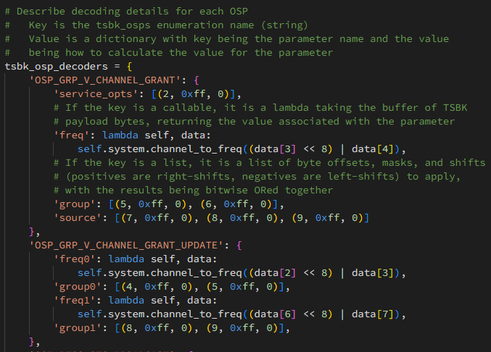
Back End: P25 Decoder Ring
Map of TSBK messages to field names and decoders
List of byte offset, masks, and shifts for each field, or lambda with decoding code
Method with same name as message called on subclass with fields as parameters
def OSP_GRP_V_CHANNEL_GRANT(self, service_opts, freq, group, source):
...
Notes:
Reading through the TIAA specs for trunking control messages and writing decoders for each field sucks, so the scanner back end has a decoder ring which is a way to more succinctly describe how to isolate fields from the TSBK messages by specifying byte offsets, masks, and shifts for each field. For some fields that need a bit more than that, however, a lambda may be provided with the code to compute the value of the field.
Then one of the coolest thing about Python is that the keys in each entry of the decoder map turn into parameter that are passed to a function with the name of the TSBK’s opcode. If the P25 scanner base class finds an appropriately named method in the subclass, it will call it with those parameters. Otherwise, it calls a generic method which just passes down the raw TSBK. That way, application developers need only concern themselves with handling messages that are relevant to their application.

Slide 23
Back End: IMBE Audio Decoder
LDU1/2 P25 DUs on traffic channel port sent to IMBE decoder
Fixed point implementation by Pavel Yazev
Decoder is standalone shared library built alongside gr-scanner
Calls subclass voice_pcm_data() with raw 16-bit PCM data at 8 kHz

Slide 24
Back End: Out Of Process Proxy
Spawns child process and loads specified module and instantiates named class
Creates pipes for IPC with proxy
Provides class with port names and input/output pipe handles
Calls class main_loop()
Serializes receive_pdu() and send_pdu() calls via pipes
Isolates back end from GR Python process

Slide 25
Example: Simple Web Scanner
PoC of mobile-oriented web-based P25 scanner written in Python
View real-time site activity with users
Monitor audio
Lock out or prioritize specific talkgroups
Visual feedback of signal quality
Playground to try out UI/UX ideas and refine framework

Slide 26
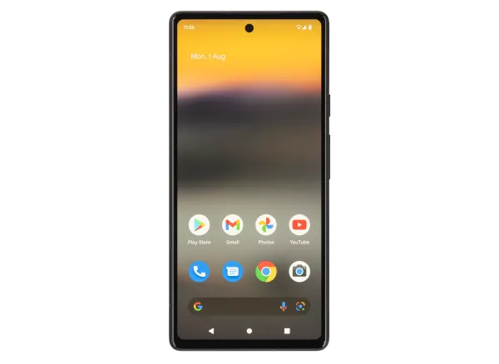
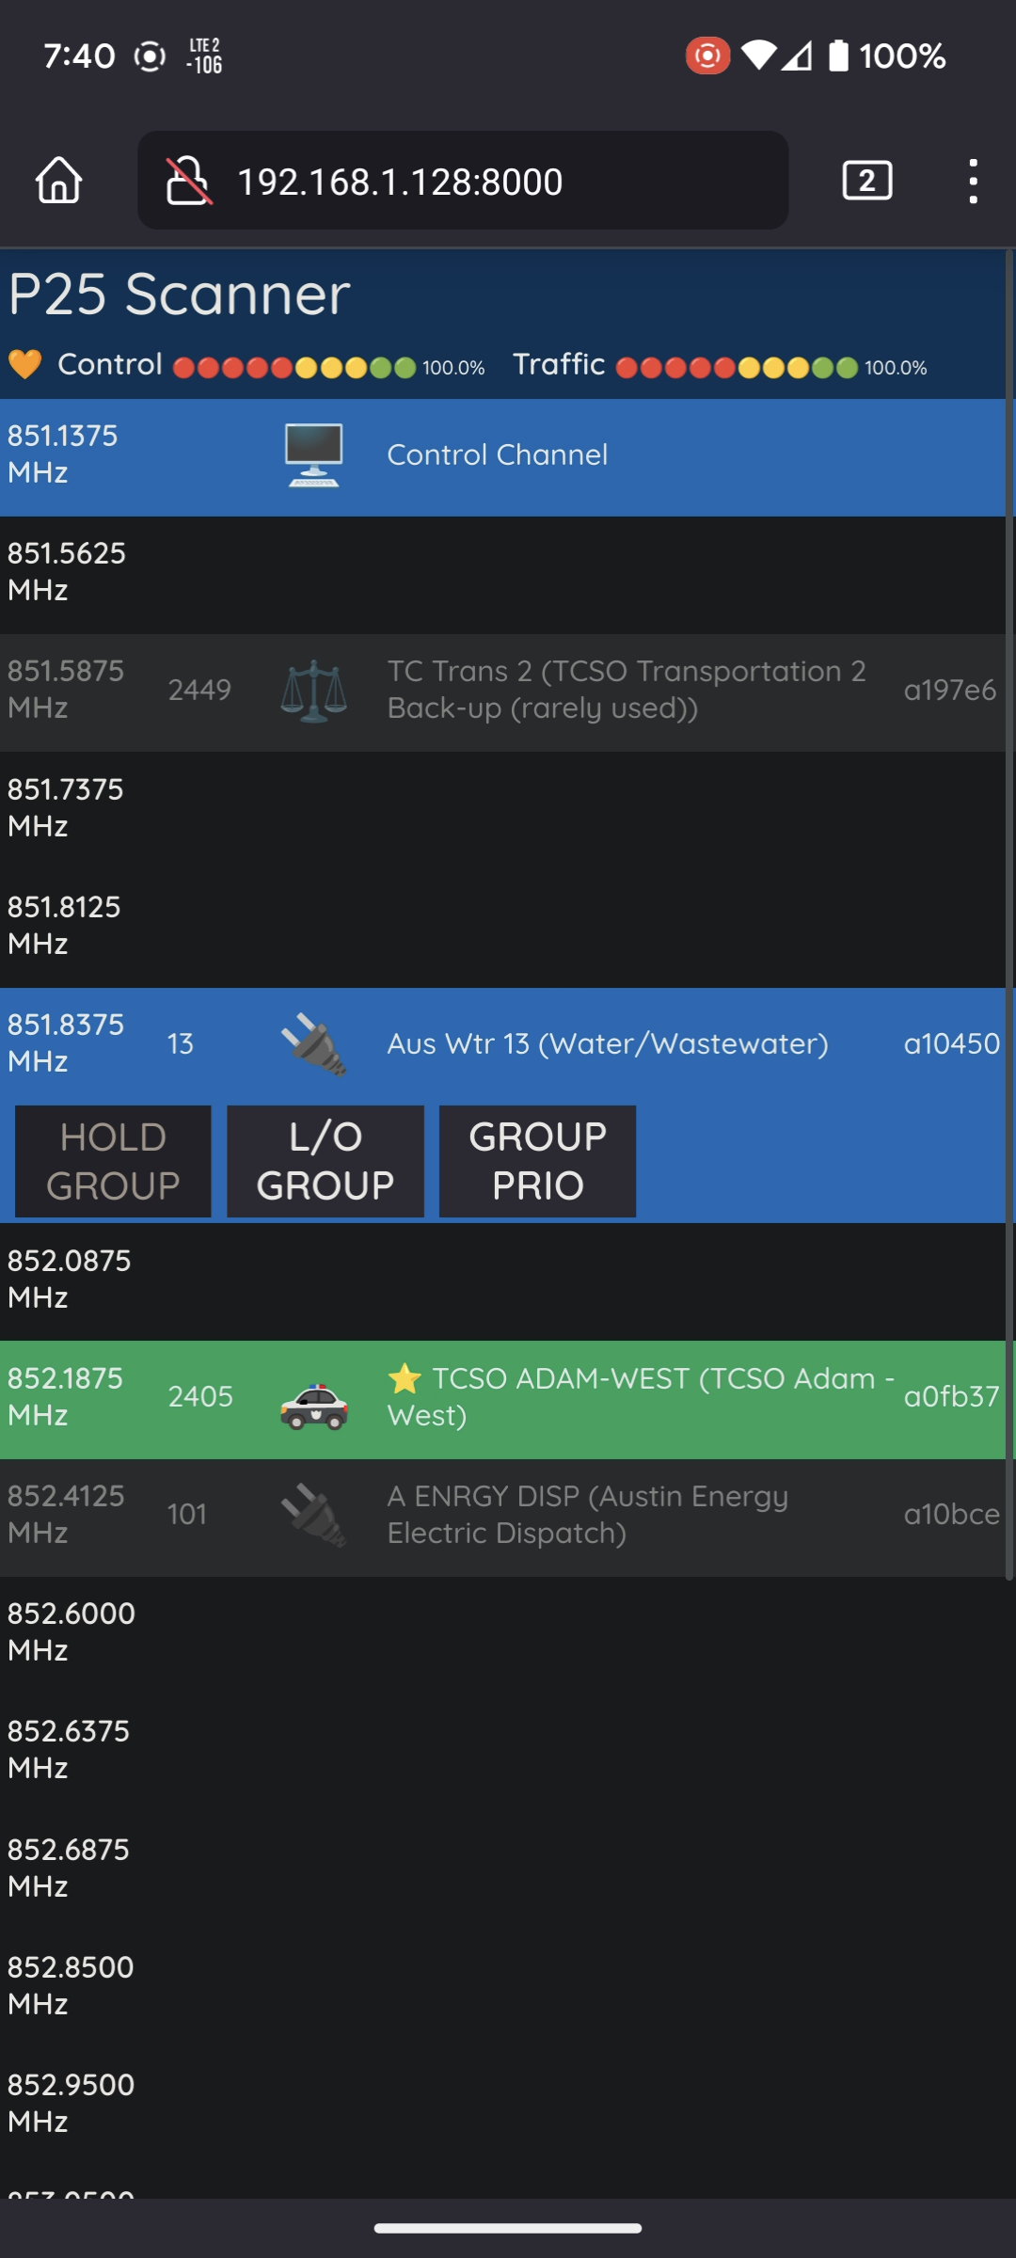
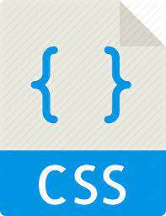
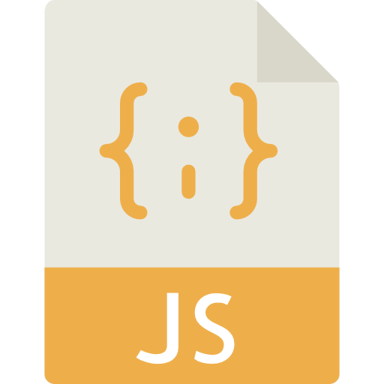
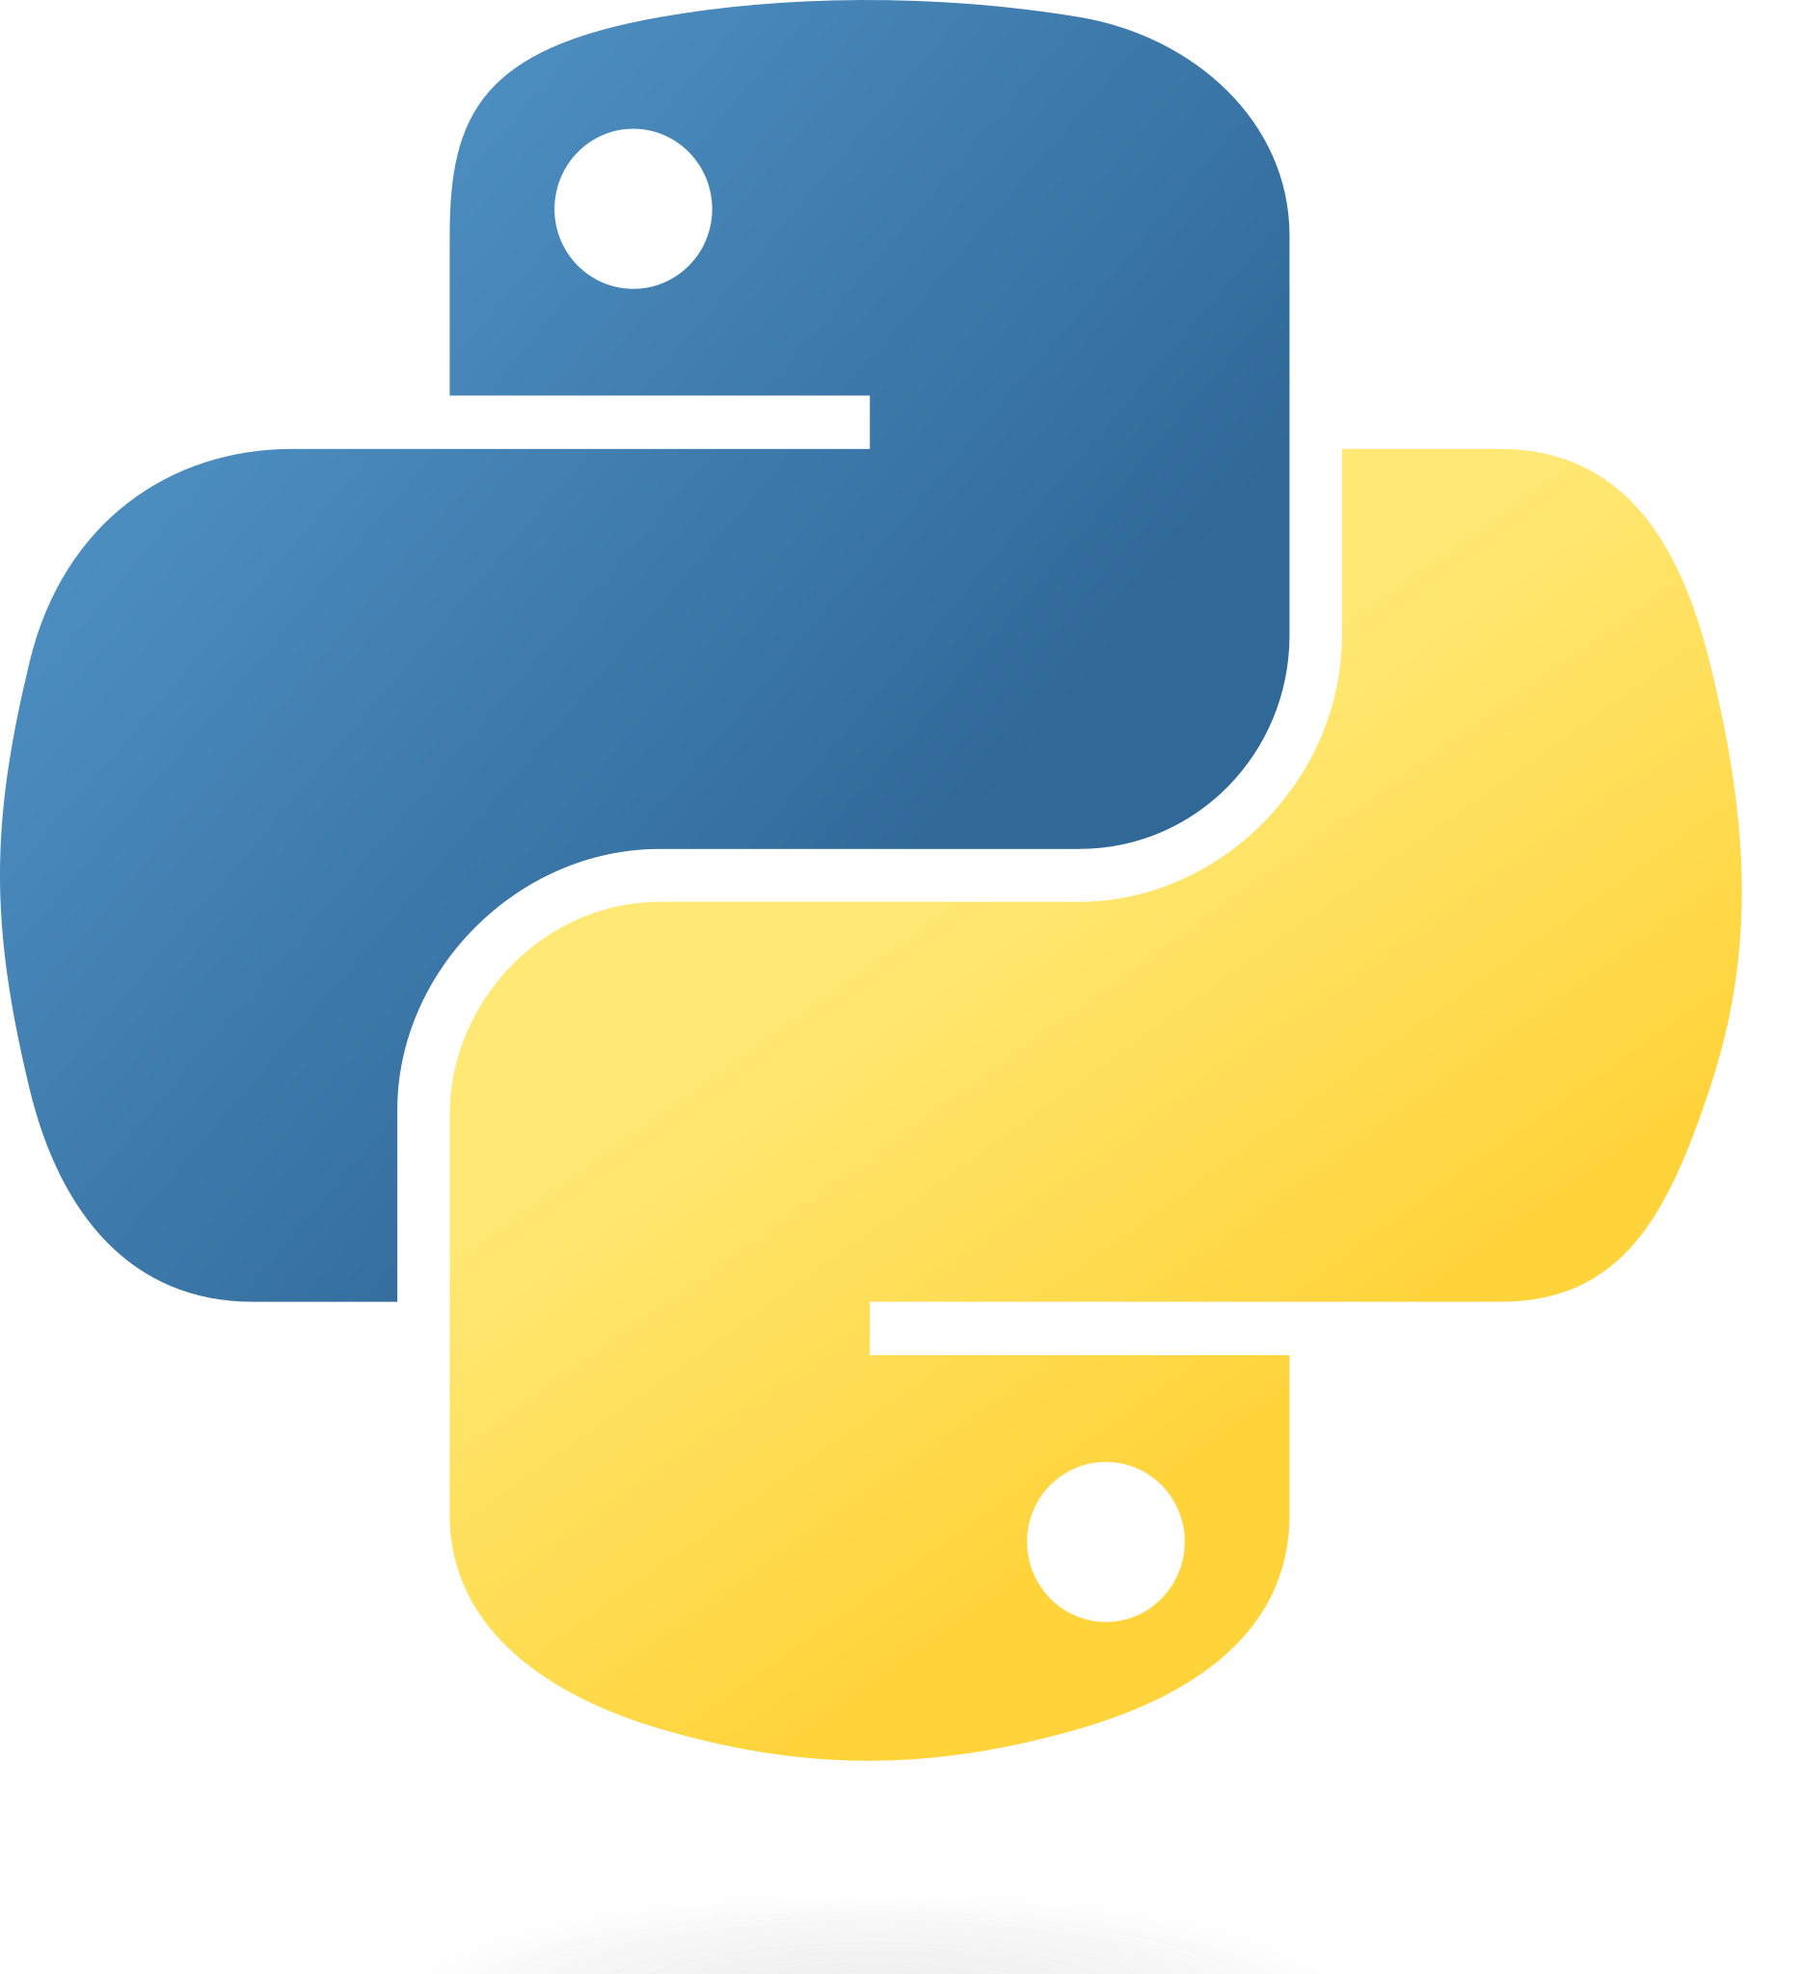
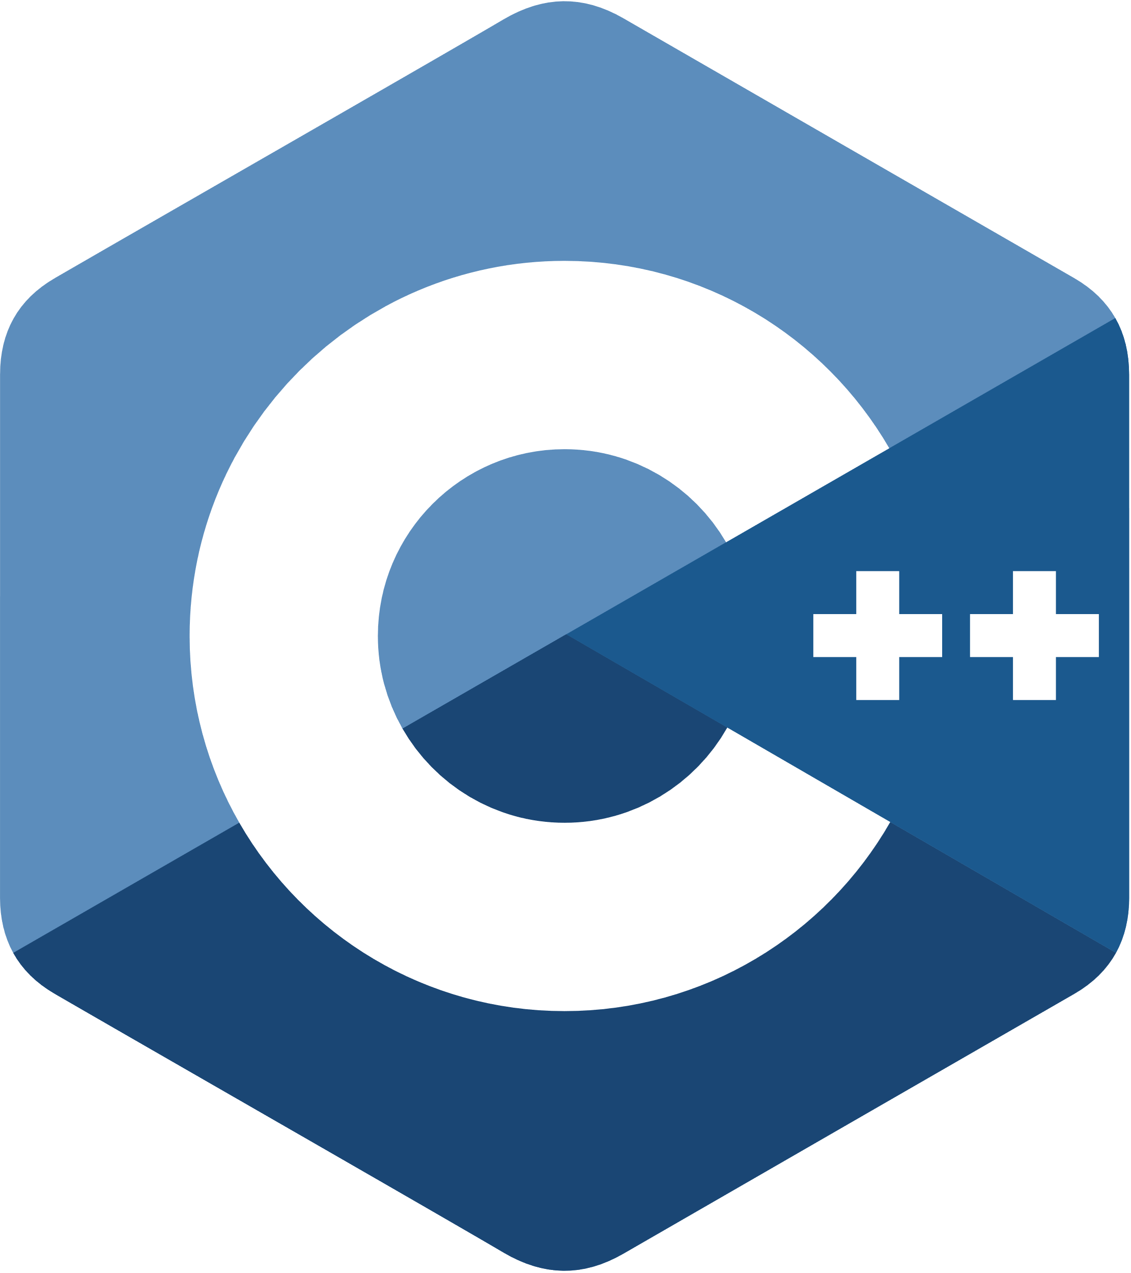
Web Scanner Architecture
Static presentation data
GNU Radio process
Front end
Front end
interface
Python http.server process
HTTP
PDUs
TCP/8000
WebSockets
JSON
Events
PCM audio stream
spawns
TCP/8001
scanner. out_of_process_proxy
scanner. p25_scanner. scanner_oop_ws
Scanner server process
scanner.p25_scanner. scanner_oop_ws
IPC
Trunked system
metadata
spawns

Slide 27
Demo

Slide 28
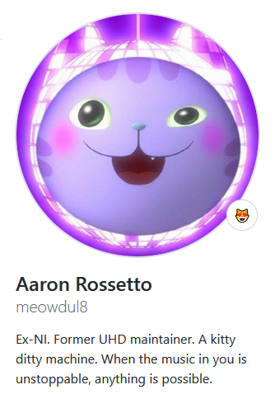
How To Play Along
https://github.com/meowdul8/gr-scanner
Fork it, improve it, send me your PRs!
Do cool things!
Potential areas of improvement/feature additions:
TLC for the overall repo
Flowgraphs for other SDRs out of the box
Support for other trunked system types
Examples for different applications
Laugh at, then improve, my Javascript code
etc. etc. etc.

Slide 29
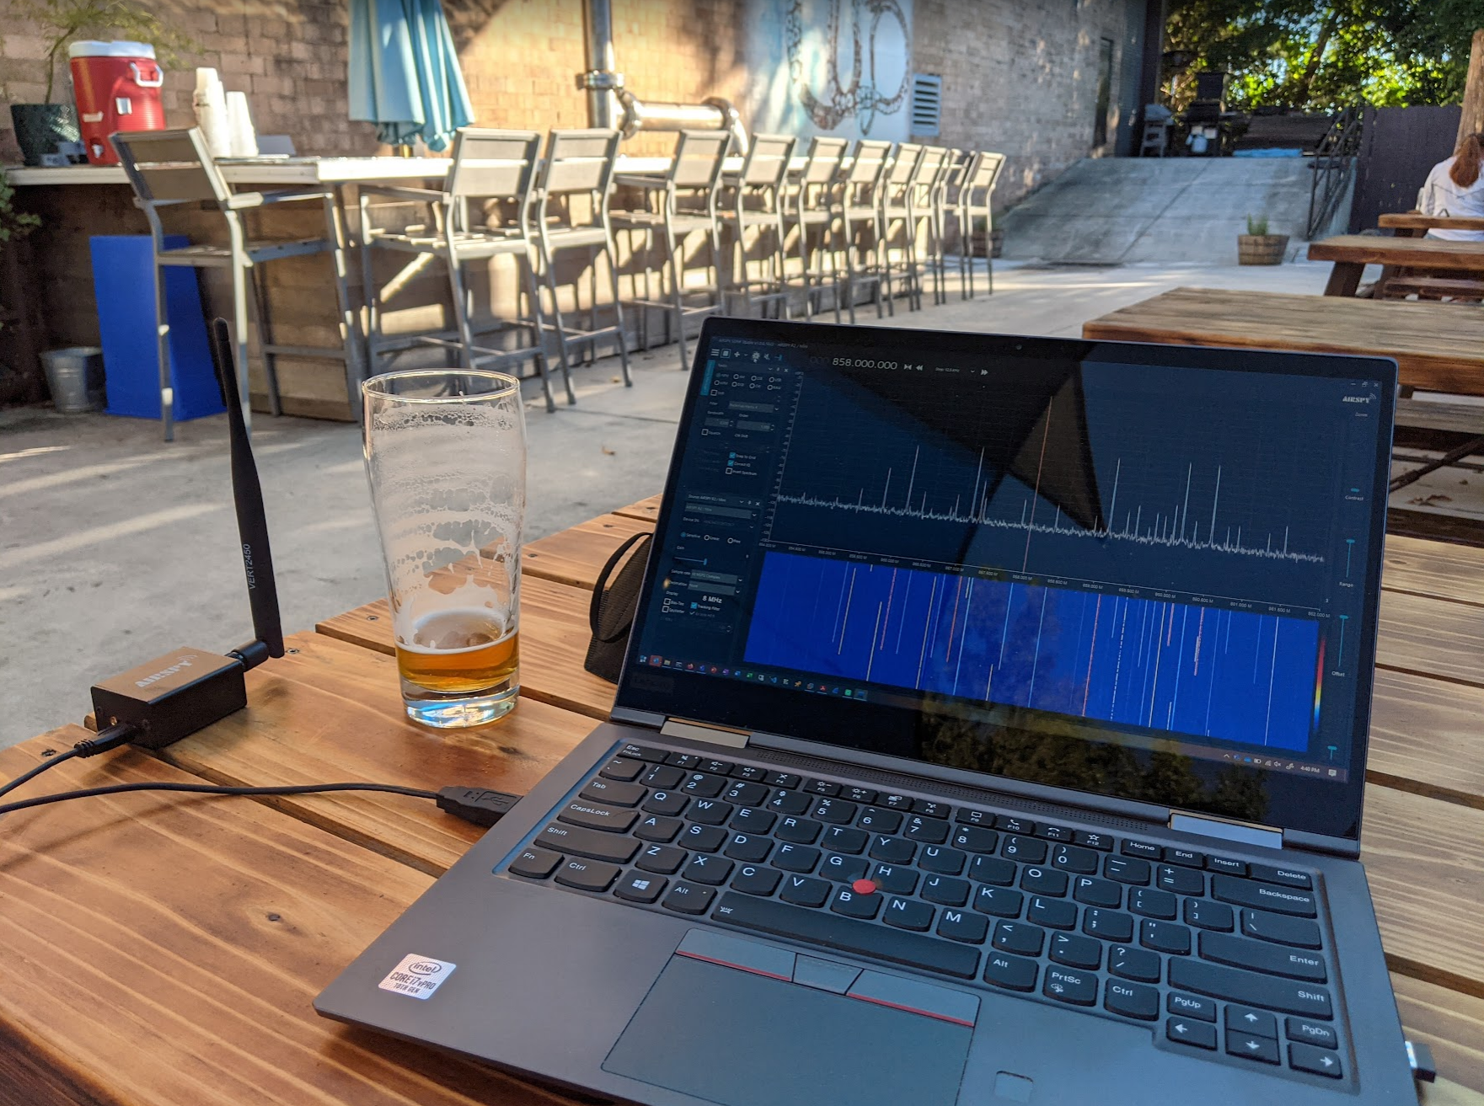
Thank you!

