Slide 1
gr-plasma A New GNU Radio-based Tool for Software-defined Radar
Shane Flandermeyer^{1,2}
Rylee Mattingly^{1,2}
Dr. Justin Metcalf^{1,2}
¹Advanced Radar Research Center, University of Oklahoma, Norman, Oklahoma, USA
²School of Electrical and Computer Engineering, University of Oklahoma, Norman, OK, USA

Slide 2
Outline
Introduction
gr-plasma blocks and features overview
Waveform generators
USRP interfacing and Control
Signal processing blocks
Miscellaneous blocks
Experimental Demonstration
Conclusions and Future Work

Slide 3
Introduction
Experimental radar systems traditionally lacked flexibility
Required expensive custom hardware for real time operation
Developments in SDR hardware and GPUs make RF research more accessible
Real time operation possible with COTS components
High-level tools like CUDA and GNU Radio significantly reduce development time
Most SDR tools designed for communications, not radar

Slide 4
Introduction
Challenges in software-defined radar operation
Transmit and receive processes must be synchronized to the sample level for localization accuracy
Reliable high-speed duplex operation required for waveforms with large bandwidths
Processing intervals too large for GNU Radio stream buffers

Slide 5
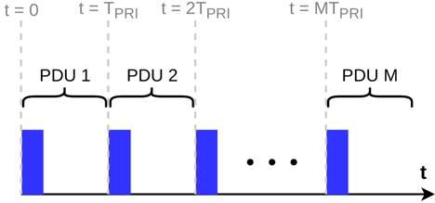
Introduction
Primarily considering pulsed radar operation
Radar pulses processed as bursty packets
A natural fit for the message passing interface!

Slide 6
The gr-plasma [1] module
An end-to-end radar processing toolbox in the message passing domain
Current capabilities include:
Waveform generation (pulsed and CW)
USRP control and calibration
Pulse-doppler processing
Processing implemented in separate plasma_dsp [2] repository
Easy to drop in other C++ or Python projects

Slide 7
USRP Interfacing and Control

Slide 8
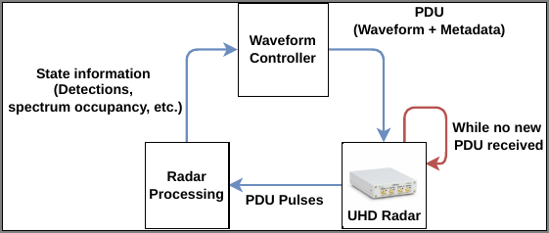
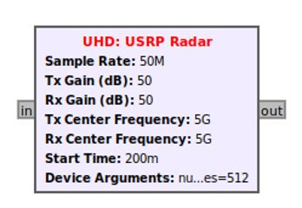
USRP Radar Module
Combines USRP source and sink into a single block
Minimizes data transfer by repeatedly transmitting last PDU received
Internally handles timing to avoid under/overflows at higher sample rates
Outputs each pulse as timed PDU

Slide 9
USRP Delay Calibration
Problem: Internal USRP DSP produces a constant delay
Produces offset from true range in radar processing
Constant value for a given radio's sample rate/master clock rate

Slide 10
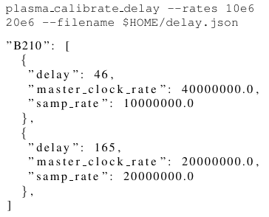
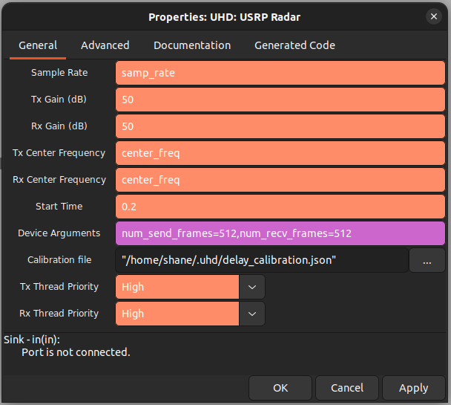
USRP Delay Calibration
Problem: Internal USRP DSP produces a constant delay
Produces offset from true range in radar processing
Constant value for a given radio's sample rate/master clock rate
Solution: Use a script to automate calibration
Inspired by Estimator Sync Pulse block in gr-radar

Slide 11
Waveform Generators

Slide 12
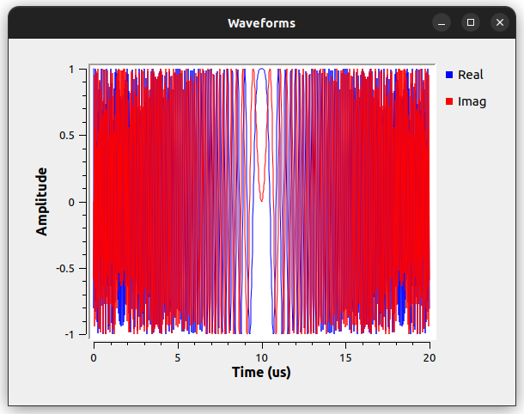
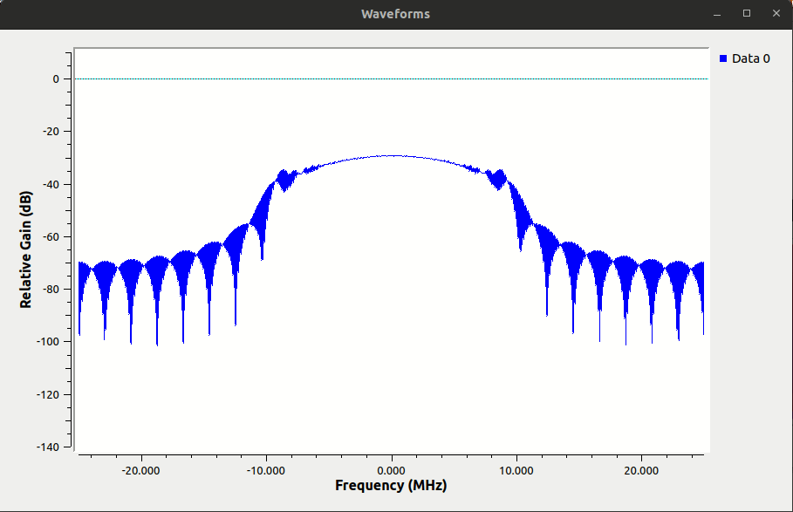
Linear FM (LFM) Waveforms
Most common radar waveform
Sweeps linearly across its bandwidth B over time interval Tp
LFM source block centers sweep around DC

Slide 13
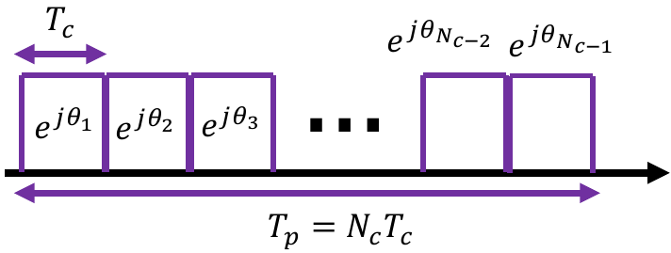
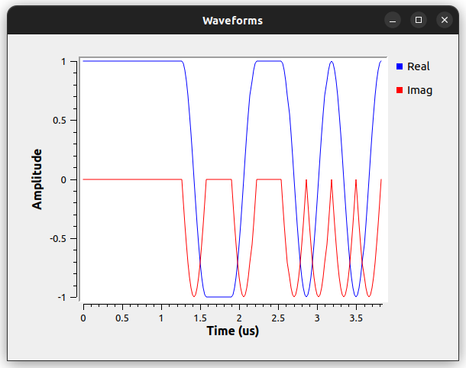
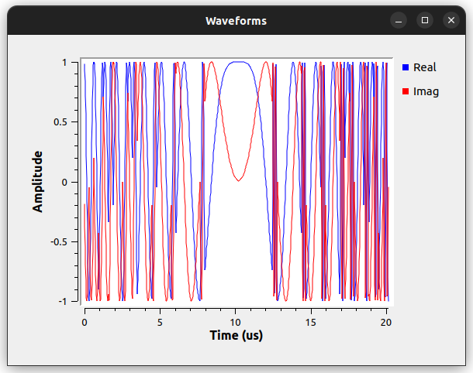
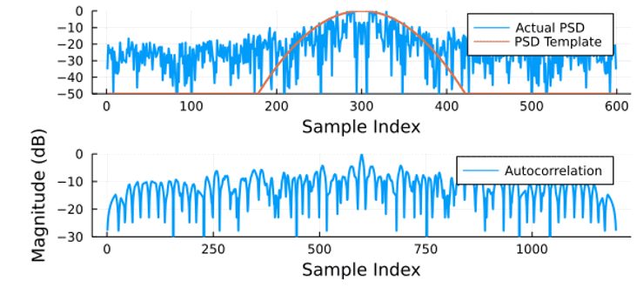
Polyphase-Coded FM (PCFM) Waveforms
Newer waveform class (first introduced in [3])
Inspired by continuous phase modulation (CPM)
Modulates a phase code instead of communications symbols
More degrees of freedom for waveform optimization

Slide 14
Signal Processing Blocks

Slide 15
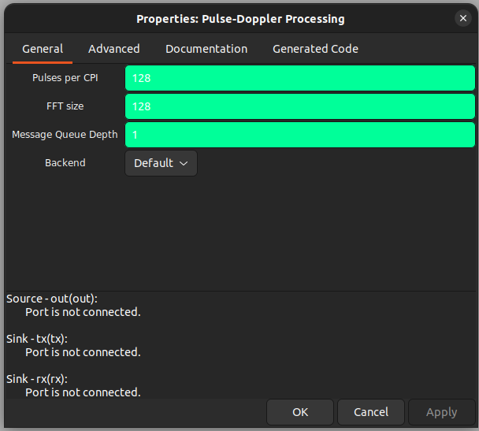
GPU Integration
ArrayFire used to greatly simplify GPU computation
Has optimized functions for common signal processing operations
CPU, CUDA, and OpenCL backends
Multi-GPU support
Backend is a block parameter
All blocks in flowgraph must use the same in gr-plasma v1.0

Slide 16
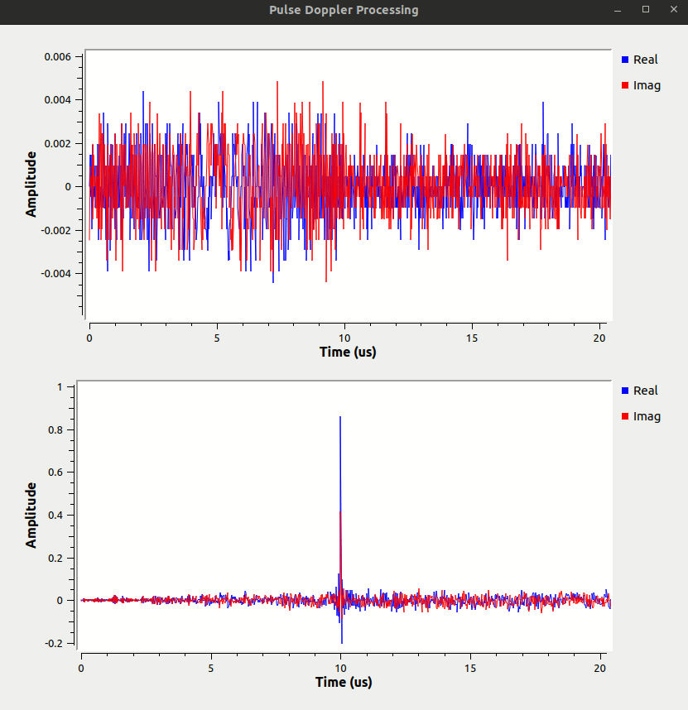
Matched Filtering
Cross-correlation between transmitted and received signals
Used to detect signals in high-power noise
Delay of peak depends on range of scatterer
Width of peak depends on waveform bandwidth

Slide 17
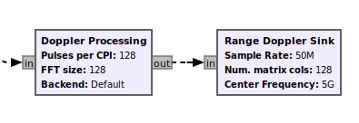
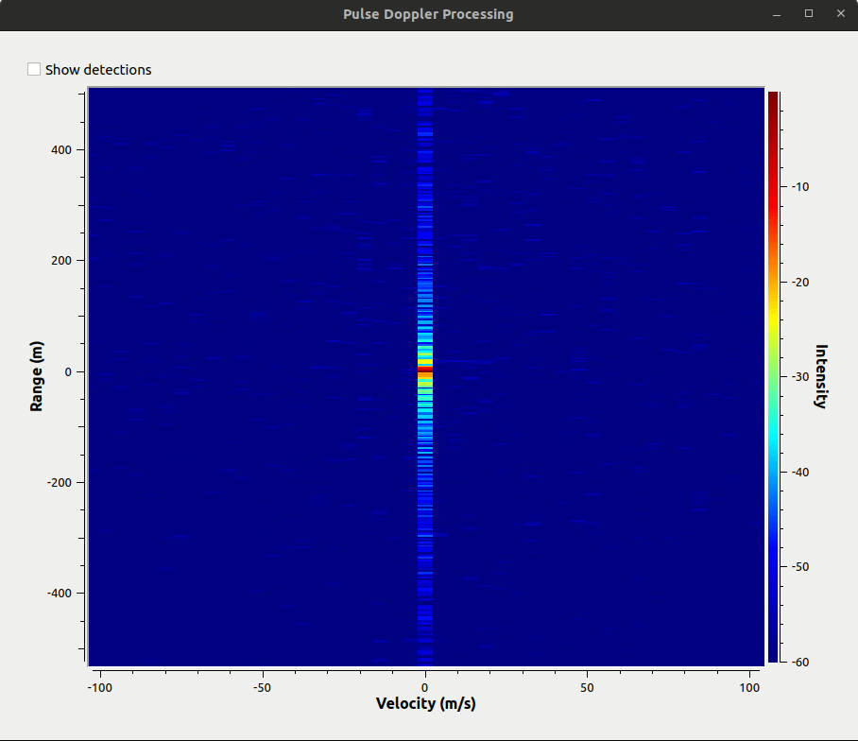
Doppler Processing
Step 1: Collect N matched filter responses of length L into the columns of a matrix
N = Number of pulses in a coherent processing interval (CPI)
Step 2: Compute an FFT across each row
Transforms pulse dimension to doppler frequency
Resulting matrix is a range-doppler map

Slide 18
Pulse-Doppler Processing
Matched filtering and doppler processing usually performed sequentially
Can use separate blocks, but wastes memory and computation
Need two identical copies of some variables
Must copy data to/from PDU messages
The Pulse-Doppler Processing block solves these problems

Slide 19
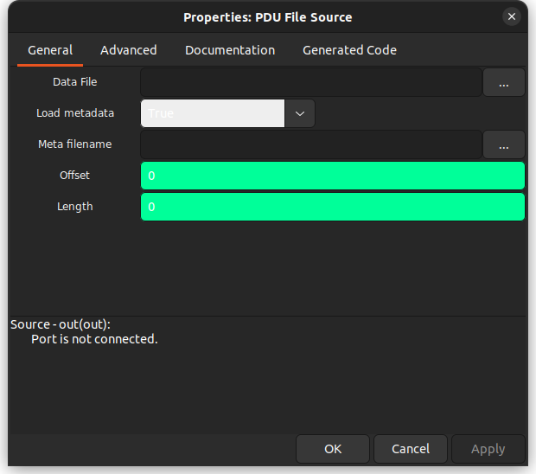
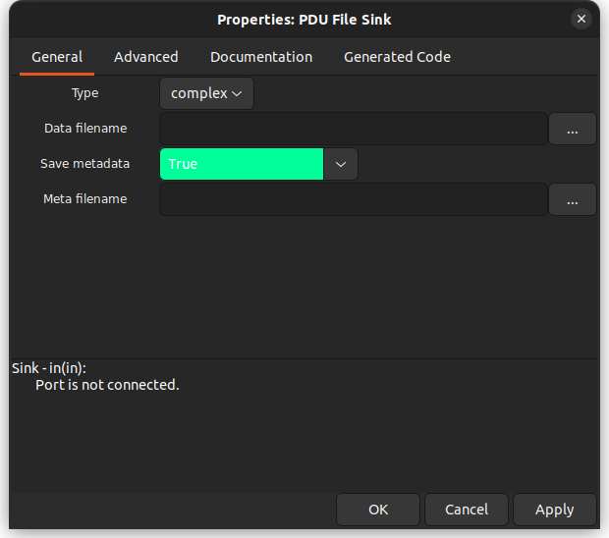
Additional Blocks
PDU File Source/Sink: Convert data and metadata to PDU and vice versa
Data loading is identical to in-tree File Source/Sink
Metadata saved as JSON and loaded as PMT dictionary
SigMF compatible!

Slide 20
Additional Blocks
Pulse to CPI: Combine N smaller PDUs into a single large PDU
PDU Head: Copy the first N PDUs to the output and consume the rest
Waveform Controller: Add a pulse repetition frequency (PRF) entry to waveform metadata dictionary
Puts USRP Radar in burst mode
Plan to eventually implement more complex logic (e.g., resource management)

Slide 21
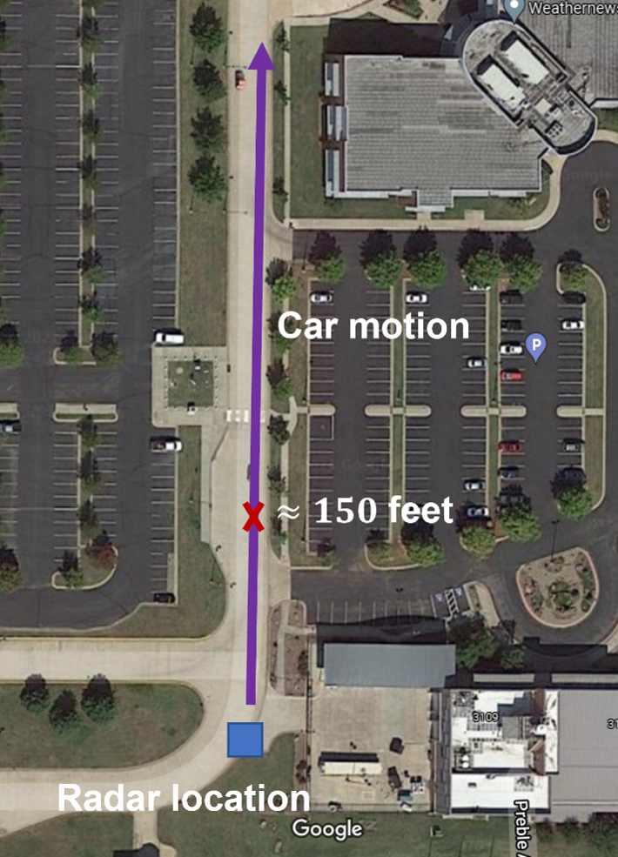
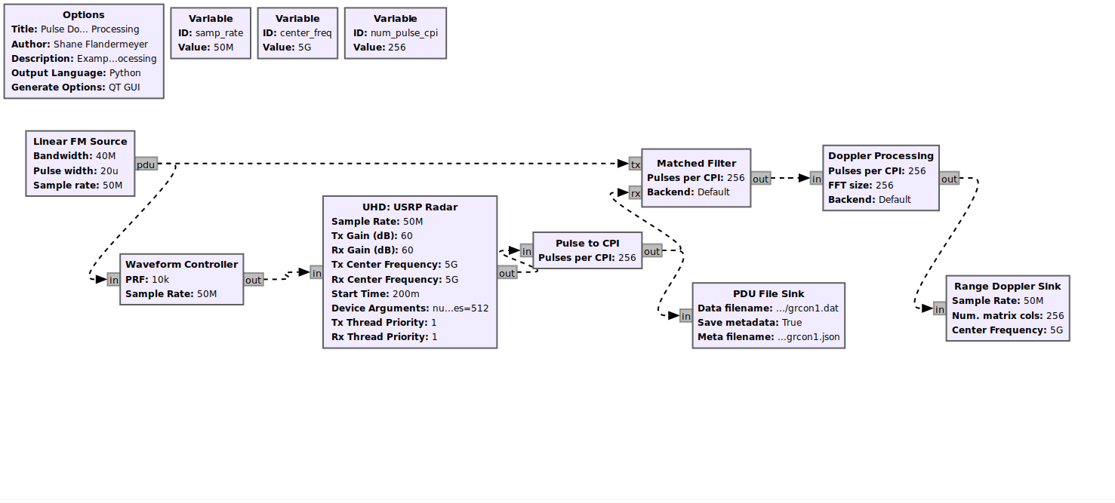
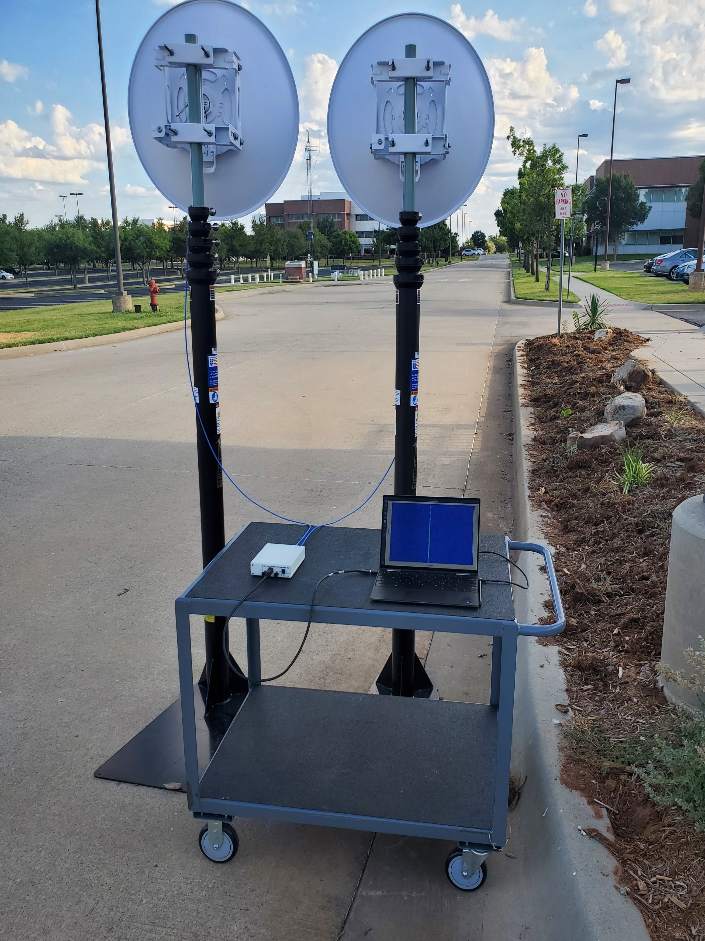
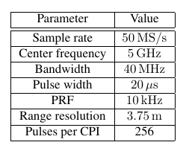
Experimental Setup
USRP B210 in monostatic configuration
Vehicles moving radially to/from the radar

Slide 22
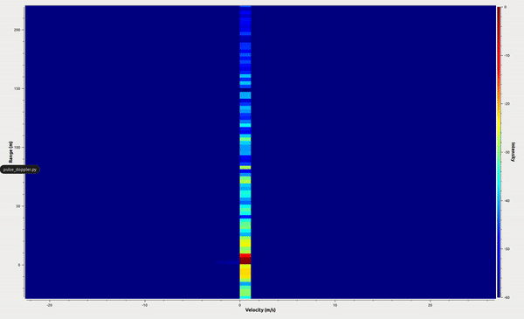
Results
Clearly visible returns in 300 m scene
Multiple targets visible
Animation captured directly from GNU Radio

Slide 23
Conclusions
gr-plasma is an OOT module for collecting and processing radar data
Uses GNU Radio's message passing architecture
heterogeneous processing with CPU, CUDA, and OpenCL
Currently has blocks for
Radar waveform generation
Pulse-doppler processing
Range-Doppler map visualizations
Demonstrated with an open-air real time experiment

Slide 24
Future Work
Develop more signal processing blocks
Constant False Alarm Rate (CFAR) detector implemented in develop branch
Close the cognitive loop
Modify waveform in USRP Radar based on downstream processing
Waveform controller block intended to handle this logic

Slide 25
References
[1] https://github.com/ShaneFlandermeyer/gr-plasma
[2] https://github.com/ShaneFlandermeyer/plasma-dsp.git
[3] S. D. Blunt, M. Cook, J. Jakabosky, J. De Graaf and E. Perrins, "Polyphase-coded FM (PCFM) radar waveforms, part I: implementation," in IEEE Transactions on Aerospace and Electronic Systems, vol. 50, no. 3, pp. 2218-2229, July 2014, doi: 10.1109/TAES.2014.130361.

Slide 26
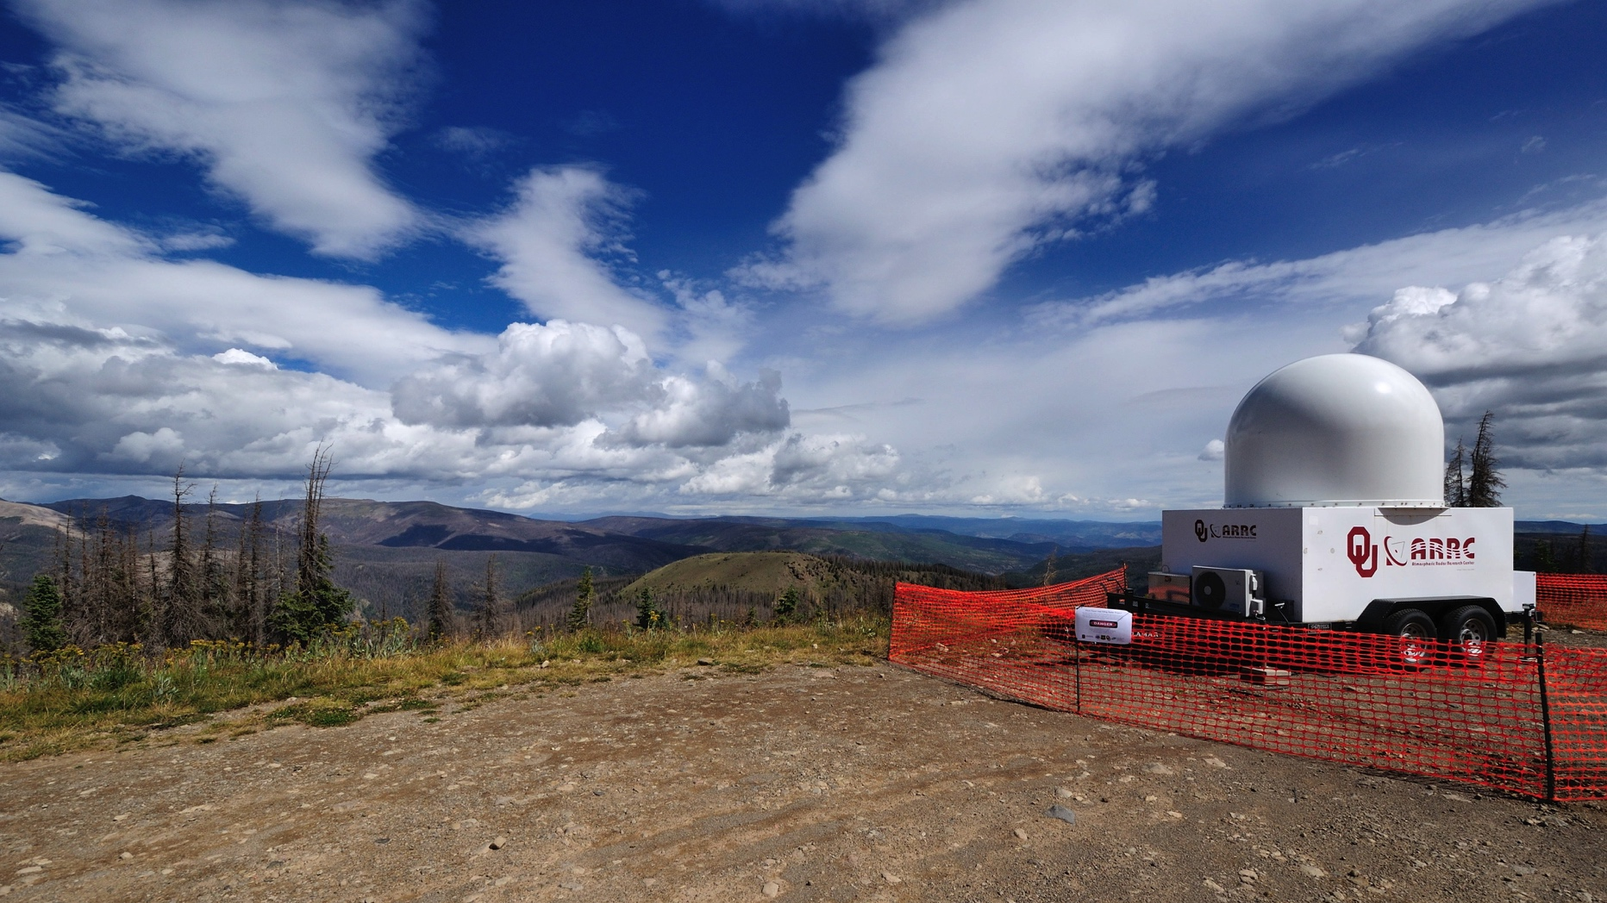
Advanced Radar Research Center
http://arrc.ou.edu

