Slide 1
Project Technical Update September 28, 2022

Slide 2
Josh Morman
Wireless/SDR Research
Co-Maintainer (with Jeff Long @willcode4) GR 4.0 Development Lead
CONTACT:
jmorman@gnuradio.org jmorman@peratonlabs.com @mormj : Matrix / Github

Slide 3
GR Releases - Year in Review
3.10.3.0 / 3.9.7.0
CI improvements
bug fixes
3.10.4.0 / 3.9.8.0
our latest releases
3.10.1.{0,1} Bug Fixes
3.10.2.0 / 3.9.6.0
Boost Reduction
JSON/YAML config blocks
Custom Buffer fixes
bug fixes
3.10.0.0 / 3.9.5.0
gr-pdu
gr-iio
Custom Buffers
No more Log4CPP
dev-4.0 branch
newsched project officially moved into gnuradio repo
GRCON 2021
GRCON 2022
Ubuntu 22.04
FOSDEM 2021
74 unique contributors to the main branch since last GRCon

Slide 4
GNU Radio 3.10
Released Jan 14, 2022 → 3.10.1.1
Packaging window for Ubuntu 22.04
Much smaller 'irritation factor' 3.9-3.10 (than 3.7 or 3.8 to 3.9)
API changes, but likely little OOT rework
Two new Modules
gr-pdu
gr-iio
Support for Hardware Accelerators
Updated Logging Infrastructure
OOT Module structure mirror in-tree
92 Unique Contributors since v3.9.0.0

Slide 5
Current Maintenance Strategy
MAIN - Where to put mainline GR changes and bugfixes
MAINT-3.10 - Stable 3.10 releases for the foreseeable future
MAINT-3.9 – no more planned releases - move to 3.10
MAINT-3.8 - Bug fix only, but not actively maintained*
DEV-4.0 - Where to put aggressive, pervasive, big changes
(Jeff Long - maintainer - does this)

Slide 6
Release Strategy
Avoiding breaks in API
main branch allows for API breaks, but not getting backported
Try to keep main/maint-3.10 as close as possible for as long as possible
What is an API break?
The API version is changed whenever there are API changes in GNU Radio that would make external applications or out-of-tree modules incompatible with other API versions.
No current plan for 3.11
Once enough API breaking features call for a 3.11
Otherwise, keep at 3.10

Slide 7
Release Strategy [continued]
Maintenance Releases
Aggressive backporting
Minor changes in stable vs. frequent ports to new version
Keeping branches consistent makes maintenance easier
Quarterly cadence to provide more choices for downstreams
Major Releases
Keep the main branch as a development branch
Aggressive and pervasive changes to dev-4.0
Notes:
Josh talks about this here at top level, process/backporting/maint will be expounded up later.

Slide 8
Our commitment to stability
3.8 and 3.9 brought major, OOT breaking changes into the codebase
They were necessary to modernize the codebase and its dependencies
3.10 was able to take a smaller step in terms of breaking changes, and we would like to continue this pattern unless absolutely necessary (problematic dependency, etc.)
The community should be proud of its efforts to make GNU Radio a mature and reliable framework
Even if we tick up the API revision, doesn't mean it will break your apps
e.g. Adding blocks, modules, extending methods with new default values, new dependency, transitive includes

Slide 9
Maintenance is a Team Effort
We are trying to keep the PR queue manageable … how can you help?
Submit a PR, review a PR (or 2 or 3)
Reviews do not need to be a comprehensive line for line code (though someone with detailed knowledge should be scrutinizing the changes)
Test out PRs out in different scenarios, on different platforms
Clean up draft PRs (or close them until they are ready again)
Respond to comments in a timely manner
Rebase and squash your commits (see CONTRIBUTING)
Commit messages and PR titles should include “module name:”
Include a short summary of the change
e.g. "digital: did some specific thing"

Slide 10
Developer Shoutout
Clayton Smith - @argilo
Contributed a tremendous amount of features and cleanup for the 3.10 maintenance releases
Boost Removal - goal being removing our dependency on most of Boost
CI Improvements
Fixed all of our intermittently failing CI tests
Makes the job of maintaining and releasing much easier

Slide 11
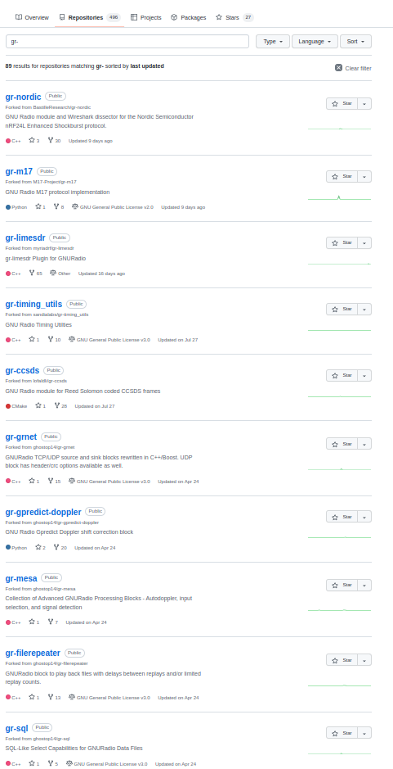
Developer Shoutout
Bjoern Kerler - @bkerler
Contributed updates to dozens (hundreds?) of OOT libraries across the ecosystem
Submitted PRs to main repos
Huge help since 3.10 will be around
Highlights improvements needed in discoverability of OOT modules across ecosystem

Slide 12
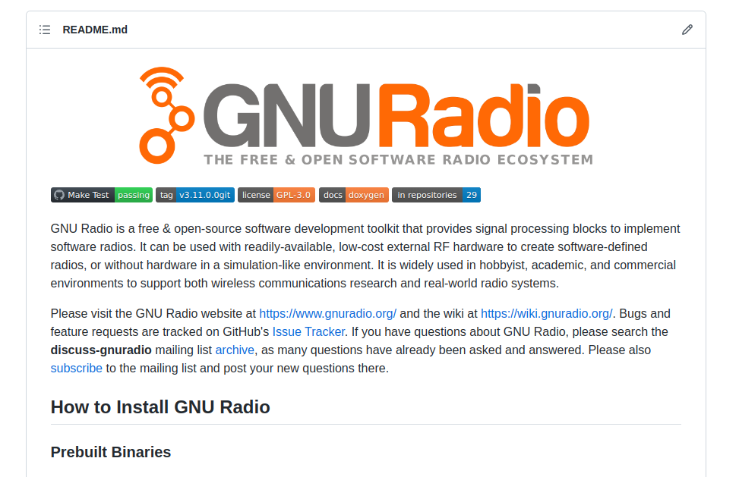
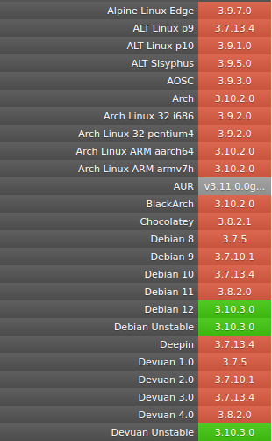
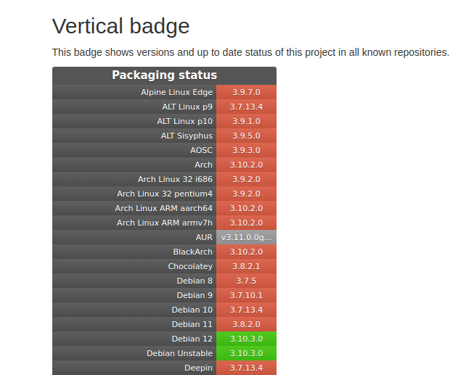
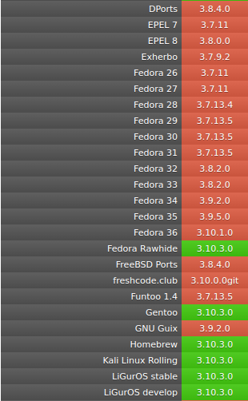
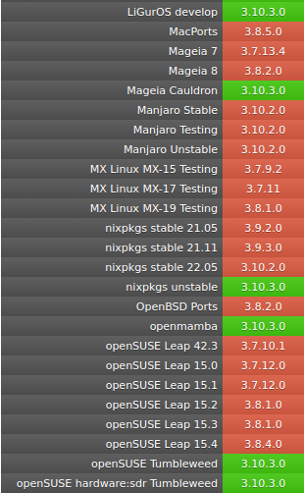
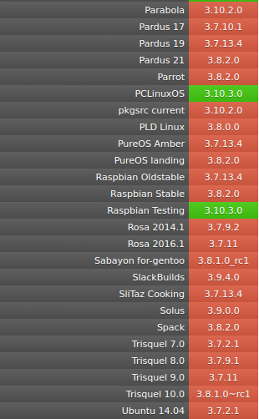
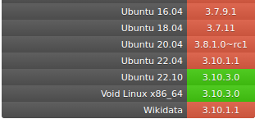
Current State of Installing GR
Thanks to our package maintainers, it is easier than ever on most linux distros to {apt, dnf, yum, pacman, zypper, … } install gnuradio
Notes:
One of the maintenance strategies has been to make things as easy as possible for maintainers

Slide 13
Current State of Installing GR
Conda Install - https://wiki.gnuradio.org/index.php/CondaInstall
Very actively maintained by Ryan Volz
Provides Windows and Mac installation (as well as linux)
Tied into CI - so we can see when Conda/Windows/Mac is broken by commits

Slide 14
Ubuntu PPA
Latest releases are kept up to date in Ubuntu PPA, so you are not locked into the version maintained by your distro - be careful to select the correct PPA:
gnuradio-releases - currently 3.10.4.0 gnuradio-releases-3.9 gnuradio-releases-3.8
sudo add-apt-repository ppa:gnuradio/gnuradio-releases
sudo apt-get update
sudo apt install gnuradio
Ubuntu Maintainer

Slide 15
When to install from source
You need to modify the gnuradio codebase itself
You need multiple versions of GR installed concurrently
You want the main branch specifically
OOTs you need are not updated to packaged versions
PyBOMBs - the old way to install from source
has been a mainstay for installing GR from source for many years
currently is only "lightly" maintained
recommendation is through distro packages / conda if you can
https://wiki.gnuradio.org/index.php?title=InstallingGR#From_Source

Slide 16
Packaging Dreams
Ubuntu Maintainer
Thanks to Maitland's efforts, Ubuntu inherits the updated Debian prior to release
We internally manage a PPA - would love a champion
Would be great to have an upstream champion to get package updates within the LTS releases
Automated Packaging
Tied into CI, upload the latest Ubuntu to launchpad
Make our tooling less manual/fragile

Slide 17
Other Development Needs
GNU Radio Binary Installers - Windows Packaging (gnuradio.msi) - MacOS - OOTs
Ongoing Maintenance and Support - Clean up Issue Queue - Many "good first issue" - Fix up CI - Add platform CI coverage

Slide 19
Current state of VOLK
LGPL re-licensing effort
-> completed
Latest Release
VOLK v2.5.2
Prepare
VOLK 3.0 release
VOLK 3.0 release
-> soon
SIMD optimized functions with a hardware agnostic API

Slide 20
Where to go, VOLK?
Ideas? Let us know!
Overhaul tests, CI, benchmarks
Fix
“Complex type”
API
Future
VOLK 4.0?
Flexibility
Standard tools
Custom tests
Understand history
Find solution for all platforms
Implement solution
No more undefined behavior
More hardware support
benchmark?
GTest?

Slide 21
GNU Radio 4.0
GR4

Slide 22
Why GNU Radio 4.0?
As awesome as GNU Radio is for prototyping/implementing signal processing and integrating with real hardware …
There are limitations that can only be overcome by an architectural overhaul
Scheduling
Heterogeneous Architectures
Distributed Computing
Ease of Development
Notes:
If I wasn't a huge fan of GNU Radio I wouldn't be here, but there are many times I've been asked how to integrate GR with something, and the honest answer is - it's not the right tool, or it will add too much overhead

Slide 23
Why GNU Radio?
Open source software radio toolkit - moving samples around between signal processing blocks and to/from hardware and accelerators
GR is not the only solution for this
… but as a general purpose framework
Fully Open Source, Actively Maintained, Vibrant Community
No one company/organization holding the keys
The real value is in:
Community - people willing to help
Ecosystem - many solutions available
Block Library - use what has already been developed for your application
Ease of Use / Flexibility
Notes:
Community based development - many invested partners / individuals

Slide 24
Vision for GNU Radio
Rapid application deployment to the largest number of available hardware platforms - heterogeneous architectures
User-friendly development methodology that will take a novice developer from zero to deployment in minutes
Largest active user base of any SDR framework - due to open source convenience and broad ecosystem
Pervasive footprint in academic courses and university labs - teaching signal processing and communications through GNU Radio
Supportability through a robust network of core developers and Industry/Government partners
Notes:
Need to survey opinions of these visions Needs for gnu radio ??? get feedback
The easier it is to use, and more people involved/contributing, the more gain in overall value

Slide 25
GNU Radio in the development workflow
Simulation
Prototype
Deployment
Push the bounds of feasible usage
Through the 4.0 architecture, expand feasible usage from simulation through to deployment

Slide 26
Technical Vision for GNU Radio 4.0
Modular CPU Runtime
Scheduler as plugin
Application-specific schedulers
Heterogeneous Architectures
Seamless integration of accelerators (e.g., FPGAs, GPUs, DSPs, SoCs)
Distributed DSP
Setup and manage flowgraphs that span multiple nodes
Straightforward implementation of (distributed) SDR systems that make efficient use of the platform and its accelerators
Notes:
Vision hasn't changed - this is the vision Bastian and I laid out a couple years ago

Slide 27
GR 4.0 Highlights
Improved/Additional Support for Hardware Accelerators
Modular Components - can be swapped in with custom or application specific implementations
Scheduler
Runtime
Buffers
Distributed Flowgraph Support
Centralized control of e.g. edge nodes
Streamlined Development Methodology
Lower the bar for application developers
Overcome the GR 3.X "Thread Per Block" limitations

Slide 28
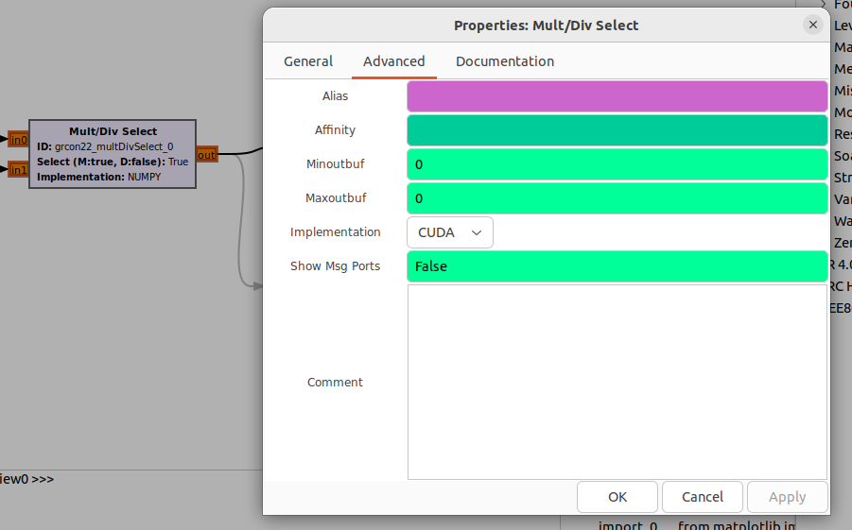
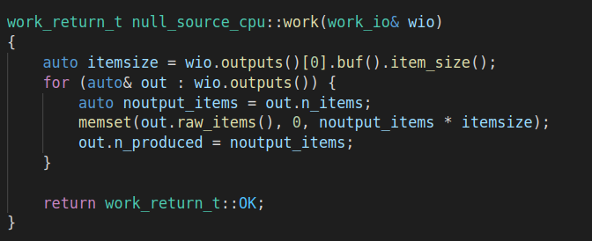
Improved Support for Hardware Accelerators
New block API passes more buffer information
Block can have awareness of the buffer it receives
Multiple implementations per block allow graphical domain selection

Slide 29
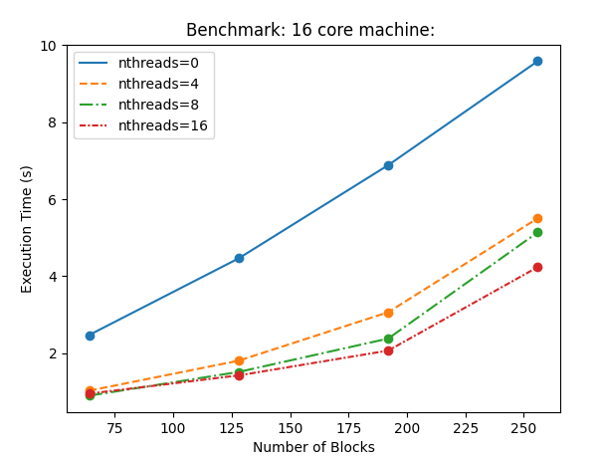
Modular Components - Scheduler
As shown previously, overcoming TPB limitations can give immediate performance gains …
But modular scheduling goes beyond this
Custom Scheduling for custom applications or hardware
TPB
nthreads == ncores
Examples:
Threadpool Scheduler
Multi-GPU Scheduler
Low-Latency Scheduler

Slide 30
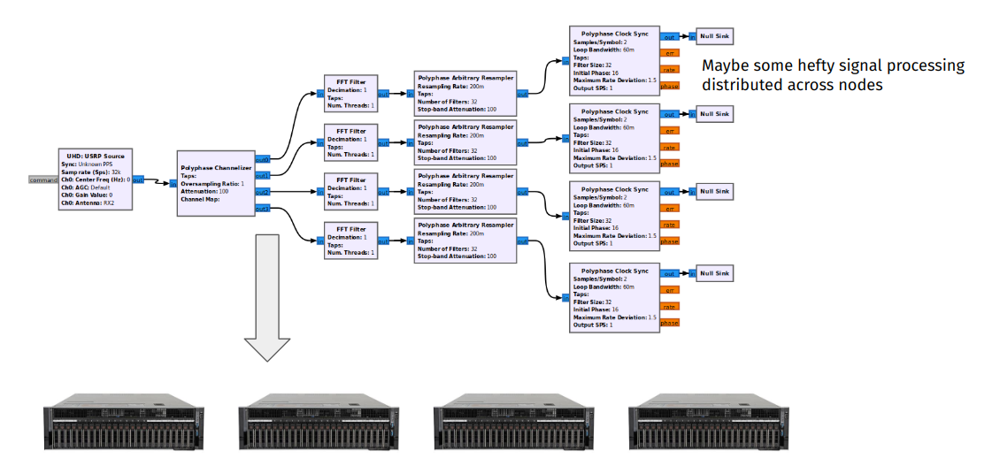
Distributed Flowgraph Support
Concept: blocks can be executed on distributed compute nodes, but controlled from a single location - appear as a single flowgraph
Enabling Features:
Modular Runtime
Reflection
Parameter Access
Stream/Msg Serialization
Proxy control

Slide 31
Containerized Runtime
Container 1
Container 2
FGM
Main Flowgraph
FGM
Command and Control
FGM Proxy
FGM Proxy
Bidirectional ZMQ
B1
B2
Streaming Data
B1
B2
B3
B4
ZMQ Custom Buffer
B4
B3
Sets Up
Sets Up
Runtime
REST
REST

Slide 32
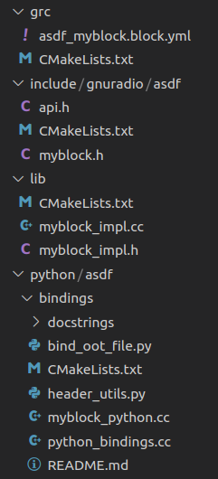
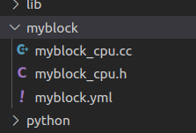
Streamlined Development Methodology
Make it as easy as possible for users to integrate their algorithms into GNU Radio blocks - if it is hard, no one wants to do it, seek other options
Get straight to the work() method
Make blocks more maintainable
Reduce Boilerplate
For Free:
Python Bindings
GRC Bindings
Constructor Args
Build System Scripts
Setters/Getters (threadsafe)

Slide 34
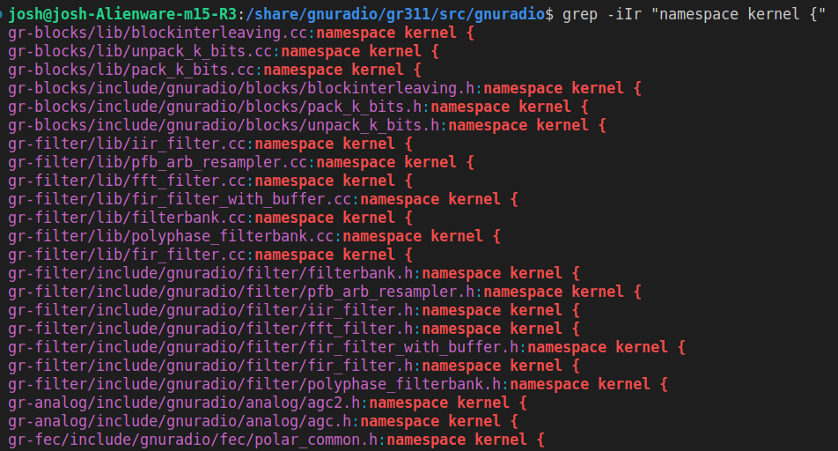
Kernel Library (Math and Signal Processing)
Goal: Reduce inter-module dependencies
Keep thing that are not blocks but separately useful out of the block library
e.g. filter, resampler, math operations
Allows core DSP and Math accessible without the entirety of GNU Radio
i.e. call signal processing without the work method
Formalization and reorganization of a concept already in GR3.x
GR 3.x Kernel Namespaces

Slide 35
Before:
VOLK
FFTW
Mathlib
gnuradio-runtime
Kernel
Kernel
Kernel
Analog
QTGui
. . .
Filter
FFT

Slide 36
FFTW
VOLK
After:
gnuradio-runtime
logging
prefs
Kernel Library
Analog
QTGui
. . .
Filter
FFT

Slide 37
Survey
https://events.gnuradio.org/event/18/surveys/9
Looking for your feedback on GR 4.0:
Vision
Direction
All the things

Slide 38
GR4 early adoption

Slide 39
GR4 early adoption

Slide 40
GR4 early adoption
For more information:
https://github.com/fair-acc/opencmw-cpp
To join this effort (hiring for strong C++ developers with an interest in SDR/GNU Radio)
Dr. Ralph Steinhagen
R.Steinhagen@gsi.de

Slide 41
GR4 - Getting Involved
Join GR 4.0 Workshop (this afternoon) to go deeper into the block development methodology
Join Architecture Working Group (next slide)
Friday Block Party!!
Try porting some blocks over
Work with myself and others
Instructions on Wiki: https://wiki.gnuradio.org/index.php?title=GNU_Radio_4.0

Slide 42
GR Architecture Working Group
The "Scheduler" group is now the "Architecture" group
Chat room:
https://chat.gnuradio.org/#/room/#architecture:gnuradio.org
Periodic Zoom calls on topics of interest to the group - trigger active discussion on chat
Next Call - Oct 13 - 12PM ET
Some Topics Covered Recently:
Custom Buffers
Latency Measurements
newsched review
Distributed Operation
FPGA Integration
PMT/PDU design
Reflection
Notes:
Beyond just the scheduler - major enhancements to GNU Radio that could broadly be lumped in with 4.0

Slide 43
GR Feature Requests
Where to discuss depending on the magnitude of the feature
CHAT #Architecture #Development
Github Issue
GREP

Slide 44
Looking for input
https://github.com/gnuradio/gnuradio/issues/6182
Generic type conversions between ports
Specific example:
Carrying confidence interval along with the signal value for scientific rigor
Allowing such a type to be 'ignored' by normal float ports

Slide 45
Looking for input
https://github.com/gnuradio/gnuradio/issues/6186
How to best handle the (lack of) forecast function
PDU / Tagged Stream convergence

Slide 46
Looking for input
https://github.com/gnuradio/gnuradio/issues/6181
Coexistence of GR3.x and GR4.0 from a packaging/installation
https://github.com/gnuradio/gnuradio/issues/6148
Allowing Soapy/UHD callbacks to be indexed parameters
https://github.com/gnuradio/gnuradio/issues/6037
Generalizing the callback methods similar to parameters

Slide 47
Looking for input
https://github.com/gnuradio/gnuradio/issues/6041
Documentation generation solution

Slide 48
Hackfest Friday!!!!!!!!!!!!!
Stick around if you can
GR4 Block Party
Try porting as many blocks as we can to the new API
Thrash the Issue Tracker
Close as many issues as we can

