Slide 1
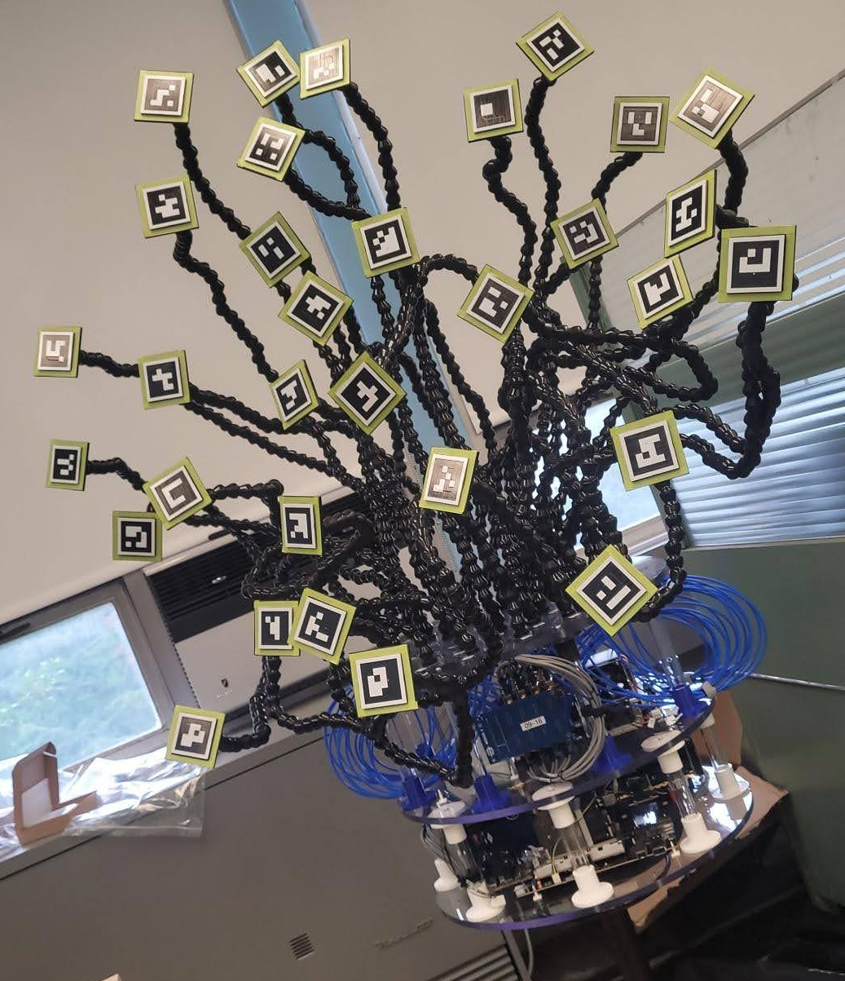
Beamforming Using Volumetric Arrays and Computer Vision
Bailey Campbell

Slide 2
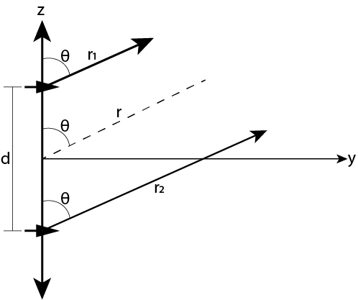
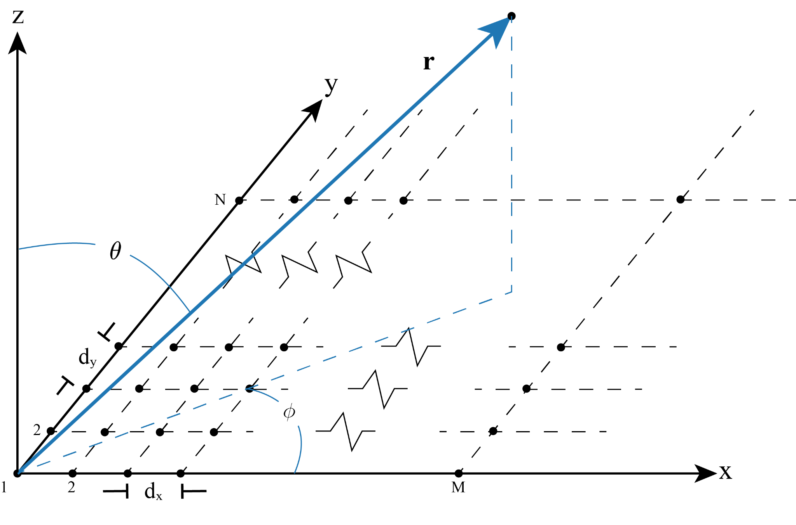
Background
Antenna Arrays
Two or more antennas working collaboratively
Linear, planar, volumetric
Pattern multiplication
Beamforming
Linear
Planar

Slide 3
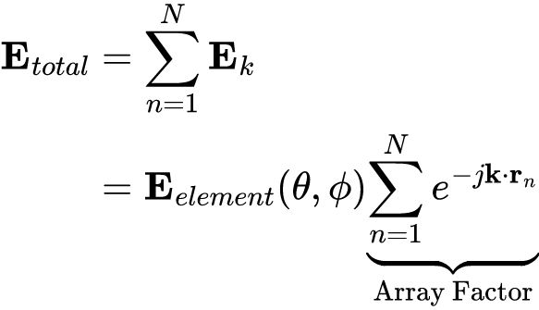
Background
Antenna Arrays
Two or more antennas working collaboratively
Linear, planar, volumetric
Pattern multiplication
Beamforming

Slide 4
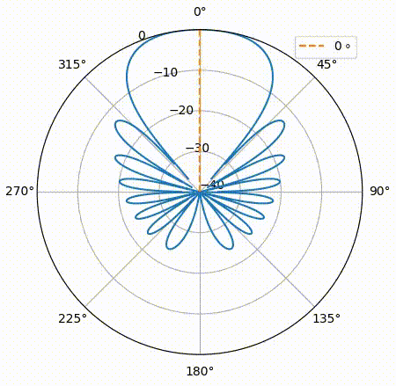
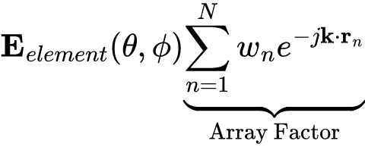
Background
Antenna Arrays
Beamforming

Slide 5
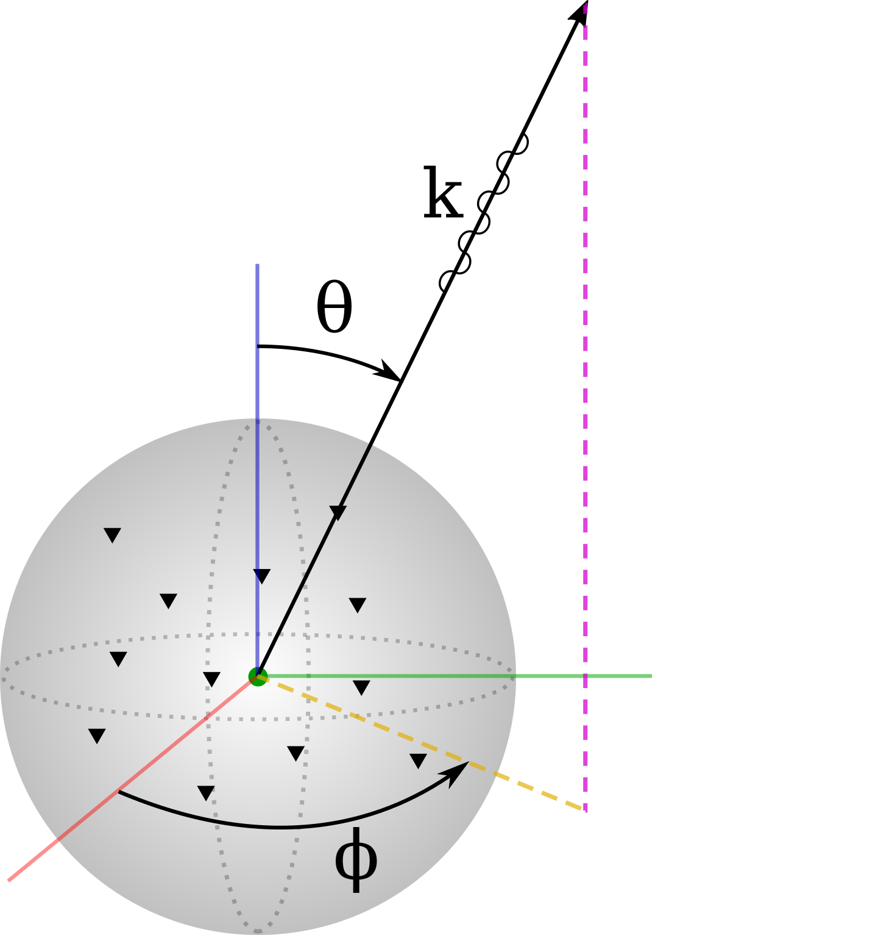
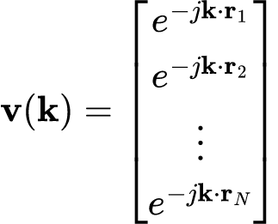
Background
Antenna Arrays
Beamforming

Slide 6
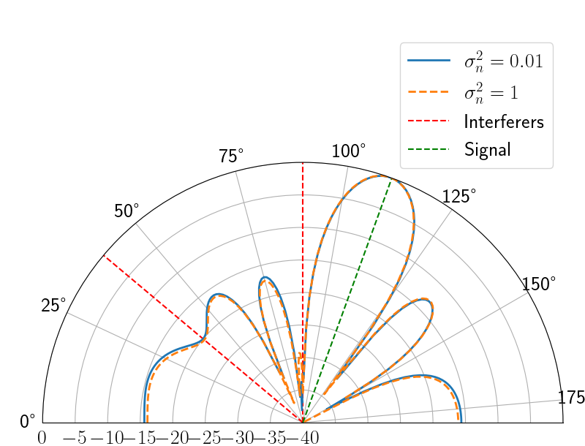
Background
Antenna Arrays
Beamforming
Minimum Mean Squared Error

Slide 7
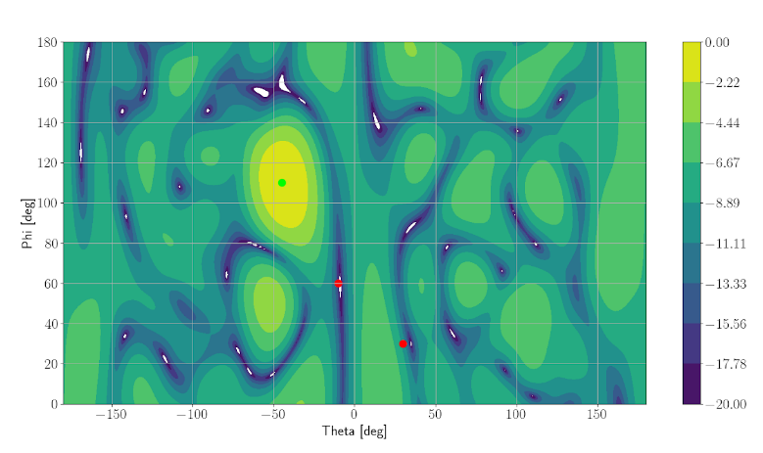
Beamforming
Optimal Weights

Slide 8
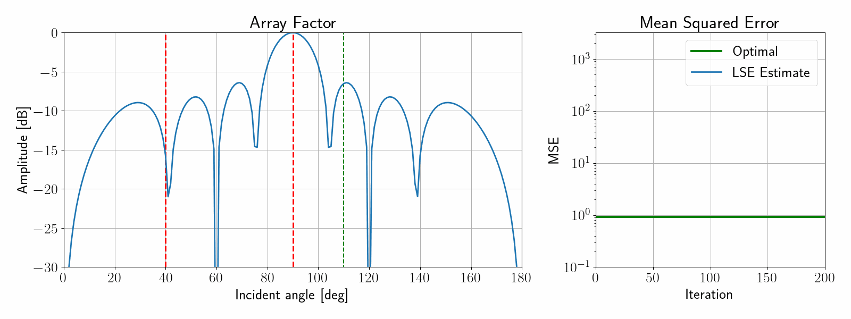
Background
Antenna Arrays
Beamforming
Minimum Mean Squared Error
Many many others

Slide 9
MEDUSA 2.0
Software defined radio testbed
Volumetric and randomly distributed array manifold
Hybrid beamforming

Slide 10
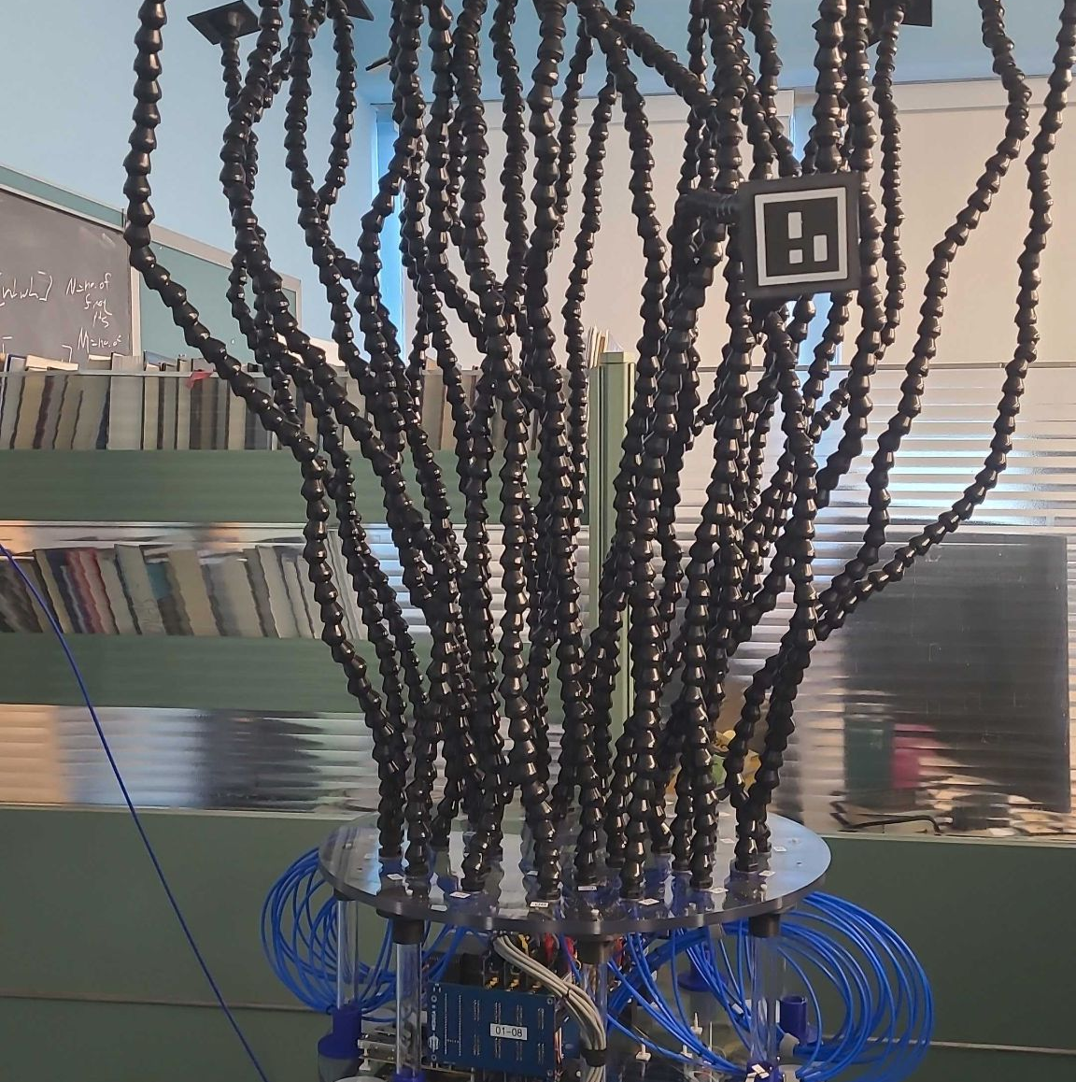
MEDUSA 2.0 - Construction
Custom 8-Channel Analog Module
Dual CP Stacked Patch with ArUco Tag
Analog Devices ADRV9009-ZU11EG
Poseable LocLine Feed Lines

Slide 11
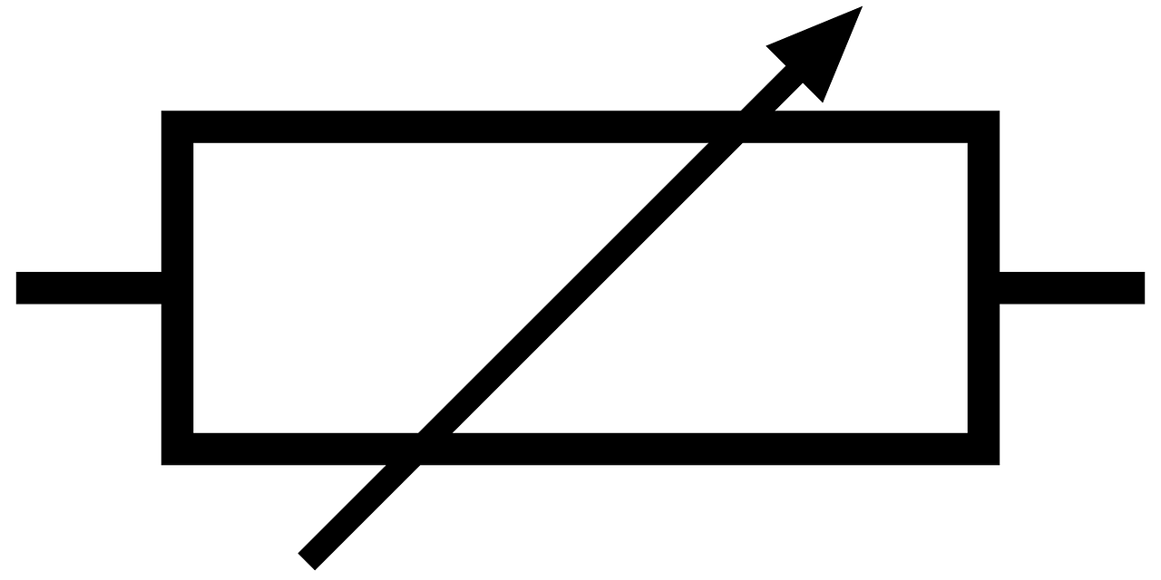
MEDUSA 2.0 - Analog Module
Ant 8
Low Noise Amplifier
7-Bit Phase Shifter
. . . . .
Programmable Attenuator
Ant 1
Teensy 4.1
Microcontroller

Slide 12
MEDUSA 2.0 - Putting it all Together
HMC-7044
HMC-7044
HMC-7044
Analog Module
ADRV9009-ZU11EG
Analog Module
ADRV9009-ZU11EG
Analog Module
ADRV9009-ZU11EG
Analog Module
ADRV9009-ZU11EG

Slide 13
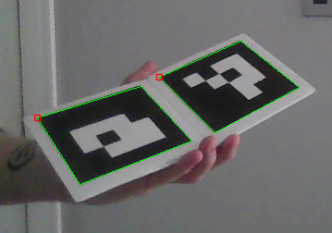
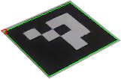
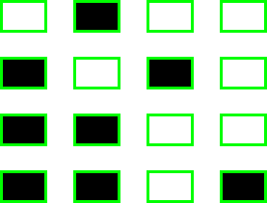
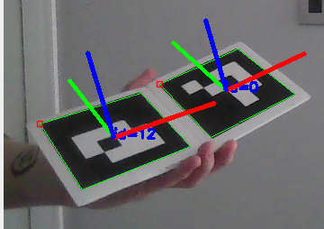
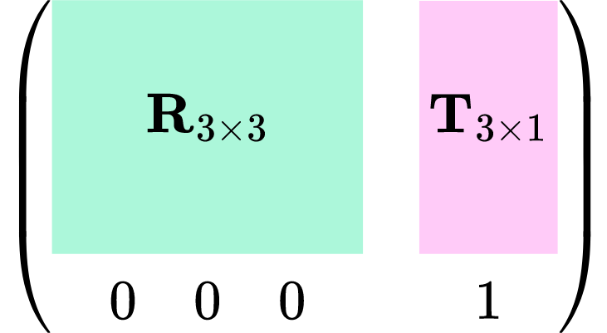
ArUco Markers
detectMarkers()
ID = 0
rotation
translation
solvePnP()

Slide 14
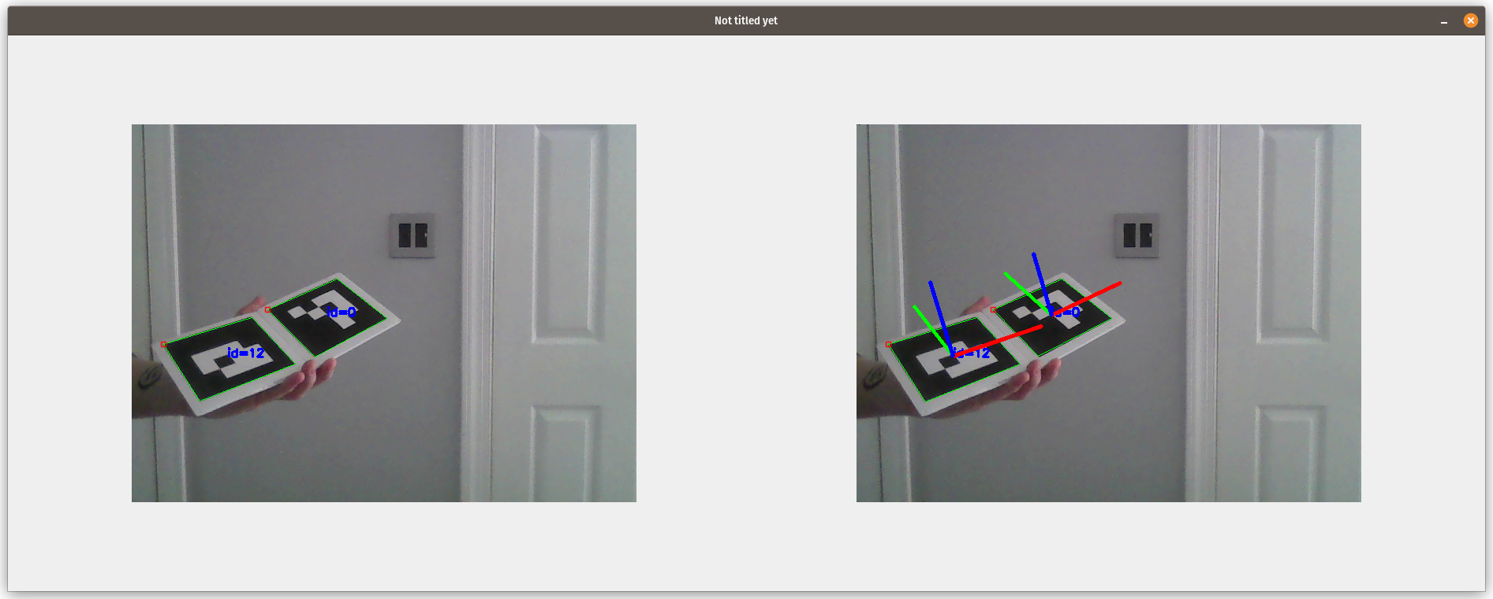
ArUco Markers - GNU Radio

Slide 15
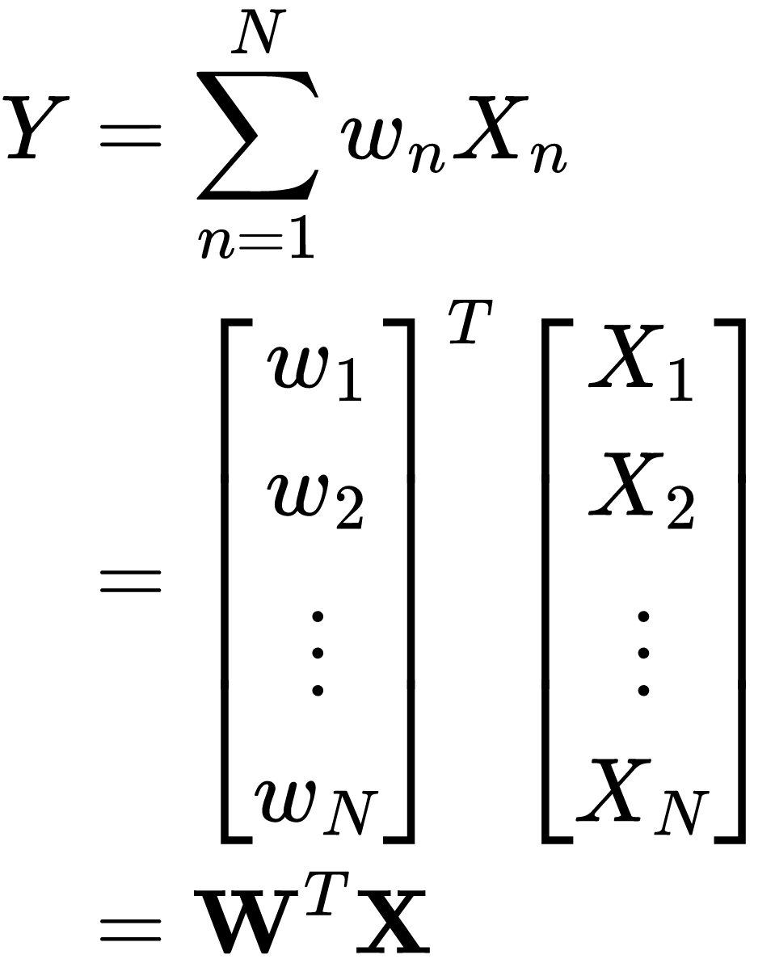
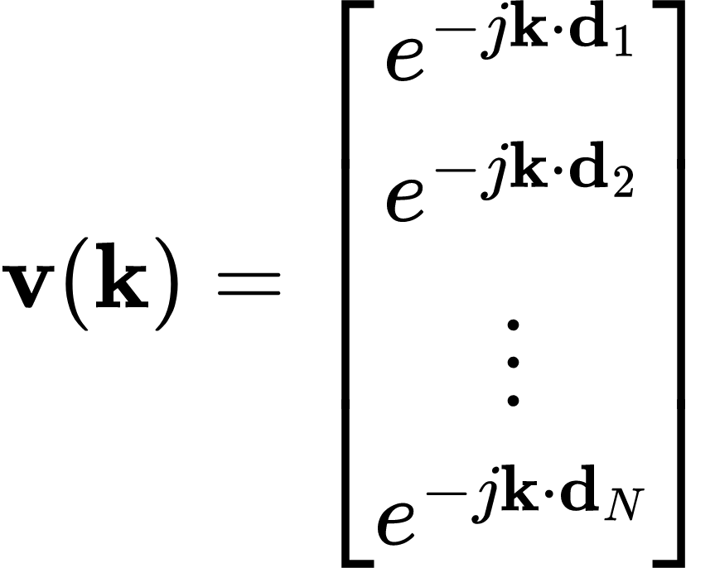
Beamforming
Antenna Outputs
Array Output
Steering Vectors

Slide 16
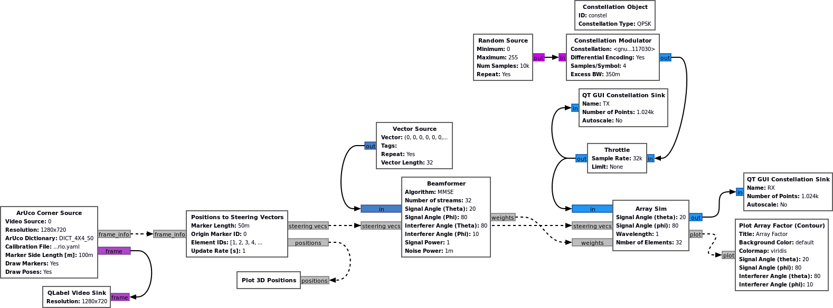
Beamforming - MMSE

Slide 17
Beamforming - MMSE

Slide 18
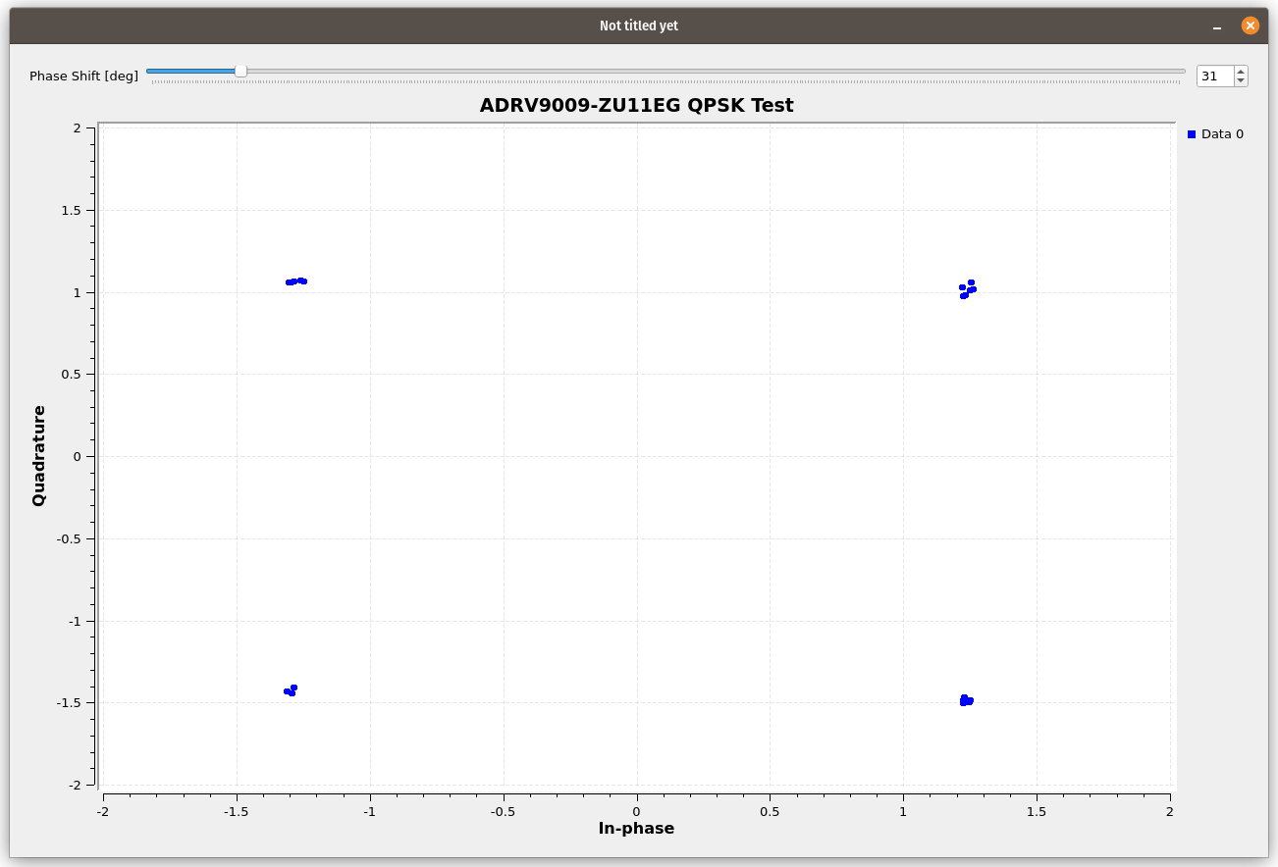
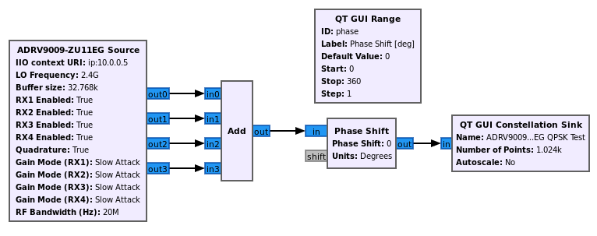
Additional GNU Radio Work
Fork to add
ADRV9009-ZU11EG Source
ADRV9009-ZU11EG Sink (!)

Slide 19
Further Work
Validation and testing of analog modules
OTA test with full system
Clock synchronization in GNU Radio
Additional beamforming algorithms

Slide 20
@cafeclimber
/HRG-Lab/gr-medusa

Slide 21
Resources
[1] “OpenCV: Detection of ArUco Markers,” docs.opencv.org. https://docs.opencv.org/4.x/d5/dae/tutorial_aruco_detection.html
[2] “The Antenna Theory Website,” www.antenna-theory.com. https://www.antenna-theory.com/
[3] R. A. Monzingo and T. W. Miller, Introduction to Adaptive Arrays. SciTech Publishing, 2004.
[4] H. L. Van, Optimum array processing. New York Wiley, 2002.

