Slide 1
IQEngine Workshop
Marc Lichtman

Slide 2
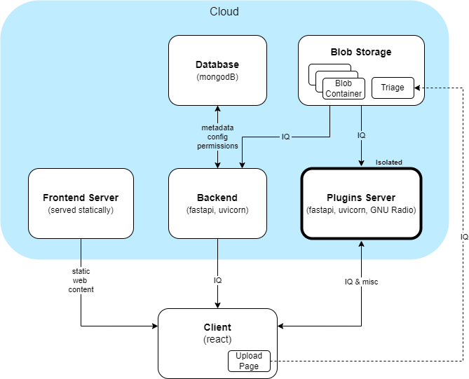
IQEngine Architecture

Slide 3
Switch to website

Slide 4
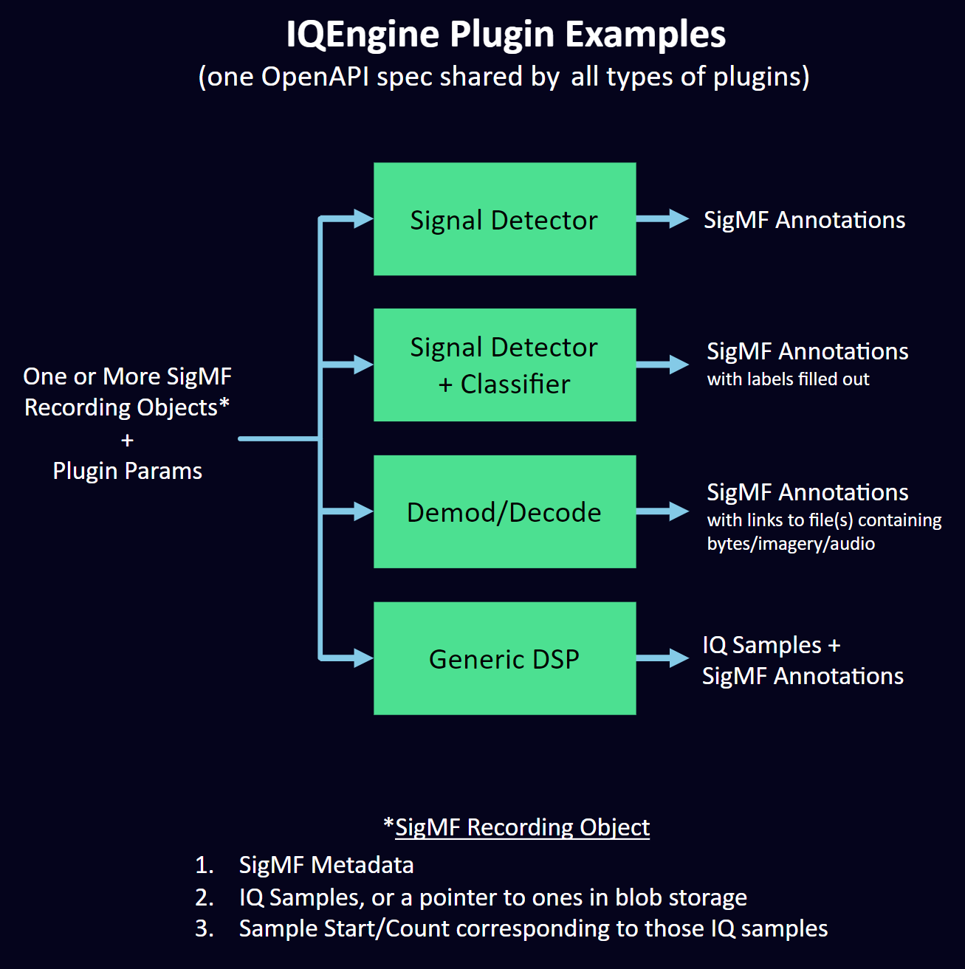

Slide 5
Plugins OpenAPI Spec
REST interface between IQEngine and plugins
Can also be used to call plugins from whatever software you want
A way to send our plugins IQ samples and params, and get back “results”
https://github.com/IQEngine/IQEngine/blob/main/plugins/plugins_openapi.yaml

Slide 7
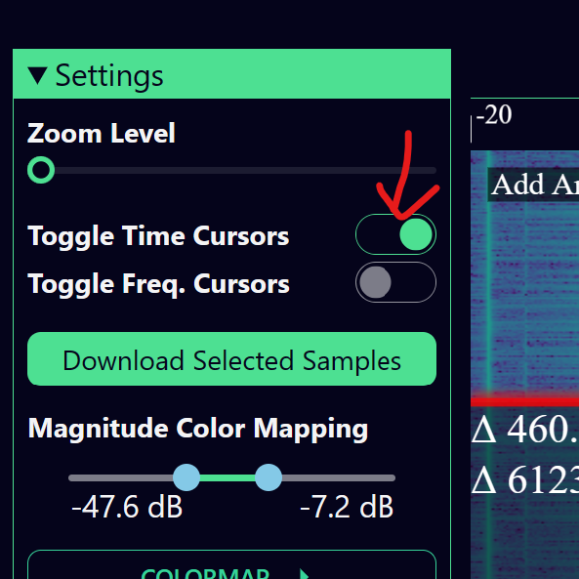
Exercise: Run a Local Plugins Server
sudo apt update
sudo apt install uvicorn ffmpeg libsm6 libxext6 python3-pip -y
git clone https://github.com/IQEngine/IQEngine.git
cd iqengine/plugins/src
pip install -r requirements.txt
uvicorn plugins_api:app --reload
Use iqengine.org for now
Open a recording, enable the time cursors on the left, then run whatever plugin you want
Try editing src/lowpass_filter/lowpass_filter.py (e.g. pass_zero=False)

Slide 8
GNU Radio Based Plugins - Prep
You need the python running the plugins server to “see” GNU Radio’s python install
Not always easy
You can test by trying to run a local GNU Radio plugin (e.g. fm_rx_gnuradio)
Alternatively, you can run the plugin server locally with Docker
Install docker (or docker desktop if you’re using WSL)
cd iqengine/plugins
docker build -t plugins_image .
docker run -dit -p 8000:8000 --name plugins_container plugins_image
“docker ps” should show one container running
Stop with docker stop plugins_container and delete with docker rm plugins_container.
SSH into container with docker exec -it plugins_container /bin/bash

Slide 9
GNU Radio Based Plugins - Creation
Copy the directory lowpass_filter_gnuradio using a new name
Make sure your flowgraph works in GRC with a File Source or SigMF Source
Disable all GUIs, set flowgraph to no-gui mode (use null sink at the end)
Generate the python flowgraph
Copy the flowgraph definition code into the plugin python code, using the lowpass_filter_gnuradio as an example
Replace the File Source with ZMQ Sub like in the example
Replace the null sink with ZMQ Pub like in the example

