Slide 1
High Accuracy Wireless Timing Synchronization Using Software Defined Radios
2023 GNU Radio Conference
High Performance SDR Applications
Jason M. Merlo and Jeffrey A. Nanzer

Slide 2
Motivation and Applications
Synchronization Technique
Software Overview & Demo
Experimental Results

Slide 3
1 | Motivation and
Applications

Slide 4

Motivation // Coherent Distributed Antenna Arrays
Traditional Phased Array
Distributed Phased Array
Far-Field Information Wavefront
Far-Field Information Wavefront
Time Synchronization
Frequency Synchronization

Slide 5
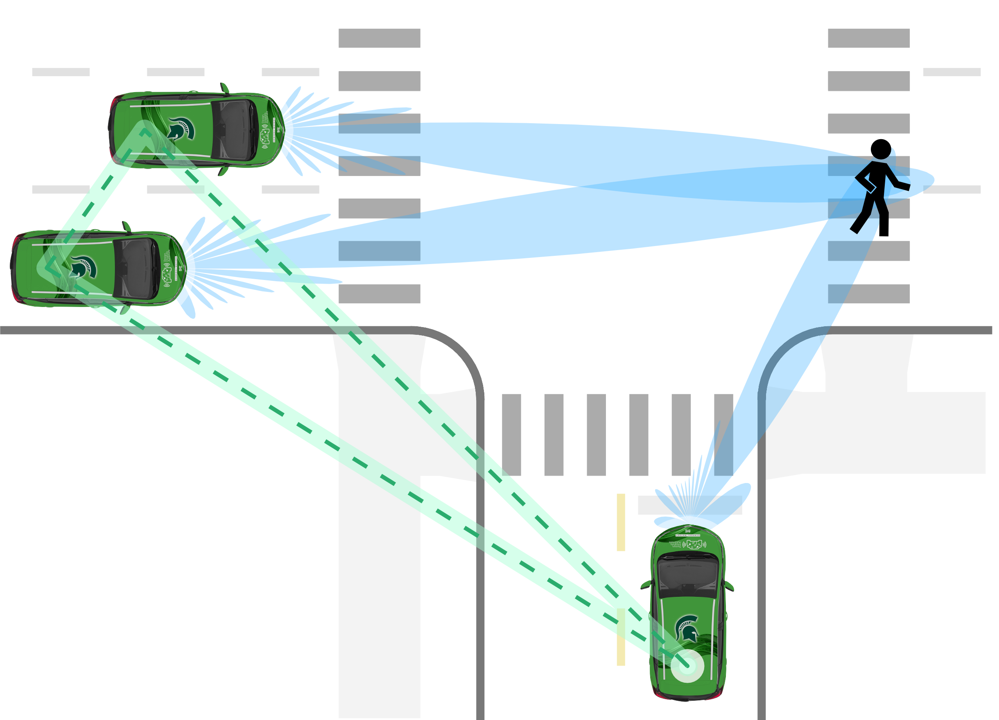
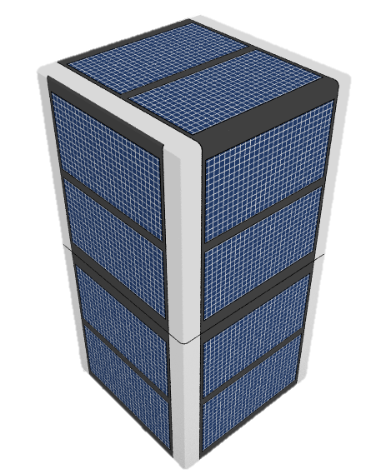



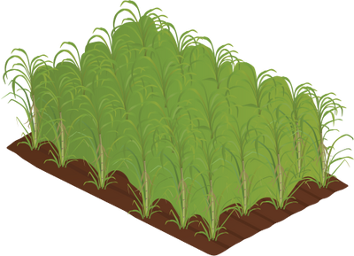
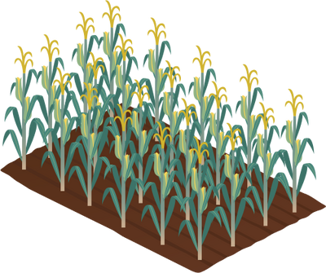



Applications of Coherent Distributed Arrays
Next Generation Satellite Cellular Networks
Distributed V2X Sensing
Space Communication
and Remote Sensing
Earth-Based
communication
base station
Precision Agricultural Sensing
Single-platform
resolution
Sensing and
communication
relay satellite
constellation
Receiver or
imaging target
Distributed array
resolution

Slide 6




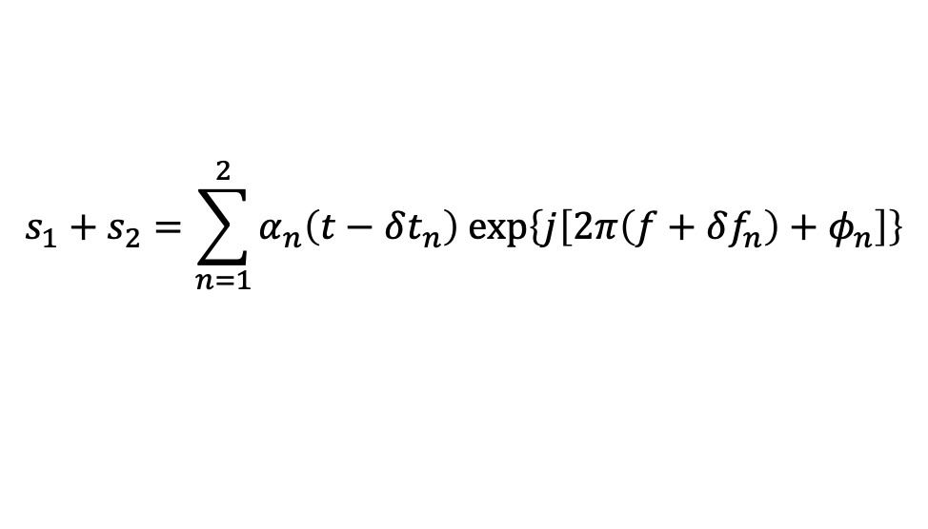


Coherent Distributed Array Synchronization
Time Synchronization
Phase Alignment
Frequency Syntonization
Node: 1
$N$₁
$N$₁
Wireless
Coordination
Node: 2
$$N2$$
$$N_{2}$$
$$Dest.$$
$$Destination$$
$$s_{1}+s_{2}=\sum_{n=1}^{2}{α_{n}\left(t−δt_{n}\right) exp\left\{j\left[2π\left(f+δf_{n}\right)+φ_{n}\right]\right\}}$$

Slide 7
2 | Synchronization Technique

Slide 8


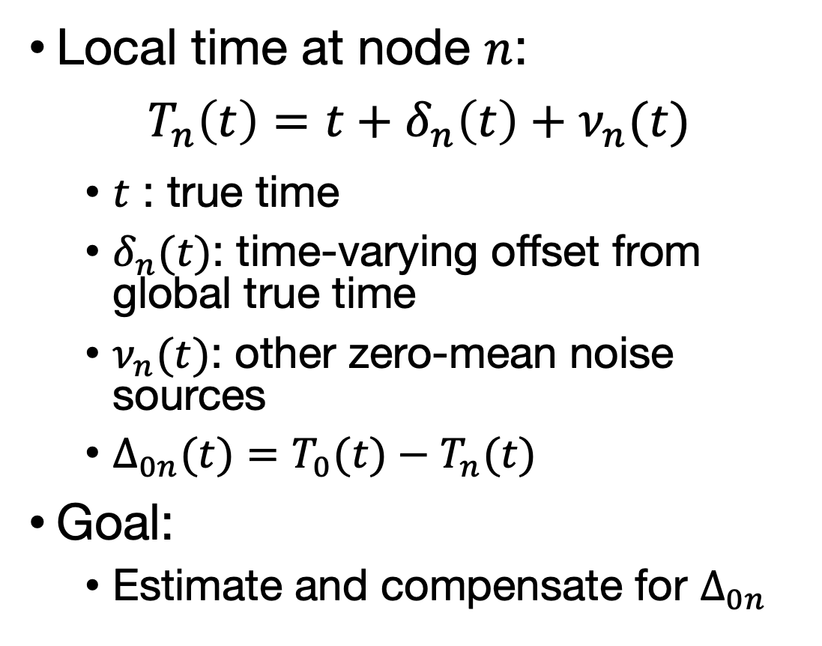


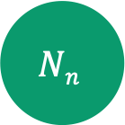
System Time Model
Local time at node $n$:
$$T_{n}\left(t\right)=t+δ_{n}\left(t\right)+ν_{n}(t)$$
  $t$ : true time
  $δ_{n}(t)$: time-varying offset from global true time
  $ν_{n}(t)$: other zero-mean noise sources
  $Δ_{0n}(t)=T_{0}(t)−T_{n}(t)$
Goal:
  Estimate and compensate for $Δ_{0n}$
Relative Clock Alignment
Node: 0
$$N0$$
$$R$$
$$Nn$$
Node: $n$
$$Δ_{0n}$$

Slide 9


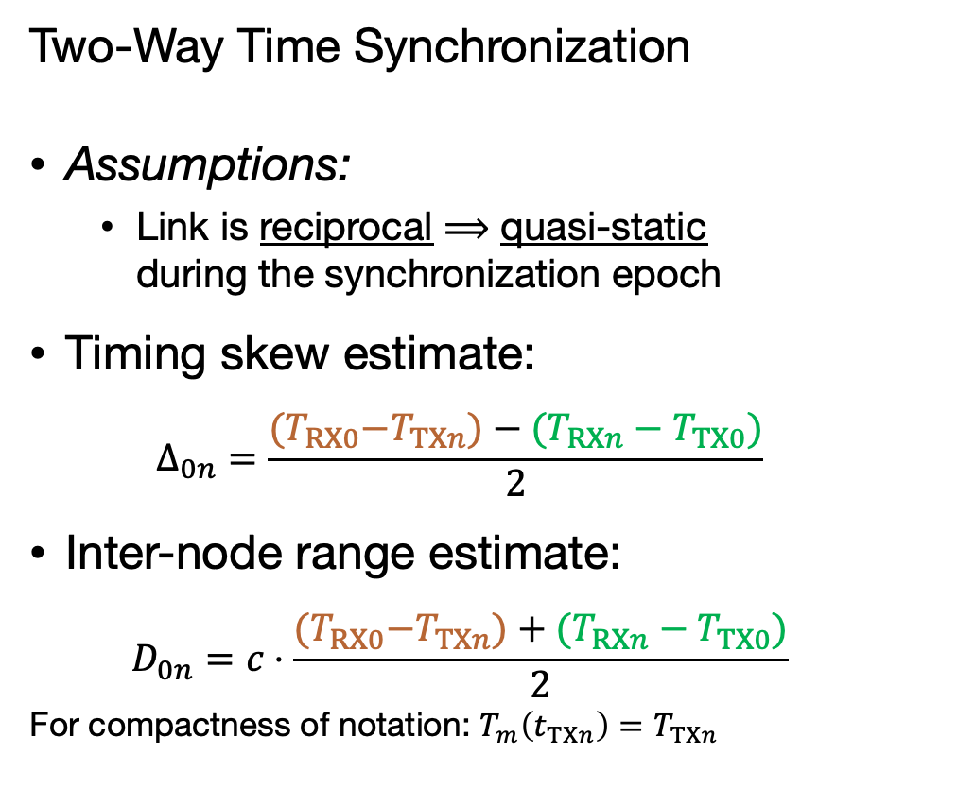
Time Synchronization Overview
Two-Way Time Synchronization
Assumptions:
  Link is reciprocal $⟹$ quasi-static
  during the synchronization epoch
Timing skew estimate:
  $$Δ_{0n}=\frac{{{(T}_{RX0}−T}_{TXn})−(T_{RXn}−T_{TX0})}{2}$$
Inter-node range estimate:
  $$D_{0n}=c⋅\frac{{{(T}_{RX0}−T}_{TXn})+(T_{RXn}−T_{TX0})}{2}$$
For compactness of notation: $T_{m}\left(t_{TXn}\right)=T_{TXn}$
$$τ$$

Slide 10
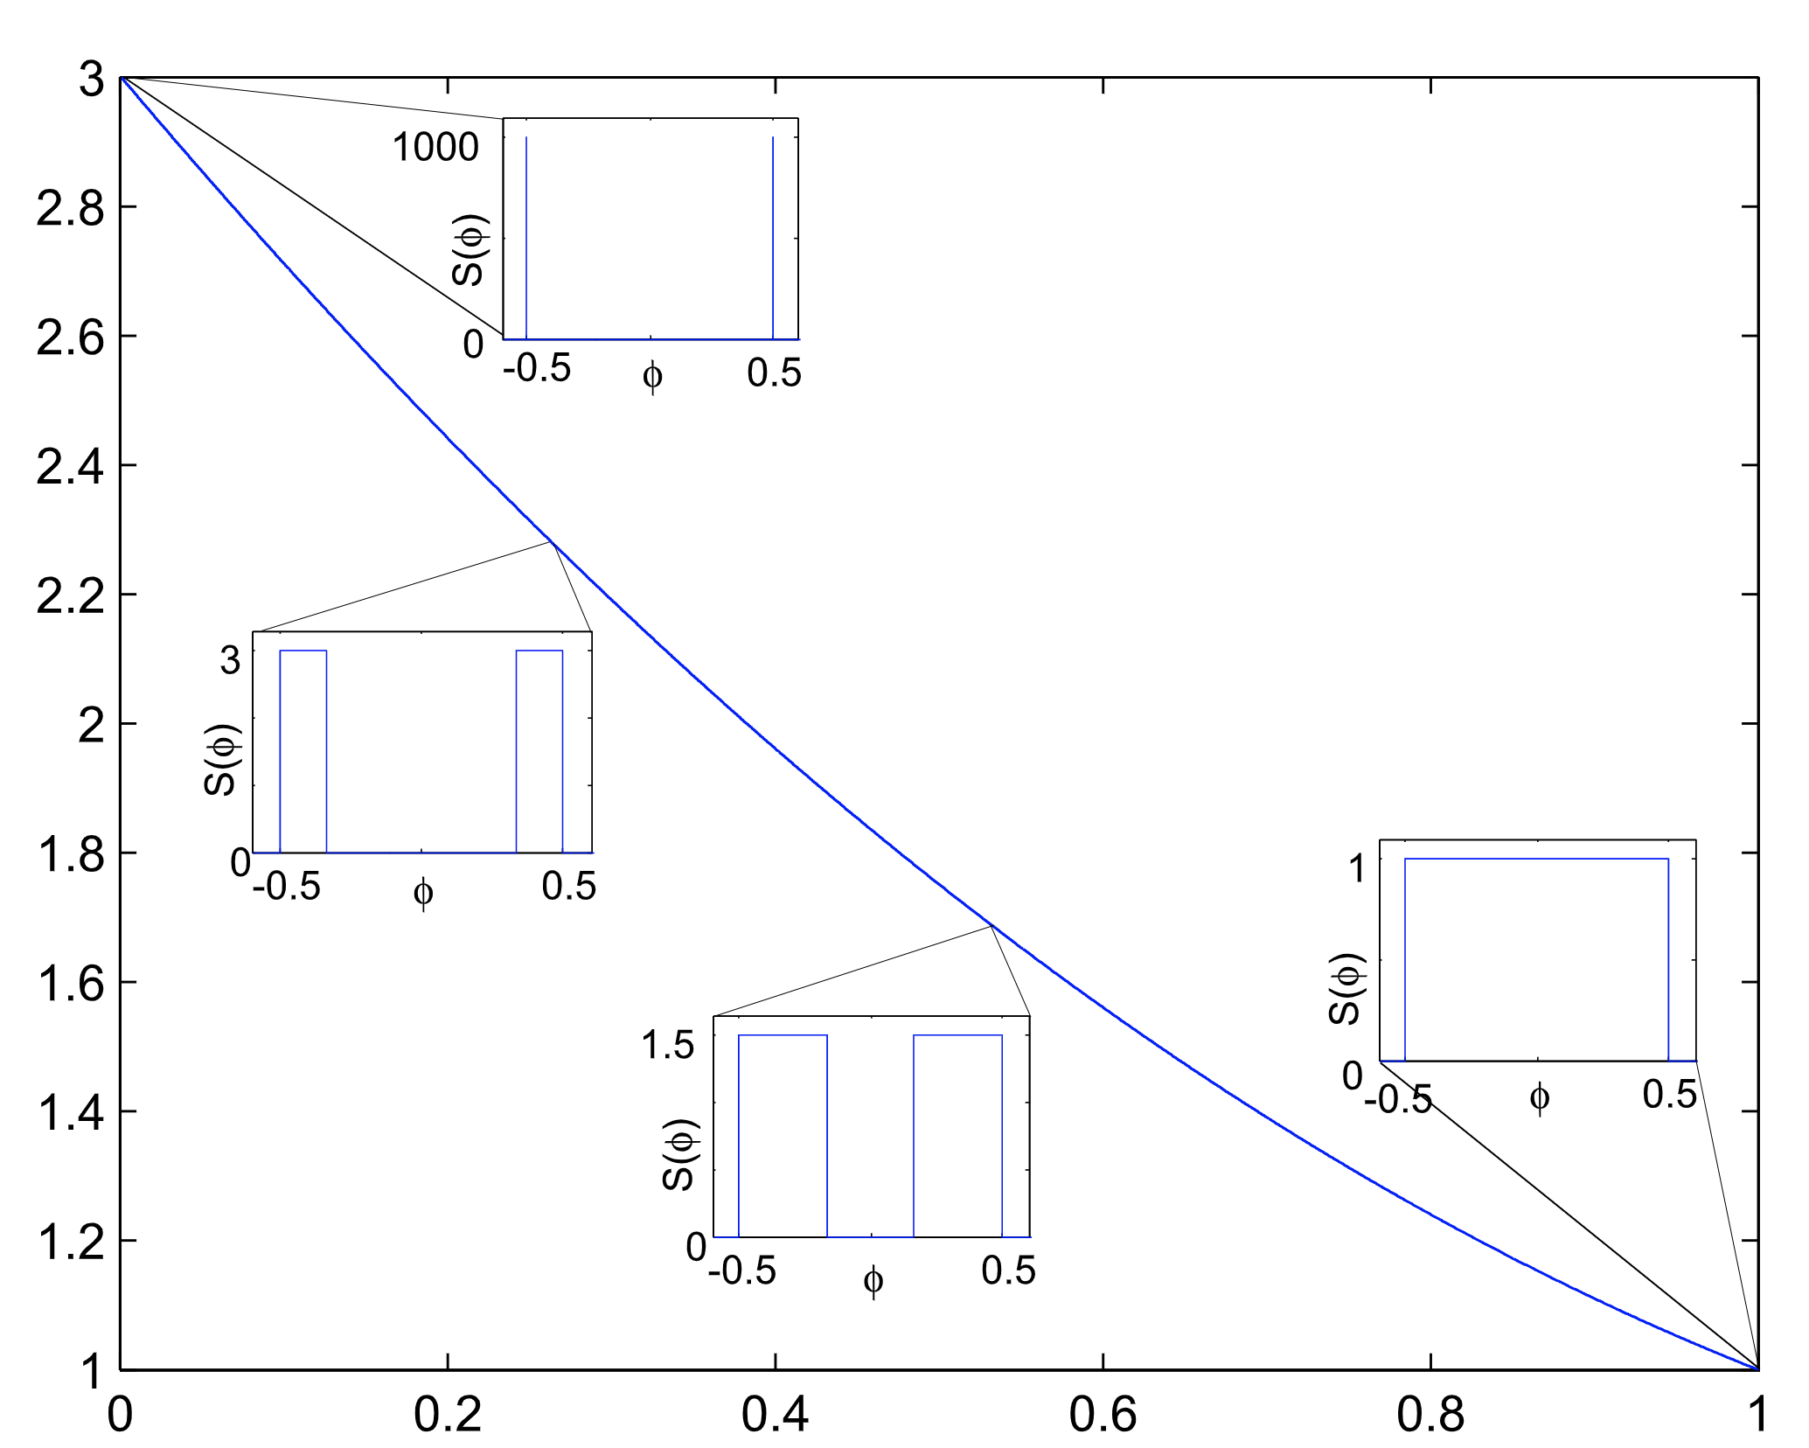

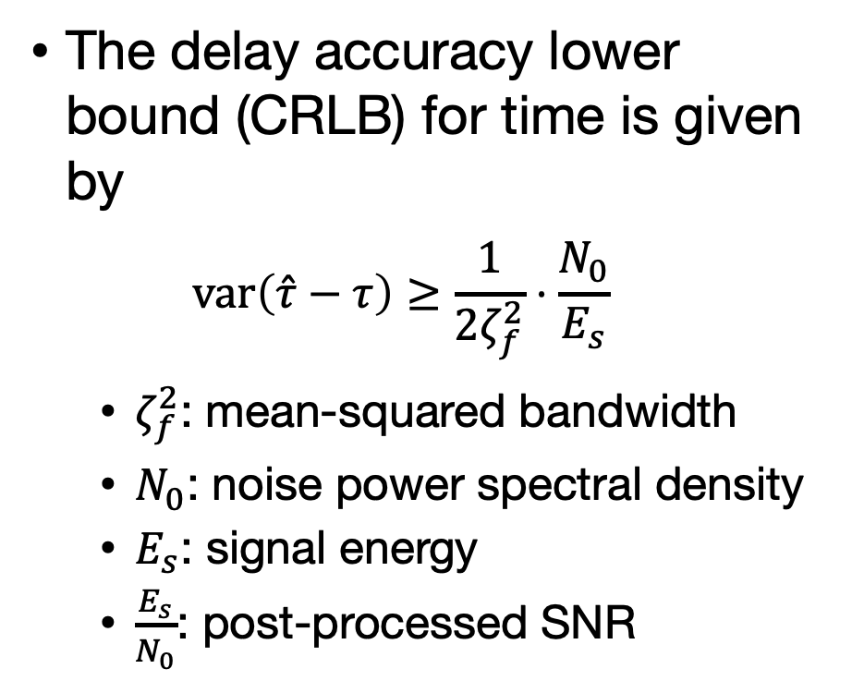



High Accuracy Delay Estimation
The delay accuracy lower bound (CRLB) for time is given by
$var\left(\hat{τ}−τ\right)≥\frac{1}{2ζ_{f}^{2}}⋅\frac{N_{0}}{E_{s}}$
  $ζ_{f}^{2}$: mean-squared bandwidth
  $N_{0}$: noise power spectral density
  $E_{s}$: signal energy
  $\frac{E_{s}}{N_{0}}$: post-processed SNR
$$ζ_{f\left(two−tone\right)}^{2}$$
Relative Mean Sq. Bandwidth $ζ_{f}^{2}/ζ_{f0}^{2}$
$$ζ_{f\left(LFM\right)}^{2}$$
Fractional Occupied Bandwidth ($ϕ$)
[3] J. A. Nanzer and M. D. Sharp, “On the Estimation of Angle Rate in Radar,” IEEE T Antenn Propag, vol. 65, no. 3, pp. 1339–1348, 2017, doi: 10.1109/tap.2016.2645785.

Slide 11
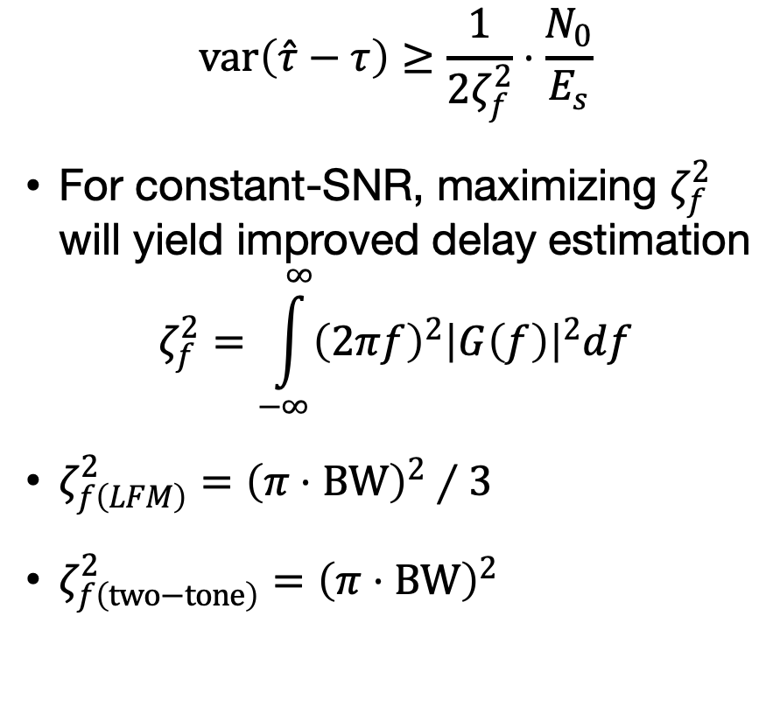
High Accuracy Delay Estimation
$$var\left(\hat{τ}−τ\right)≥\frac{1}{2ζ_{f}^{2}}⋅\frac{N_{0}}{E_{s}}$$
For constant-SNR, maximizing $ζ_{f}^{2}$ will yield improved delay estimation
$$ζ_{f}^{2}=\int_{−∞}^{∞}{{\left(2πf\right)}^{2}{\left|G\left(f\right)\right|}^{2}df}$$
$ζ_{f\left(LFM\right)}^{2}={\left(π⋅BW\right)}^{2}∕3$
$ζ_{f\left(two−tone\right)}^{2}={\left(π⋅BW\right)}^{2}$
$$ζ_{f\left(two−tone\right)}^{2}$$
Relative Mean Sq. Bandwidth $ζ_{f}^{2}/ζ_{f0}^{2}$
$$ζ_{f\left(LFM\right)}^{2}$$
Fractional Occupied Bandwidth ($ϕ$)
[3] J. A. Nanzer and M. D. Sharp, “On the Estimation of Angle Rate in Radar,” IEEE T Antenn Propag, vol. 65, no. 3, pp. 1339–1348, 2017, doi: 10.1109/tap.2016.2645785.

Slide 12
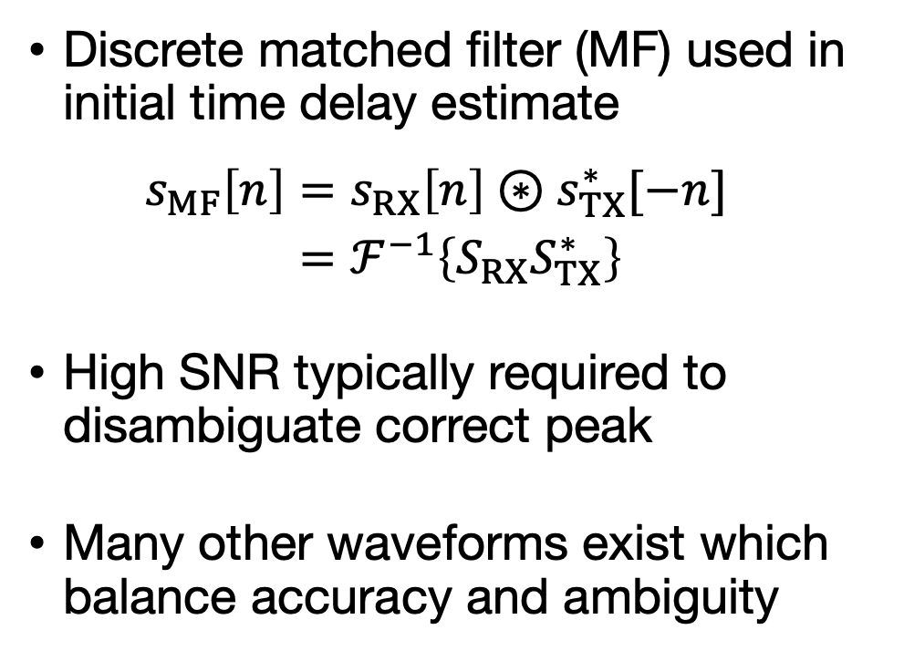
Delay Estimation
Discrete matched filter (MF) used in initial time delay estimate
$\begin{aligned}s_{MF}\left[n\right]&=s_{RX}\left[n\right]⊛s_{TX}^{∗}[−n] \\ &=ℱ^{−1}\left\{S_{RX}S_{TX}^{∗}\right\}\end{aligned}$
High SNR typically required to disambiguate correct peak
Many other waveforms exist which balance accuracy and ambiguity
[4] J. M. Merlo, S. R. Mghabghab and J. A. Nanzer, "Wireless Picosecond Time Synchronization for Distributed Antenna Arrays," in IEEE Transactions on Microwave Theory and Techniques, vol. 71, no. 4, pp. 1720-1731, April 2023, doi: 10.1109/TMTT.2022.3227878.

Slide 13
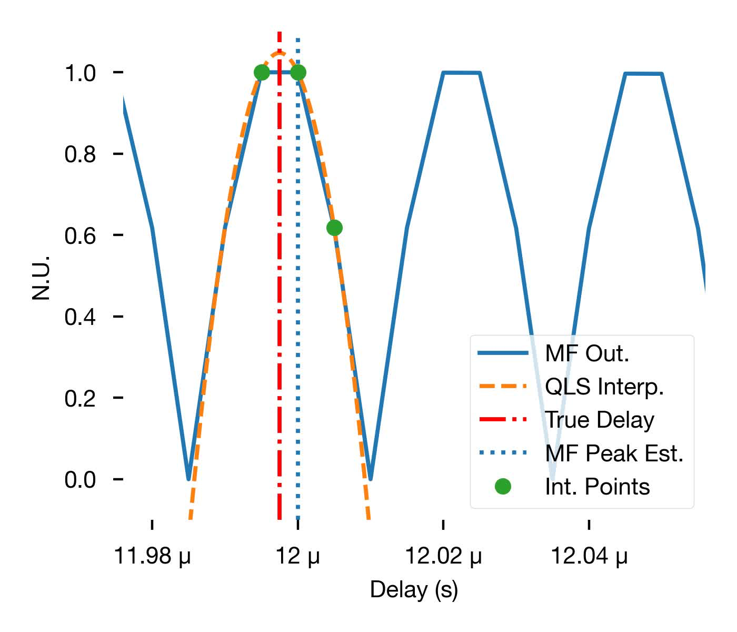
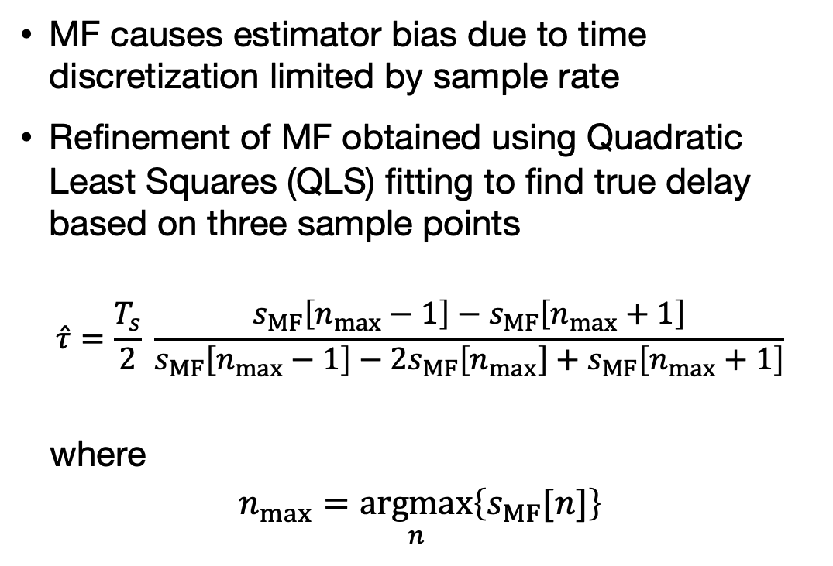
Delay Estimation Refinement
MF causes estimator bias due to time discretization limited by sample rate
Refinement of MF obtained using Quadratic Least Squares (QLS) fitting to find true delay based on three sample points
$$\hat{τ}=\frac{T_{s}}{2} \frac{s_{MF}\left[n_{max}−1\right]−s_{MF}\left[n_{max}+1\right]}{s_{MF}\left[n_{max}−1\right]−2s_{MF}\left[n_{max}\right]+s_{MF}\left[n_{max}+1\right]}$$
where
$$n_{max}=\underset{n}{argmax}\left\{s_{MF}[n]\right\}$$
[4] J. M. Merlo, S. R. Mghabghab and J. A. Nanzer, "Wireless Picosecond Time Synchronization for Distributed Antenna Arrays," in IEEE Transactions on Microwave Theory and Techniques, vol. 71, no. 4, pp. 1720-1731, April 2023, doi: 10.1109/TMTT.2022.3227878.

Slide 14
Delay Estimation Refinement
QLS results in small residual bias due to an imperfect representation of the underlying MF output
Residual bias is a function of waveform and sample rate
Can be easily corrected via lookup table
[4] J. M. Merlo, S. R. Mghabghab and J. A. Nanzer, "Wireless Picosecond Time Synchronization for Distributed Antenna Arrays," in IEEE Transactions on Microwave Theory and Techniques, vol. 71, no. 4, pp. 1720-1731, April 2023, doi: 10.1109/TMTT.2022.3227878.

Slide 15
3 | Software Overview

Slide 16
Software Challenges
High/full sample rate with low CPU utilization
  Use “bursty” transmission scheme
Reasonably low latency
  Use message/PDU-based flowgraph
Maintain groupings of PDUs for each channel transmitted/received
  Use lists of PDUs; initially created a “Wide PDU” type, but switched for compatibility with existing codebase

Slide 17
Software Guiding Principles
Code reusability
  Implemented on top of DELTA Python Package for code reusability
Implementation/iteration speed
  Scientific processing implemented in Python first, data manipulation in C++
  Benchmark, re-implement in C++ if necessary

Slide 18


Time Estimation Process
Generate Waveform
Matched
Filter
Peak-Find
QLS Estimate
4
TX Window
RX Window
Processing
N0
1
4
t
$$10μs$$
$$10μs$$
N1
2
3
t
RX Window
Processing
TX Window
are shared between nodes to determine corrections
1
2
3
4
Matched
Filter
Peak-Find
QLS Estimate
Generate Waveform
2

Slide 19
Time Transfer Flow Graph

Slide 20
Wavegen Block

Slide 21
USRP Sync Burst Block

Slide 22
PDU Matched Filter Block

Slide 23
PDU QLS Peak Estimator Block

Slide 24
Time Sync Controller Block

Slide 25
Software Demo

Slide 26
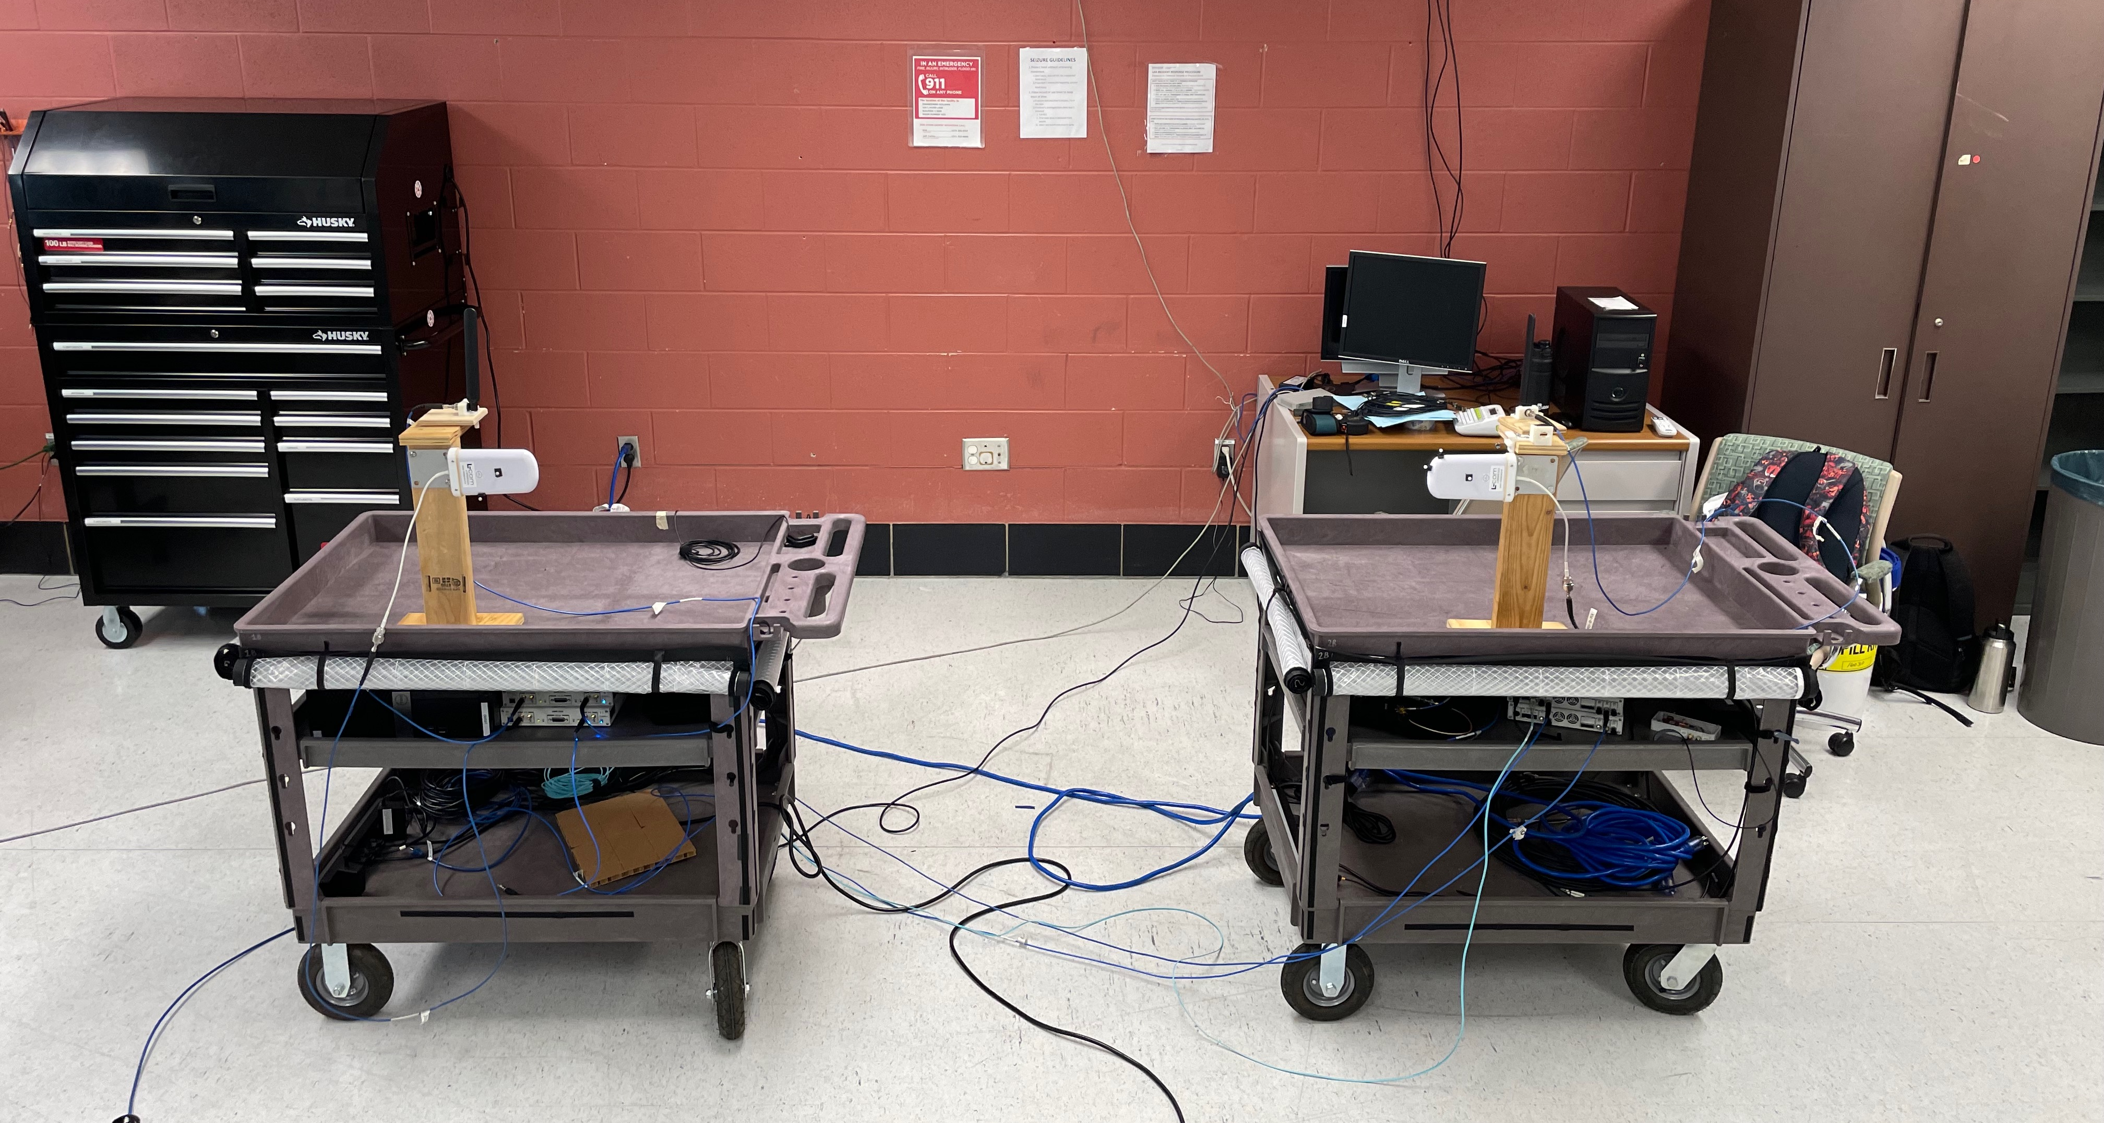
Software Demo
Time Transfer Antennas
Coordination Server
Radios (X310s)

Slide 27
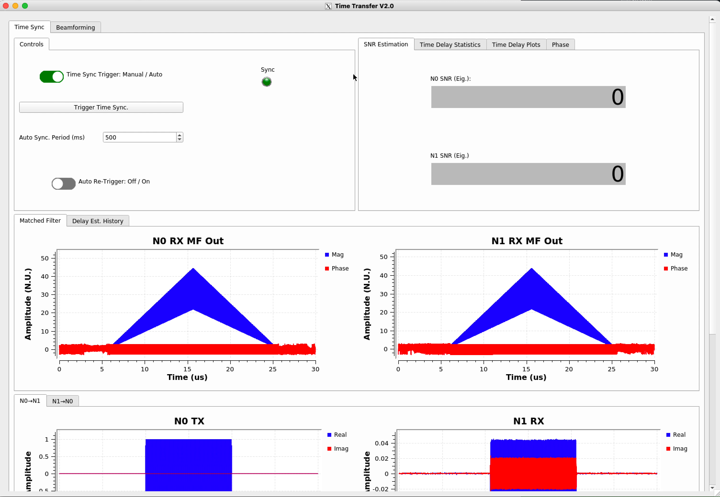

Slide 28
4 | Experimental Results
Beamforming

Slide 29
System Configuration
Manually muted ~100s of milliseconds
2–5 m
[5] J. M. Merlo, A. Schlegel and J. A. Nanzer, "High Accuracy Wireless Time-Frequency Transfer For Distributed Phased Array Beamforming," in 2023 IEEE/MTT-S International Microwave Symposium - IMS 2023, San Diego, CA, USA, 2023.

Slide 30
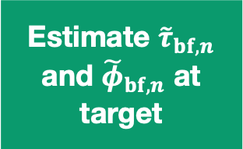

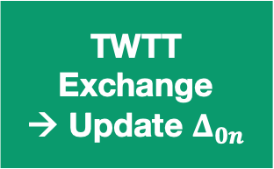
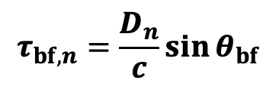
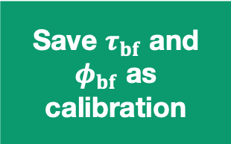

System State Flow
Initial PPS Sync
TWTT Exchange
→ Update $Δ_{0n}$
Transmit beamforming pulses
Estimate ${\tilde{τ}}_{bf,n}$ and ${\tilde{φ}}_{bf,n}$ at target
Start
Coarse alignment ~10 ns
Residual bias compensated to picosecond level
Compensate using $Δ_{0n}$, and beamsteer using $τ_{bf,n}$ and $φ_{bf,n}$
Beamsteering
First Pulse?
No
$$τ_{bf,n}=\frac{D_{n}}{c}\sin{θ_{bf}}$$
$$φ_{bf,n}=2π{ f}_{ci} τ_{bf,n}$$
Save $τ_{bf}$ and $φ_{bf}$ as calibration
Yes
[5] J. M. Merlo, A. Schlegel and J. A. Nanzer, "High Accuracy Wireless Time-Frequency Transfer For Distributed Phased Array Beamforming," in 2023 IEEE/MTT-S International Microwave Symposium - IMS 2023, San Diego, CA, USA, 2023.

Slide 31
Performance Evaluation Waveforms
Each node transmitted orthogonal LFMs followed by two CW pulses
Node 0
…
t
Node 1
…
t
LFM: Time/Phase Estimation
CW Pulses: Coherent Gain Estimation
[5] J. M. Merlo, A. Schlegel and J. A. Nanzer, "High Accuracy Wireless Time-Frequency Transfer For Distributed Phased Array Beamforming," in 2023 IEEE/MTT-S International Microwave Symposium - IMS 2023, San Diego, CA, USA, 2023.

Slide 32
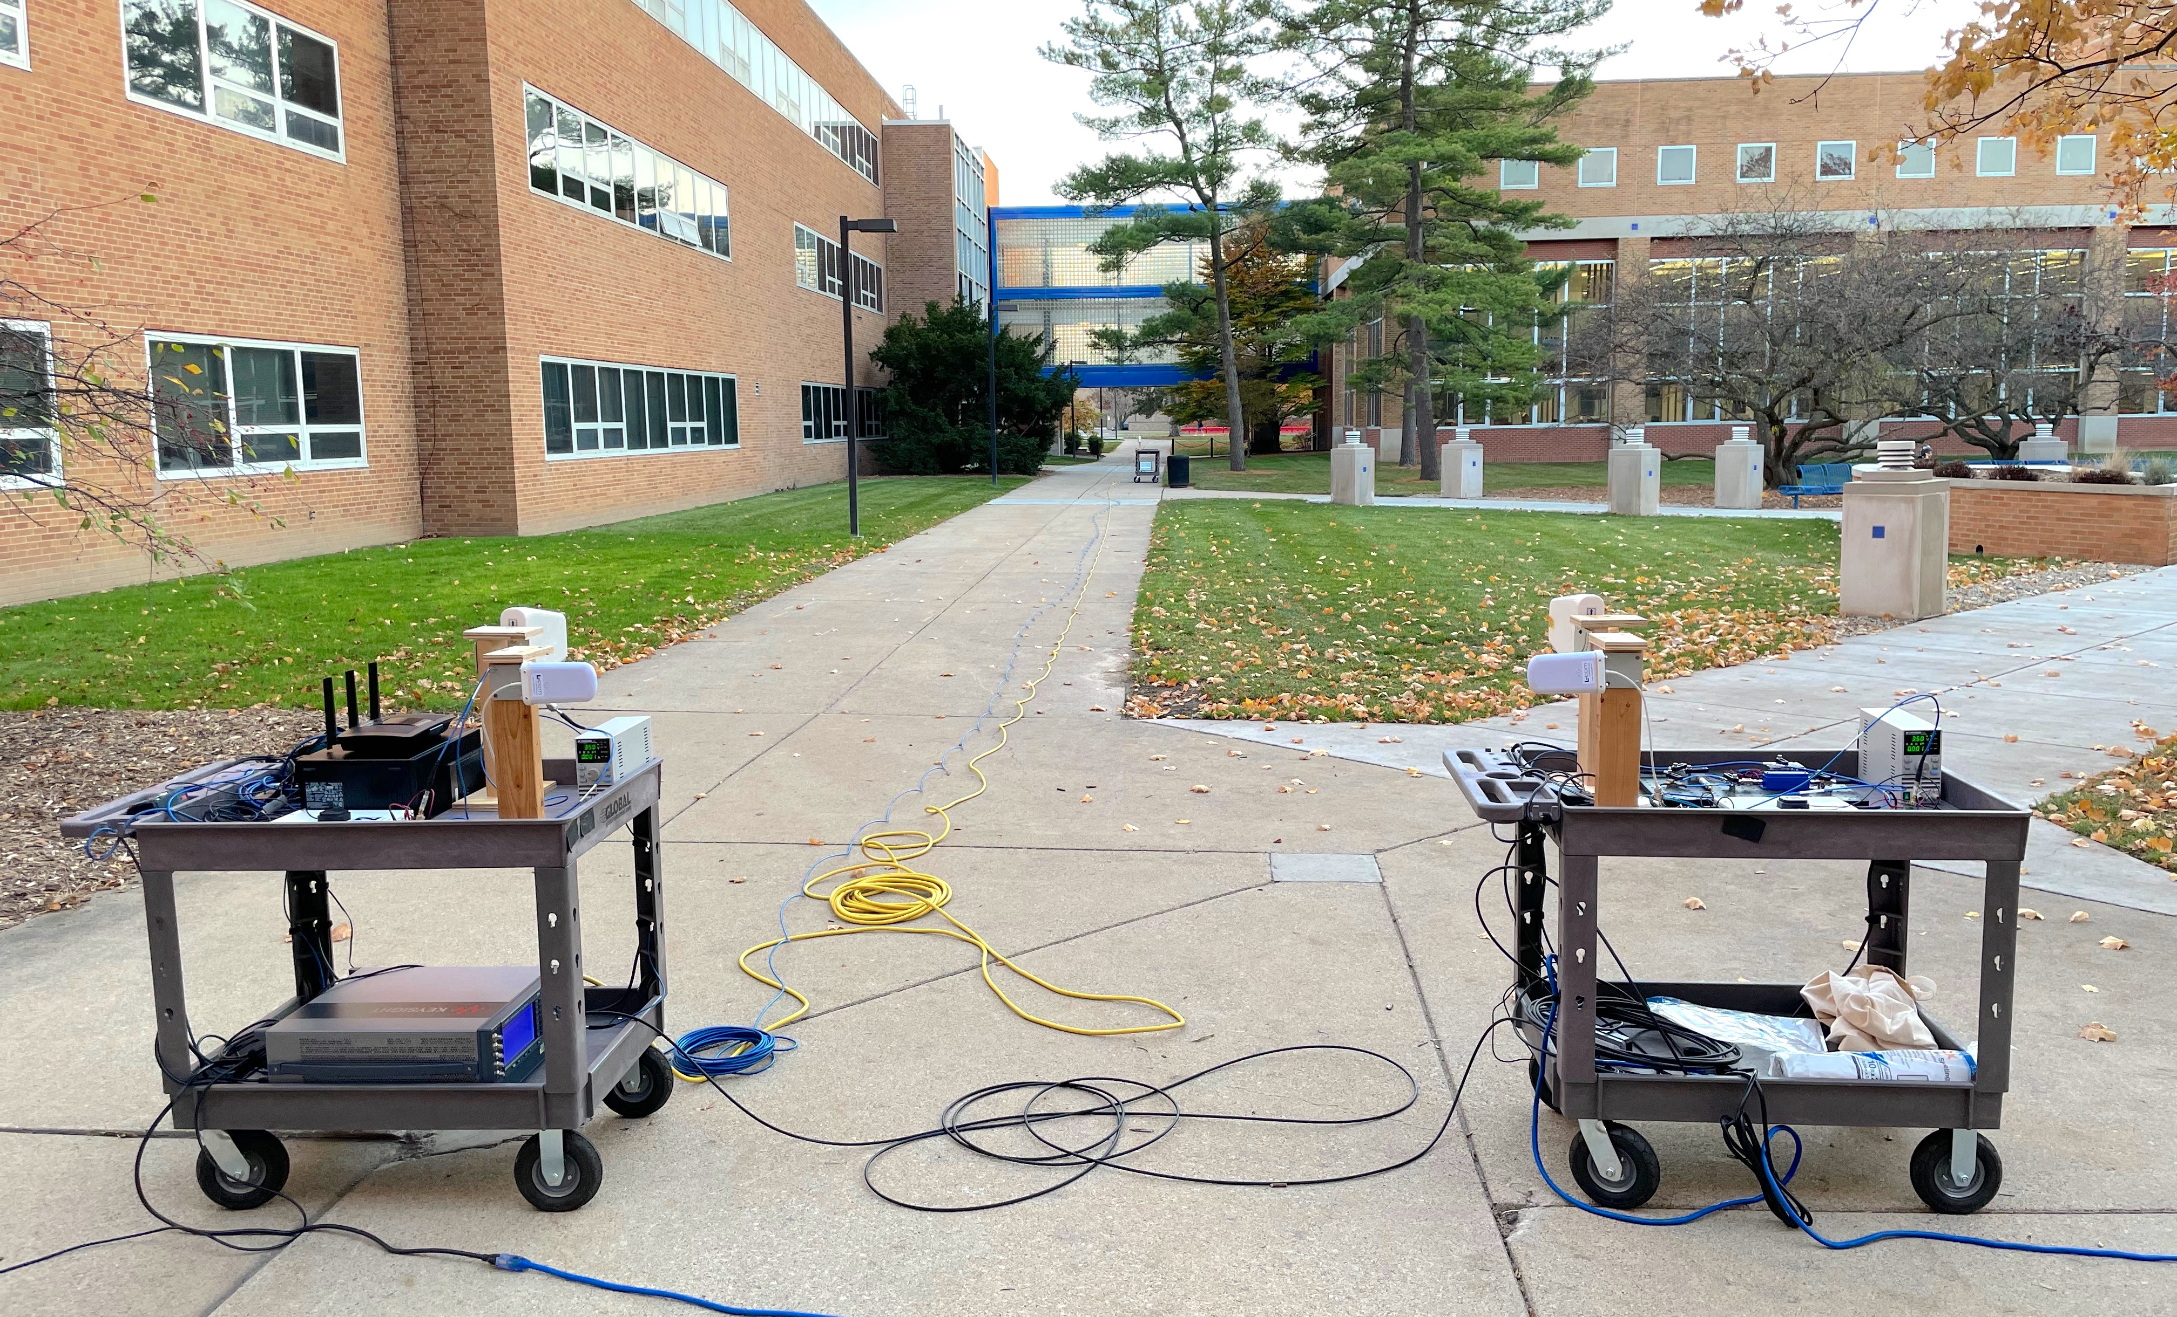
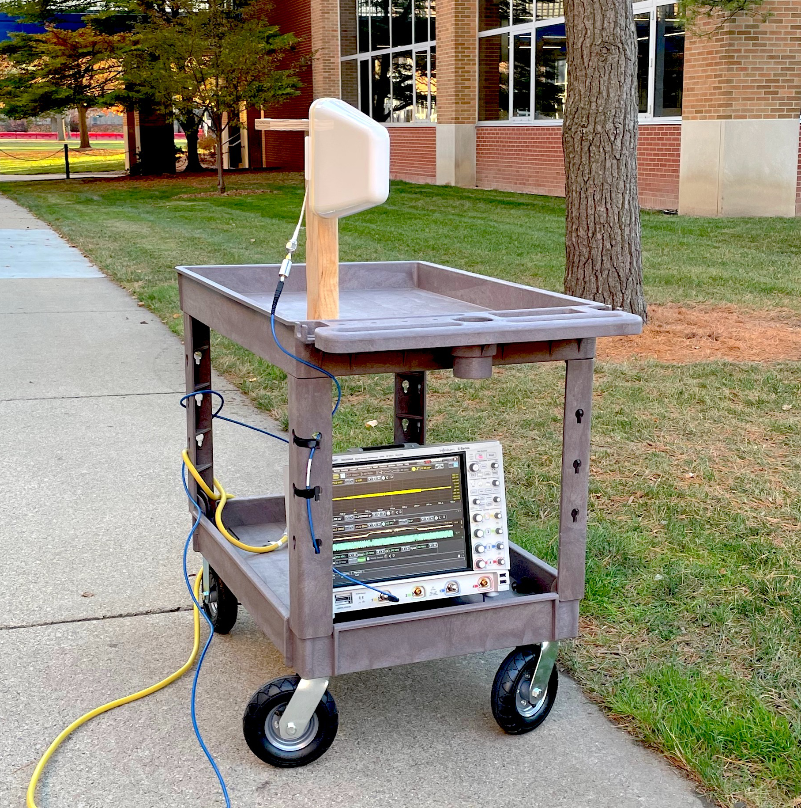
Experimental Configuration
2.1 m
Transmit Nodes Setup
Target Node Setup (41 m downrange)
[5] J. M. Merlo, A. Schlegel and J. A. Nanzer, "High Accuracy Wireless Time-Frequency Transfer For Distributed Phased Array Beamforming," in 2023 IEEE/MTT-S International Microwave Symposium - IMS 2023, San Diego, CA, USA, 2023.

Slide 33
Beamforming Results
Induced Frequency Transfer Failure
[5] J. M. Merlo, A. Schlegel and J. A. Nanzer, "High Accuracy Wireless Time-Frequency Transfer For Distributed Phased Array Beamforming," in 2023 IEEE/MTT-S International Microwave Symposium - IMS 2023, San Diego, CA, USA, 2023.
Notes:
Time Transfer SNR: ~23dB
Cycle Time: ~4 s
Beamforming Std.: $18<σ_{bf}<40$ ps
Phase Std.: $0.04π<σ_{φ}<0.10π$
Throughput (BPSK): $2.5<b_{max}<5.5$ Gbps
Max Carrier Freq.: $1.0<f_{max}<2.78$ GHz

Slide 34
Beamforming Results
mV
V
mV
mV
[5] J. M. Merlo, A. Schlegel and J. A. Nanzer, "High Accuracy Wireless Time-Frequency Transfer For Distributed Phased Array Beamforming," in 2023 IEEE/MTT-S International Microwave Symposium - IMS 2023, San Diego, CA, USA, 2023.

Slide 35
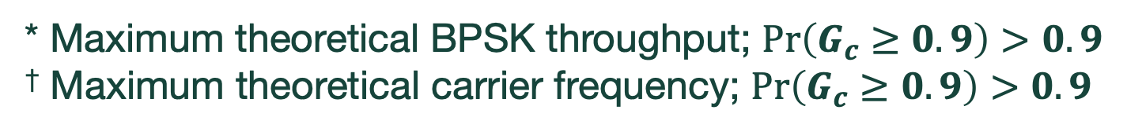
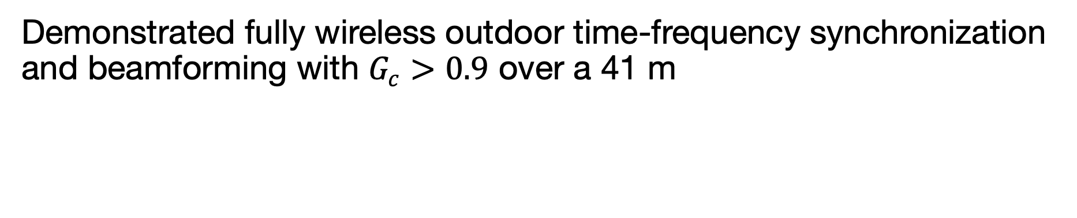
Measurement Summary
Demonstrated fully wireless outdoor time-frequency synchronization and beamforming with $G_{c}>0.9$ over a 41 m
Internode Distance | Min. Time Transfer Std. | Min. Beamforming Std. | Max. Throughput* | Max. Carrier Frequency†
2.1 m | 10.47 ps | 18.00 ps | 5.56 Gbps | 2.78 GHz
5.0 m | 14.79 ps | 24.02 ps | 4.16 Gbps | 2.08 GHz
* Maximum theoretical BPSK throughput; $Pr\left(G_{c}≥0.9\right)>0.9$
† Maximum theoretical carrier frequency; $Pr\left(G_{c}≥0.9\right)>0.9$
[5] J. M. Merlo, A. Schlegel and J. A. Nanzer, "High Accuracy Wireless Time-Frequency Transfer For Distributed Phased Array Beamforming," in 2023 IEEE/MTT-S International Microwave Symposium - IMS 2023, San Diego, CA, USA, 2023.

Slide 36
Project Status and Conclusion
In Progress:
Standardizing inter-block communications (use PDUs/list of PDUs)
Complete fully distributed compute software implementation
  Testing in progress
Adding/improving documentation
Planned Work:
Add test cases for CI/CD
Open source releases
Investigate use of streaming interface with managed latency to leverage existing streaming blocks

Slide 37



Questions?
merlojas@msu.edu
Thank you to our project sponsors and collaborators:
National
Science
Foundation
This work was supported under the auspices of the U.S. Department of Energy by Lawrence Livermore National Laboratory under Contract DEAC52-07NA27344, by the LLNL-LDRD Program under Project No. 22-ER-035, by the Office of Naval Research under grant #N00014-20-1-2389, and by the National Science Foundation under Grant #1751655.

