Slide 1
RECOGNIZING FORWARD ERROR-CORRECTING CODES WITH MACHINE LEARNING
Rafael Turner
Director of Machine Learning
Dedrone
DEDRONE.COM

Slide 2
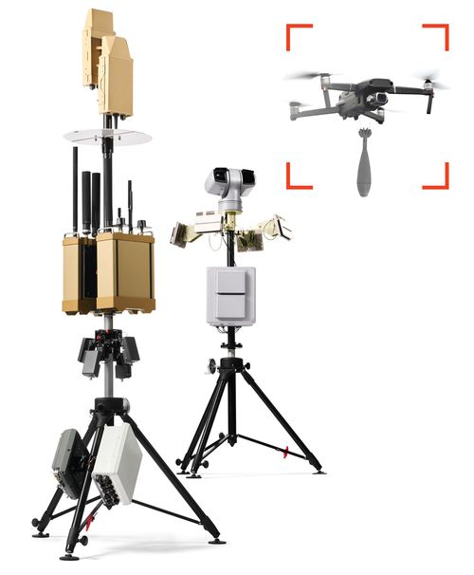
The ability to understand communication systems is a very important part of what we do.

Slide 3
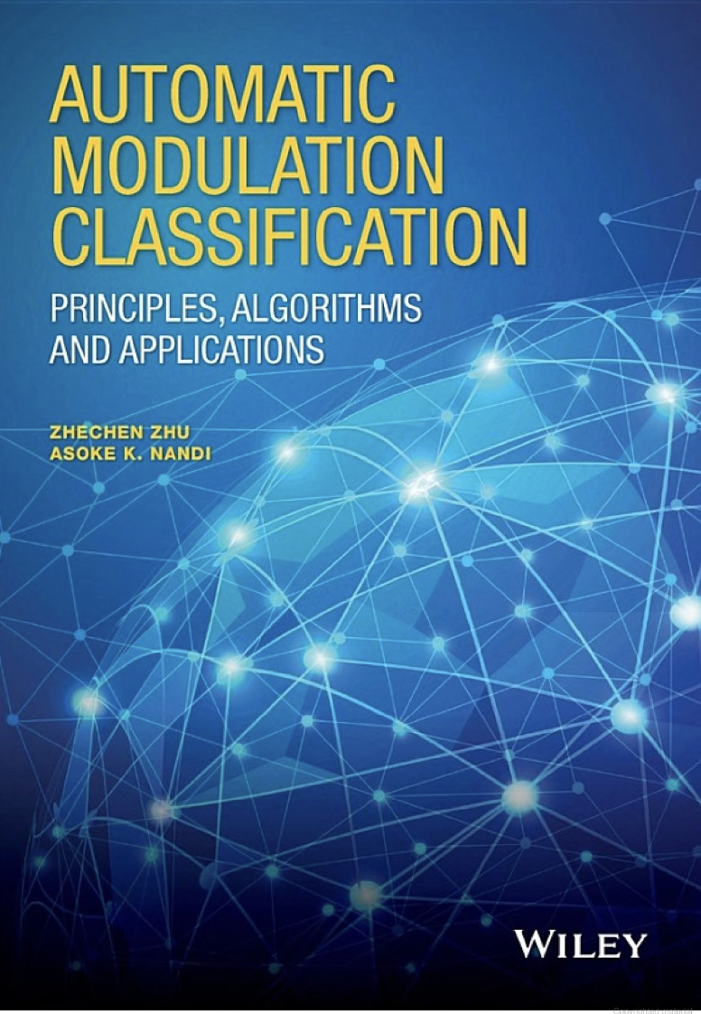
Machine Learning in RF Has mostly Focused on Physical Layer Modulation
Radio Frequency Machine Learning Systems (RFMLS)

Slide 4
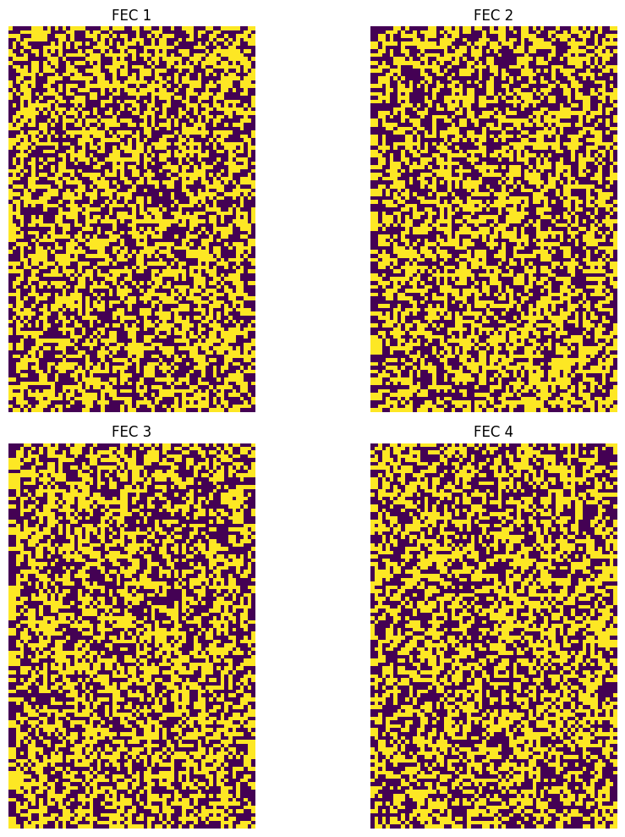
The Challenge

Slide 5
Introduction to FEC

Slide 6
what is a forward error-correcting algorithm?
FEC Encoder
FEC Decoder
Noisy Channel
0
1 - p
0
p
1
p
1
1 - p

Slide 7
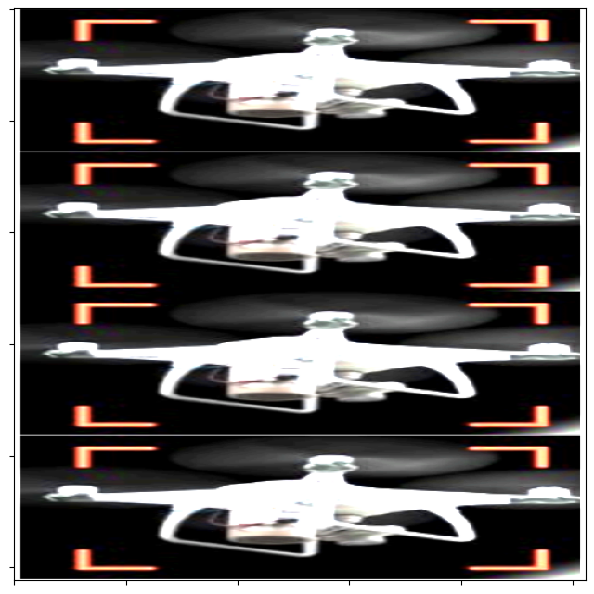
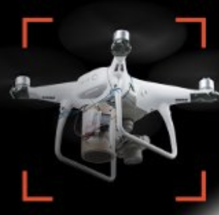
Repetition Code
FEC Encoder
Decoder
Noisy Channel

Slide 8
Why Move way from Repetition Codes?
Fixes 1 error out of 3 bits 33% efficiency (rate of the code)

Slide 9
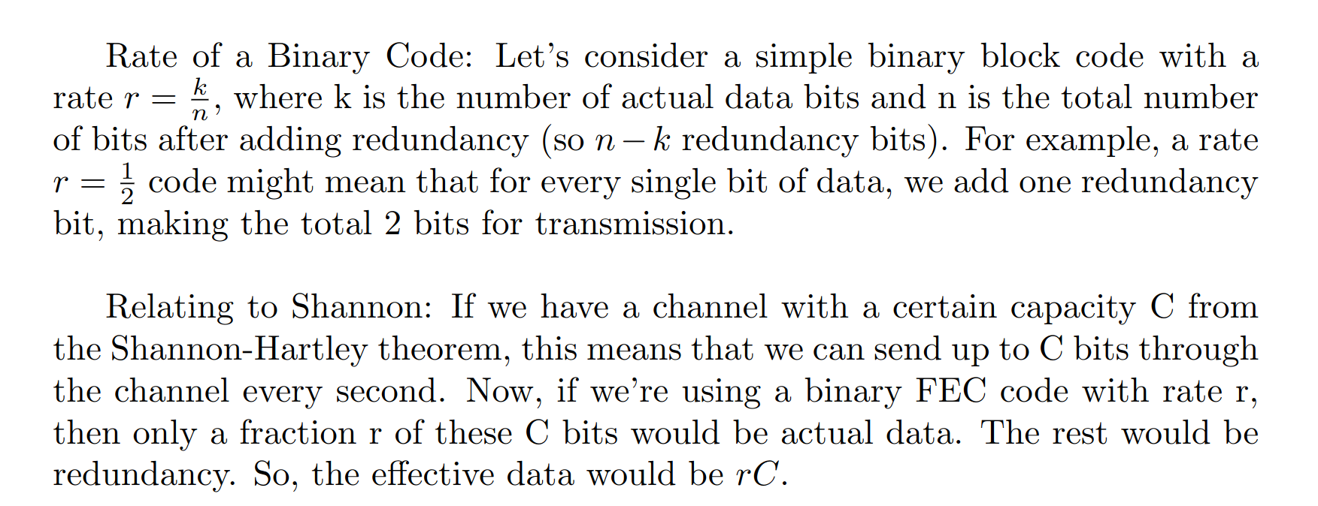
Why Move way from Repetition Codes?

Slide 10
Linear Codes
FEC Encoder
FEC Decoder
Noisy Channel
What kind of function is this?

Slide 11
Parity Check Equations
1
Writing these appended bits as a combination of multiplication and addition modulo 2 gives rise to a linear code
1
0
1
Linear Encoder
1
1
1
1
0
1
1
1
1
1
=
1
1
1
1
1
0
0
=
1
0
1
0
1
1
0
1
=
1
1
1
1
0
0
=
9
1
1
0
1
0
=
1
0
1
0
1
=
1
1
1
1

Slide 12
Linear Codes

Slide 13
LINEAR CODES

Slide 14
LINEAR CODES

Slide 15
LINEAR CODES

Slide 16
LINEAR CODES
In coding theory, codes are represented as subspaces of a finite-dimensional vector space over the binary field.
1. Generator Matrix: This is a matrix whose rows form a basis for the code. When you multiply a message vector by G, you get a codeword.
2. Parity-Check Matrix: This matrix is used to check the validity of a codeword. Specifically, for a valid codeword, the product with H should be the zero vector.
3. Error Detection: If you receive a vector and find that the result of multiplying H is not the zero vector, then v is not a valid codeword, indicating that an error occurred during transmission.
4. Error Correction: Some coding schemes, especially those designed for error correction, can use the result of the multiplication (the syndrome) to not just detect, but also correct certain types of errors.
5. Kernel Dimension: The dimension of the kernel of the parity-Check Matrix gives you the dimension of the code, which is the number of information bits in a codeword. The codeword's length minus this dimension gives the number of redundancy bits added for error detection and/or correction.

Slide 17
Repetition Code - Revisted

Slide 18
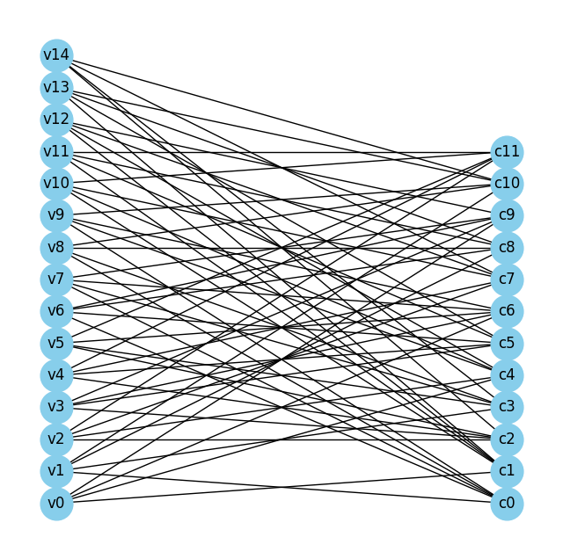
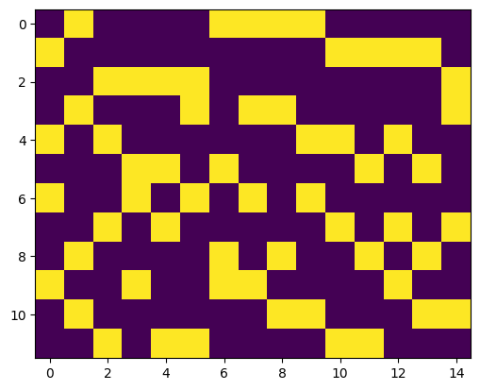
LDPC

Slide 19
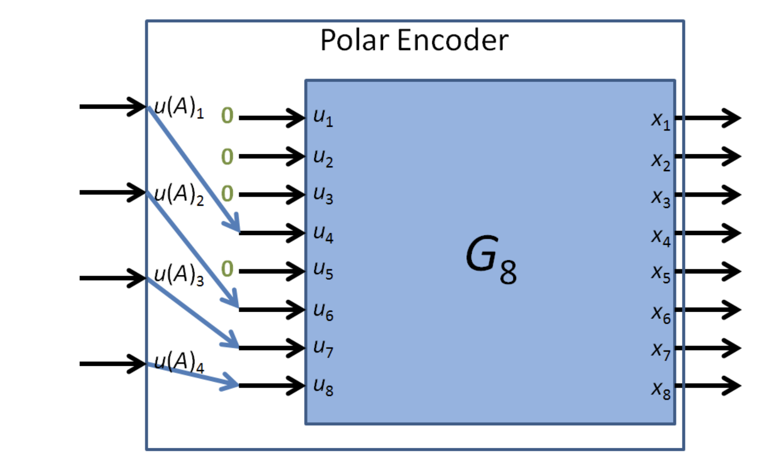
Polar Codes
The idea motivating polar code is that when decoding a corrupted message, most the uncertainty ends up being in the subset of bits that were frozen

Slide 20
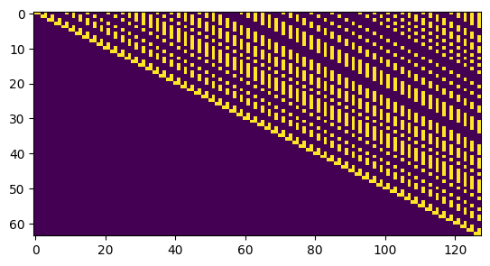
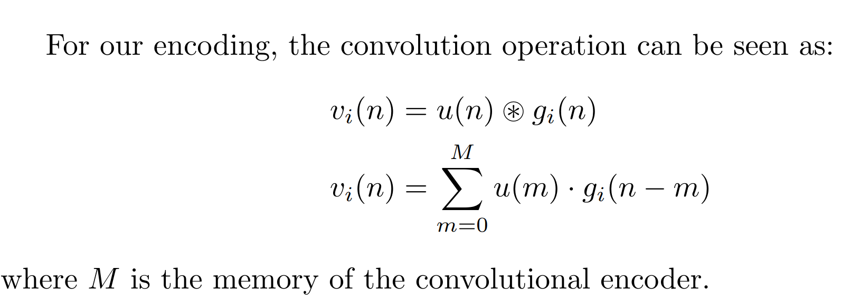
Convolutional Codes
For a convolutional code, the Generator matrix isn't as straightforward as that of a block code. However, if we were to attempt to capture a convolutional code in matrix form, the convolution operation would manifest as a Toeplitz matrix (a diagonal-constant matrix). Each row of this matrix represents one of the generator polynomials, and the matrix's action on an input vector effectively "encodes" it.

Slide 21
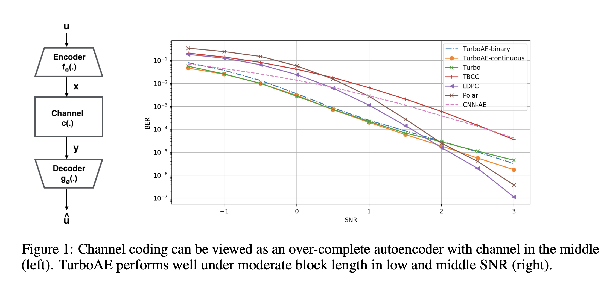
Non-Linear Codes
Jiang, Yihan, Hyeji Kim, Himanshu Asnani, Sreeram Kannan, Sewoong Oh, and Pramod Viswanath. "Turbo autoencoder: Deep learning based channel codes for point-to-point communication channels." Advances in neural information processing systems 32 (2019).

Slide 22
Automatically Recognizing Forward Error

Slide 23
The Challenge

Slide 24
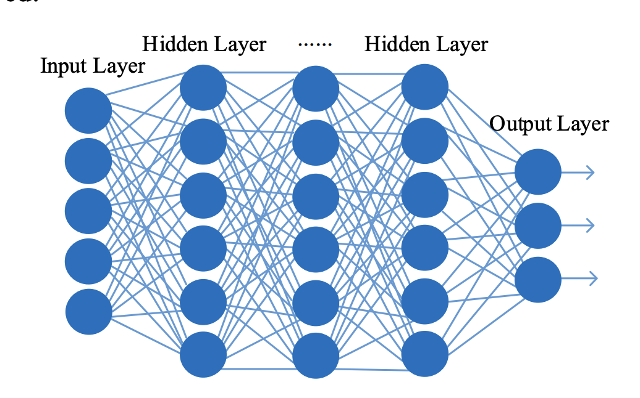
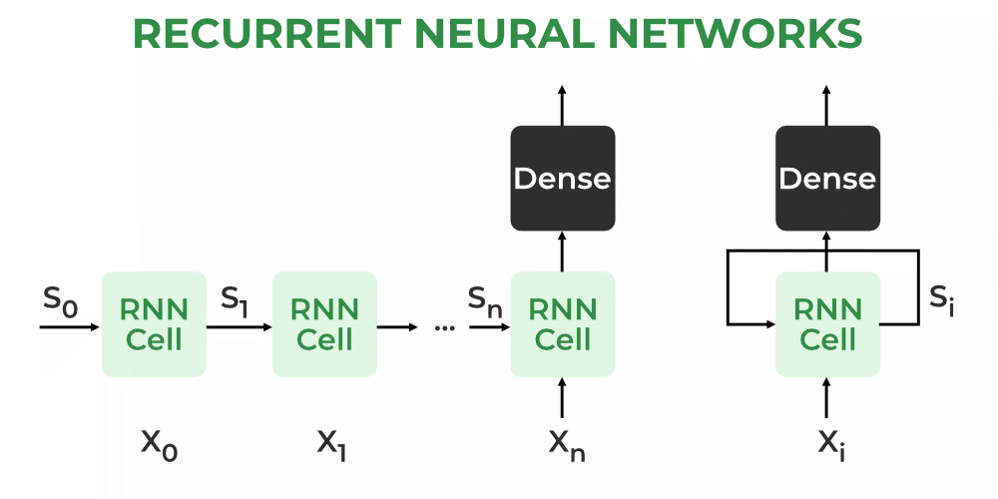
Past work
Ni, Yanqin, Shengliang Peng, Lin Zhou, and Xi Yang. "Blind identification of LDPC code based on deep learning." In 2019 6th International Conference on Dependable Systems and Their Applications (DSA), pp. 460-464. IEEE, 2020.
Mei, F., Chen, H. and Lei, Y., 2021. Blind recognition of forward error correction codes based on recurrent neural network. Sensors, 21(11), p.3884.
Focus on assuming a fixed dimension on the code words but a variable input length. Multiple models would have to be trained for every possible code word dimension. Doesn't exploit any structure inherent in forward error correcting codes. Harder to debug.

Slide 25
Recovering the Dual Code
The problem of recovering a forward error code is a challenging problem. At its core we are trying to recover an unknown vector space. One way to make it easier is by looking for elements that are orthogonal to elements of the vector space.

Slide 26
Recovering the Dual Code
If we can find n − k linearly independent dual words, then we have reconstructed the parity check matrix and completely characterize the code.
But how we do find elements of the dual space?

Slide 27
Recovering the Dual Code
Take all the received codewords and create a M by n matrix called X.
If h belongs to the dual space, then hX^T is a linear combination of the columns of X which gives a low weight vector. In the case where there is no noise, then hX^T should be the zero vector. The expected weight of hX^T depends on the bit error probability and on the weight of h. If h does not belong to dual space, then h is not a special vector and behaves like a random vector with an expected weight of M/2. Observing how dual code words behavior on noisy code words gives us a way to discriminate the dual codewords from the others, and points to a reconstruction algorithm for the parity check matrix, and hence the generator matrix.

Slide 28
Recovering the Dual Code
At this point, we have reduced the problem of recovering to two steps: 1. Enumerate low weight vectors in the span of 2. Keep or reject these possible dual code words based on some statistical test.

Slide 29
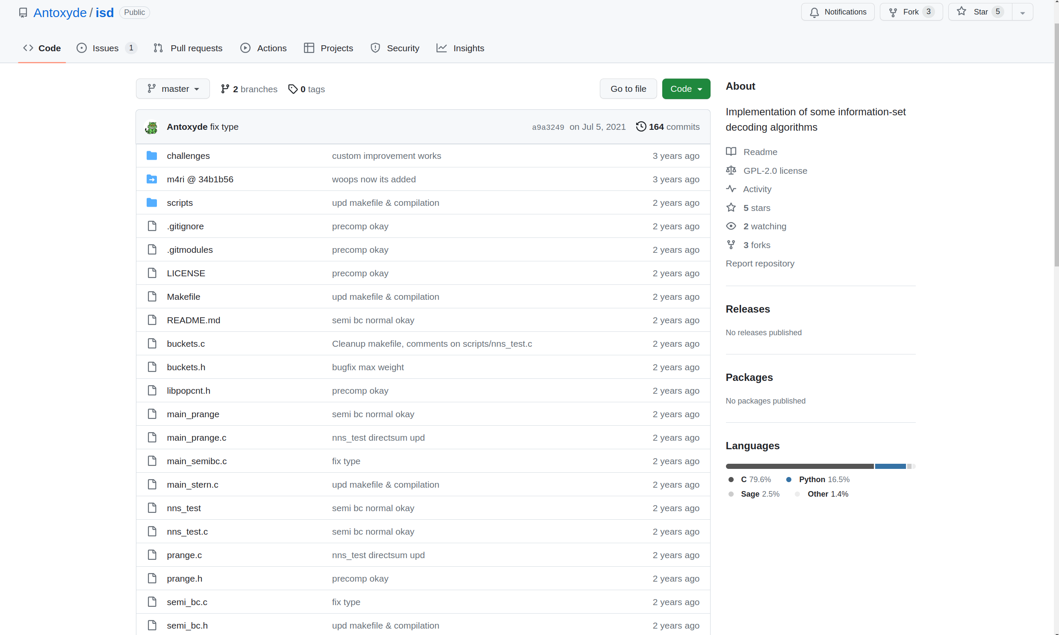
Enumerating low weight vectors
A lot of very neat advancements here. The simplest approach would be to brute force. But there are much better ways available.

Slide 30
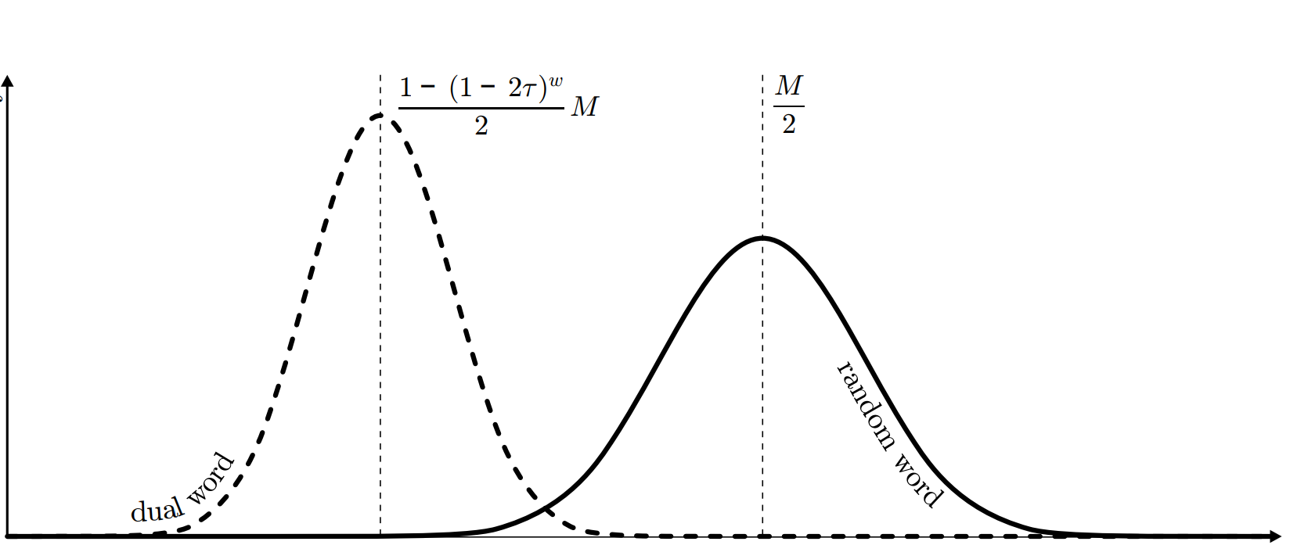
Recovering the Dual Code
Mathieu Cluzeau and Matthieu Finiasz, 2008

Slide 31
Gaussian Elimination
Swapping two rows: If you represent it as a matrix operation, it corresponds to multiplying the system of equations by a permutation matrix, which is a linear transformation.
Multiplying a row by a nonzero scalar: This operation corresponds to multiplying the system by a diagonal matrix where all the diagonal entries are 1 except for the one corresponding to the row being multiplied, which has the scalar value.
Adding a multiple of one row to another: This operation can be represented by a matrix that has 1s on the diagonal and the multiplier in the position corresponding to the operation.
The transformation of the initial system to the simplified system consists of a series of elementary row operations. Specifically, these operations are:
Swapping two rows
Multiplying a row by a nonzero scalar
Adding (or subtracting) a multiple of one row to another row
Gaussian Elimination is a composition of linear maps and so it is a differential layer

Slide 32
Result?!

Slide 33
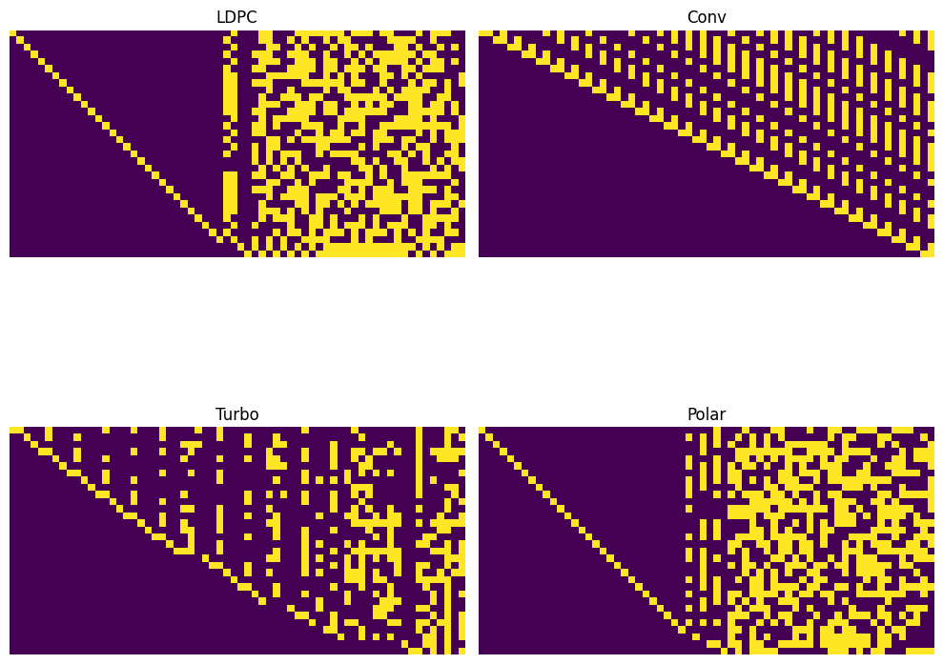
Can we teach a computer to See these patterns?

Slide 34
Can we combine the linear algebra approach with a single deep-learning model?

Slide 35
Combinined Approach
Recovered Dual Code words
0 | 1 | 1 | 0 | 0 | 1 | 0
1 | 0 | 0 | 0 | 1 | 1 | 0
0 | 1 | 0 | 1 | 0 | 1 | 0
1 | 1 | 1 | 0 | 1 | 1 | 1
0 | 1 | 0 | 1 | 0 | 0 | 1
1 | 0 | 1 | 0 | 1 | 1 | 0
0 | 0 | 0 | 1 | 1 | 0 | 0
1 | 1 | 1 | 0 | 1 | 0 | 1
Computer Vision Model
Gaussian Elimination Layer
1 | 0 | 0 | 1 | 0
0 | 1 | 1 | 0 | 1
1 | 0 | 0 | 0 | 1
1 | 1 | 1 | 1 | 1

Slide 36
Experimental Setup
Training & Test:
1/2 and 1/3 rates
Data bits: 32, 64, 128, 512, 256
Observed: 10, 50, 60, 70, 80, 90, 100, 200, 300, 400, 500, 600, 700, 1000
Codes:
LDPC
Convolutional
Polar
Turbo

Slide 37
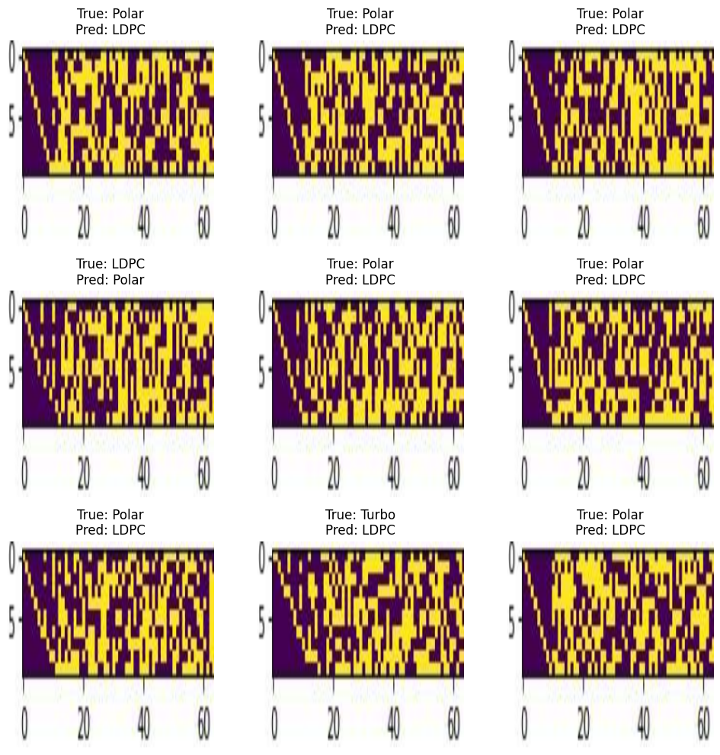
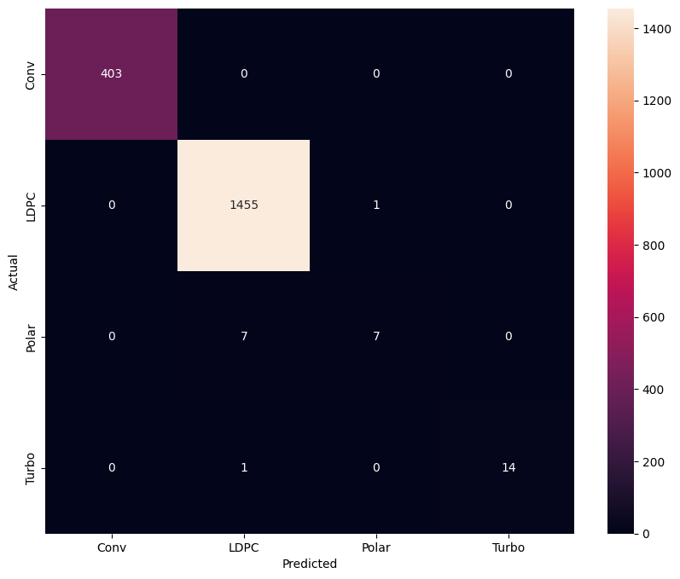
Results on the Test set

Slide 38
Conclusion and Future Work

Slide 39
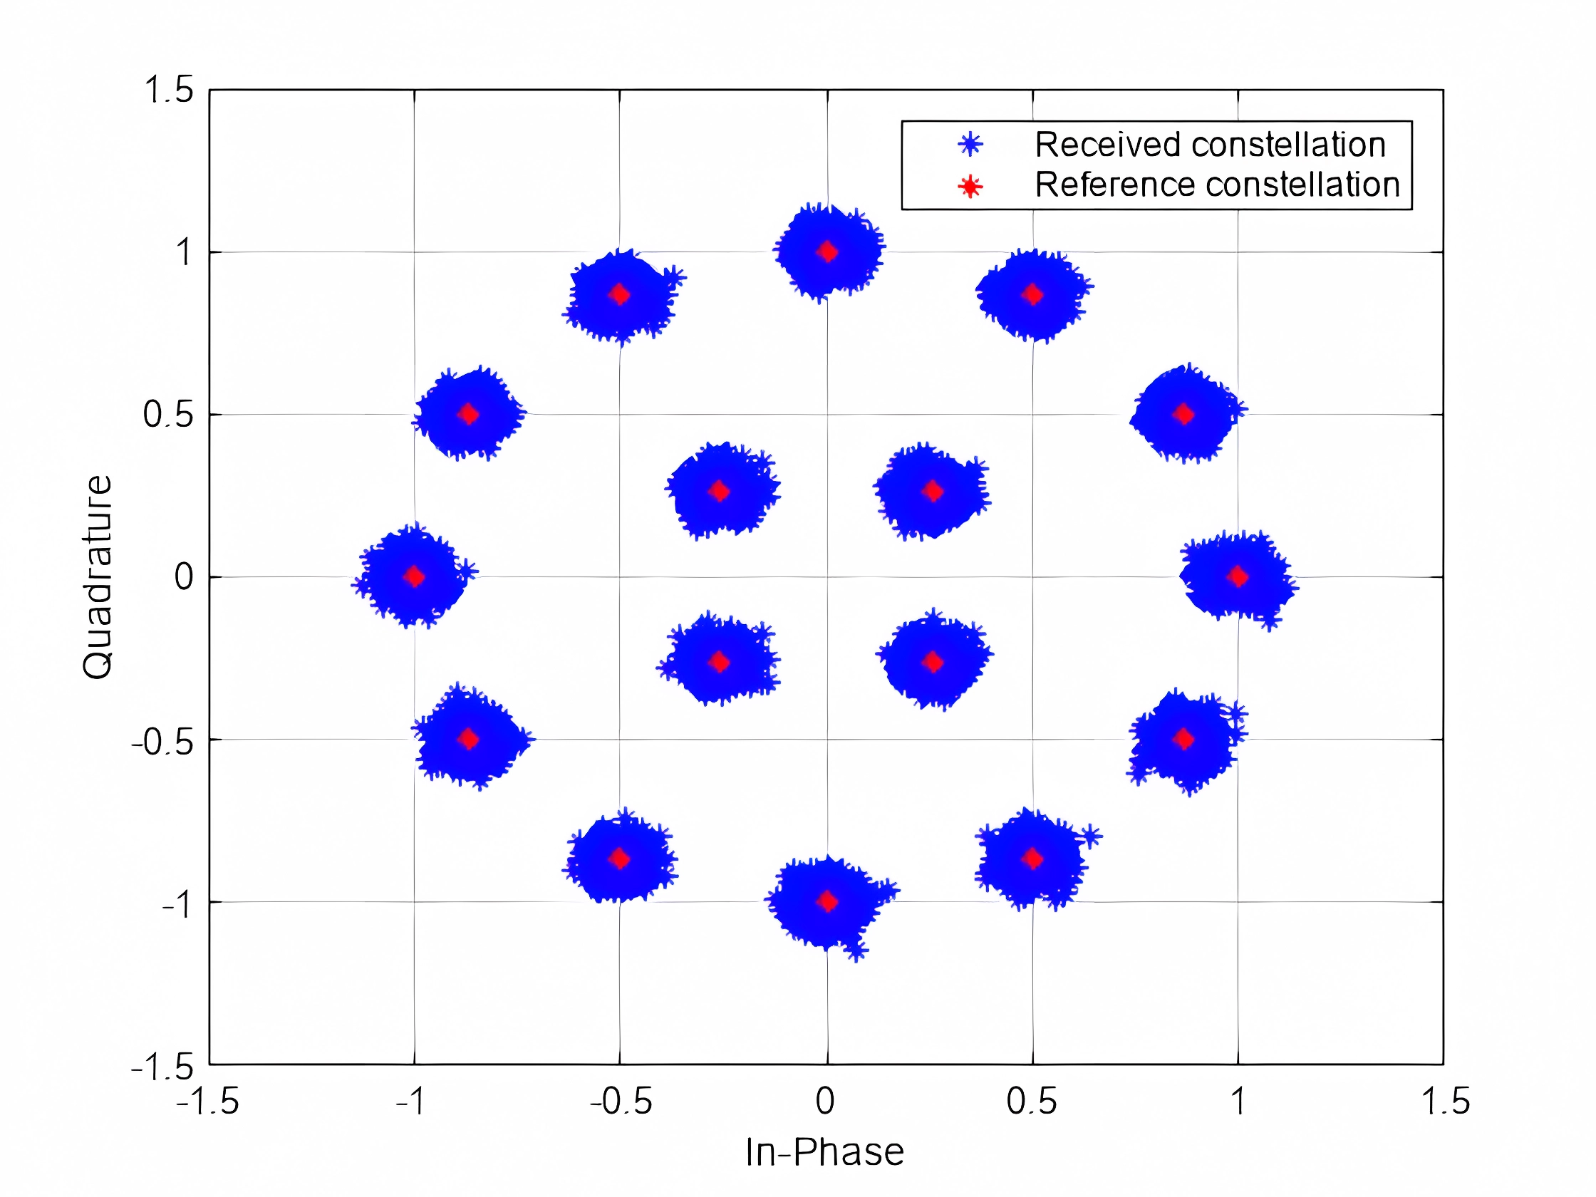
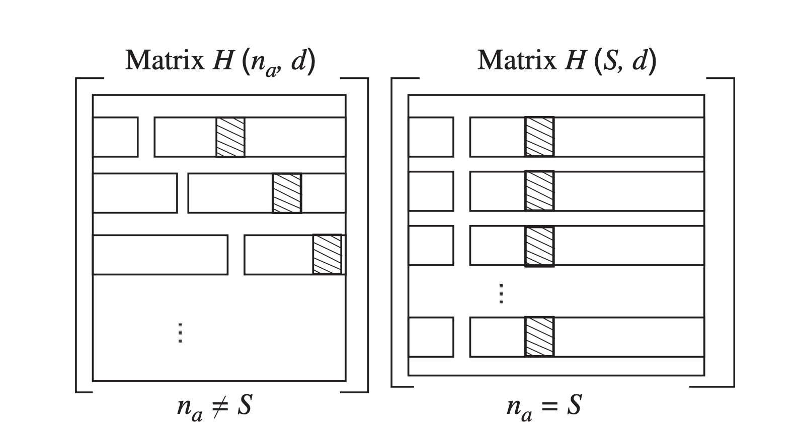
Future Work
Soft Decoding
Neural Network Based FEC
Expand scope of model

Slide 40
References
Valembois, A., 2001. Detection and recognition of a binary linear code. Discrete Applied Mathematics, 111(1-2), pp.199-218.
Cluzeau, M., 2006. Reconstruction d'un schéma de codage (Doctoral dissertation, Ecole Polytechnique X).
Cluzeau, M. and Finiasz, M., 2009, June. Recovering a code's length and synchronization from a noisy intercepted bitstream. In 2009 IEEE International Symposium on Information Theory (pp. 2737-2741). IEEE. Wang, P., Guan, Y.L., Wang, L. and Cheng, P., 2023. Fast Blind Recovery of Linear Block Codes over Noisy Channels. arXiv preprint arXiv:2305.04190.
Mei, F., Chen, H. and Lei, Y., 2021. Blind recognition of forward error correction codes based on recurrent neural network. Sensors, 21(11), p.3884.
Jiang, Yihan, Hyeji Kim, Himanshu Asnani, Sreeram Kannan, Sewoong Oh, and Pramod Viswanath. "Turbo autoencoder: Deep learning based channel codes for point-to-point communication channels." Advances in neural information processing systems 32 (2019).

Slide 41
Thank you!!
We are hiring! If you are interested in ML and RF reverse engineering, reach out!!
Twitter @learnerofmath
linkedin.com/in/rafael-turner
DEDRONE.COM

