Slide 1


GNU Radio realization of Waveform Co-design for Joint Radar-Communications system using SDRs
Shammi A. Doly, Alex R. Chiriyath, Wylie Standage-Beierand, Daniel W. Bliss
School of Electrical, Computer, and Energy Engineering
Wireless Information Systems and Computational Architectures

Slide 2

Outline -
Research motivation and key contributions
Prior Research on Joint Sensing and Communications (JSCs) waveform design
Design of the SIC Receiver Model in GNU-Radio
SDRs within GNU-Radio Environment Over-The-Air Experiment
Results and Discussion
Shammi- GRConf’23

Slide 3
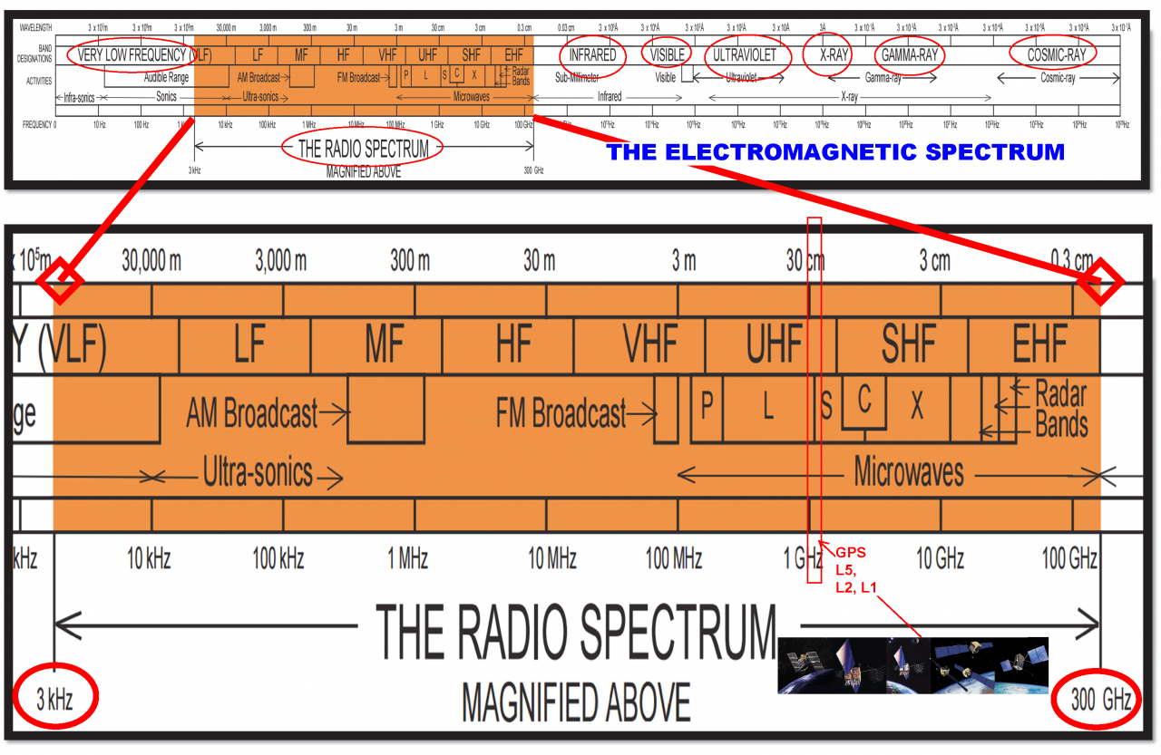
Motivation
[Image courtesy: US Dept. of Transportation]
Limited and expensive radio spectrum resource!
≤ 3000 GHz (3 THz). [courtesy of ITU].
4.88 billion smart phones & 21.5 billion interconnected devices in the world (statistics– Mar 29, 2021) [courtesy of TechJury].
By 2030, it is estimated that there will be 25.4∼27 billion IoT devices.
Reallocation of radar spectrum as a potential solution.
Co-design systems to utilize other systems to benefit one another
    Assume capable nodes (radar/communications)
    Radios estimate targets
    High quality wireless and accurate sensing.
Shammi- GRConf’23

Slide 4
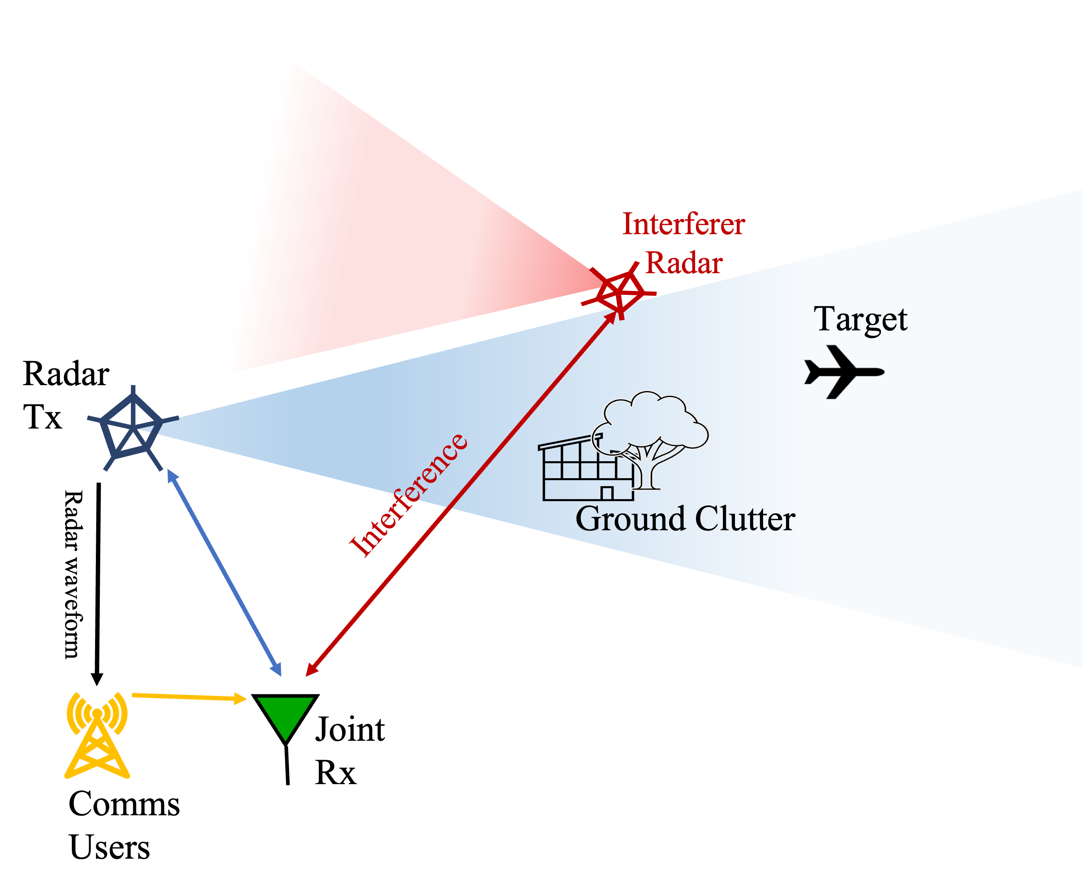
Key Contributions
Pose the Joint Radar-Communications Waveform Codesign in GNU Radio Algorithmic Environment using the USRP B210 SDRs
We conduct a Hardware-In-The-Loop (HWIL) over-the-air (OTA) experiment to demonstrate the feasibility of the proposed waveform design technique.
Replicate the Successive Interference Cancellation (SIC) model in GNU Radio
We evaluate the performance of un-optimized modulated (BPSK or QPSK) communications signal and an ASK radar signal
Not considered in this experiment
Joint radar-communications system configuration
Shammi- GRConf’23
^{[1]}S. Doly, A. R. Chiriyath, H. Mittelmann, D. Bliss, and S. Ragi, “Waveform codesign for radar-communications spectral coexistence via dynamic programming,” IEEE Transactions on Aerospace and Electronic Systems, 2022

Slide 5
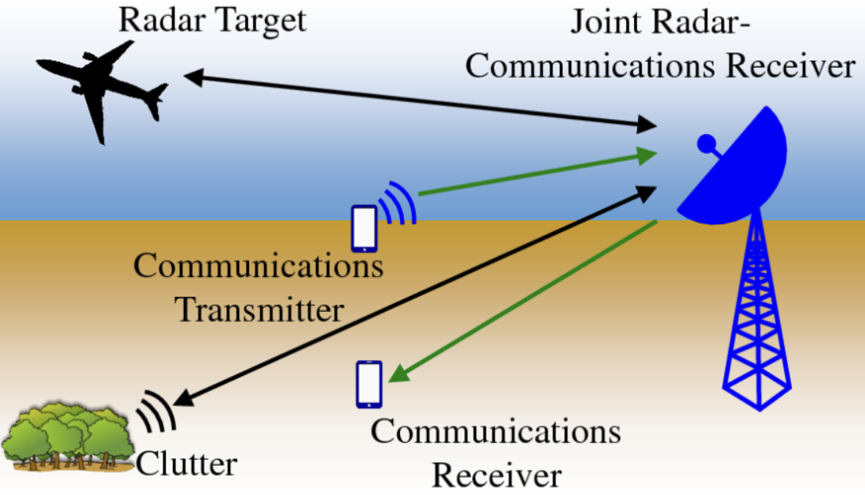
Joint Sensing and Communications (JSCs) waveform co-design background
Multiple-access scenario
Performance Metrics
Multi-access scenario with two users having corresponding rates, R₁ , R₂
The corresponding users’ rates are defined by the Shannon’s channel capacity with the bandwidth of B
Radar estimation rate (R_{est} )
Communication rate (R_{com} )
Receiver Model
Successive interference cancellation (SIC)
A multiuser detection technique used for a two-user multiple-access
communications channel
Image courtesy to Bliss Lab
Shammi- GRConf’23
A. Chiriyath, S. Ragi, H. D. Mittelmann, D. W. Bliss, "Radar Waveform Optimization for Joint Radar Communications Performance," Electronics, special issue on Cooperative Communications for Future Wireless Systems, vol. 8, no. 12, December 2019.

Slide 6
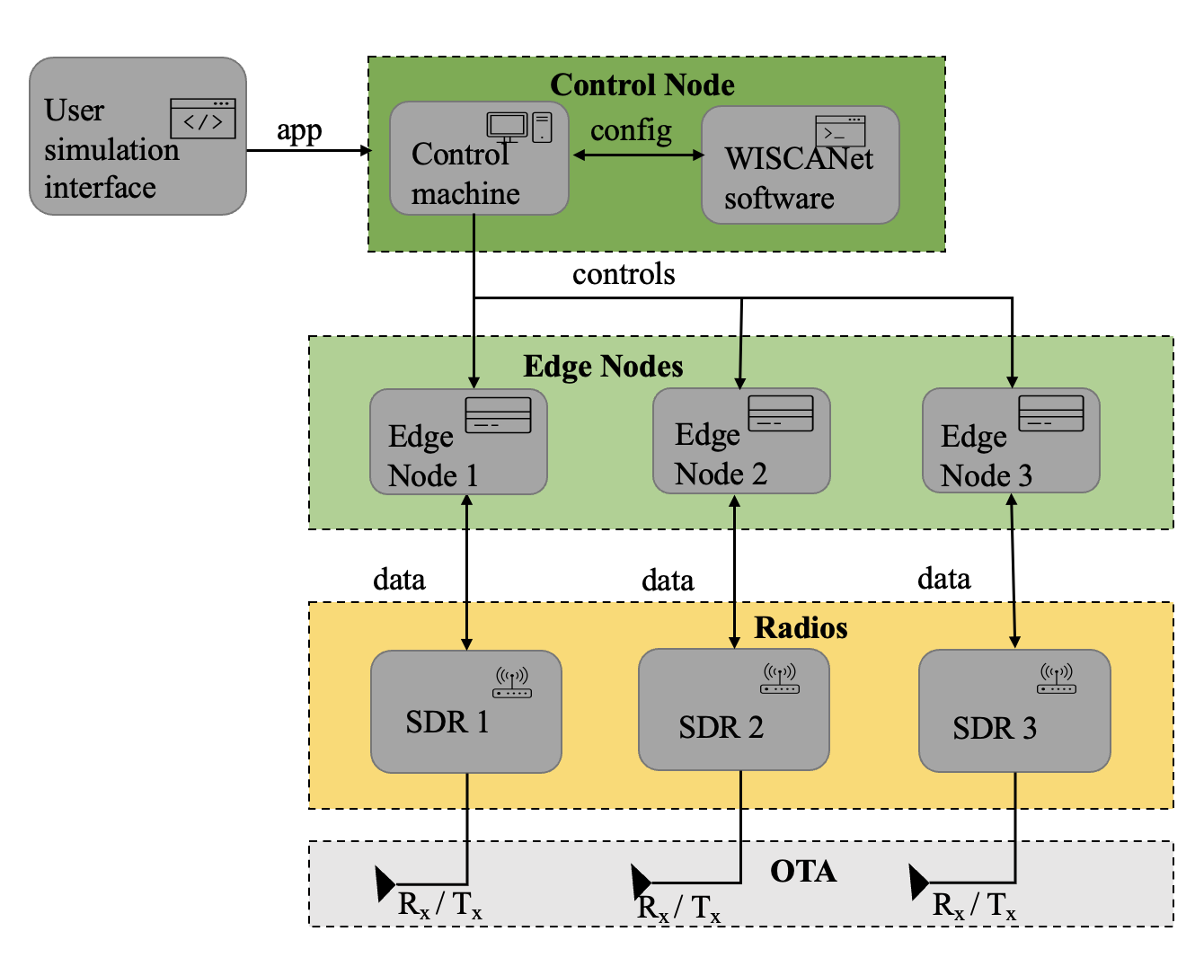
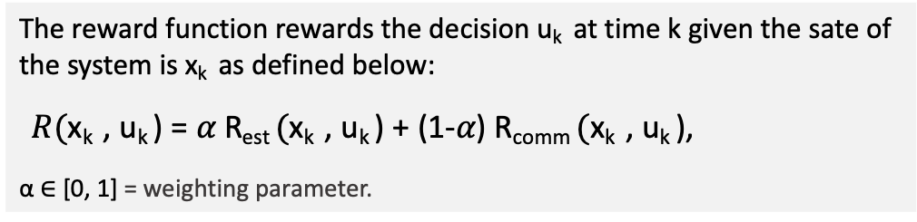
Prior Research on Waveform Codesign Problem
WISCANet Over-The-Air Experiments
Waveform co-design via Dynamic Programming
The reward function rewards the decision u_{k} at time k given the sate of the system is x_{k} as defined below:
$R(\text{x}\text{k}$, u_{k} ) = 𝛼 R_{est} $(\text{x}\text{k}$, u_{k} ) + (1-𝛼) R_{comm} $(\text{x}\text{k}$, u_{k} ),
α ∈ [0, 1] = weighting parameter.
Radar-comms system
Dynamic environment
Radar-comms receiver
POMDP planner
Transmitted
waveform
Waveform
selected
Relationship between an agent and its environment
Learn
& decide
The WISCANet control software runs on a control computer, connected edge nodes to radio to execute it.
Measurement
of the system
Radar return+ comms sig
S. A. Doly, A. R. Chiriyath, A. Herschfelt, J. Holtom, S. Ragi and D. W. Bliss, "Radar-Communications Waveform Co-Design Over-the-Air Using the WISCANet SDR Network," 2023 IEEE Radar Conference (RadarConf23.
S. Doly, A. R. Chiriyath, H. Mittelmann, D. Bliss, and S. Ragi, “Waveform codesign for radar-communications spectral coexistence via dynamic programming,” IEEE Transactions on Aerospace and Electronic Systems, 2022
Shammi- GRConf’23

Slide 7
System Model
Simplify the hard joint radar-communications waveform Co-design decision-making problem with a real-time signal processing problem.
The radar-communication system is established with two USRPs B210 SDR Kit -Dual Channel Transceiver.
Radar and Comms Tx nodes and joint Rx node.
Shammi- GRConf’23

Slide 8
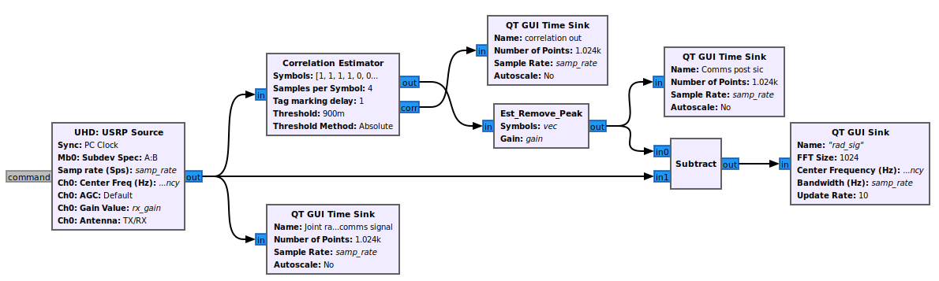
Receiver Model
Successive Interference Cancellation (SIC)
GNU Radio-based Joint Receiver Model-
Correlation estimator block correlates the input signal against the provided reference signal.
The correlation tags information as the output of the "Correlation-Estimator" block is sent to our designed "Est-Remove-Peak" block to remove the estimated peak of the joint received signal.
Radar signal is the strongest one and remove radar return first.
Remove the strongest signal first
subtract
Decode
Shammi- GRConf’23

Slide 9
Over-The-Air Experiment
The network topology of JRCs
Ettus Research universal software radio peripheral (USRP) B210 transceiver with continuous frequency coverage from 70 MHz – 6 GHz
High gain horn antennas (Rad Tx, Comms Tx)
Monopole antenna (joint Rx)
Shammi- GRConf’23

Slide 10
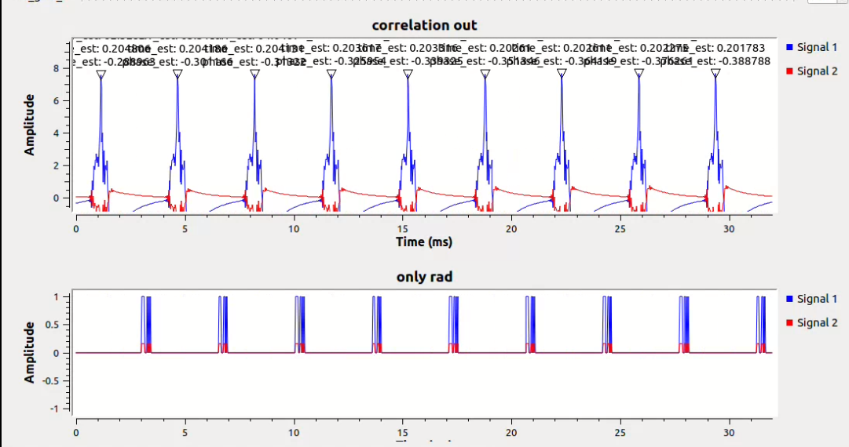
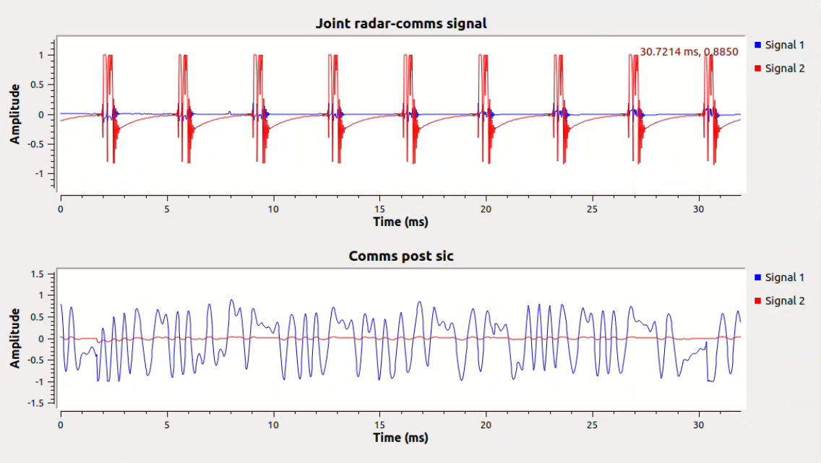
Waveform Separation
(upper) we can observe an overlap between radar returns with the communications signals. The red and blue lines denote the real and imaginary parts of a signal. (lower) we can see the resultant output of post SIC.
As we can see, the first estimated peak is detected at about 2.5ms and then continued at 5ms, 7ms, and so on in (upper plot) and (lower plot) we plot the original radar waveform.
Shammi- GRConf’23

Slide 11
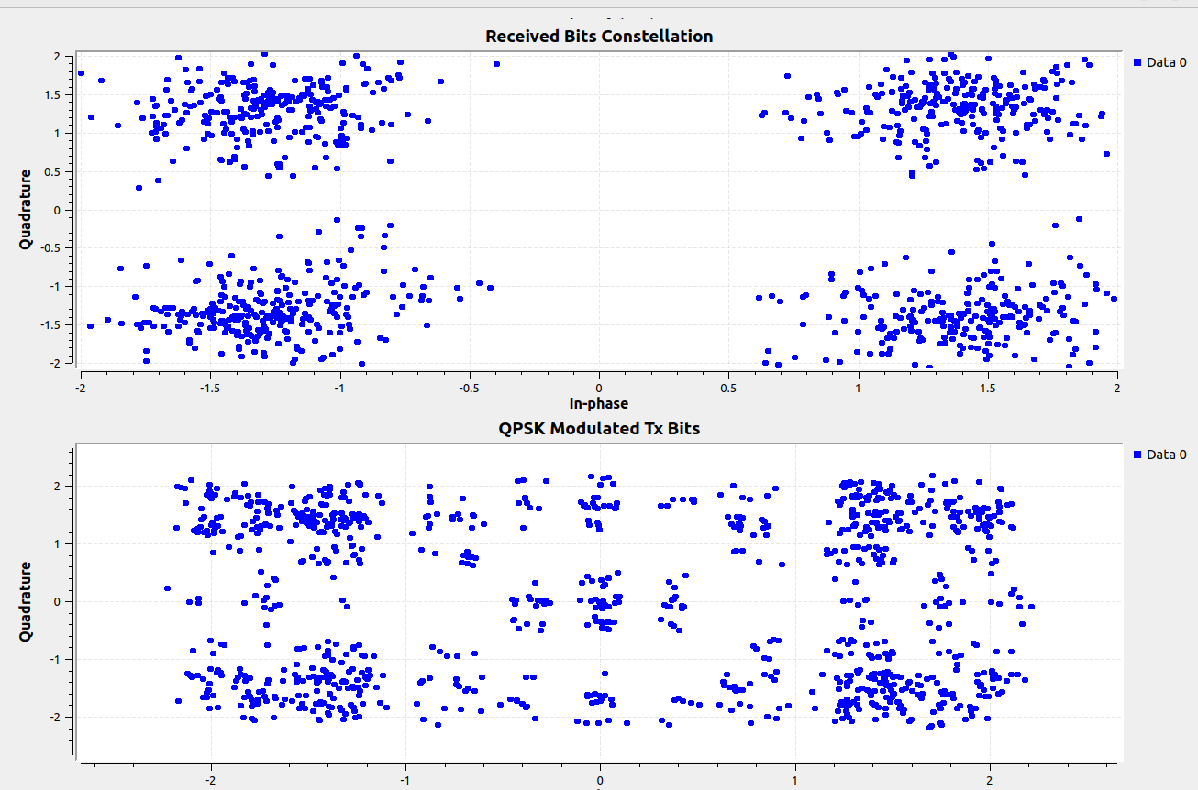
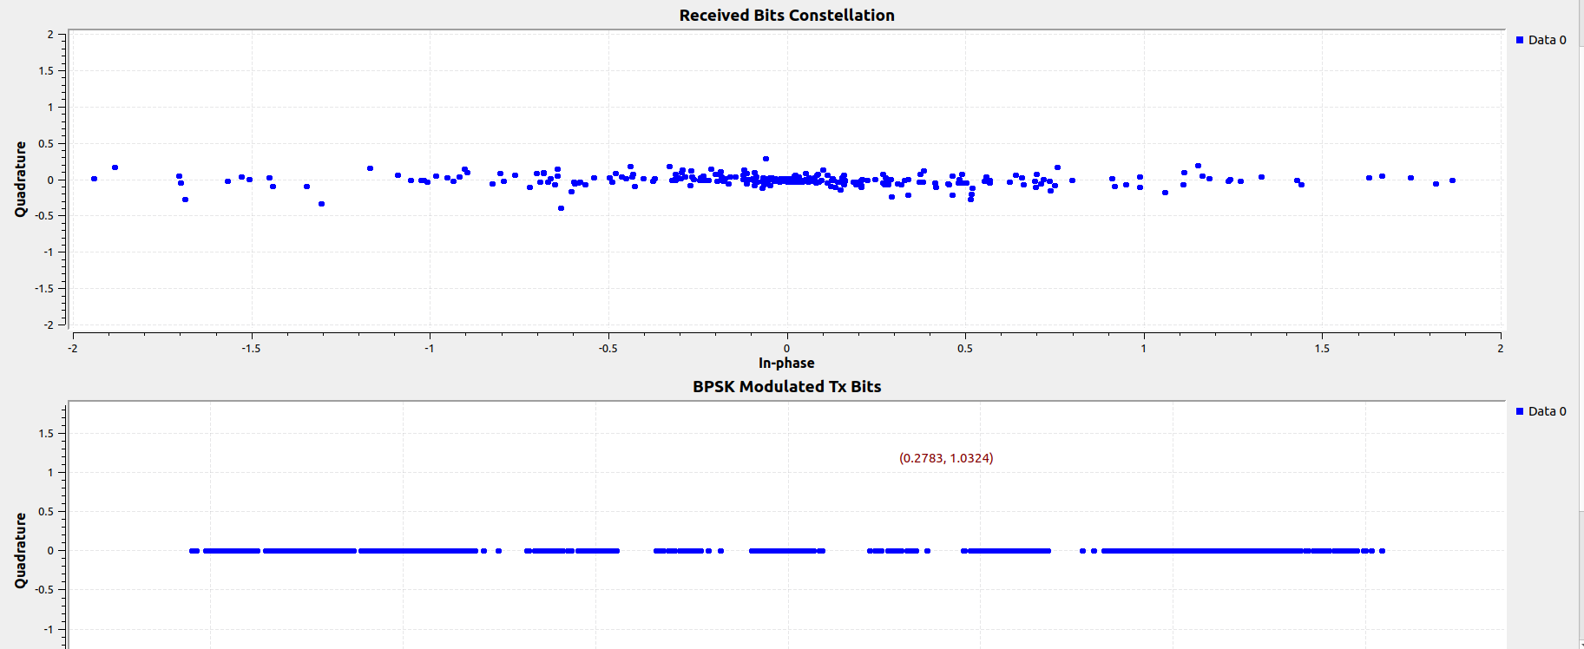
Communications Signals Restore
The constellation of BPSK modulated header and message bits at the transmitting and receiving ends
The constellation of the BPSK modulated header and the QPSK modulated message bits at the transmitting and receiving ends.
Shammi- GRConf’23

Slide 12
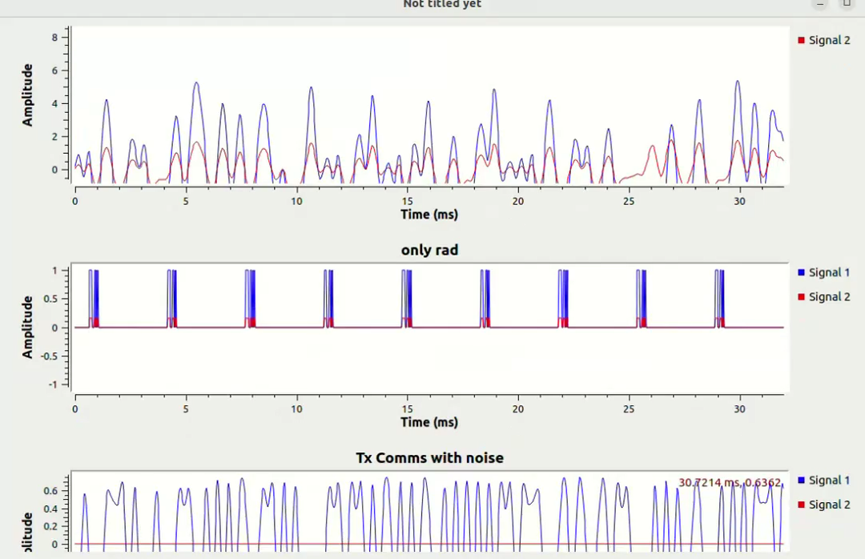
Over-The-Air Live Results
Shammi- GRConf’23

Slide 13
Conclusion
Research Motivation
Spectrum congestion problem!
Challenges
GNU Radio is a free & open-source software development toolkit- laggy!
macOS (NO), windows (NO), Linux (YES)!
High power radios and power system for real target detection
This simple system set-up can be used to test the joint radar-communications performance of any type of waveform employed.
Key Contributions
Future work
Pose the Joint Radar-Communications Waveform Codesign in GNU Radio Algorithmic Environment using the USRP B210 SDRs
We conduct a Hardware-In-The-Loop (HWIL) over-the-air (OTA) experiment to demonstrate the feasibility of the proposed waveform design technique.
Replicate the Successive Interference Cancellation (SIC) model in GNU Radio
We evaluate the performance of un-optimized modulated (BPSK or QPSK) communications signal and an ASK radar signal
Hardware-In-The-Loop (HWIL) in real time target range and Doppler estimation.
evaluate the performance of optimized waveform.
Shammi- GRConf’23

Slide 14
Thank You
Shammi- GRConf’23

