Slide 1

OFDM Based Joint Communications and Human Vital Sign Sensing with GNU Radio
Adarsh Venkataramani, Isabella Lenz,
Yu Rong and Daniel Bliss
School of Electrical, Computer, and Energy Engineering
Wireless Information Systems and Computational Architectures

Slide 2
Topics
Motivation
SDR Human Sensing
  Operational Modes for Vital Sign Sensing
OFDM Communication Link
OFDM RADAR
System Design
Signal Processing
Results
Conclusions

Slide 3



Motivation
Problem
Increasingly large demand on wireless communication devices and sensing applications
Resulting in RF spectral congestion
Requiring spectrum management solutions
Goal
Build SDR-enabled Joint Sensing and Communications Platform
Comms
Radar

Slide 4
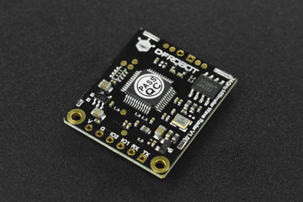
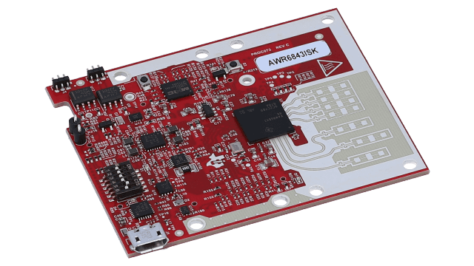
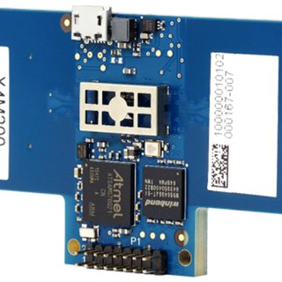
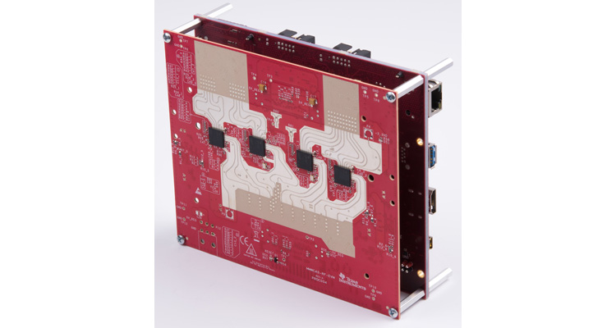
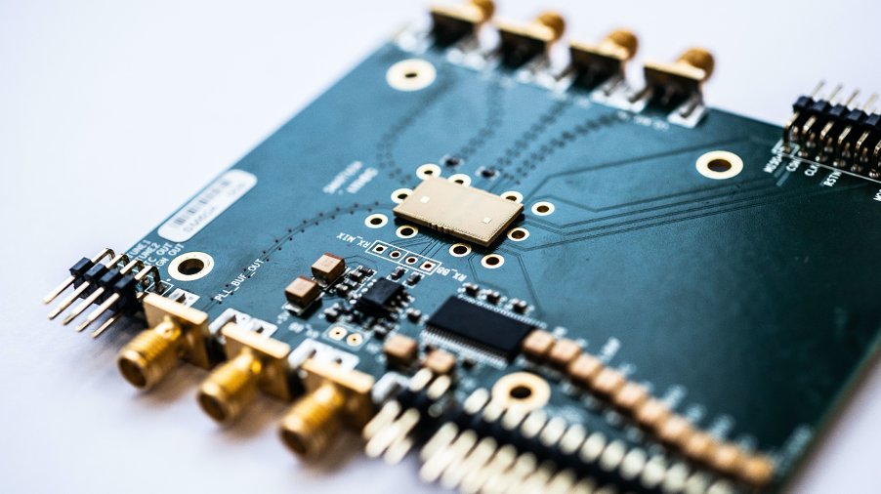


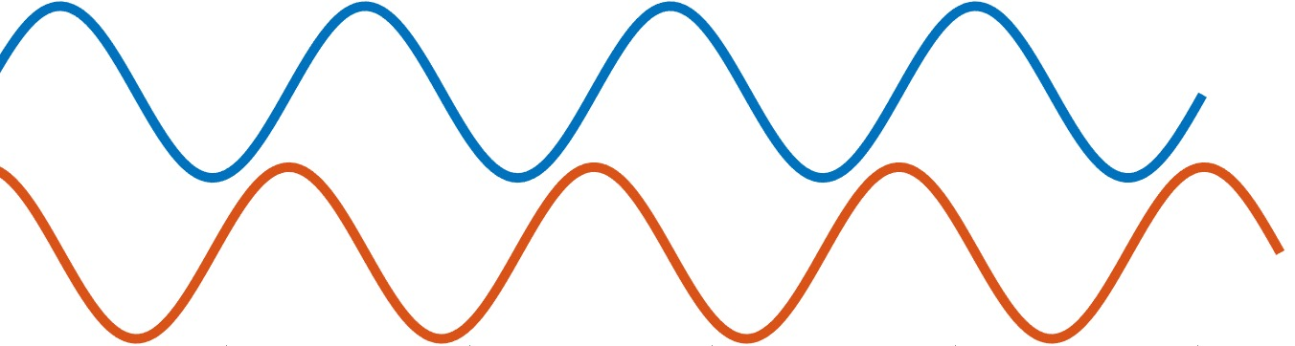
SDR Vital Sign Sensing
Contactless human sensing is widely motivated
  Current technology/studies operate on band-specific chips, mostly FMCW and CW based
    Require an alternative low cost/flexible operating mechanism
SDRs allow ad-hoc switching capabilities for different bandwidths/carrier/waveforms
Previous Work
GNURadio Conference 2022 ^{[1]}
Implemented CW radar using Ettus B210 and GNURadio
Captured heart and respiration activity
PC
SDR
Tx Ant
Software
Hardware
GNU Radio
Rx Ant
[1] "Respiratory and heart rate detection using continuous-wave radar testbed implemented in GNU radio"", I. Lenz, J. Holtom, A. Herschfelt, Y. Rong, D. Bliss
Proceedings of the GNU Radio Conference, 2022.

Slide 5
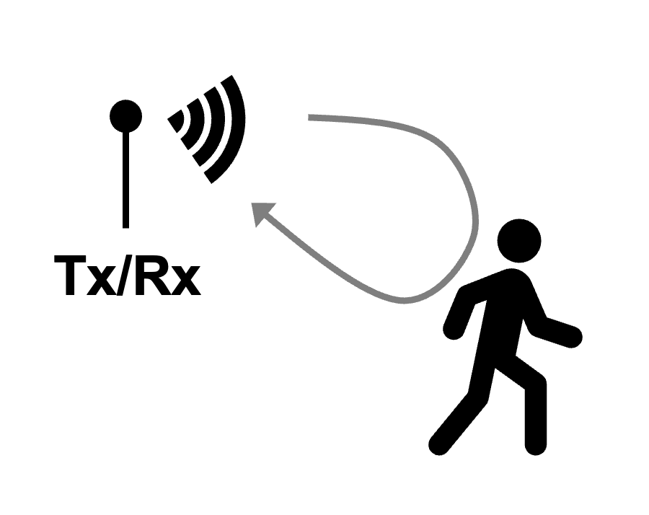
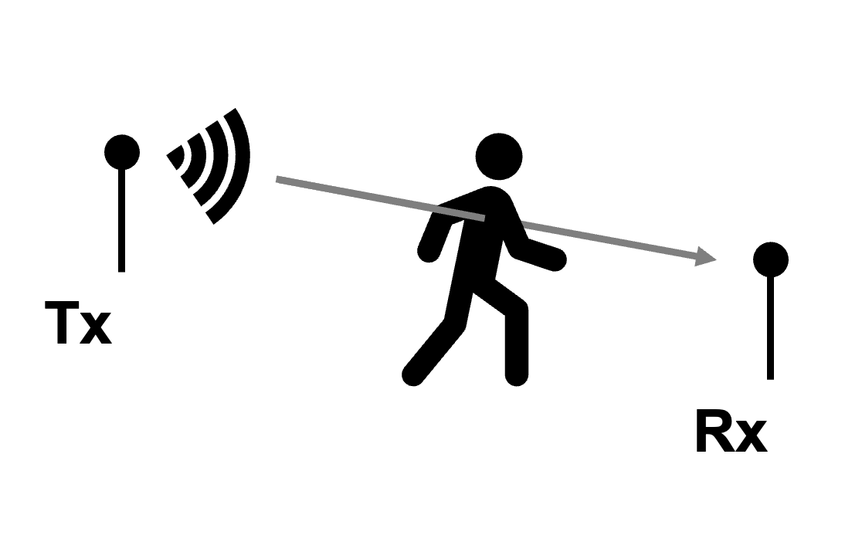
Operational Modes for Vital Sign Sensing
Varying modes offer situational advantages
  Monostatic mode
    Receiver knows radar waveform
    Operate in either TDM or simultaneous receive/transmit
  Mixed mode
    Monostatic radar sensing with separate communications receiver
    Vital sign monitoring geared more towards mixed mode
    Decoding payload on as-need basis
  General Bi-static Mode
    Requires carrier and sampling frequency corrections (CFO/SFO)
    Non-trivial for radar without additional system configurations
    Inclined more towards surveillance
Monostatic Mode
Mixed Mode
Bi-static Mode
Comms. Aided
Sensing
Comms.
Sensing
Joint Function

Slide 6
Operational Modes for Vital Sign Sensing
Varying modes offer situational advantages
  Monostatic mode
    Receiver knows radar waveform
    Operate in either TDM or simultaneous receive/transmit
  Mixed mode
    Monostatic radar sensing with separate communications receiver
    Vital sign monitoring geared more towards mixed mode
    Decoding payload on as-need basis
  General Bi-static Mode
    Requires carrier and sampling frequency corrections (CFO/SFO)
    Non-trivial for radar without additional system configurations
    Inclined more towards surveillance
Monostatic Mode
Mixed Mode
Bi-static Mode
Comms. Aided
Sensing
Comms.
Comms.
Sensing
Sensing
Joint Function

Slide 7
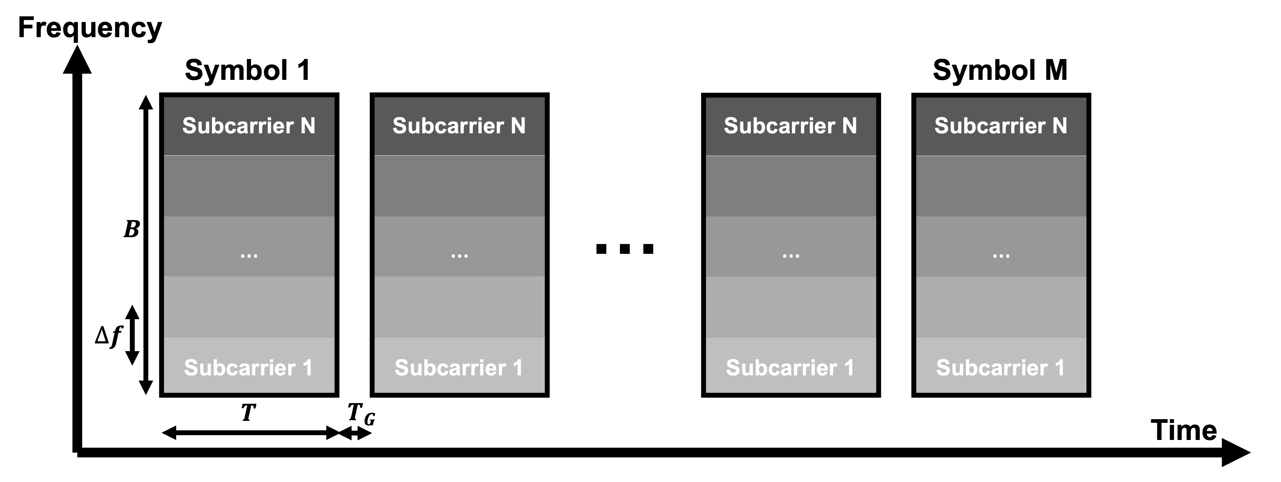
OFDM Communication Link
Select OFDM as communications waveform
  Widely used and offers robust waveform properties
OFDM (Orthogonal Frequency-Division Multiplexing)
  Fragment bandwidth into numerous narrow band orthogonal subcarriers (channels)
Pros
Robust to multipath and frequency selective fading
Efficient spectrum usage
Robust to jamming and interference
Cons
Large bandwidth
Sensitive to frequency and phase error
High peak-to-avg power (PAPR)

Slide 8
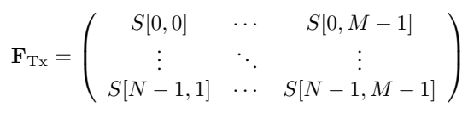
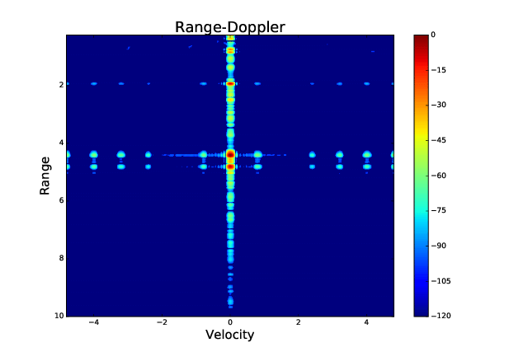

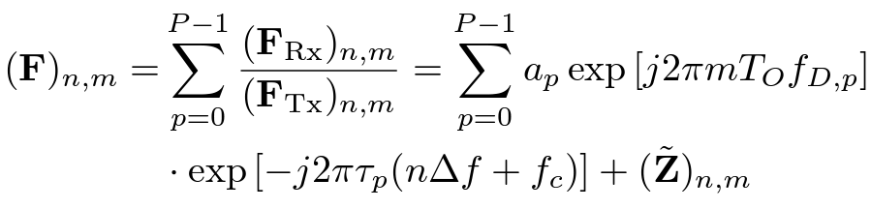


OFDM RADAR
Dual use OFDM waveform for ranging, OFDM Radar ^{[1]}
  Small operational cost
  Allows to co-exist with current communication devices
TX
OFDM Payload
Divide
Rx
OFDM Payload
Time-varying channel + noise
from P-targets
[1] "OFDM Radar Algorithms in Mobile Communication Networks", Braun, K. (2014)

Slide 9
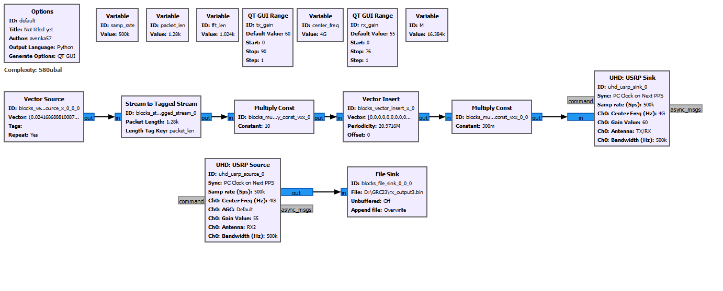
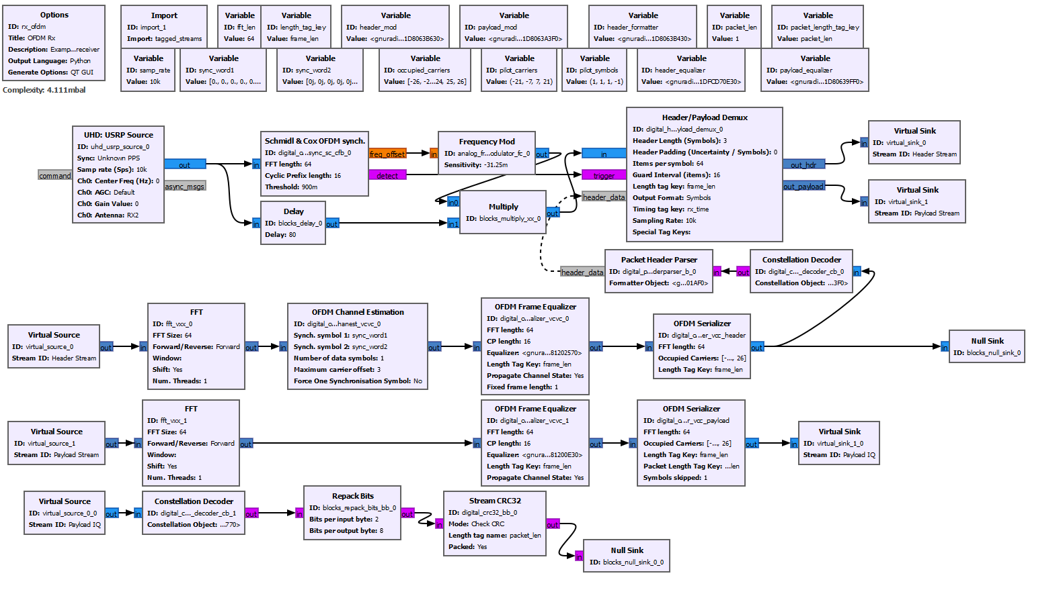

GNU Radio System Design
Supports monostatic and bi-static configurations
  Communications receiver leverages CFO/SFO/STO corrections
  Radar receiver leverages known payload
Analysis on offline radar processing
Comms./Radar Transmitter
and Radar Receiver
Radar Analysis
Traditional Communications Receiver
with Schmidl & Cox timing/frequency corrections

Slide 10
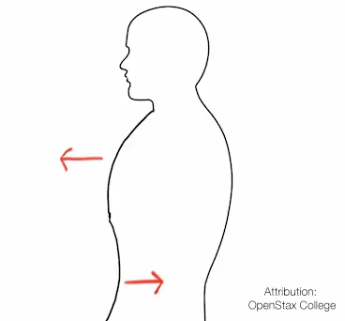
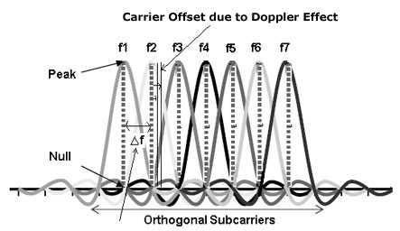
Vital Sign Signal Processing
Vital signs induce Doppler on OFDM payload
  Obtain channel estimate by division
  Analyze time-varying channel estimates across different OFDM symbols and deduce Doppler
A minimum of two distinct peaks appear
  Breathing Rate (Movement of Chest)
  Heart Rate (Pulsation of heart)
Assumptions for OFDM
  Induced Doppler is same across all sub-carriers
  Subject is in close range and is fairly stationary
  Sub-carrier distance is at least one order of magnitude larger than the largest heart rate possible (~190 bpm for infants)

Slide 11
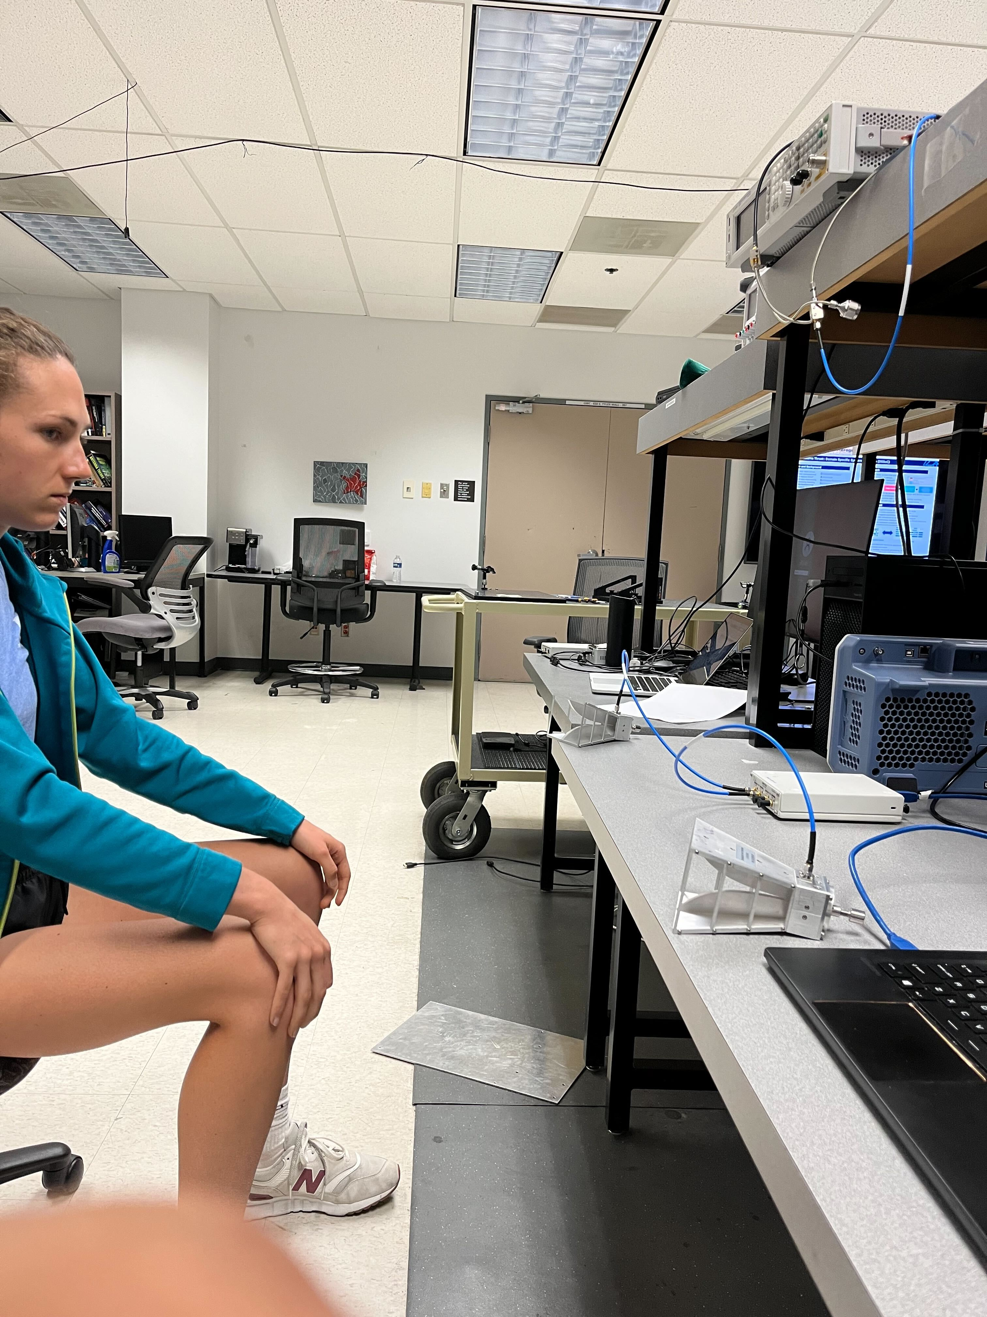
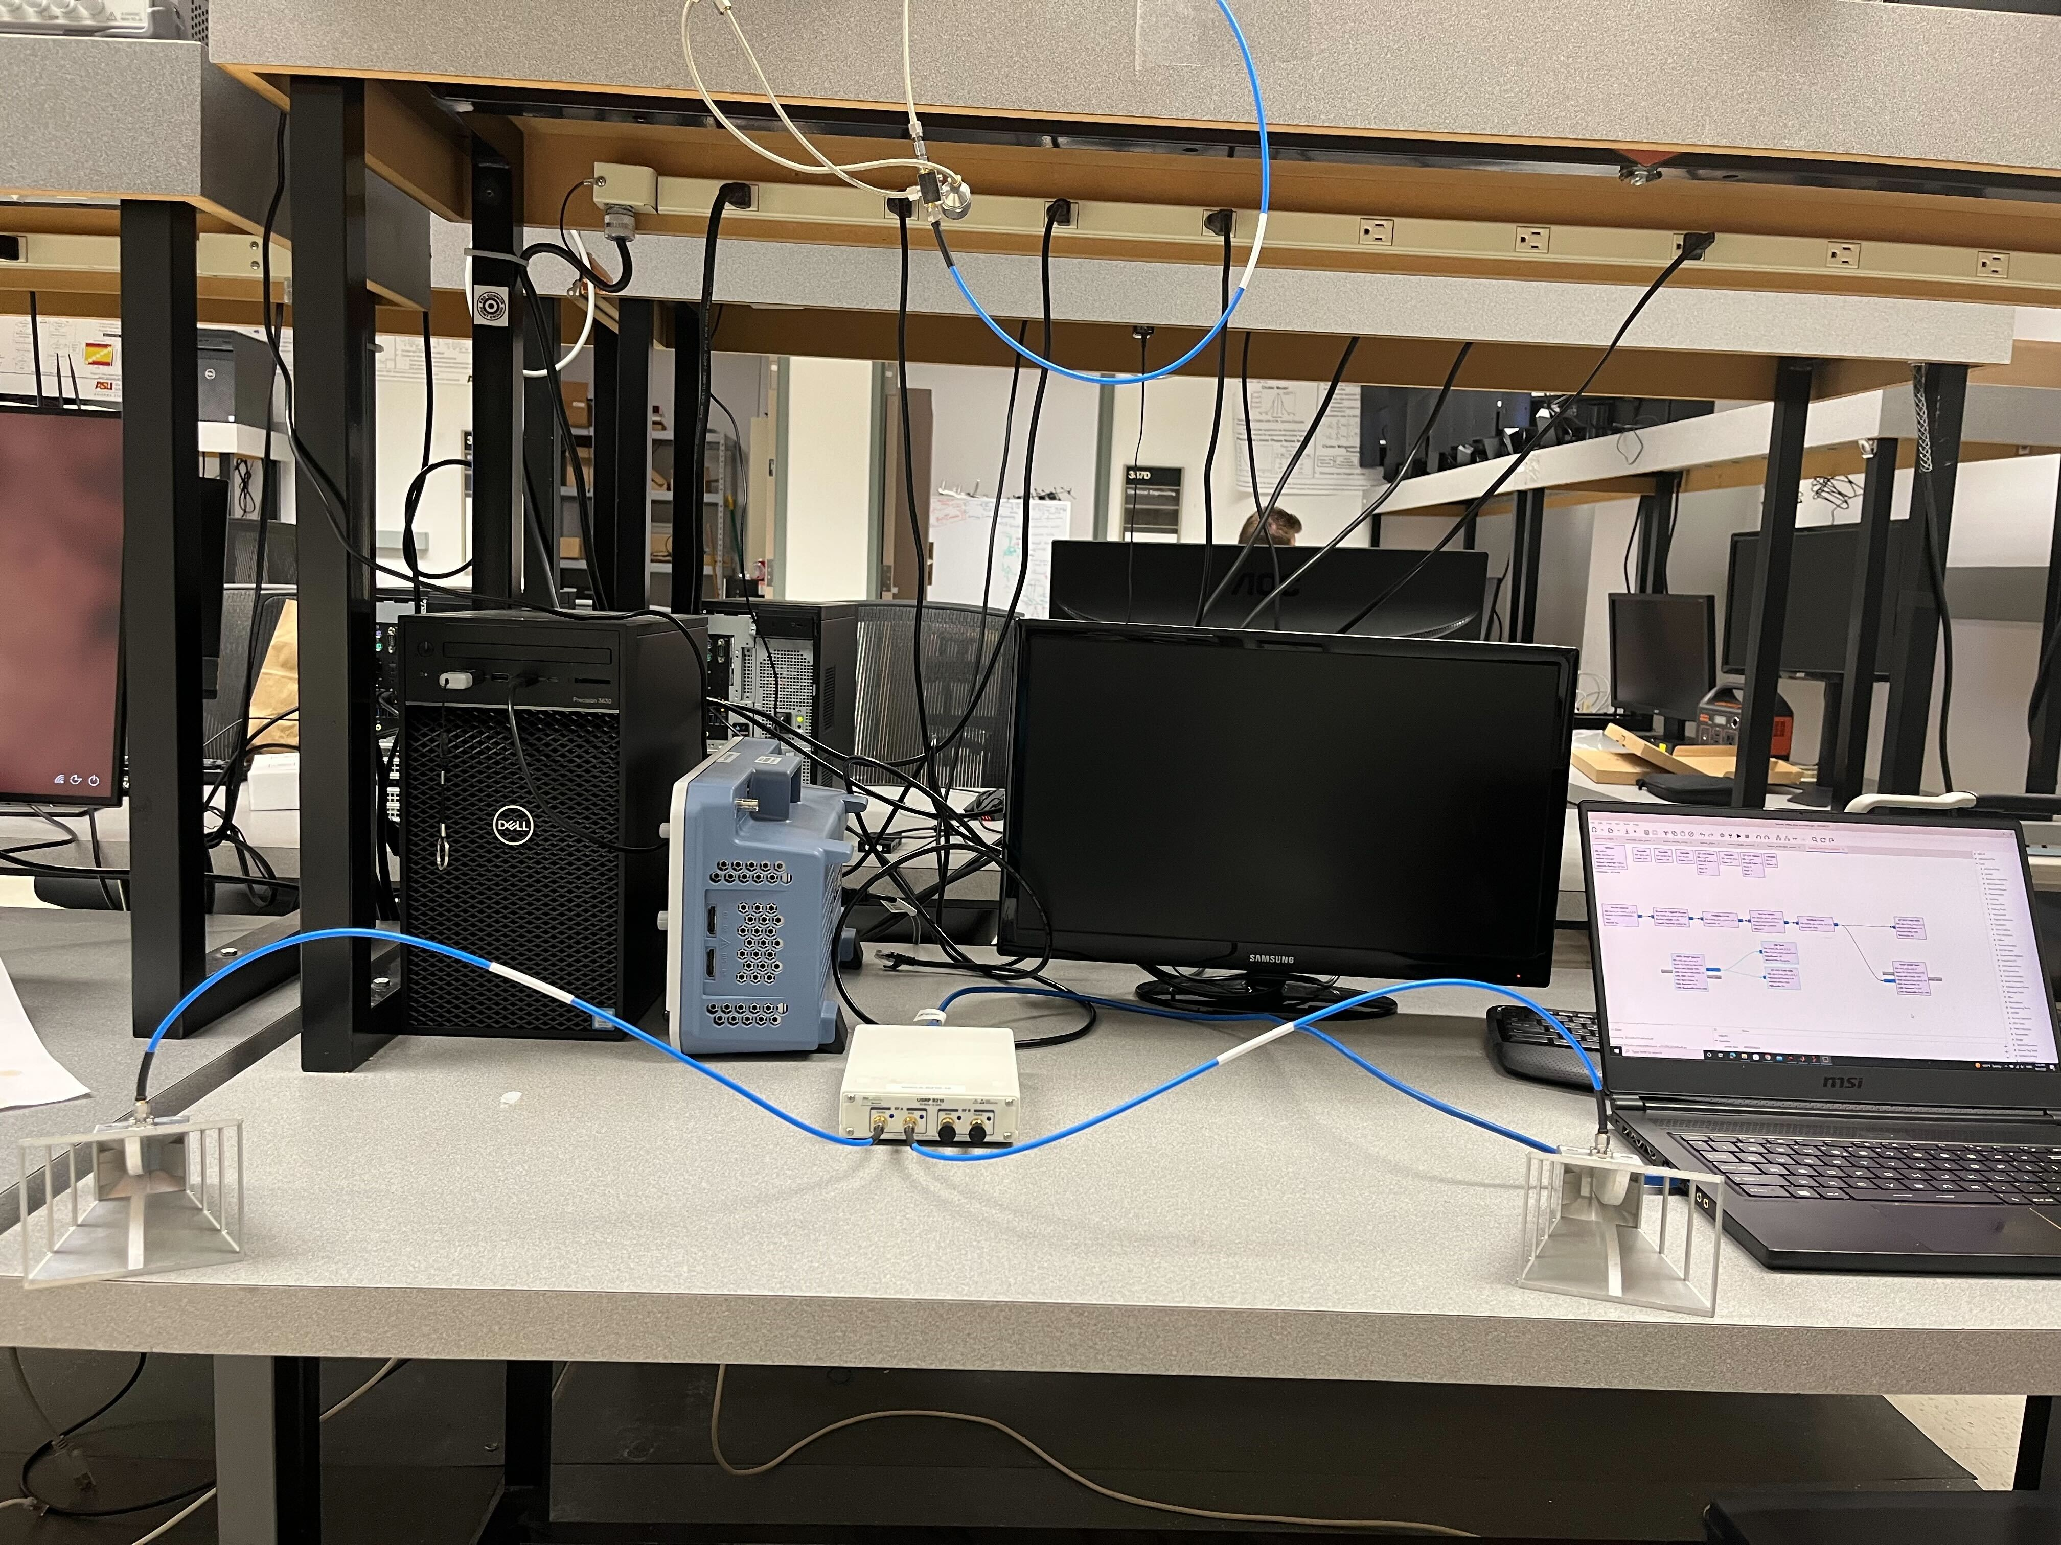
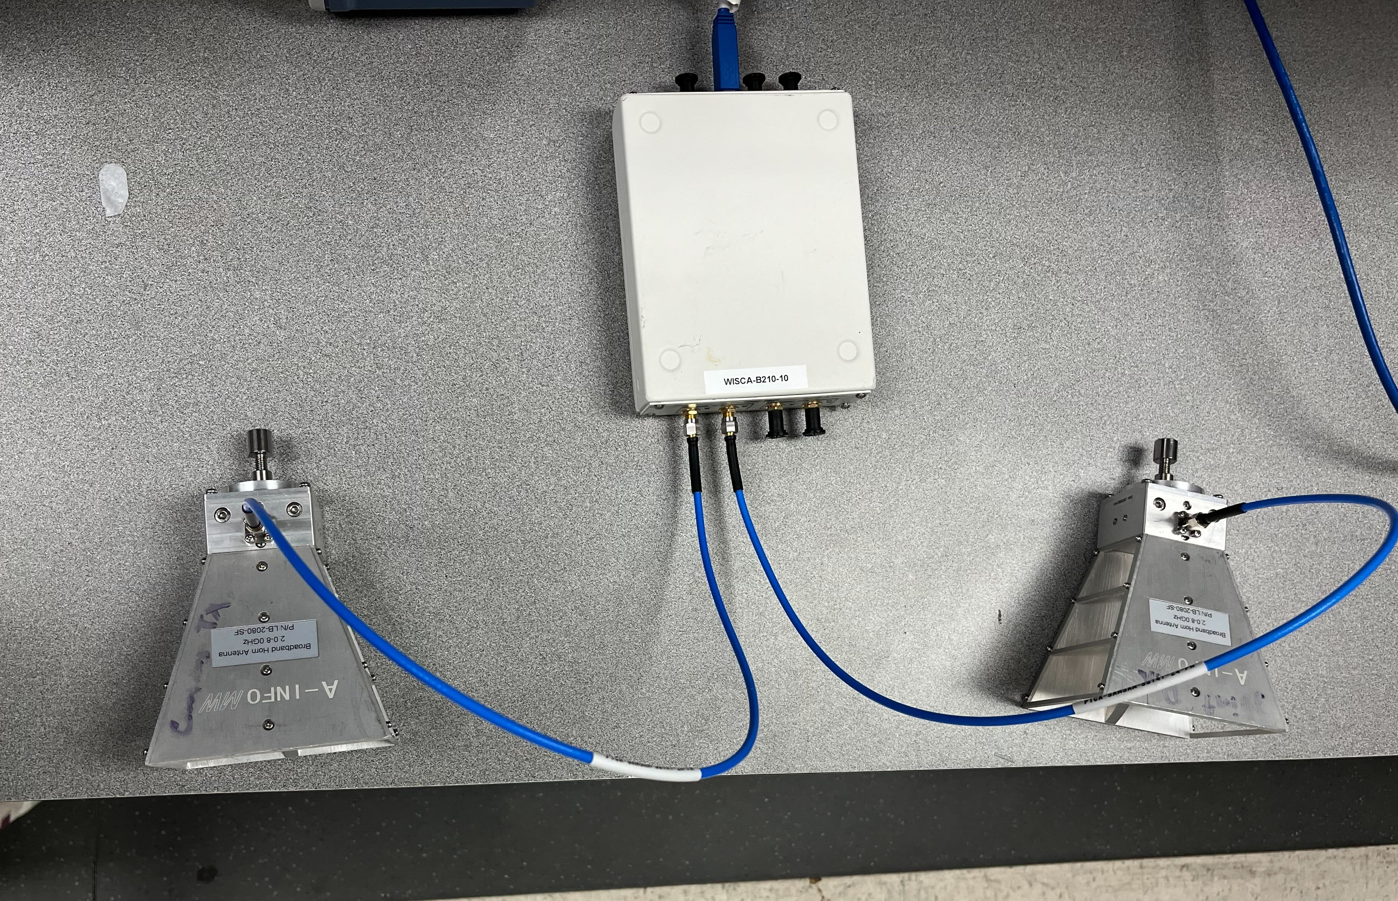
Experimental Setup
Operating on a small budget setup
  Two B210s
  One monostatic radar, One comms. receiver
  One Subject
  Horns 1m apart to avoid S11 (Tx-Rx) coupling
OFDM System Parameters
  3.5GHz carrier, 1024 sub-carriers
  1MHz BW, 781 Hz spacing with 256 symbol cyclic-prefix
  Long payload – 16384 OFDM symbols with QPSK message symbols, 2 channel estimation symbols, 1 sync symbol
  Poor range resolution
    But advantageous - target in first bin
  Backed-off sufficiently from max rails
    PAPR ~= 9dB

Slide 12
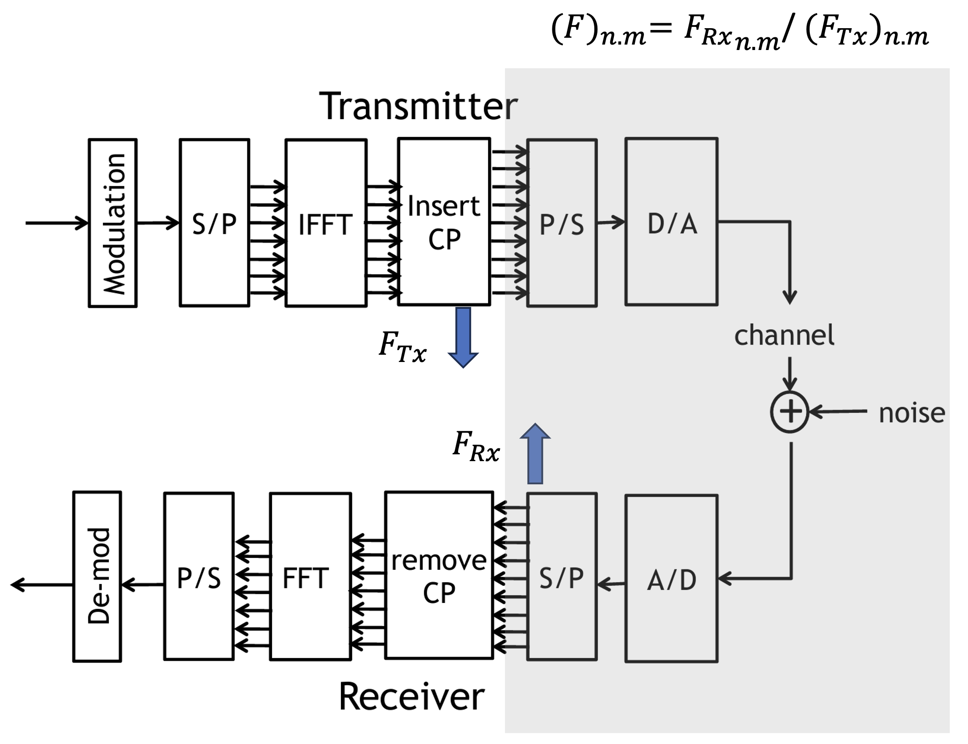
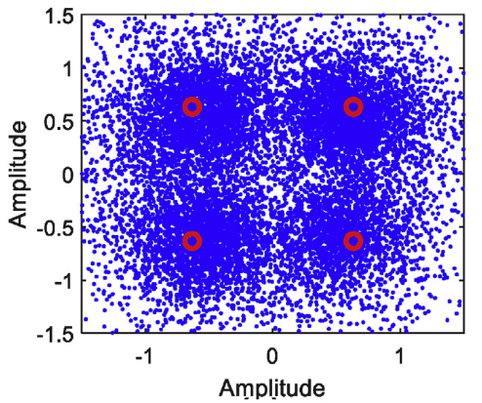
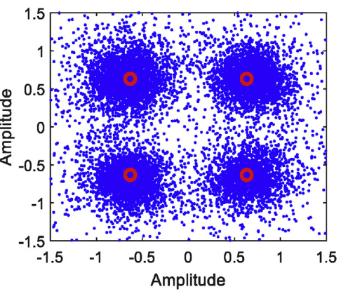
Communication Output
Conventional OFDM link
  Perform time-frequency corrections if necessary
  Decode as per operating standard
Our OFDM decodes with BER of 10% (slightly high)
  Industry standard OFDM strategies will yield better performance
  Need long contiguous sequences for vital sign detection

Slide 13
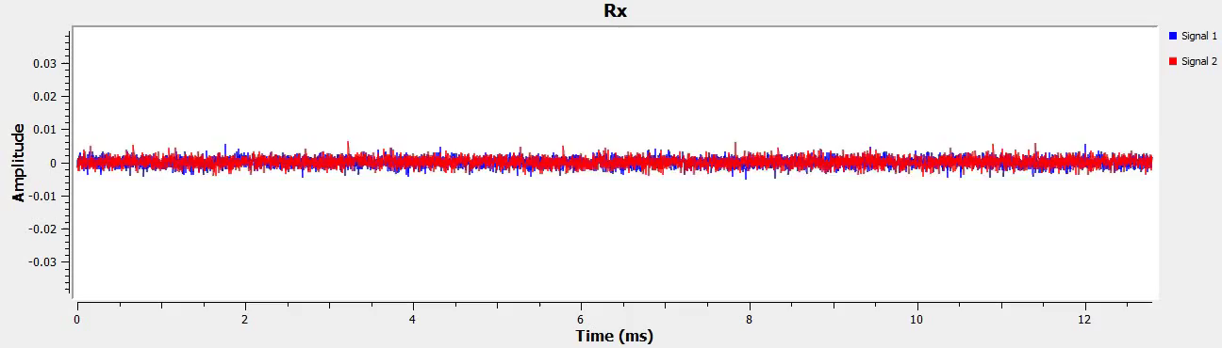
Vital Sign Pre-processing
Received waveform as recorded on GNU Radio
Processing chain for vital sign recovery
OFDM Radar
Division
Background
subtraction
Coarse Channel
Equalization
DC offset
correction
Doppler
FFT
Averaging
Filter
Heart Rate
Breathing Rate

Slide 14
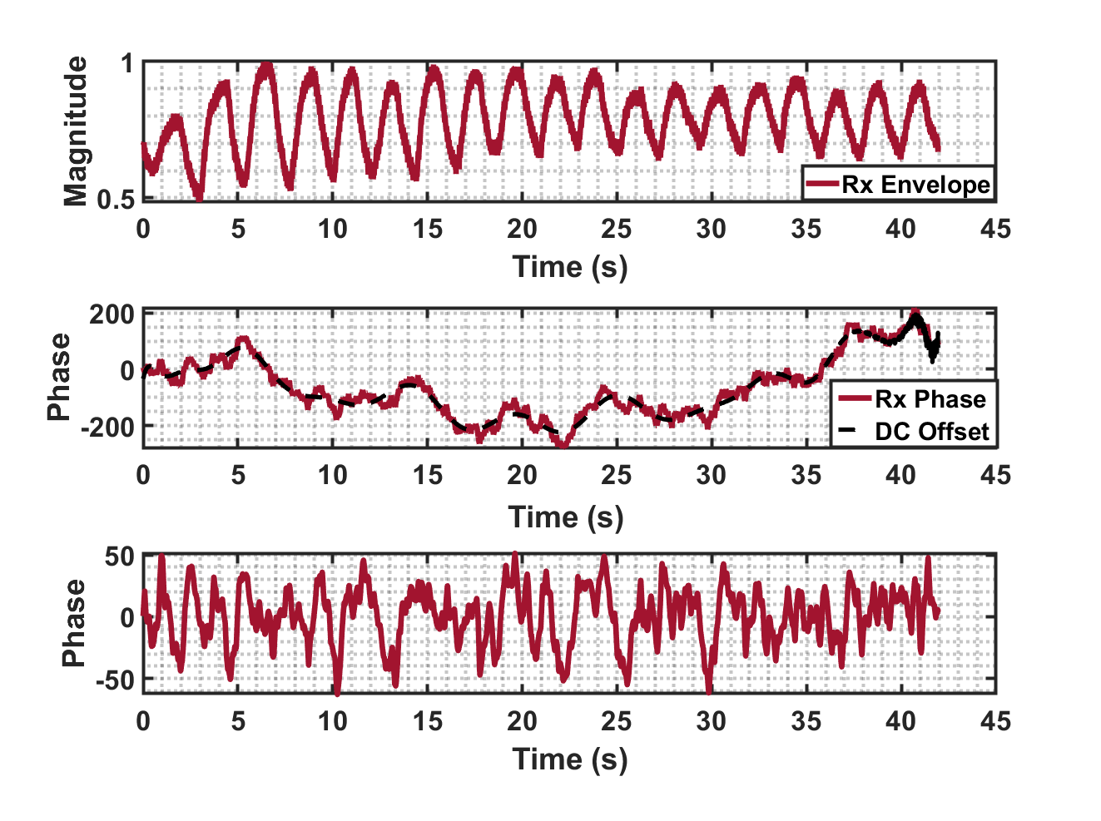
Vital-Sign Sensing Results
Respiratory pattern is observable
  Envelope power sensitive to distance (R⁴)
  DC offset correction removes ranging phase noise
Doppler FFT shows heart/breathing rate
  Subject located ~1m away and fairly rested
  Roughly 21-22 breaths per minute
  Heart rate was not simultaneously measured using PPG/ECG
Windowed Moving
Max Signal Power
Unwrapped
Phase
After DC Offset
Correction

Slide 15
Conclusions
Achieved OFDM based Joint Communications-and-Vital Sign Sensing
  Using lowest possible bandwidth
Long bursty payloads offer better vital sign detection
  Better time-BW relation
For real-time operation lowest possible PRF is necessary (for memory, power etc.)
  However, narrow subcarrier spacing increases sensitivity to phase noise
TX/RX isolation is important in this BW since we look only at first range bin
  DC offset correction removes some range dependent phase noise
Future possible work
  Use decoded payload as "known" waveform to perform OFDM vital sign estimation
  Sub-Hz estimation accuracy improvements
  Real-time detection using GNU Radio

