Slide 1
…and one to accelerate them all
German: „Das Heer der Ringe“
an overview of the GSI and FAIR accelerator
facility by Jens Stadlmann
(GSI, Darmstadt)

Slide 2
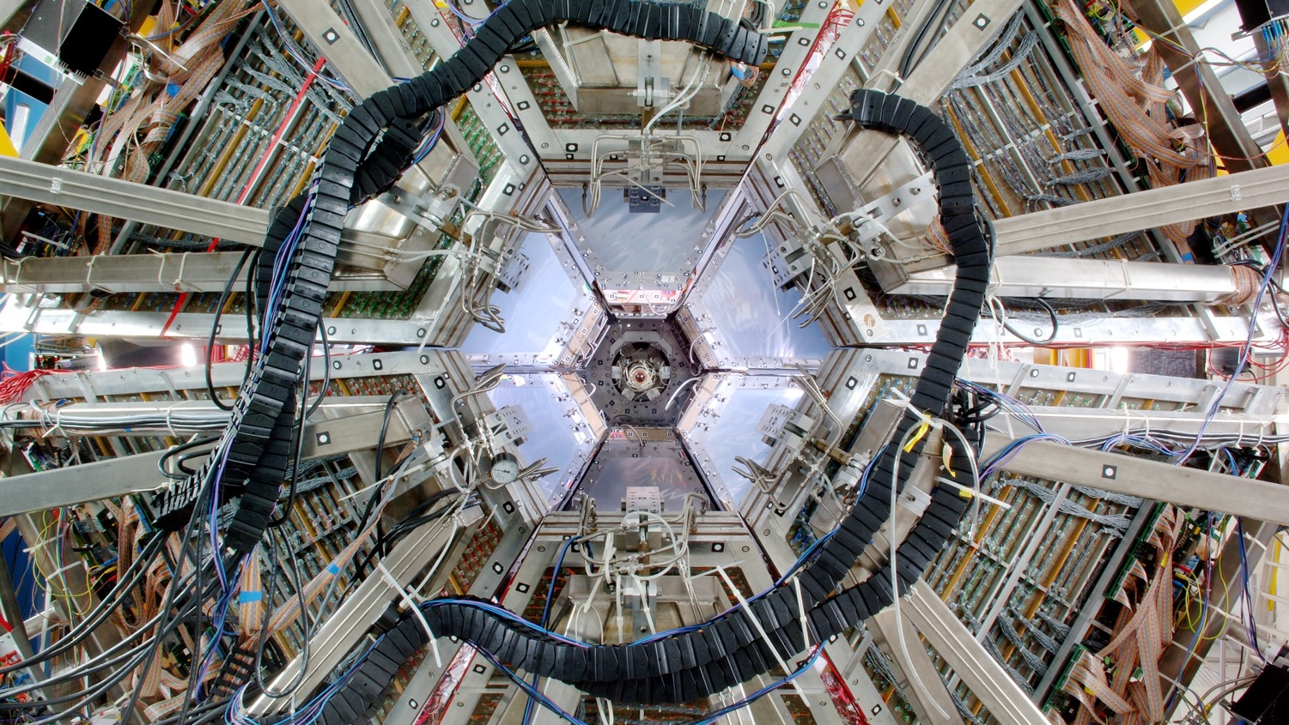

Photo: G. Otto/GSI
  Welcome to the international
  research center GSI and FAIR

Slide 3
  Welcome to the international
  research center GSI and FAIR
Photo: G. Otto/GSI
  Why we build accelerators?
  What is an accelerator ?
  Why exactly like this?

Slide 4
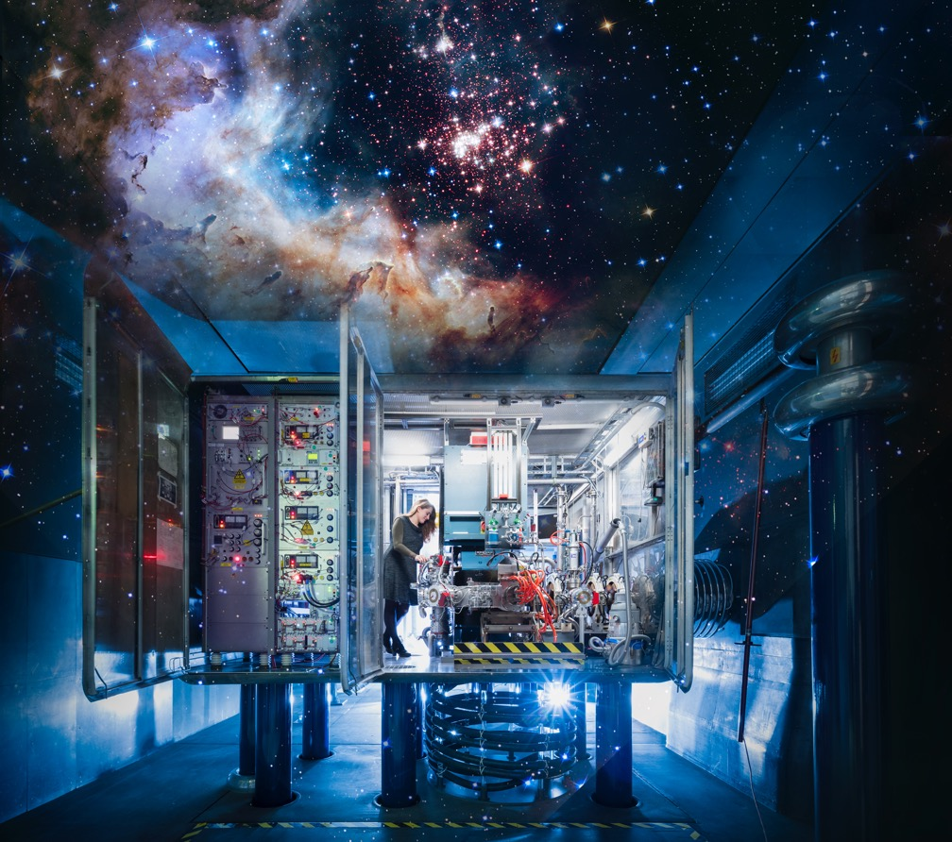
We explore
the universe…
Photo: J. Hosan/GSI/FAIR, “NASA, ESA, the Hubble Heritage Team (STScl/AURA), A. Nota (ESA/STScl), and the Westerlund 2 Science Team”
…in the lab.

Slide 5
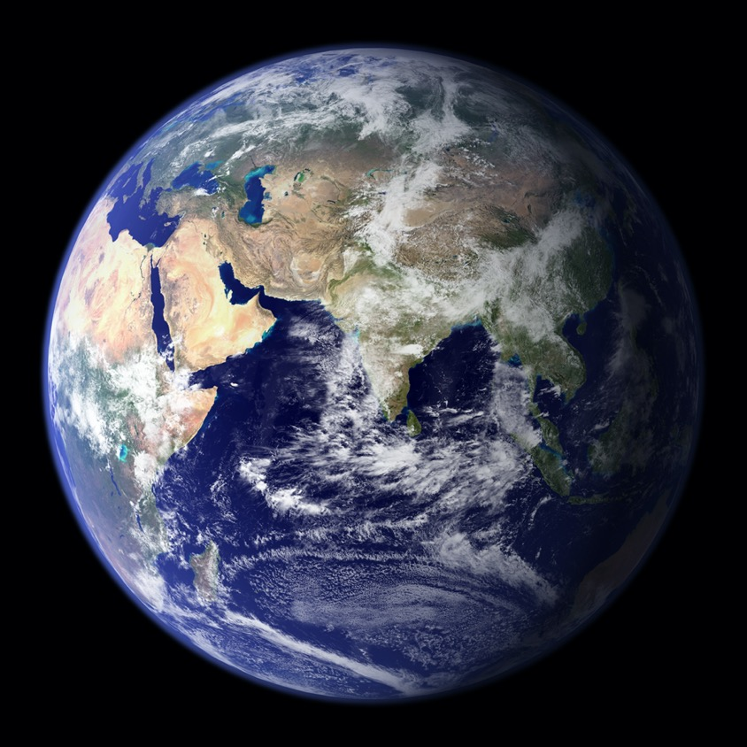
What are the smallest
building blocks
of matter?
Photo: NASA
How, where and when were they created?

Slide 6
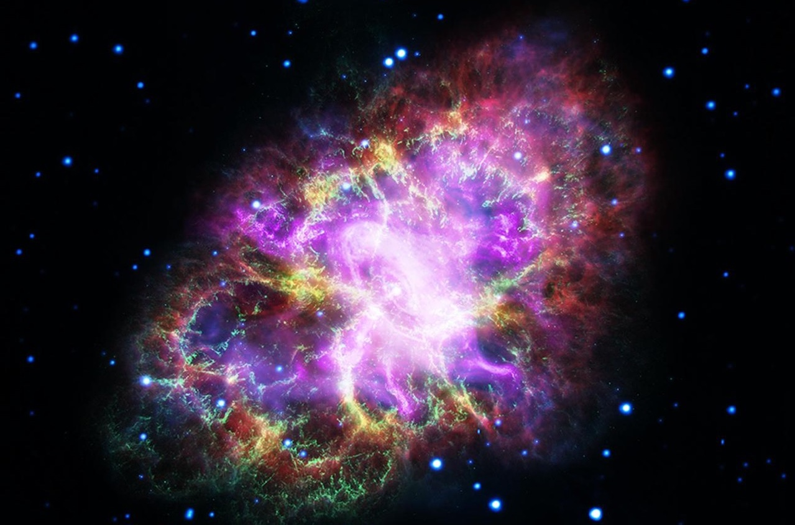
How are chemical elements formed in stellar explosions?
Photo: NASA, ESA, G. Dubner (IAFE, CONICET-University of Buenos Aires) et al.; A. Loll et al.; T. Temim et al.; F. Seward et al.; VLA/NRAO/AUI/NSF; Chandra/CXC; Spitzer/JPL-Caltech; XMM-Newton/ESA; and Hubble/STScI

Slide 7
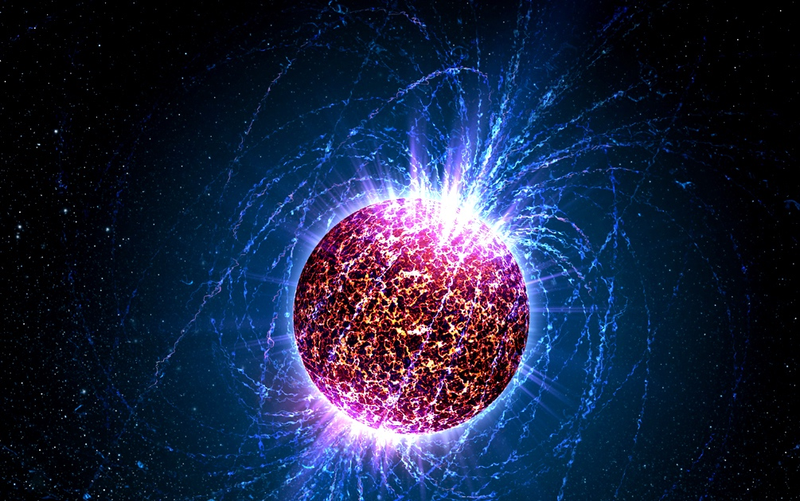
What does matter look like in the most heavy objects of our universe, the neutron stars?
Photo: Penn State University

Slide 8
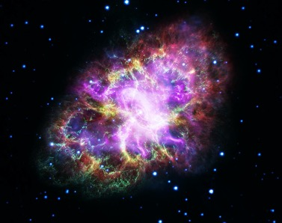
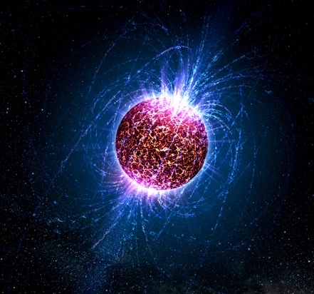
Photo: NASA, ESA, G. Dubner (IAFE, CONICET-University of Buenos Aires) et al.; A. Loll et al.; T. Temim et al.; F. Seward et al.; VLA/NRAO/AUI/NSF; Chandra/CXC; Spitzer/JPL-Caltech; XMM-Newton/ESA; and Hubble/STScI (oben), Penn State University (unten)
Various cosmic matter can be produced with particle accelerators in the lab.

Slide 9
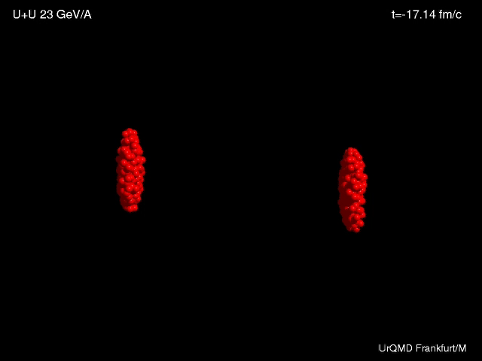
Animation: UrQMDFrankfurt/M

Slide 10
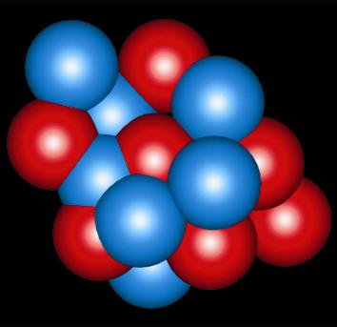
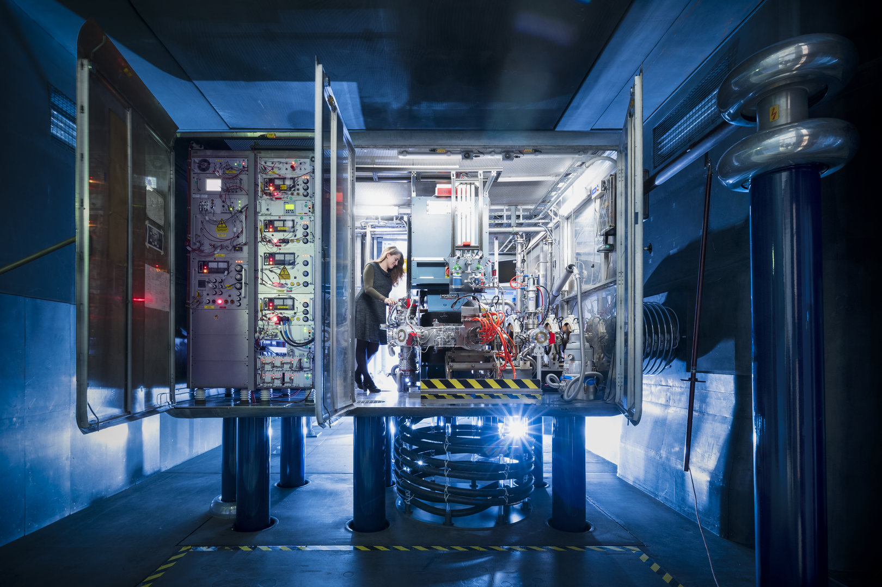

How does an accelerator work?
First we need ions!
atomic shell
+
Nucleus
Proton
Neutron
Elektron
An ion
-
Neon light from the ancient pre LED times
View of one ion source terminal
Notes:
Was ist ein Ion, damit geht es los- Teilchen muss geladen sein, sonst kann ich es nicht anfassen

Slide 11
Principle of acceleration
+
+
+
+
+
+
+
+
+
+
+
+
+
+
+
+
+
+
+
+
+
+
+
+
+
+
+
+
+
-
+
+
_

Slide 12
Beating the Limitation of DC voltage –> AC Voltage
AC voltage (*)
τ
E
t₁
elektr. field
ion „bunches“
t
t₂
(*) actually it‘s radio frequency
for example 36 and 108 MHz @UNILAC here at GSI
drift tubes
L
Notes:
Jetzt kommt die Wechselspannung, aber wie geht es ?

Slide 13
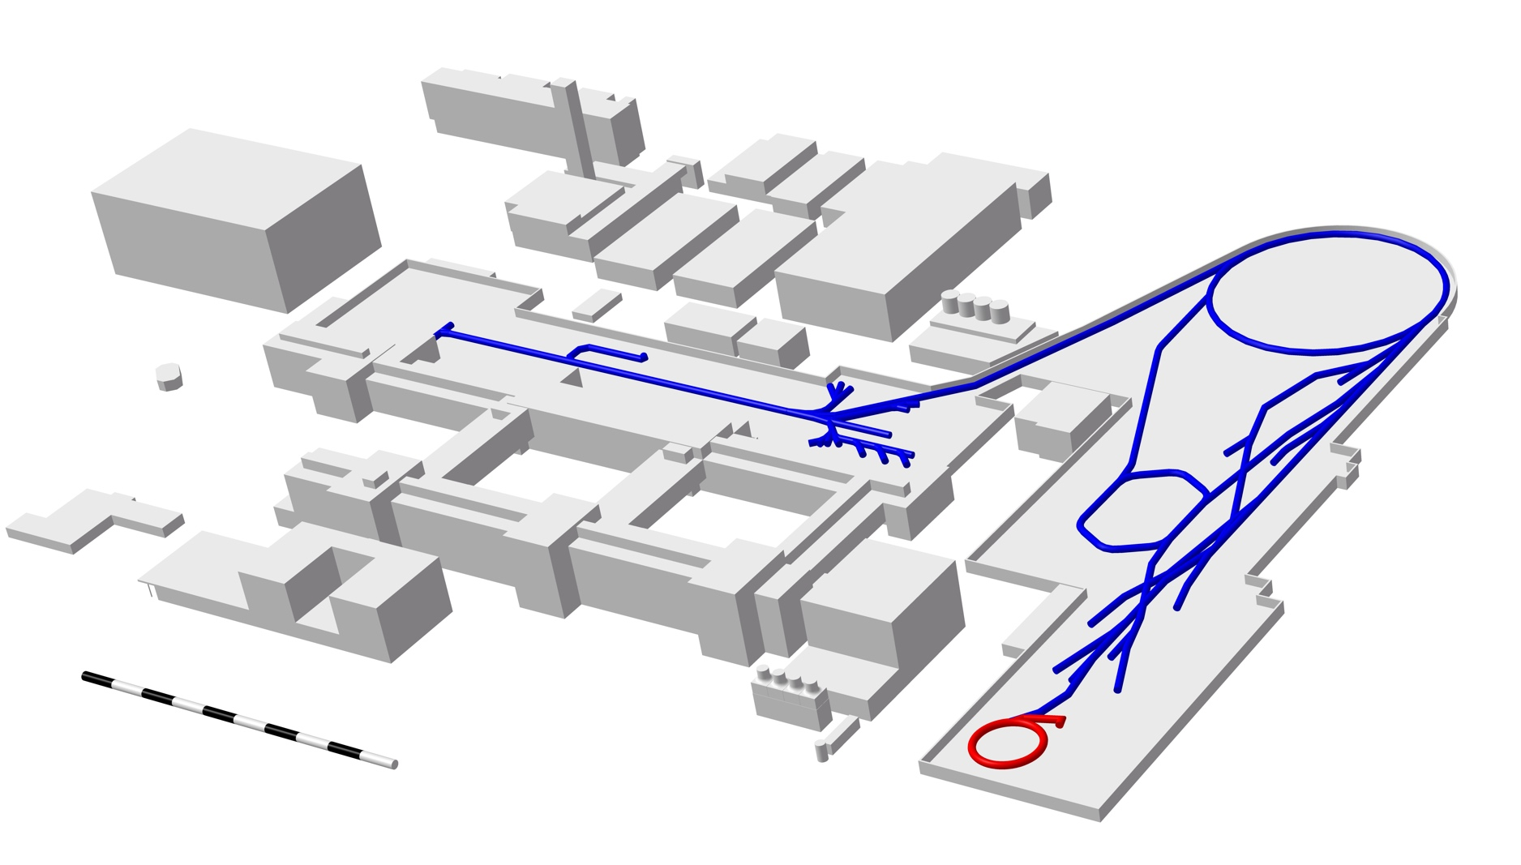
GSI accelerator facility
Graph: GSI/FAIR
Ion sources
all elements
Linear accelerator
20% of the speed of light
Ring accelerator
90% of the speed of light
we are here!
SIS18
UNILAC
FRS
ESR
Experimental areas
100 m

Slide 14
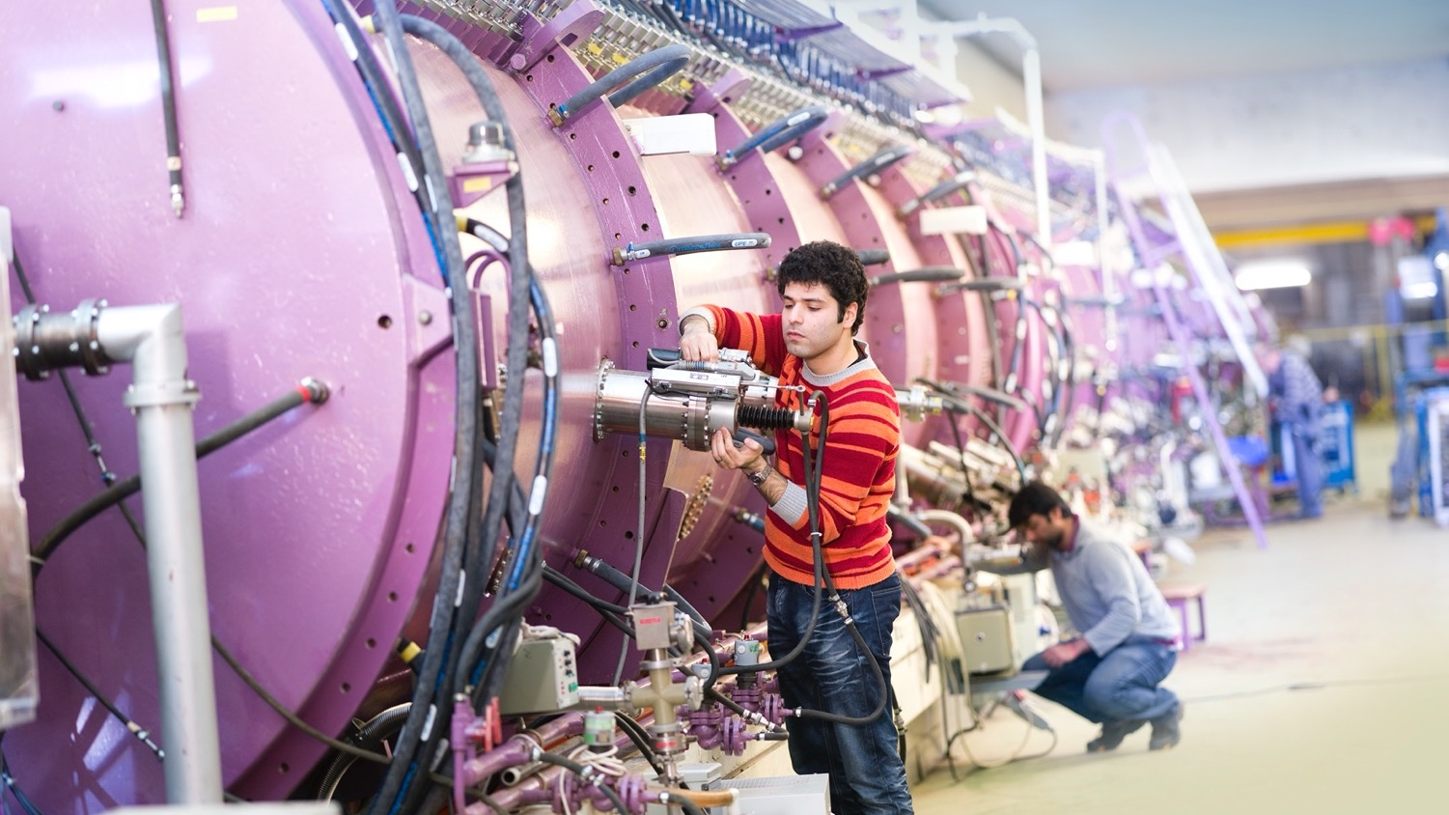
Photo: J. Hosan/HA Hessen Agentur

Slide 15
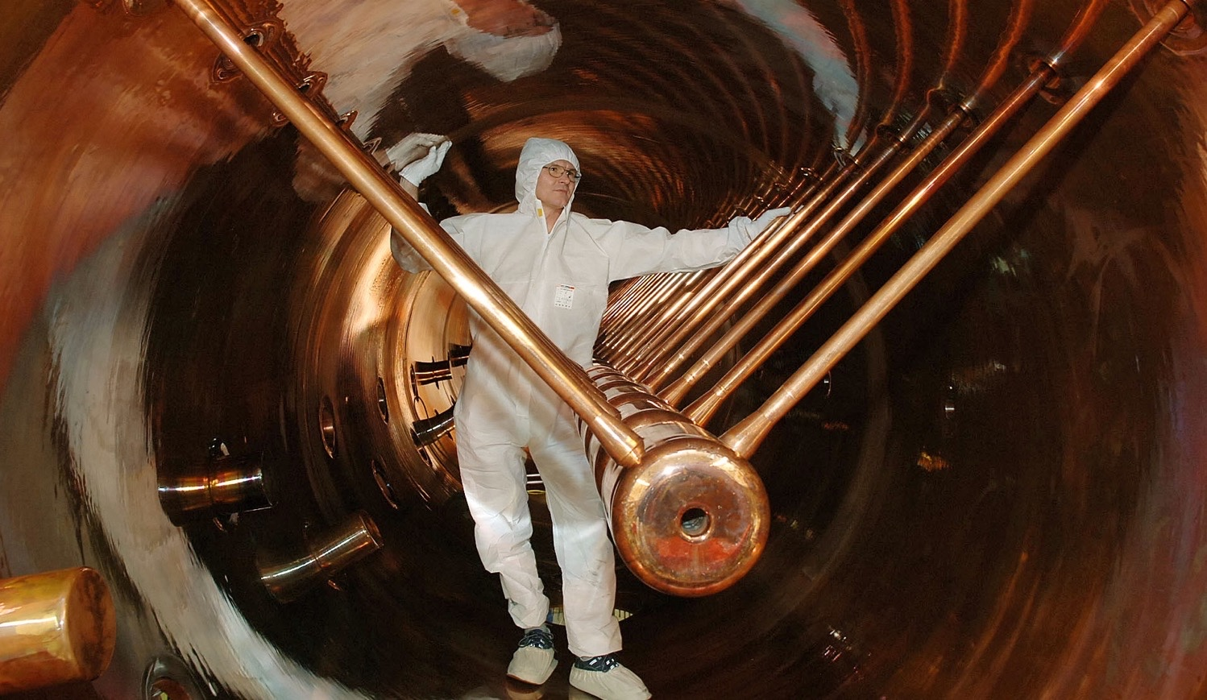
Photo: G. Otto/GSI

Slide 16
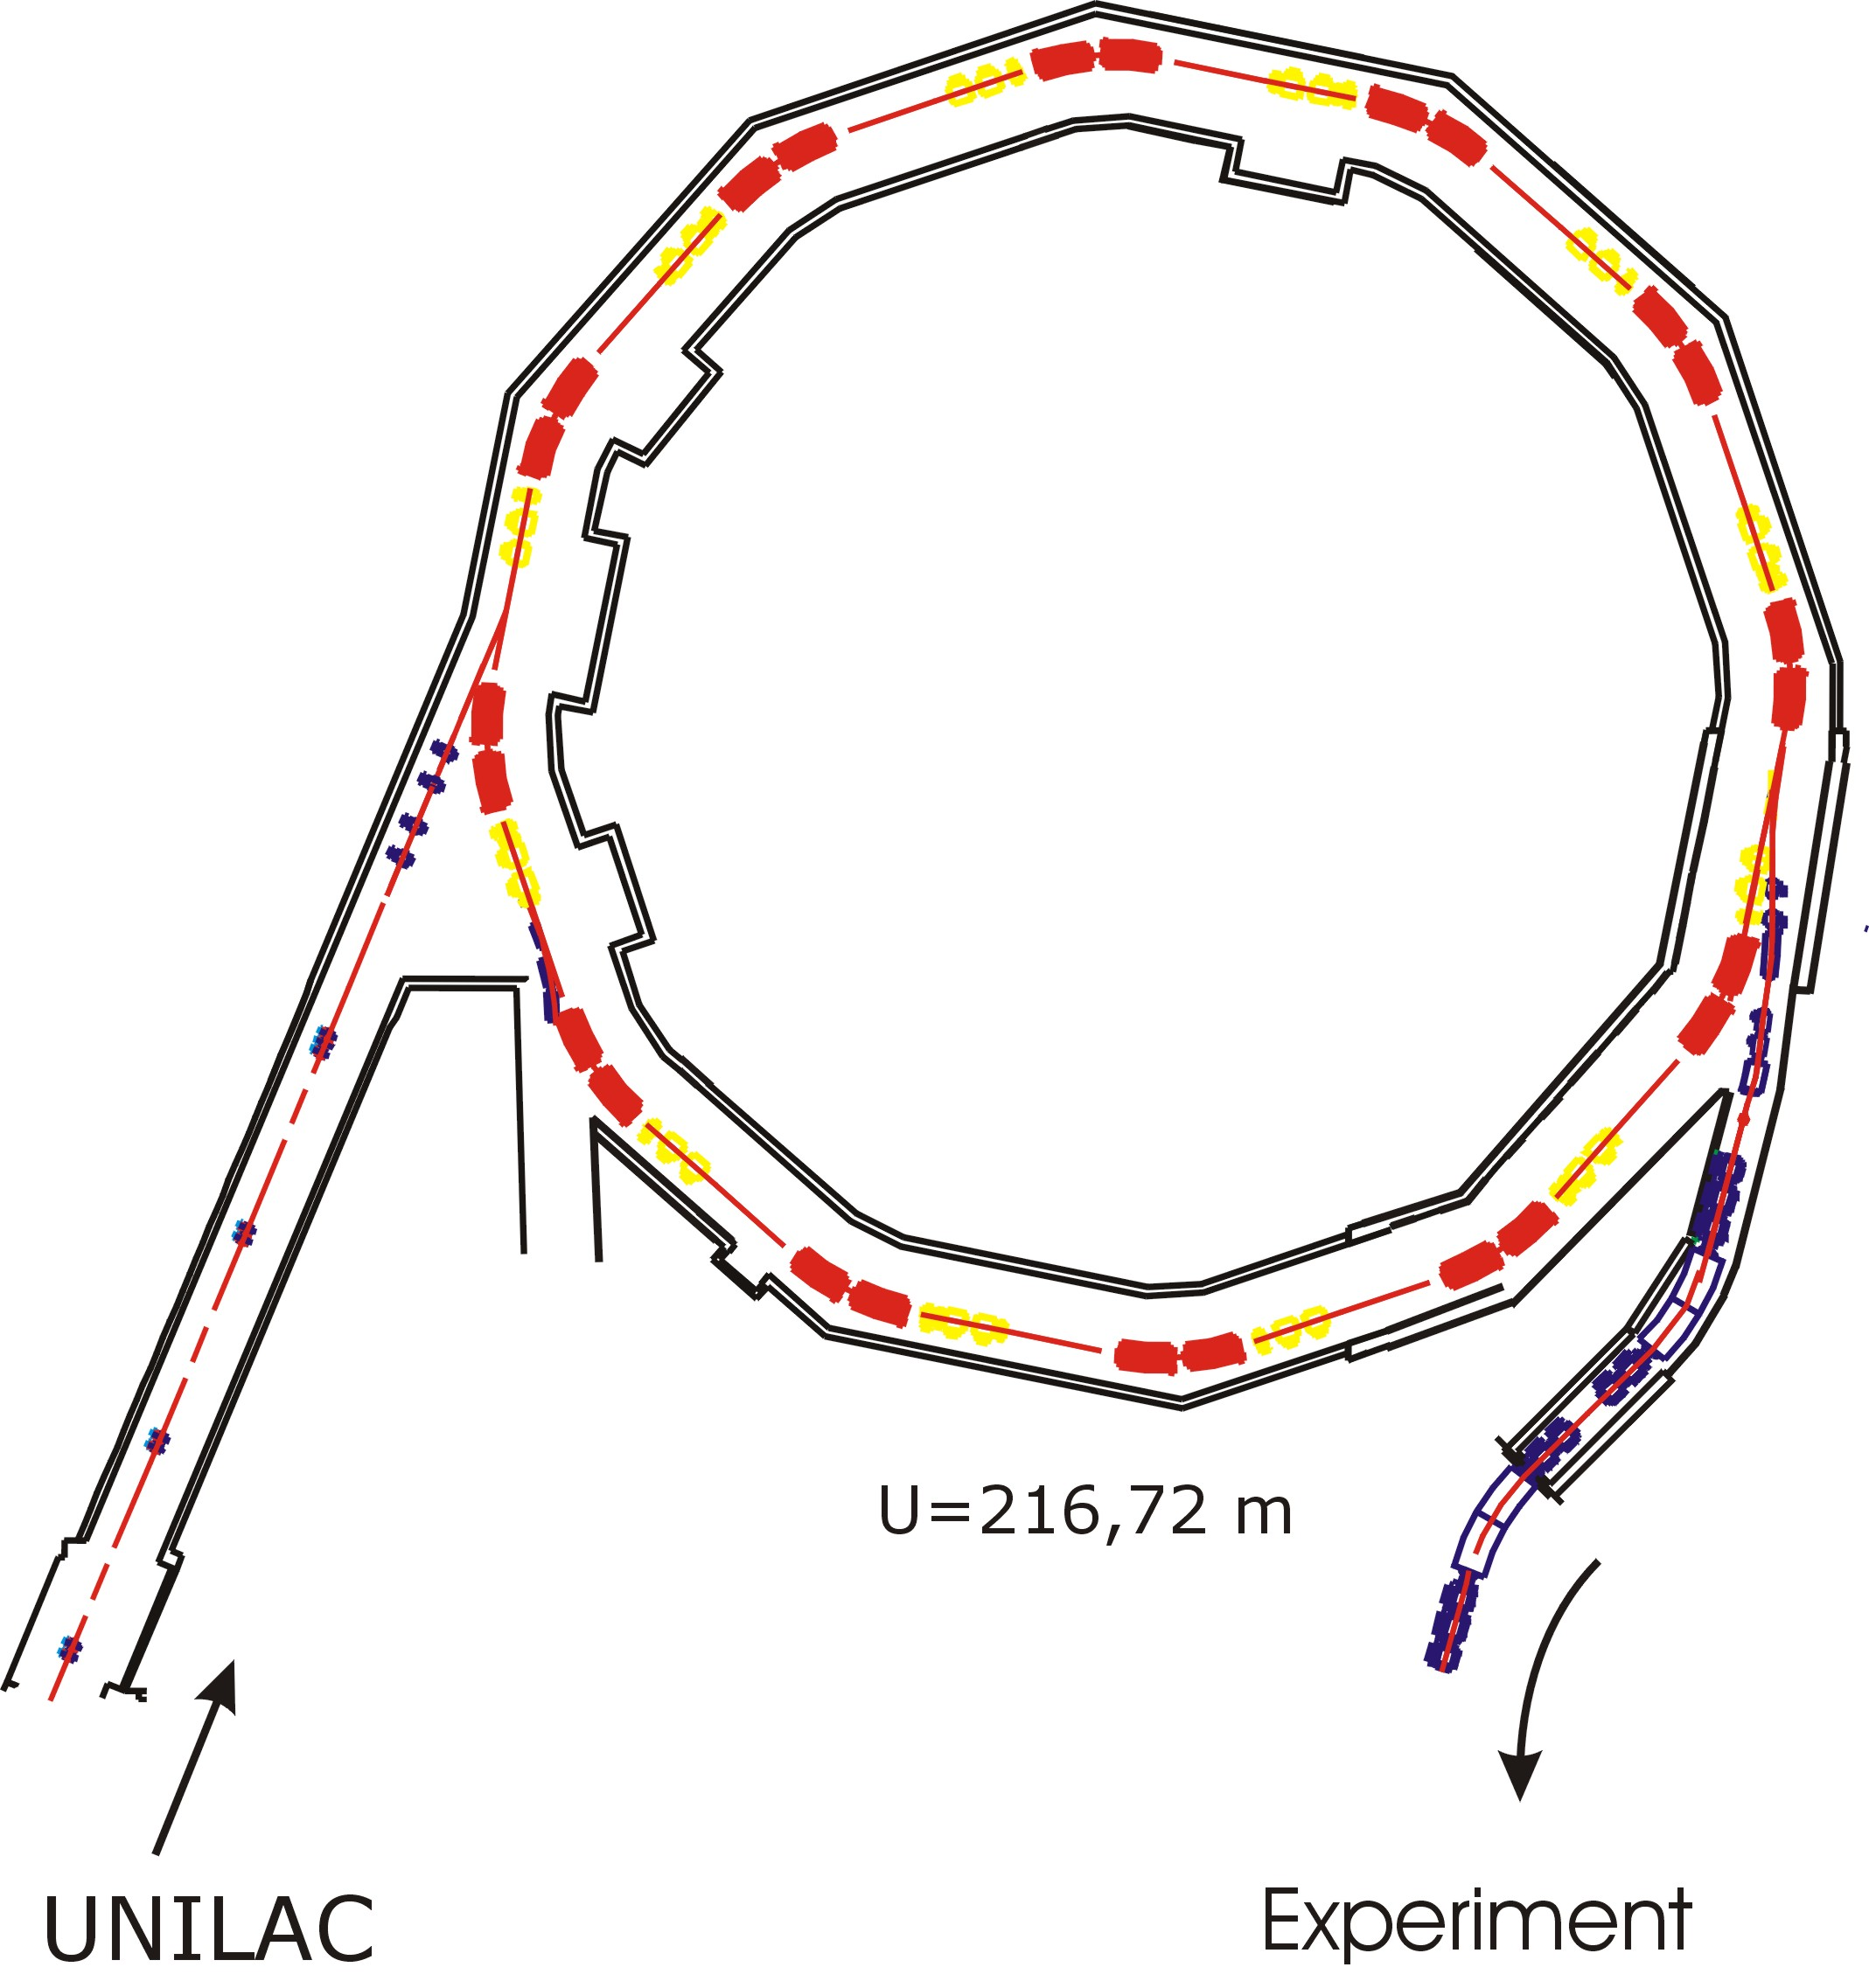
SIS – Schwerionensynchrotron
Heavy Ion Synchrotron
Circumference: 216 m
during Acceleration :
from 100 000 to 1 Mio revolutions per second
Magnets: up to 1.8 T field strength
1 GeV/u Uranium Ions
(yep, thats 238 GeV per ion)
4.7 GeV protons
slow and fast extraction
different ion and energy possible from cycle to cycle
Acceleration Cavity
Bending magnets
Focussing magnets
20% Lichtgeschwindigkeit
Max. 90% Lichtgeschwindigkeit
UNILAC
Experiment

Slide 17
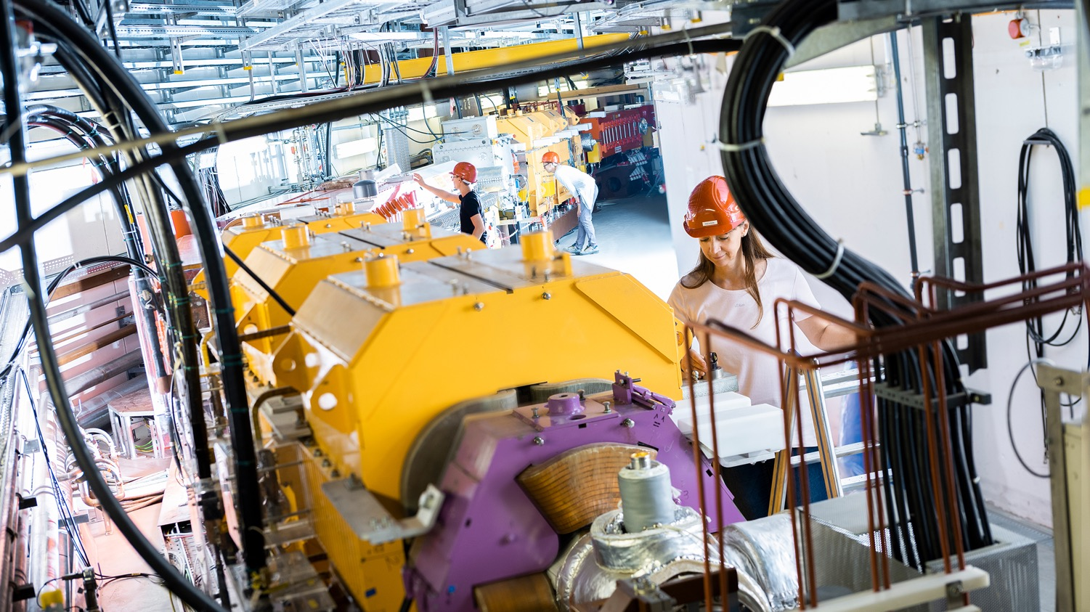
Photo: J. Hosan/GSI/FAIR

Slide 18
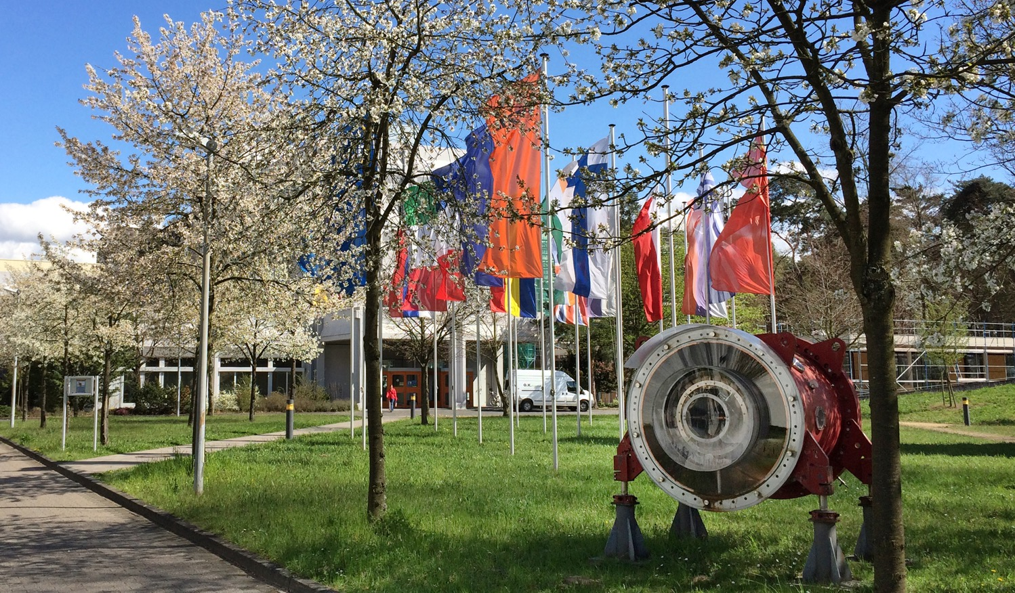
GSI –
Scientific expertise
for more than 50 years
Photo: G. Otto/GSI/FAIR

Slide 19
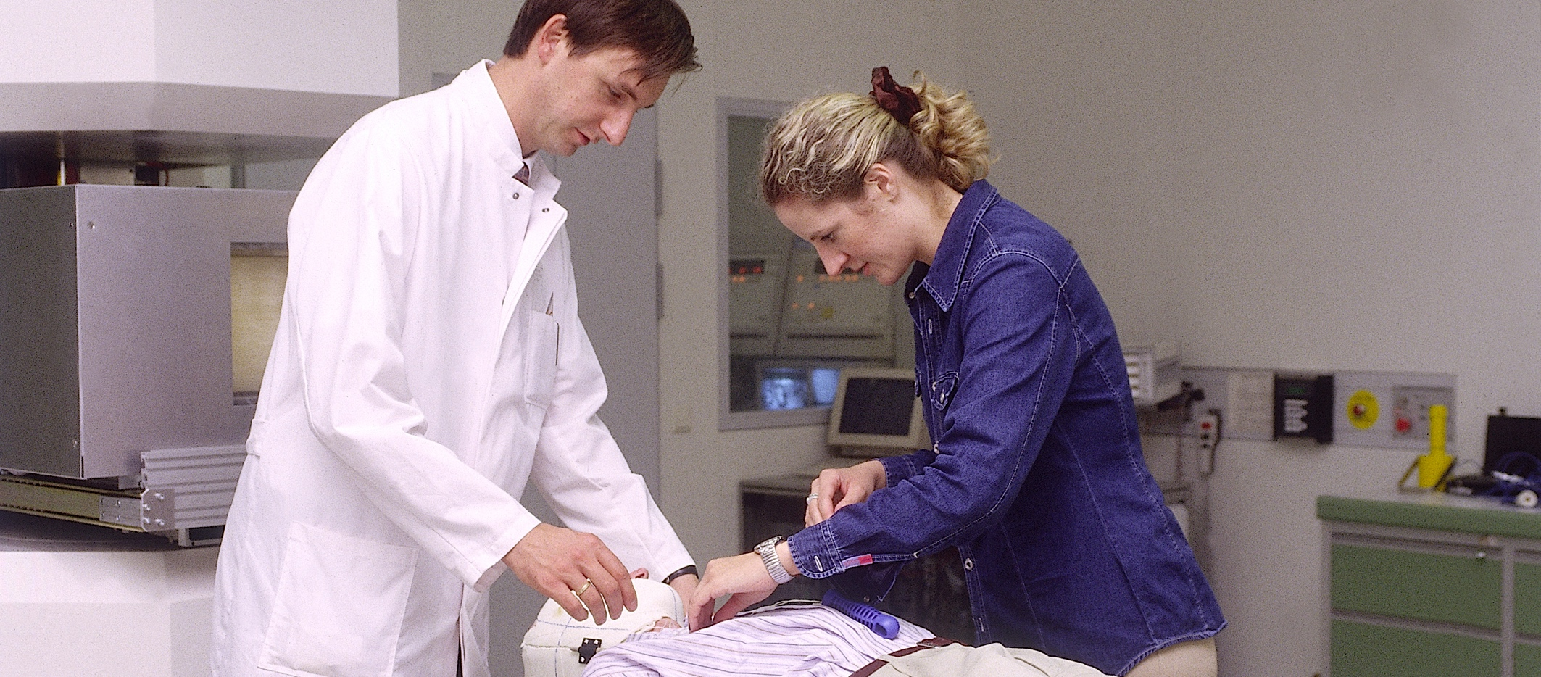
Cancer therapy with heavy ions
Photo: A. Zschau/GSI
Precise, gentle and very successful
Treatment of 440 patients at GSI
By now established and in clinical operation, among others in Heidelberg and Marburg
At GSI: Research and further development

Slide 20
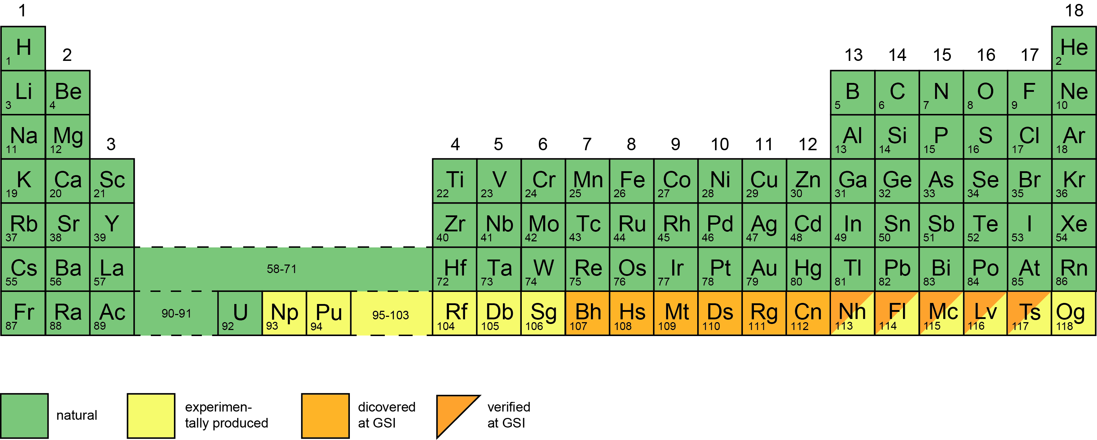
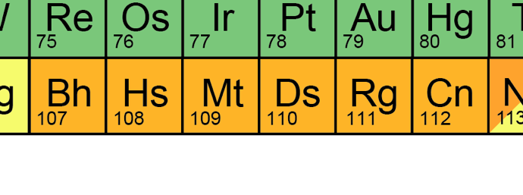
Discovery of new elements
Graph: GSI/FAIR
Bohrium
Hassium
Meitnerium
Darmstadtium
Roentgenium
Copernicium

Slide 21
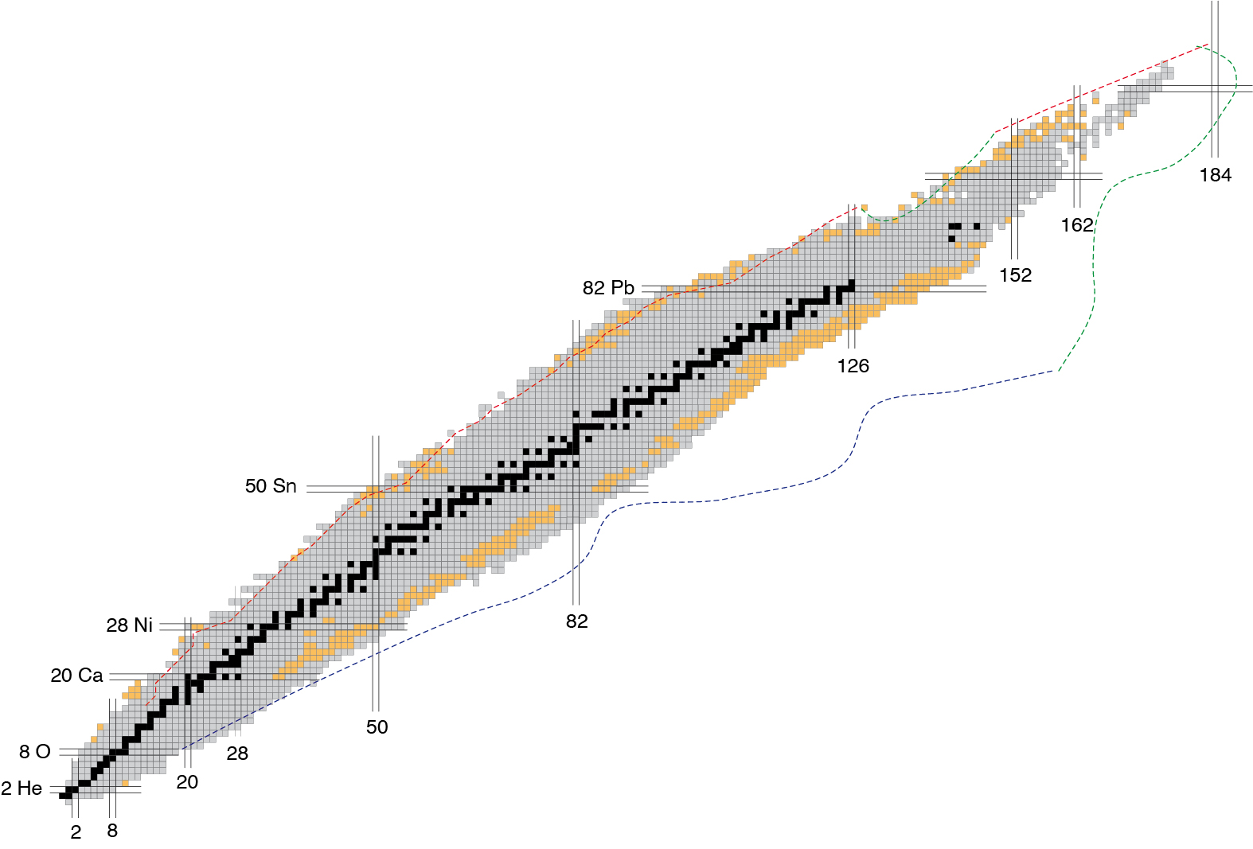
Discovery of new atomic nuclei
445 atomic nuclei have been discovered at GSI/FAIR
Number of protons
discovered at GSI/FAIR
stable nuclei
known nuclei
Number of neutrons

Slide 22
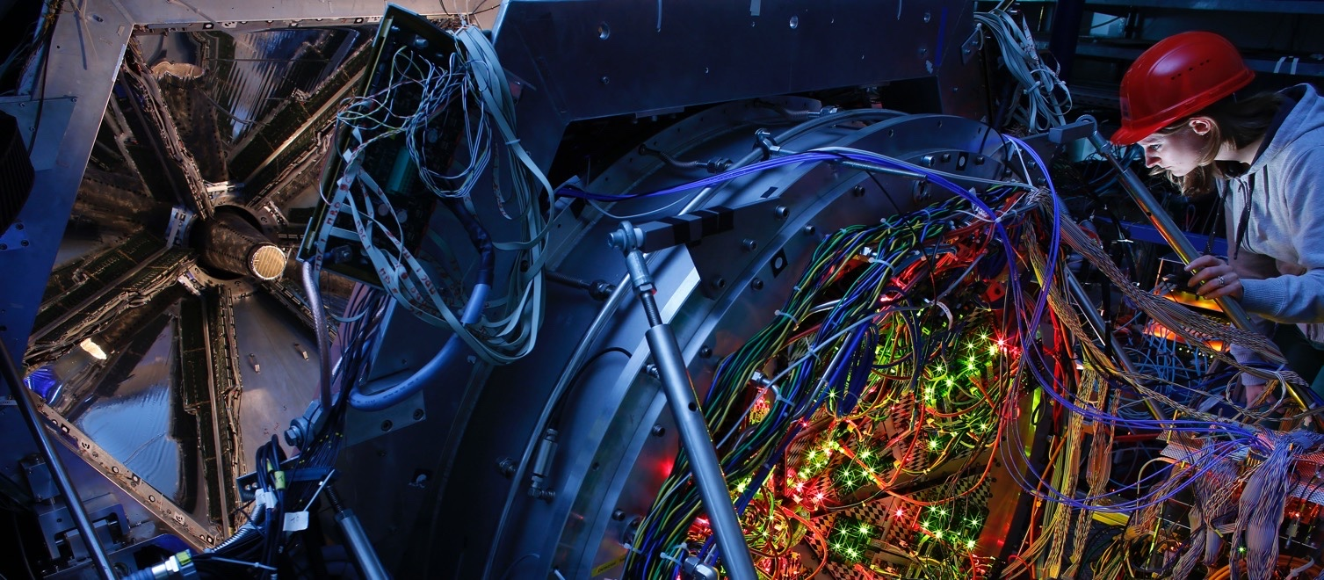
FAIR – Facility for Antiproton and Ion Research
Photo: T. Ernsting/HA Hessen Agentur
A world-wide unique particle accelerator
Exotic forms of matter occurring in the universe can be produced and investigated in the laboratory
Basic research and the development of applications
for materials research, radiobiology, space travel, etc.
Collaboration between several teams of internationally leading researchers (more than 3,000 scientists)

Slide 23
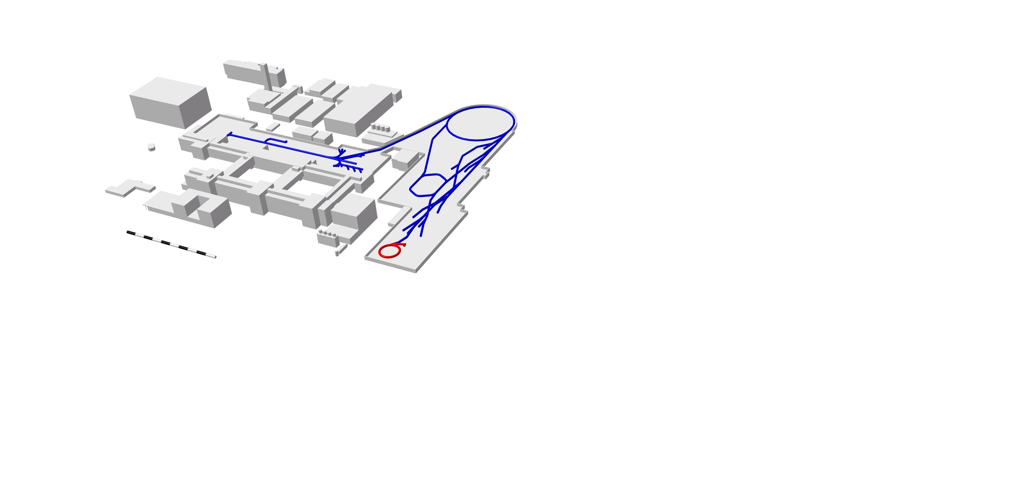
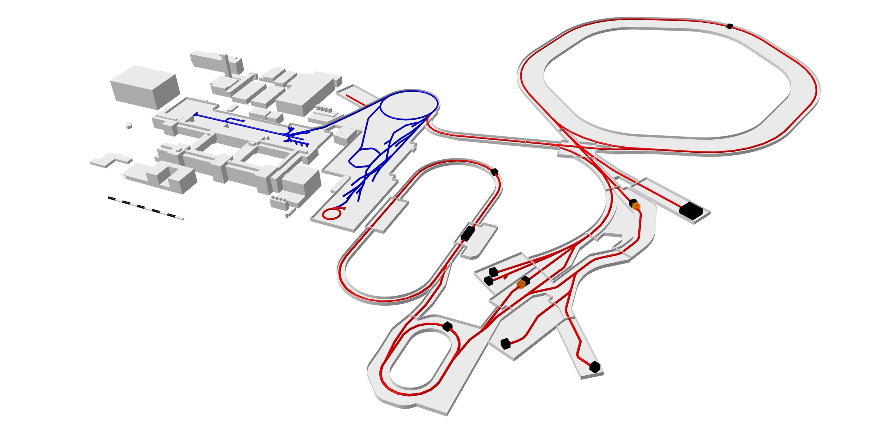
FAIR – Facility for Antiproton and Ion Research
Graph: GSI/FAIR
Linear accelerator
Ring accelerator
SIS18
Ring accelerator
SIS100
Production
of new nuclei
Production
of antiprotons
Experimental and
storage rings
Existing facility
Planned facility
Experimental setups

Slide 24
FAIR – Facility for Antiproton and Ion Research
Performance!
Graph: GSI/FAIR
Linear accelerator
Ring accelerator
SIS18
Ring accelerator
SIS100
up to factor 100-1000 more
intensity
secondary particles up to
a factor of 10000
energy of ions factor 11
Production
of new nuclei
Production
of antiprotons
Existing facility
Planned facility
Experimental and
storage rings
Experimental setups

Slide 25


Intensity up, but how?
Grafik: GSI/FAIR
Linearbeschleuniger
Ringbeschleuniger
SIS18
Ringbeschleuniger
SIS100
Produktion
neuer Atomkerne
SIS18 + UNILAC
Produktion
von Antiprotonen
Experimentier- und
Speicherringe
UNILAC und source improvement
SIS 18 will be (is) faster
(about. 10x faster)
Leave one stripper away -> What is that?
Existierende Anlage
Geplante Anlage
The existing facility is continuously being improved and upgraded.
Experimente

Slide 26
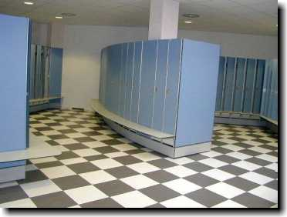
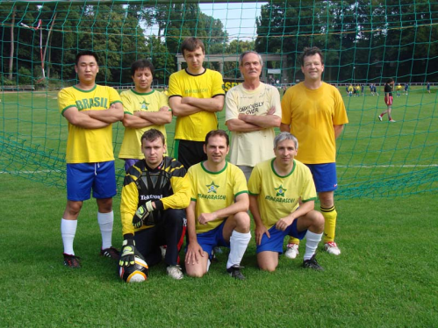

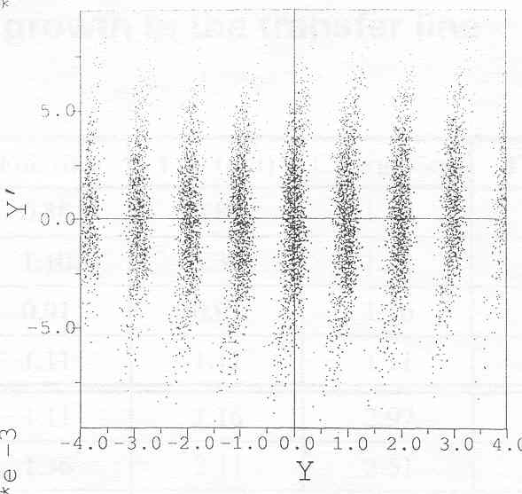
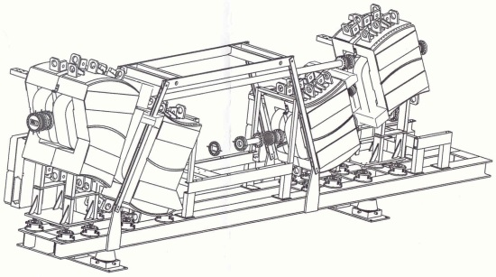
Stripper?
Children
Change
Team?
not that easy!
Ion beaml
„foil stripper"
„charge distribnution"

Slide 27
Lowly charged ions, what now?
Intensity is higher, less waste
Beam gets more stable because the particle repel each other less (experts: less „space charge")
BUT
The ions are hard to accelerate and bent around corners thats why we need SIS100
make way
Go away!

Slide 28
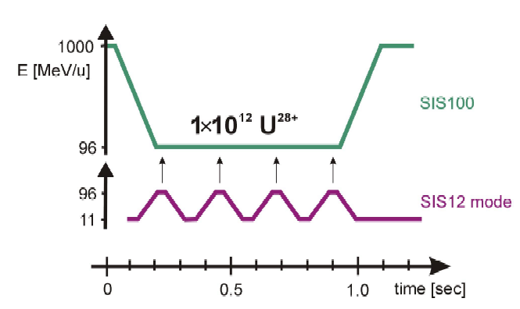
SIS100 will be the FAIR workhorse
Grafik: GSI/FAIR
Linearbeschleuniger
Ringbeschleuniger
SIS18
Ringbeschleuniger
SIS100
SIS100
Produktion
neuer Atomkerne
Produktion
von Antiprotonen
Accelerates the now lowly charged ions to same or even little higher energies
in addition naked ions can be accelerated to much higher energies (11 GeV/u)
protons even higher (29 GeV)
Experimentier- und
Speicherringe
Existierende Anlage
SIS 100 Zyklus
Geplante Anlage
0.7 Hz
Experimente
5x10¹¹ U²⁸⁺
2.7 Hz
4x SIS 18 Zyklus

Slide 29
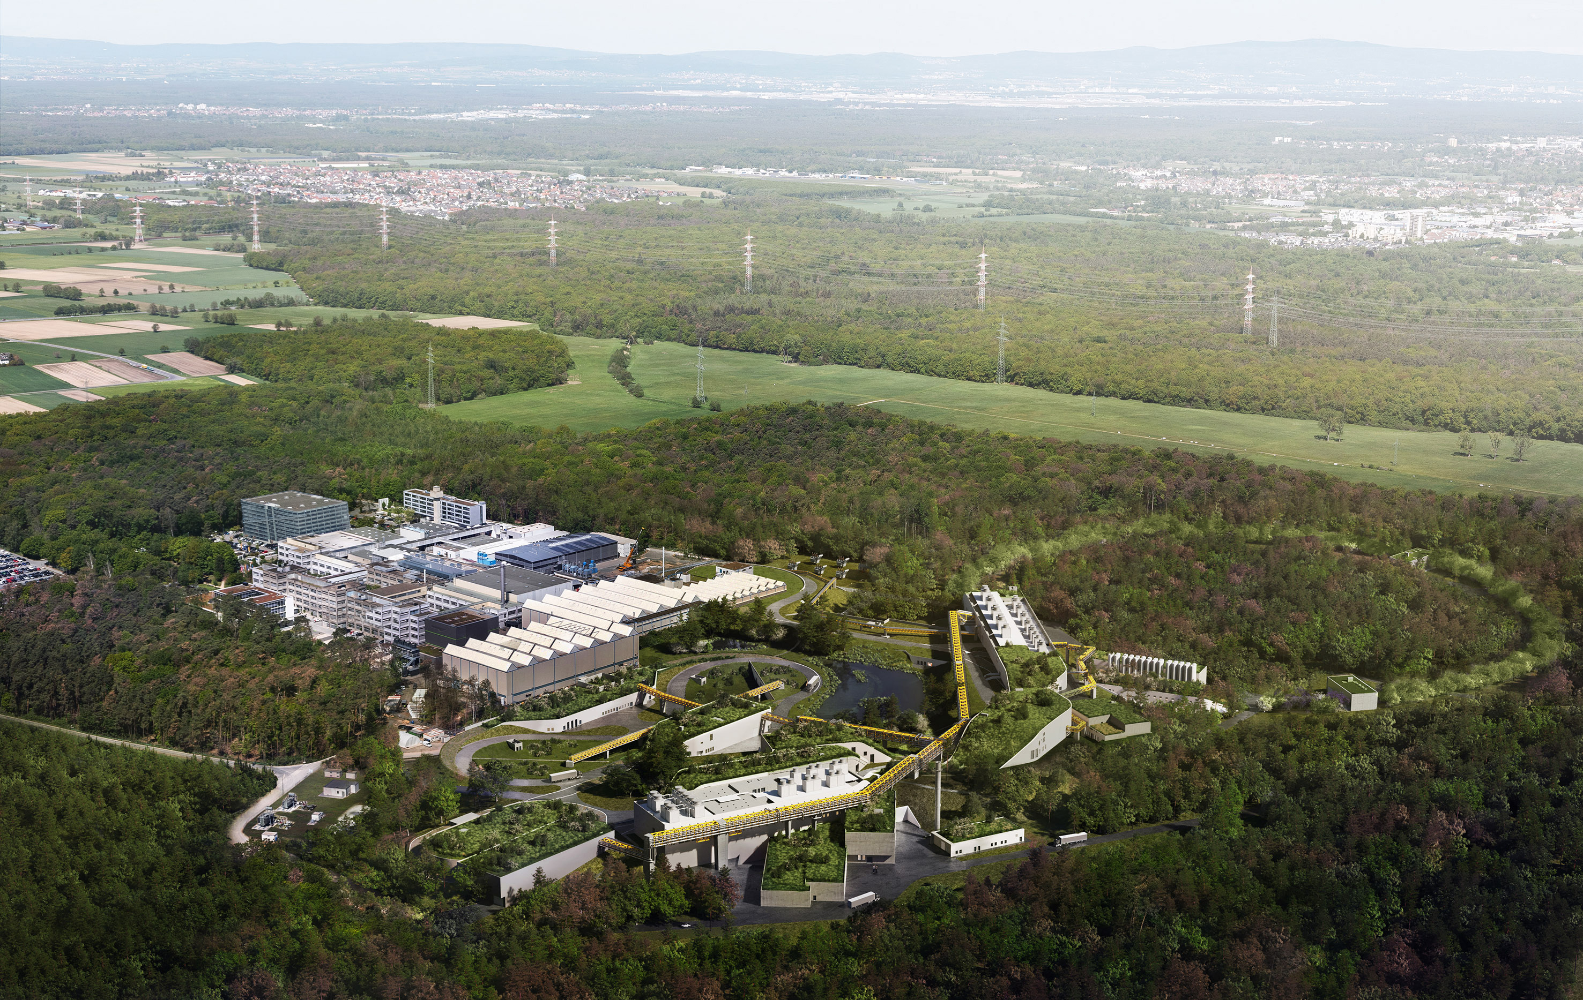
FAIR
Picture: ion42, D. Fehrenz, GSI/FAIR
World-leading accelerator laboratory for decades
Unique research in physics and applications
Milestone in the European research roadmap (ESFRI)
Top priority in the European nuclear physics community

Slide 30
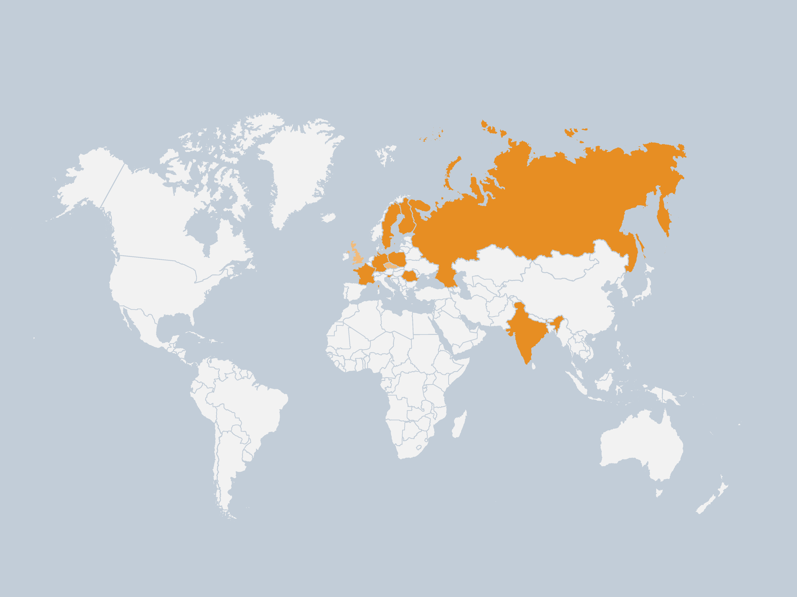
Shareholders worldwide
Graph: GSI/FAIR
Shareholders
Finland
France
Germany
India
Poland
Romania
Russia
Sweden
Slowenia
Associated
United Kingdom
Aspirant
Czech Republic

Slide 31
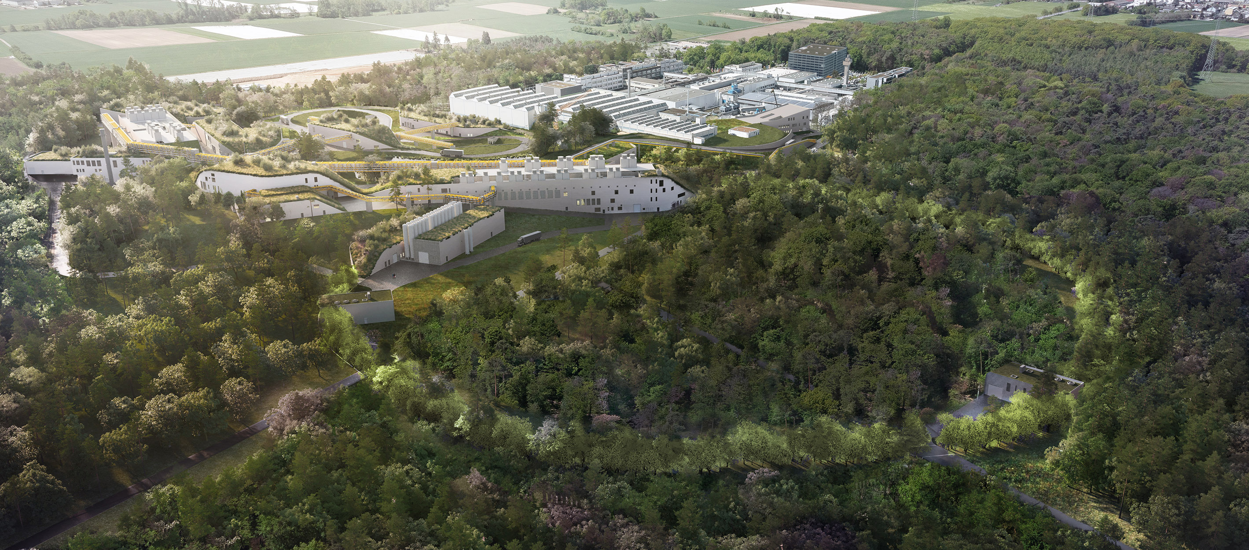
FAIR
Picture: ion42, D. Fehrenz, GSI/FAIR
25 accelerator and experimental structures,
labs and other operation
and supply structures
Underground accelerator ring
with a circumference
of approx. 1,100 m
Around 150,000 m² of total area

Slide 32
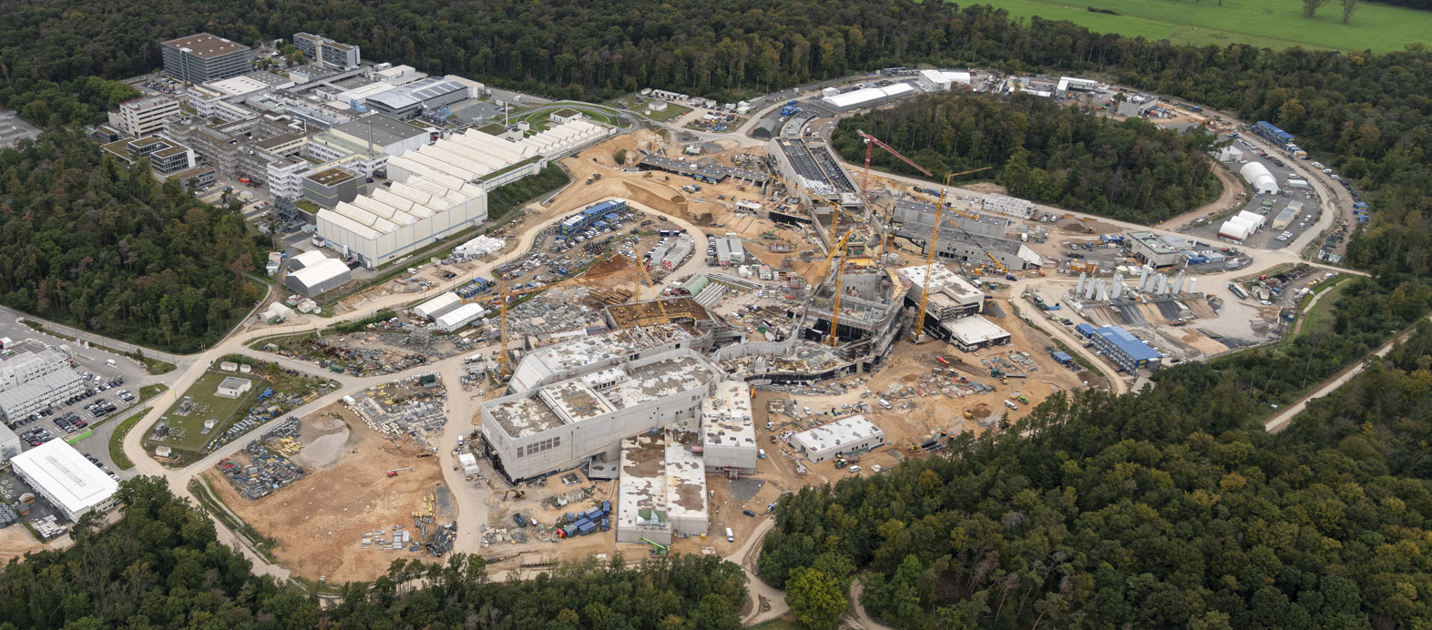
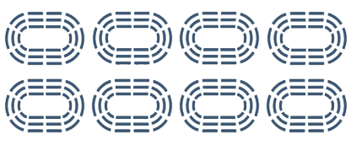
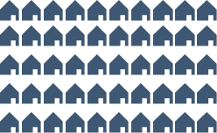
FAIR — Construction volumes
2 milion m³
600,000 m³
65,000 t
of earth
of concrete
of steel
to be moved
to be used
to be utilized
  As much as for 5,000 single-family homes.
  As much as eight Frankfurt football stadiums.
  As much as nine Eiffel Towers.

Slide 33
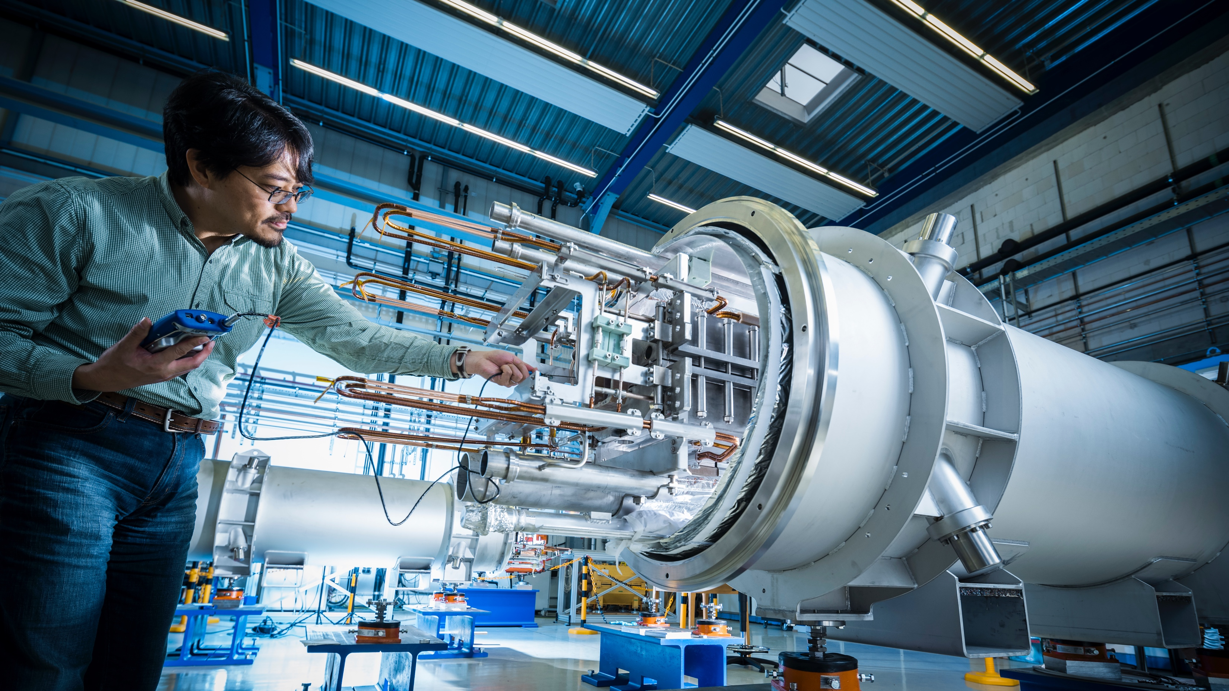
Photo: J. Hosan, GSI/FAIR
FAIR develops and uses
innovative measurement
methods and techniques.

Slide 34
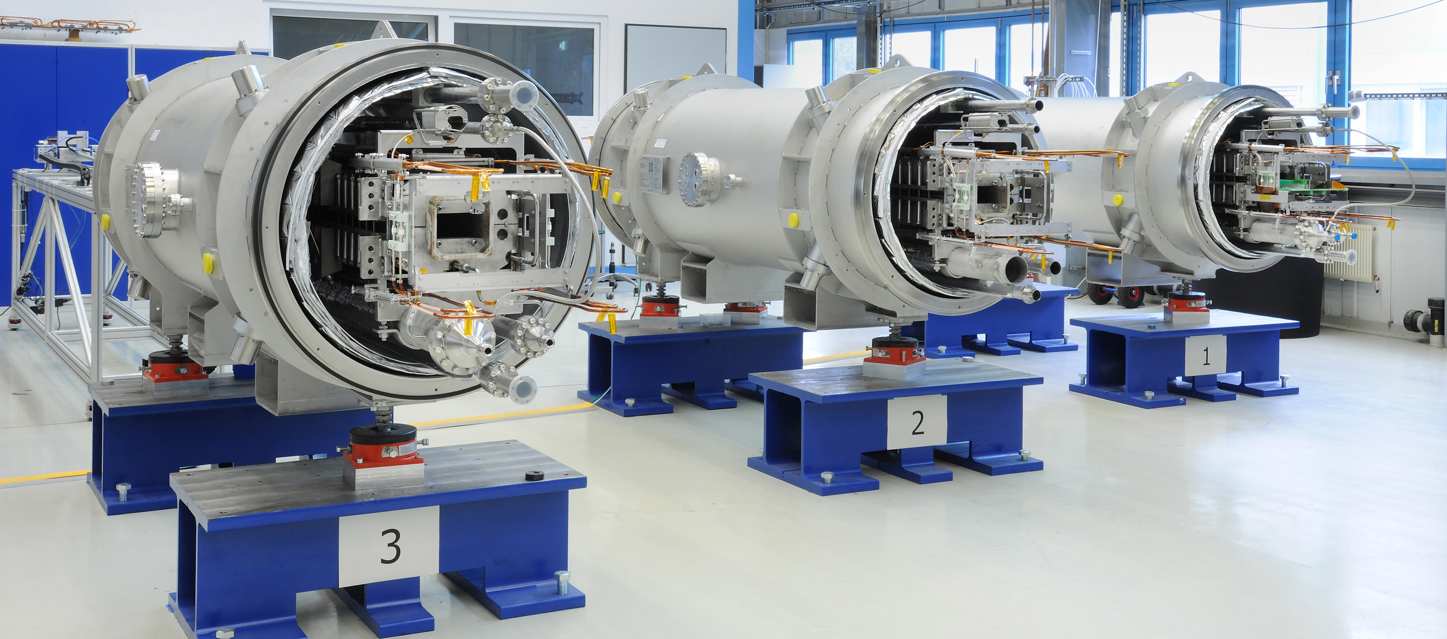
Hightech for FAIR
Photo: G. Otto, GSI/FAIR
Superconducting magnets: for strong and rapidly changing magnetic fields with maximum field precision
Sophisticated cryotechnology: Use of liquid helium to cool down to 4 Kelvin
(-269°C)
Ultra-high vacuum: 10¹⁵ times below the earth’s air pressure
Development and construction of cryo-collimators with special coatings

Slide 35
Latest drone video of FAIR construction site
Copyright: GSI/FAIR/L. Möller, Intermedial Design

Slide 36




Safety instructions
The tour leads through research facilities.
Please take not of the following safety instructions:
Keep distance from technical equipment.
Don’t touch anything.
Stay with your group. You are not allowed to stay/move on campus unsupervised.
Don’t eat or drink in the research facilities.

Slide 37
Picture: ion42, D. Fehrenz, GSI/FAIR
  Thank you for
  your attention!
Presentation provided by GSI and FAIR Public Relations Department.

Slide 38
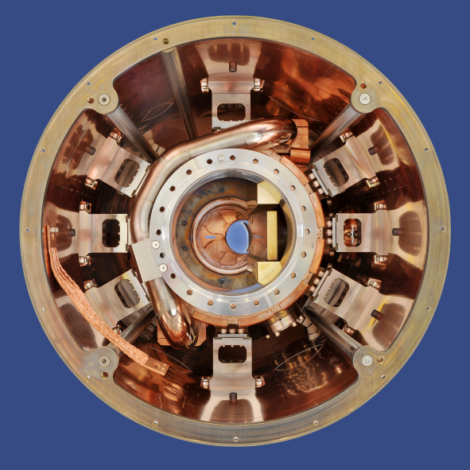
Cryocatcher, neue Technologie

Slide 39





Stay in touch with us!
Mastodon:
@FAIR_GSI_de
@helmholtz.social
Instagram:
@universeinthelab
Facebook:
@GSIHelmholtzzentrum
@FAIRAccelerator
YouTube:
FAIR GSI – The Universe
in the Lab
LinkedIn:
GSI Helmholtz Centre
for Heavy Ion Research

