Slide 1
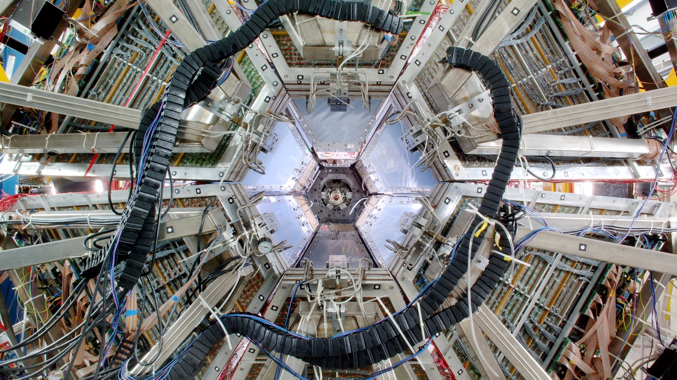

Photo: G. Otto/GSI
  Welcome to the international
  research center GSI and FAIR

Slide 2


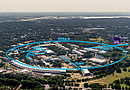

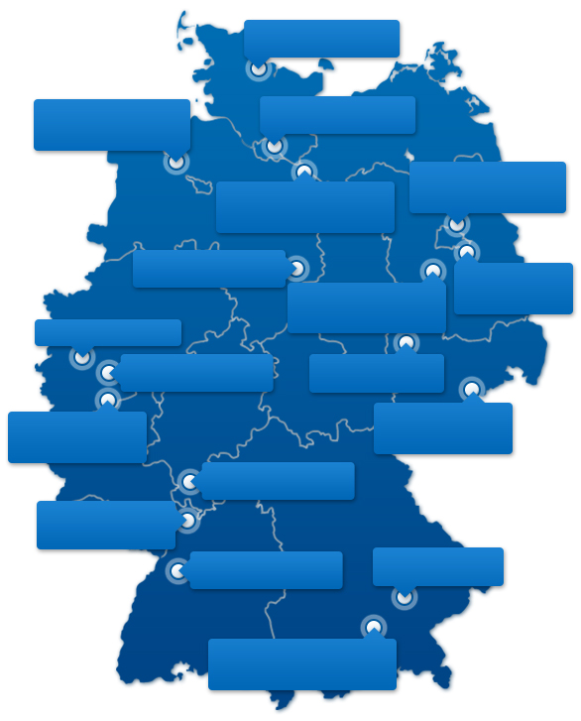










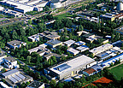
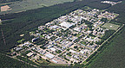

The Helmholtz Association
Research for grand challenges
Helmholtz in Numbers:
46 000 employees
6 Billion € annual budget
18 Large scale reserach centers
14500 international users
GEOMAR:
Ocean Research
Alfred Wegener Inst.: Polar Research und Oceanography
DESY: Deutsches Elektronen Synchrotron
Max Delbrück Zentrum: Molecular Medicin
HZ Hereon: Materials- und Coastal Research
HZ für Infektionsforschung
HZB: Materials
and Energy
GFZ Potsdam: German Research Centre for Geoscience
Forschungszentrum Jülich
DLR: German Aerospace Center
UFZ: Centre for Environmental Res.
DZNE: Neurodegenerative Diseases
Helholtz Zentrum Dresden-Rossendorf
GSI – HZ for Heavy Ion Research
DKZF: German Cancer Research Center
KIT: Karlsruhe Institute for Technology
MPP:
Plasmaphysics
HZ Munich:
Health and Environment

Slide 3
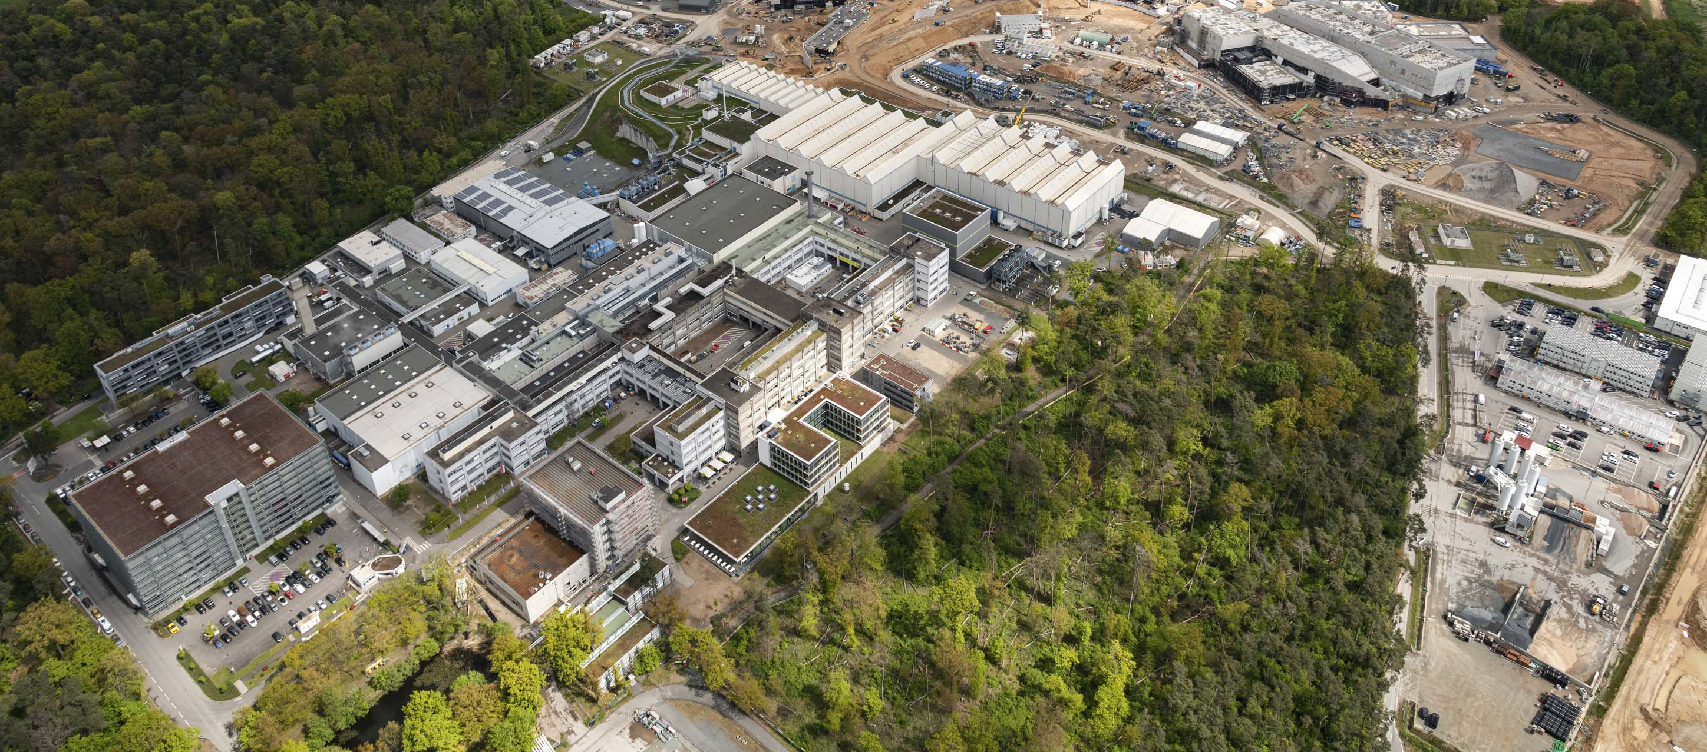
GSI GmbH – Helmholtzzentrum für Schwerionenforschung
Photo: D. Fehrenz/GSI/FAIR, April 2023
Existing facility: GSI Darmstadt (Foundation: 1969)
Shareholders: federal government (90%), Hesse (8%), Rhineland-Palatinate (1%), Thuringia (1%)
Further locations (Helmholtz Institutes) in Mainz and Jena
Future facility: FAIR (Foundation: 2010)
Employees on campus: approx.1,580

Slide 4
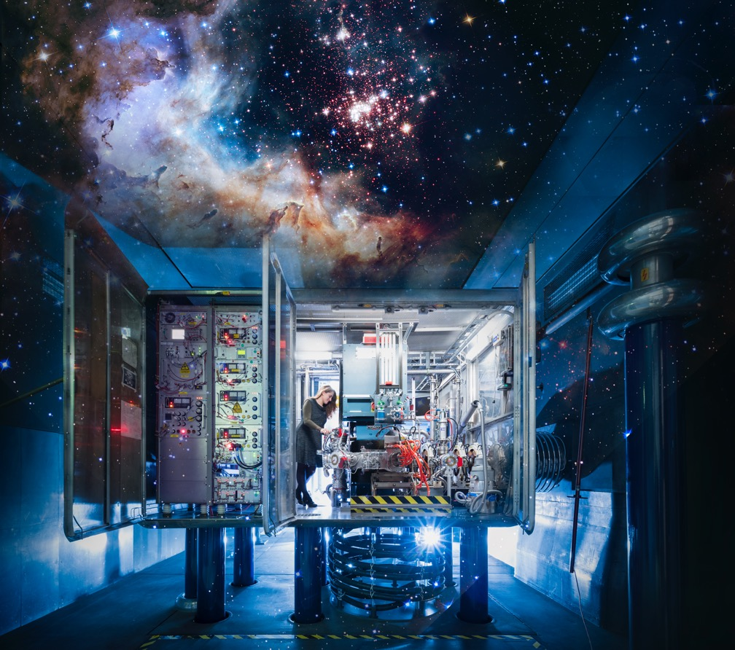
We explore
the universe…
Photo: J. Hosan/GSI/FAIR, “NASA, ESA, the Hubble Heritage Team (STScl/AURA), A. Nota (ESA/STScl), and the Westerlund 2 Science Team”
…in the lab.

Slide 5
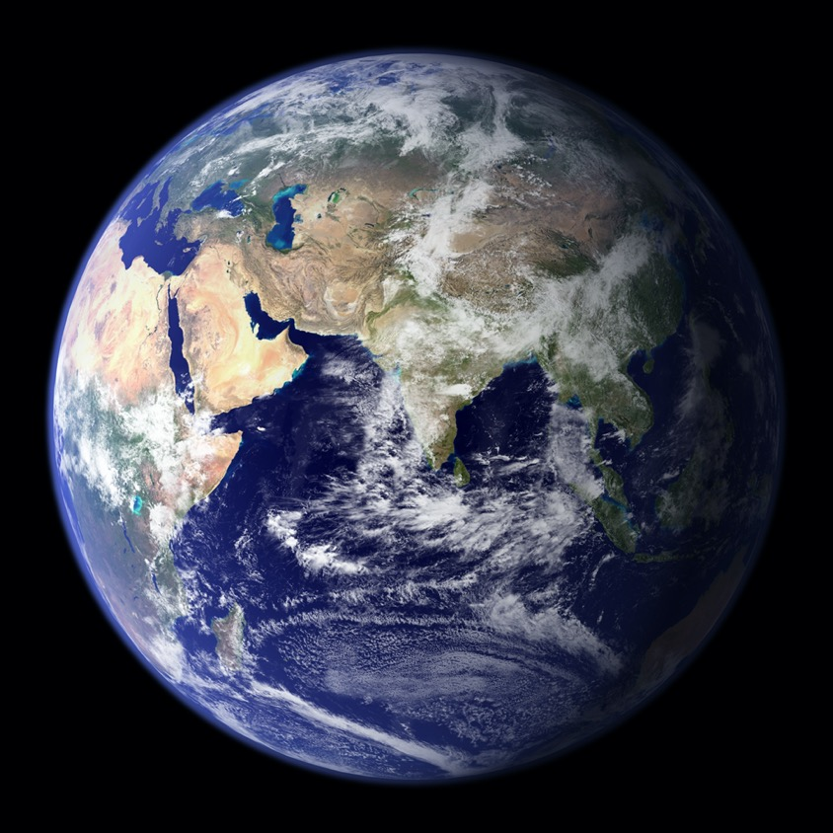
What are the smallest
building blocks
of matter?
Photo: NASA
How, where and when were they created?

Slide 6
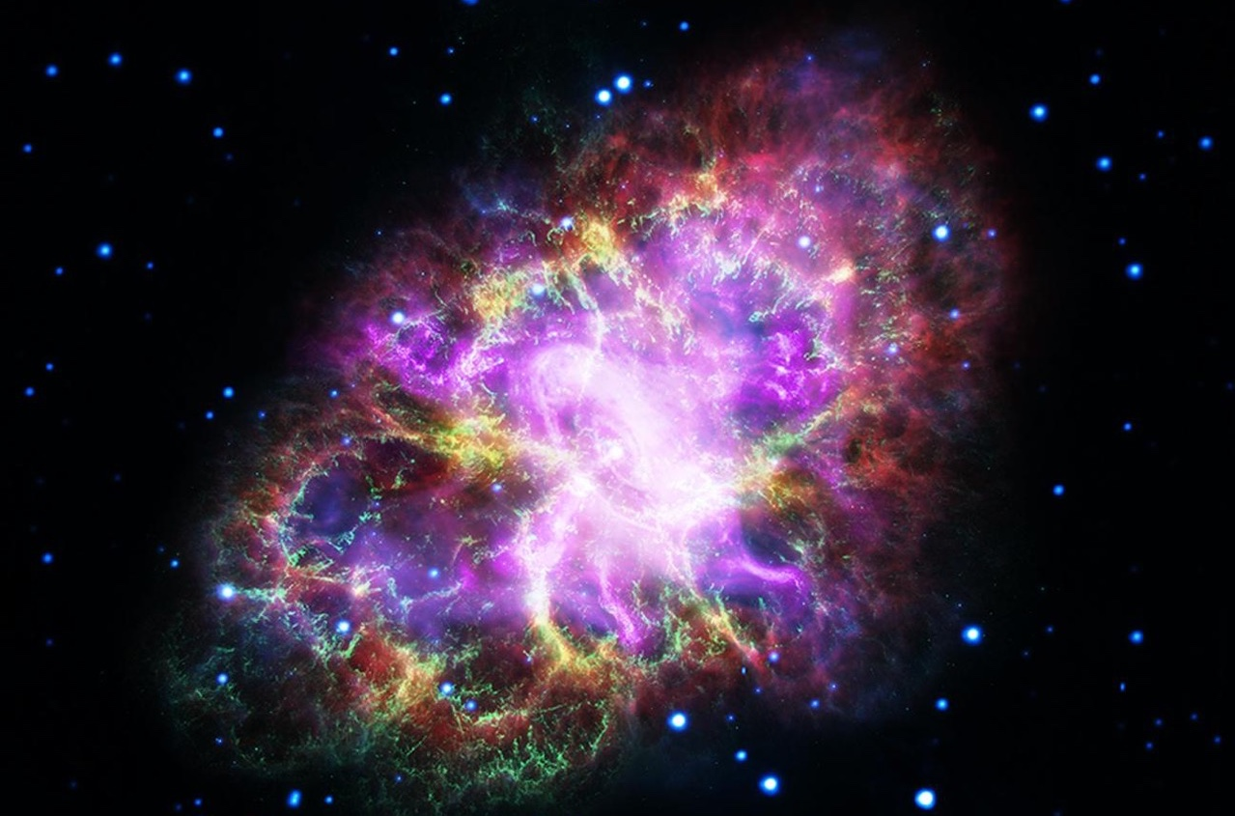
How are chemical elements formed in stellar explosions?
Photo: NASA, ESA, G. Dubner (IAFE, CONICET-University of Buenos Aires) et al.; A. Loll et al.; T. Temim et al.; F. Seward et al.; VLA/NRAO/AUI/NSF; Chandra/CXC; Spitzer/JPL-Caltech; XMM-Newton/ESA; and Hubble/STScI

Slide 7
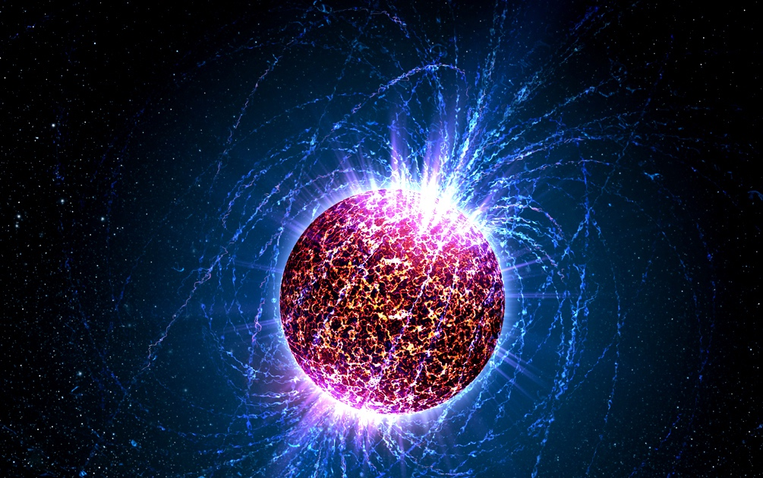
What does matter look like in the most heavy objects of our universe, the neutron stars?
Photo: Penn State University

Slide 8
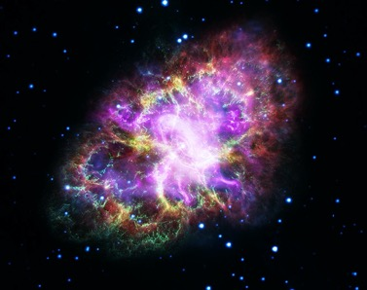
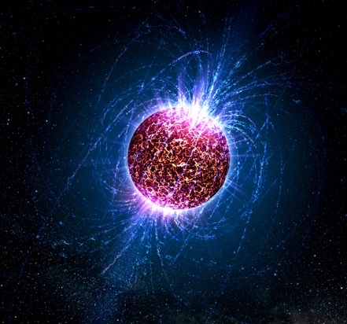
Photo: NASA, ESA, G. Dubner (IAFE, CONICET-University of Buenos Aires) et al.; A. Loll et al.; T. Temim et al.; F. Seward et al.; VLA/NRAO/AUI/NSF; Chandra/CXC; Spitzer/JPL-Caltech; XMM-Newton/ESA; and Hubble/STScI (oben), Penn State University (unten)
Cosmic matter can be produced with particle accelerators in the lab.

Slide 9
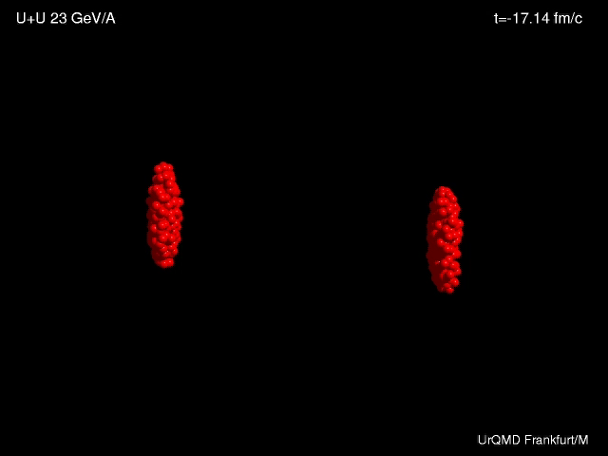
Animation: UrQMDFrankfurt/M

Slide 10
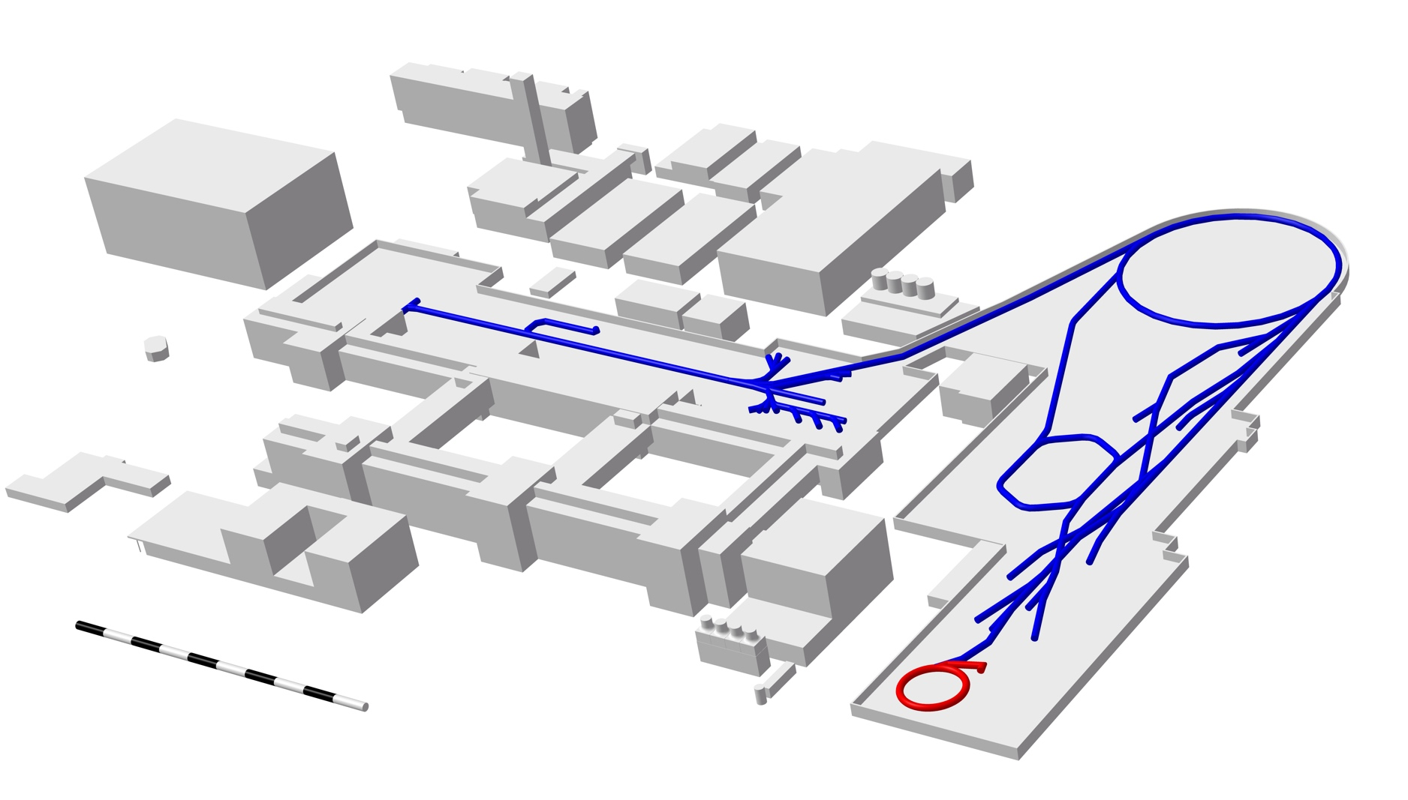
GSI accelerator facility
Graph: GSI/FAIR
Ion sources
all elements
Linear accelerator UNILAC
20% of the speed of light
Ring accelerator SIS18
90% of the speed of light
SIS18
FRS
Fragmentseparator
UNILAC
ESR
Experimental storage ring
Experimental areas
Storage ring CRYRING
100 m

Slide 11
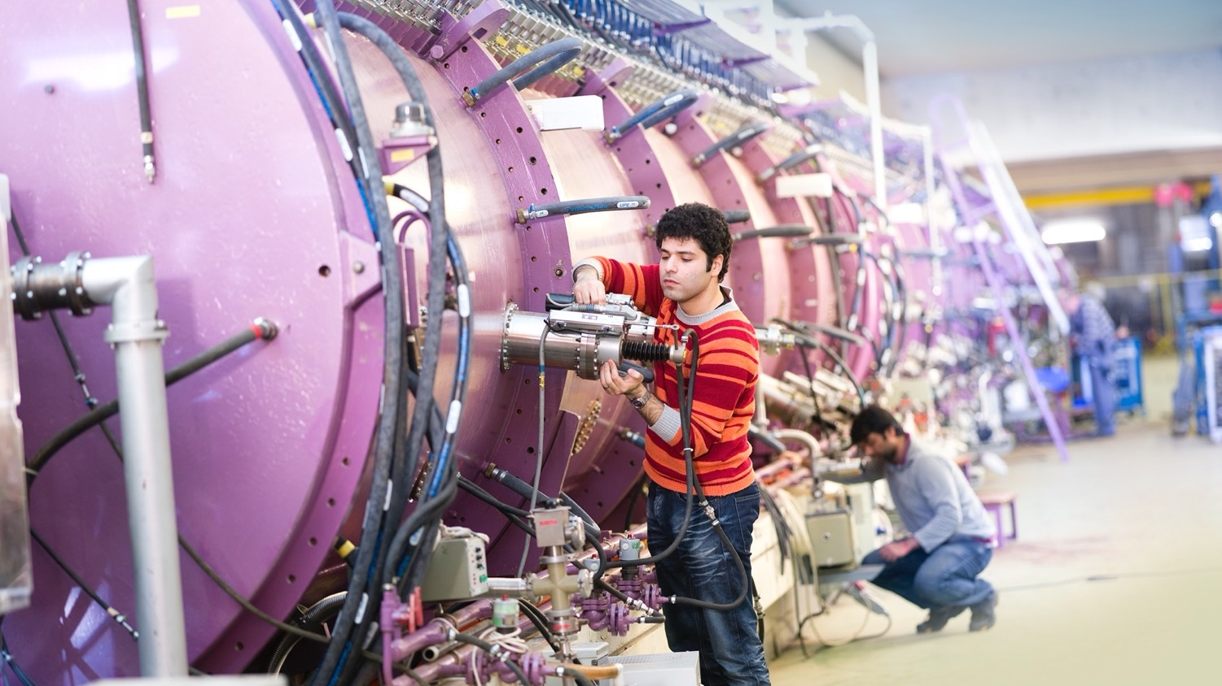
Photo: J. Hosan/HA Hessen Agentur

Slide 12
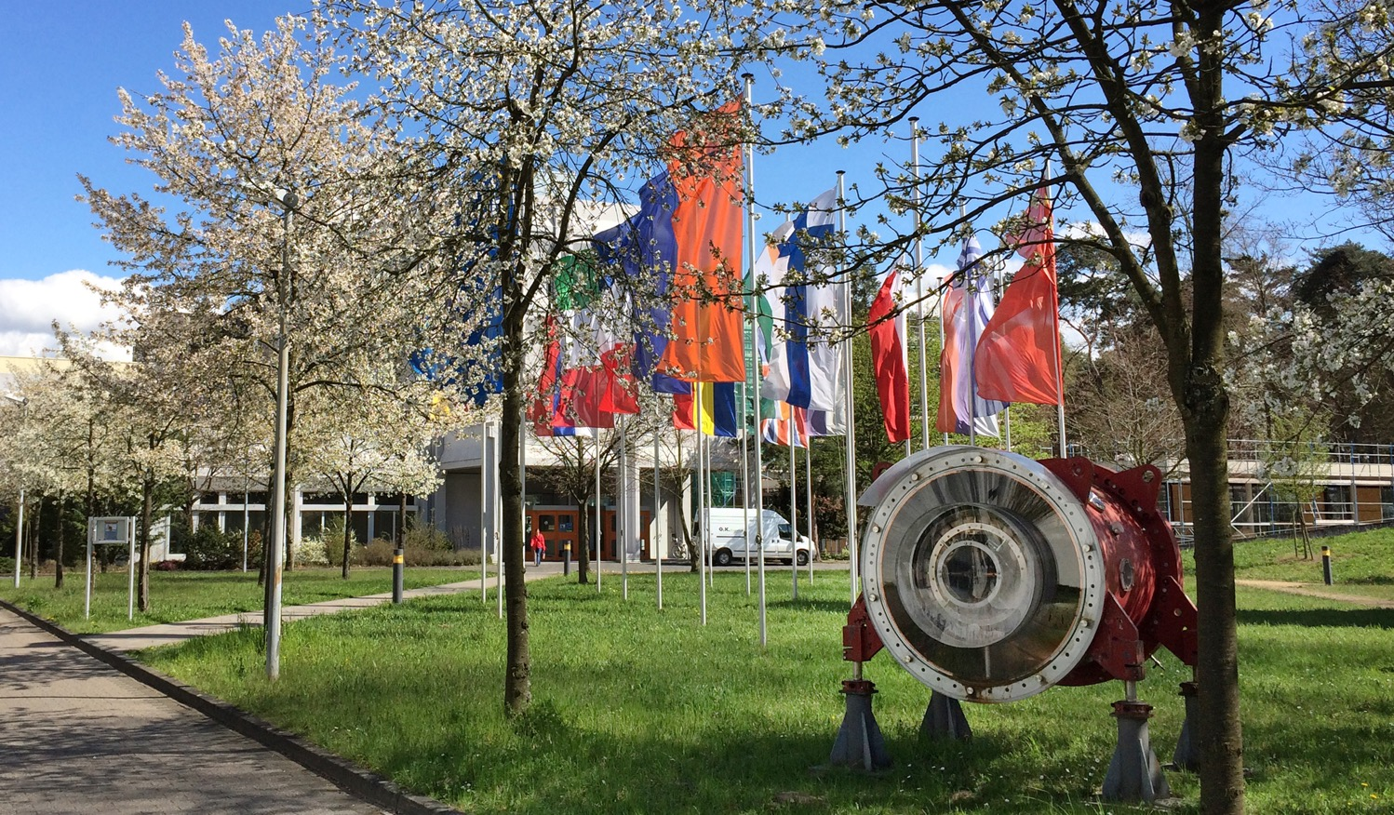
GSI –
Scientific expertise
for more than 50 years
Photo: G. Otto/GSI/FAIR

Slide 13
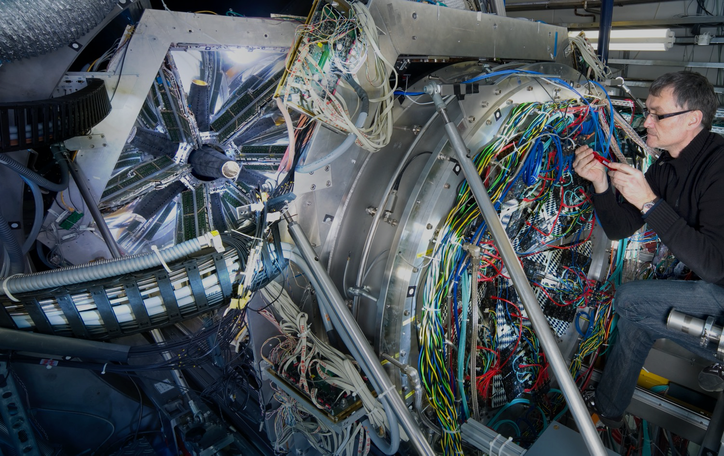
Photo: J. Hosan/HA Hessen Agentur
Research with forefront detector technology

Slide 14
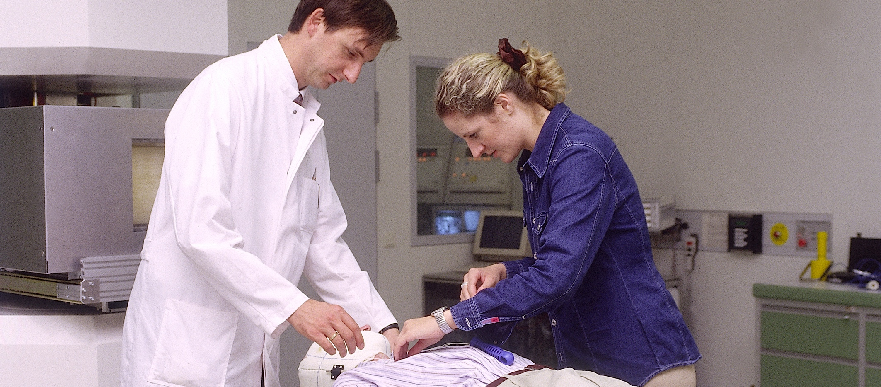
Cancer therapy with heavy ions
Photo: A. Zschau/GSI
Precise, gentle and very successful
Treatment of 440 patients at GSI
By now established and in clinical operation, among others in Heidelberg and Marburg
At GSI: Research and further development

Slide 15
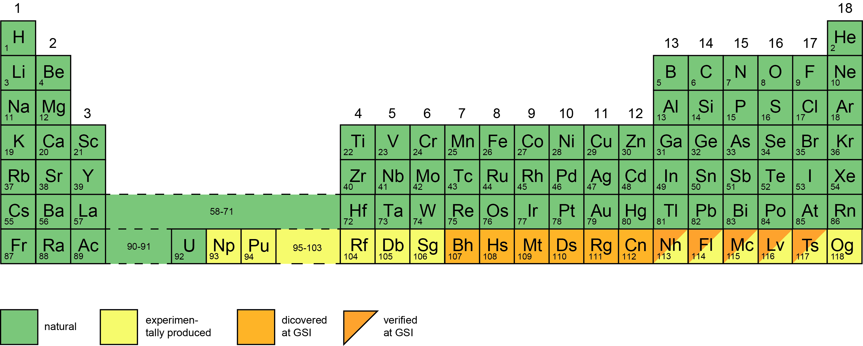
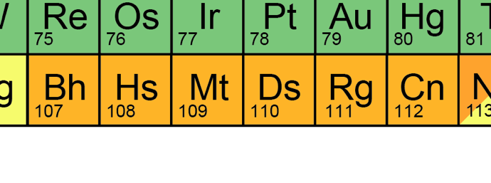
Discovery of new elements
Graph: GSI/FAIR
Bohrium
Hassium
Meitnerium
Darmstadtium
Roentgenium
Copernicium

Slide 16
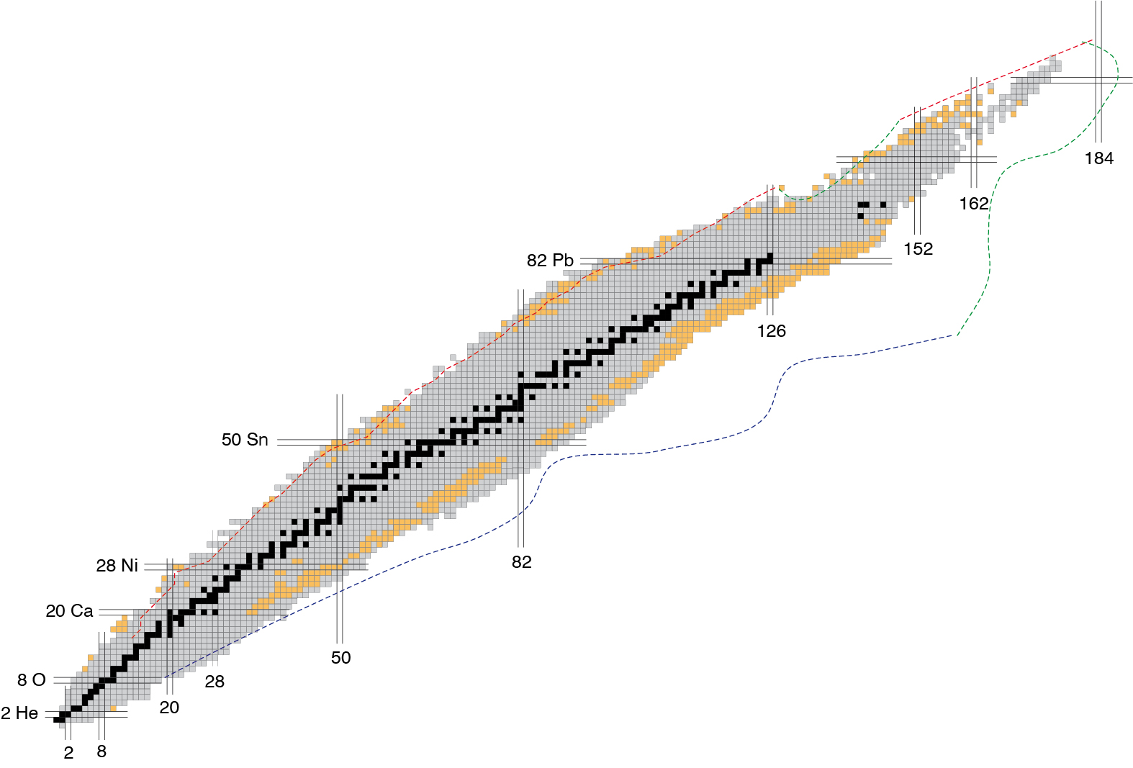
Discovery of new atomic nuclei
445 atomic nuclei have been discovered at GSI/FAIR
Number of protons
discovered at GSI/FAIR
stable nuclei
known nuclei
Number of neutrons

Slide 17
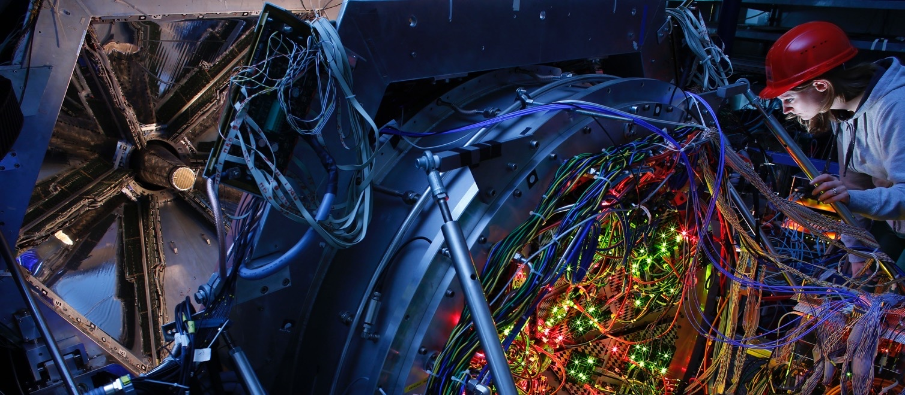
FAIR – Facility for Antiproton and Ion Research
Photo: T. Ernsting/HA Hessen Agentur
A world-wide unique particle accelerator
Exotic forms of matter occurring in the universe can be produced and investigated in the laboratory
Basic research and the development of applications
for materials research, radiobiology, space travel, etc.
Collaboration between several teams of internationally leading researchers (more than 3,000 scientists)

Slide 18
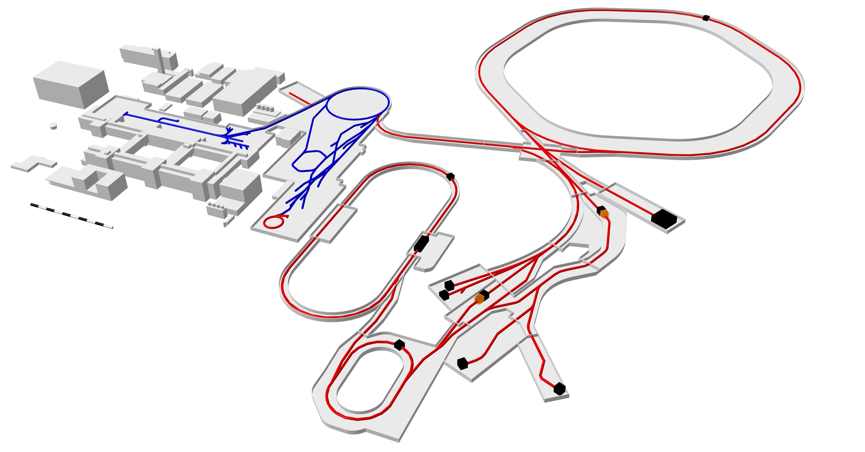
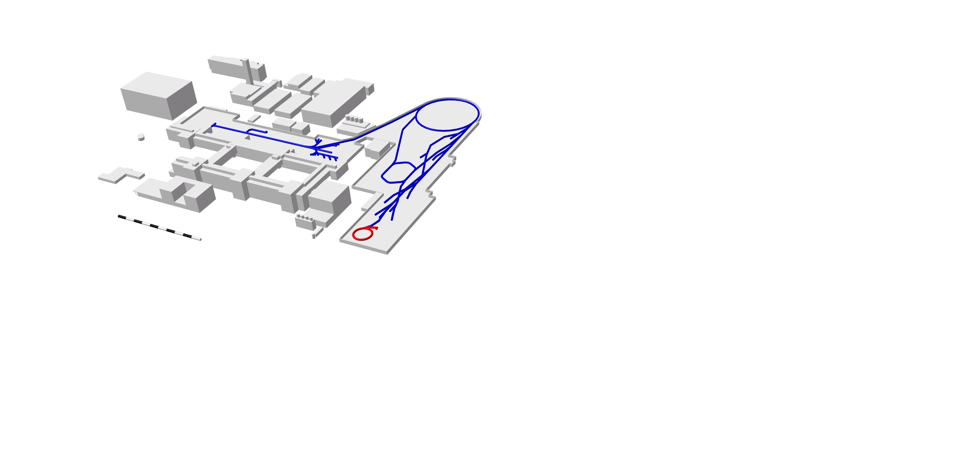
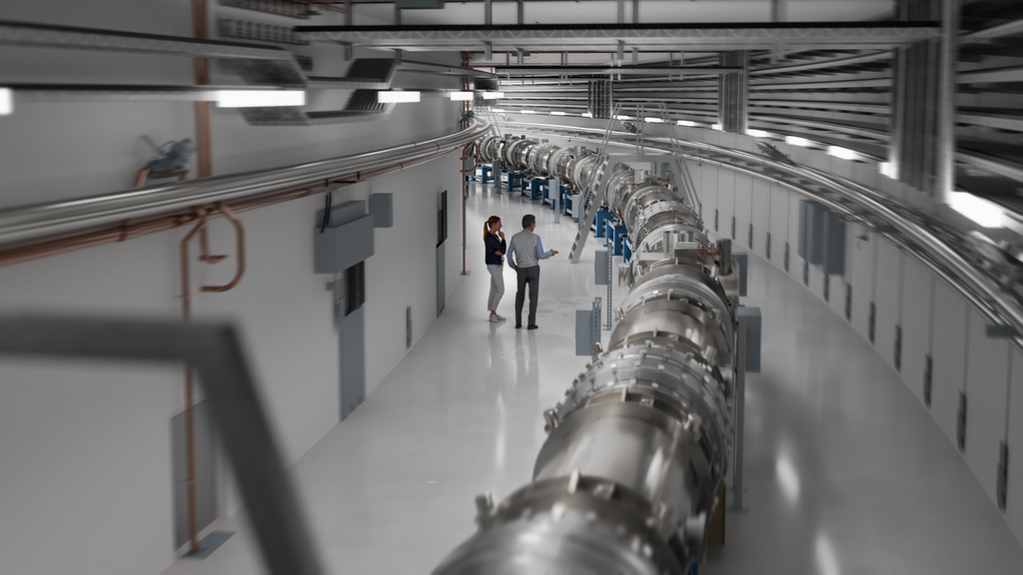
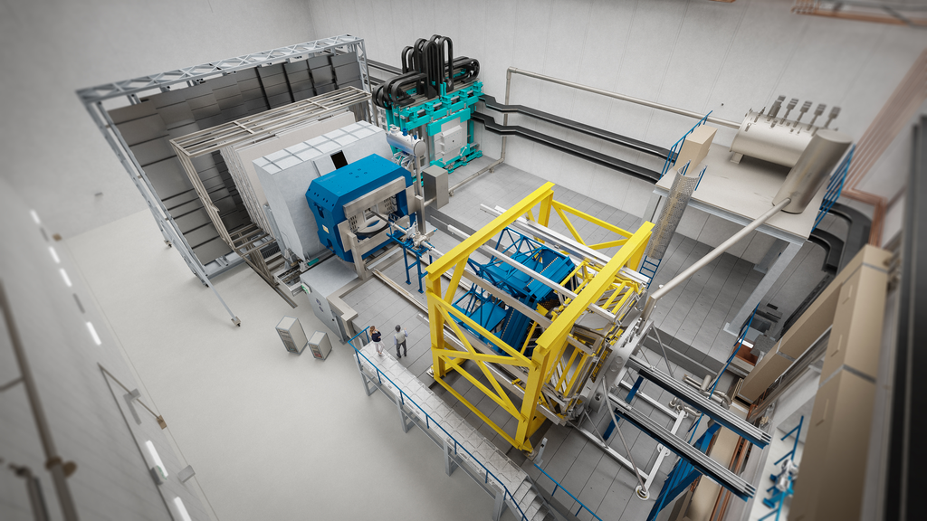
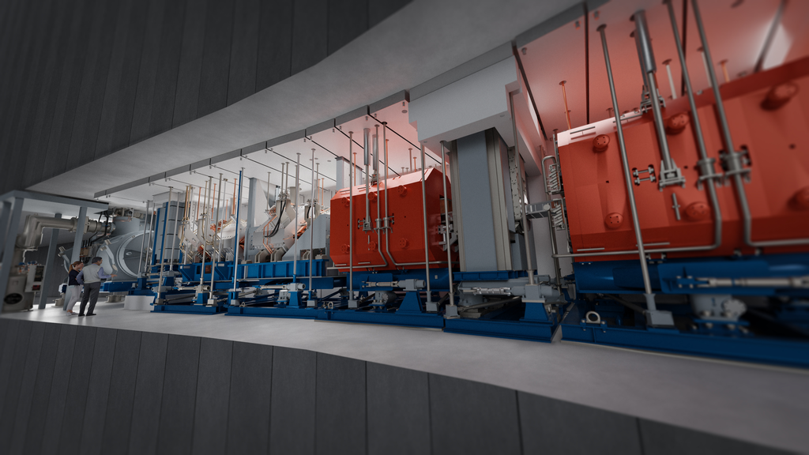
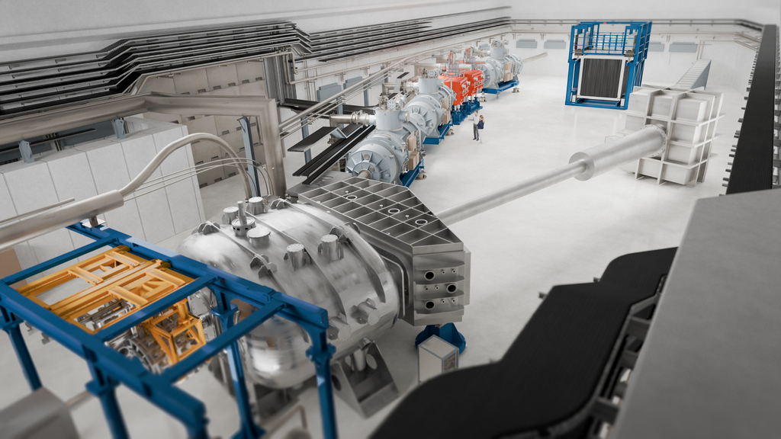
FAIR MSV 0-3 - Early and First Science
Graph: GSI/FAIR
Ring accelerator SIS100
SIS100
CBM
High Energy Storage Ring HESR
Super-FRS
NUSTAR
Existing facility
Planned facility
Experimental setups

Slide 19
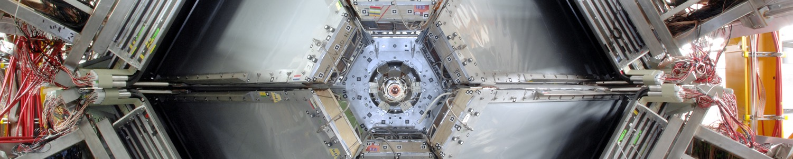
FAIR will accelerate particles
with unprecedented…
Photo: G. Otto/GSI/FAIR
intensity
output
Up to 10,000 times more particles
Up to 100 times more Watts
quality
versatility
Precision
All chemical elements/ions
and antiprotons

Slide 20
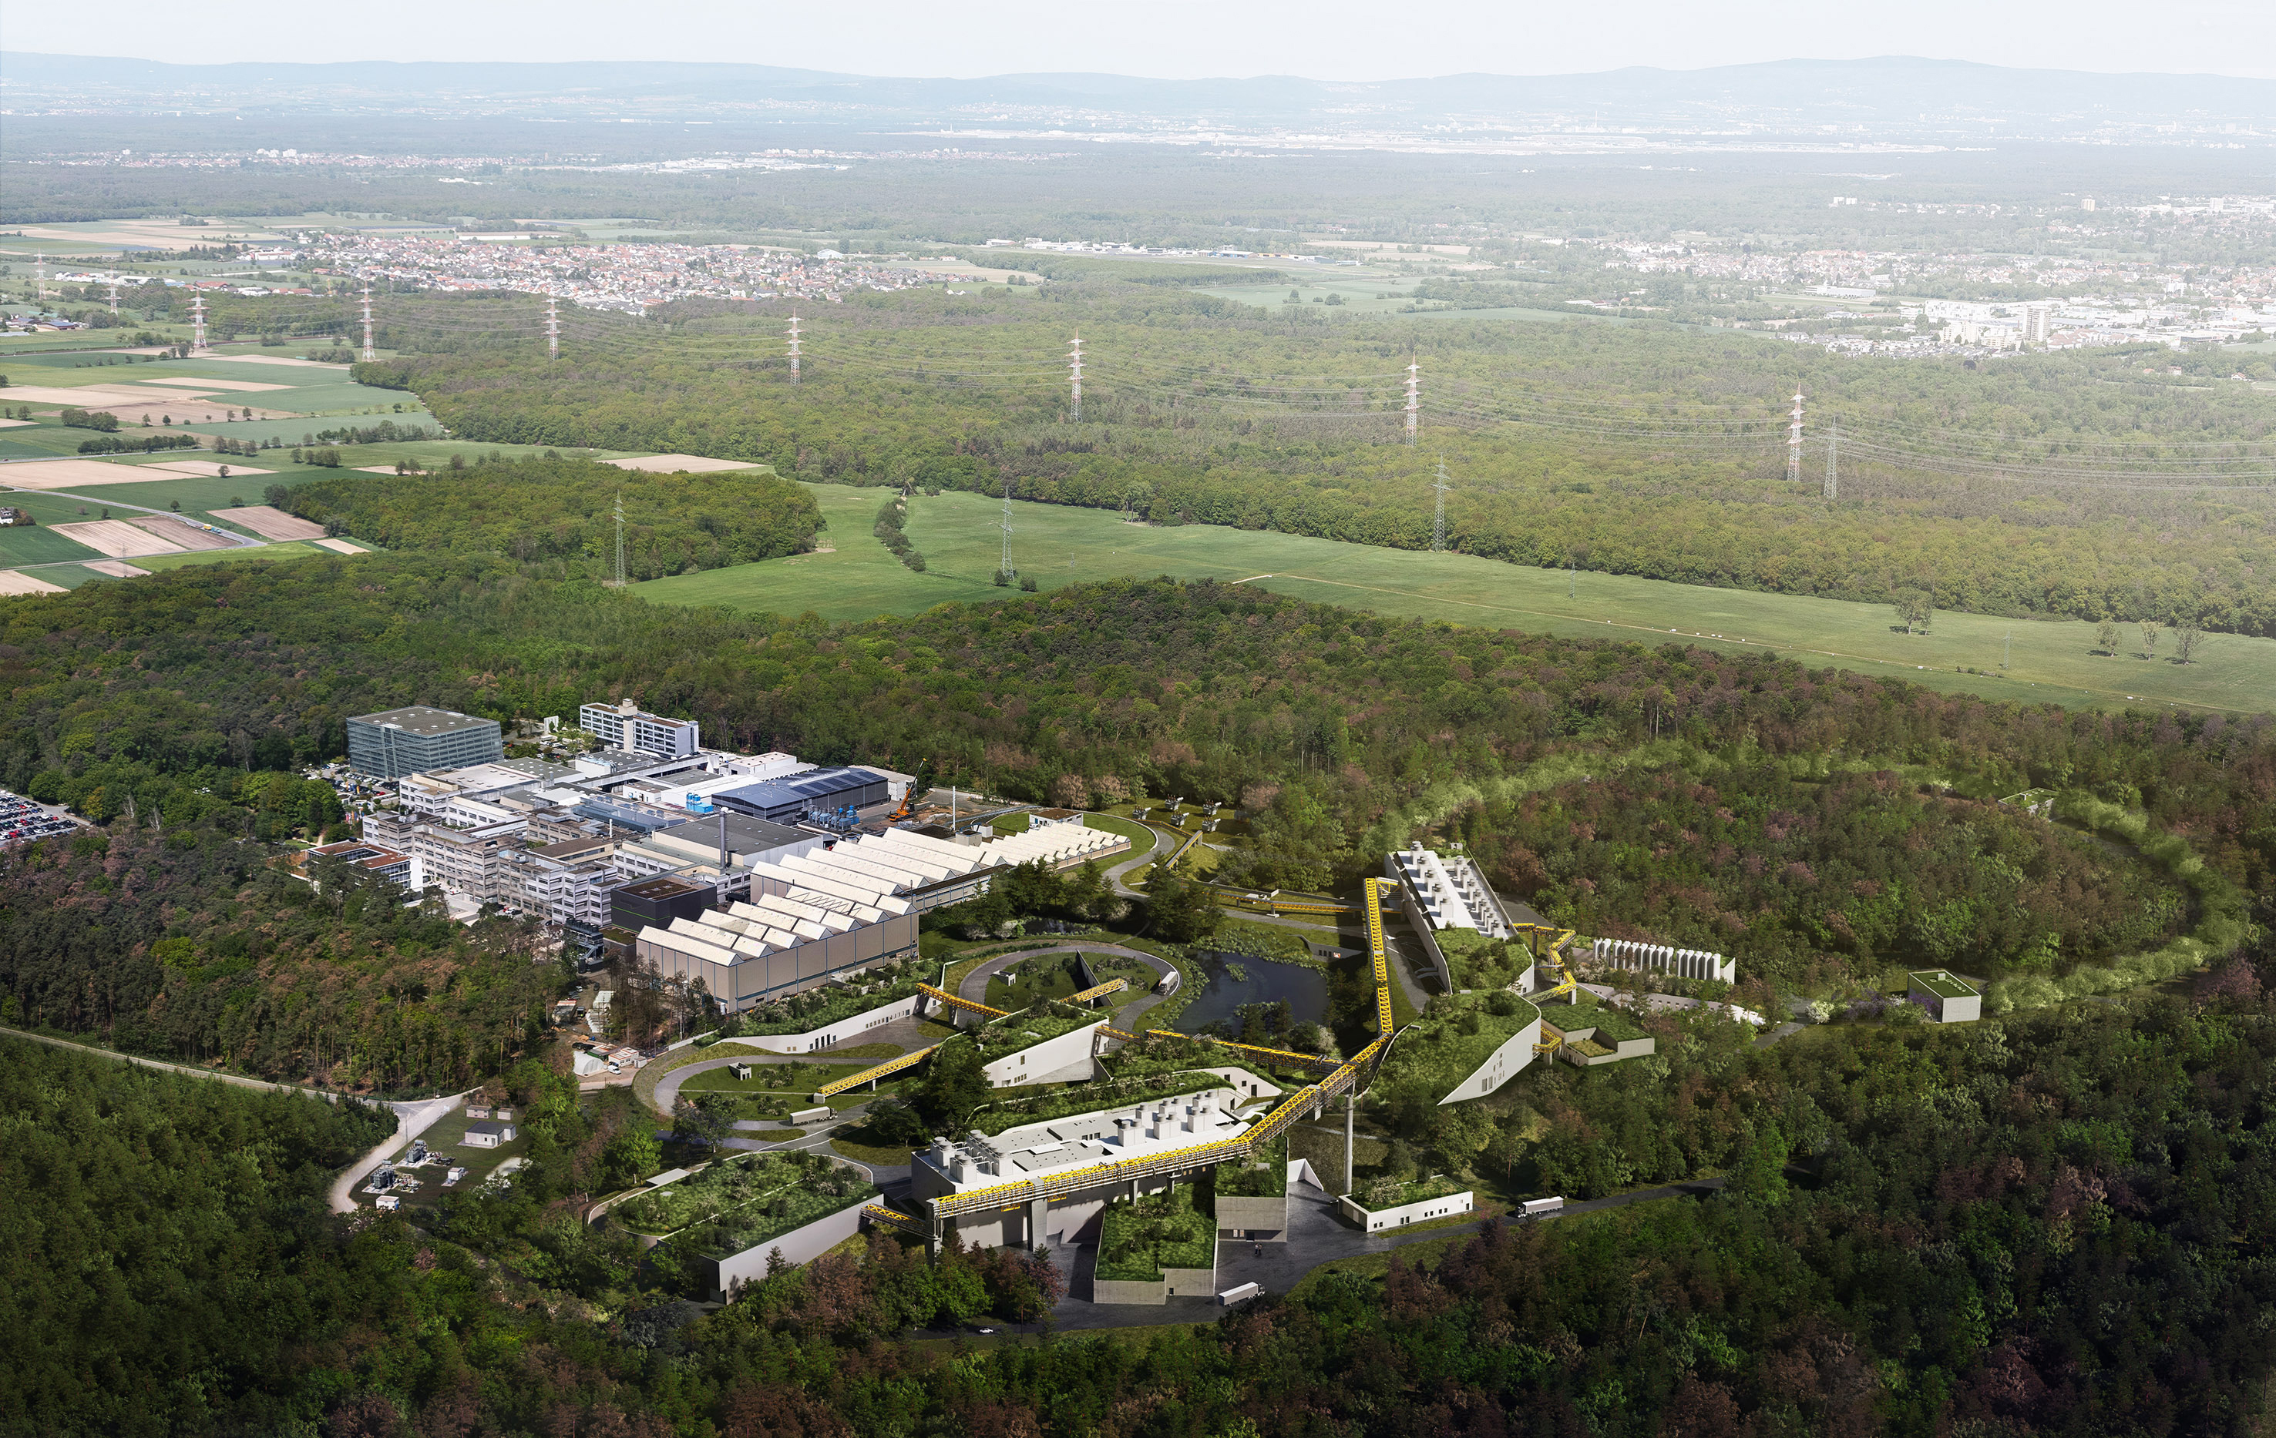
FAIR
Picture: ion42, D. Fehrenz, GSI/FAIR
World-leading accelerator laboratory for decades
Unique research in physics and applications
Milestone in the European research roadmap (ESFRI)
Top priority in the European nuclear physics community

Slide 21
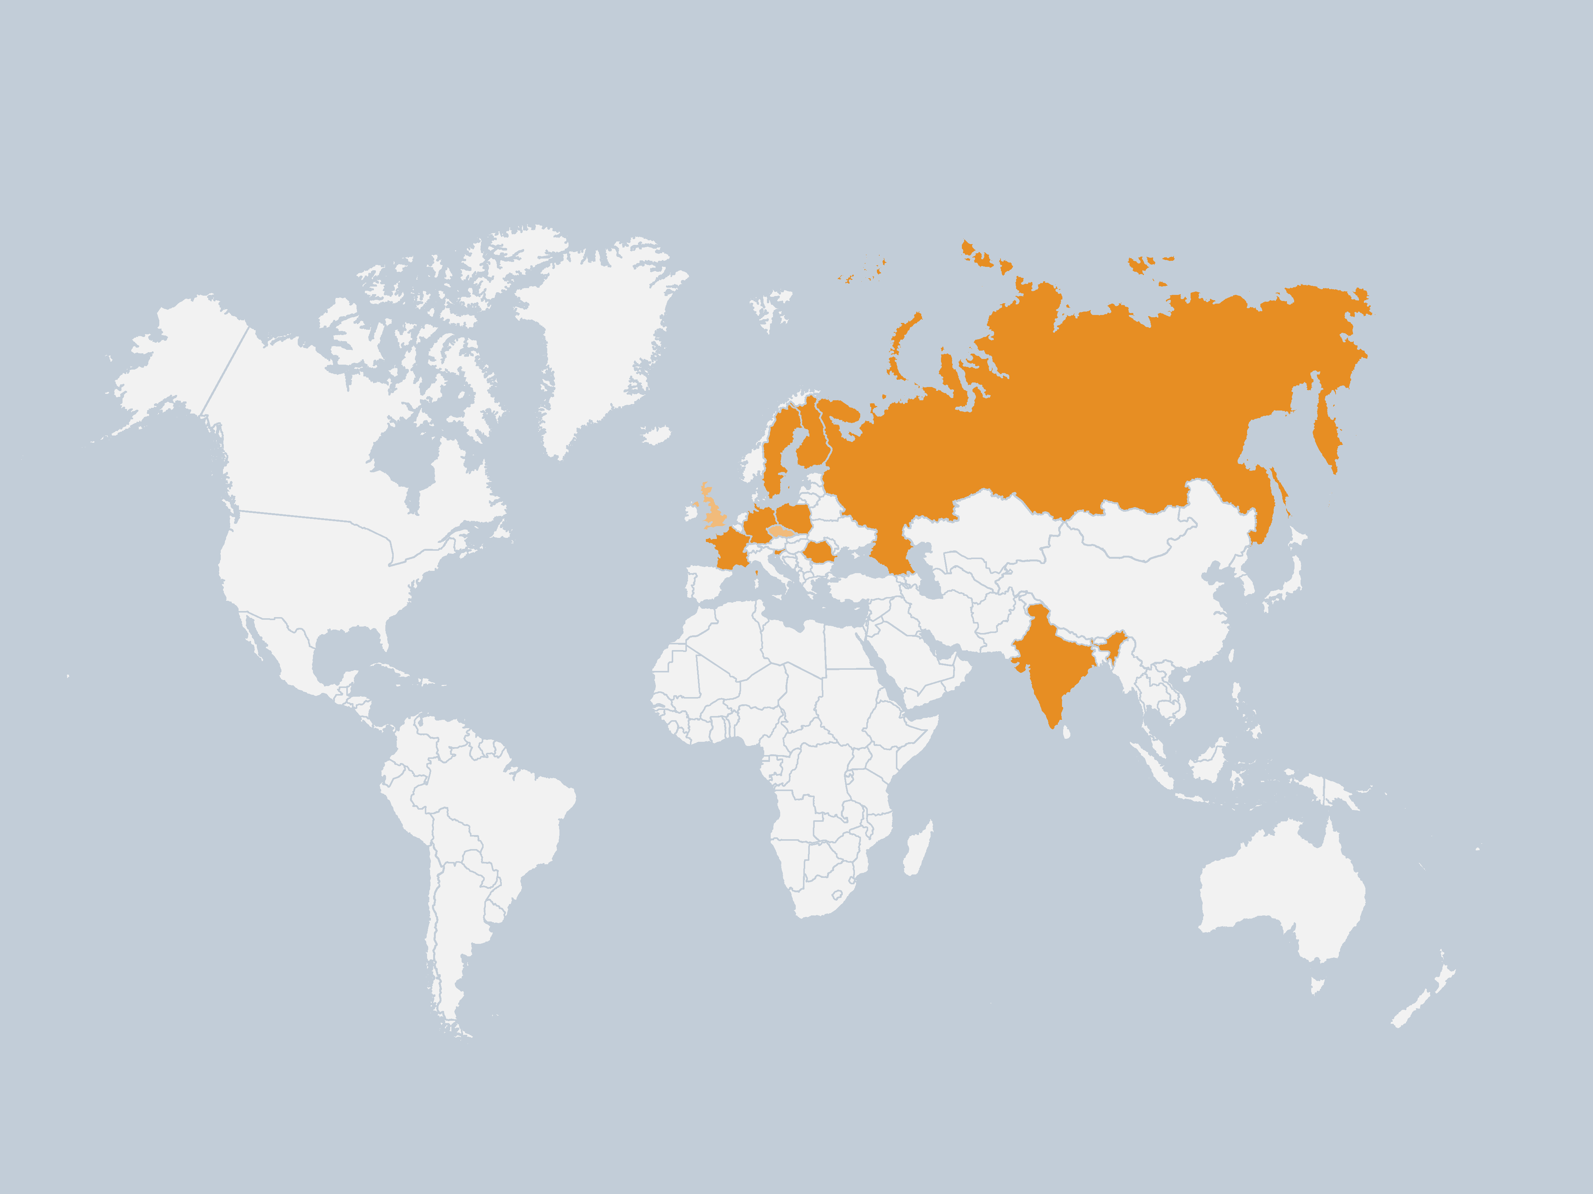
Shareholders worldwide
Graph: GSI/FAIR
Shareholders
Finland
France
Germany
India
Poland
Romania
Russia
Sweden
Slowenia
Associated
United Kingdom
Aspirant
Czech Republic

Slide 22
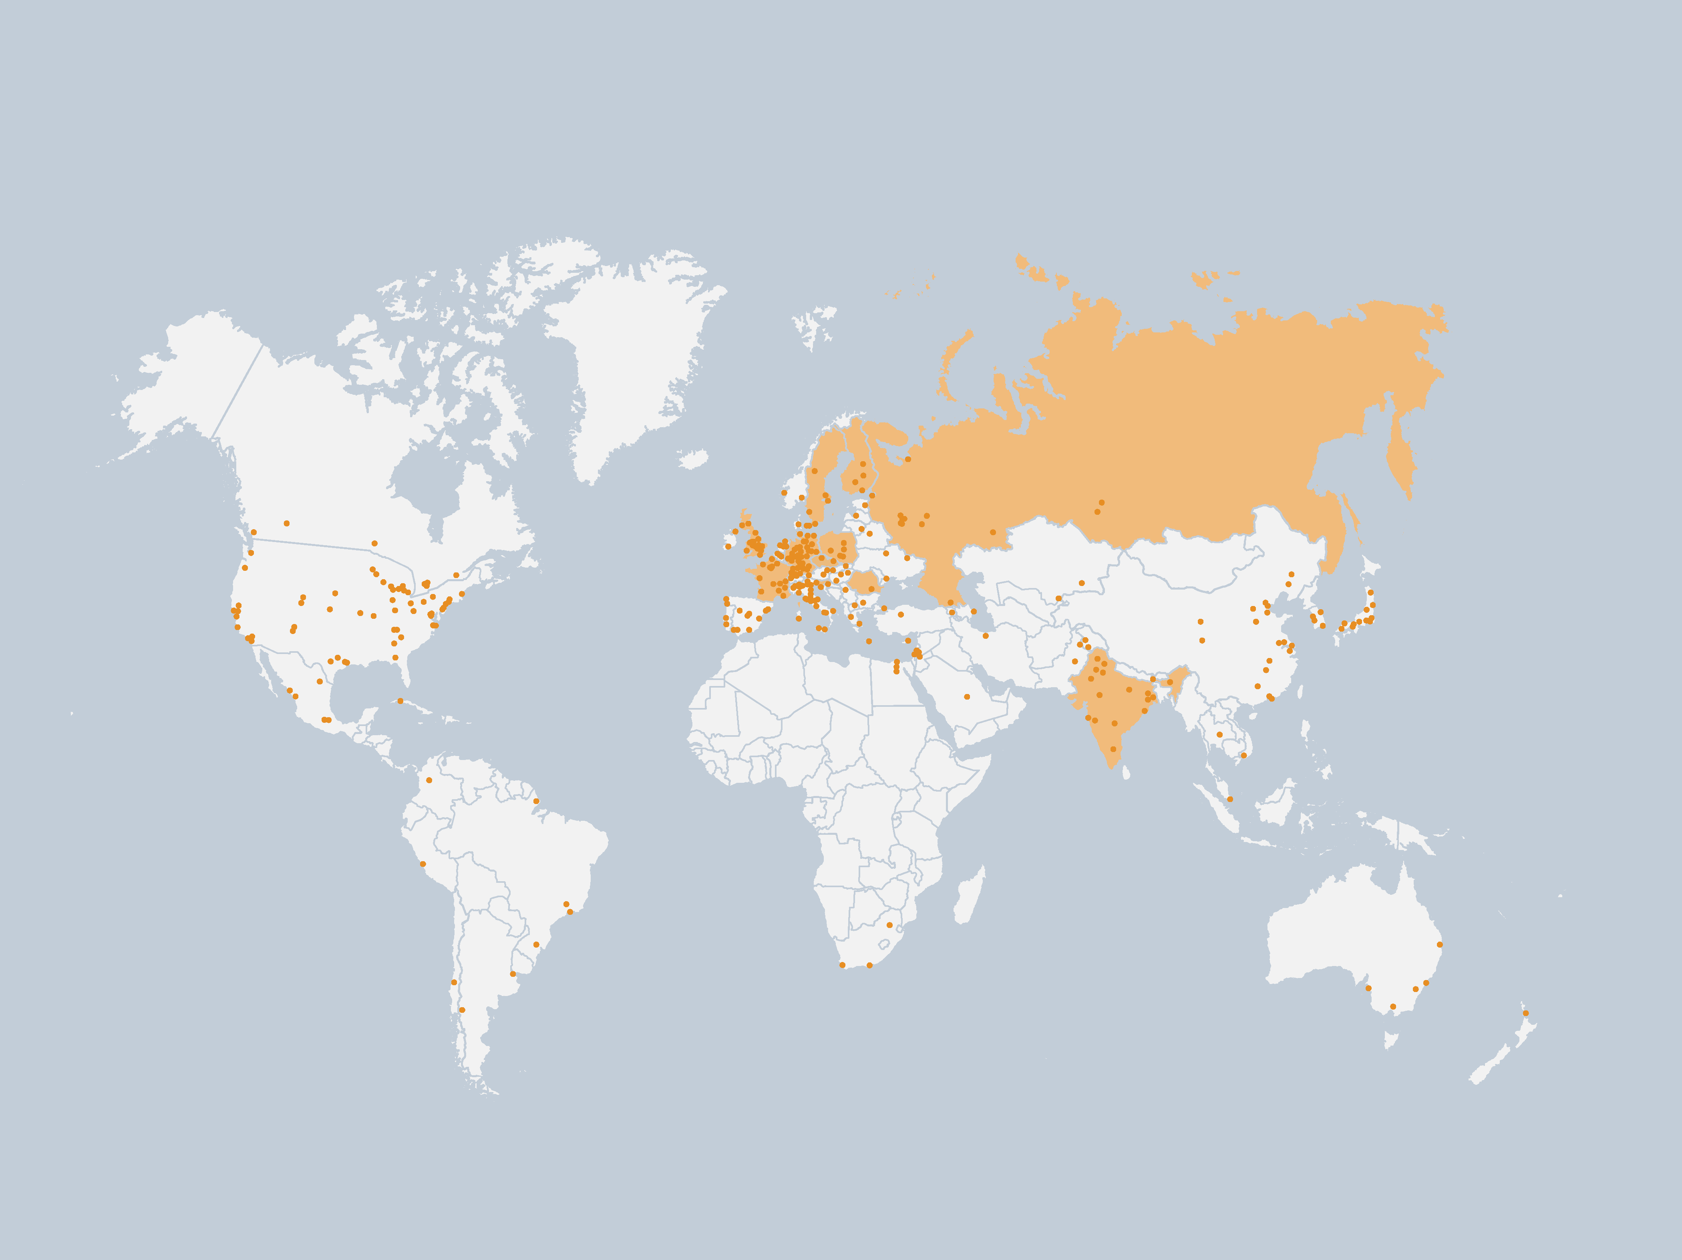
Scientific partners worldwide
Graph: GSI/FAIR
Locations
of scientific partners

Slide 23
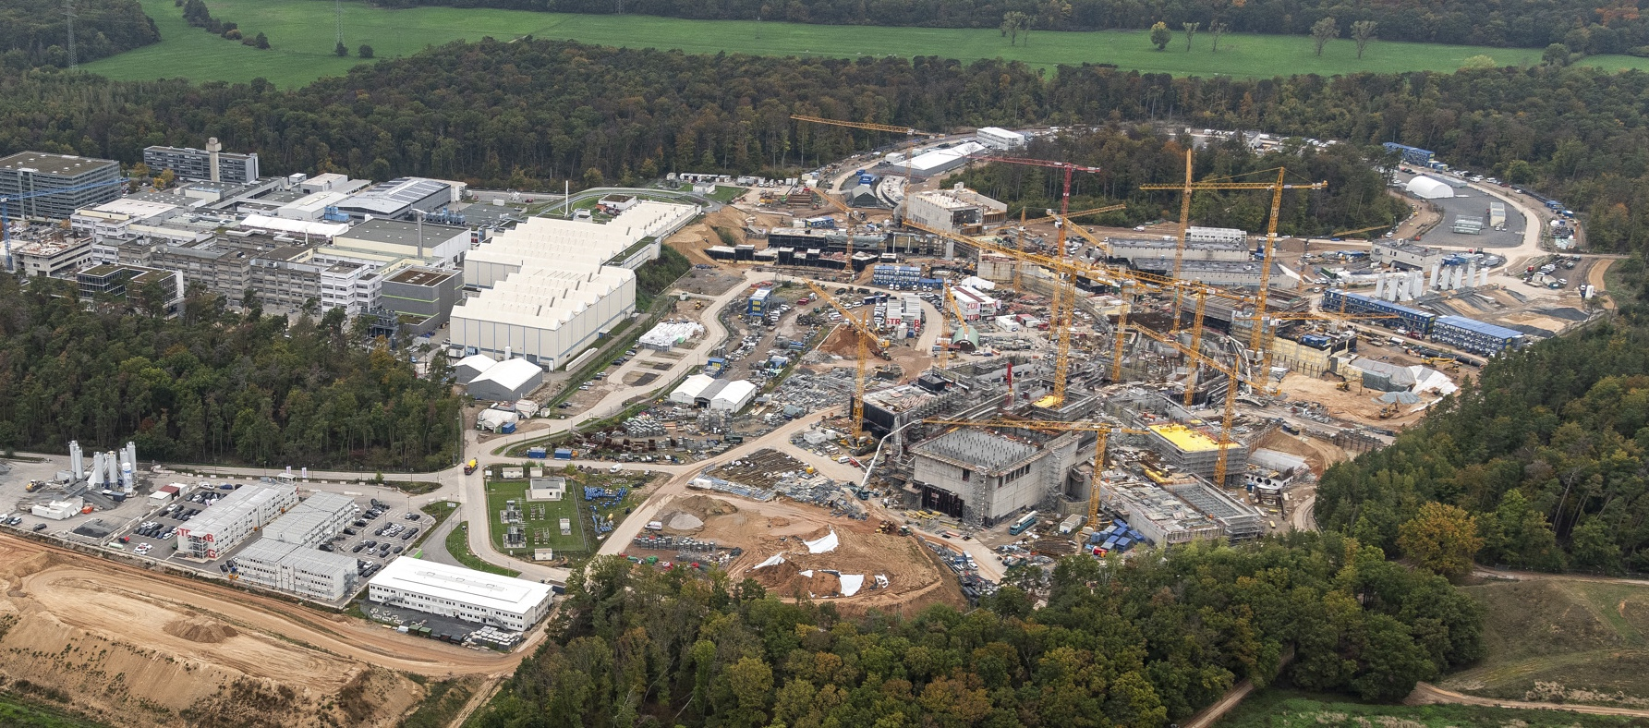
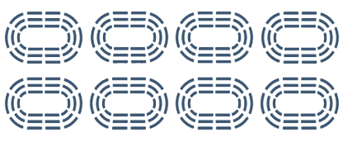

FAIR — Construction volumes
2 milion m³
600,000 m³
65,000 t
of earth
of concrete
of steel
to be moved
to be used
to be utilized
Status August 2023 : shell construction almost completed
  As much as for 5,000 single-family homes.
  As much as eight Frankfurt football stadiums.
  As much as nine Eiffel Towers.

Slide 24
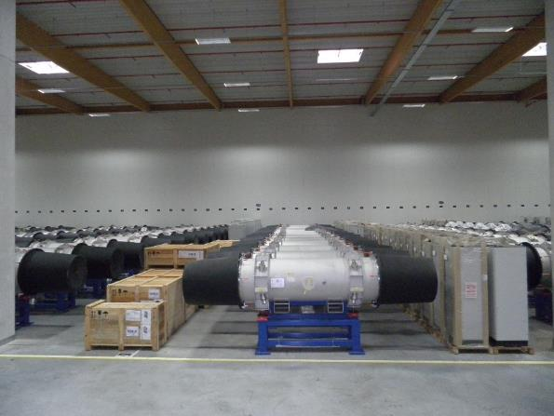
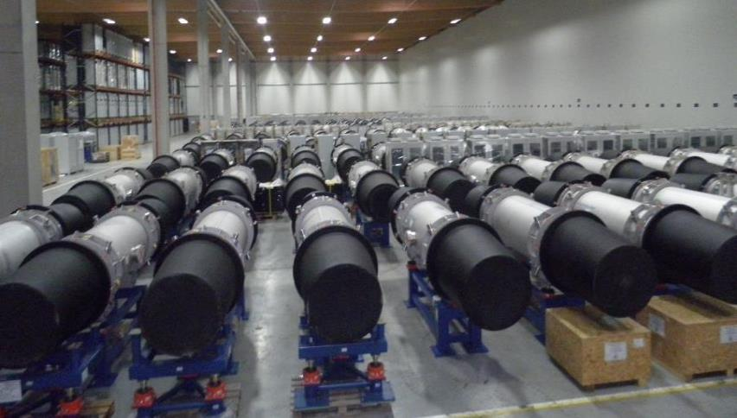
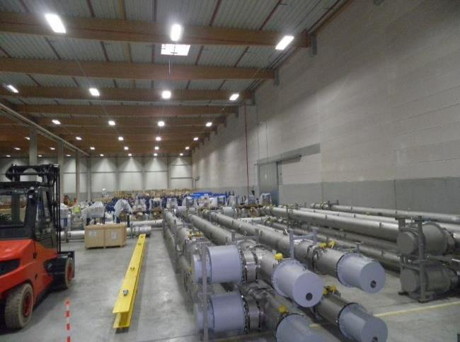
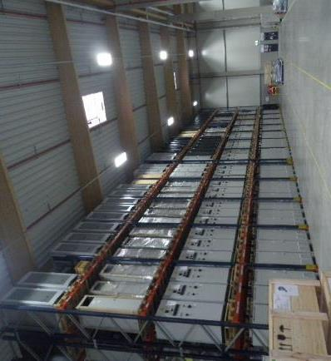
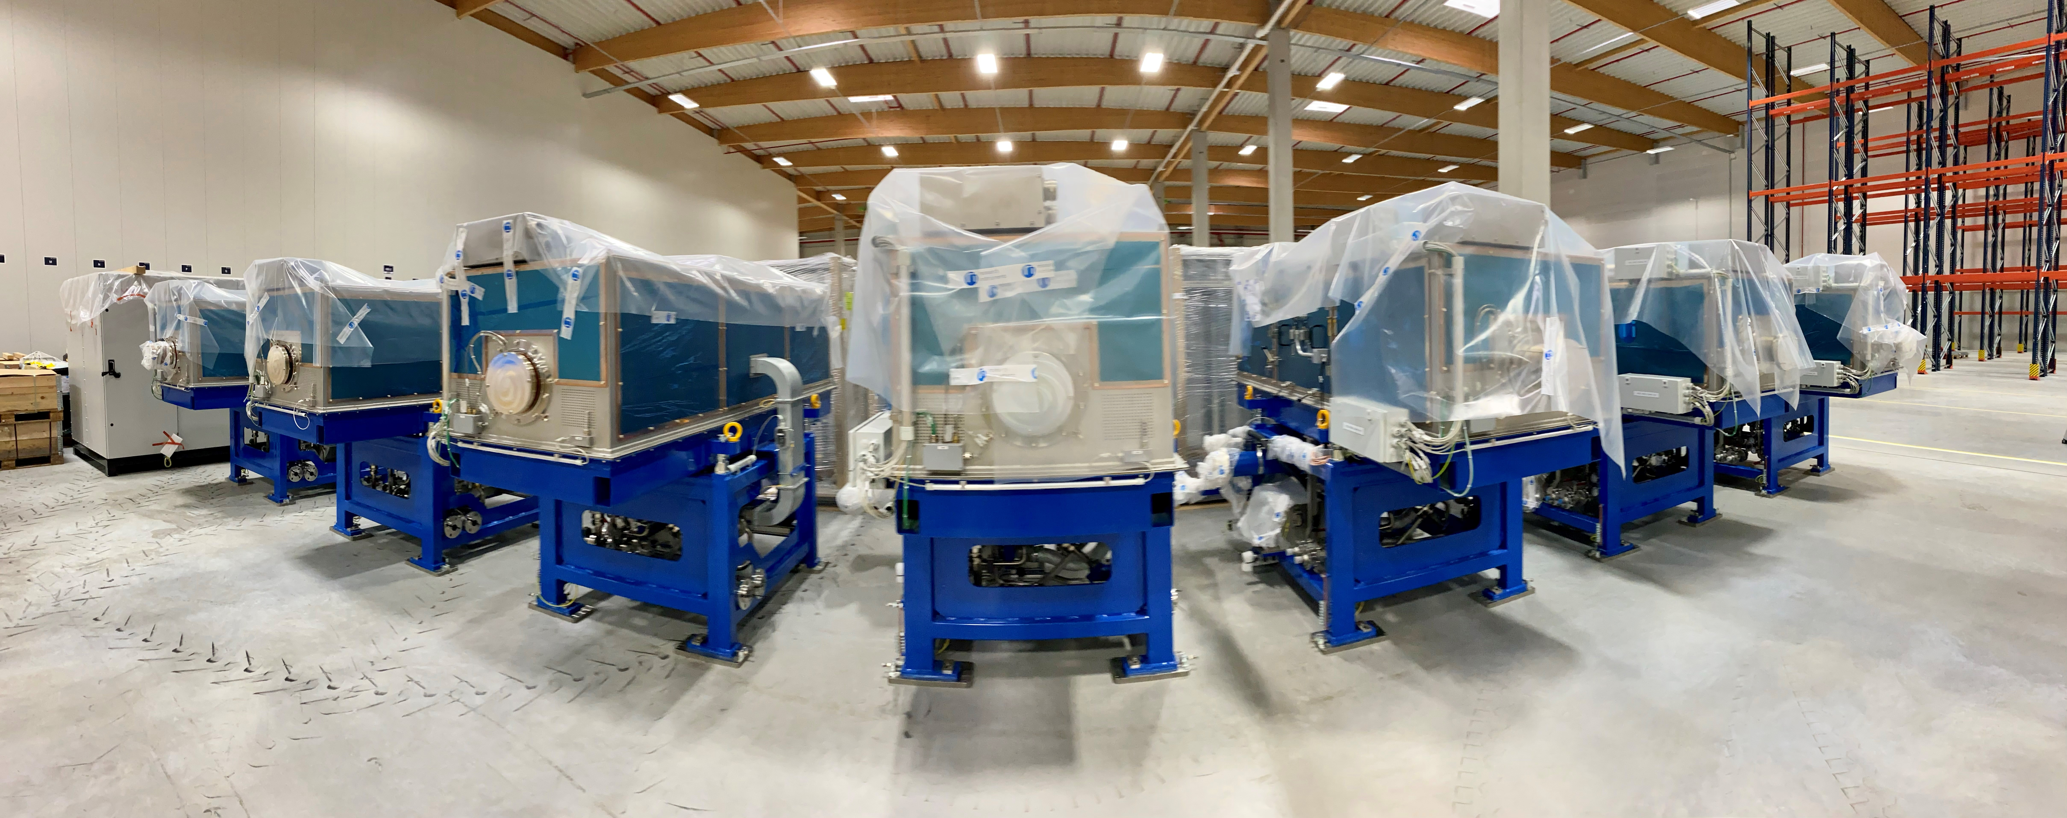
FAIR Highlights - Storage Area Weiterstadt
  Completed and delivered high-tech components for accelerator and experiments
Storage area: approx. 9.900 m²
4.195 objects (Components, assemblies, boxes, etc.)
50% of SIS100 components stored
90% of HESR components stored
9

Slide 25
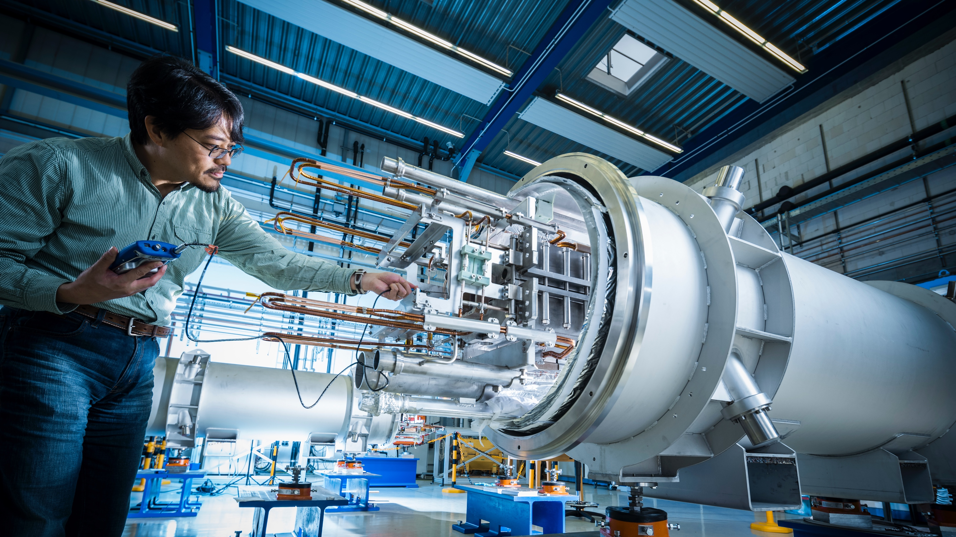
Photo: J. Hosan, GSI/FAIR
FAIR develops and uses
innovative measurement
methods and techniques.

Slide 26
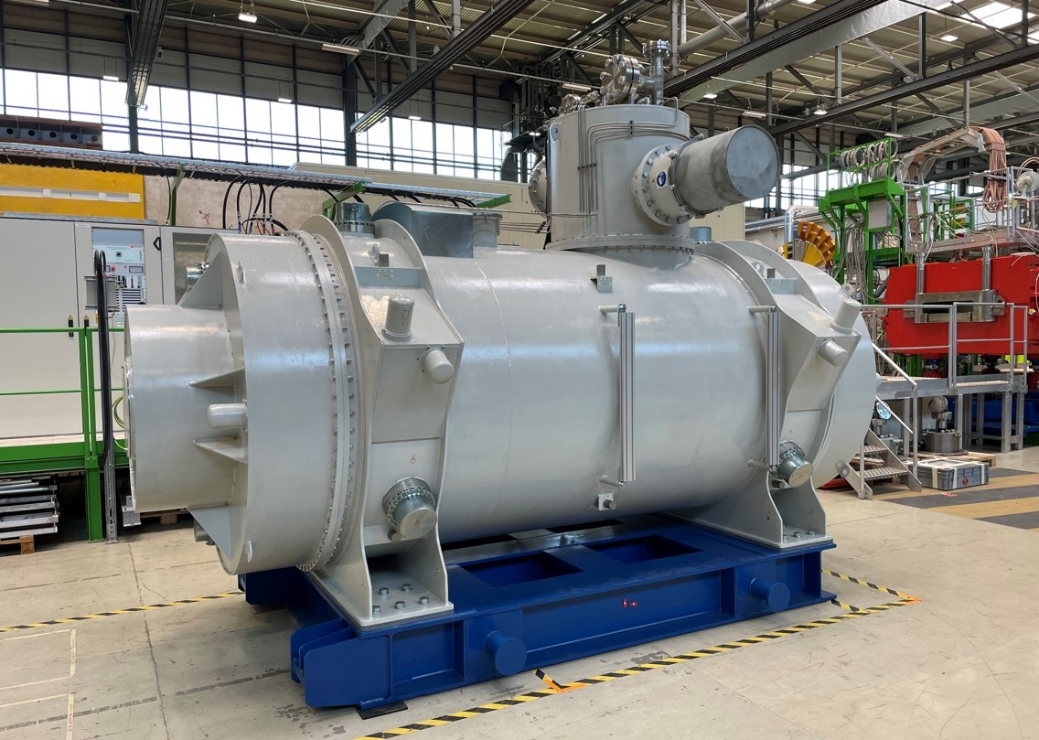
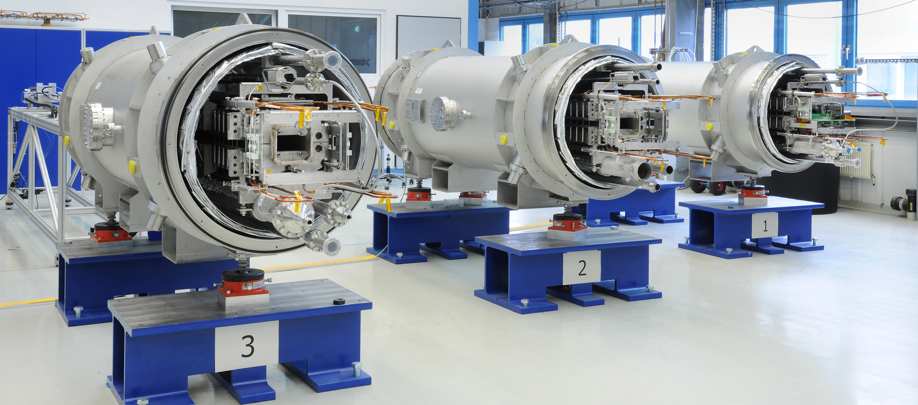
Hightech for FAIR
Photo: G. Otto, GSI/FAIR
Superconducting magnets: for strong and rapidly changing magnetic fields with maximum field precision
Sophisticated cryotechnology: Use of liquid helium to cool down to 4 Kelvin
(-269°C)
Ultra-high vacuum: 10¹⁵ times below the earth’s air pressure
Development and construction of cryo-collimators with special coatings

Slide 27
Picture: ion42, D. Fehrenz, GSI/FAIR
  Thank you for
  your attention!

Slide 28






Stay in touch with us!
Facebook:
@GSIHelmholtzzentrum
@FAIRAccelerator
Instagram:
@universeinthelab
Twitter:
@FAIR_GSI_de
@FAIR_GSI_en
Mastodon:
@FAIR_GSI_de
@helmholtz.social
LinkedIn:
GSI Helmholtz Centre
for Heavy Ion Research
YouTube:
FAIR GSI – The Universe
in the Lab

