Slide 1

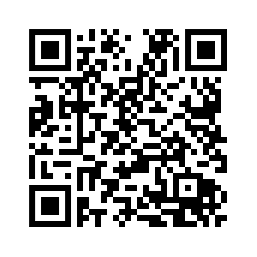
gr-pdw
An OOT Module for Pulse Descriptor Word (PDW) Generation
Presenter: James ‘Trip’ Humphries
trip.humphries@gtri.gatech.edu
James Landreth, Stan Sutphin, Brian Mulvaney
GRCon 2024

Slide 2
OUR MISSION
As a University Affiliated Research Center (UARC), the Georgia Tech Research Institute (GTRI) is the nonprofit, applied research unit of the Georgia Institute of Technology (Georgia Tech). GTRI leverages the science and engineering base of Georgia Tech to enhance the impact of our collective research output. Collaboratively, we advance technology and provide innovative solutions to:
Enhance economic impact for the State of Georgia
Serve national security
Improve the human condition
Educate future technology leaders
Notes:
Serve National Security
Our service to national security will continue to be the engine of GTRI. We excel at solving our sponsors’ problems and now wish to leverage that spirit and expertise to help our sponsors think through their challenges and identify the most significant problems to be solved. Our strategic plan aims at expanding our national thought leadership impact through presence, participation, and partnership with our sponsors.
Enhance Economic Impact for the State of Georgia
Our strategic plan identifies paths to be recognized as a valuable, unique enabler to the state. We will dedicate ourselves to being a partner and thought leader integral to making Georgia the East Coast’s innovation hub. The focus of our strategy will be to constantly increase our impact to, not increase revenue from, the State of Georgia. Our national security mission work has enabled GTRI to develop a wide array of core capabilities and expertise that can be pivoted to support economic impact in the State of Georgia. Our strategy will focus on enabling that pivot.
Improve the Human Condition
Our mission extends beyond the State of Georgia; it challenges us to look beyond borders and apply our skillsets to improve everyone’s lives. The United Nations’ 17 Sustainable Development Goals are a guidepost for this mission. The strategic plan will lay the groundwork for us to explore how our core capabilities, combined with those of Georgia Tech and external partners, can catapult us into leadership roles in addressing the critical issues impacting the human condition.
Educate Future Technology Leaders
This plan emphasizes exposing future leaders to an environment where curiosity, diversity, and inclusive innovation are celebrated. We will focus on expanding the current efforts around STEM outreach and student hiring to include historically black colleges and universities (HBCUs), minority-serving institutions (MSI), and visiting students. The diverse base of our students will lead to innovative solutions and will build upon our growing base of exceptional talent.

Slide 3
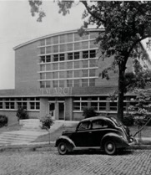
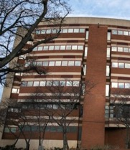
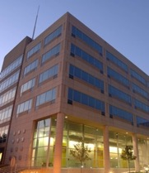
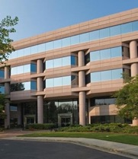
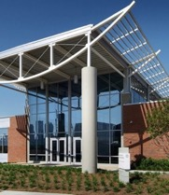
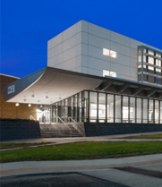
History of Service to the State and Nation
1946 – The name “Georgia Tech Research Institute” is given to a non-profit corporation created to handle EES contract and patent issues.
1973 – The Agricultural Technology Research Program is established to support Georgia’s economically important poultry industry.
1984 – EES celebrates its 50th Anniversary by, among other things, changing its name to the Georgia Tech Research Institute (GTRI).
1930s
1940s
1950s
1960s
1970s
1980s
1990s
2000s
FY23 – $941M in Research Awards
& 2,966 Workforce
1952 – EES personnel help found Scientific Atlanta, later renowned for its satellite Earth stations and cable TV equipment.
1979 – The Huntsville Research Laboratory begins operations, giving EES a presence
at Redstone Arsenal that continues to this day.
1995 – GTRI is designated a University Affiliated Research Center (UARC) by the Director of Defense Research and Engineering (DDR&E), Office of the Secretary of Defense (OSD).
1940 – Federal funding linked to World War II begins bringing in more projects, including work in wind-tunnel testing and communications technology.
1934 – The State Engineering Experiment Station (EES) opens in Georgia Tech’s Old Shop Building, with a little more than $5,000 in state funding and 13 part-time faculty researchers.
90
89 years of problem solving for Georgia and the nation
Notes:
2966 Workforce includes fulltime, part-time, affiliate and student employees
GTRI employees ~ 600 students each year. Most work on sponsored work and gain clearances. It is our goal to show them a meaningful career working national security; for GTRI, the government, or industry.

Slide 4
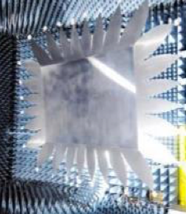
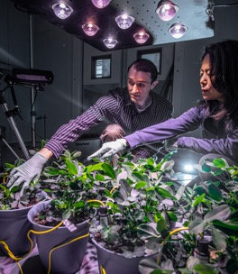
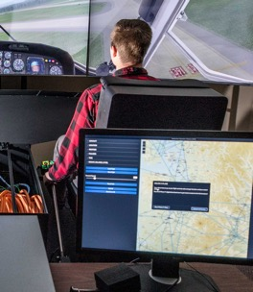

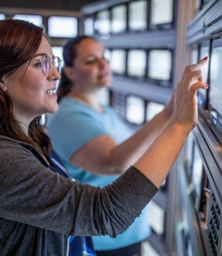
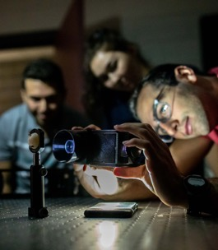

GTRI Laboratories
Advanced Concepts
Aerospace, Transportation
& Advanced Systems
Applied Systems
Cybersecurity, Information Protection & Hardware Evaluation
Spectrum Warfare and Operations Research Division
(SWORD)
Electronic Systems
Electro-Optical Systems
Information &
Communications
Sensors & Electromagnetic
Applications
A Diverse Base of Applied Innovation
Notes:
GTRI’s research enterprise is organized into “labs” and run by “Lab Directors.” Each lab has a technical focus area and researchers are generally hired and organized according to those technical areas. However, many sponsored projects use teams matrixed across the organization. This is especially true for large or system integration projects. Below identifies the major technology areas in each lab.
Advanced Concepts
Tactical Systems & Signatures
RF Sensor Technology
Systems Analysis & Modeling
Aerospace, Transportation & Advanced Systems
Threat Systems
Autonomous Systems & Robotics
Agriculture & Food Processing
Applied Systems
Air & Missile Defense
C2 & Decision Support
Cybersecurity, Information Protection & Hardware Evaluation
Cybersecurity
Secure Information Systems
Embedded & Cyber-Physical Systems
Electronic Systems
Electronic Warfare
Avionics & Open Systems
Human Systems
Electro-Optical Systems
Electro-Optical Systems
Modeling & Simulation
Materials & Devices
Information & Communications
C2 & Decision Support
Communications Systems
Information & Data Analytics
Sensors & Electromagnetic Applications
RF Sensors
Air & Missile Defense
Electronic Warfare

Slide 5
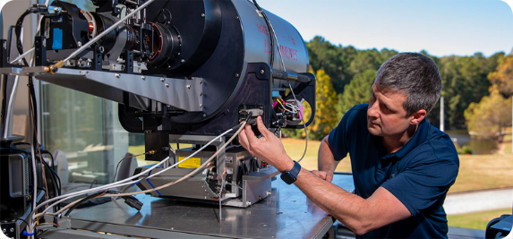
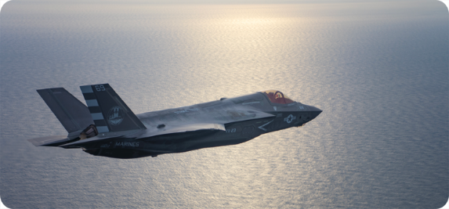
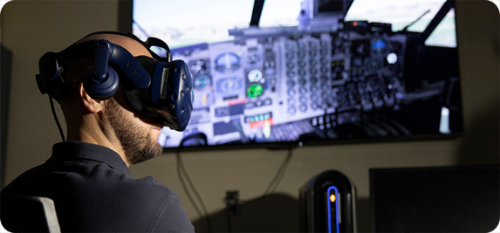
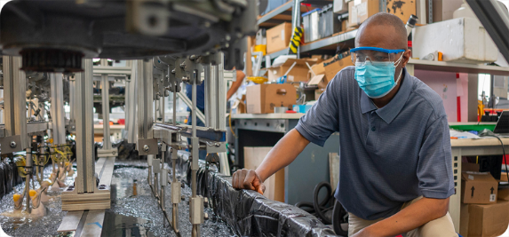
GTRI Research Portfolio Groups
SENSORS
INFORMATION
SYSTEMS
TECHNOLOGY FOR SOCIETY
Electromagnetic Spectrum
Operations (EMSO)
Command,
Control, and Communications (C3)
Educate Future
Technology Leaders
Aerospace
Intelligence, Surveillance, and Reconnaissance (ISR)
Air and Missile Defense (AMD)
Enhance Economic Impact for the
State of Georgia
Cybersecurity
Robotics and Autonomy
Decision
Superiority
Threat Systems Analysis
Improve the
Human Condition
Information and Data Science
Training, Test, and Evaluation
Notes:
GTRI has approximately 1,000 active projects. GTRI business development is done at the researcher-to-sponsor interaction level. GTRI is a very grass roots, entrepreneurial research house. To understand the body of GTRI’s research, we have used a portfolio organization tool. This is the overview. GTRI has three Deputy Directors for Research and each has responsibility for Sensors, Information, Systems, and Technology for Society portfolio groups.

Slide 6
GTRI by the Numbers
2023
941
MILLION
 | GT FY23 | GTRI FY23
Sponsored Research Awards | $1.42B | $941M
Economic Impact to State | FY22 $4.2B | FY22 $2.1B
Full-time Faculty and Staff | 9,659 | 2,479
Total Faculty | 4,658 | 1,851
Army’s Largest University Affiliated
Research Center (UARC)
  Second largest of 14 UARCs
  Operates under Federal Acquisition Regulation (FAR) 31.2
    Non-profit electing to operate under cost principles for commercial organizations where fee is collected
GTRI Sponsors
30%
4% Other Federal
Air Force
17%
17%
19%
3 % State and Local
Army
Navy
Other DoD
5%
3% Private Industry
Space Force
Notes:
These numbers are FY23 numbers ending June 30, 2023
Student count is calculated for an entire year, not at a given time within the year.

Slide 7
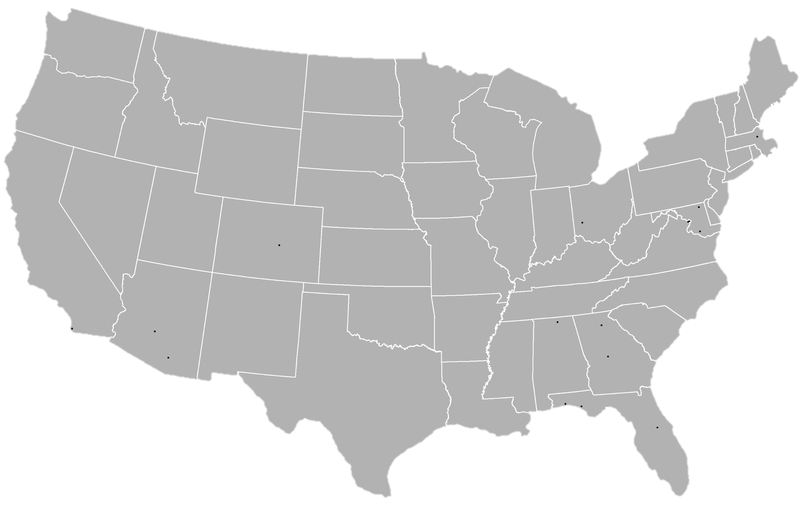

GTRI Field Offices/Presence
Stuttgart, Germany
Wiesbaden, Germany
Field Offices (# of occupants) | Total ASF
Aberdeen, MD (2) | 1,711
Arlington, VA (13) | 7,308
Colorado, CO (21) | 5,347
Dayton, OH (31) | 16,347
Huntsville, AL (107) | 60,000
Lincoln, MA (13) | 6,596
Orlando, FL (18) | 3,361
Panama City, FL (3) | 2,016
Patuxent River, MD (8) | 6,355
Phoenix, AZ (15) | 6,236
Quantico, VA (7) | 6,058
Salt Lake City, UT (13) | 11,300
San Diego, CA (75) | 17,414
Shalimar, FL (18) | 5,992
Tucson, AZ (21) | 4,780
Warner Robins (63) | 19,832
Rome, NY
Lincoln, MA
Detroit, MI
Salt Lake City, UT
Dayton, OH
Aberdeen, MD
Arlington, VA
Quantico, VA
St. Joseph, MO
Patuxent River, MD
* Colorado Springs, CO
Langley AFB, VA
Norfolk VA
Pentagon
Washington, DC
Nellis AFB, NV
* New Lease in Colorado Springs to 12,000 ASF
Huntsville, AL
San Diego, CA
Albuquerque NM
Tinker, OK
Phoenix, AZ
Tucson, AZ
Warner Robins, GA
Shalimar, FL
Jacksonville, FL
Oahu HI
Office
Open Lab
High Bay
Secure Space
San Antonio, TX
Panama City, FL
Orlando, FL
Space Types
Tampa, FL
GTRI Presence

Slide 8
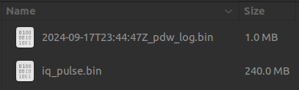
Pulse Descriptor Word (PDW)
Measurements that describe a pulse
Generates pulse meta-data without requiring all of the I/Q to be stored. Real-time pulse analysis.
  Considerable reduction in amount of data recorded
Measurements Can Include:
  Pulse width
  Pulse Power
  Pulse Frequency
  Modulation
  Time of Arrival (ToA)
  Pulse Repetition Interval
  Polarization
  Angle of Arrival
  Many Others
240MB
30 seconds of data at 1 MSPS
5us Pulse, 1kHz PRI
1.0MB
SDR
IQ
gr-pdw
pdw

Slide 9
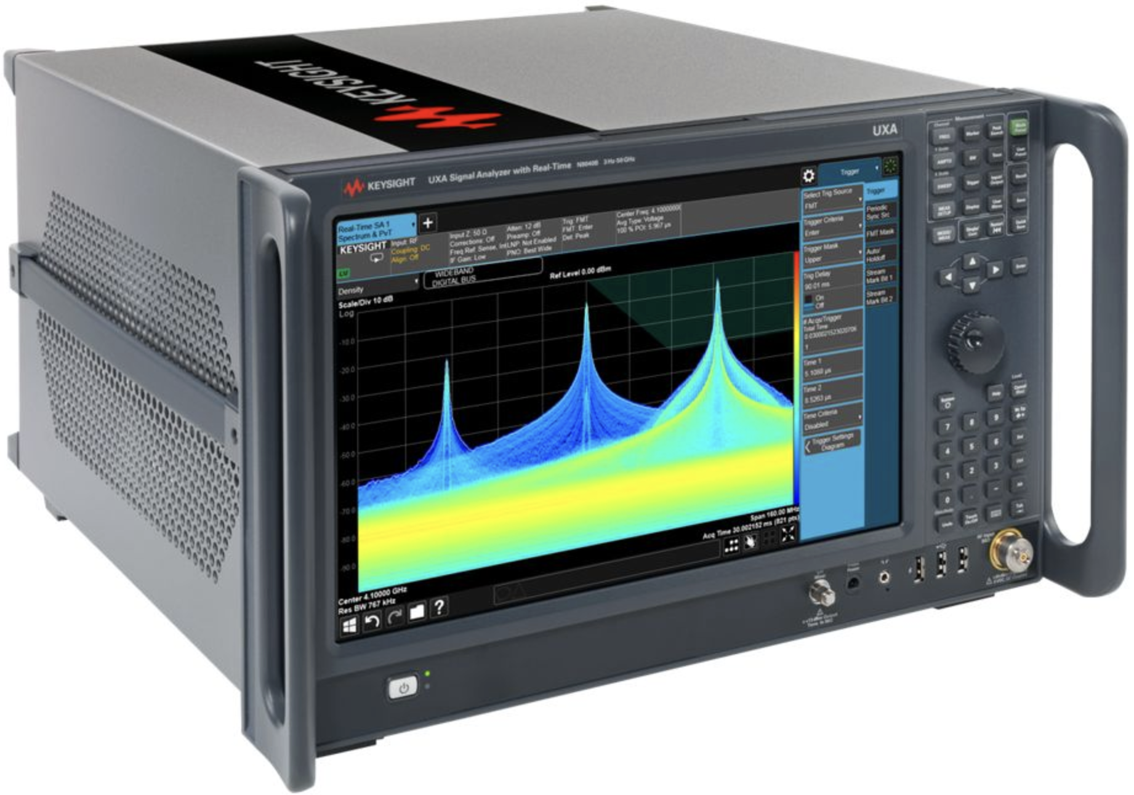
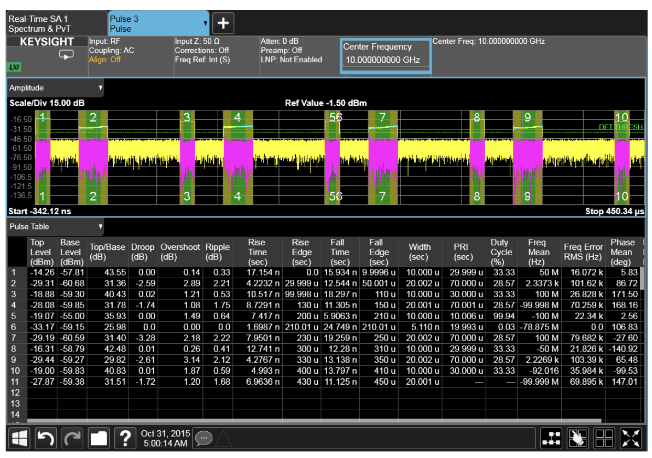
Motivation
Field Tests / Exercises / Lab
Signal externals are often used to characterize pulse emissions (radar, digital communications) but this capability is typically limited to:
  Custom hardware / firmware:
    Very cost prohibitive
    Often has mission critical tasks
  COTS Test Equipment:
    Very cost prohibitive (Hardware and software)
    Not suitable for rugged environments (temperature, dust, fast maneuvers)
    Difficult to move around

Slide 10
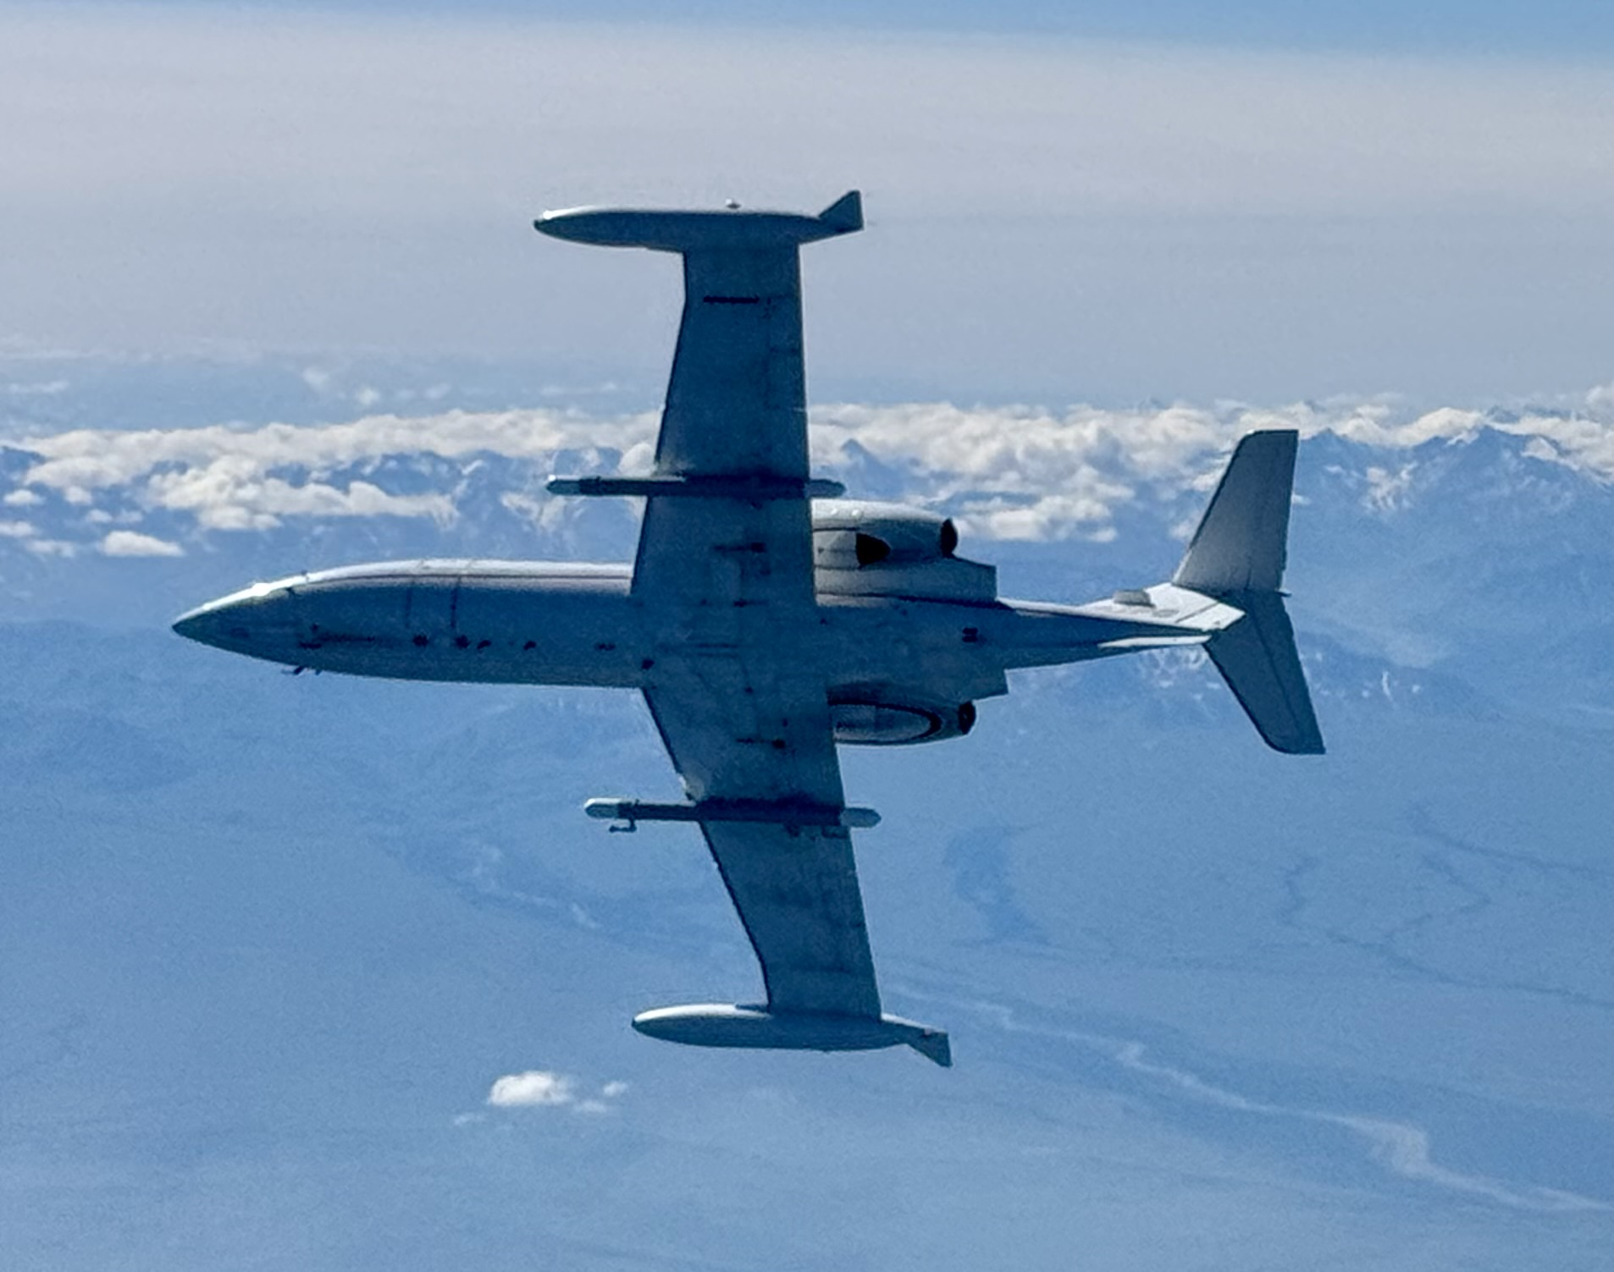
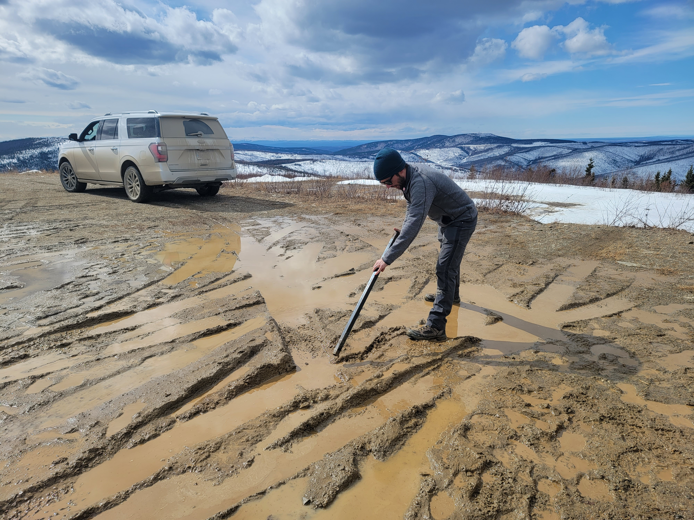
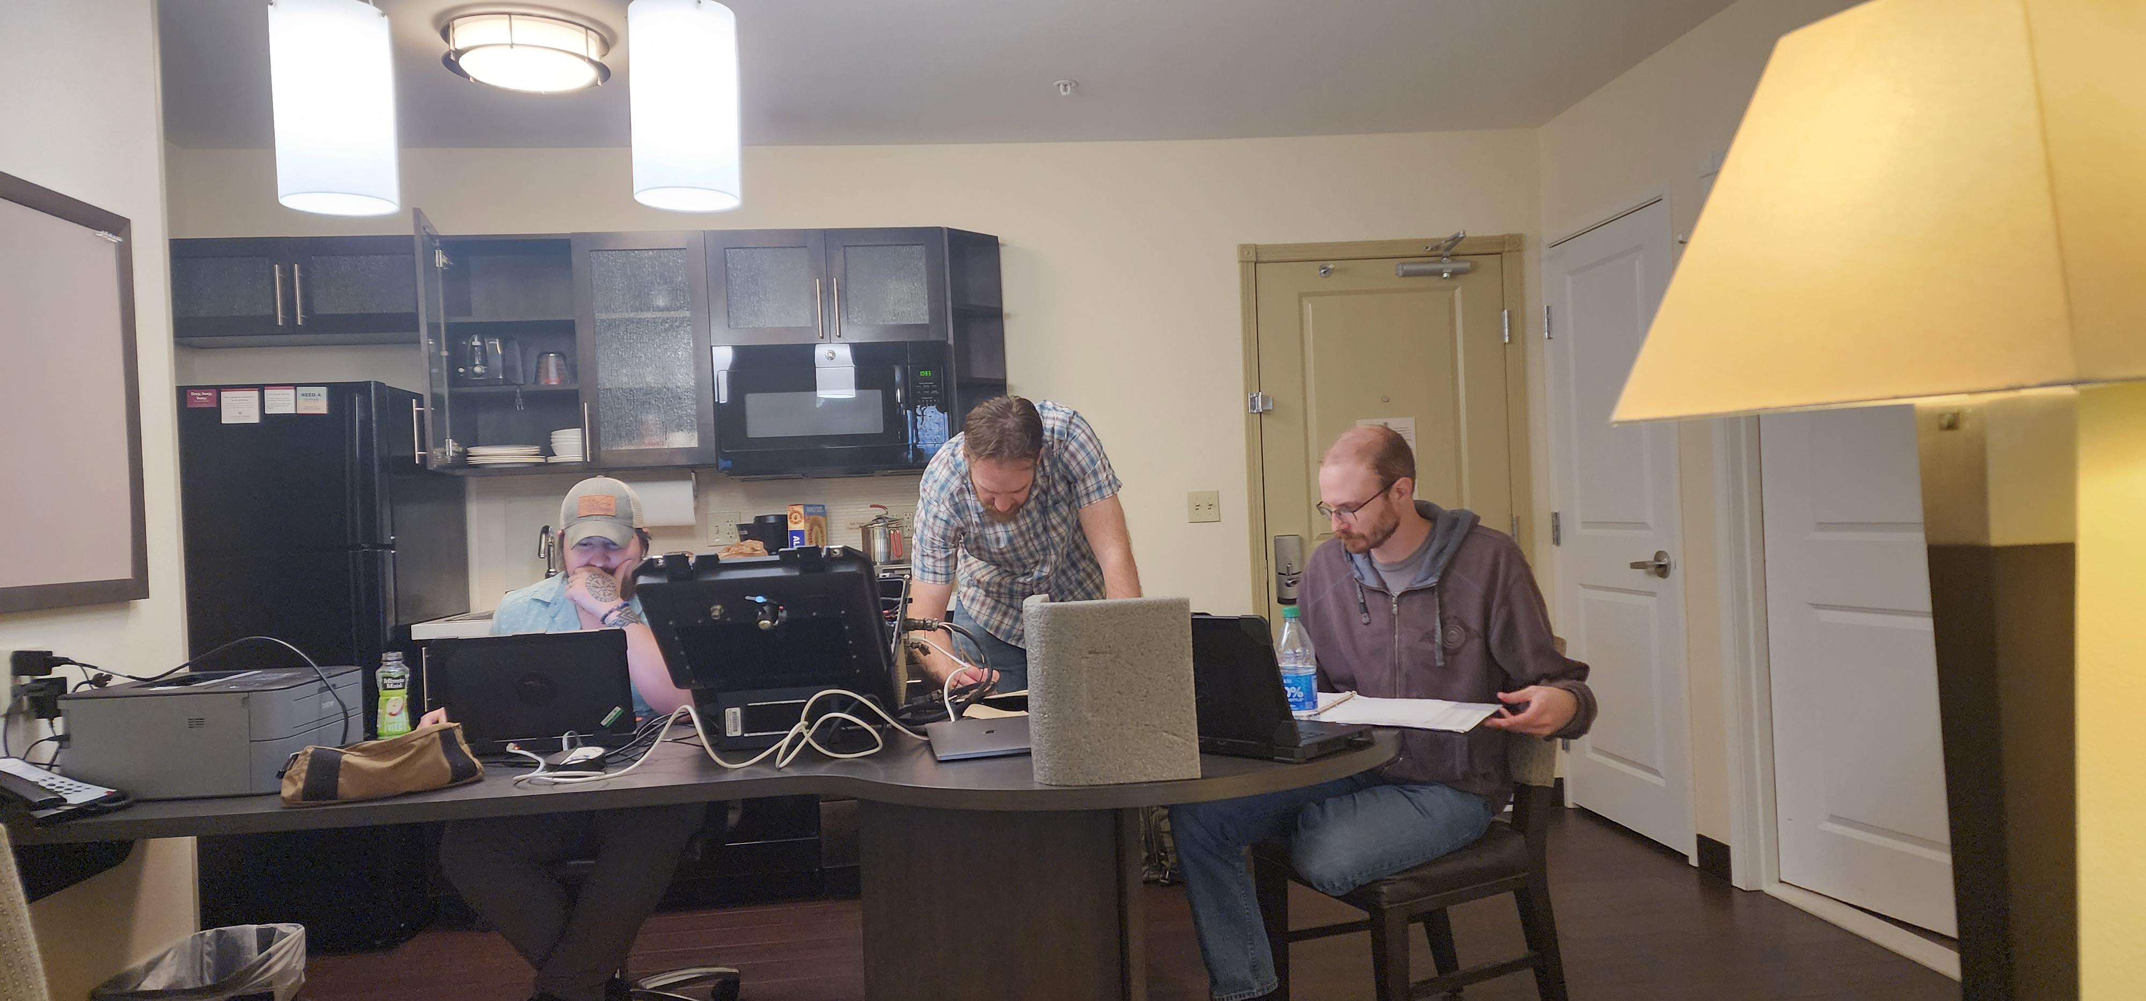
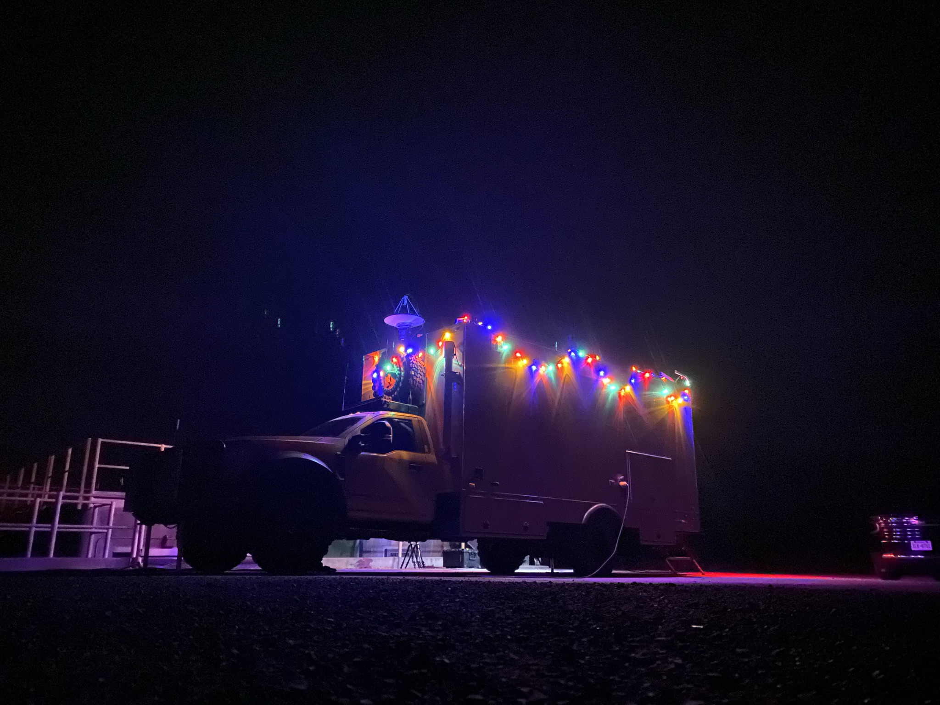
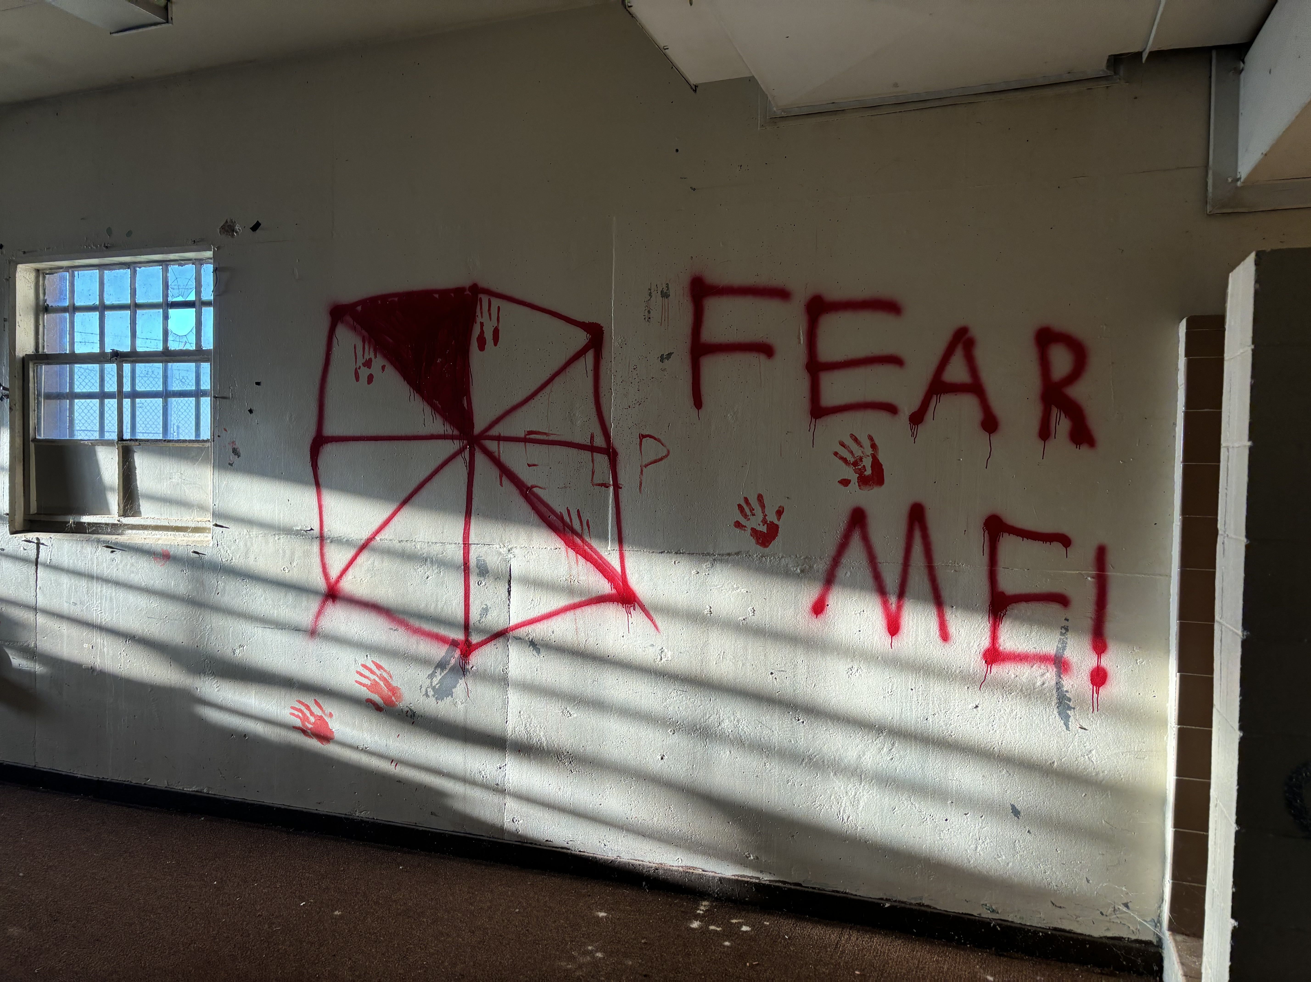
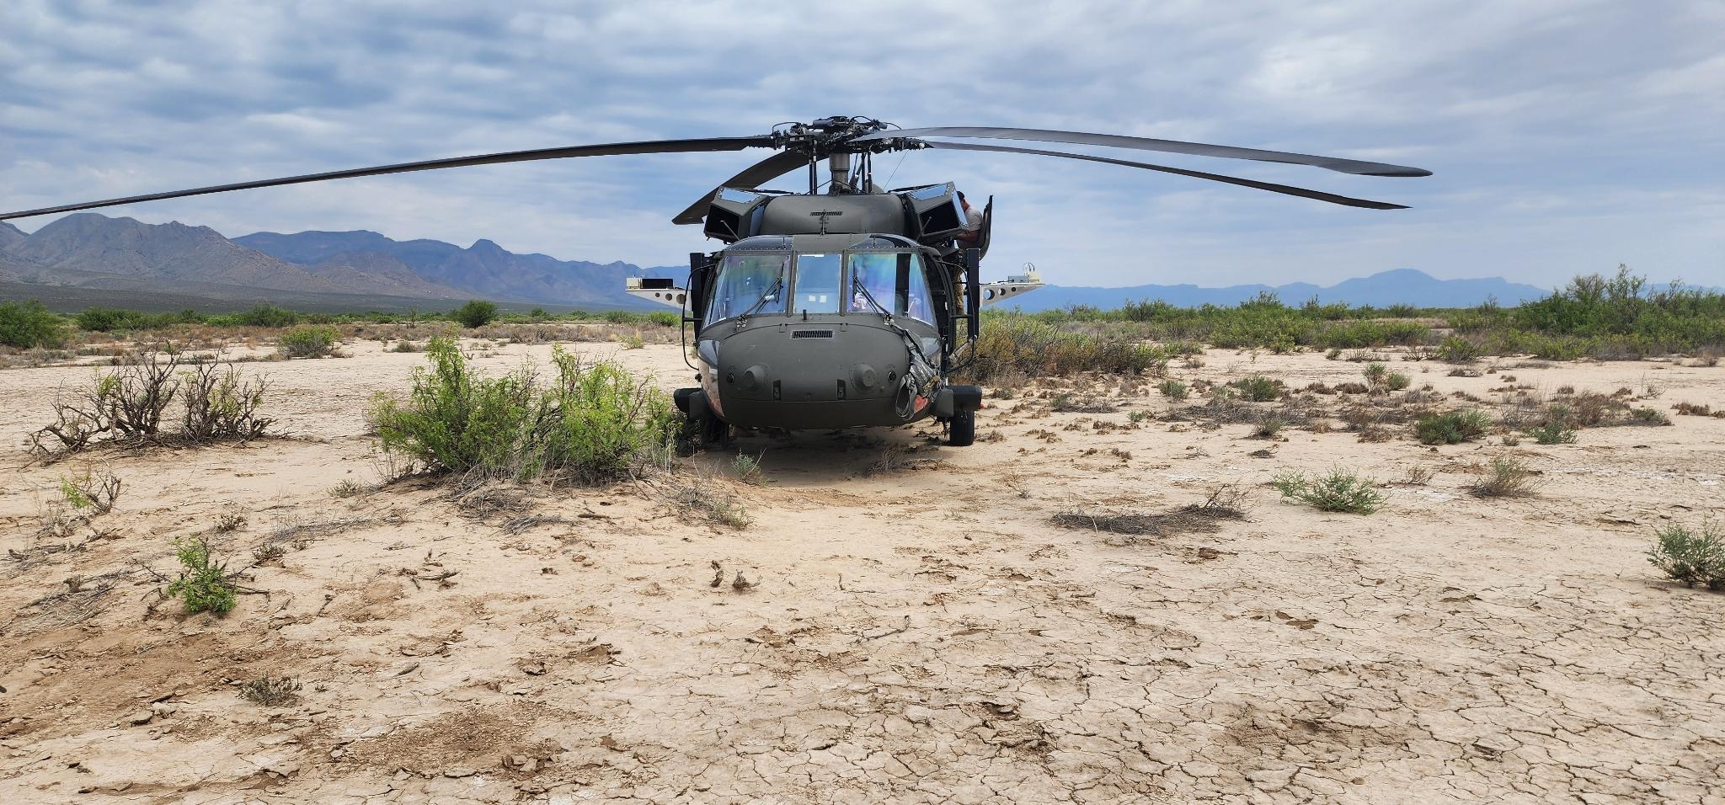
Rugged Environments?

Slide 11
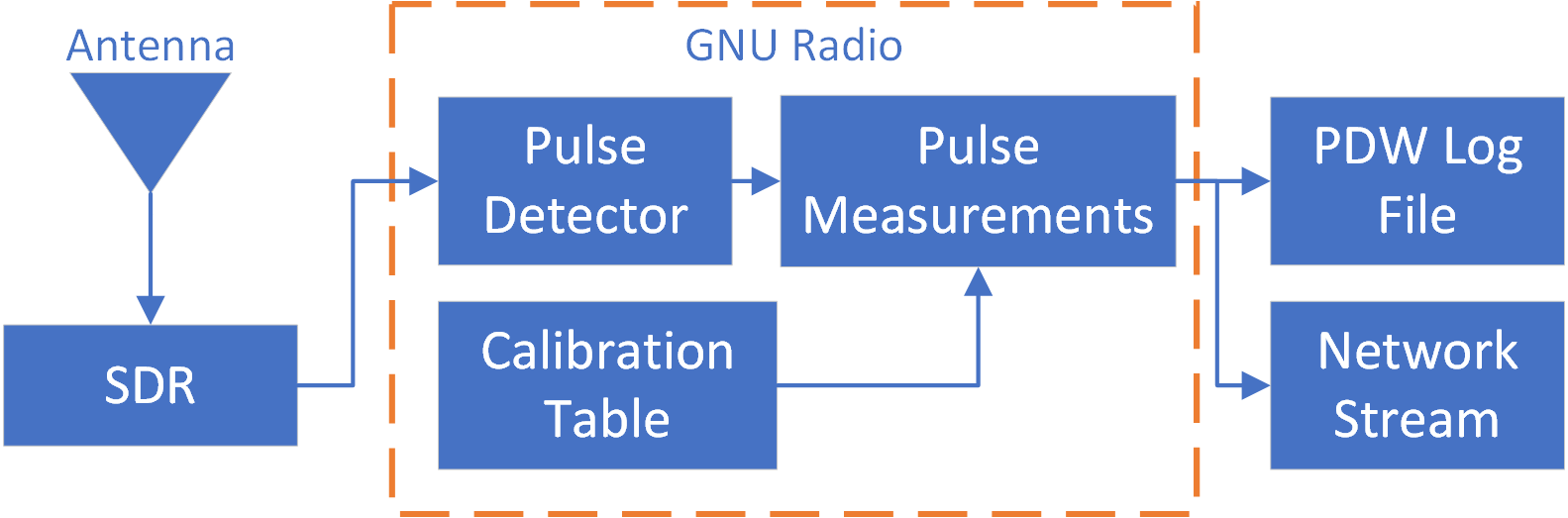
gr-pdw
Out of tree Module (OOT) for GNU Radio to perform pulse descriptor word (PDW) measurements
Goal: Give any SDR ability to characterize pulses in real time
Blocks:
  Pulse Detector: Tags start and stop of pulses based on threshold
  Pulse Extraction: Extracts IQ from Tagged Stream, calculates PDW measurements
  PDW to File: Store PDW measurements to a file (tool included to read file)
  Calibration Table: Scale pulse amplitude to calibrated power measurement
  PDW Plot: PDW Measurement visualizations

Slide 12
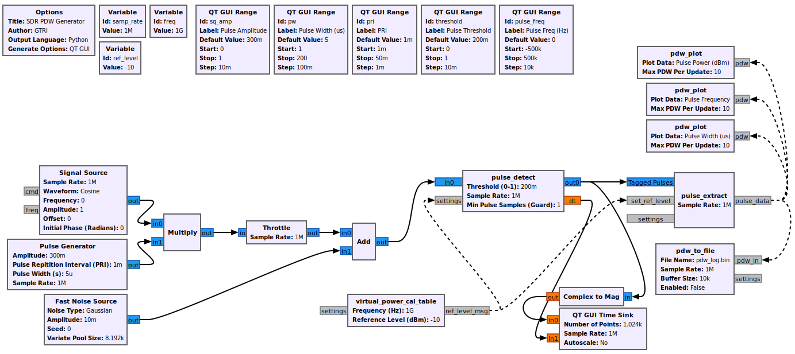
Typical Flowgraph

Slide 13
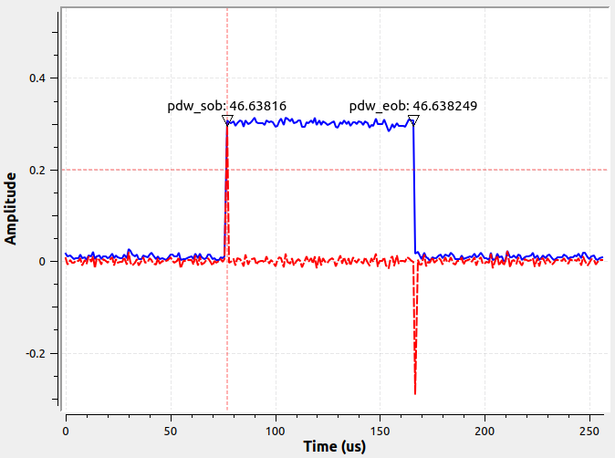
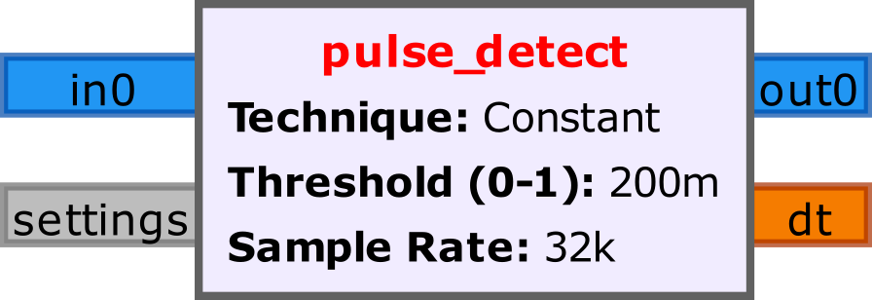
Block: Pulse Detection
Constant threshold applied to the input signal.
Threshold:
  Assumes Range: 0 – 1
  Can adjust while running
Tags:
  Start: pdw_sob
  End: pdw_eob
Debug Signal
(Derivative of Input Signal)

Slide 14
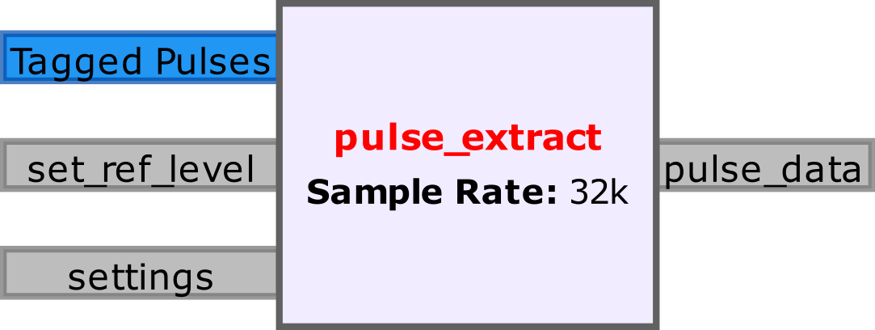
Block: Pulse Extraction
PDW
Width
TOA
Power
Freq
Extracts I/Q in input tagged stream
  Between: pdw_sob ↔︎ pdw_eob
Measurements Performed on Each Subset of I/Q
  Pulse Width
  Pulse Power
  Pulse Frequency
  SNR
Pulse IQ Data

Slide 15
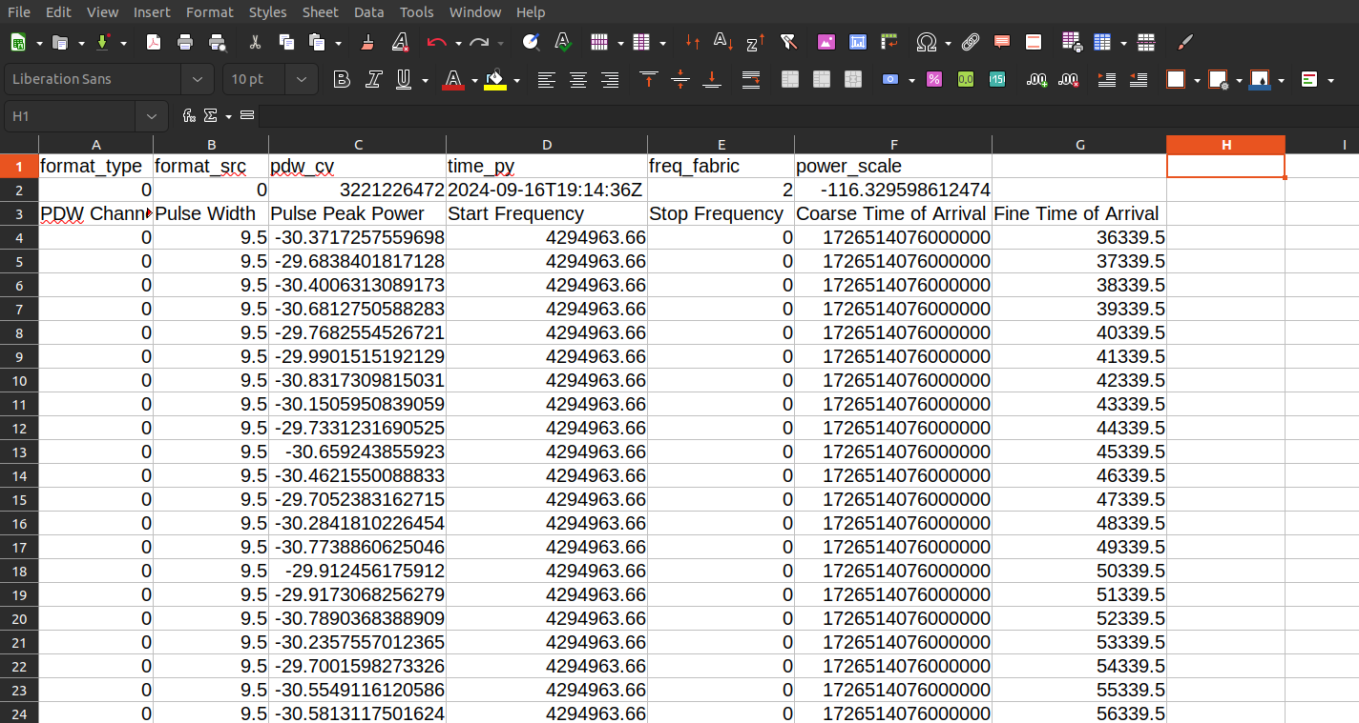

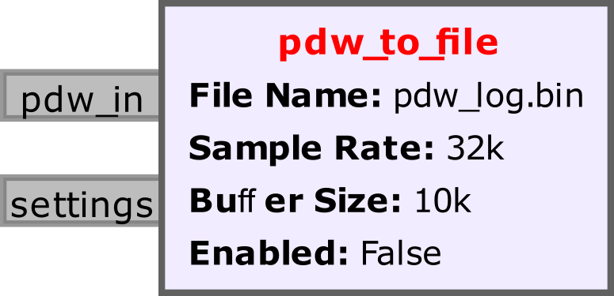

Block: PDW to File
Writes PDW measurements to a binary file for offline analysis
Tool Provided to Read / Write / Manipulate PDW Files:
  gr-pdw → Examples → pdw.py
pdw.py

Slide 16
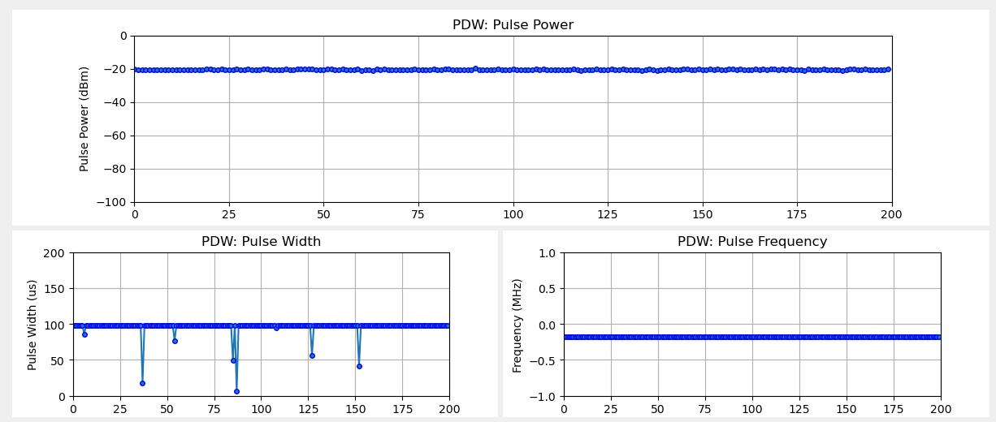
Block: PDW Plot
Plots selected measurements from PDW:
  Pulse Power (dBm)
  Pulse Frequency (MHz)
  Pulse Width (μs)

Slide 17
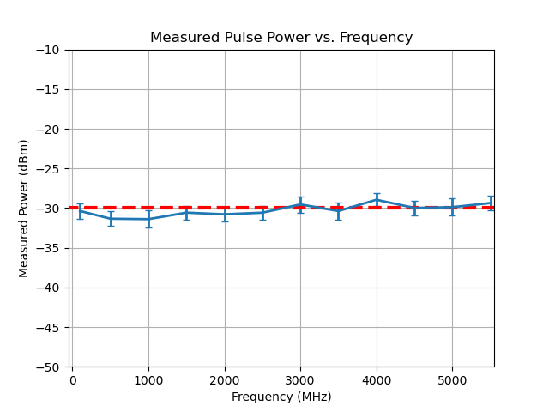
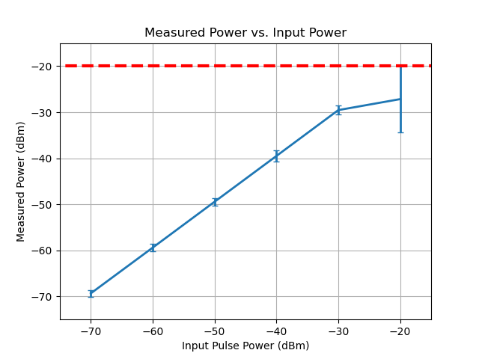
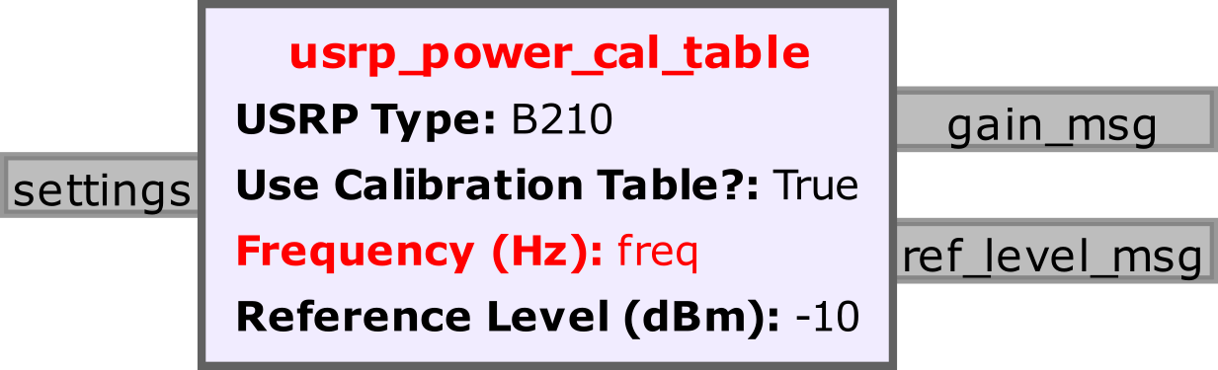
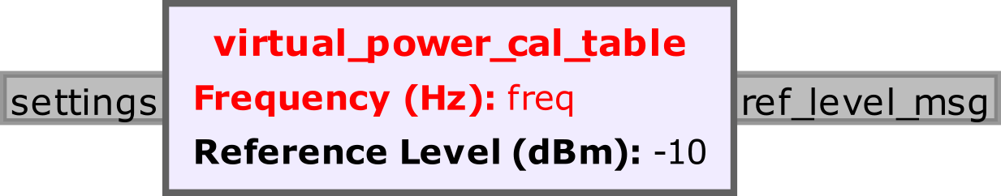
Block: Calibration Tables
USRP Power Calibration utility
  uhd_power_cal.py
  Save calibration table as .pickle
R&S Signal Generator
  Automated Calibration
User selects reference level
  Block outputs a gain setting for USRP

Slide 18
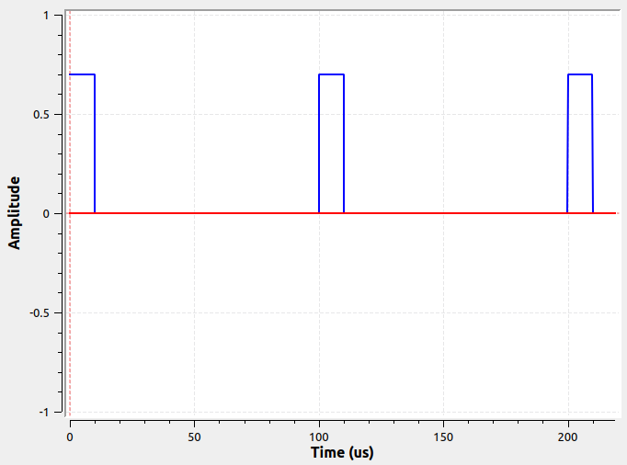
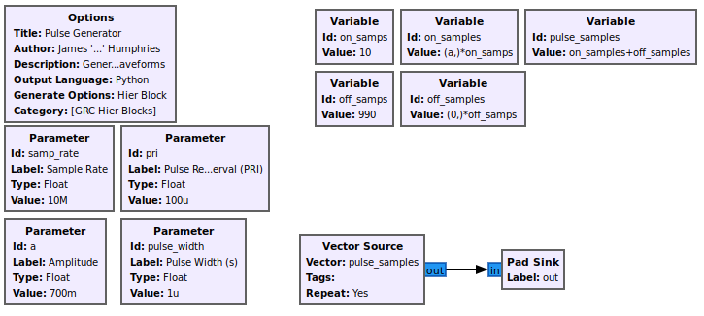
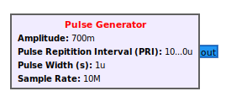
Extras: pulses.grc
Hierarchal block to generate simple pulsed waveforms
Inputs:
  Amplitude
  Pulse Repetition Interval (PRI)
  Pulse Width
  Sample Rate

Slide 19
Example Flowgraph: Virtual Mode

Slide 20
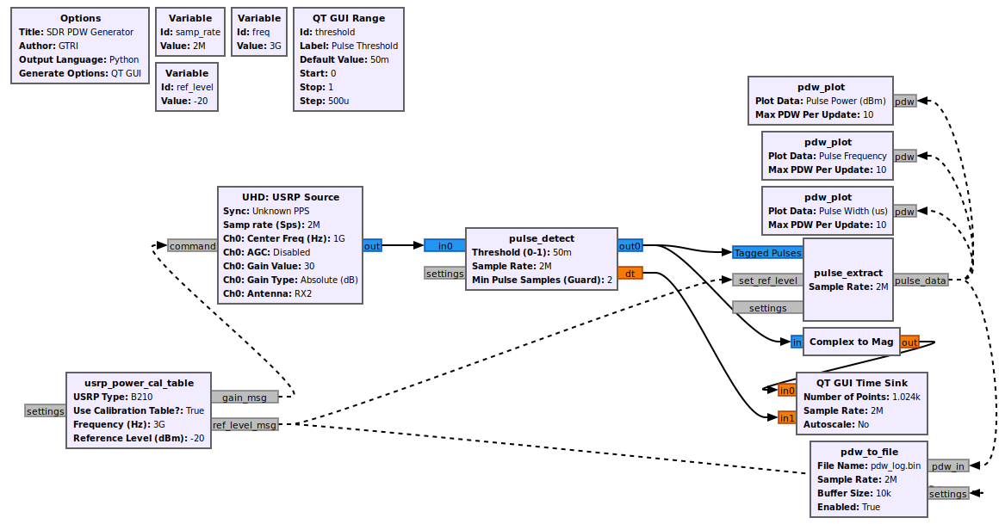
Example Flowgraph: USRP

Slide 21
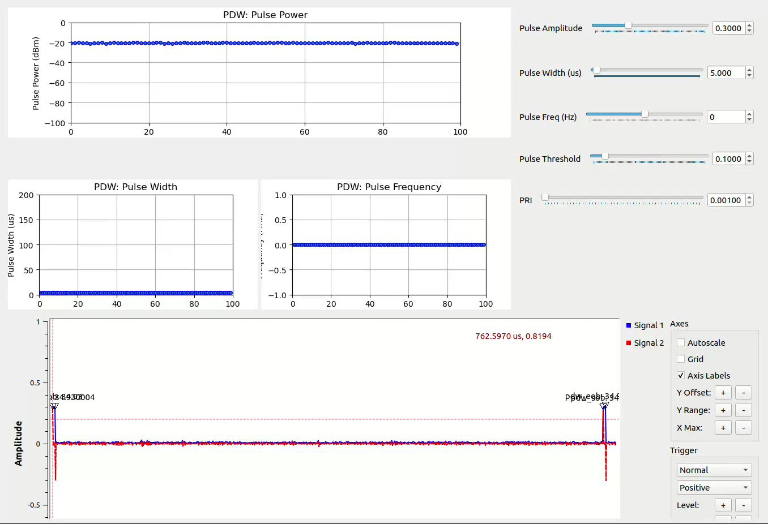
Demo (Video)

Slide 22
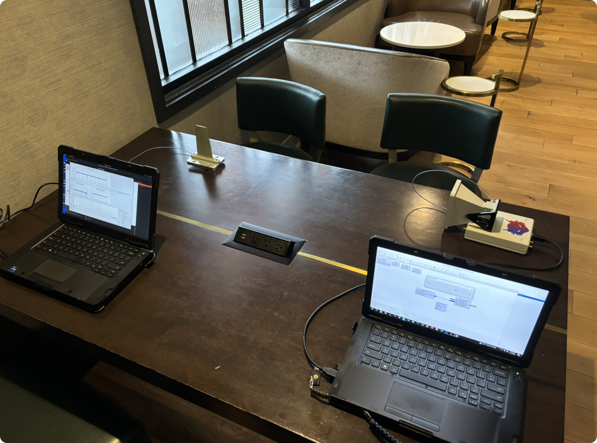
Demo: Test Setup

Slide 23
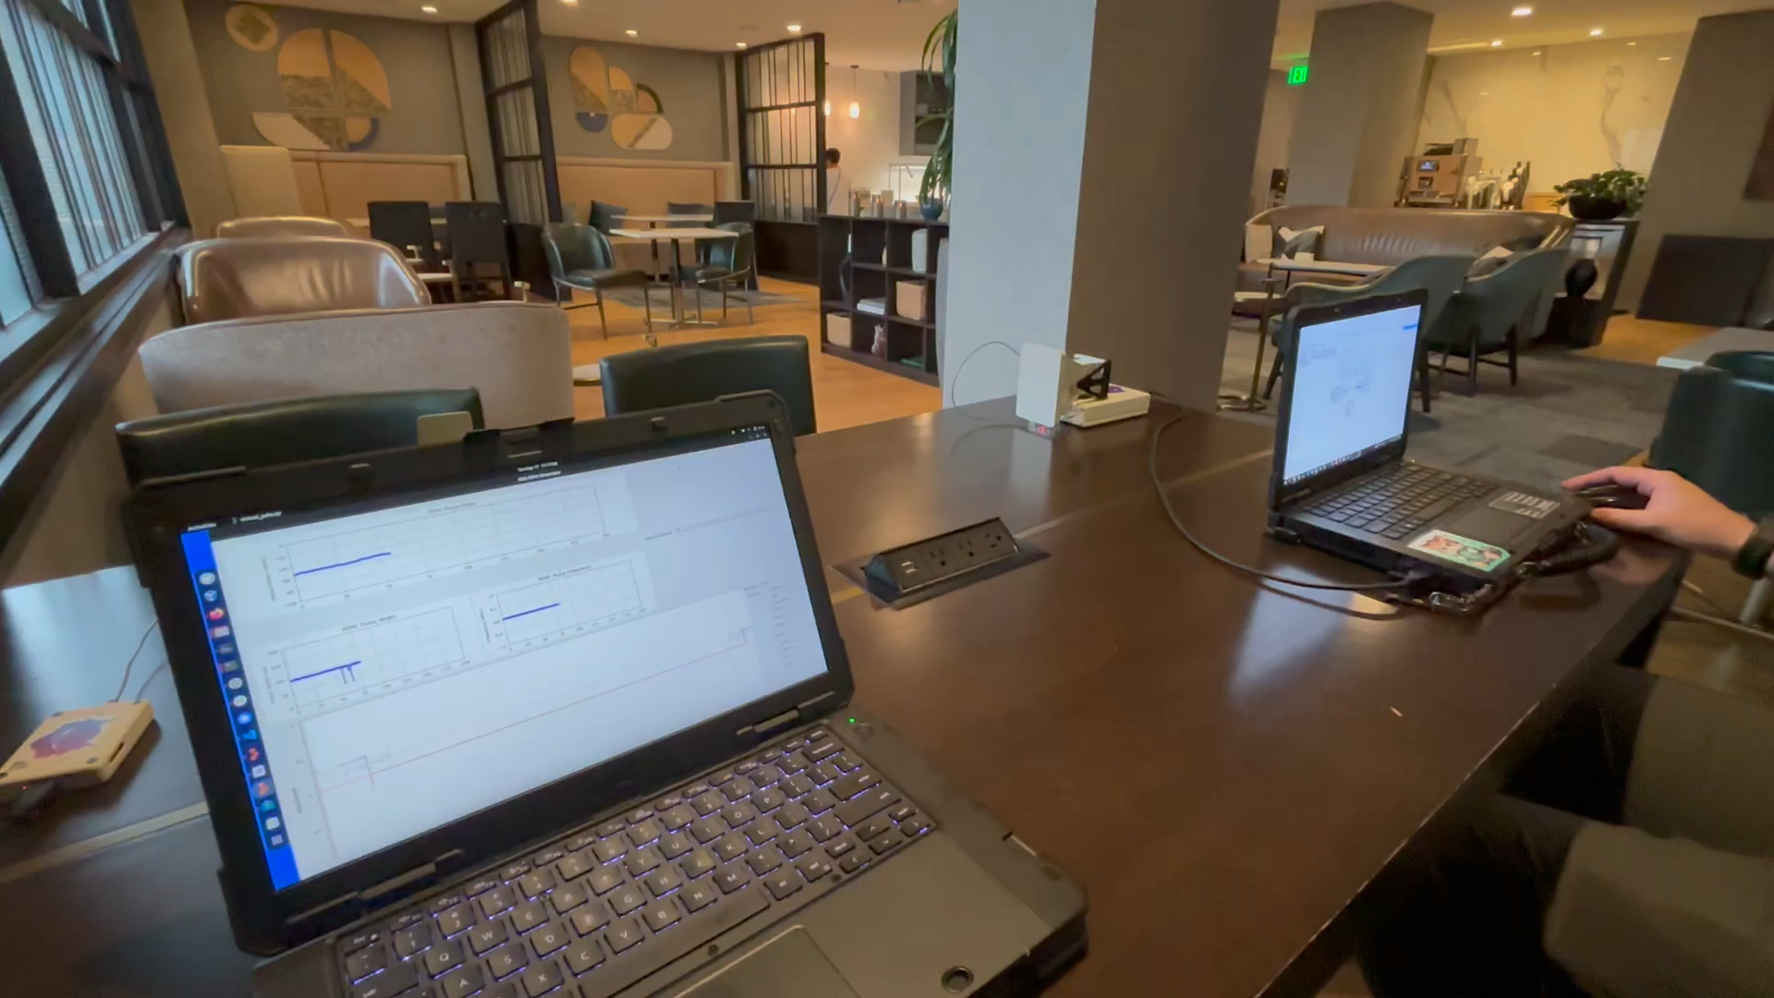
Demo: Wireless PDW Measurements

Slide 24
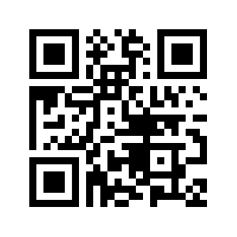
gr-pdw: Available on GitHub
SOONTM
https://github.com/gtri/gr-pdw
Pull requests are VERY welcome

Slide 25
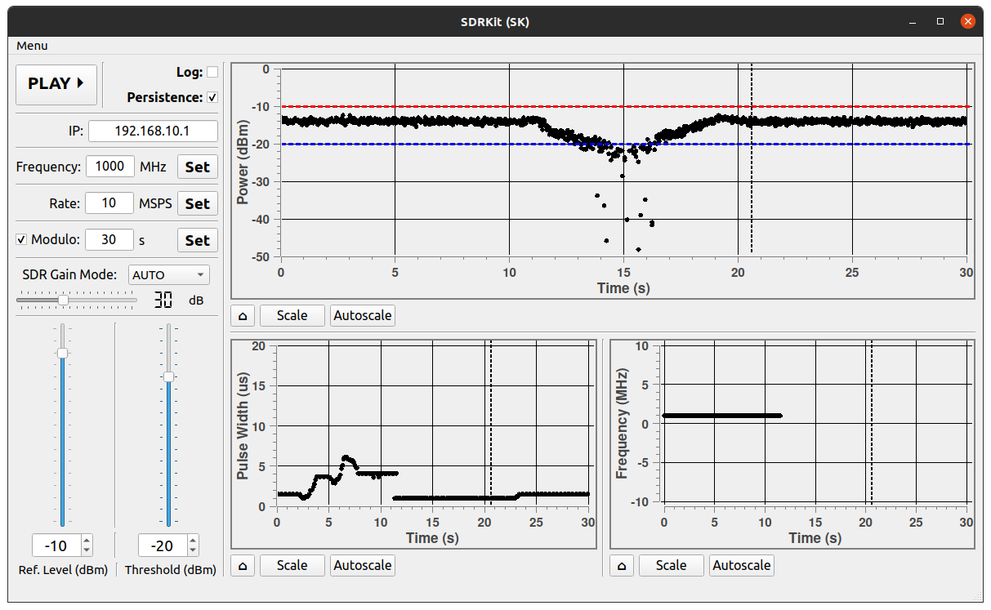
Future Plans
Port blocks to C++
Improved plotting / visualization tools
Modulation detection
Pulse I/Q export
PDW Streaming (Network)
Firmware / RFNoC PDW generation (High Bandwidth)
PDW Replay
Qt based GUI to display network PDW stream

Slide 26
Questions?
trip.humphries@gtri.gatech.edu

