Slide 1
¹
²
³
5G Base-Station with Hardware Acceleration for Non-Terrestrial Networks on a Space-Grade System-on-Chip
Gnu Radio Conference 2024, 18th of September, 2024
Michael Petry ^{1,2}, Michael Hennerich ³, Raphael Mayr ¹
PhD Student
Michael.petry@airbus.com
Sr. Director, ADI Fellow
michael.hennerich@analog.com
FPGA Engineer
Raphael.mayr@airbus.com

Slide 2
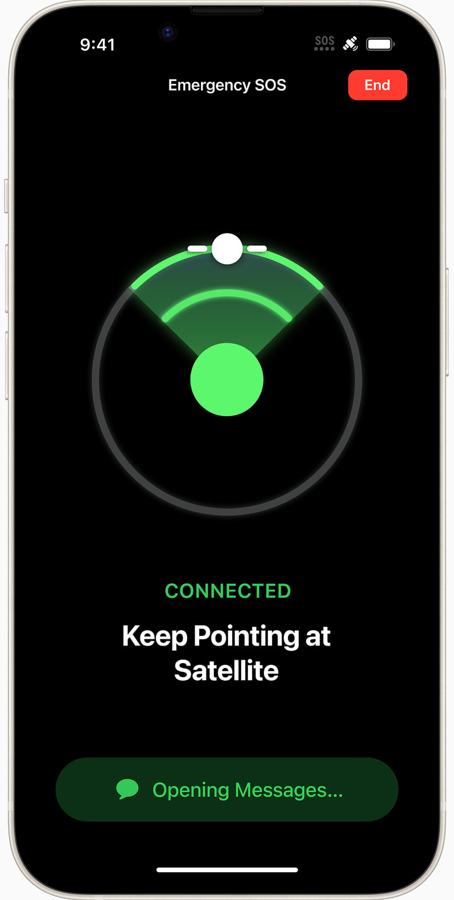
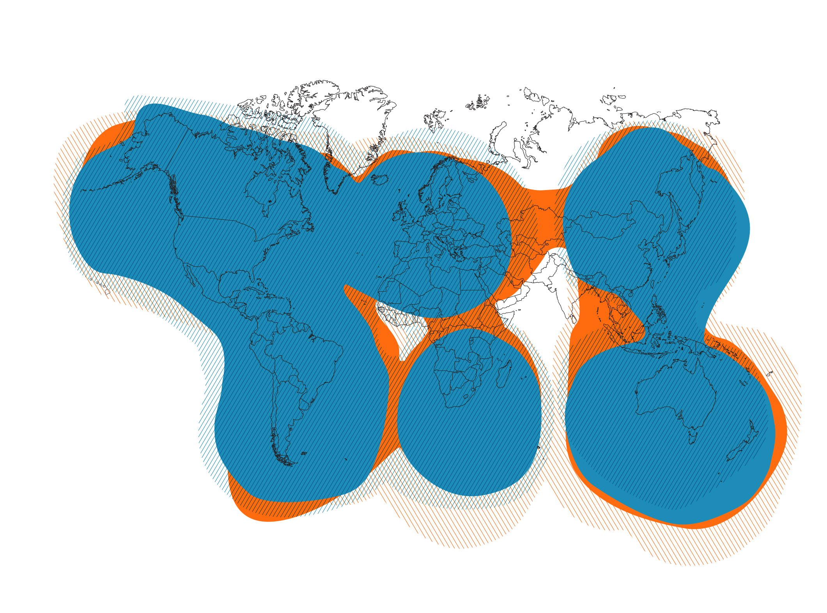
Existing Mobile Satellite Solutions
Service: Emergency Message
Send & Receive
Partner: Globalstar
Satellites: 24 + 1 (spare)
Type: Transparent
ISL: No
85% network capacity reserved for Apple
Coverage: non polar
No ISL: Gateway must be in sight
Linkbudget / Speed: ?
Satellite Technology / Beams
GRCon 18th Sept. 2024, 5G NTN Presentation, M. Petry
2

Slide 3
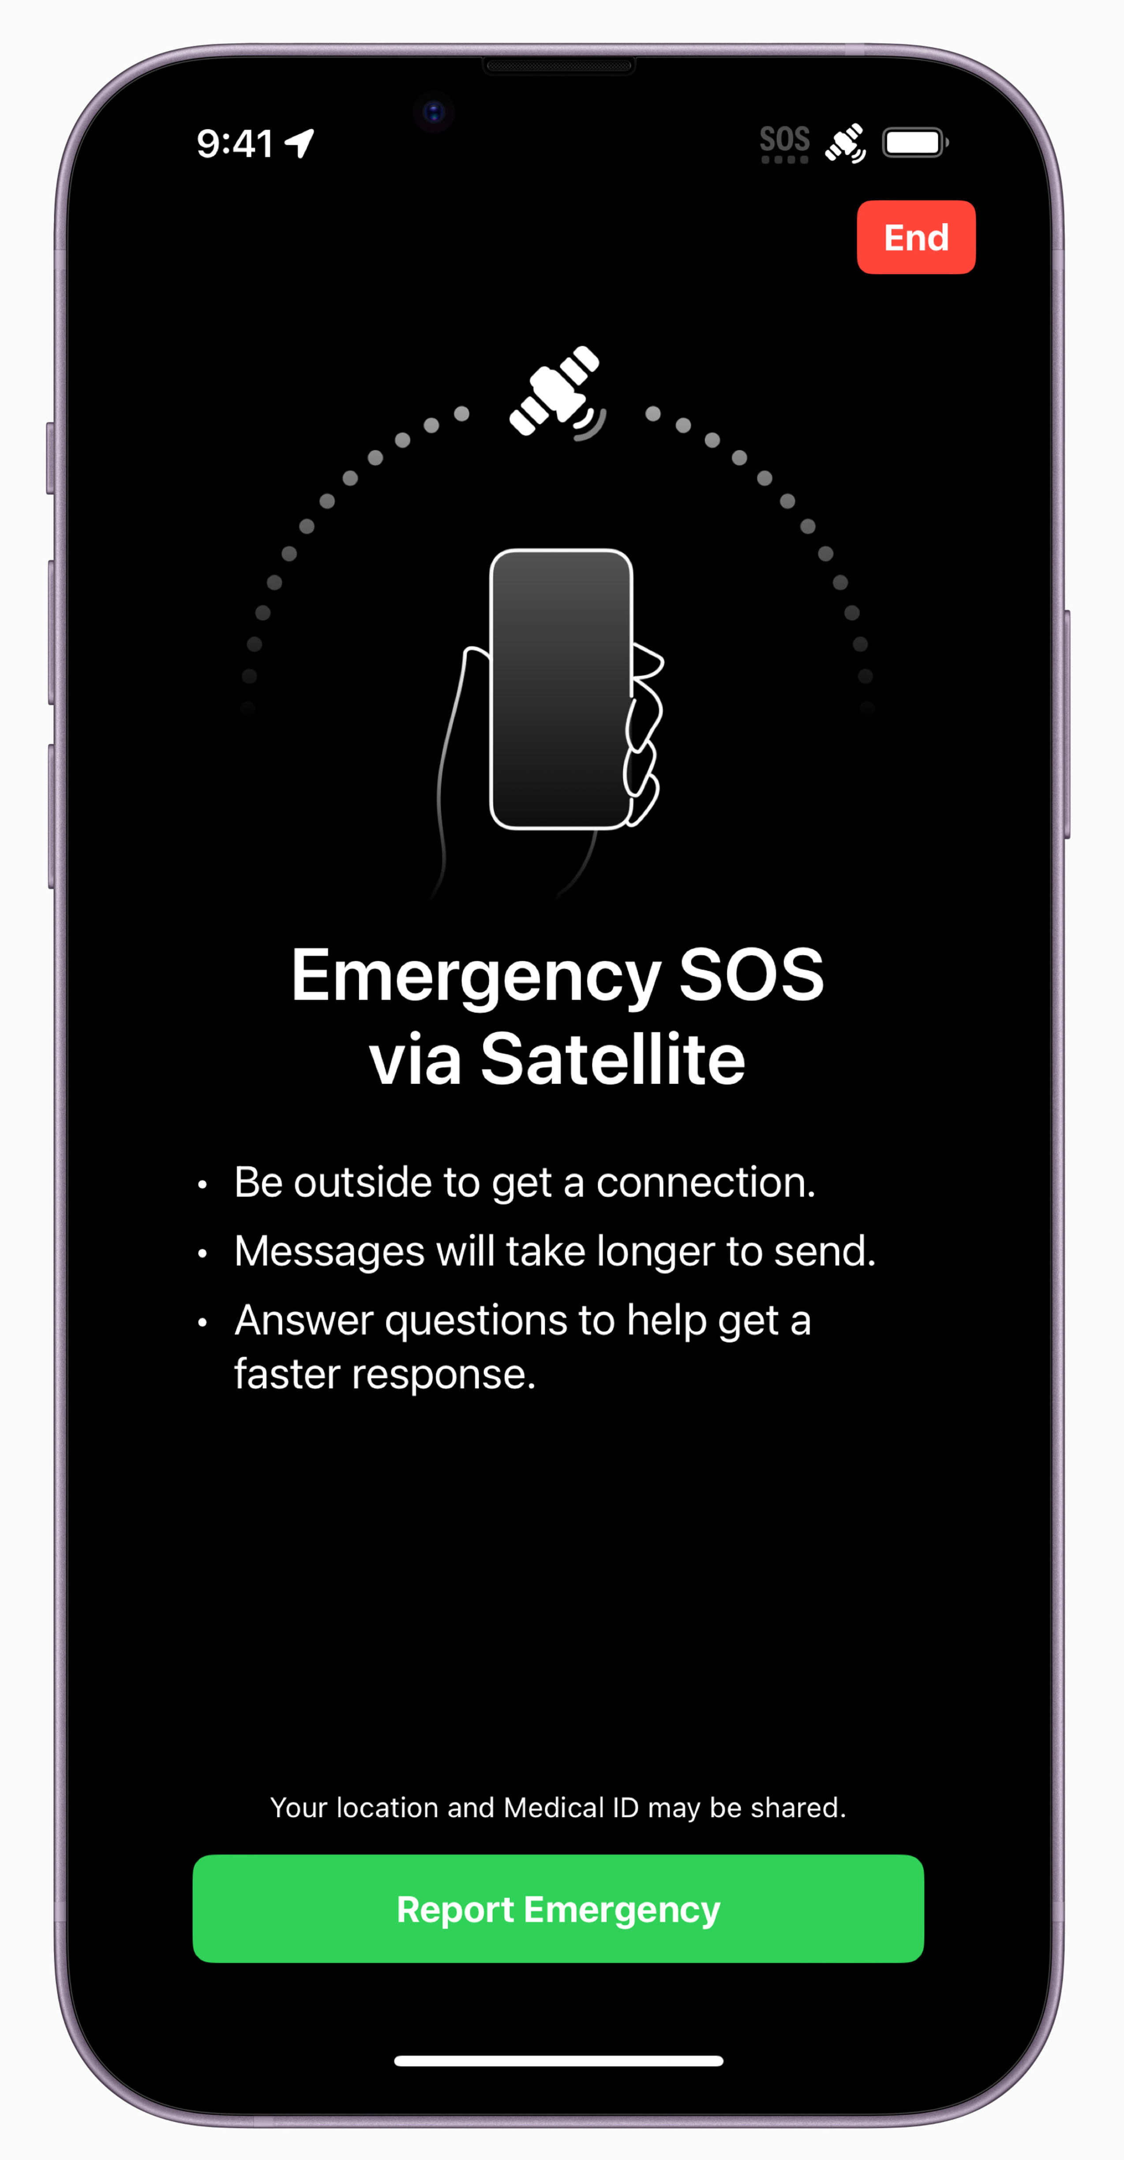
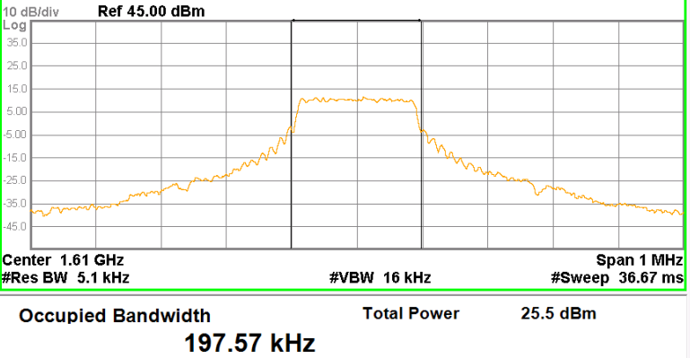
iPhone SOS – A proprietary solution
Transparent Satellite (Bent-Pipe)
Frequency Conversion
No On-Board Processing
No Storage
Downlink
S-Band: 2483.5 – 2500 MHz
Chip: Snapdragon X65 / X70
Waveform: CDMA
C-Band
6875 – 7055 MHz
C-Band
5091 –5250 MHz
Uplink
L-Band: 1610 – 1618.7 MHz
Bandwidth: 200 kHz ¹
Power: 26 dBm ¹
Chip: Custom (?)
Waveform: SC-OFDMA (LTE-UL)
¹ 14040866-E22V1 FCC_IC MSS Report
GRCon 18th Sept. 2024, 5G NTN Presentation, M. Petry
3

Slide 4
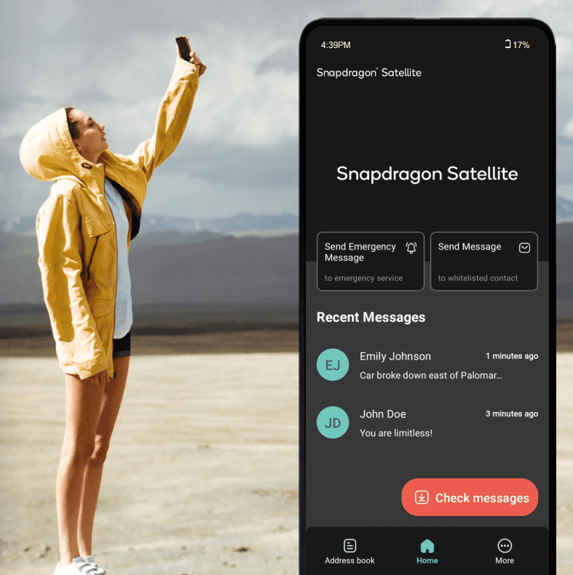
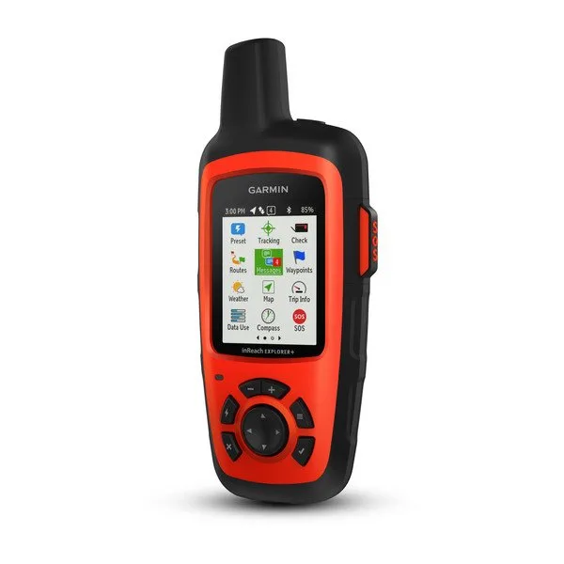
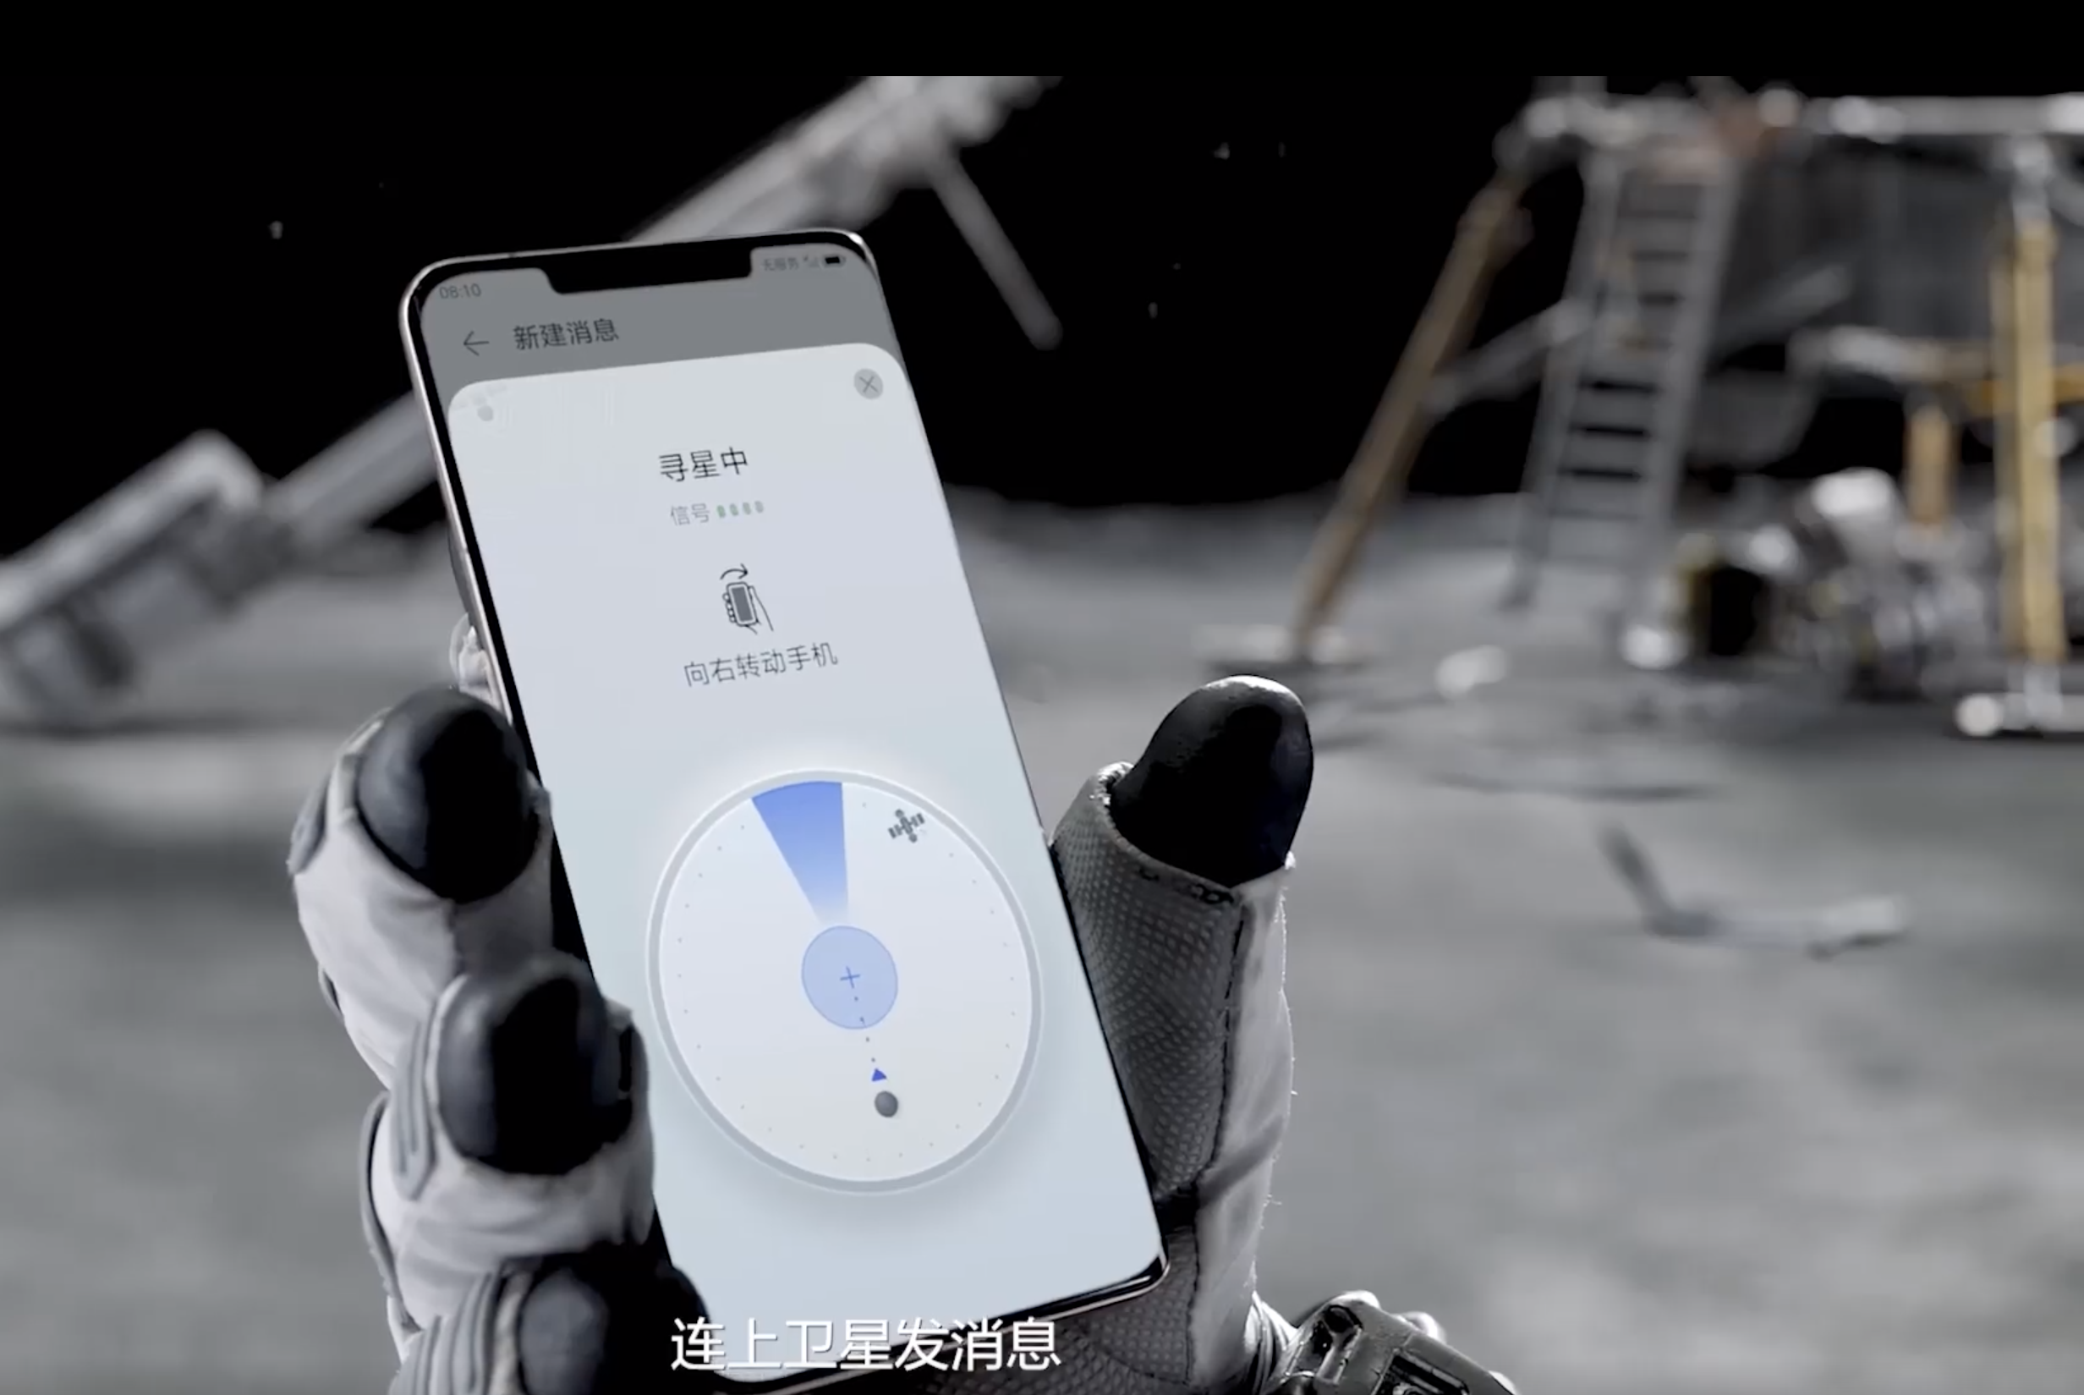
Other Proprietary Mobile Satellite Solutions
Snapdragon Satellite
Garmin inReach
Skylo / Quectel / MediaTek
Beidou
GRCon 18th Sept. 2024, 5G NTN Presentation, M. Petry
4

Slide 5
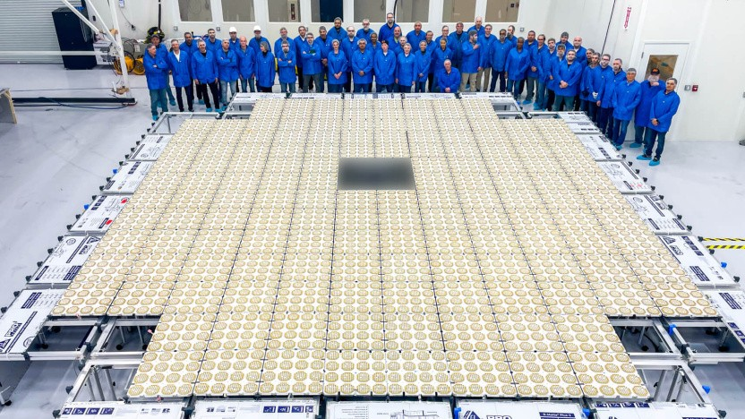
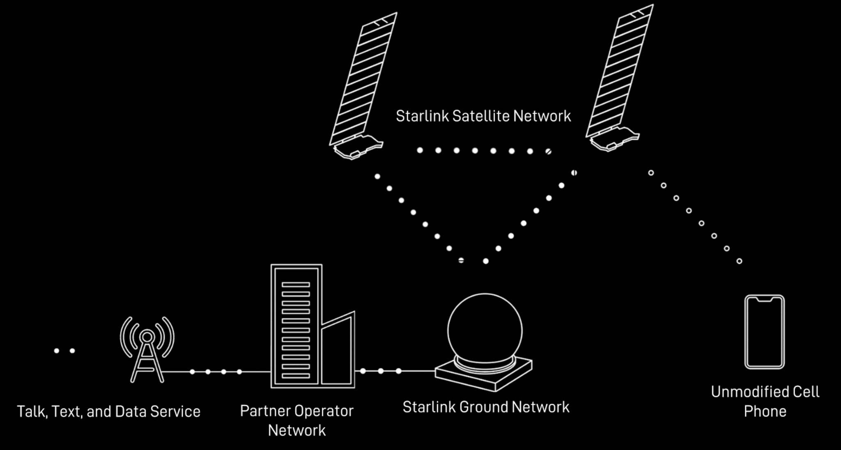
Cellular Standard-based Solutions
Starlink Direct-to-Cell
AST SpaceMobile
GRCon 18th Sept. 2024, 5G NTN Presentation, M. Petry
5

Slide 6
1
Non-Terrestrial Networks in the Cellular Standards
GRCon 18th Sept. 2024, 5G NTN Presentation, M. Petry
6

Slide 7
Evolution of Mobile Networks
1 G
2 G
3 G
4 G
5 G
6 G
< 1.9 GHz
< 2.1 GHz
< 2.5 GHz
FR1: < 6 GHz - FR2: < 95 GHz
1981
1990
1993
2001
2006
2010
2015
2018
2020
2024
2030
1 G
2 G
2.5 G
3 G
Rel. 99
3.5 G
Rel. 5-7
3.9 G
Rel. 8
4.5 G
Rel. 10
4.9 G
Rel. 13/14
5 G
Rel. 15 - 17
5.5 G
Rel. 18 - 20
6 G
Rel. 21?
C-Net NMT AMPS TACS
GSM¹
IS-95A
GPRS²
IS-95B
EDGE³
UMTS⁴
CDMA 2000
HSDPA⁵
HSPA+
1xEV-D0
LTE⁶ ^{(CAT 4)}
LTE-
Adv.⁶
^{(CAT 6)}
LTE-
Adv. Pro
^{(CAT 11)}
LTE / NR⁸
Non-SA / SA
40 Kbps*
0.5 – 1 s
200 kHz
2.4 Kbps*
> 1s
30 kHz
9.6 Kbps*
0.5 – 1 s
200 kHz
384 Kbps
O(100 ms)
200 kHz
7.2/42 Mbps
69-75 ms
5 MHz
150 Mbps
50 ms
20 MHz
300 Mbps
15-50 ms
100 MHz
600/1200 Mbps
15 ms
640 MHz
< 10 Gbps
> 1 ms
700 MkHz
Satellites come here
¹ Global System for Mobile Communication ² General Packet Radio Service ³ Enhanced Data Rate for Global Evolution ⁴ Universal Mobile Telecommunications System ⁵ High Speed Packet Access ⁶ Long Term Evolution ⁷ LTE Advanced ⁸ New Radio *Analog service only, no data
GRCon 18th Sept. 2024, 5G NTN Presentation, M. Petry
7

Slide 8
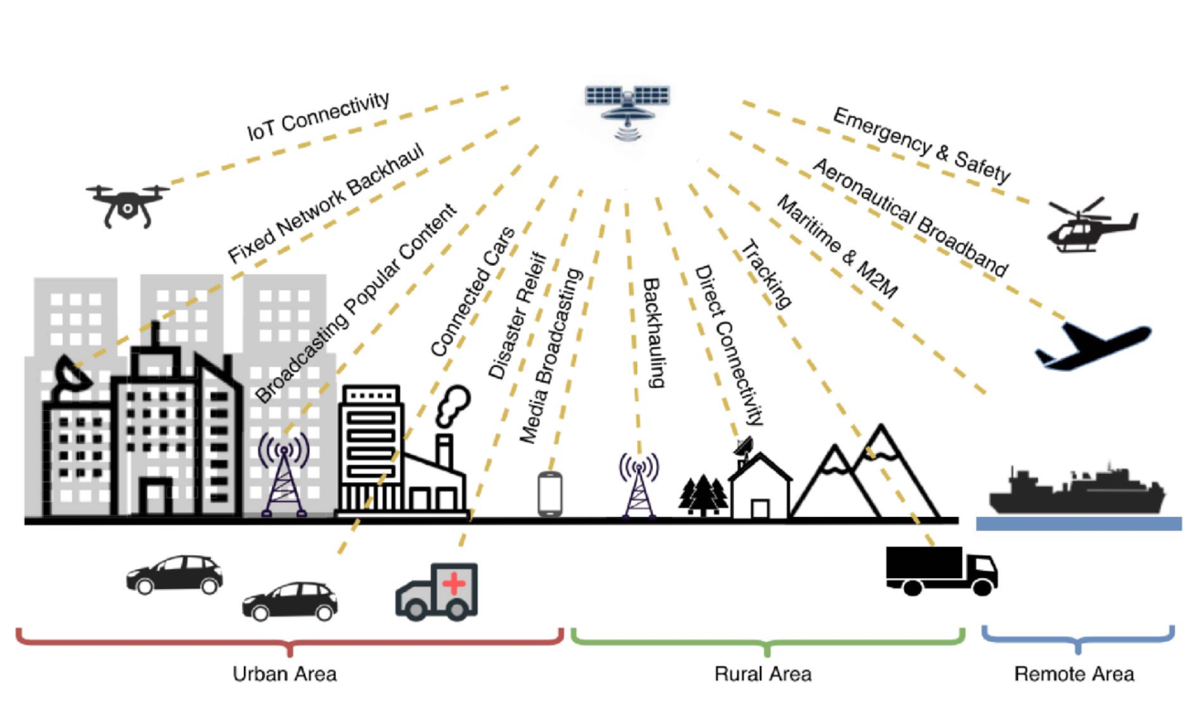
5G NTN Use Cases
GRCon 18th Sept. 2024, 5G NTN Presentation, M. Petry
8

Slide 9
Satellite „Sweet Spots“ in the 5G Ecosystem
TRUNKING & HEAD-END FEED
BACKHAULING & TOWER FEED
COMMS
ON THE MOVE
HYBRID
MULTIPLAY
Satellites provide a direct connectivity option to remote / hard-to-reach locations
Satellites provide a connectivity to wireless towers, access points and the cloud
Satellites provide a direct
and/or complementary
connection for users on the move
Satellites deliver content
complementing terrestrial
broadband (as well as direct
broadband connectivity in
some cases)
GRCon 18th Sept. 2024, 5G NTN Presentation, M. Petry
9

Slide 10
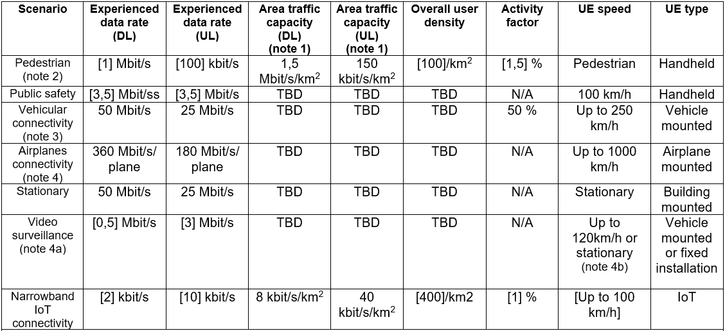
5G NTN Performance Goals
[1] Mbit/s
Downlink Link-Budget
Handheld
[100] Kbit/s
Uplink Link-Budget
50 Mbit/s
25 Mbit/s
Vehicle
mounted
 | Frequency | TX: EIRP [dBm] | RX: G/T [dB/T] | BW [MHz] | Path Loss [dB] | Add. L. [dB] | CNR [dB] | Shannon-Limit Data-Rate
LEO | S-Band | 78.8 | -31.6 | 30 | 159.1 | 5.3 | 6.6 | 22.37 Mbit/s
GEO | S-Band | 103.8 | -31.6 | 30 | 190.6 | 5.3 | 0.0 | 9.03 Mbit/s
 | Frequency | TX: EIRP [dBm] | RX: G/T [dB/T] | BW [MHz] | Path Loss [dB] | Add. Losses [dB] | CNR [dB] | Shannon-Limit Data-Rate
LEO | S-Band | 23 | 1.1 | 0.4 | 159.1 | 5.2 | 2.8 | 185.2 Kbit/s
GEO | S-Band | 23 | 19 | 0.4 | 190.6 | 5.4 | -10.9 | 13.57 Kbit/s
Assumptions: Full Target Resource Utilization, No Interference, No Frequency Re-Use, Ideal Channel Conditions
Source: 3GPP TR22.261 (19.7.0) „Service requirements for the 5G system; Stage 1” Table 7.4.2-1. Example Calculations based on SC4 and SC9
GRCon 18th Sept. 2024, 5G NTN Presentation, M. Petry
10

Slide 11
2
5G Satellite Integration Architecture
GRCon 18th Sept. 2024, 5G NTN Presentation, M. Petry
11

Slide 12
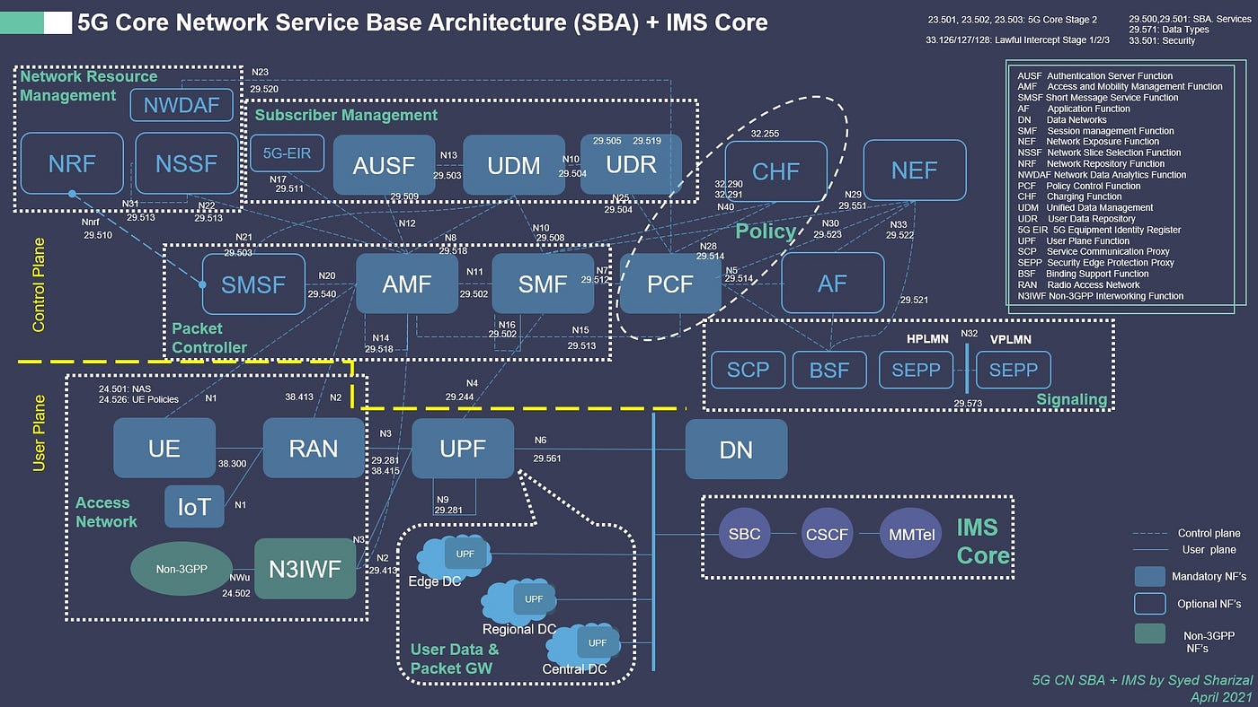
5G – The Land of Abbreviations
GRCon 18th Sept. 2024, 5G NTN Presentation, M. Petry
12

Slide 13
5G Base Station Architecture Primer
User-Equipment
Base station (gNB)
5G Core Network
Data Network
NR-Uu
NG
N6
Split Boundary
5G Stack Layers
Central Unit
Distributed Unit
Downlink
RF
PHY
MAC
Radio Link Control
Packet Data Convergence
Protocol
Service Data Adaption Protocol
Uplink
RF
PHY
MAC
Radio Link Control
Packet Data Convergence
Protocol
Service Data Adaption Protocol
Idea: Functional Split into Central Unit (CU) and Distributed Unit (DU)
GRCon 18th Sept. 2024, 5G NTN Presentation, M. Petry
13
Notes:
Why Split the Base station in two parts?
Serve multiple locations with 1 gNB
2
3

Slide 14
5G gNodeB Functional Split Options
Option 7.3
Downlink
SDAP
PDCP
RLC
MAC
PHY
RF
Coding
Rate Matching
Scrambling
Modulation
Layer Mapping
Resource Element Mapping
Beamforming
IFFT
CP Insertion
Uplink
SDAP
PDCP
RLC
MAC
PHY
RF
Decoding
Rate Matching
Descrambling
Demodulation
IDFT
Equalizer
Diversity Combiner
Channel Estimation
Resource Element Demapping
Port Reduction
FFT
CP removal
F1-Interface
4 Gbps
Inter-PHY / eCPRI splits
10 – 30 Gbps
Option 7.2
Option 7.1
CPRI
160 Gbps
GRCon 18th Sept. 2024, 5G NTN Presentation, M. Petry
14

Slide 15
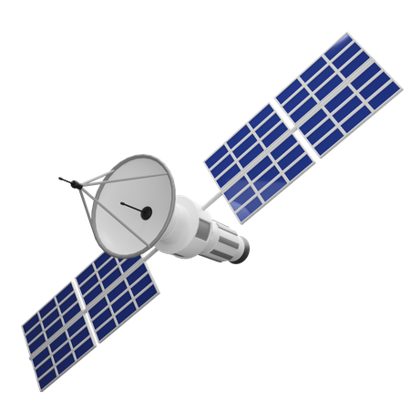
5G NTN Architecture - Categories
Transparent Architecture
Regenerative Architecture
gNodeB
in space
Transparent Satellite
Regenerative Satellite
NR Uu
NR Uu
5G-NR Waveform
5G-NR Waveform
NR Uu
NG
5G-NR Waveform
5G Backhaul
gNodeB
On ground
Gateway
Gateway
NG
NG
5G Core Network
GRCon 18th Sept. 2024, 5G NTN Presentation, M. Petry
15

Slide 16
Regenerative vs. Transparent - V2V Case Study
Round-Trip + 5G Processing Time
Regenerative [Transparent]:
LEO: 61.5 [113] ms
GEO: 1090 [2175,8] ms
Factor 0.5
Winner: Regenerative
V2V-Link
Intra gNodeB communication
Phase 1
Source for RT + Processing times: 3GPP TR38.821 (V16.2.0) „Solutions for NR to support non-terrestrial networks (NTN)” Table 7.1-1. 2x 5 ms Processing time assumed. Roundtrip is defined between vehicles. Worst-case propagtation delay assumed.
GRCon 18th Sept. 2024, 5G NTN Presentation, M. Petry
16

Slide 17
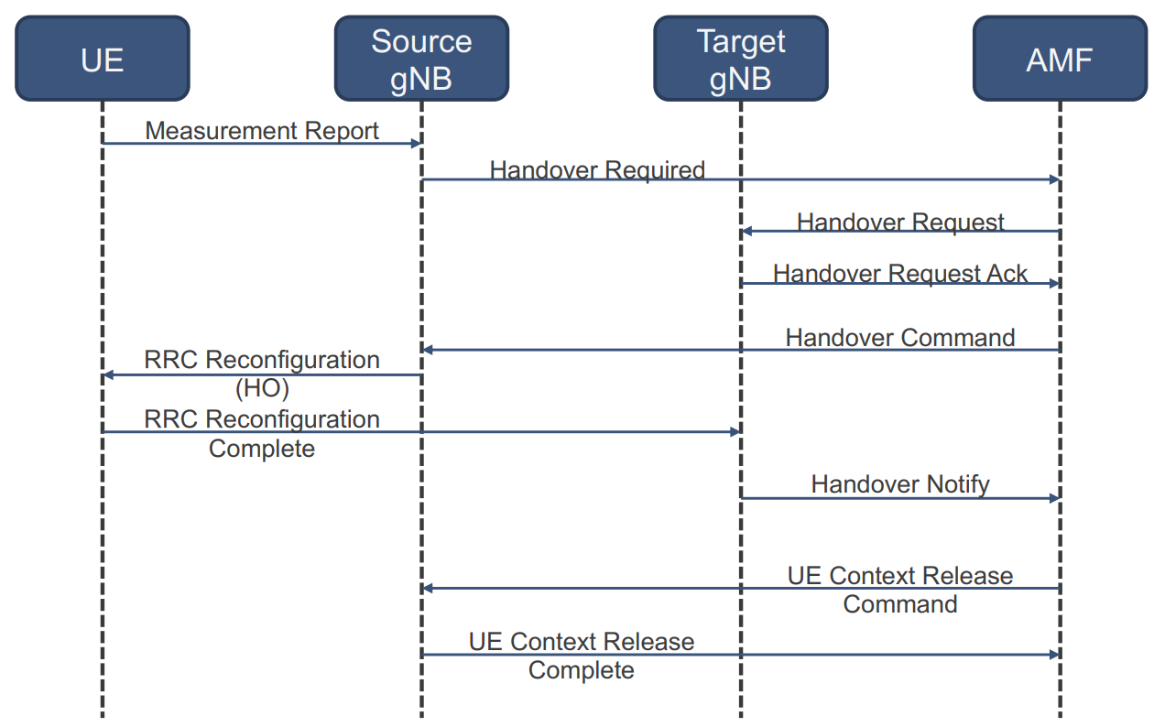
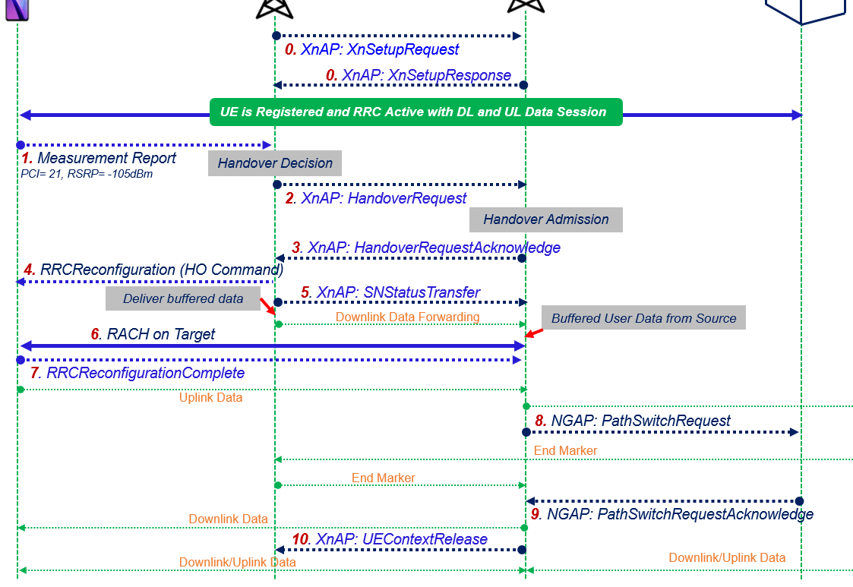
Regenerative vs. Transparent – Inter gNB Handover
Inter gNodeB handover
5GC-assisted (N2-based)
handover procedure time:
Regenerative [Transparent]
LEO: 163,9 [112] ms
GEO: 2742,3 [1659,38] ms
Factor 1.5
ISL-assisted (Xn-based) handover procedure time:
LEO: 104,4 ms
GEO: 1663,65 ms
Factor 1
Inter-Satellite Link
Xn
5G Handover Protocol ¹
5G Handover Protocol with Inter-gNB Link
UE
Source gNB
Target gNB
5GC
5GC
V2V-Link
No Winner
Intra gNodeB communication
Handover + Inter gNodeB communication
Phase 1
Phase 2a
¹ https://openairinterface.org/wp-content/uploads/2022/11/4-GTRI.pdf Geoergia Tech Research Institute
GRCon 18th Sept. 2024, 5G NTN Presentation, M. Petry
17
Notes:
LEO Transparent:
ue - gnb1: 2: 2x 25.77
ue - gnb2: 1: 1x 25.77
gnb1-core: 4: 4x 5? ms
gnb2-core: 3: 3x 5? ms
Total: 112
LEO Regen:
ue - gnb1: 2: 2x 12.89
ue - gnb2: 1: 1x 12.89
gnb1-core: 4: 4x 12.89 + 5?
gnb2-core: 3: 3x 12.89 + 5?
Total: 163,9 (Factor 1,4633928571428571428571428571429 worse)
GEO Transparent:
ue - gnb1: 2: 2x 541.46 ms
ue - gnb2: 1: 1x 541.46 ms
gnb1-core: 4: 4x 5? ms
gnb2-core: 3: 3x 5? ms
Total: 1659,38 ms
GEO Regen:
ue - gnb1: 2: 2x 270.73 ms
ue - gnb2: 1: 1x 270.73 ms
gnb1-core: 4: 4x 270.73 + 5? ms
gnb2-core: 3: 3x 270.73 + 5? ms
Total: 2742,3 ms (Factor 1,6526051898901999541997613566513 worse)
LEO Regen (with ISL):
ue - gnb1: 2x 12.89
ue - gnb2: 1x 12.89
gnb1-gnb2: 3x 10ms
gnb1-core: 0
gnb2-core: 2x 12.89 +5
Total: 104,45 ms
GEO Regen (with ISL):
ue - gnb1: 2x 270.73 ms
ue - gnb2: 1x 270.73 ms
gnb1-gnb2: 3x 100ms
gnb1-core: 0
gnb2-core: 2x 270.73 ms +5
Total: 1663,65 ms
More info:
https://www.tetcos.com/pdf/Performance-analysis-of-5G-Handovers-using-NetSim.pdf

Slide 18
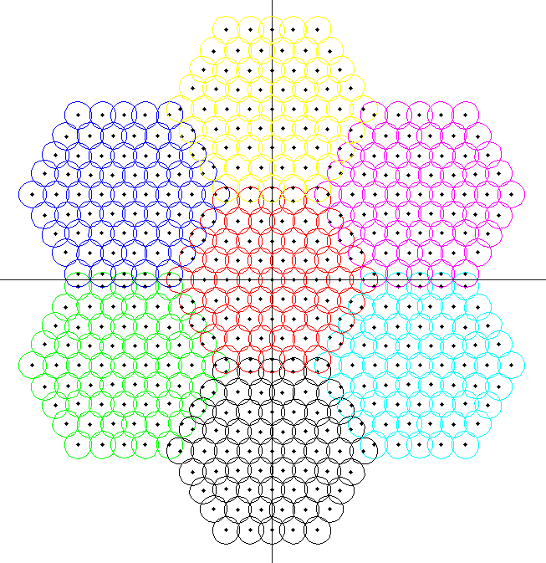
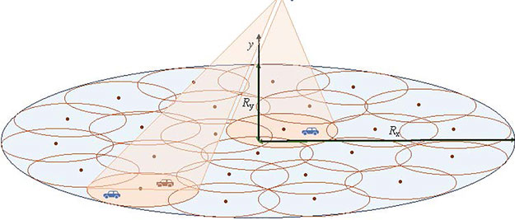
Regenerative vs. Transparent – Intra gNB Handover
Handover between sectors within a base station
Terrestrial
Non-Terrestrial
20km
Sector radius: 20 km (2m aperture / G=30 dBi)
Satellite Ground Speed: 7.4 km/s
Sector-Change every 2.7 seconds for non-stationary sectors
Intra gNodeB communication
Intra gNodeB handover
Phase 1
Phase 2b
GRCon 18th Sept. 2024, 5G NTN Presentation, M. Petry
18

Slide 19
Regenerative vs. Transparent – Inter-gNB Coms.
Inter-Satellite Link
Round-Trip + 5G Processing Time
Regenerative (Xn) [Transparent]:
LEO: 71,5 [123] ms
GEO: 1282 [2185,8] ms
Factor 0.58
Xn
Winner: Regenerative
V2V-Link
Intra gNodeB communication
Handover + Inter gNodeB communication
Phase 1
Phase 2
Intra gNodeB communication
Phase 3
GRCon 18th Sept. 2024, 5G NTN Presentation, M. Petry
19

Slide 20
3
5G gNodeB Implementation on-board the Satellite
GRCon 18th Sept. 2024, 5G NTN Presentation, M. Petry
20

Slide 21
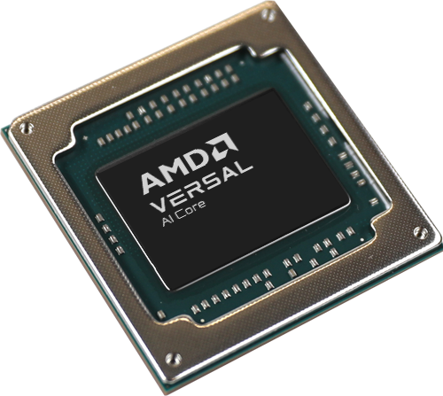
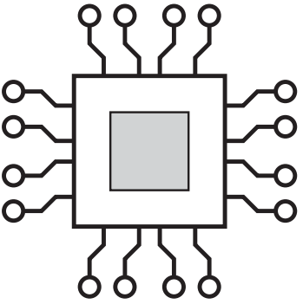
5G gNodeB on AMD-Xilinx VERSAL
AMD-Xilinx VERSAL™ aSoC
Adaptive System on Chip
… is a hybrid architecture integrating
Programmable Processors (CPU)
Programmable FPGA Fabric
Programmable Accelerator Engines
5G Software Stack
OpenAirInterface
… is a 5G framework
Open-source
Developed by our partners
Big Community
CPU
FPGA
Intelligent Engines
DUAL-CORE ARM® CORTEX™-A72
Application Processor
DUAL-CORE ARM CORTEX-R5F
Real-Time Processor
=> General Purpose Functions
Look-up tables: 900k
Logic cells: ~2M
=> DSP Functions
400 AI Engines
DSP Engines
=> AI Functions
GRCon 18th Sept. 2024, 5G NTN Presentation, M. Petry
21

Slide 22
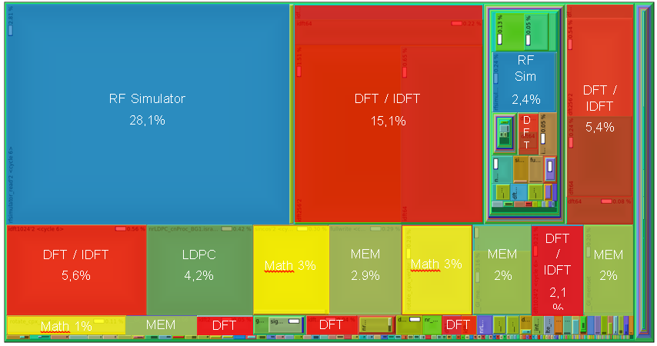
Approach 1: OAI on VERSAL without HW acceleration
CPU Resource Utilization Profiling by Function
CPU
=> General Purpose Functions
Not used
FPGA
=> DSP Functions
GRCon 18th Sept. 2024, 5G NTN Presentation, M. Petry
22

Slide 23
Approach 2: OAI on VERSAL with PHY HW acceleration
Preliminary Performance Evaluation: Inter-PHY Split Option 7.1
Resource utilization for multiple PHY configurations for HW-accelerated and non-HW-accelerated mode:
No Hardware Acceleration
no
73 %
yes
53 %
75 %
DFT/IDFT Hardware Acceleration
no
yes
55 %
no
93 %
yes
91 %
Evaluated PHY configurations:
CPU in saturation
20 % CPU Utilization Reduction with HW-accelerated DFT/IDFT
GRCon 18th Sept. 2024, 5G NTN Presentation, M. Petry
24

Slide 24
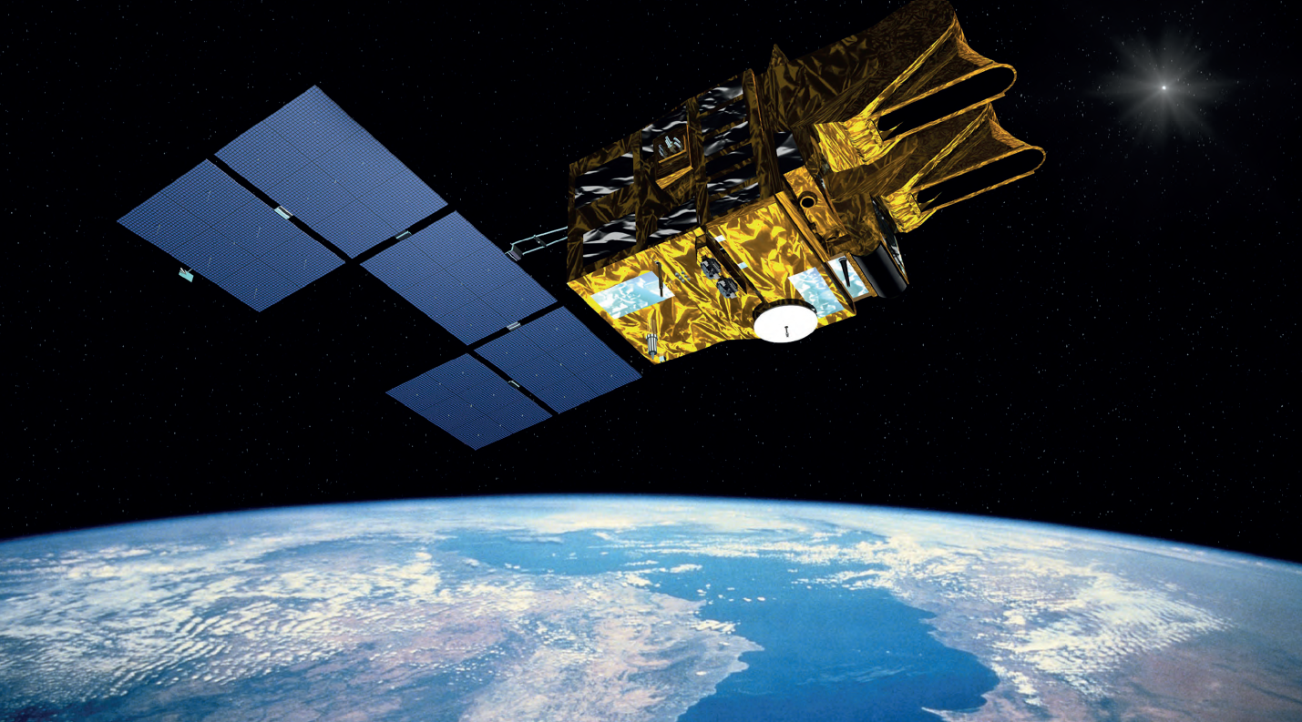
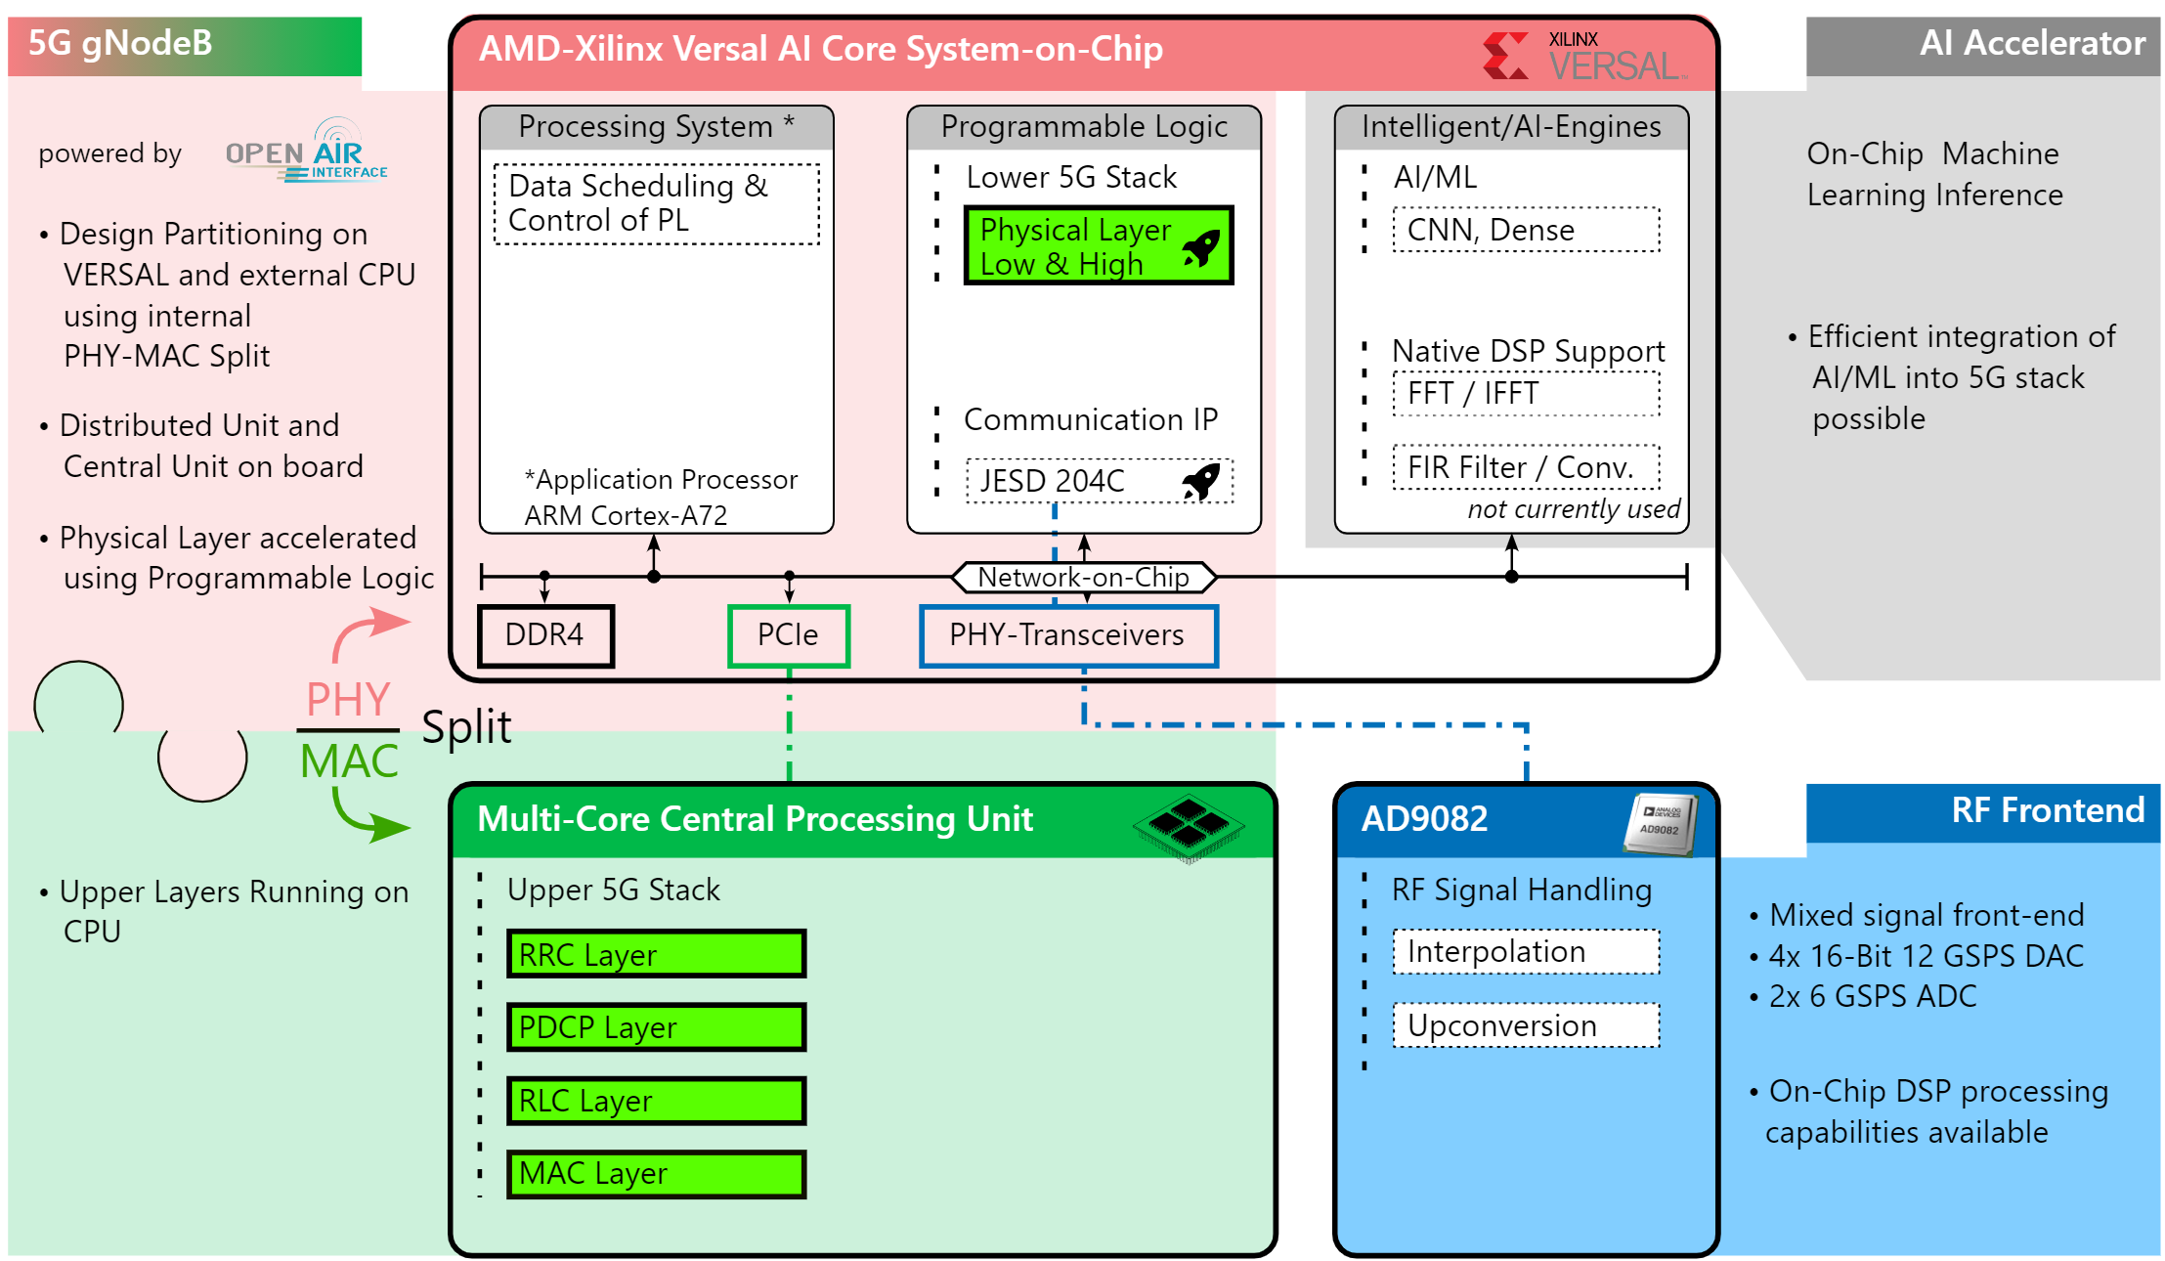
The Big Picture: gNodeB on Next-Gen Telecom-Sat. Processor
CAN / Space-Wire Bus
Fibre interconnect
5G gNodeB
Developed at
Slices
Control Unit
RF Frontend
Re-Gen Module
Multi-Core
Processor
FPGA
VERSAL
Theia Processor
Harness
Multi-Core Processor
Control Unit
FPGA Slice
Re-Gen Module
RF Frontend
NVRAM
SX4000
(ASIC)
AD9082
Slow i/o
Main MCU
1st stage conversion
Versal adaptive SoC
Multi-Core Processor System
Fibre connector
DDR4
Fibre connector
DDR4
Functional Slices
A/D Converters
CAN
Fibre
Optical transceiver
PCIe
SX4000
(ASIC)
Up/Down Conversion
Optical Transceivers
Fibre connector
DDR4
Supervisor
CAN / SpW
DDR4
NVRAM
CAN / SpW
GRCon 18th Sept. 2024, 5G NTN Presentation, M. Petry
25
Notes:
Eine kleine Intro zu den Komponenten (high-level) die ein neuer, ML-tauglicher Telekom-Satellit-Prozessor hat. Auch intro zu den typischen RF use-cases: Transparent (d.h., signal quasi nur empfangen, und verstärkt in eine andere Richtung abstrahlen), Re-Gen (Regeneration) (d.h., Signal wirklich demodulieren und decodieren und frisch neu generieren, damit gewinnt man ein paar dB, dafür ist es aufwendiger), und neu RF mit ML capabilities (z.B. für 5G/6G, allgemein gehalten)
Kleine Infos zu den verschiedenen Slices: Control (selbsterklärend), RF-Frontend (1.5 GHz bandbreite 4 ADC+4DAC, bis 28 GHz), Re-Gen (mit proprietary ASIC DVB-S2 standard), US-FPGA (Versal) ist speziell für AI optimiert (siehe später).

Slide 25
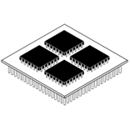
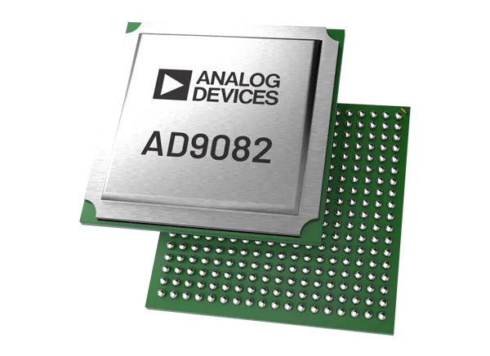
Heterogeneous gNodeB Implementation Concept
5G gNodeB
AMD-Xilinx VERSAL AI Core System-on-Chip
AI Accelerator
powered by
Processing System*
Programmable Logic
Intelligent/AI Engines
• On-Chip Machine
Learning Inference
• Design Partitioning on
VERSAL and external CPU
using internal
PHY-MAC Split
Data Scheduling & Control of PL
Lower 5G Stack
AI / ML
Physical Layer Low & High
CNN, Dense
• Efficient integration of
AI/ML into 5G stack
possible
Native DSP Support
• Distributed Unit and
Central Unit on board
Communication IP
FFT / IFFT
*Application Processor ARM Cortex-A72
JESD 204C
FIR Filter / Conv.
not currently used
• Physical Layer accelerated
using Programmable Logic
Network-on-Chip
HW accelerated
DDR4
PCIe
PHY-Transceivers
PHY
MAC
5G Layer
Split
Non-5G Layer
Multi-Core Central Processing Unit
AD9082
RF Frontend
• Upper Layers Running on
Multi-Core CPU
Upper 5G Stack
RF Signal Handling
• Mixed signal front-end
• 4x 16-Bit 12 GSPS DAC
• 2x 6 GSPS ADC
RRC Layer
Interpolation
PDCP Layer
Upconversion
RLC Layer
• On-Chip DSP processing
capabilities available
MAC Layer
GRCon 18th Sept. 2024, 5G NTN Presentation, M. Petry
26

Slide 26
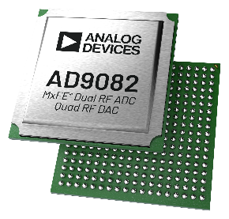
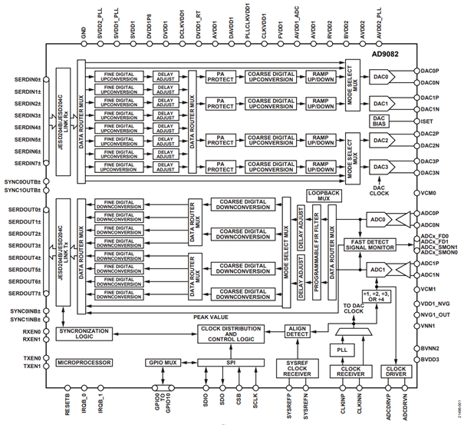
AD9082 mixed signal front-end (MxFE®)
AD9082
Features & Specifications
Configurable sampling rate schemes
Four 16-bit DACs: 3 GSPS to 12 GSPS
Two 12-bit ADCs: 1.5 GSPS to 6 GSPS
RF synthesis and sampling up to 7.5 GHz (3 dB RF bandwidth)
Maximum receive bandwidth of 3 GHz (Nyquist)
Maximum transmit bandwidth is configuration dependent
Four transmit channels: 16-bit = 1.2 GHz IBW, 12-bit = 1.6 GHz IBW
Two transmit channels: 16-bit = 2.4 GHz IBW, 12-bit = 3.2 GHz IBW
One transmit channel: 4.8 GHz IBW for N' = 8-bit
Signal processing blocks supporting multiband
Transmit: eight DUC paths shared by four DACs; up to 64× interpolation
Receive: eight DDC paths shared by two ADCs; up to 96× decimation
Additional DSP features
PA protection for transmit
96-tap programmable filter per ADC; or 192 taps total for receive
Timing adjustments for receive QEC optimization
Flexible on-chip PLL for clocking; multichip synchronization
GRCon 18th Sept. 2024, 5G NTN Presentation, M. Petry
26
Notes:
This slide shows proof of this product’s strengths.

Slide 27
Check out our 5G NTN Live Demo in the Exhibition
GRCon 18th Sept. 2024, 5G NTN Presentation, M. Petry
28

Slide 28
Excited?
The Future of Space Communications is Bright
5G NTN is going to come
It will revolutionize satellite access
… for the better of everyone
GRCon 18th Sept. 2024, 5G NTN Presentation, M. Petry
29

