Slide 1
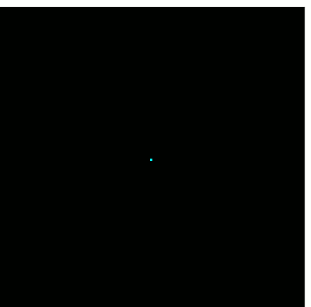
SigMF Update GRCon24
Marc Lichtman

Slide 2
SigMF Overview
Open standard for storing RF to file
Binary IQ file + JSON file
SigMF specifies the JSON
Forces proper documenting of critical metadata easily lost when throwing tons of IQ files into a folder
Includes numerous optional fields specific to RF signals
Annotations can be used to mark interesting time-frequency bounding boxes
Extensions

Slide 3
History
Started in 2017 at DARPA Hackfest in Brussels, by Ben Hilburn and others
Developed as a GNU Radio organization project
Motivation:
Software interoperability
Avoid bitrot of datasets
Collaborative processing/analysis
Nothing already out there specific to RF signals (besides proprietary formats)

Slide 4
Used by Many
NTIA maintains their own set of Extensions https://github.com/NTIA/sigmf-ns-ntia
Basic support in lots of software (GNU Radio, Inspectrum, etc)
IQEngine.org is entirely built on top of the SigMF standard
Muon Space is using SigMF to bring raw RF from satellites to a data pipeline on the ground
DeepSig within OmniSIG and their datasets
Airbus, as part of internal software
MISP open source threat intelligence and sharing platform
MATLAB’s sigmf() function
Notes:
Sigmoidal membership function

Slide 5
{
"global": {
"core:datatype": "cf32_le",
"core:sample_rate": 40000000,
"core:hw": "PlutoSDR with whip antenna",
"core:author": "Art Vandelay",
"core:version": "1.0.0",
"core:description": "Describe your signal/recording here"
},
"captures": [
{
"core:sample_start": 0,
"core:frequency": 880000000,
"core:datetime": "2022-03-17T16:43:30Z"
}
],
"annotations": [
{
"core:sample_start": 100000,
"core:sample_count": 200000,
"core:freq_upper_edge": 884625000,
"core:freq_lower_edge": 883275000,
"core:label": "LTE"
},
…

Slide 6
Datatype Reference

Slide 7
Where to find the Specs
Source of truth is now the official JSON schema
We render HTML and PDF from the JSON schema and a .md file
https://sigmf.org/
PDF
New process improves readability and ensures content only lives in 1 spot

Slide 8
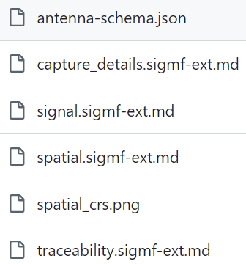
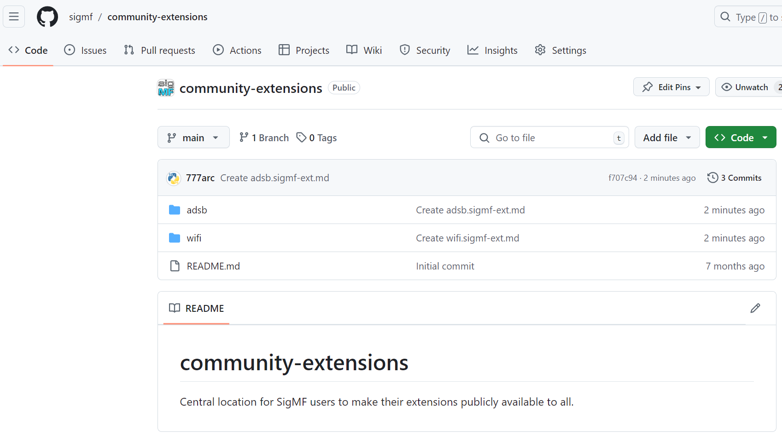
Community Extensions
“Core” extensions can be found in the main repo →
A separate repo in the SigMF GitHub org for anyone to submit extensions
Must be used by at least one group or individual and have potential to improve software interoperability that SigMF enables
https://github.com/sigmf/community-extensions

Slide 9
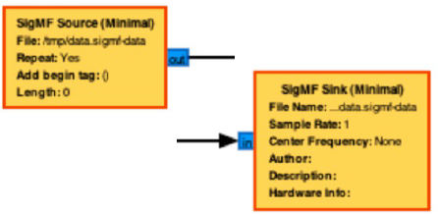
SigMF in GNU Radio
SigMF “Minimal” Blocks – basic functionality
https://github.com/jacobagilbert/gr-sigmf_utils
SigMF File Source – intelligent file specification, type conversion, etc
Add Tags From Metadata – adds annotation metadata as stream tags
Tag Meta Writer – produces metadata annotations from stream tags
PDU Meta Writer – produces metadata annotations from PDUs
Looking for someone or some group to lead an official gr-sigmf!

Slide 10
Python Package
pip install sigmf
Code lives https://github.com/sigmf/sigmf-python
Read, create, validate SigMF
Also includes support for Collections and Archives
Huge thanks to Kyle Logue (aka Teque5) for maintaining it, and the many contributors

Slide 11
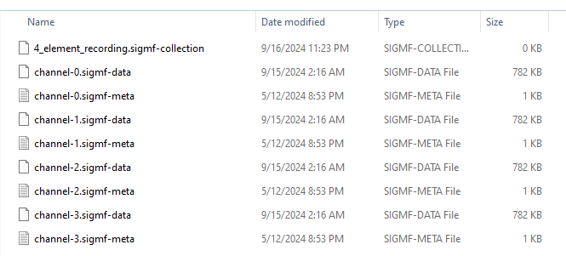
Collections and Archives
Using a Collection to logically group up a bunch of Recordings
An “Archive” is when you .tar multiple Recordings (and usually a Collection file)
The .tar itself does not include compression, SigMF does not care which compression is used on top of the .tar

Slide 12
Spec Updates
v1.2.0 released Feb ’24
New optional uuid in the Annotations object
Some tweaks to the spatial extension
Lots of language improvements/clarifications
Officially recommending Collections as the go-to method for multichannel recordings (avoid using num_channels!)
Likely adding a Captures scope geolocation field in the near future (currently it’s a Global field, although it’s not being removed)
Moving away from SigMF as an acronym

Slide 13
Next steps
Landing page for https://sigmf.org/
Until then, learn more at https://iqengine.org/sigmf
Includes a “learn SigMF in 5 minutes” readthrough, and validator
Making JSON schemas for the remaining core extensions, allowing them to be automatically rendered in the HTML/PDF
VSCode extension?
Increasing adoption
Get our Wikipedia draft approved https://wikipedia.com/SigMF
Release a v1.3 once we make a couple more minor specs changes
We’re in a stable state at this point

