Slide 1


Real-Time FMCW Radar System for Waveform Optimization using SDRs
Shammi Doly
Ph.D. Candidate in Electrical Engineering
A work of Prof. Dr. Daniel W. Bliss
WISCA FutureG/CoE JRCs Research

Slide 2

Outline
Background
System Overview
Approaches and Challenges
Results and Analysis
HWIL Over-The-Air Demo
sdoly.grconf-24

Slide 3
System Overview
Key Contribution
Develop a highly flexible real-time FMCW radar system for designing and testing different radar waveforms (e.g., triangular, sawtooth),
Waveform adaptive co-design technique in a single a real-time feedback loop for multi-user networks applications leveraging low-cost SDRs,
Explore the benefits radar waveform optimization, particularly through increasing RMS bandwidth, significantly boosting target detection performance by enhancing range resolution.
sdoly.grconf-24

Slide 4
System Design
Contributions
VCO-based Chirp Design/ Waveform Selection
Spectrum Shaping/ Waveform Optimization
Delay Detection Test
sdoly.grconf-24

Slide 5

Pulsed vs CW Radar
Most radars use pulsed waveforms
  The pulse is repeated each PRI
  Switch between transmit and receive modes (T/R modules)
  Duty cycles range from .1 to 10%
  Longer pulse means more integration (good)
CW Radar transmits and receives simultaneously
Self interference can potentially be huge
  Can literally blow up front ends
  Typically limited to lower power systems
Historically, often assumed to be pure tone waveform
  No ranging, just detection and Doppler estimation
Frequency-modulated continuous wave (FMCW)
  Provides both range and velocity information
  Complex
Courtesy: Dan’s lecture
PRI
Slow time
Radar
Target
sdoly.grconf-24

Slide 6
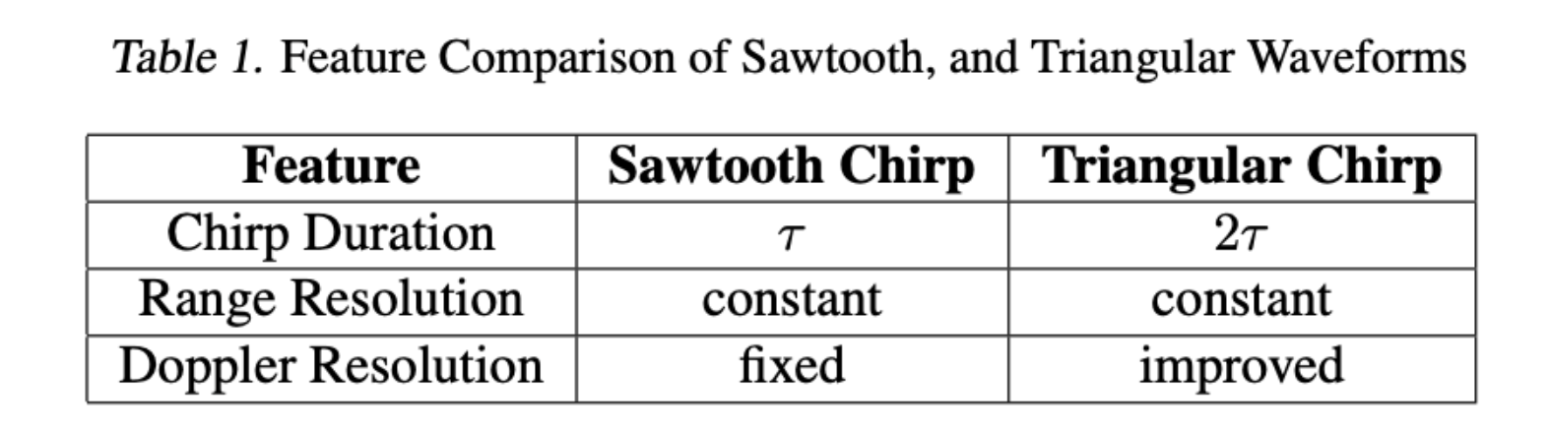
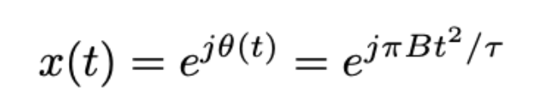
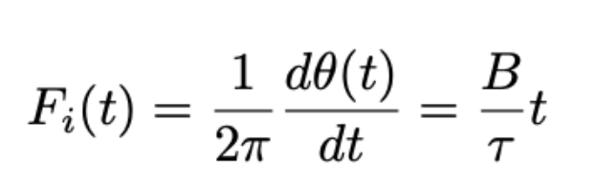
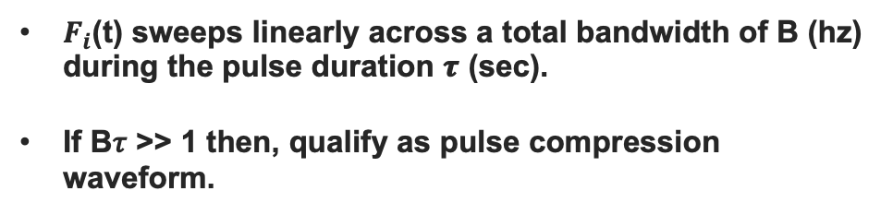
Radar Waveforms
(Chirp)
Linear FM Waveforms
$F_{i}$(t) sweeps linearly across a total bandwidth of B (hz) during the pulse duration 𝝉 (sec).
If B𝜏 >> 1 then, qualify as pulse compression waveform.
Chirp Spectral Cartoon
Power Spectral
Density (linear)
Courtesy: Dan’s lecture
B = 4
T = 20
sdoly.grconf-24

Slide 7
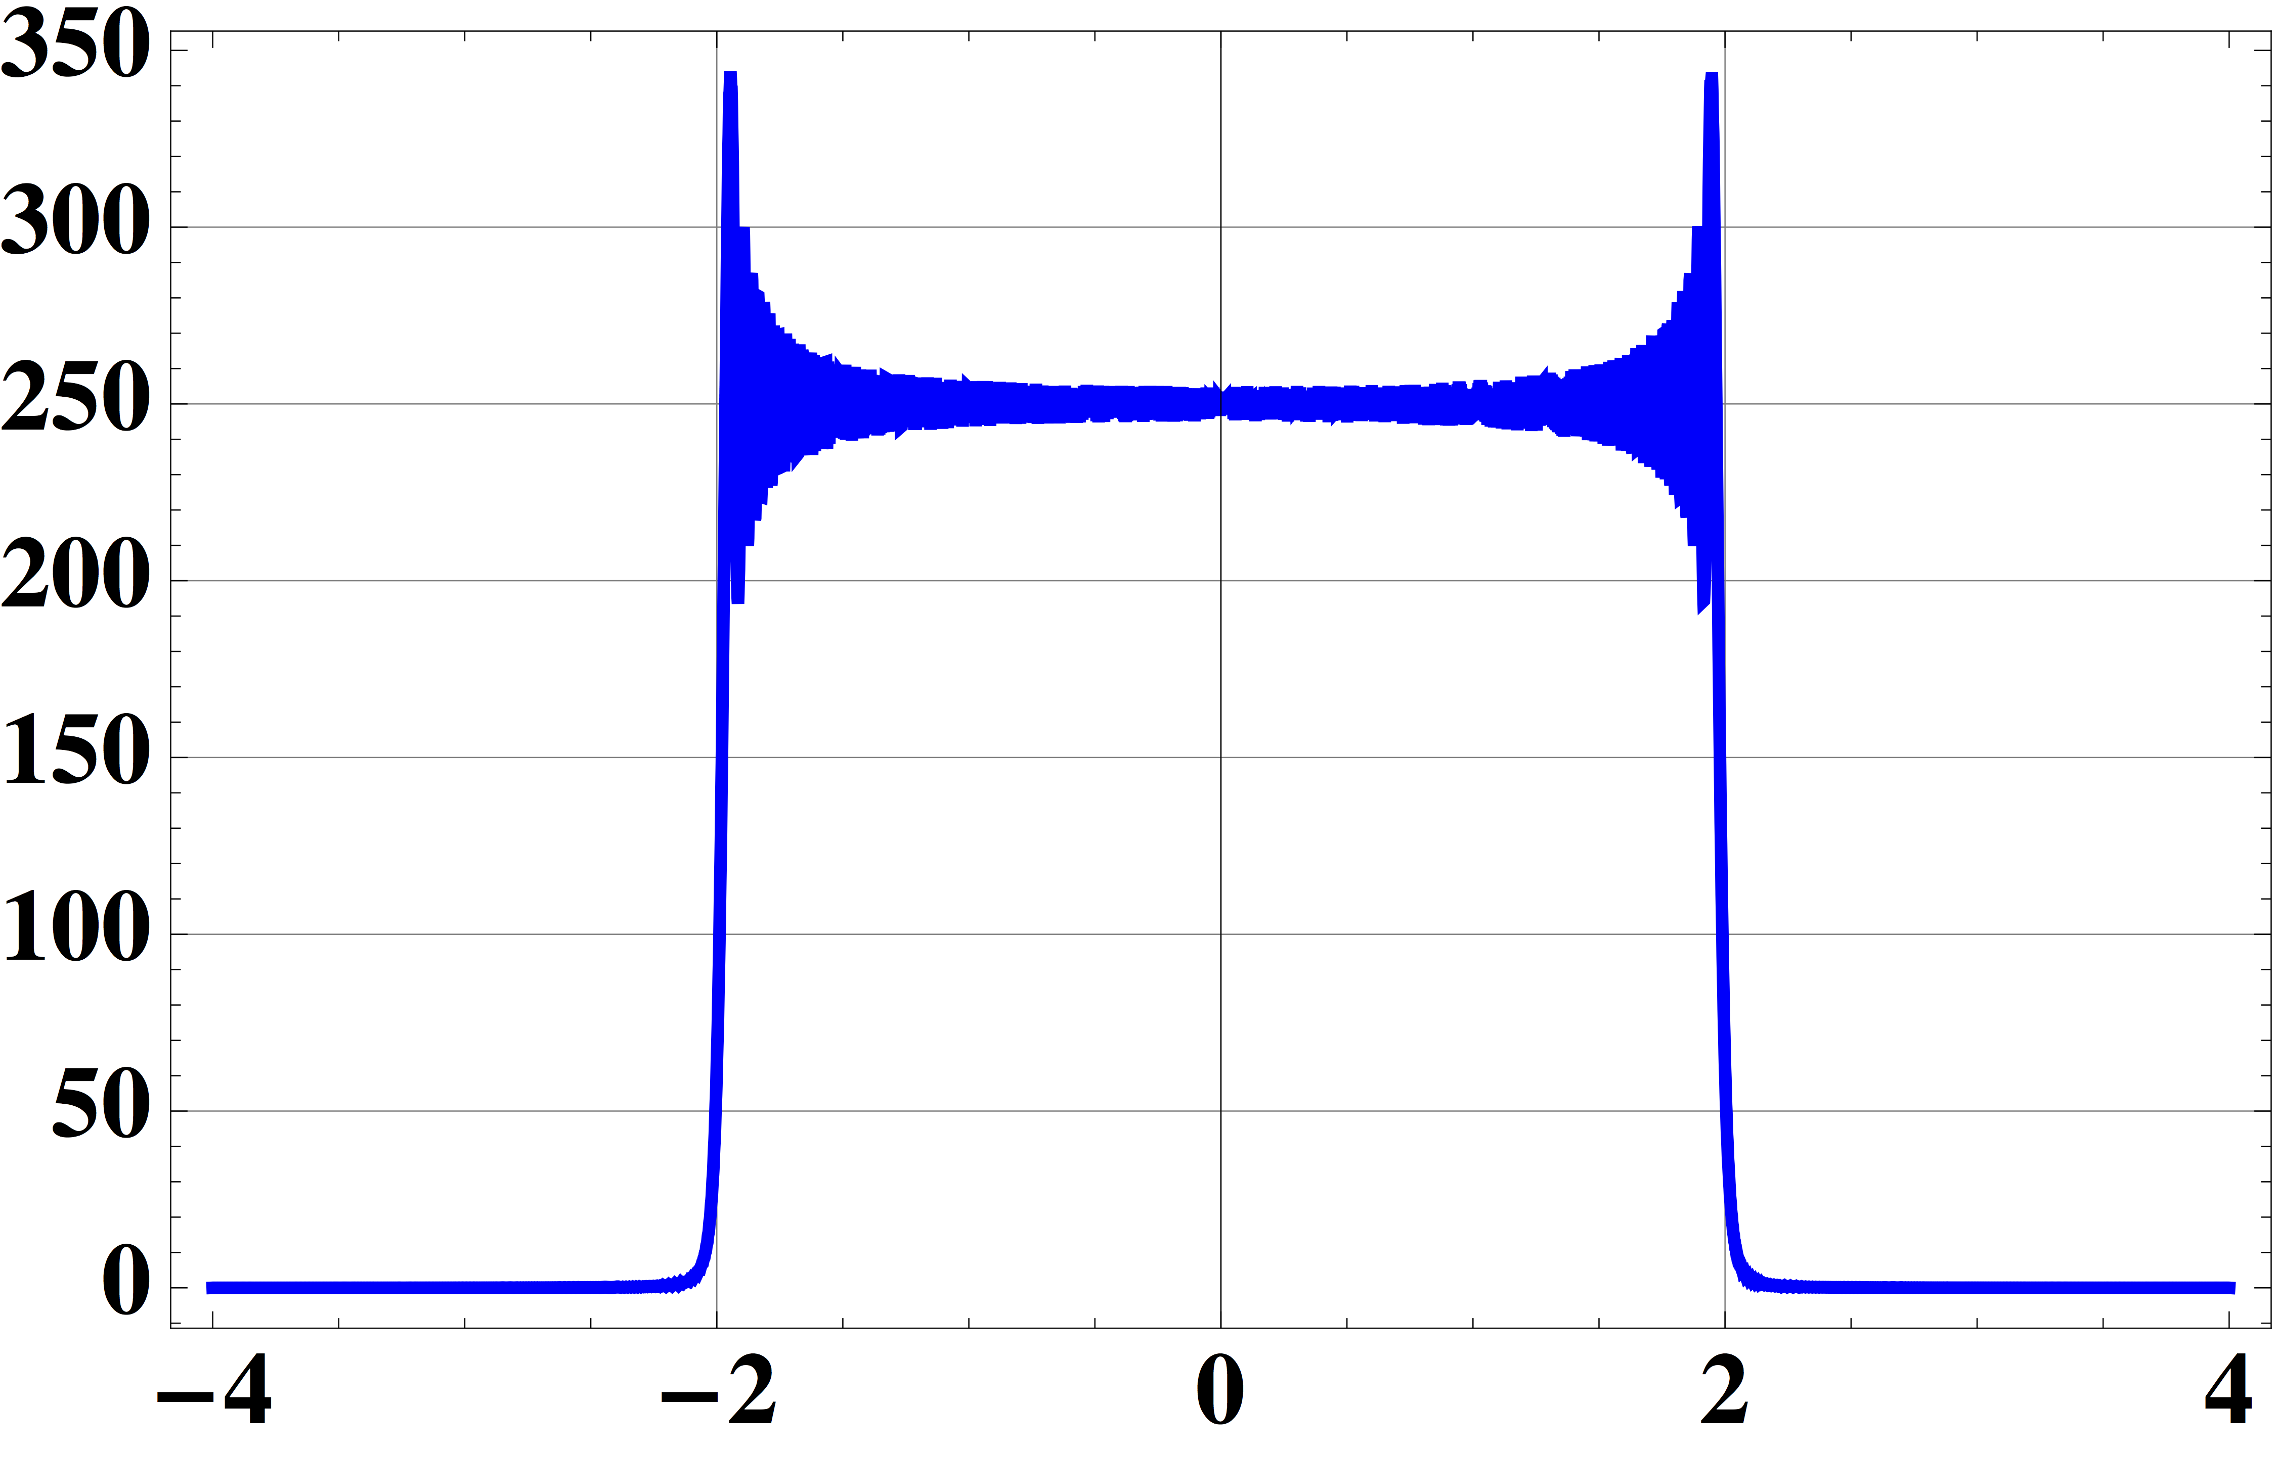

FM Pulse Compression Chirp
Waveform Design
Spectral coverage becomes more uniform as pulse duration increases
Only one free parameter in design of pulse radar -
Range
  Cell ~ 1/Bandwidth
Angle
  Cell ~ 1/Aperture
Doppler
  Cell ~ 1/Duration
Pulse compression decouple energy and resolution
If B𝜏 >> 1 then, qualify as pulse compression waveform. ( Rayleigh bandwidth B = 1/ 𝜏)
Power Spectral
Density (linear)
Power Spectral
Density (linear)
B = 4
T = 20
B = 4
T = 100
I Am Batman
Power Spectral
Density (linear)
B = 4
T = 1000
dc.wikia.com
Courtesy: Dan’s lecture
sdoly.grconf-24

Slide 8
System Design
Contributions
Radar Design/ Waveform Selection
Spectrum Shaping/ Waveform Optimization
Delay Detection Test
sdoly.grconf-24

Slide 9
RF Convergence
(Background)
FCC Allocation Chart
Goal : Optimization of Linear Frequency Modulation (LFM) chirp waveforms for optimal jt. performance.
Waveform Co-design Approach
We pose waveform design problem as--
partially observable Markov decision process (POMDP^{)1.}
Dynamic programming approaches.
  Nominal belief-state optimization (NBO),
  Random sampling-multipath hypothesis propagation (RS-MHP)
Heterogeneous and large network we can consider Dec-POMDP.
Courtesy: Dan’s lecture
Relationship between an agent and its environment
Radar-comms system
Dynamic environment
Radar-comms receiver
POMDP planner
Transmitted
waveform
Motivations / Benefits
  Spectrum Sharing
  Resource Efficiency
  Reduced Costs
  Next-Gen Wireless
Waveform
selected
Learn
& decide
Measurement
of the system
Radar return+ comms sig
Multi-access scenario
¹S. Doly, A. R. Chiriyath, H. Mittelmann, D. Bliss, and S. Ragi, “Waveform codesign for radar-communications spectral coexistence via dynamic programming,” IEEE Transactions on Aerospace and Electronic Systems, 2022
sdoly.grconf-24

Slide 10
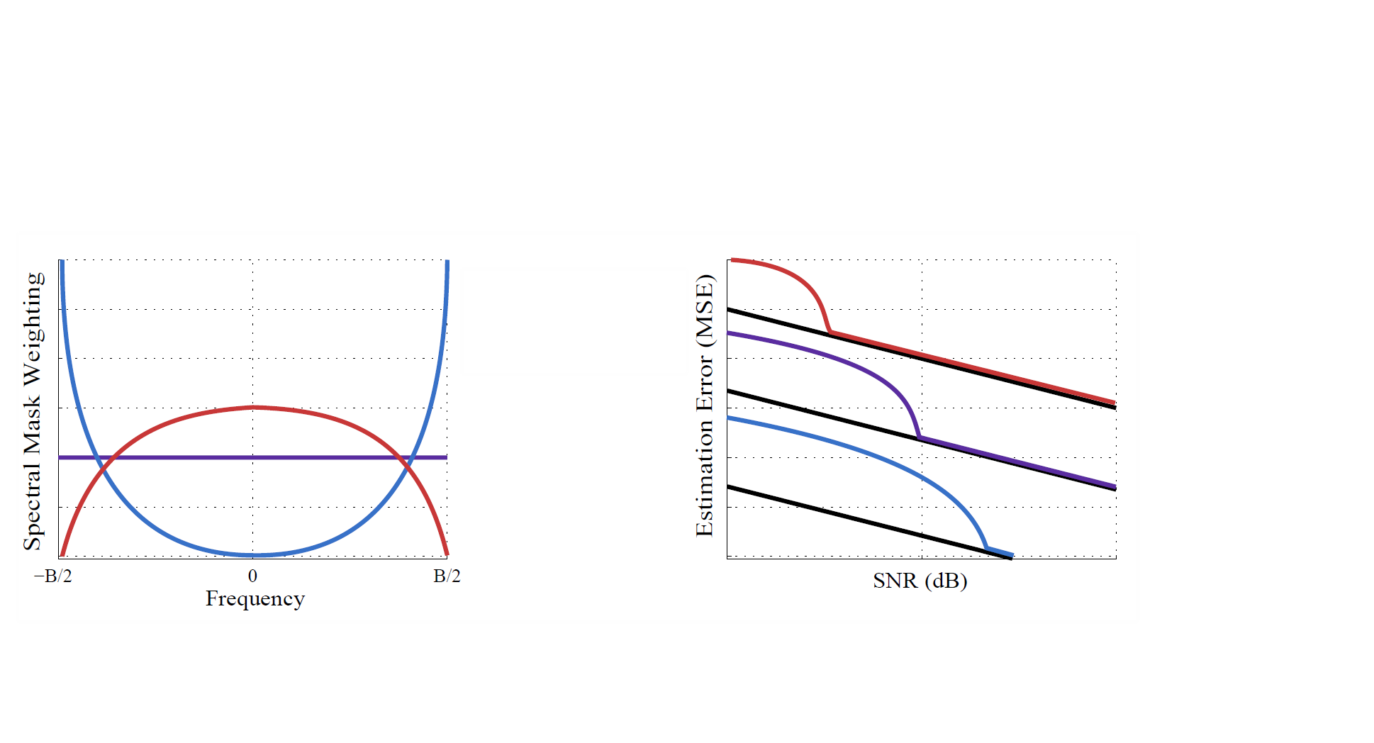
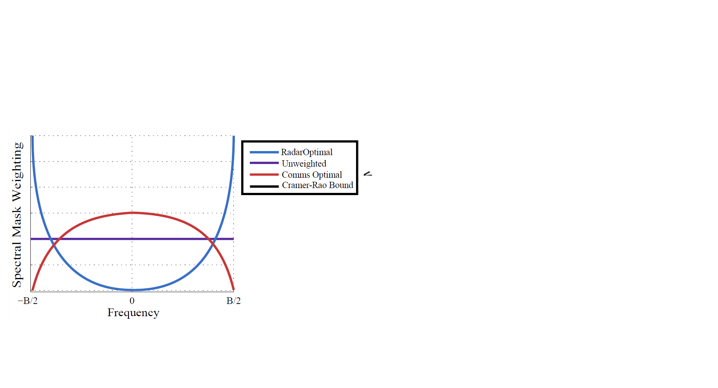
Range (Delay) Estimation Uncertainty
( Importance of Spectrum Shaping)
Accurate delay estimation is crucial for determining the range of a target.
Cramér-Rao Bound (CRB) provides theoretical limit on the accuracy with which the delay of a signal can be estimated.
Cramer-Rao Bound
Radar
Target
Courtesy: Dan’s lecture
(dB)
Est. Perf. vs. CRLB Threshold Tradeoff
More Bandwidth Higher the SNR
  improves the Fisher Information,
  leading to a lower CRB,
  more information about the delay.
Pic Courtesy : Alex
sdoly.grconf-24

Slide 11
System Design
Radar Design/ Waveform Selection
Spectrum Shaping
Radar Test -- > Stretch Processing
sdoly.grconf-24

Slide 12
Pulse Compression
Stretch Processing – Cheap Chirp Trick
Reference Chirp and Return
Approximate matched filter
  Multiply by conjugate chirp at receiver
Exploit delay-Doppler degeneracy
  Delay produces frequency shift
  Estimate range with FFT
Chirp Spectral Cartoon
Reference Chirp and Return
Overlapped section
Delay translates into
beat frequency
Courtesy: Dan’s lecture
sdoly.grconf-24

Slide 13
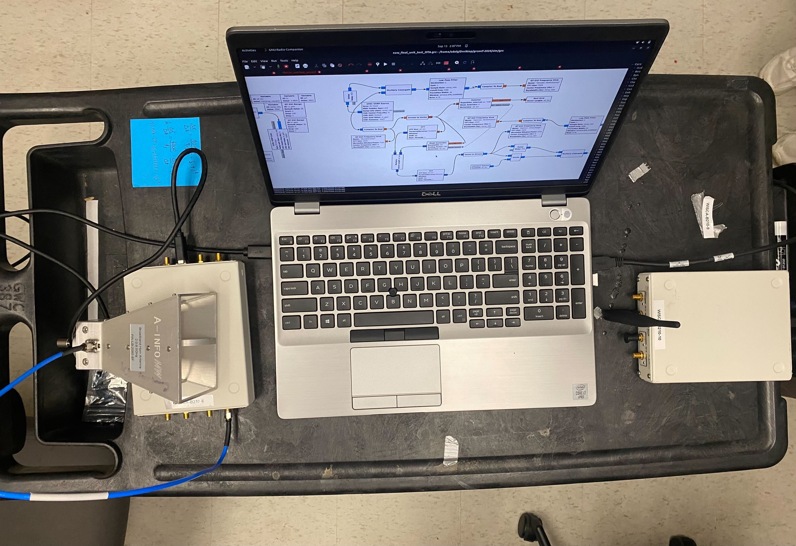
System Design
Stretch Processing
GNU Radio Experimental Flowgraph
VCO-based chirp synthesizer
  Sawtooth
  Triangular
Chirp optimization
  Mask generator
  Feedback / message generator block
Stretch Processing
Chirp Optimization
Chirp Synthesizer
Transmitter
Receiver
Stretch Processing
sdoly.grconf-24

Slide 14
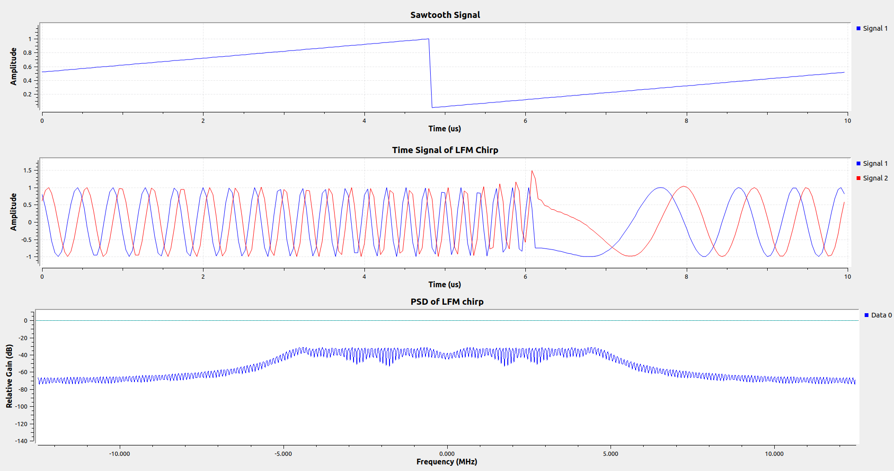
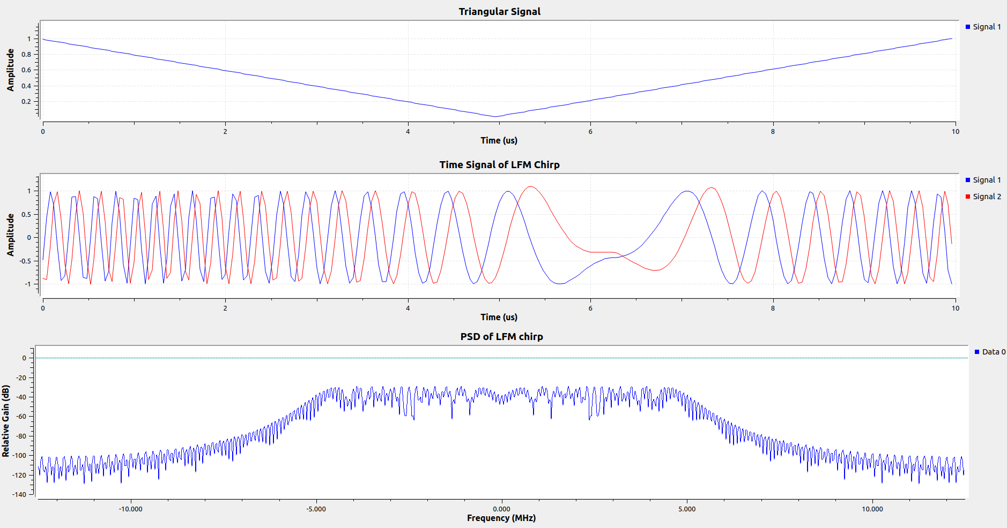
VCO - based Chirp Synthesizers
Sawtooth Chirp
Up-sweep only (0 to T)
Block Processing Latency
GNU Radio Chirp Generation Flowgraph
Triangular Chirp
  Up-sweep (0 – T/2)
  Down-sweep (T/2 – T)
GNU Radio Voltage-Controlled Oscillator - (VCO)
  input: float stream of control voltages
  output: float oscillator output
  VCO Sensitivity = (2 * 𝜋* BW / input volt)
  lag between the VCO I/Q samples output
  and a signal generator
Parameters
  Sample Rates(Hz)
  Sensitivity (radians/sec/(input unit)
  Amplitude
Block Processing Latency
sdoly.grconf-24

Slide 15
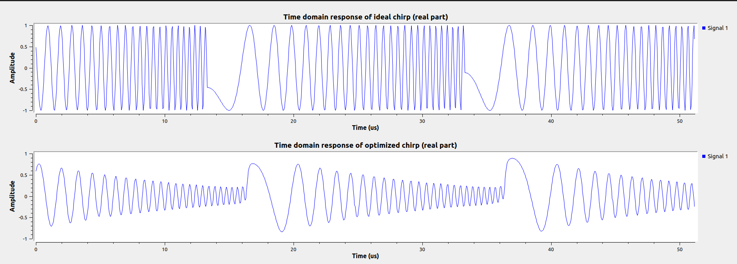
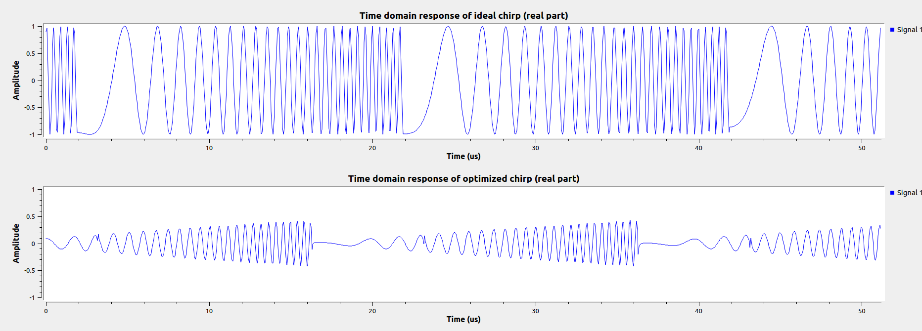
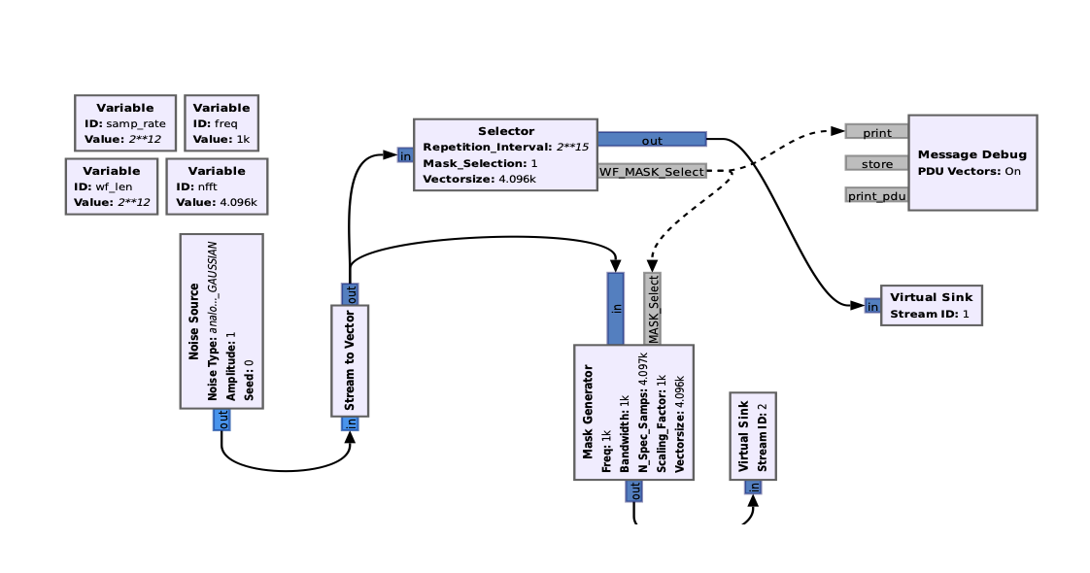
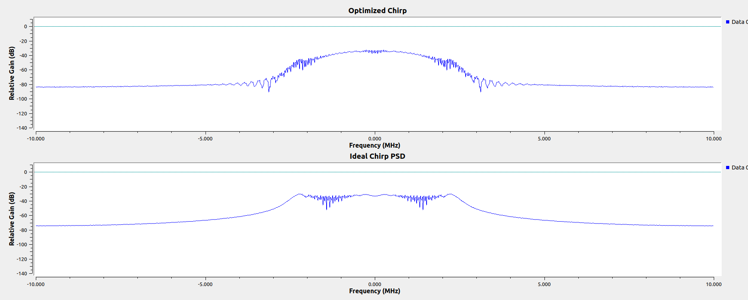
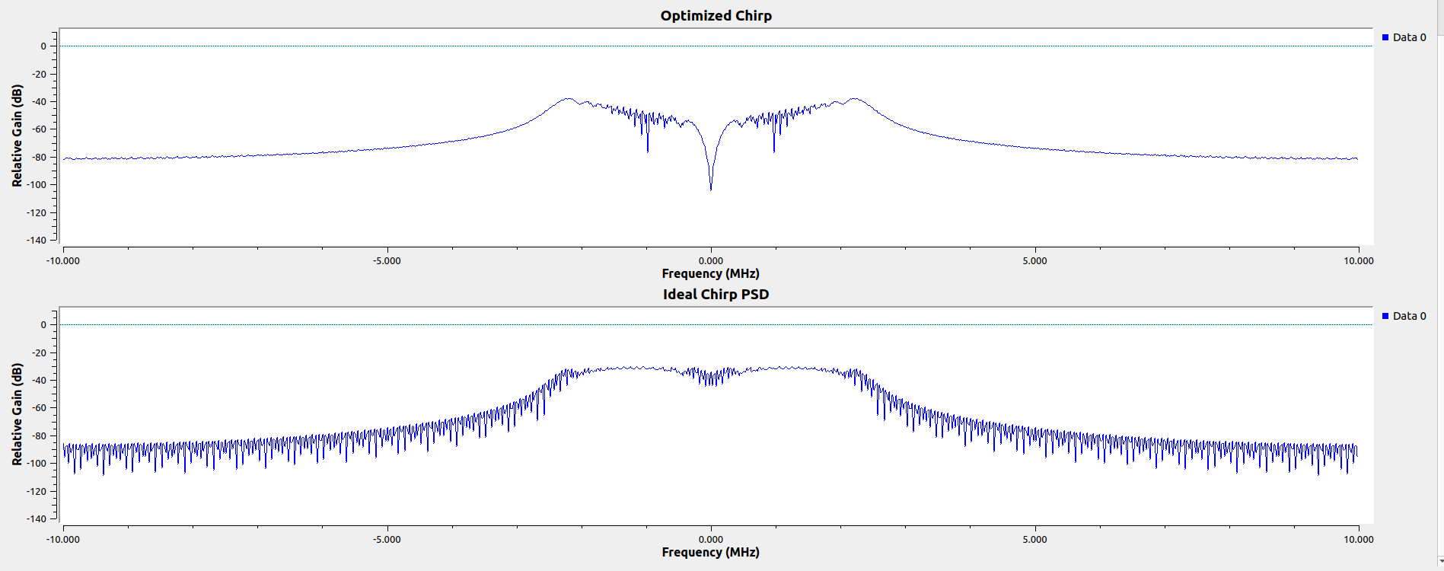
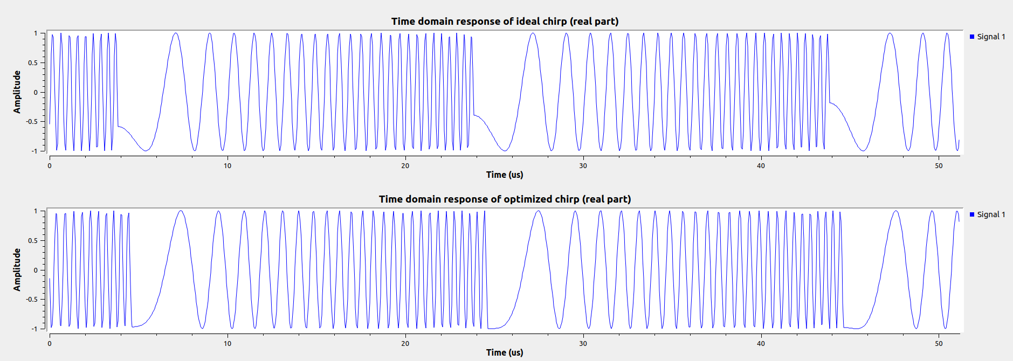
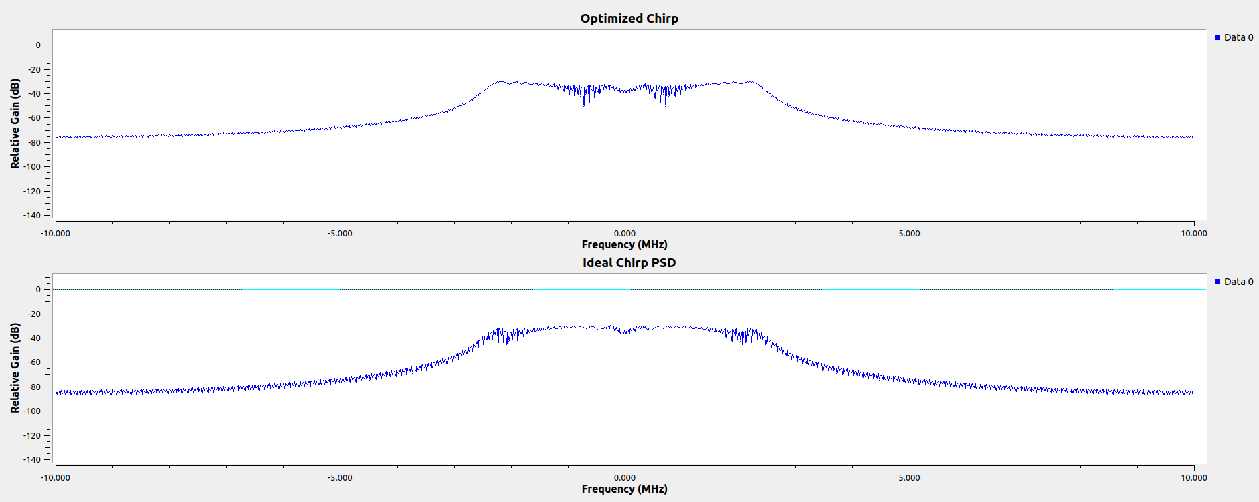
Chirp Optimization : Spectral Masking Method
Radar Optimal
Feedback loop
Comms Optimal
Spectrum Masking Flowgraph
Est. Perf. vs. CRLB Threshold Tradeoff
Radar Optimal: Brms
Comms Optimal : Brms
Pic Courtesy : Alex
Unweighted
sdoly.grconf-24

Slide 16
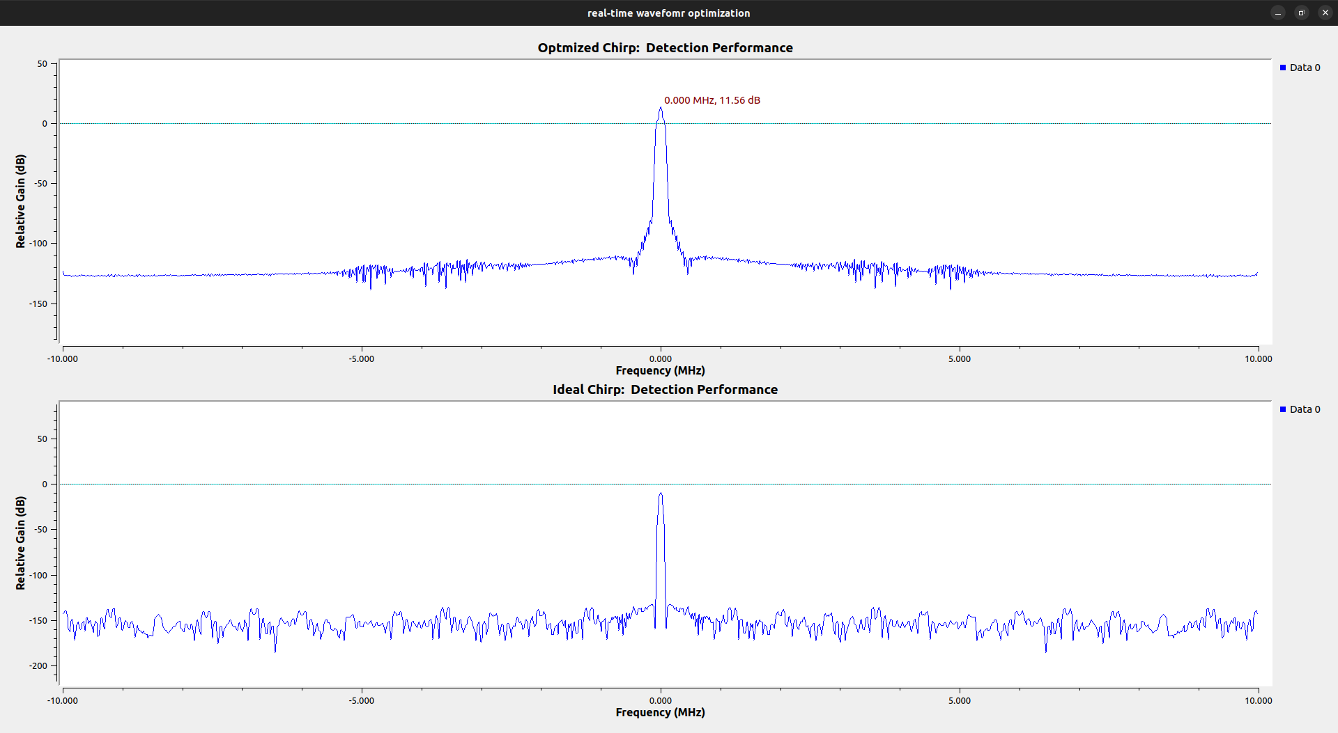
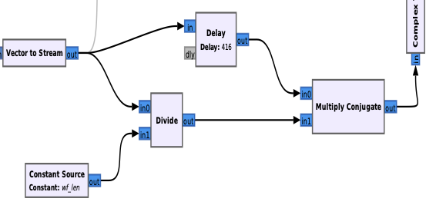
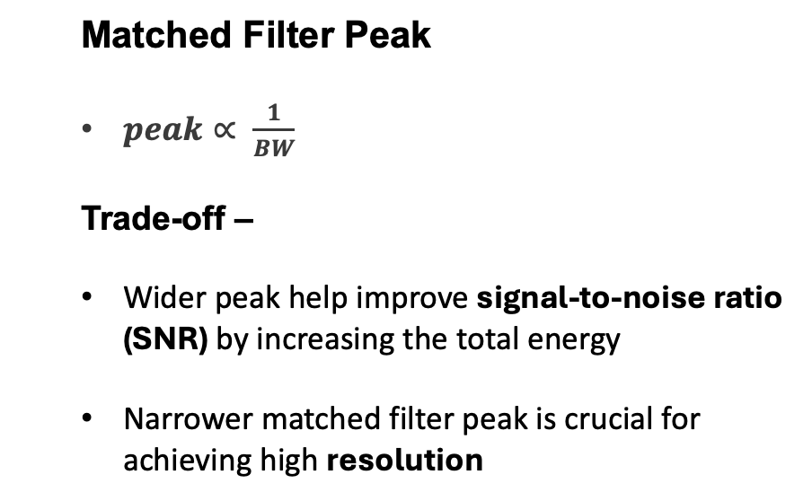
Stretch Processing : Matched Filter Frequency Response
(Cheap trick)
Optimized Chirp ~ (11.56 dB)
Stretch Processing Flowgraph
  Matched Filter Peak
  $peak∝ \frac{1}{BW}$
  Trade-off –
  Wider peak help improve signal-to-noise ratio (SNR) by increasing the total energy
  Narrower matched filter peak is crucial for achieving high resolution
Standard Chirp ~ (- 20dB)
sdoly.grconf-24

Slide 17
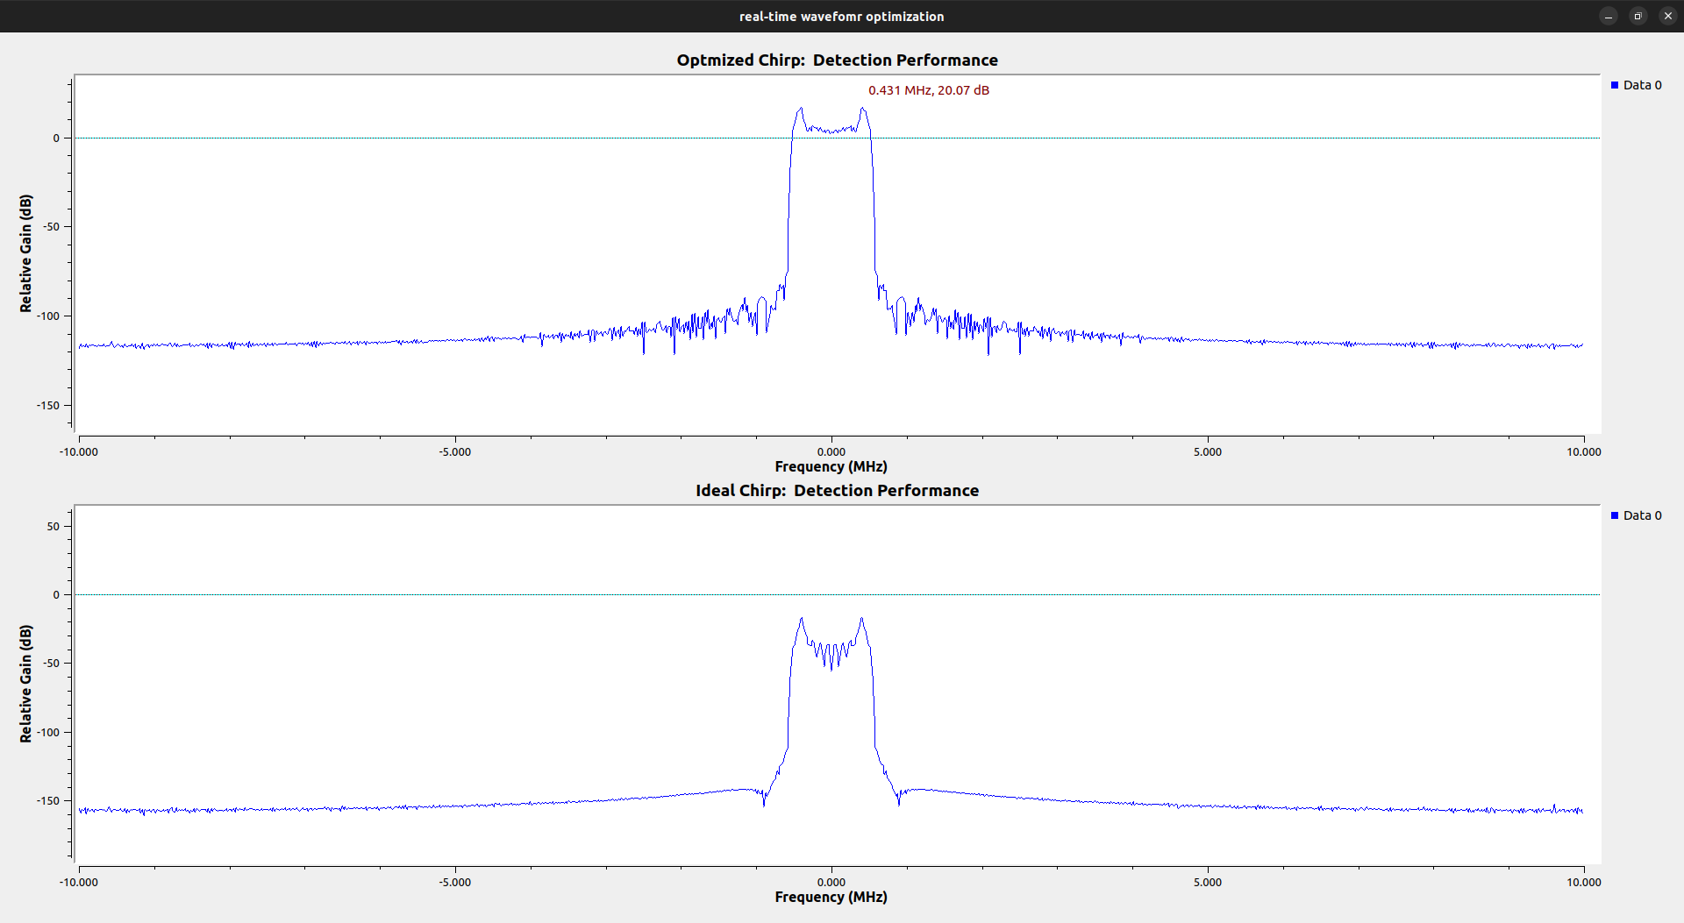
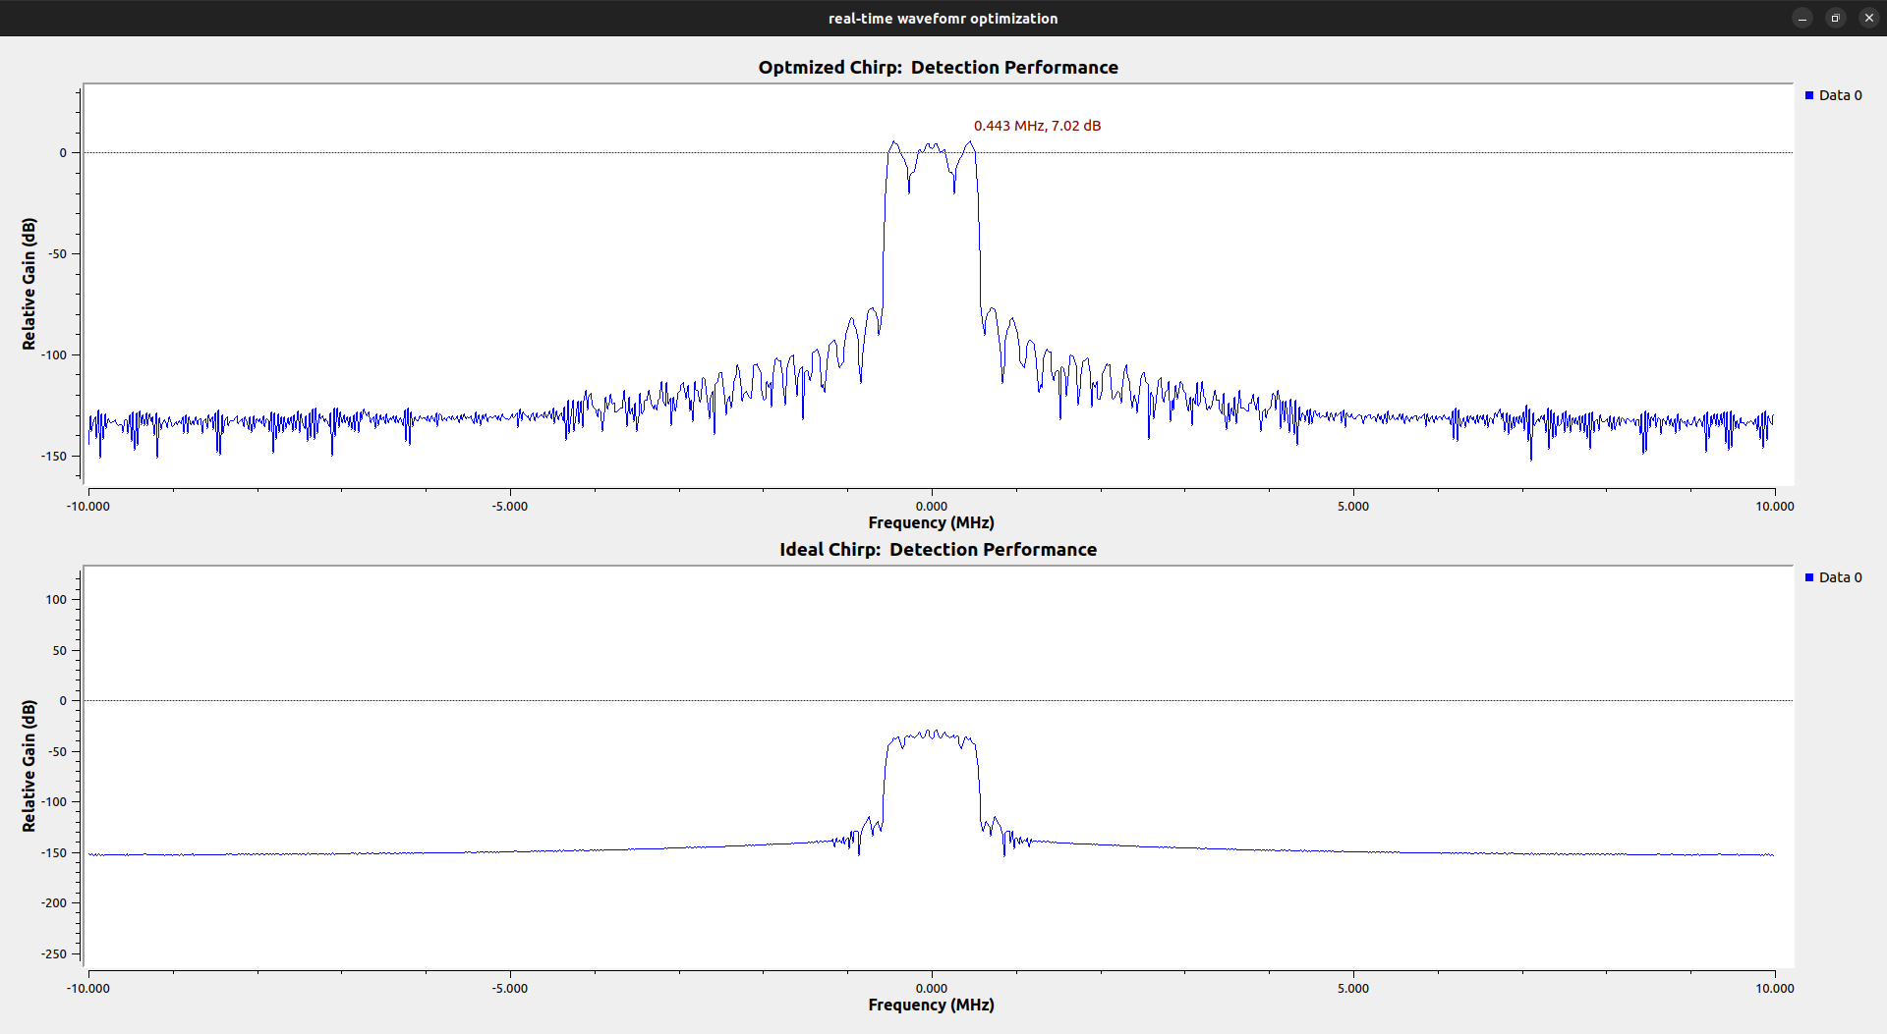
RMS Bandwidth and Peak Detection
Cramér-Rao Bound (CRB)
Optimized chirp
Peak detected
Optimized chirp
fixed delay
Detected peak
Standard chirp
Standard chirp
Unable to detect the peak
More Bandwidth Higher the SNR
  improves the Fisher Information,
  leading to a lower CRB,
  more information about the delay.
SNR reduced due to increased distance
Filter failed to detect the peak
Reference Chirp and Return
Reference Chirp and Return
Optimize bandwidth (rms) ensure effective detection of the matched filter peak
Increased the delays
sdoly.grconf-24

Slide 18
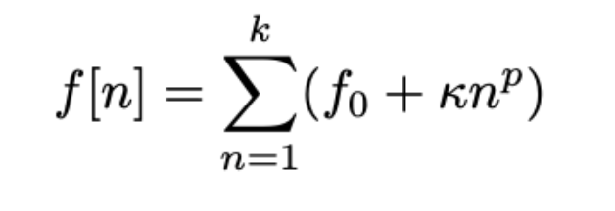
Conclusion and Future Research
Key Contribution
Challenges
Develop a highly flexible real-time FMCW radar system for designing and testing different radar waveforms (e.g., triangular, sawtooth),
Waveform adaptive co-design technique in a single a real-time feedback loop for multi-user networks applications leveraging low-cost SDRs,
Explore the benefits radar waveform optimization, particularly through increasing RMS bandwidth, significantly boosting target detection performance by enhancing range resolution.
GNU radio block processing latency
Indeterministic feedback loop
Next Step
Implement ISACs system
Real target detection
NLFM Waveform
Est. Perf. vs. CRLB Threshold Tradeoff
Pic Courtesy : Alex
sdoly.grconf-24

Slide 19
Thank You

