Slide 1
Enabling Integrated Circuit-Based Full-Duplex Wireless in GNU Radio
Alon S. Levin, Manav Kohli, Sasank Garikapati, Mahmood Baraani Dastjerdi, Harish Krishnaswamy, Gil Zussman, Igor Kadota, Tingjun Chen, Aravind Nagulu, Jin Zhou, Ivan Seskar

Slide 2
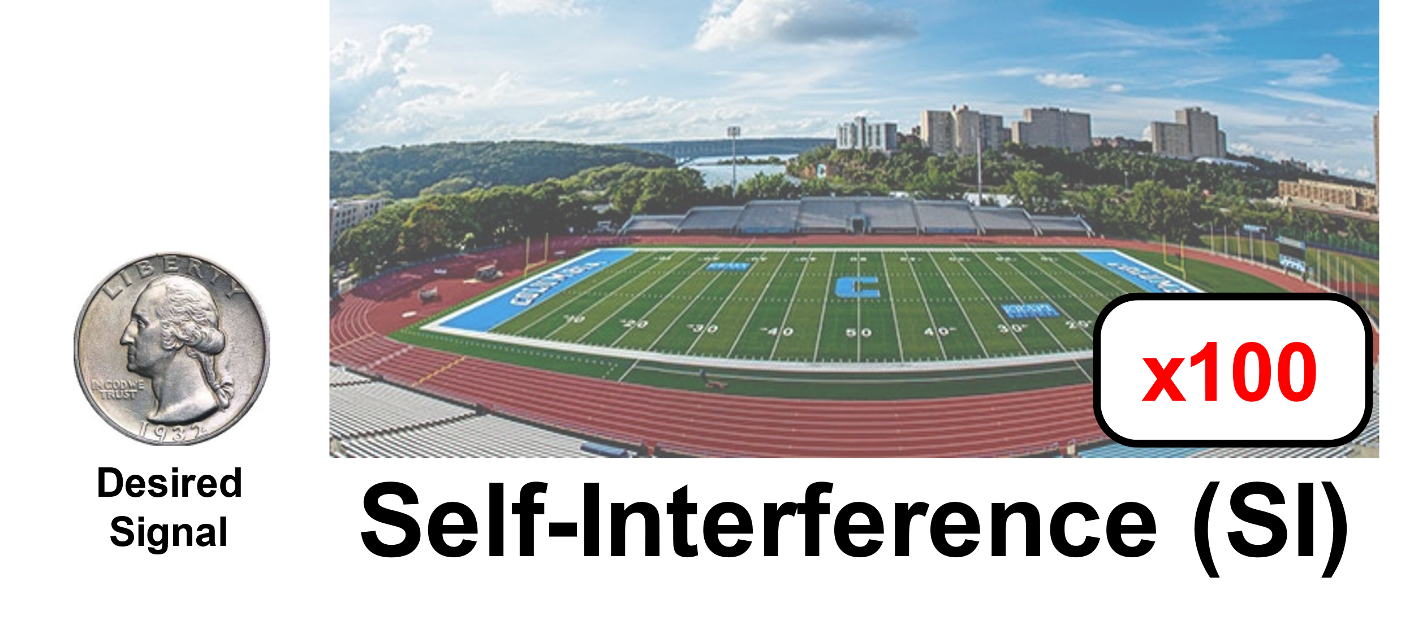
Full-Duplex Communication
Simultaneous transmission and reception on the same frequency
Increased system throughput and reduced latency
More flexible use of wireless spectrum resources
Suffers from self-interference (SI) due to transmitter leakage, requiring 70–110 dB of SI cancellation (SIC) across antenna, analog, and digital domains for successful operation
D. Bharadia, E. McMilin, and S. Katti. 2013. Full Duplex Radios. In Proc. ACM SIGCOMM’13.
A. Sabharwal, P. Schniter, D. Guo, D. W. Bliss, S. Rangarajan, and R. Wichman. 2014. In-Band Full-Duplex Wireless: Challenges and Opportunities. IEEE Journal on Selected Areas in Communications 32, 9 (2014), 1637–1652.

Slide 3
Typical FD Transceiver

Slide 4
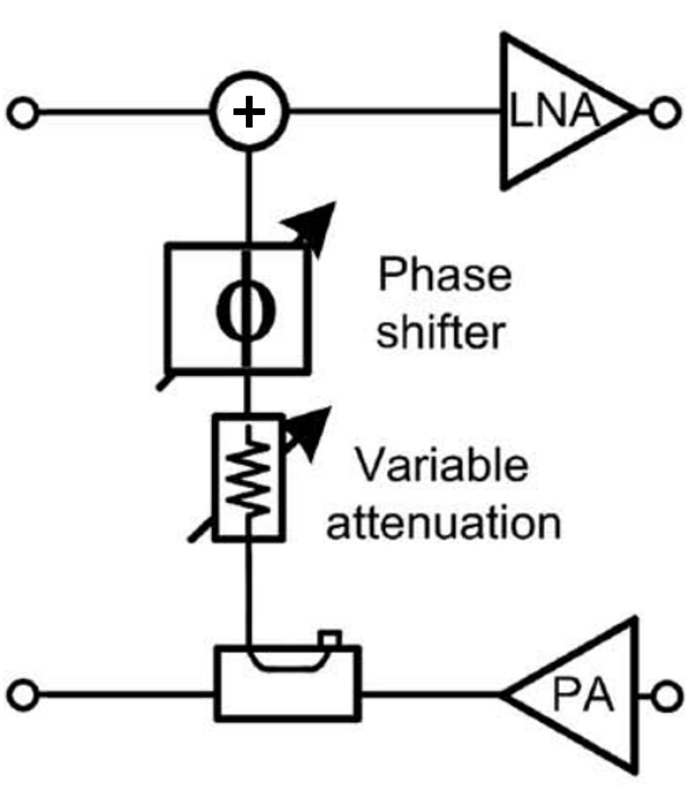
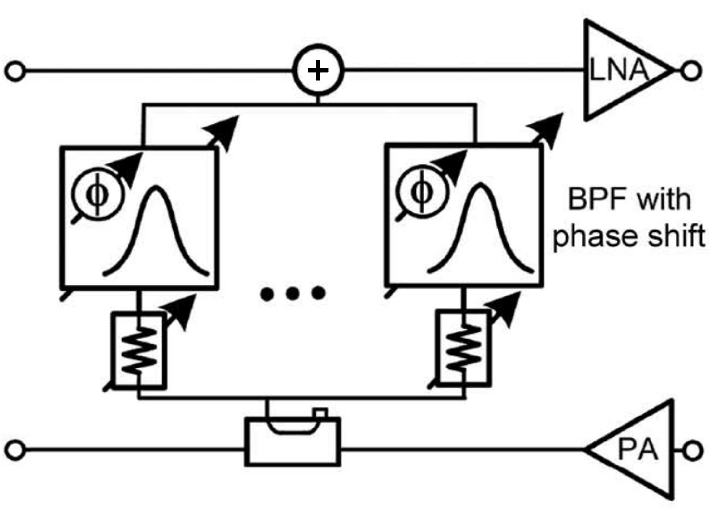
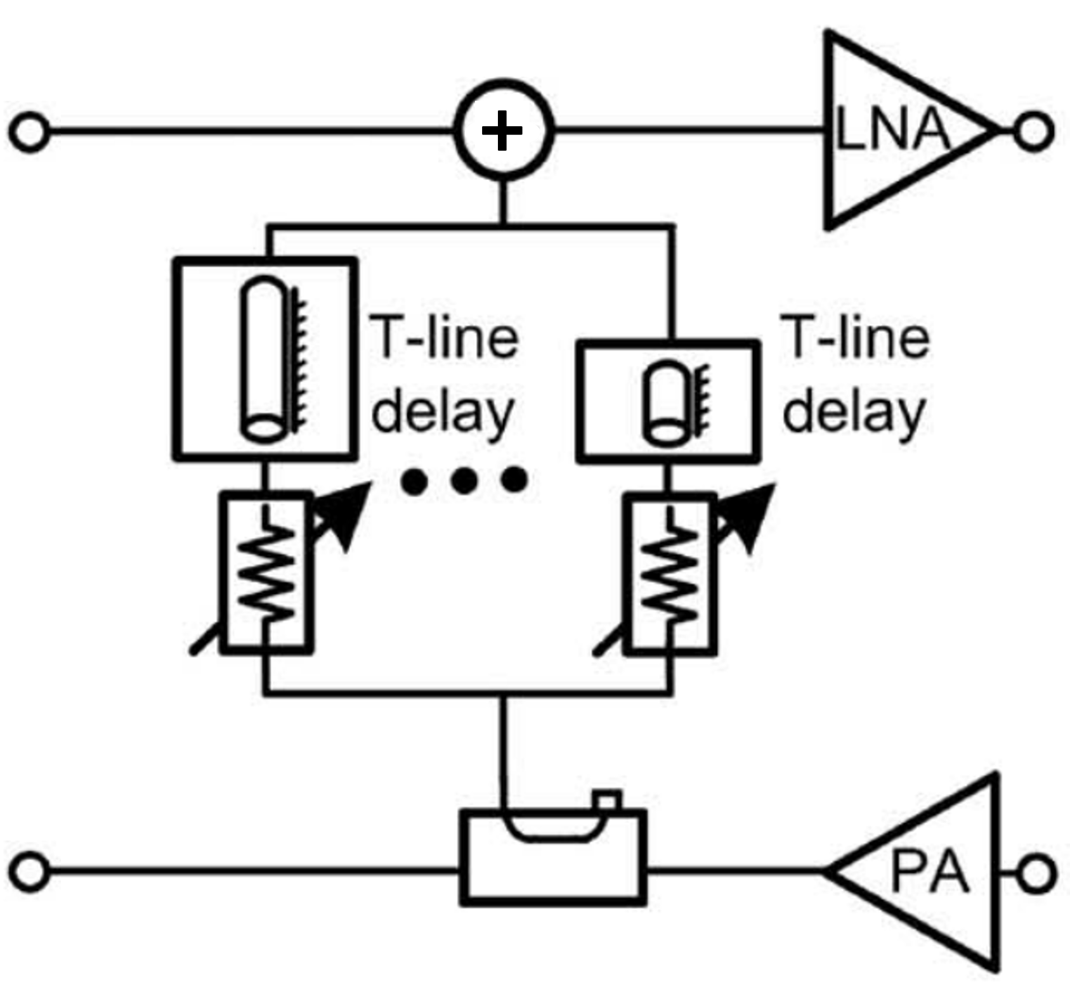
RF Canceller Classes
Phase- and Amplitude- Based Equalization
Frequency-Domain Equalization
Time-Domain Equalization
Aravind Nagulu, Negar Reiskarimian, Tingjun Chen, Sasank Garikapati, Igor Kadota, Tolga Dinc, Sastry Lakshmi Garimella, Manav Kohli, Alon Simon Levin, Gil Zussman, and Harish Krishnaswamy. Doubling Down on Wireless Capacity: A Review of Integrated Circuits, Systems, and Networks for Full Duplex. Proceedings of the IEEE, 112(5):405–432, 2024.
Notes:
GEN-1 AND GEN-2 ARE MISPLACED – THESE ARE THE WRONG IMAGES

Slide 5
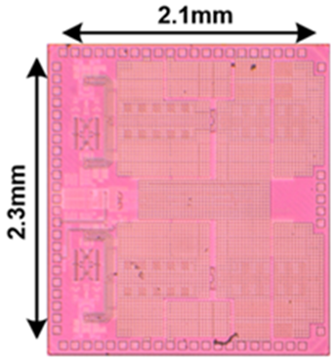
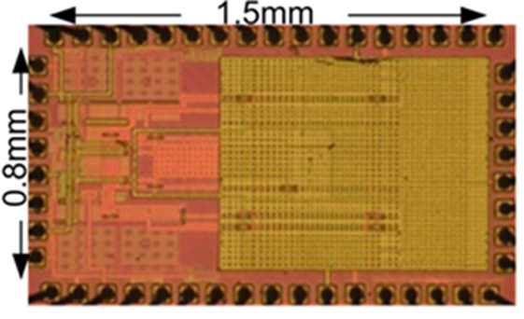
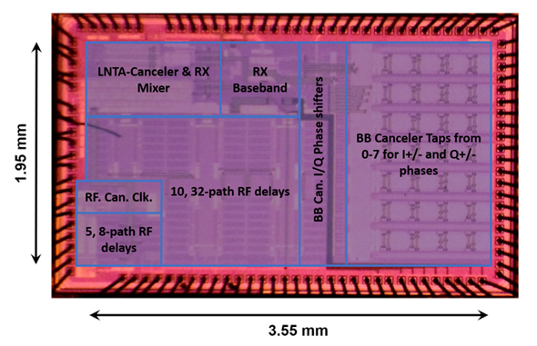
Small Form-Factor Implementations
Phase- and Amplitude- Based Equalization
Frequency-Domain Equalization
Time-Domain Equalization
Jin Zhou, Peter R. Kinget, and Harish Krishnaswamy, "A Blocker-Resilient Wideband Receiver with Low-Noise Active Two-Point Cancellation of >0dBm TX Leakage and TX Noise in RX Band for FDD/Co-Existence," in Proc. IEEE ISSCC'14, 2014.
Jin Zhou, Tsung-Hao Chuang, Tolga Dinc, and Harish Krishnaswamy, “Reconfigurable Receiver with >20MHz Bandwidth Self-Interference Cancellation Suitable for FDD, Co-existence and Full-Duplex Applications,” in Proc. IEEE ISSCC’15, 2015.
Aravind Nagulu, Sasank Garikapati, Igor Kadota, Mostafa Essawy, Tingjun Chen, Arun Natarajan, Gil Zussman, and Harish Krishnaswamy, “Full-duplex receiver with wideband multi-domain FIR cancellation based on stacked-capacitor, N-path switched-capacitor delay lines achieving >+54dB SIC Across 80MHz BW and >+15dBm TX power handling,” in Proc. IEEE ISSCC’21, 2021.
Notes:
GEN-1 AND GEN-2 ARE MISPLACED – THESE ARE THE WRONG IMAGES

Slide 6
Gen-1 FD Radio: P&A Canceller
Circulator-based antenna interface
PCB emulates P&A canceller:
$$H_{P\&A}(f)=αe^{−jφ}$$
Configurable through GNU Radio
43dB of RF SIC across 5MHz
Harish Krishnaswamy, Gil Zussman, Jin Zhou, Jelena Marašević, Negar Reiskarimian, Tolga Dinc, and Tingjun Chen, "Full-Duplex in a Hand-Held Device - From Fundamental Physics to Complex Integrated Circuits, Systems and Networks: An Overview of the Columbia FlexICoN Project," in Proc. Asilomar Conference on Signals, Systems, and Computers (invited paper), Nov. 2016.

Slide 7
Gen-2 FD Radio: FDE Canceller
Circulator-based antenna interface
PCB emulates FDE canceller:
$$H_{FDE}(f)=\sum_{n=1}^{2}{\frac{A_{n}e^{−jφ_{n}}}{1−jQ_{n}\left({f_{c,n}}/f−f/{f_{c,n}}\right)}}$$
Configurable through GNU Radio
50dB of RF SIC across 20MHz
Tingjun Chen, Mahmood Baraani Dastjerdi, Jin Zhou, Harish Krishnaswamy, and Gil Zussman, “Wideband Full-Duplex Wireless via Frequency-Domain Equalization: Design and Experimentation,” in Proc. ACM MobiCom'19, Oct. 2019.

Slide 8
Gen-3 FD Radio: TDE Canceller
Dual-antenna interface
IC-based TDE canceller:
$$H_{TDE}\left(f\right)=\sum_{n=1}^{16}{α_{n}e^{−j2πfτ_{n}}}$$
Configurable through GNU Radio
50dB of RF SIC across 50MHz
Alon S. Levin, Igor Kadota, Sasank Garikapati, Bo Zhang, Aditya Jolly, Manav Kohli, Mingoo Seok, Harish Krishnaswamy, and Gil Zussman, "Demo: Experimentation with Wideband Real-Time Adaptive Full Duplex Radios,“ in Proc. ACM SIGCOMM'23, Sept. 2023.

Slide 9
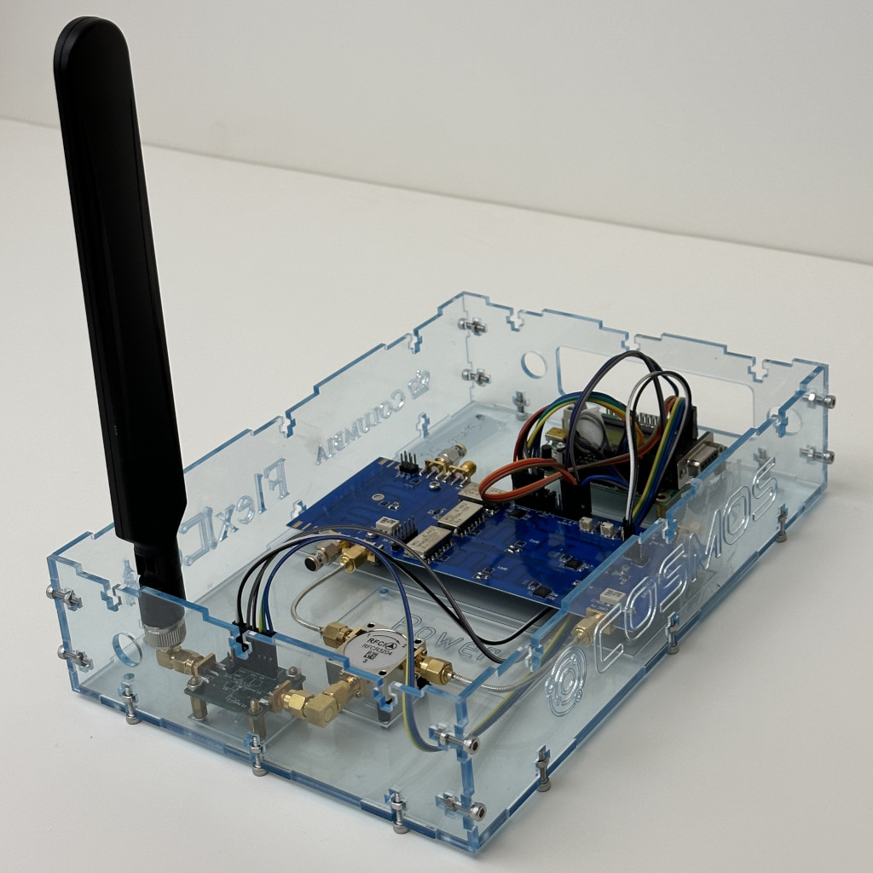
Canceller RFIC
Full-Duplex Radio

Slide 10
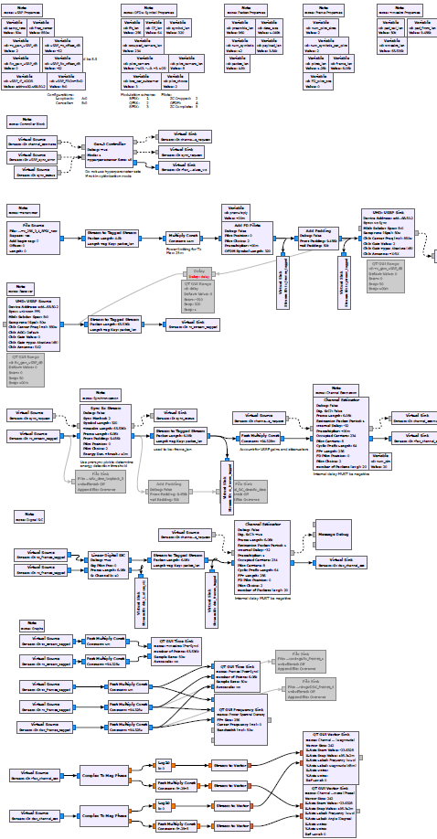
Canceller RFIC
Full-Duplex Radio

Slide 11
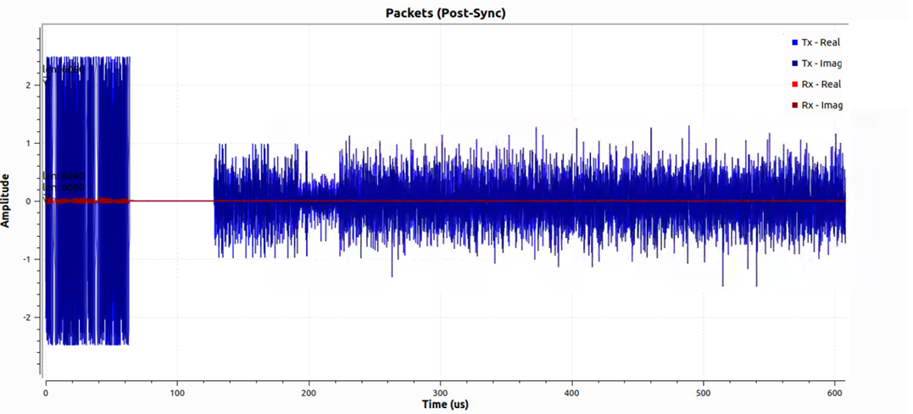
Transmission: Packet Encapsulation
Each radio is assigned a pilot slot to ensure “quiet” time to measure the SI channel. In this figure, the radio is assigned Pilot Slot 0.
P0
P1
Payload
Pilot Slots

Slide 12
Reception: Synchronization
Intra-Node Synchronization
Goal: to align the radio’s received SI signal with the corresponding transmission
P0
Payload

Slide 13
Reception: Synchronization
Intra-Node Synchronization
Goal: to align the radio’s received SI signal with the corresponding transmission
P0
Payload

Slide 14
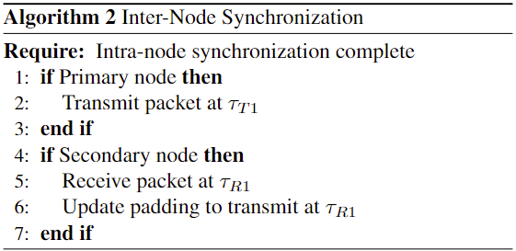
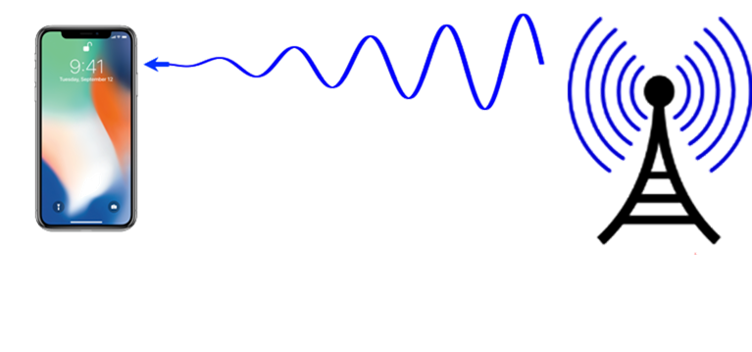
Reception: Synchronization
Inter-Node Synchronization
Goal: to align radios’ transmissions such that the payloads overlap and pilot slots do not interfere
P0
Payload

Slide 15
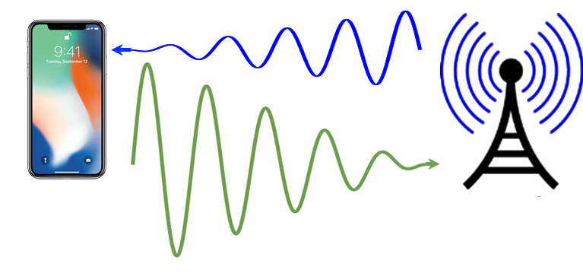
Reception: Synchronization
Inter-Node Synchronization
Goal: to align radios’ transmissions such that the payloads overlap and pilot slots do not interfere
P0
P1
Payload

Slide 16
SI Channel Estimation
Transmit pilot symbols $X$
Receive pilot symbols
$$Y=H_{SI}⋅X$$
Recover the SI channel:
$${\hat{H}}_{SI}\left[k\right]=\frac{1}{M}\left[\frac{1}{X\left[k\right]}\sum_{m=1}^{M}{Y^{(m)}[k]}\right]$$
Tx and Rx signal processing chains must be on the same master clock cycle!

Slide 17
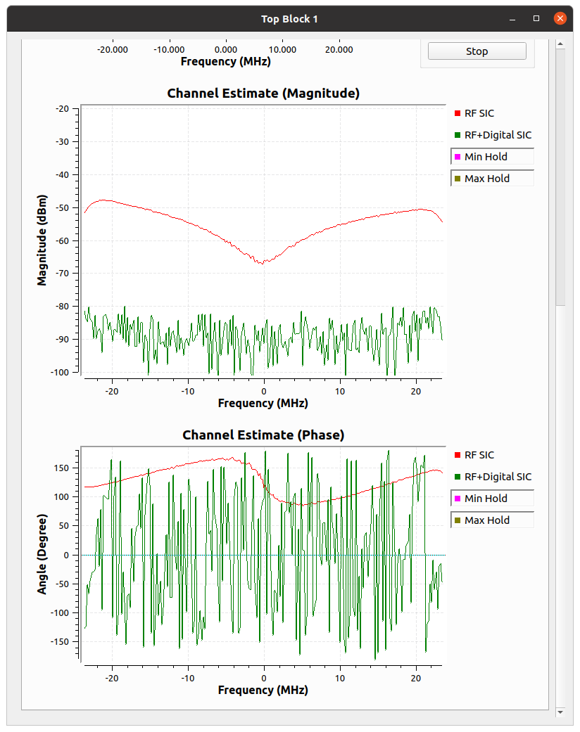
Digital SIC
Truncated Volterra series model:
$$r\left[n\right]=y\left[n\right]−\sum_{i=1}^{I}{\sum_{k=0}^{K}{h_{i}\left[k\right]x{\left[n−k\right]}^{i}}}$$
Simplified first-order model:
$$r=y−A\hat{h}$$
$$A=\left[\begin{matrix}x[1] & x[2] & x[3] \\ x[3] & x[1] & x[2] \\ x[2] & x[3] & x[1]\end{matrix}\right]$$
P1
P1
P0
P1
Payload
Payload
Payload

Slide 18
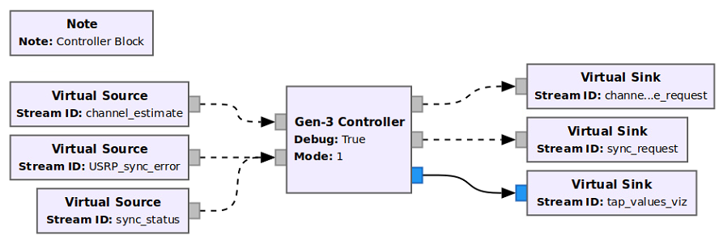
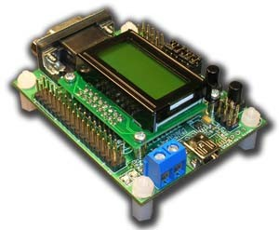
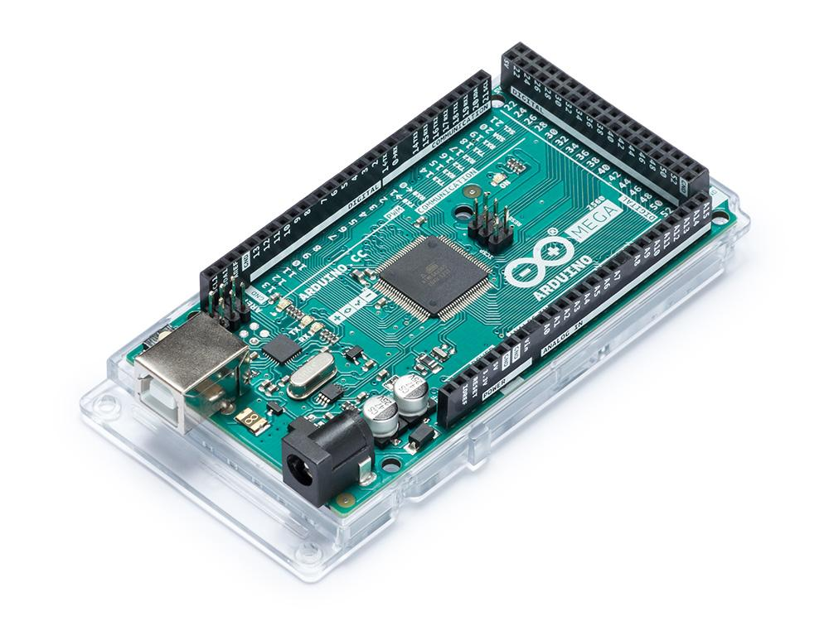
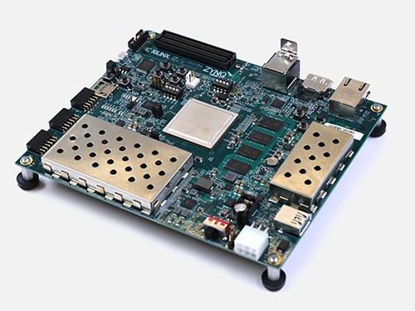
System Control and Coordination
Error Detection and Synchronization Control
Channel Estimation Control
Visualization
SPI Interface
Microcontroller
FPGA

Slide 19
RFIC Optimization
Tx Signal
SI after Ant. Int. + RFIC
SI after Ant. Int. + RFIC + DSIC

Slide 20
Evolution of SI Cancellation
Alon S. Levin, Igor Kadota, Sasank Garikapati, Bo Zhang, Aditya Jolly, Manav Kohli, Mingoo Seok, Harish Krishnaswamy, and Gil Zussman, "Demo: Experimentation with Wideband Real-Time Adaptive Full Duplex Radios,“ in Proc. ACM SIGCOMM'23, Sept. 2023.

Slide 21
Open-Access FD Wireless Testbeds
Gen-1 FD Radio in ORBIT
Mobile Gen-1 FD Radio
Manav Kohli, Tingjun Chen, Mahmood Baraani Dastjerdi, Jackson Welles, Ivan Seskar, Harish Krishnaswamy, and Gil Zussman, “Open-access full-duplex wireless in the ORBIT and COSMOS testbeds,” Computer Networks, no. 199, p. 108420, Nov. 2021.

Slide 22
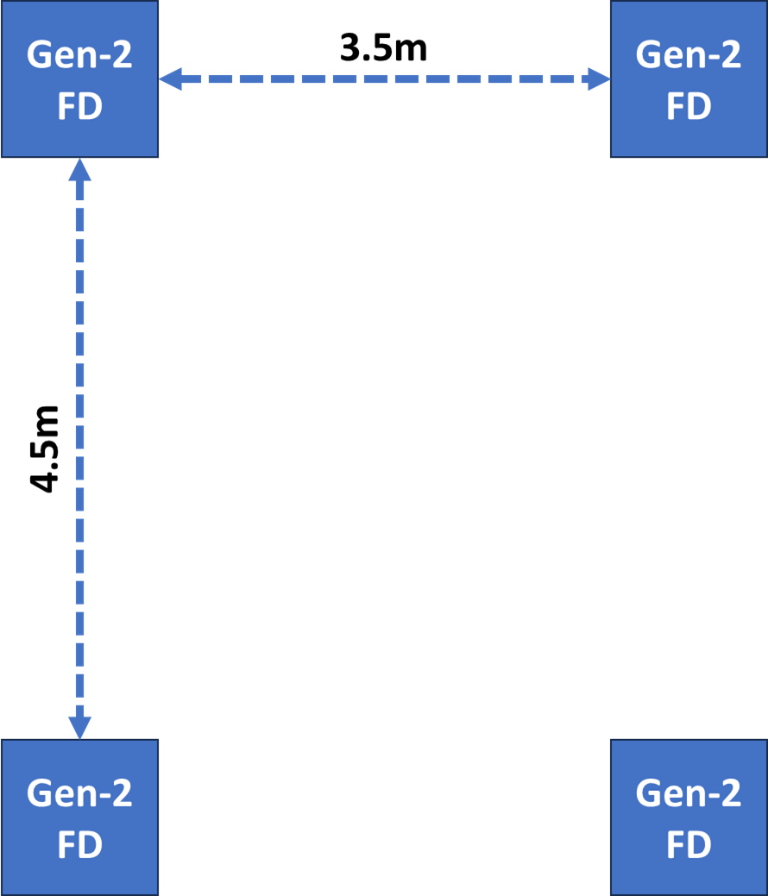
Open-Access FD Wireless Testbeds
Gen-2 FD Radio in COSMOS
Manav Kohli, Tingjun Chen, Mahmood Baraani Dastjerdi, Jackson Welles, Ivan Seskar, Harish Krishnaswamy, and Gil Zussman, “Open-access full-duplex wireless in the ORBIT and COSMOS testbeds,” Computer Networks, no. 199, p. 108420, Nov. 2021.

Slide 23
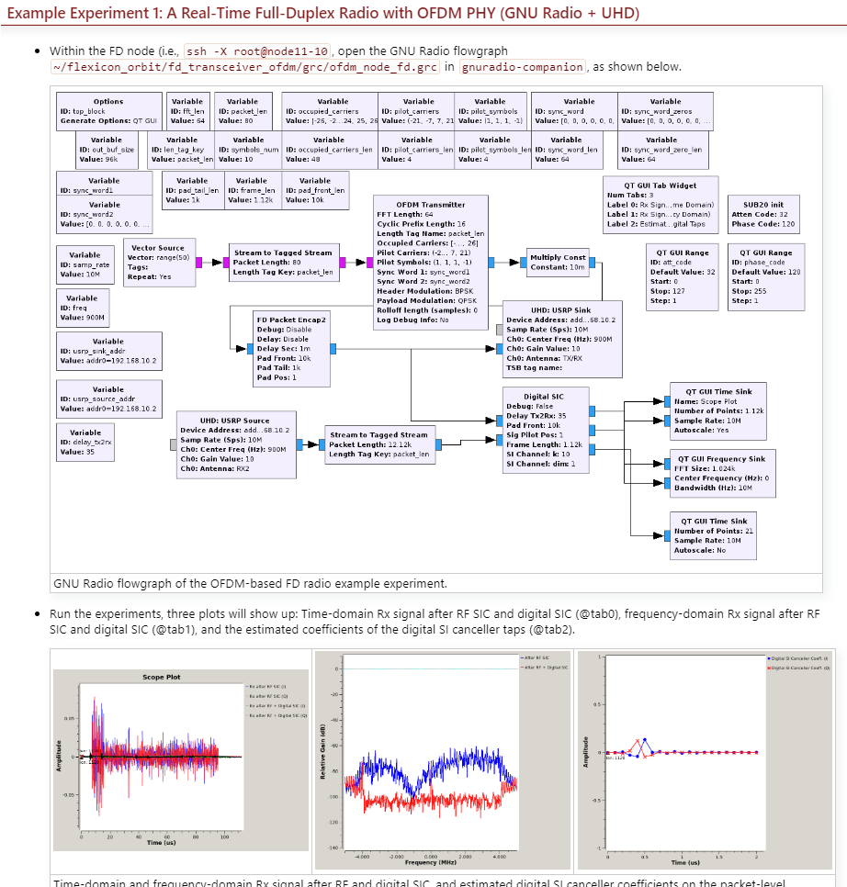
Open-Access FD Wireless Testbeds
Gen-3 FD Radio in COSMOS
Coming Soon!
Powered by GNU Radio

Slide 24
Thank You!
More information:
flexicon.ee.columbia.edu
alon.s.levin@columbia.edu

