Slide 1



Real-time Device Fingerprinting and Re-identification in GNUradio
Stepan Mazokha
Postdoctoral Fellow
Florida Atlantic University
September 2025

Slide 2
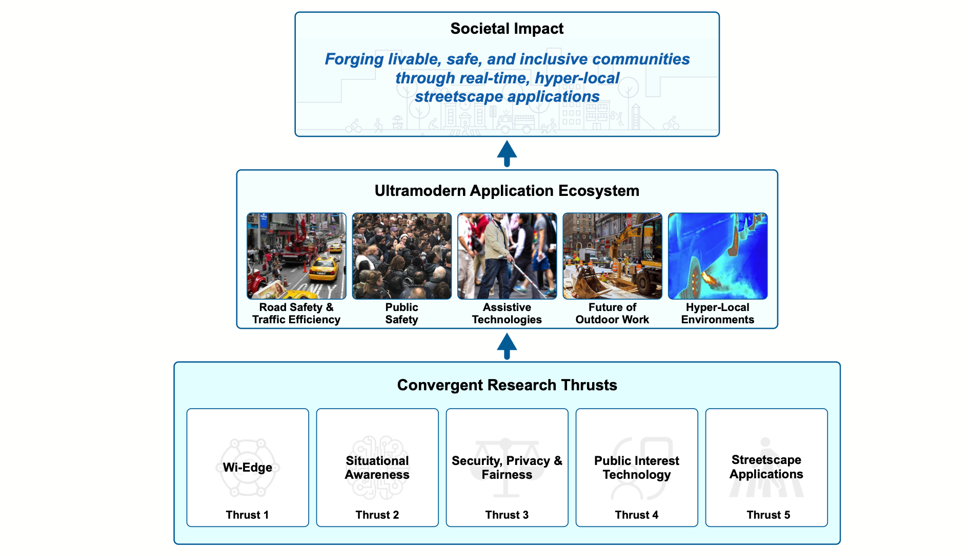

2

Slide 3

Data-driven Decisions for Smart Cities
3
Evolving city infrastructure requires constant optimization;
Improvement decisions must be data-driven;
Mobility monitoring provides insights into pedestrian traffic;
Can help city officials, local businesses optimize operations & public spaces;

Slide 4
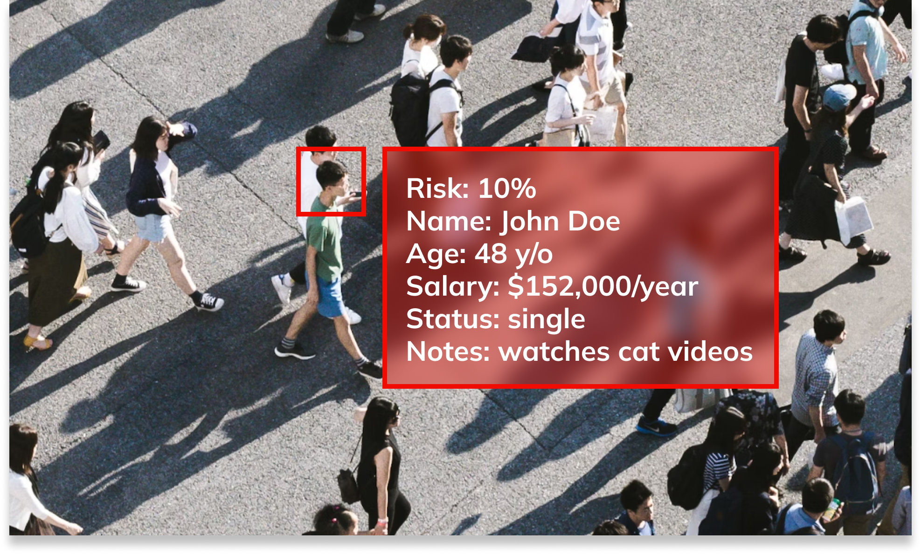
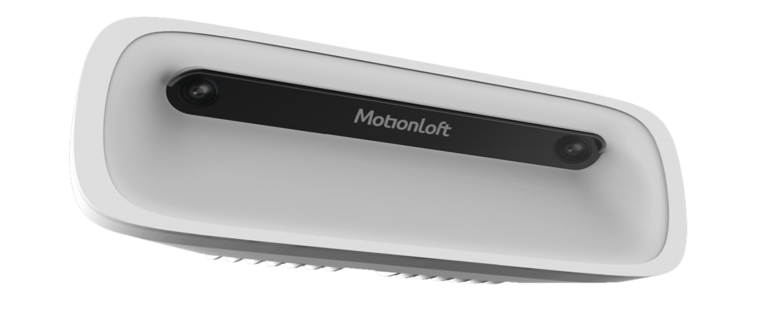
Status Quo: Video Surveillance
4
Relies on computer vision;
Real-time pedestrian counts on street corners;
Expensive hardware & privacy concerns;
Example CV Sensor

Slide 5

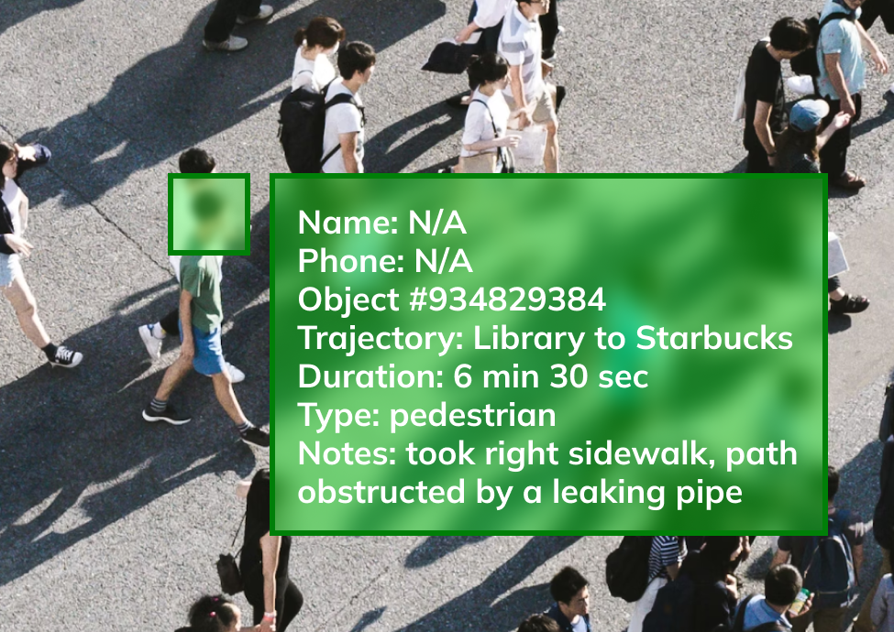
How About Privacy-Centric Mobility Intelligence?
5

Slide 6
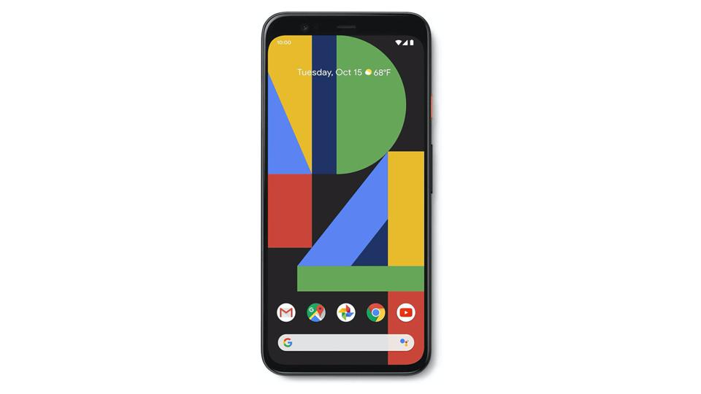
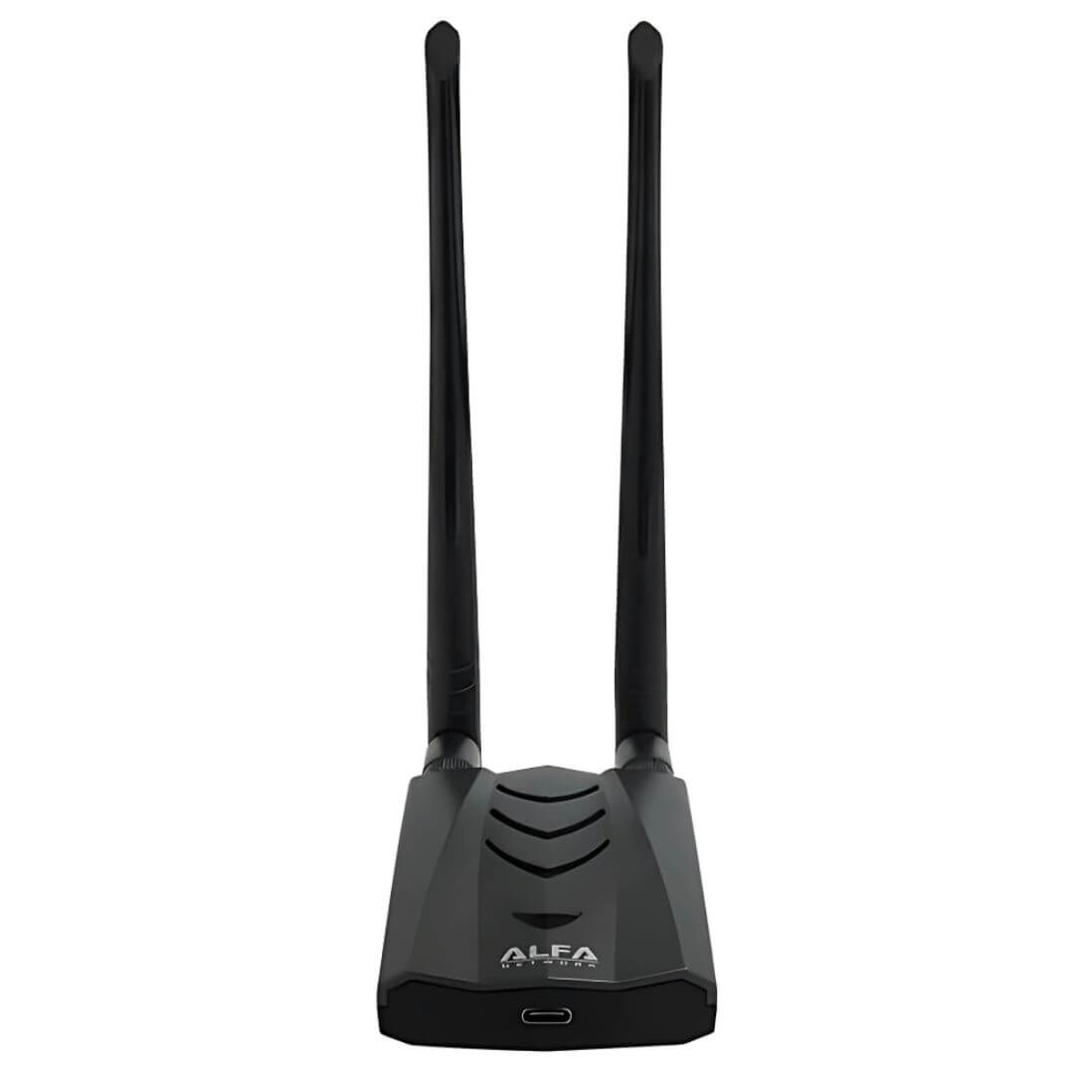

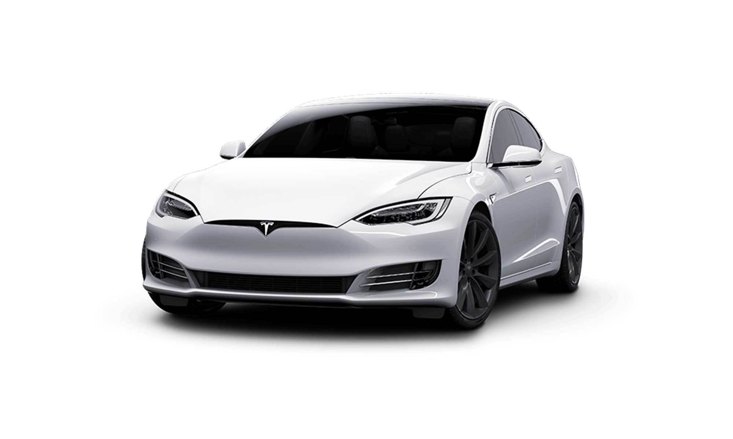
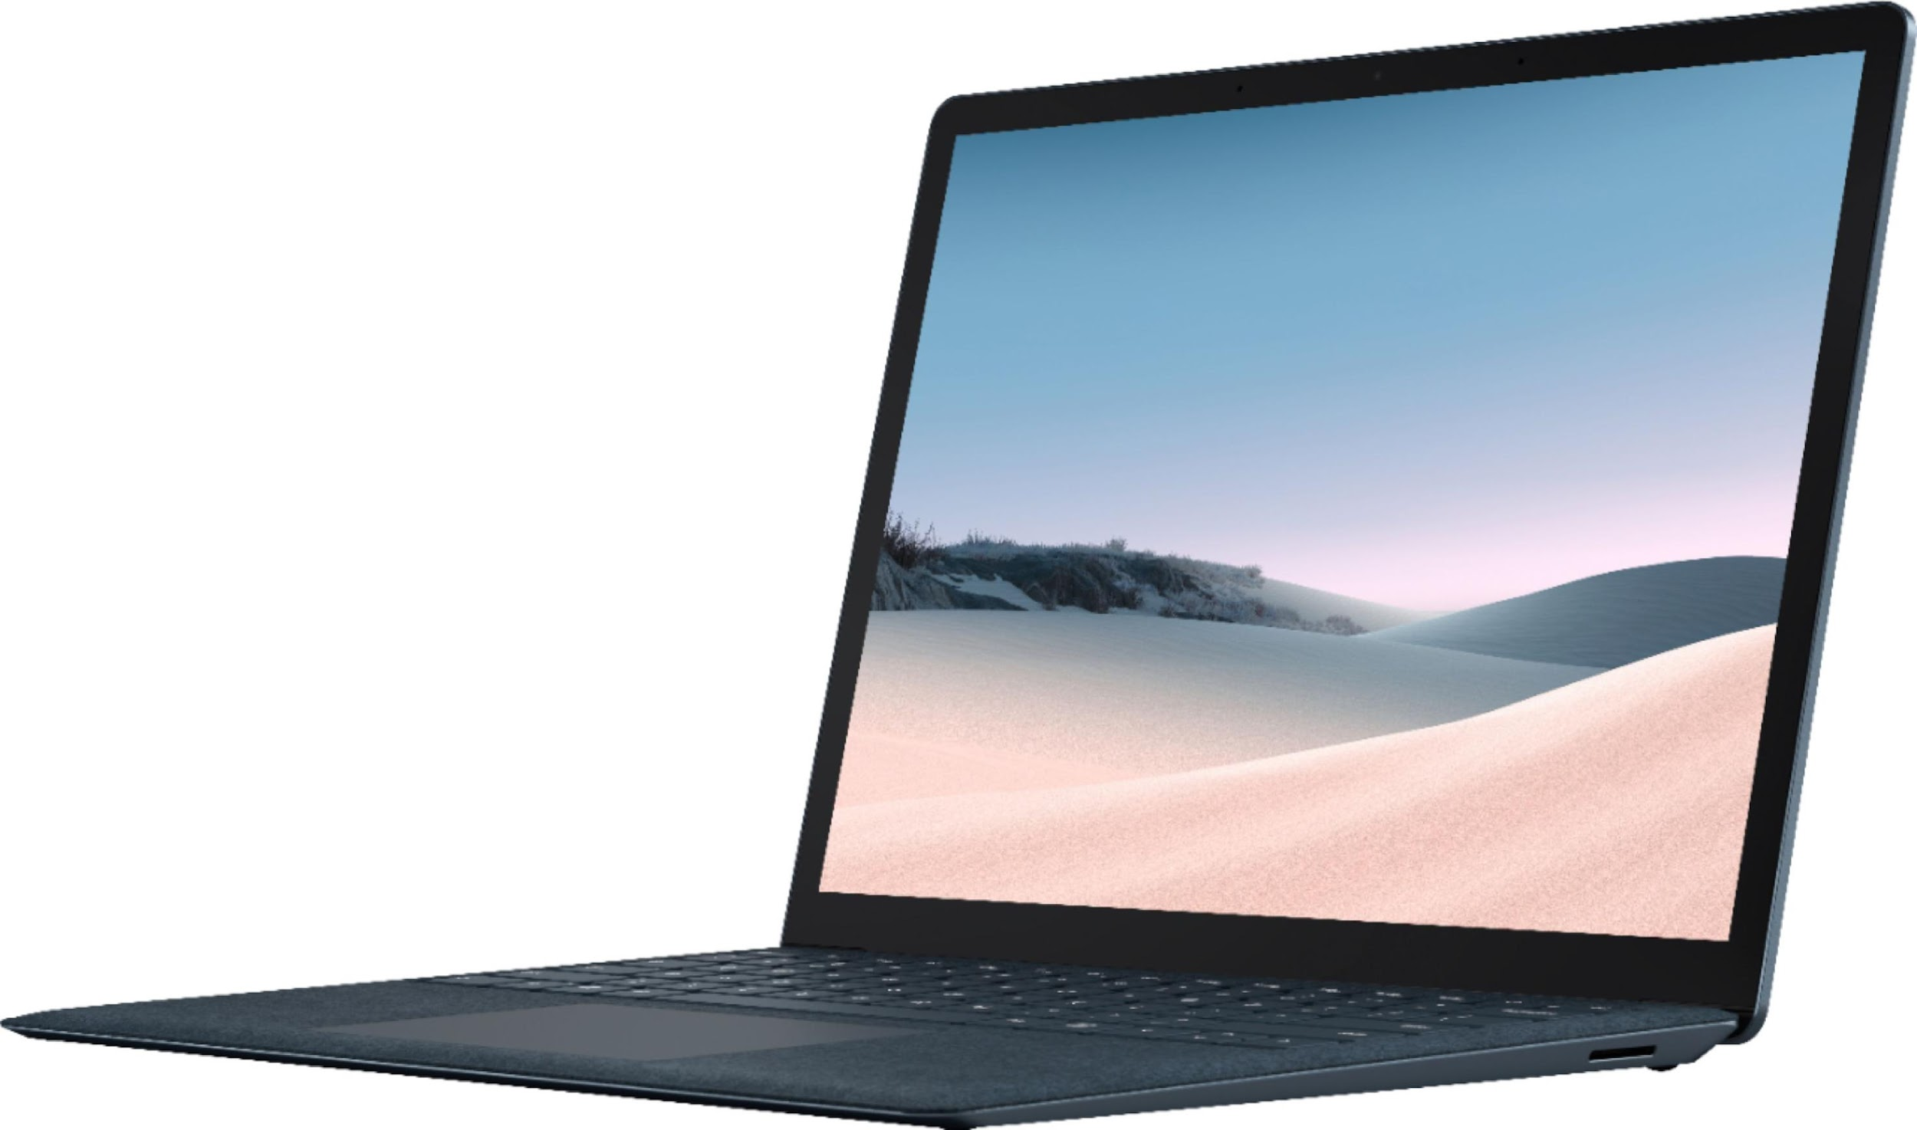
Our Vision: Non-cooperative WiFi Probe Request Monitoring
6
Alfa WiFi Adapter AWUS036ACH

Slide 7
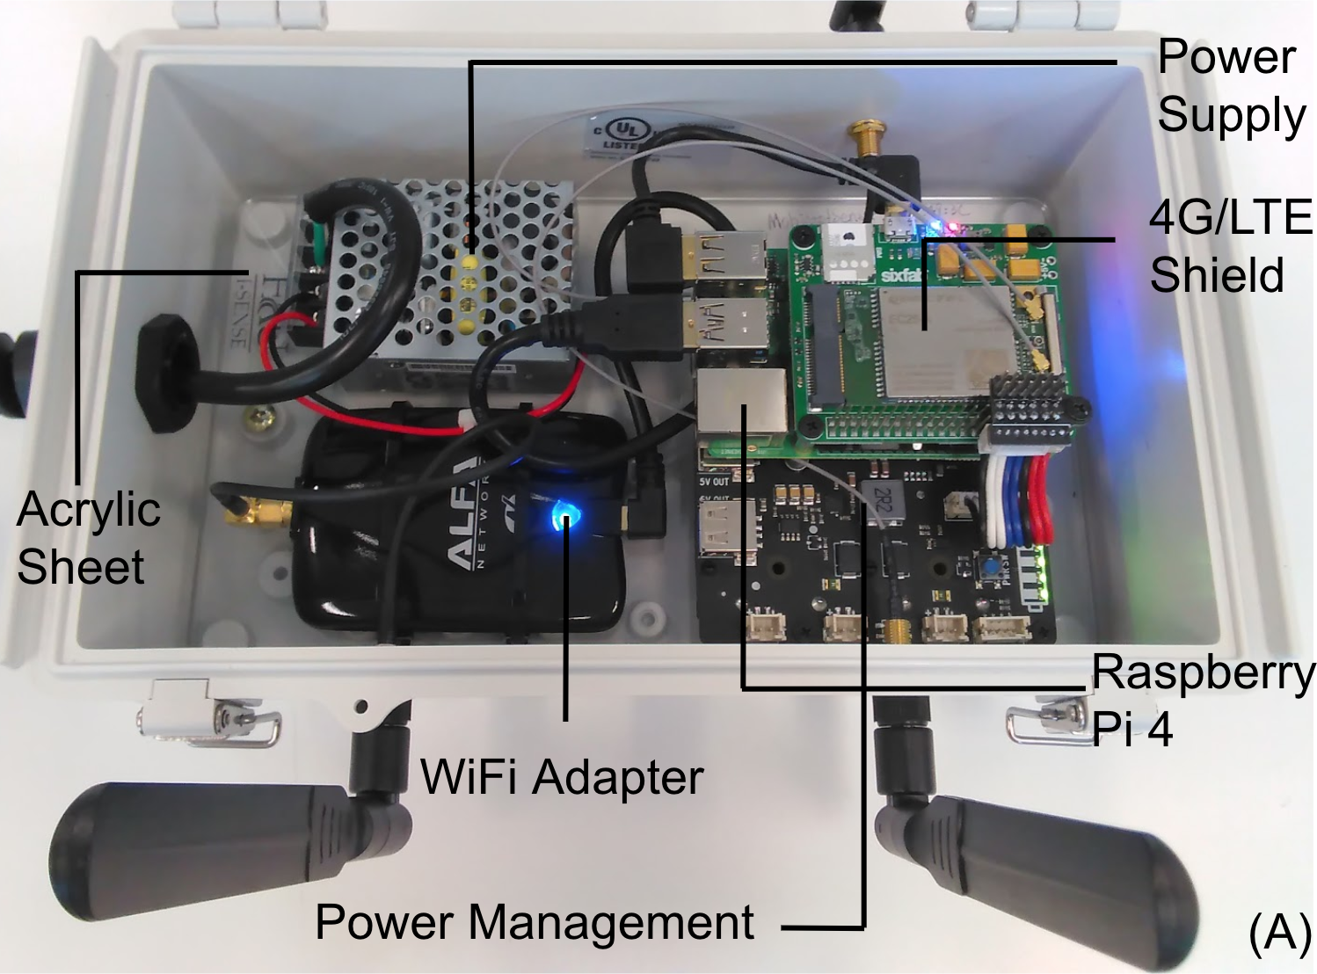
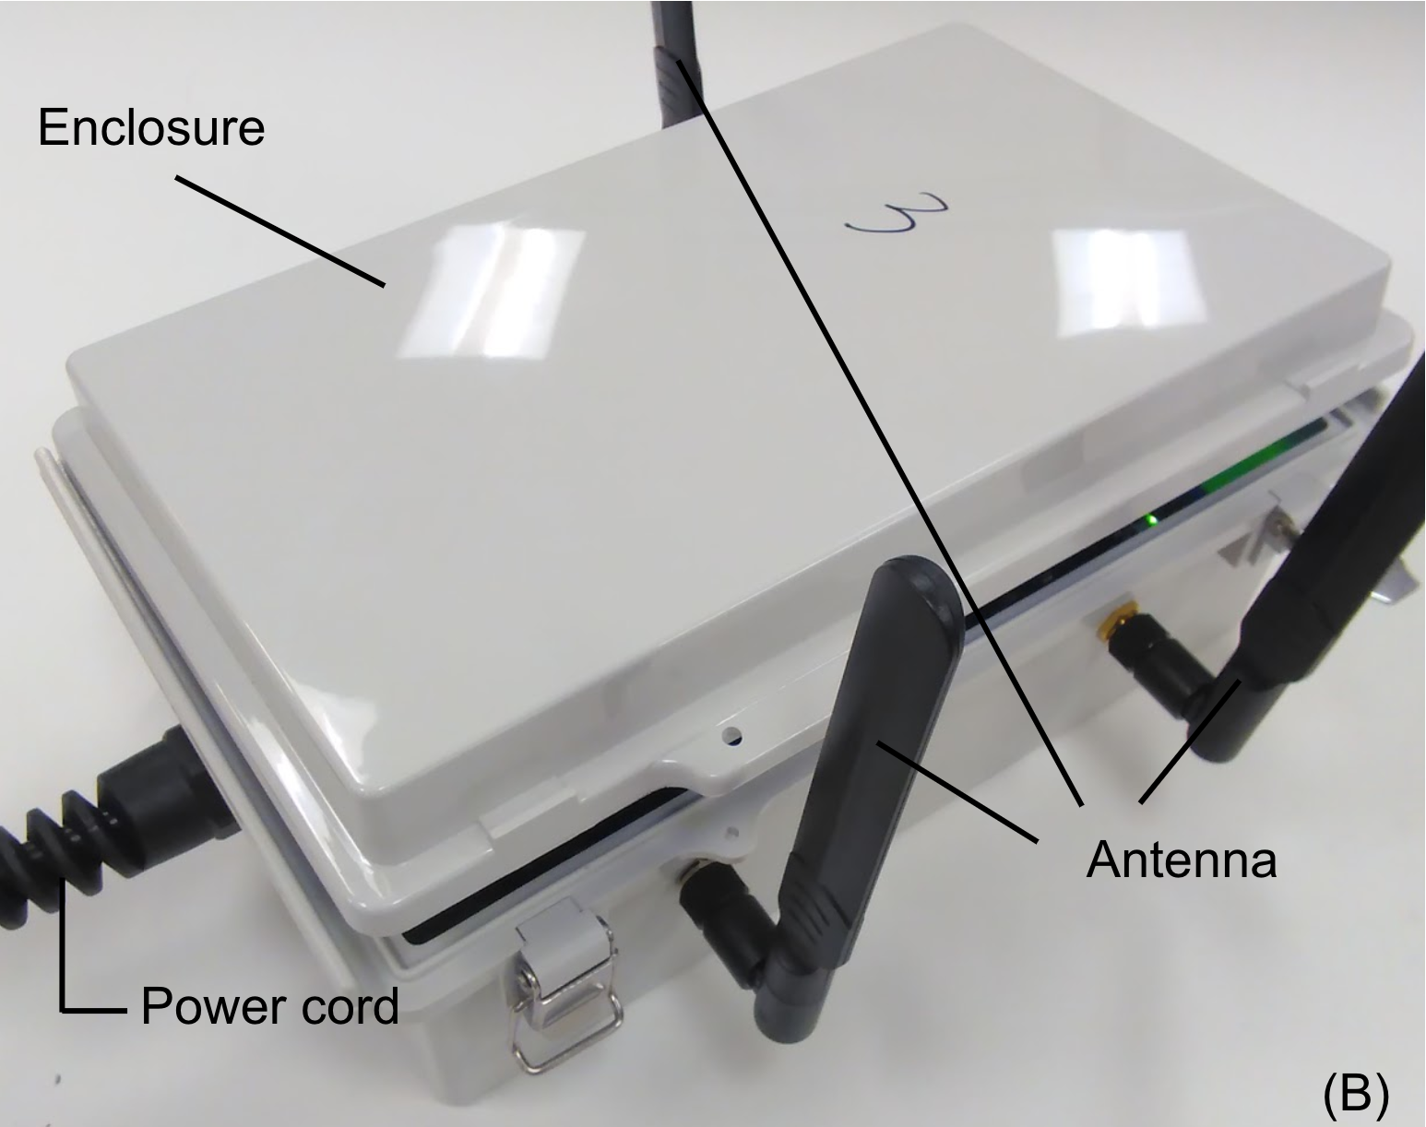
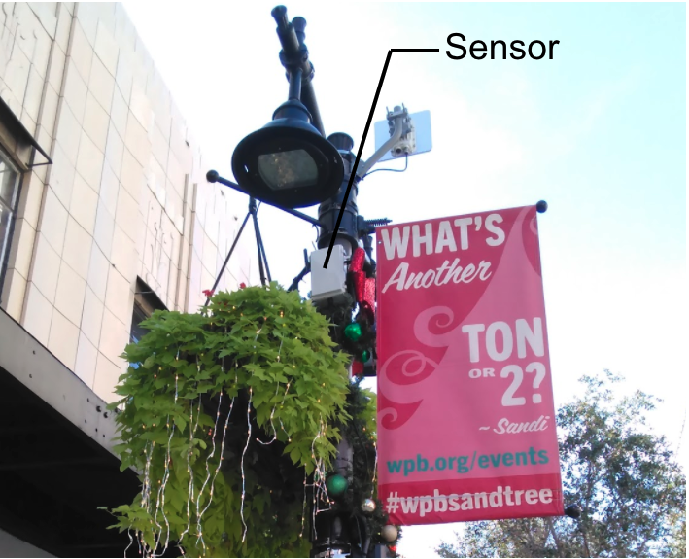
MobIntel Testbed in West Palm Beach
7
Inner Components
Enclosure
Deployment

Slide 8
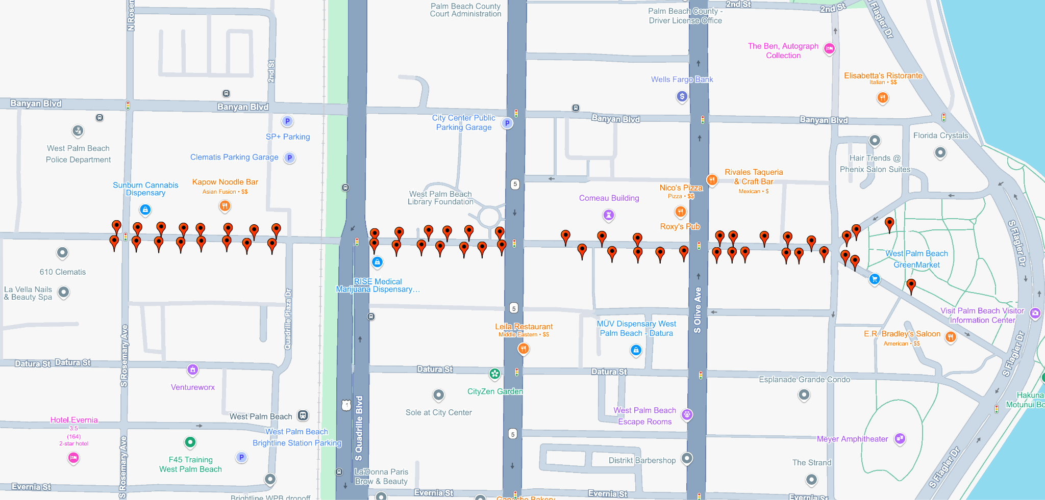
MobIntel Testbed, Clematis Street, West Palm Beach, FL
8

Slide 9
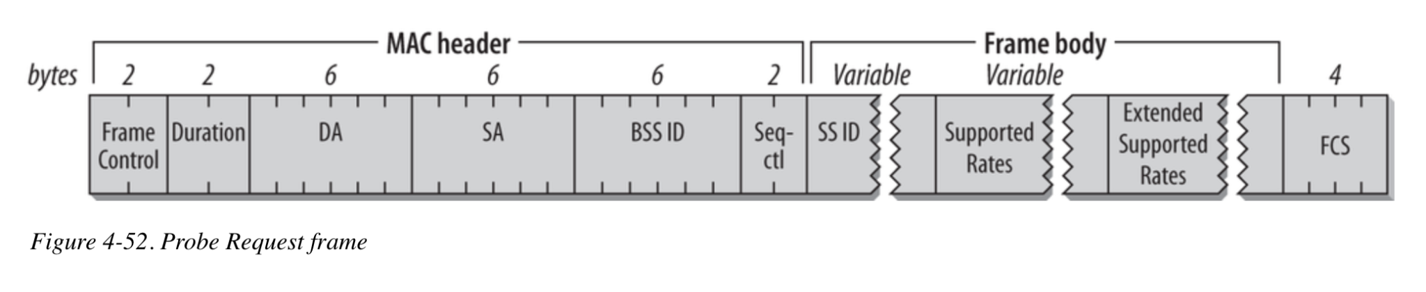
WiFi Packet of Choice: Probe Requests
9
IEEE 802.11 network discovery protocol frame;
Regularly emitted by WiFi devices (e.g., phones, smartwatches, EVs, etc):
Ubiquitous;
Emitted in bursts across all WiFi channels;
Can be passively monitored;
Anonymized by design (via MAC address randomization);
Consistent source of signal for localization and estimating pedestrian activity;
Reference

Slide 10
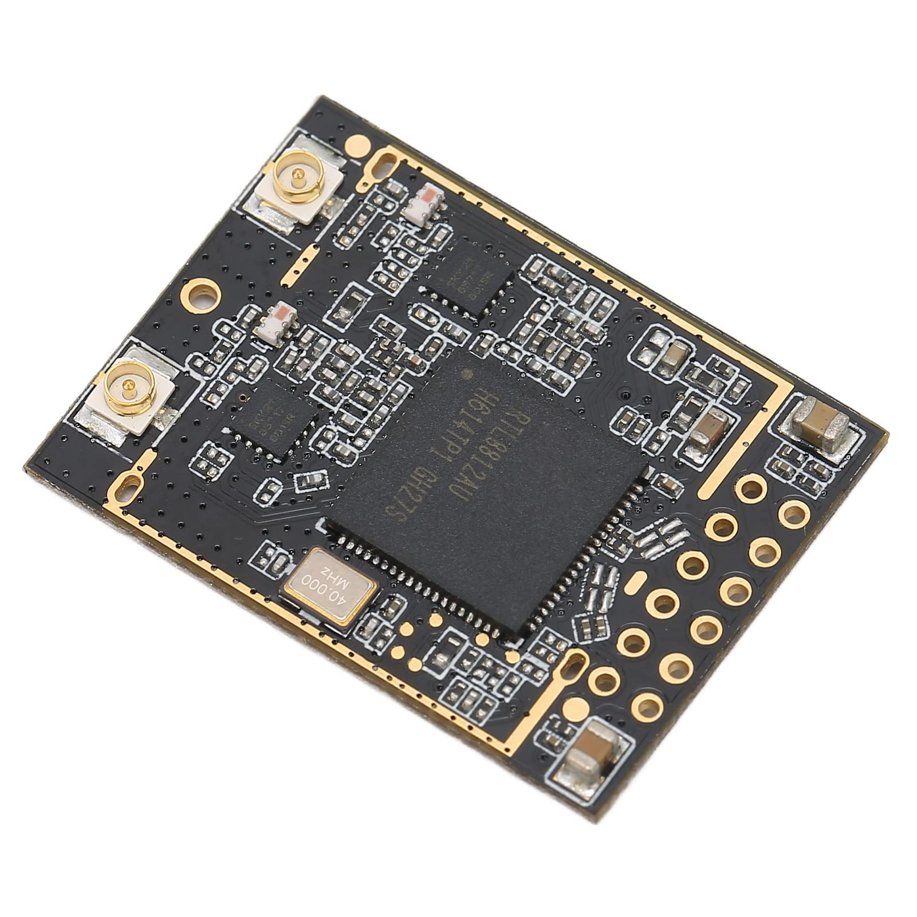
Solution: RF-based Device Fingerprinting & Identification (RFFI)
10
How:
Using deep learning to extract device-identifying features based on hardware impairments of the RF chipsets;
Why:
Can produce non-cooperative device identifiers for re-identification
Problems:
Sensitive to environment changes & transceiver synchronization issues (e.g., carrier frequency offsets)
Requires a dataset representing all supported WiFi chipsets & varying conditions;
Receiver-specific (unless generalization techniques implemented);
Realtek RTL8812AU
(802.11ac/abgn USB WLAN Network Controller)

Slide 11
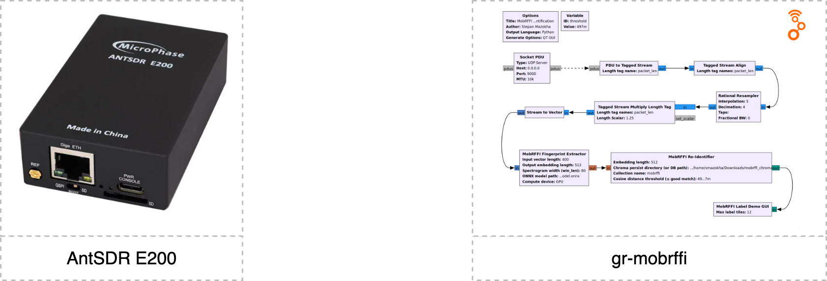
Solution: gr-mobrffi
11

Slide 12
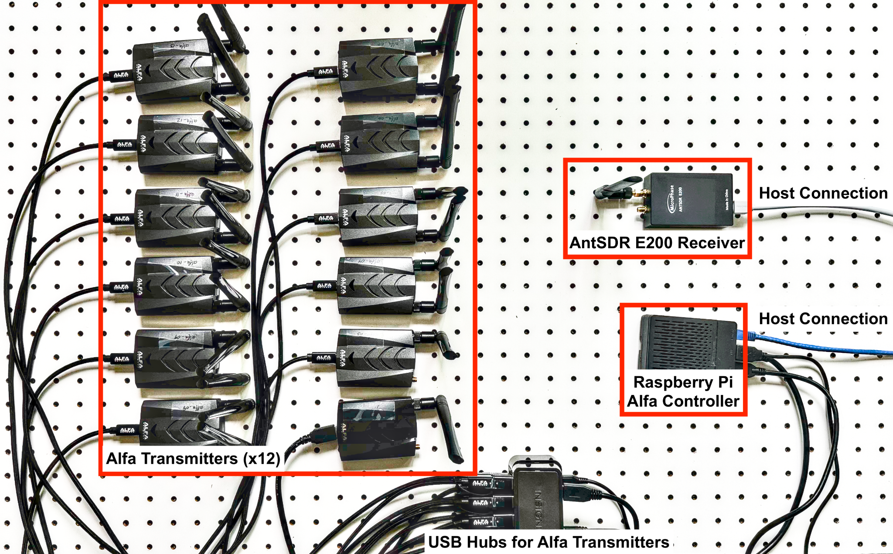
gr-mobrffi: AntSDR + OpenWiFi
14

Slide 13
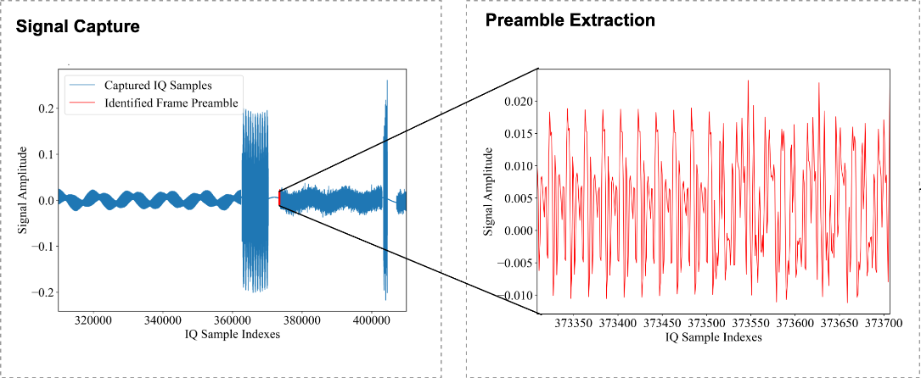
Signal Capture: AntSDR + OpenWiFi
13

Slide 14
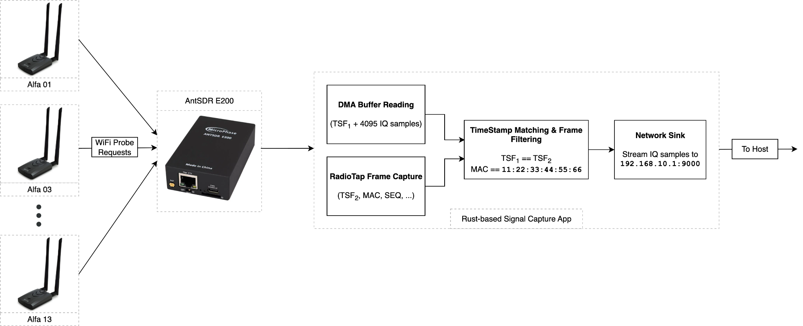
Signal Capture: AntSDR + OpenWiFi
12

Slide 15
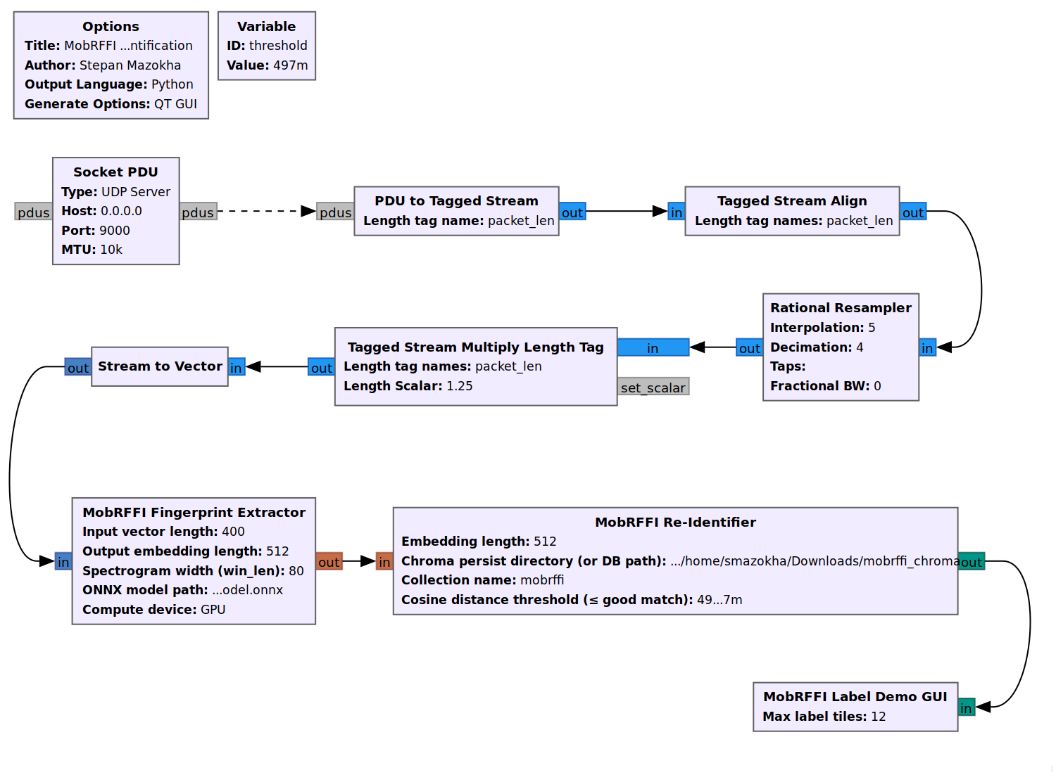
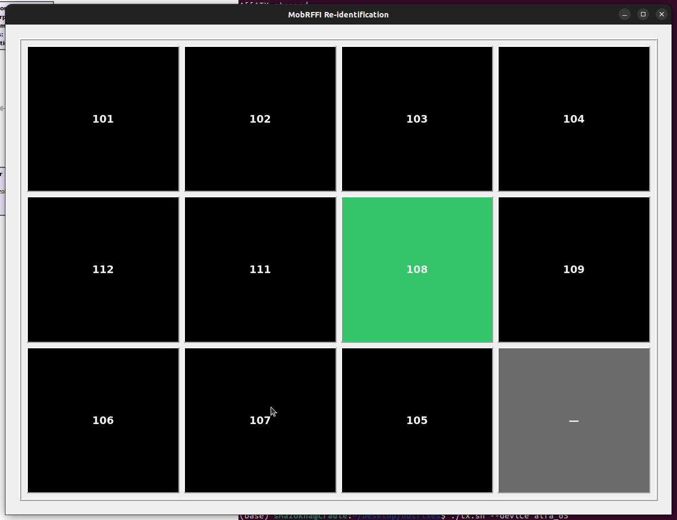
gr-mobrffi
15
From AntSDR

Slide 16
gr-mobrffi: Part 1, Conversion & Upsampling
16

Slide 17
gr-mobrffi: Part 2, Transformation & FP Extraction
17

Slide 18
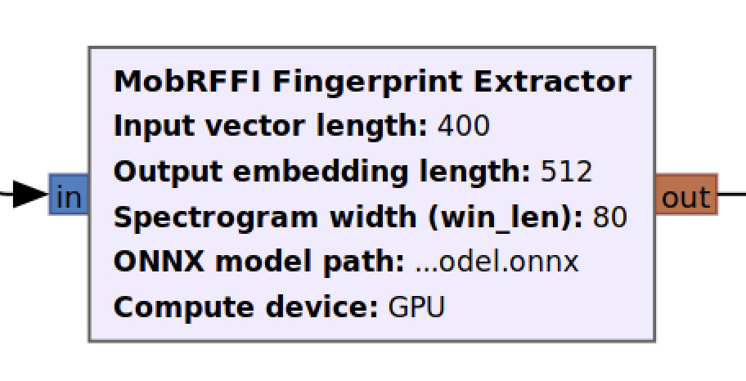
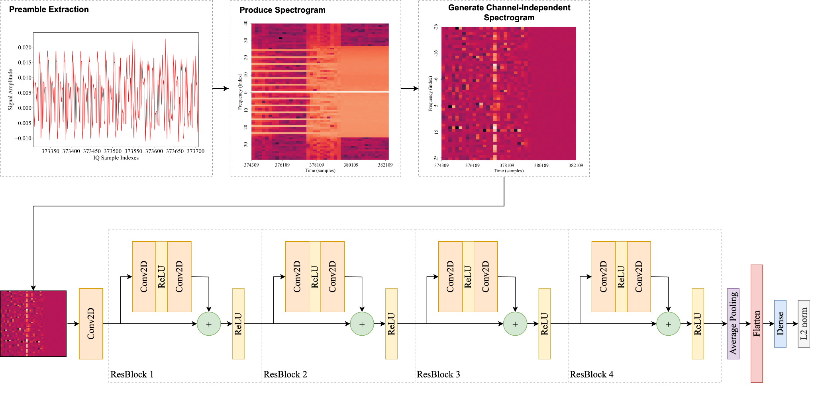
gr-mobrffi: Part 2, Transformation & FP Extraction
18

Slide 19
gr-mobrffi: Part 2, Transformation & FP Extraction
19

Slide 20
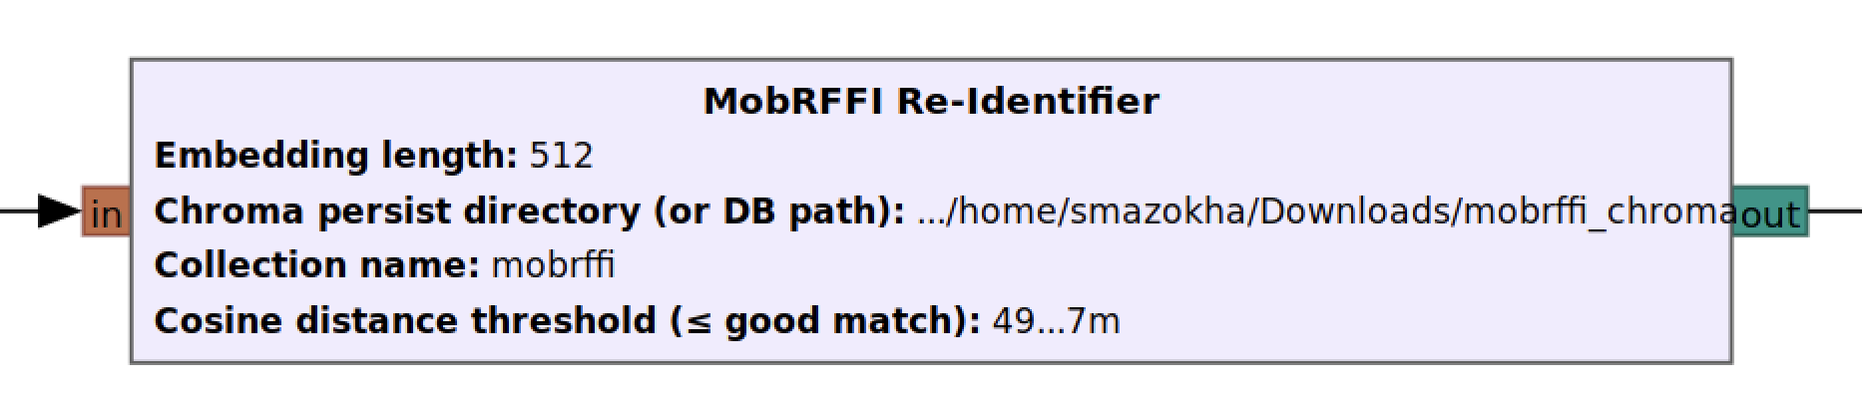
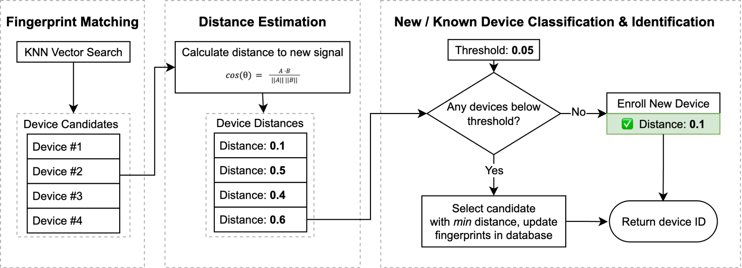
gr-mobrffi: Re-identification
20

Slide 21

gr-mobrffi: How to Use
21
Prior Tasks:
Capture dataset & train extractor model;
Online Mode:
TX (RPi): launch injector tool
RX (AntSDR):
Launch capture app;
Host:
Launch GNUradio pipeline.

Slide 22
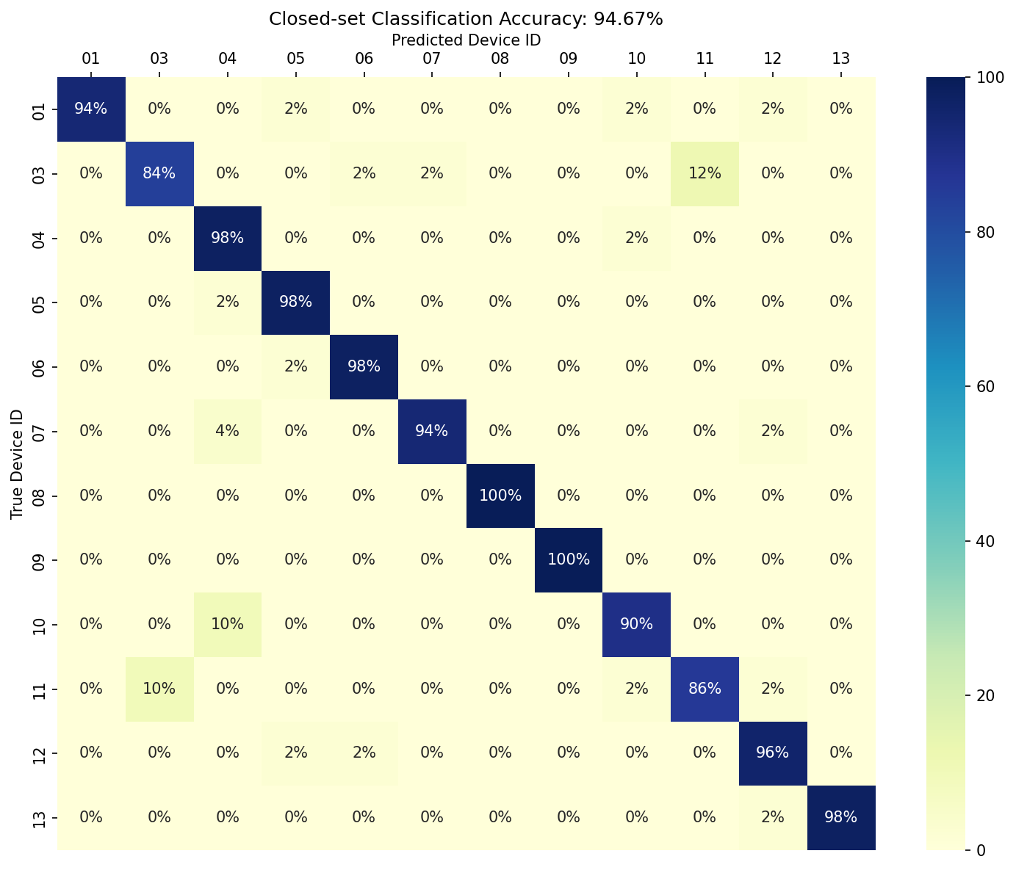
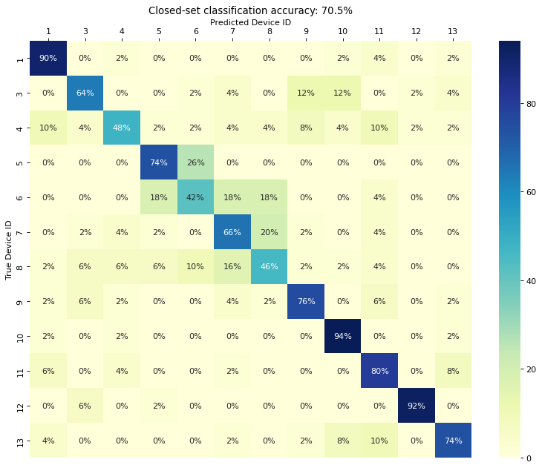
gr-mobrffi: Preliminary Evaluation (not without challenges…)
22
Same-day Re-ID (94.67%)
Multi-day Re-ID (70.5%)

Slide 23

Let’s Collaborate!
23
Build larger dataset to include most commonly adopted RF chipsets;
Build & deploy MobIntel Testbed V2 sensors: AntSDR + Nvidia AGX for edge compute;
Introduce federated learning (lower training cost, multi-receiver fingerprint sharing);
Expand reach beyond West Palm Beach, FL!
Find us online:
isense.fau.edu
c2a2.fau.edu
cs3-erc.org

