Slide 1
Over-the-Air Sequential Uplink Data Processing in Small-Scale Cell-Free mMIMO Networks
Catherine Mertens
Thesis supervisor and Co-author: Prof. dr. ir. Sofie Pollin
Mentors and Co-authors: Dr. ir. Franco Minucci, Dr. ir. Vida Ranjbar
catherine.mertens@student.kuleuven.be, catherine.mertens@outlook.com
Notes:
0.5 min

Slide 2
Table of Contents
Who am I?
Introduction
Research Direction
OFDM link
Small-Scale Cell-Free mMIMO Networks
Conclusion
Notes:
Gebruik deze slide! INTRODUCTION SLIDE

Slide 3
Table of Contents
Who am I?
Introduction
Research Direction
OFDM link
Small-Scale Cell-Free mMIMO Networks
Conclusion
Notes:
Gebruik deze slide! INTRODUCTION SLIDE

Slide 4
Catherine Mertens
1. Who Am I?
Master Student KU Leuven, Belgium
Electrical Engineering, Signal Processing and Information Systems
Master Thesis in Telecommunication
Got the amazing opportunity to present here!
This work has received funding from Smart Networks and Services Joint Undertaking (SNS JU) under the European Union’s Horizon Europe research and innovation programme under Grand Agreements: 101096954 (6G BRICKS) and 101139257 (SUNRISE-6G).
Notes:
https://www.rtl-sdr.com/adalm-pluto-sdr-unboxing-and-initial-testing/
https://www.tutorialspoint.com/data_communication_computer_network/wireless_transmission.htm

Slide 5
Table of Contents
Who am I?
Introduction
Research Direction
OFDM link
Small-Scale Cell-Free mMIMO Networks
Conclusion
Notes:
Gebruik deze slide! INTRODUCTION SLIDE

Slide 6
Table of Contents
Who am I?
Introduction
Research Direction
OFDM link
Small-Scale Cell-Free mMIMO Networks
Conclusion
Notes:
Gebruik deze slide! INTRODUCTION SLIDE

Slide 7
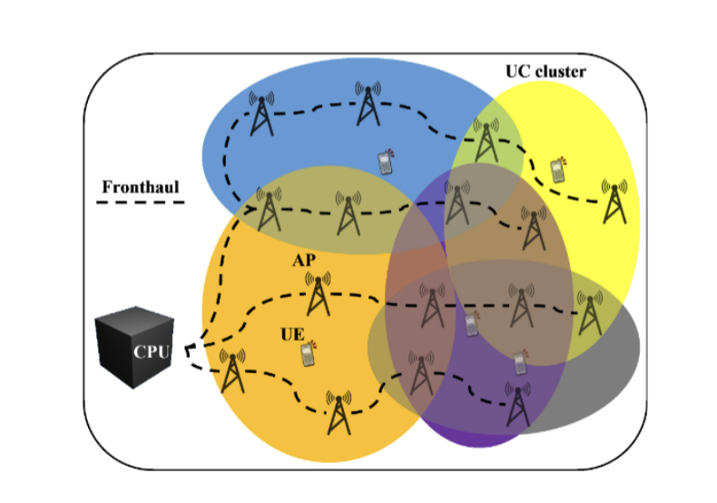
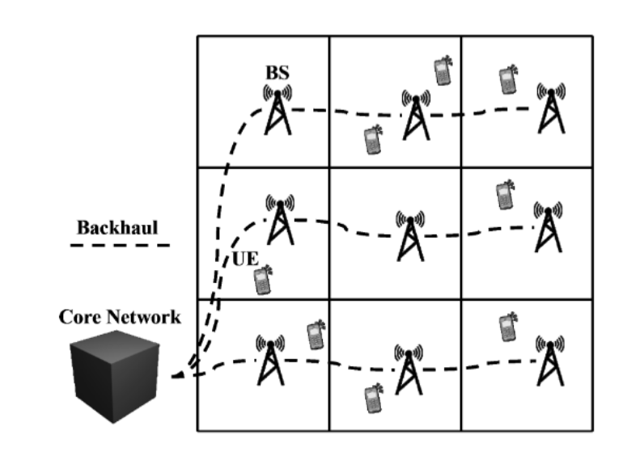
Cellular Networks vs. Cell-Free Networks
2. Introduction
Cellular Networks
Cell-Free Networks
Base station per cell
Base station serves users in the area
Service depends on the distance to the base station
No division in cells
Multiple Access Points serve each user
Uniformly good service throughout the area
Figures from
[1] M. Zaher, Practical Deployment Aspects of Cell-Free Massive MIMO Net-
works. PhD thesis, KTH Royal Institute of Technology, 2023. QC 20230503.
Notes:
Give example of the stadium
Animation + add what is sent over the link
Altijd access points zeggen als er AP staat

Slide 8
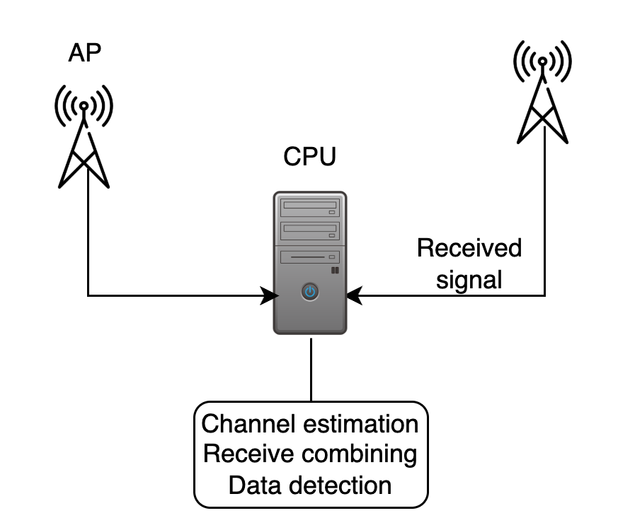
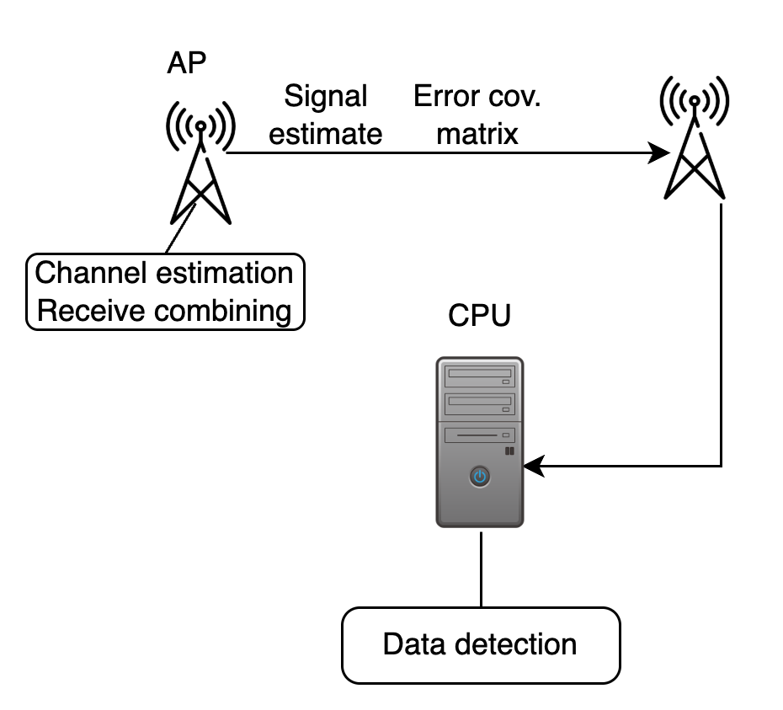
Uplink Data Processing in Cell-Free mMIMO
2. Introduction
Centralised processing
Sequential processing
Disadvantages
- All Access Points (APs) wired to the CPU
- High data rates on the fronthaul links
- All computations in the CPU
Advantages
+ Computations distributed
+ Lower data rates on the fronthaul links
+Less wiring
Disadvantages
- Delay
- Quantisation error propagation
Figures based on :
[2] Demir, Ö., Björnson, E. and Sanguinetti, L. (2021). Foundations of User-Centric Cell-Free Massive MIMO. Foundations and Trends® in Signal Processing, 14(3–4), 162–472.
[3] Z. H. Shaik, E. Björnson and E. G. Larsson, "MMSE-Optimal Sequential Processing for Cell-Free Massive MIMO With Radio Stripes," in IEEE Transactions on Communications, vol. 69, no. 11, pp. 7775-7789, Nov. 2021, doi: 10.1109/TCOMM.2021.3100619.
Notes:
Give example of the stadium
Animation + add what is sent over the link
Altijd access points zeggen als er AP staat

Slide 9
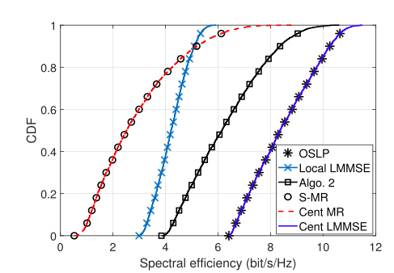
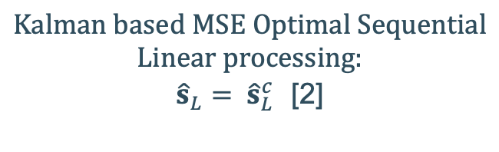
Uplink Data Processing in Cell-Free mMIMO
2. Introduction
Same SE
[3]
What are the effects of over-the-air transmission and processing on this result?
[3] Z. H. Shaik, E. Björnson and E. G. Larsson, "MMSE-Optimal Sequential Processing for Cell-Free Massive MIMO With Radio Stripes," in IEEE Transactions on Communications, vol. 69, no. 11, pp. 7775-7789, Nov. 2021, doi: 10.1109/TCOMM.2021.3100619.
Notes:
Mention that ideal fronthaul connections and full capacity

Slide 10
Table of Contents
Who am I?
Introduction
Research Direction
OFDM link
Small-Scale Cell-Free mMIMO Networks
Conclusion
Notes:
Gebruik deze slide! INTRODUCTION SLIDE

Slide 11
Table of Contents
Who am I?
Introduction
Research Direction
OFDM link
Small-Scale Cell-Free mMIMO Networks
Conclusion
Notes:
Gebruik deze slide! INTRODUCTION SLIDE

Slide 12
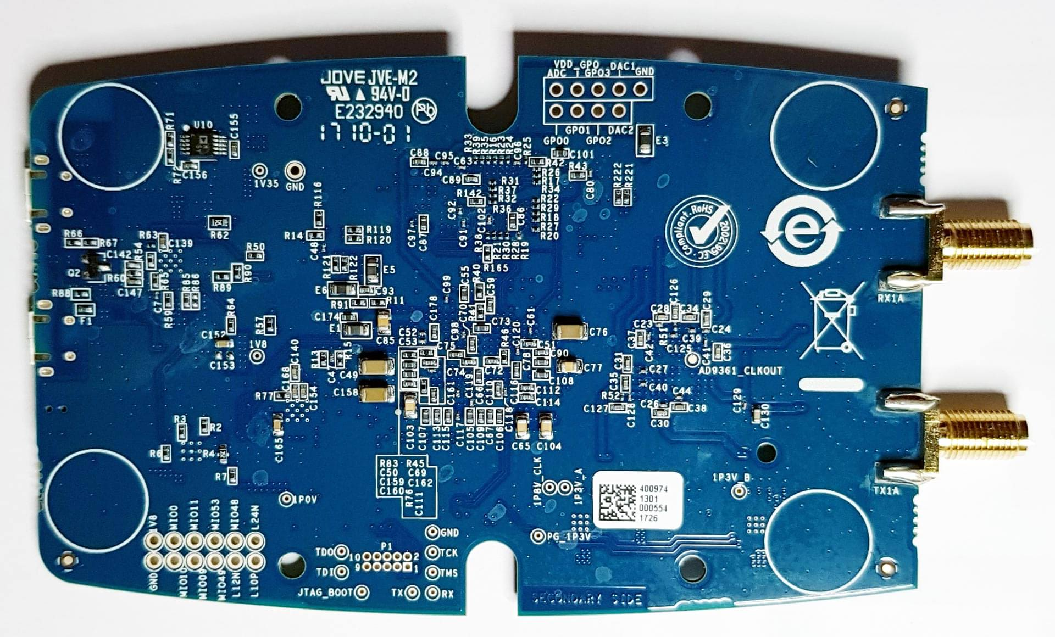
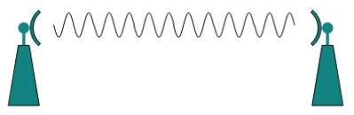
Research Question
3. Research Direction
How does sequential uplink signal processing perform using real-world transmission and processing?
Including
Wireless channel
RX front-end of the radio
Synchronisation
Measured channel statistics
Fronthaul limitations
[4]
[3]
[3] R. B. (RTL-SDR Blog), "ADALM-PLUTO SDR Unboxing and Initial Testing," RTL-SDR Blog. [Online]. Available: https://www.rtl-sdr.com/adalm-pluto-sdr-unboxing-and-initial-testing/. [Accessed: Jun. 23, 2025].
[4] Tutorials Point, "Wireless Transmission," Tutorials Point. [Online]. Available: https://www.tutorialspoint.com/data_communication_computer_network/wireless_transmission.htm. [Accessed: Jun. 23, 2025].
Notes:
https://www.rtl-sdr.com/adalm-pluto-sdr-unboxing-and-initial-testing/
https://www.tutorialspoint.com/data_communication_computer_network/wireless_transmission.htm

Slide 13
Research Methodology
3. Research Direction
Steps for achieving this goal:
Researching (and extending) existing implementations of OFDM link in GNU radio
Setting up a small-scale Cell-Free mMIMO network with centralised and sequential processing

Slide 14
Table of Contents
Who am I?
Introduction
Research Direction
OFDM link
Small-Scale Cell-Free mMIMO Networks
Conclusion
Notes:
Gebruik deze slide! INTRODUCTION SLIDE

Slide 15
Table of Contents
Who am I?
Introduction
Research Direction
OFDM link
Small-Scale Cell-Free mMIMO Networks
Conclusion
Notes:
Gebruik deze slide! INTRODUCTION SLIDE

Slide 16
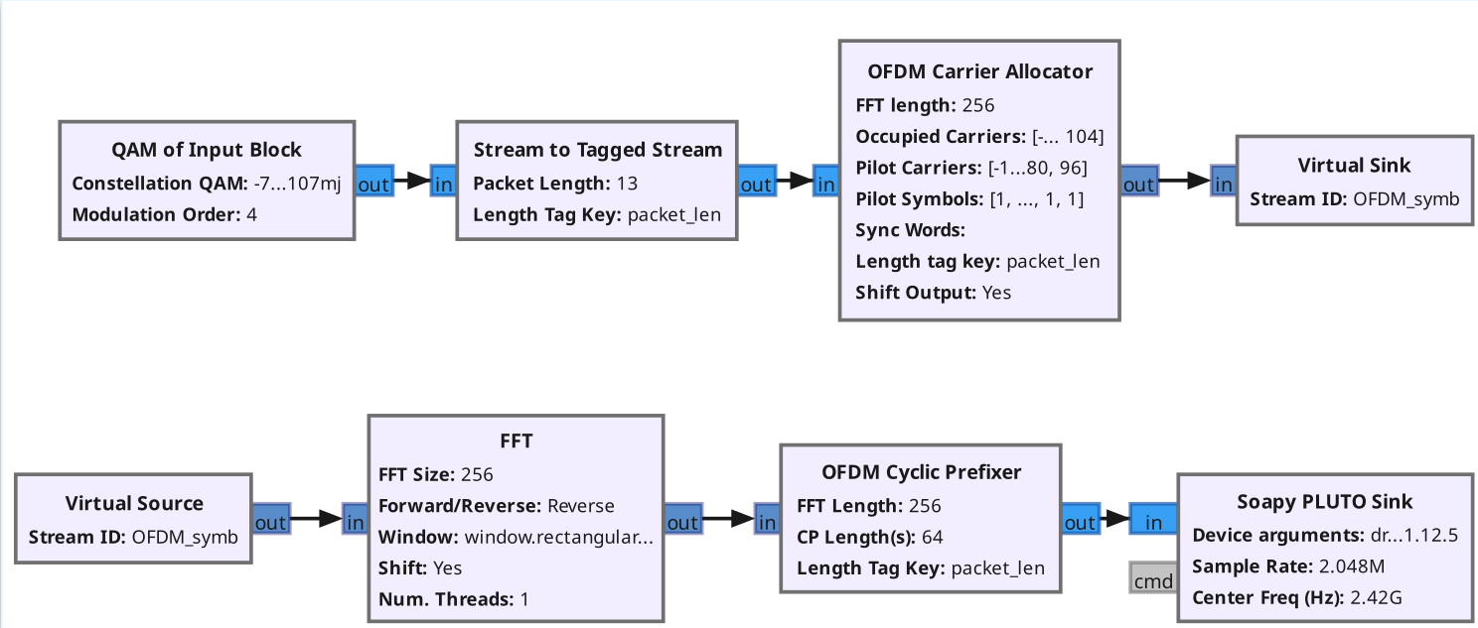
Extension of Existing OFDM Transmitter
5. OFDM link
Appropriate existing OFDM Transmitter in GNU Radio
Extend for easy reconfiguration for multiple User Equipments (UEs)

Slide 17
Extension of Existing OFDM Transmitter
5. OFDM link
Input parameters
FFT size
Active Subcarrier Spacing (ASCS)
Number of UEs K
Guard band width
Implemented automatic spectrum divisioning in (coherence) blocks
Pilot subcarriers indices
Data subcarriers indices
Pilot symbols

Slide 18
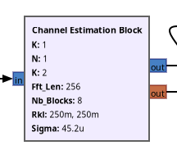
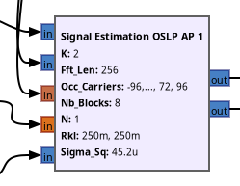
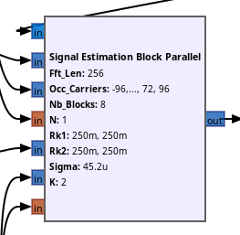
Extension of Existing OFDM Receiver
5. OFDM link
Existing (open-source) implementation does not allow for:
LMMSE channel and signal estimation,
easy extensions to multiple APs, multiple UEs,
sequential signal processing
Implement custom Python receiver to solve these shortcomings

Slide 19
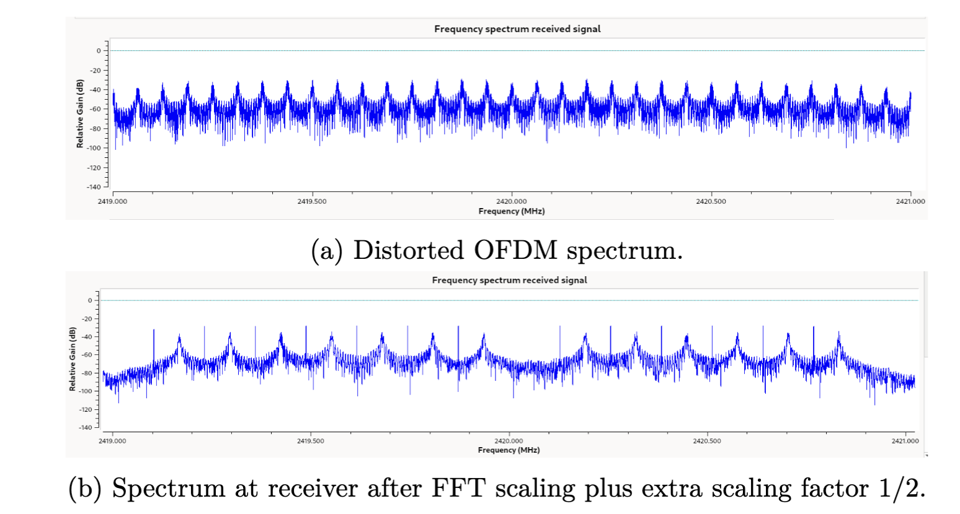
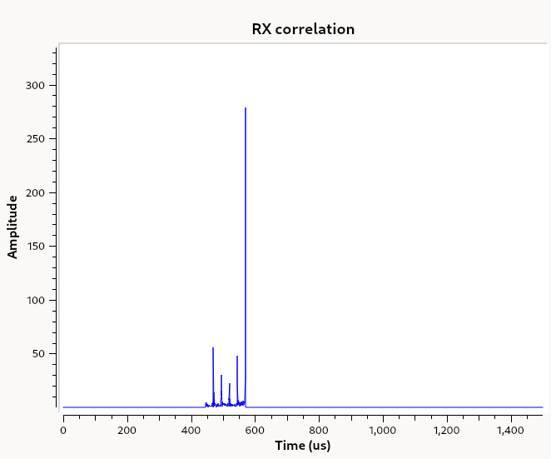
Challenges
5. OFDM link
Coarse time synchronisation
Frequency synchronisation
Distortion
Correlation with preamble at receiver
Determine threshold via measurement statistics
Placing PlutoSDR Rx and Tx GNU Radio block in same flowgraph
Scale FFT
Experimental extra scaling factor
Notes:
MISSCHIEN DEZE SLIDE ERUIT

Slide 20
Table of Contents
Who am I?
Introduction
Research Direction
OFDM link
Small-Scale Cell-Free mMIMO Networks
Conclusion
Notes:
Gebruik deze slide! INTRODUCTION SLIDE

Slide 21
Table of Contents
Who am I?
Introduction
Research Direction
OFDM link
Small-Scale Cell-Free mMIMO Networks
Conclusion
Notes:
Gebruik deze slide! INTRODUCTION SLIDE

Slide 22
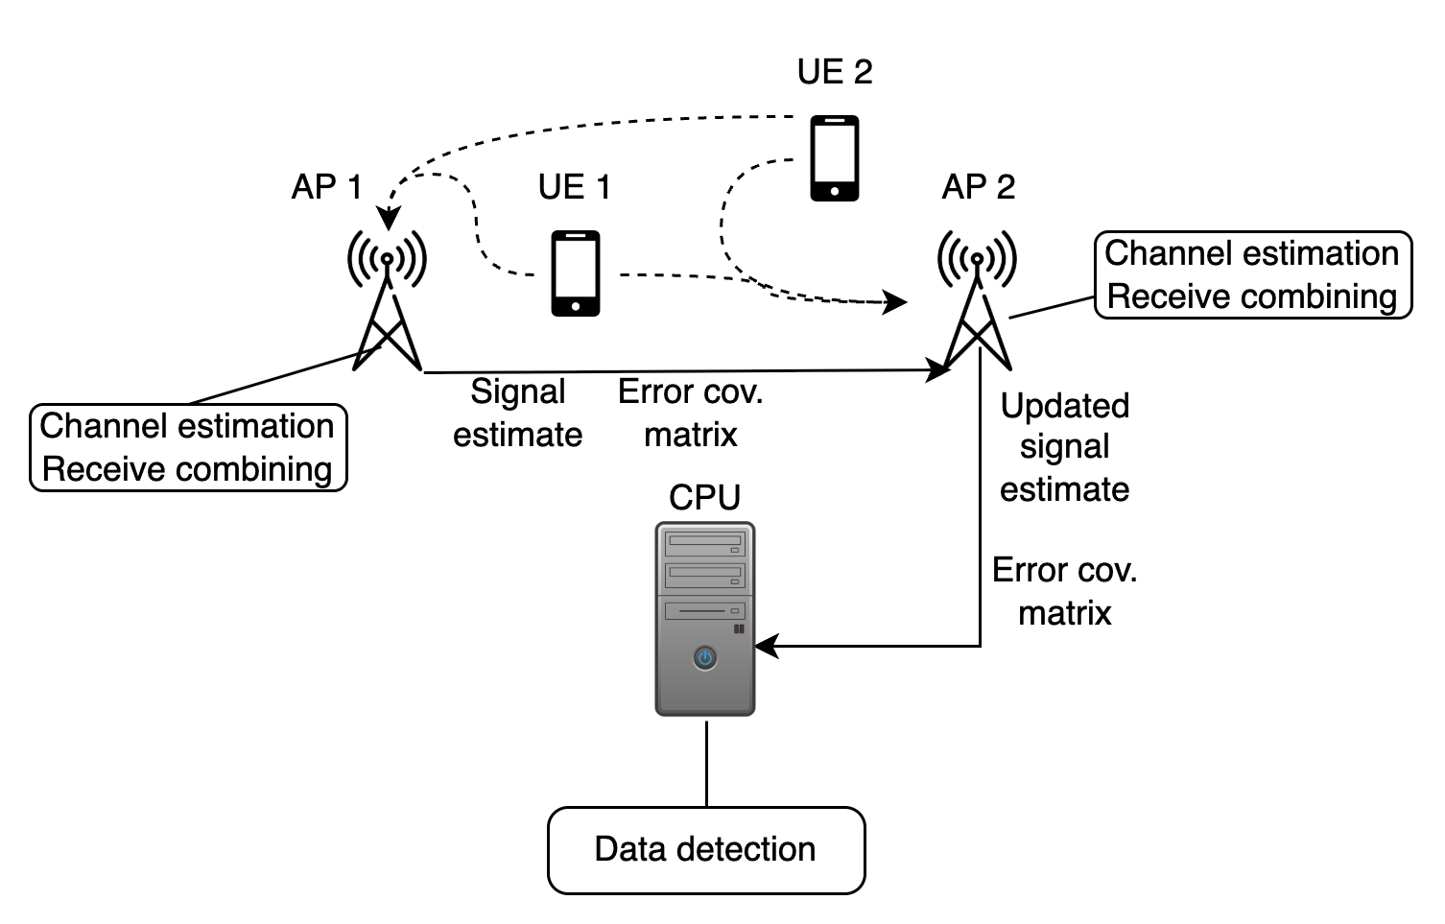
Sequential Architecture
6. Small-Scale Cell-Free mMIMO Networks
Target configuration: two UEs and two APs

Slide 23
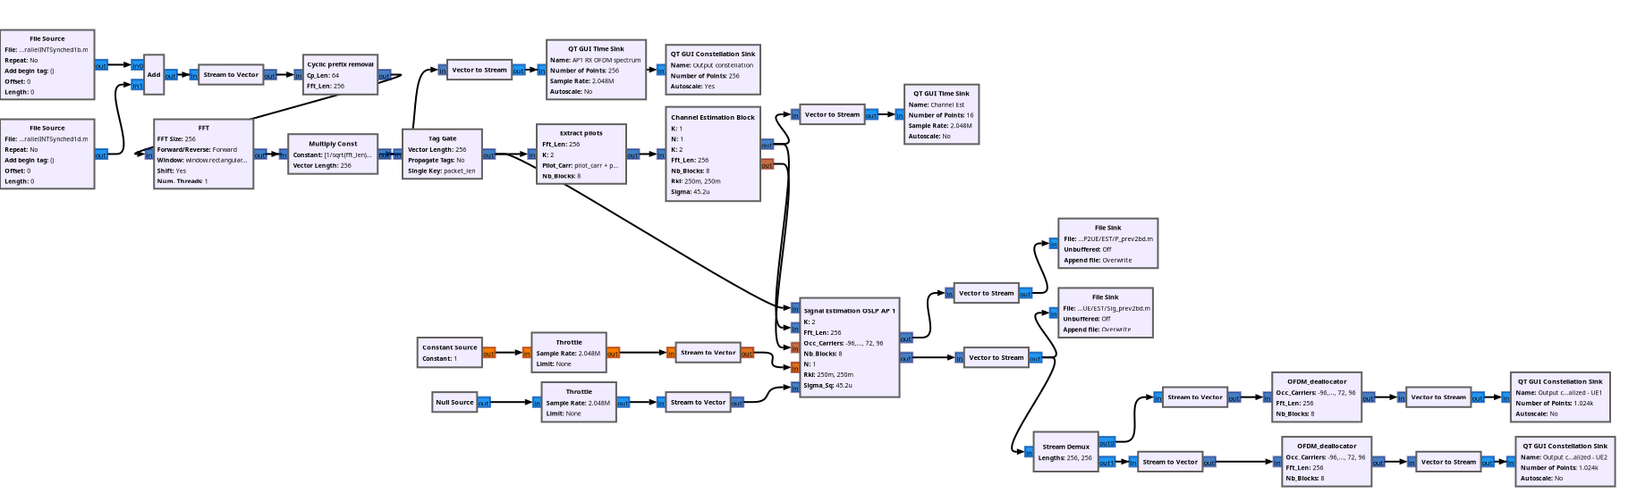
GNU Radio Flowgraph
6. Small-Scale Cell-Free mMIMO Networks
OFDM demodulation
Channel Estimation
Signal Estimation
Forwarding

Slide 24
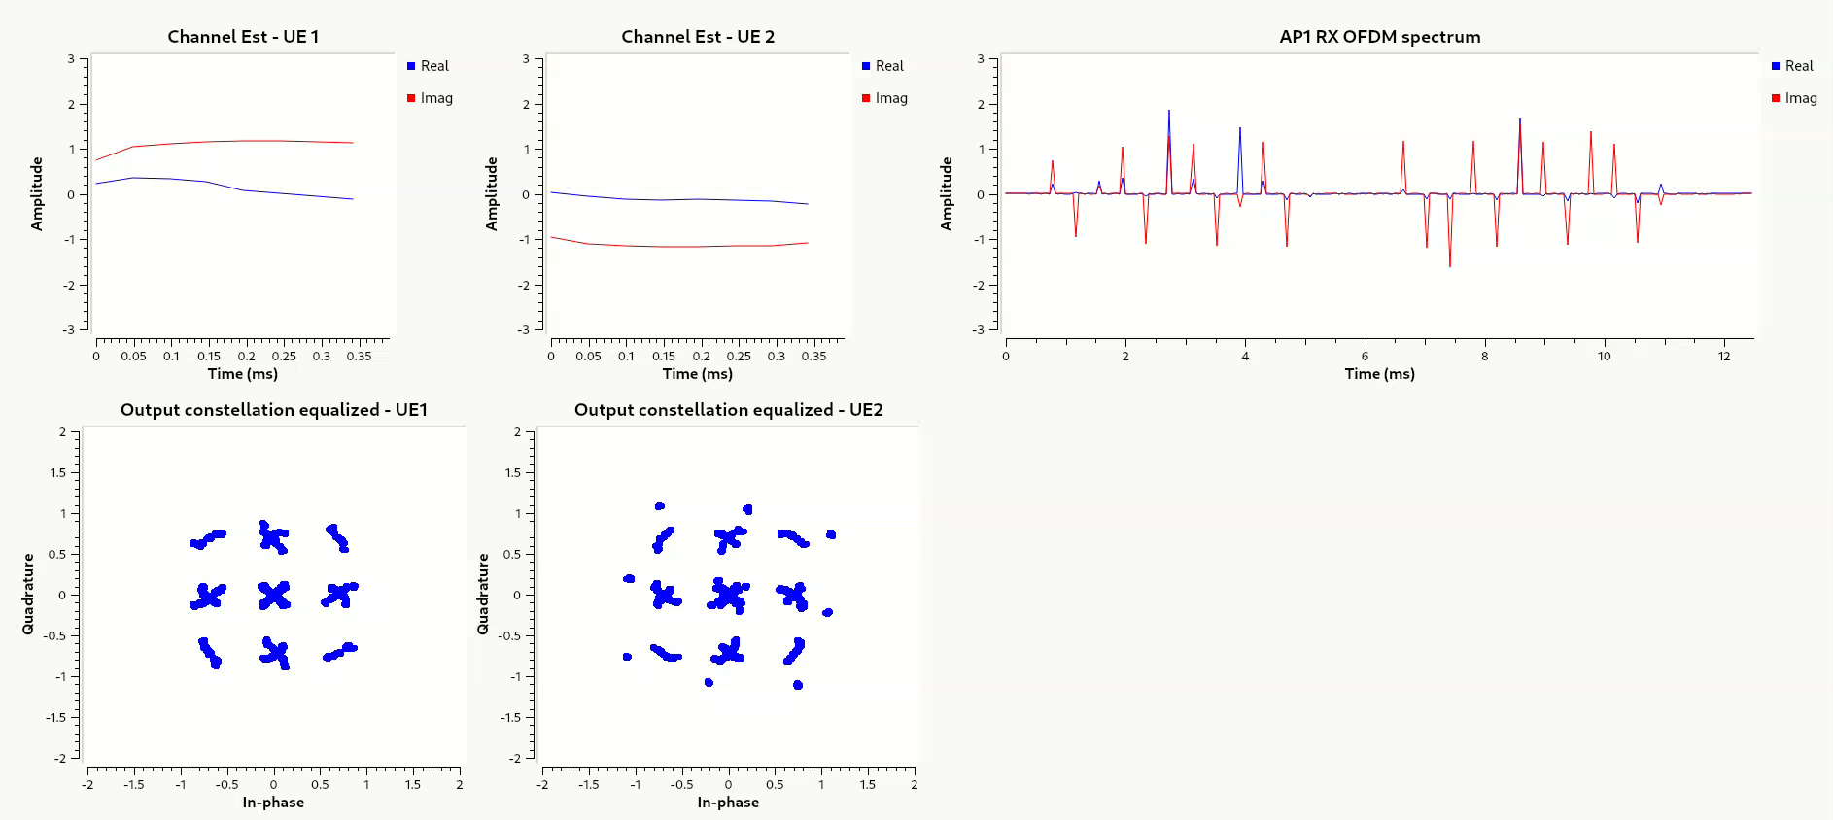
Demo Sequential Data Processing – AP 1
6. Small-Scale Cell-Free mMIMO Networks

Slide 25
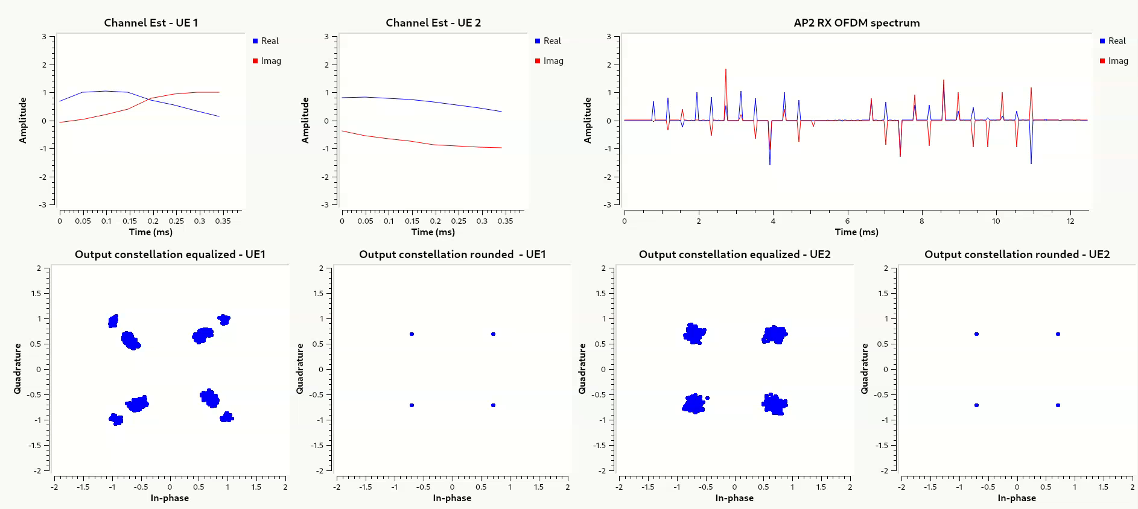
Demo Sequential Data Processing – AP 2
6. Small-Scale Cell-Free mMIMO Networks

Slide 26
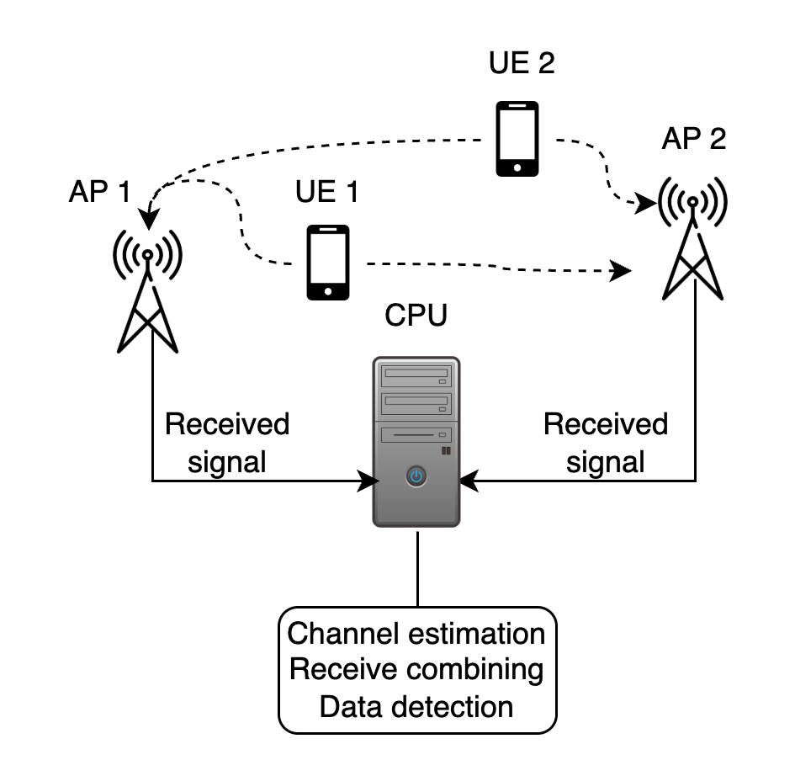
Centralised Architecture
6. Small-Scale Cell-Free mMIMO Networks
Target configuration: two UEs and two APs

Slide 27
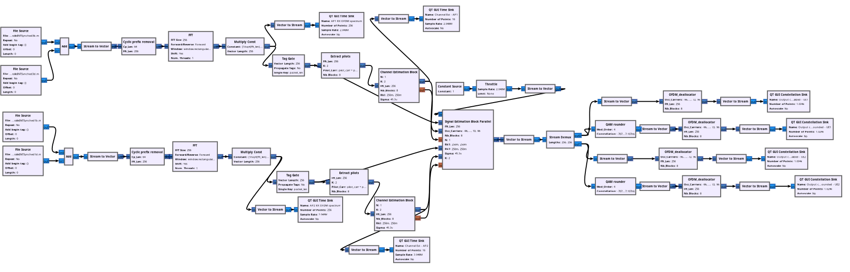
GNU Radio Flowgraph
6. Small-Scale Cell-Free mMIMO Networks
OFDM demodulation
Channel Estimation
Signal Estimation

Slide 28
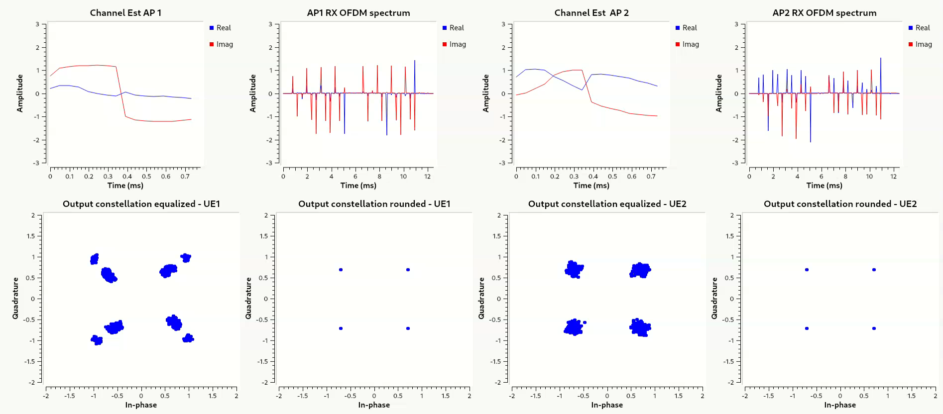
Demo Centralised Data Processing
6. Small-Scale Cell-Free mMIMO Networks

Slide 29
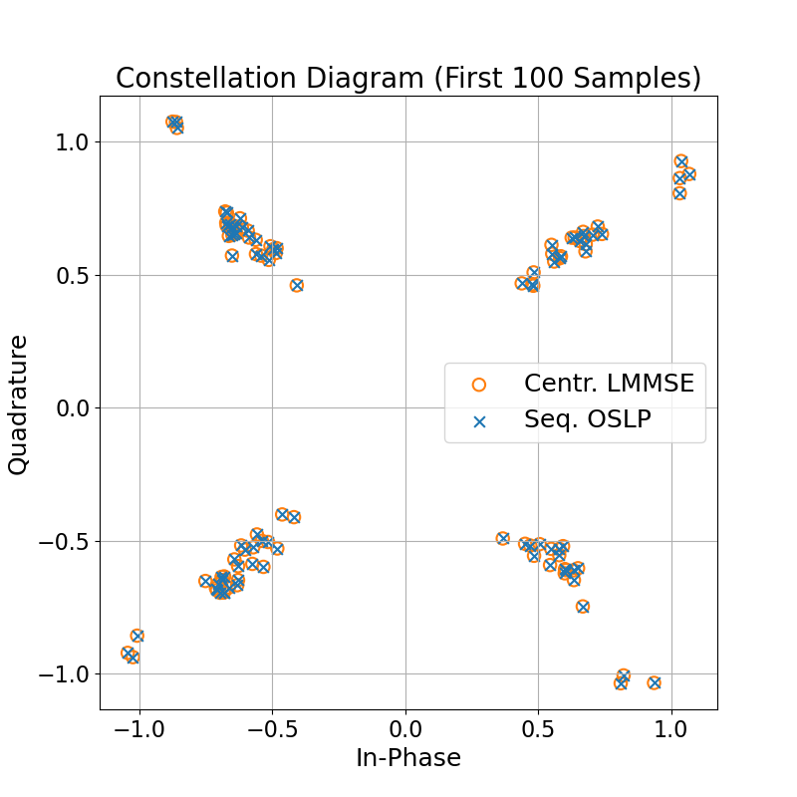
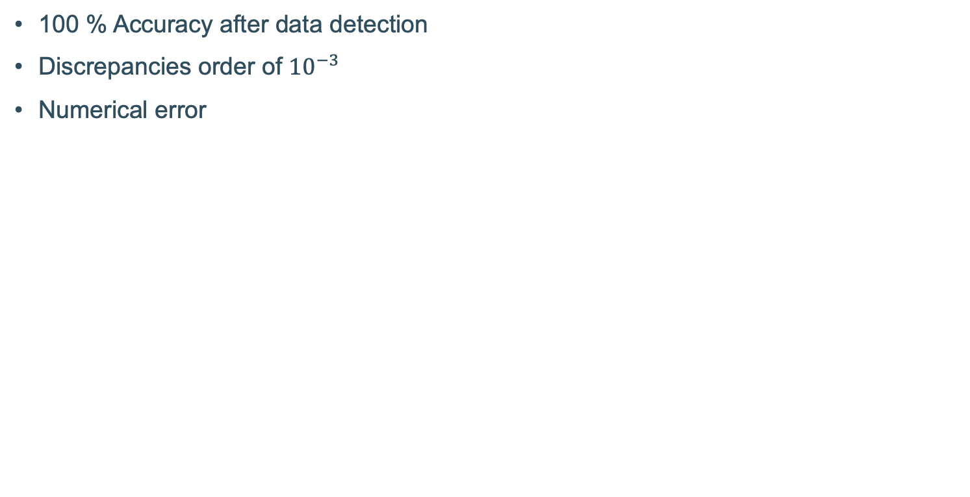
Result
6. Small-Scale Cell-Free mMIMO Networks

Slide 30
Table of Contents
Who am I?
Introduction
Research Direction
OFDM link
Small-Scale Cell-Free mMIMO Networks
Conclusion
Notes:
Gebruik deze slide! INTRODUCTION SLIDE

Slide 31
Table of Contents
Who am I?
Introduction
Research Direction
OFDM link
Small-Scale Cell-Free mMIMO Networks
Conclusion
Notes:
Gebruik deze slide! INTRODUCTION SLIDE

Slide 32
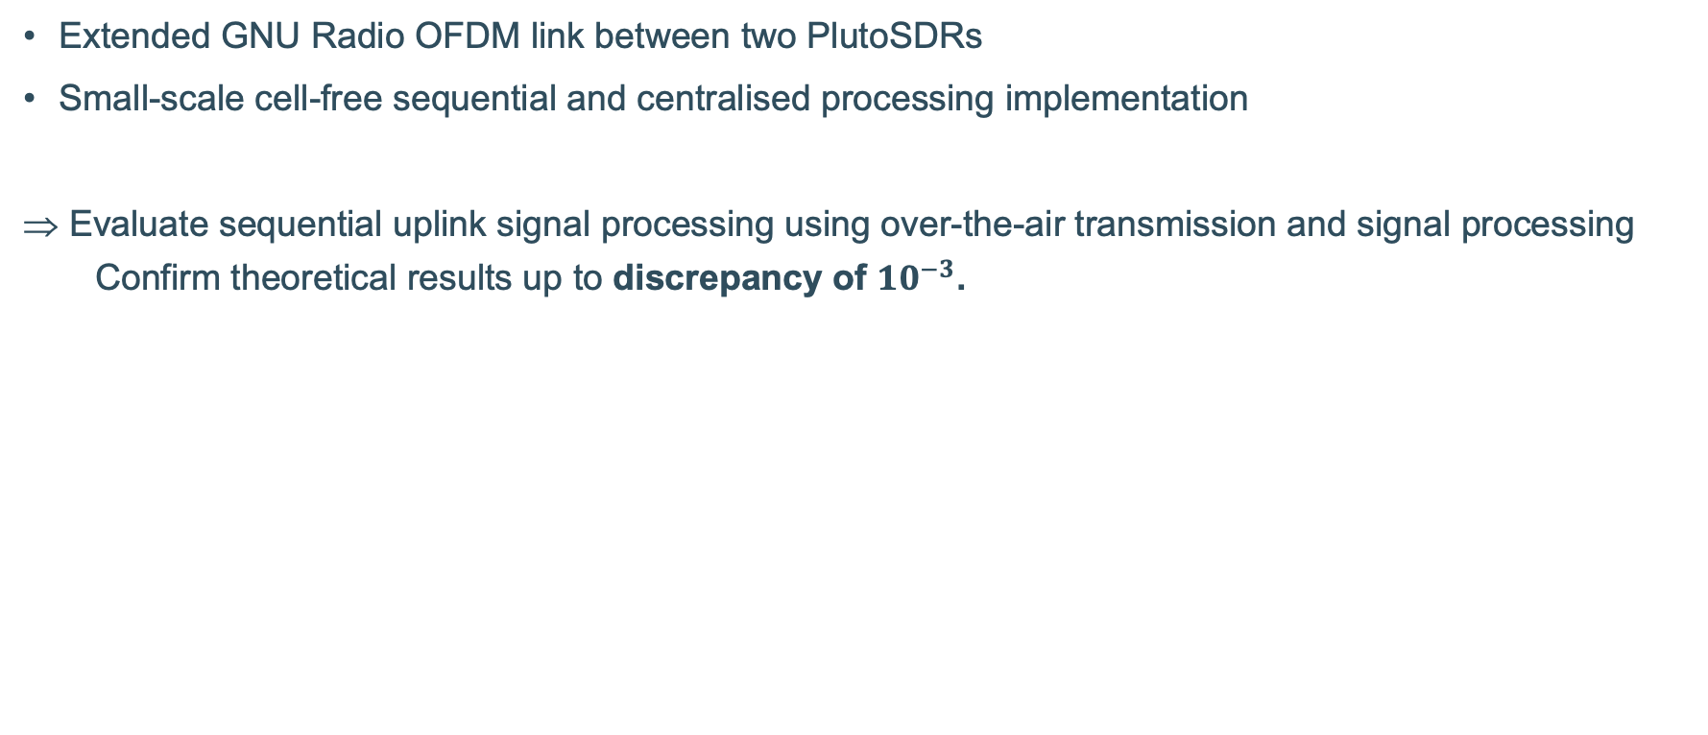
Contributions
7. Conclusion
Notes:
https://jemengineering.com/blog-antennas-a-history/

Slide 33
Limitations and Future Work
7. Conclusion
Limitations
Real disadvantages of sequential processing not used
Small-scale
No real multi-path fading
Future Work
Synchronisation enhancements
Fronthaul limitations
Extension to more antennas, APs and UEs
Multi-path fading environment
Notes:
https://jemengineering.com/blog-antennas-a-history/

Slide 34
Thank you for listening
catherine.mertens@student.kuleuven.be

Slide 35
References
[1] M. Zaher, Practical Deployment Aspects of Cell-Free Massive MIMO Networks. PhD thesis, KTH Royal Institute of Technology, 2023. QC 20230503.
[2] Demir, Ö., Björnson, E. and Sanguinetti, L. (2021). Foundations of User-Centric Cell-Free Massive MIMO. Foundations and Trends® in Signal Processing, 14(3–4), 162–472.
[3] Z. H. Shaik, E. Björnson and E. G. Larsson, "MMSE-Optimal Sequential Processing for Cell-Free Massive MIMO With Radio Stripes," in IEEE Transactions on Communications, vol. 69, no. 11, pp. 7775-7789, Nov. 2021, doi: 10.1109/TCOMM.2021.3100619.
[4] Tutorials Point, "Wireless Transmission," Tutorials Point. [Online]. Available: https://www.tutorialspoint.com/data_communication_computer_network/wireless_transmission.htm. [Accessed: Jun. 23, 2025].

Slide 36
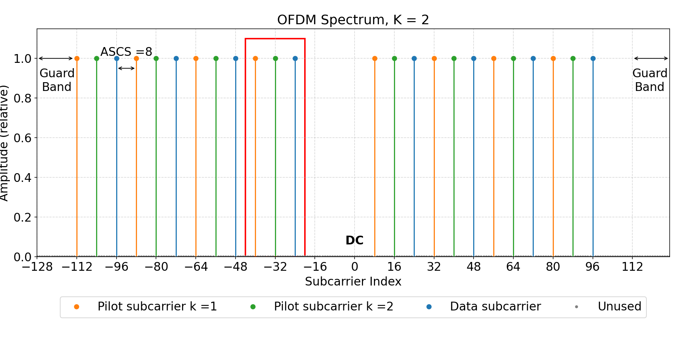
Extension of existing OFDM Transmitter
4. Extension of GNU Radio OFDM Tx and Rx
Example, FFT size = 256, ASCS = 8, K = 2, guard band width = 16
Notes:
Should explain / add extra slide on that this is a coherency block and the pilot assignment method?

Slide 37
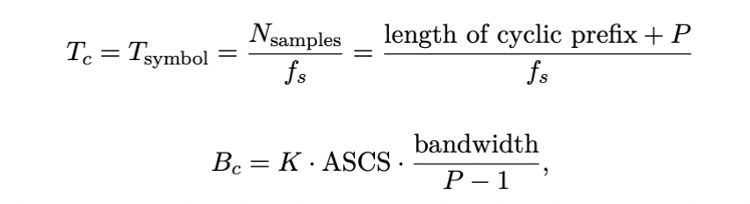
Coherence time and bandwidth

Slide 38

OFDM structure

Slide 39
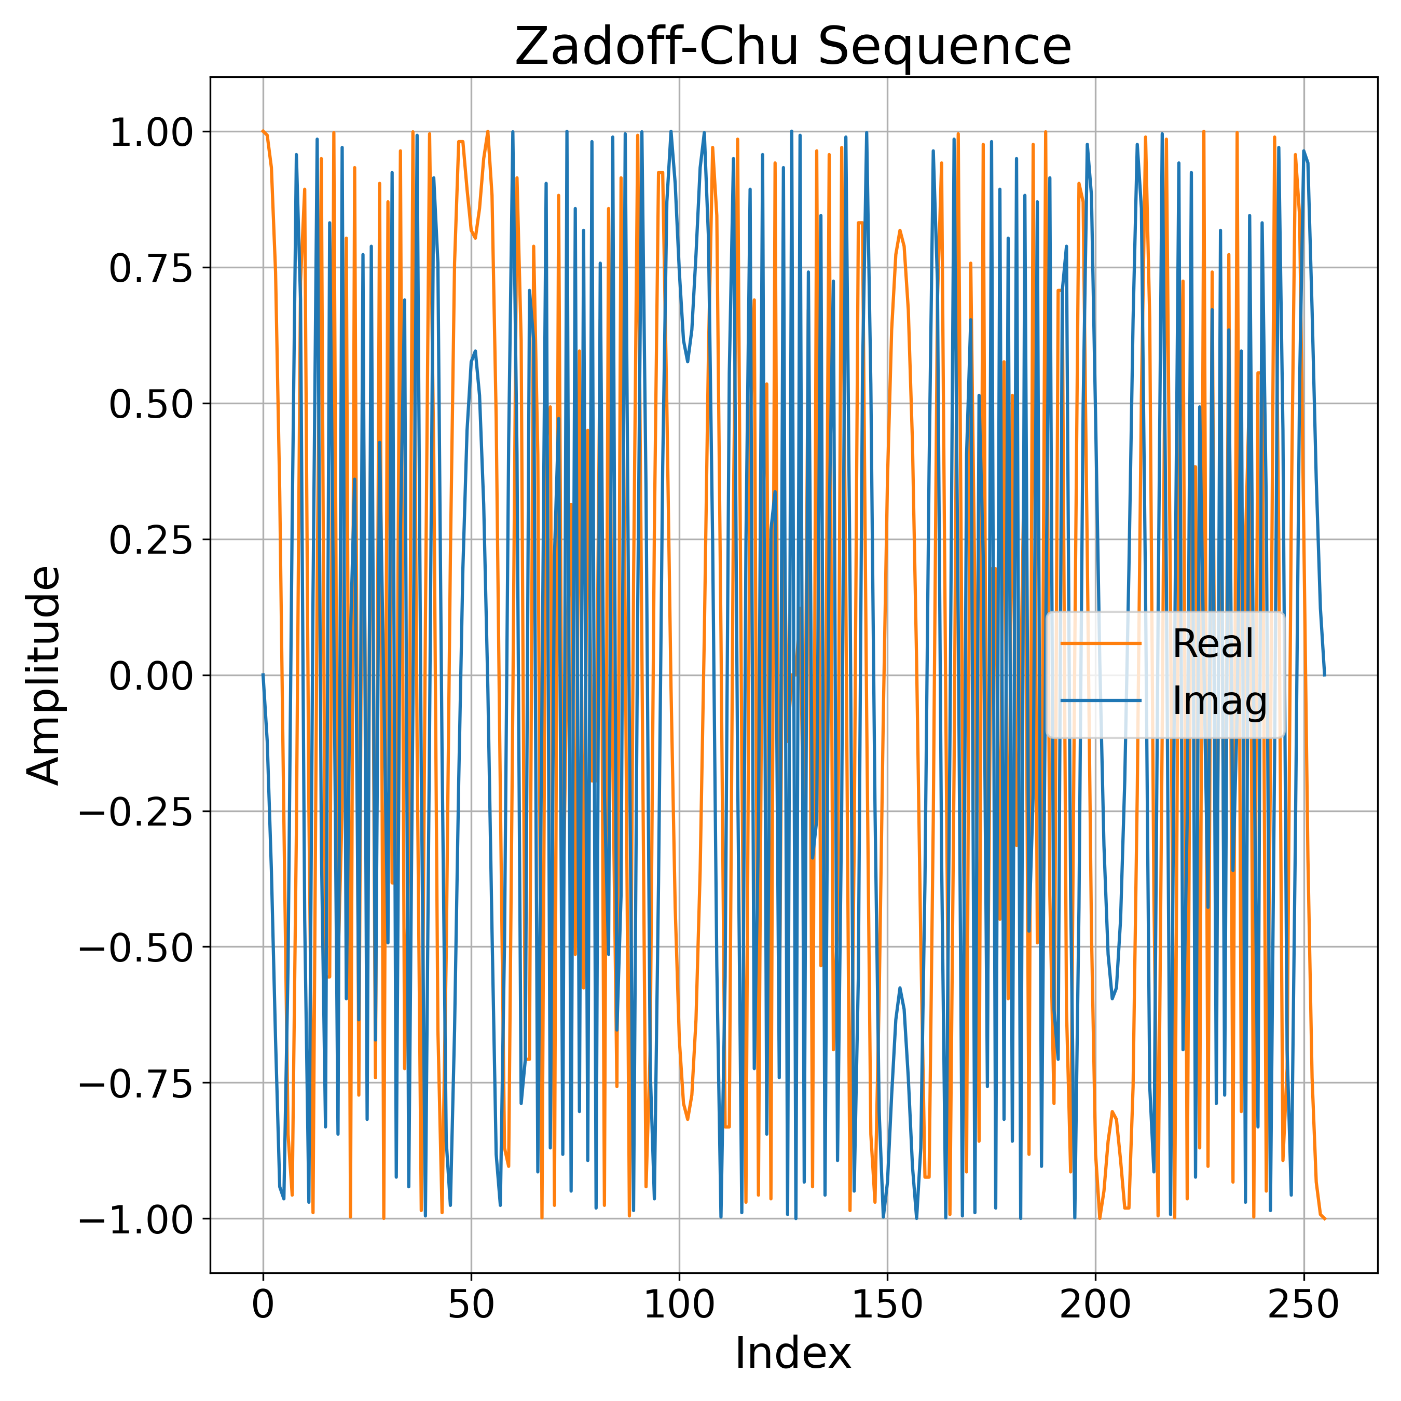
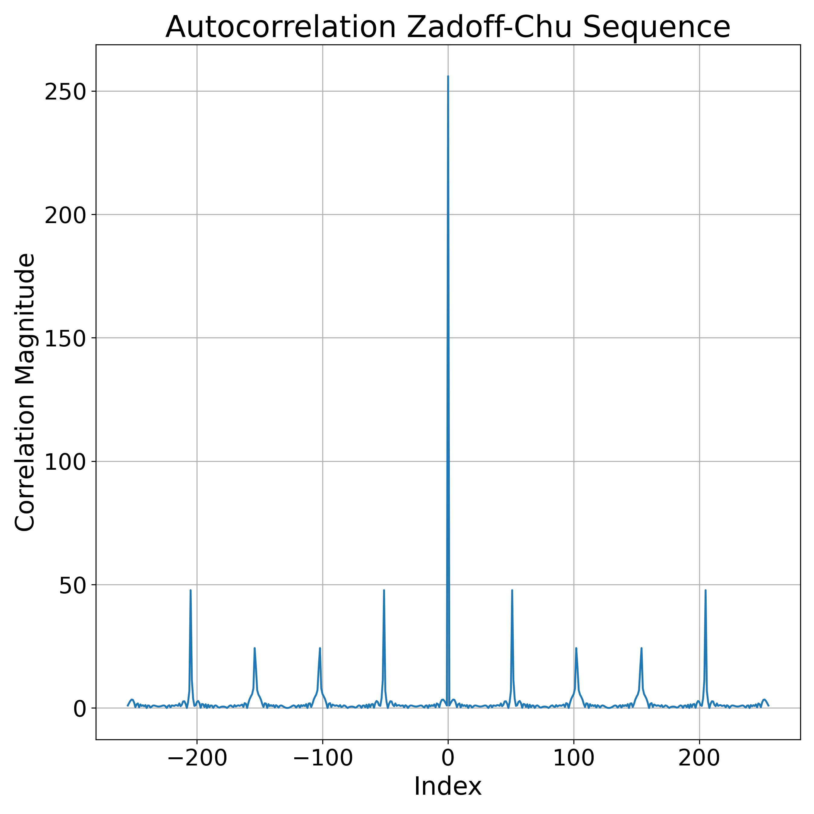
Zadoff-Chu

Slide 40
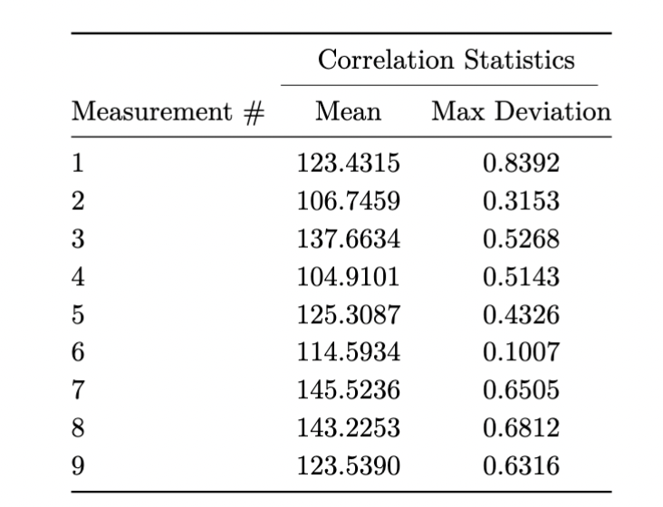
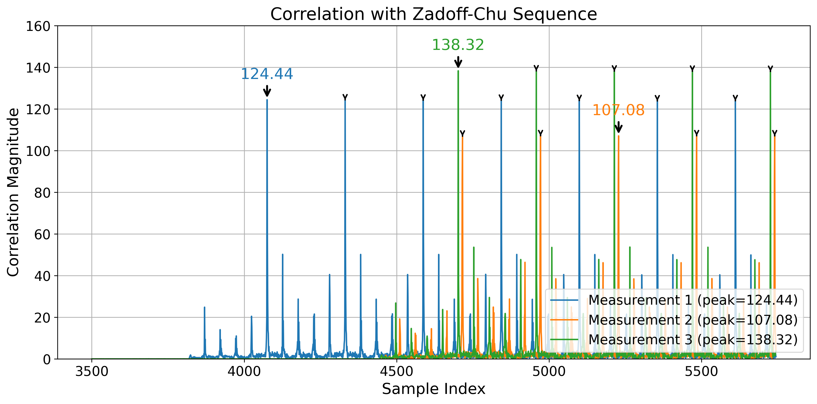
Zadoff-Chu Statistics

Slide 41
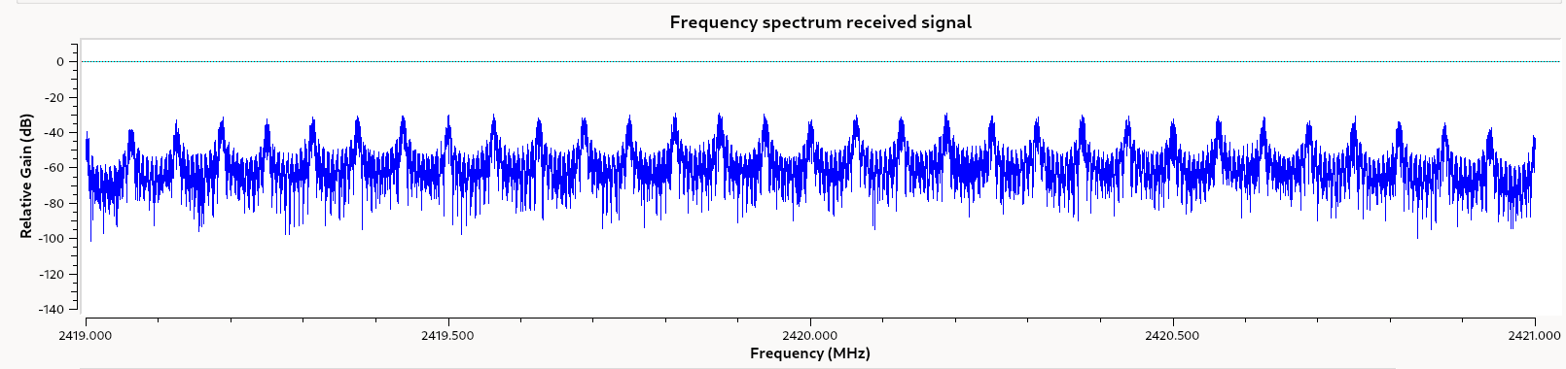
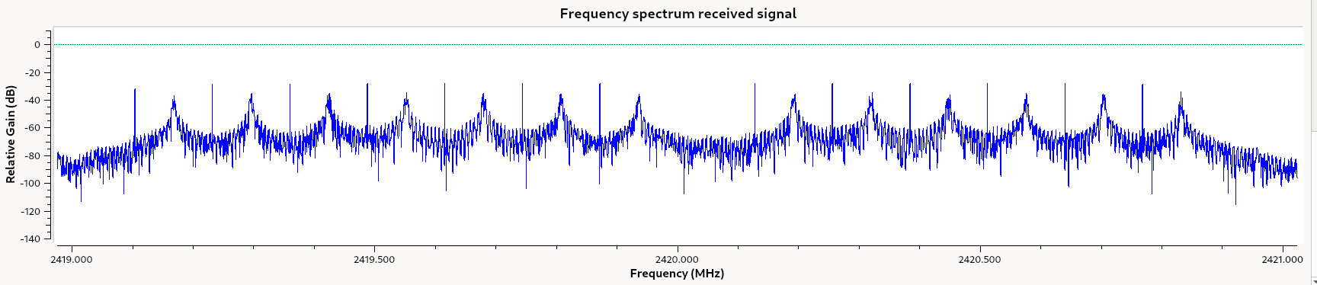
Distortion

Slide 42
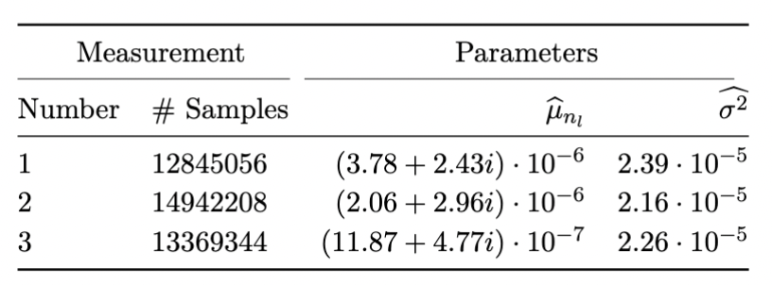
Noise Statistics

Slide 43
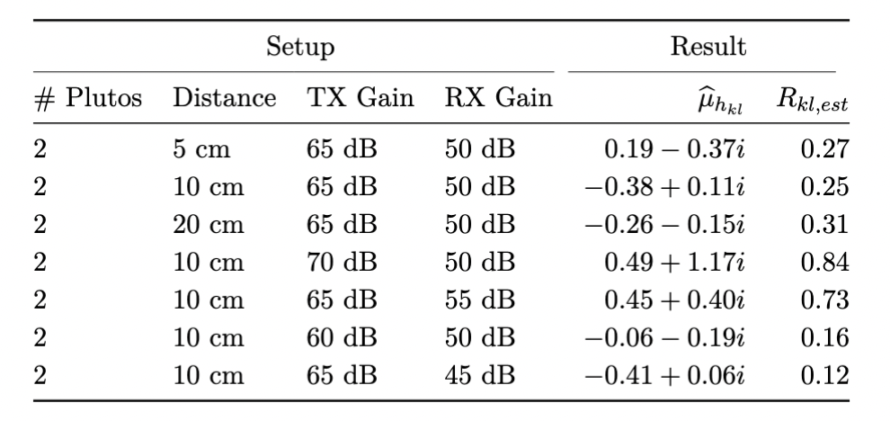
Channel Statistics

Slide 44
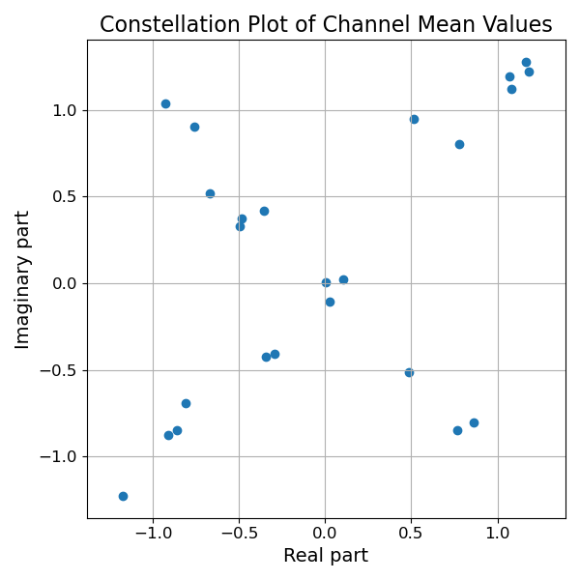
Channel Mean Values

Slide 45
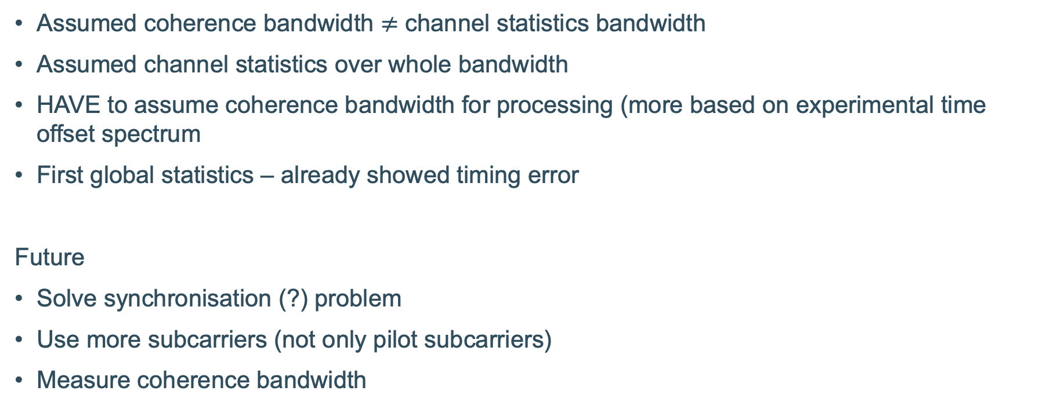
Limitations
Debaenst, W., Feys, A., Cuiñas, I., García Sánchez, M., & Verhaevert, J. (2020). RMS Delay Spread vs. Coherence Bandwidth from 5G Indoor Radio Channel Measurements at 3.5 GHz Band. Sensors (Basel, Switzerland), 20(3), 750. https://doi.org/10.3390/s20030750

Slide 46
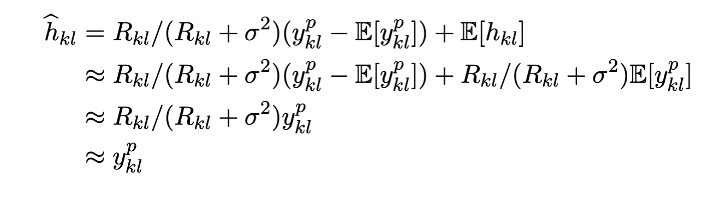
Channel Statistics Variability

Slide 47
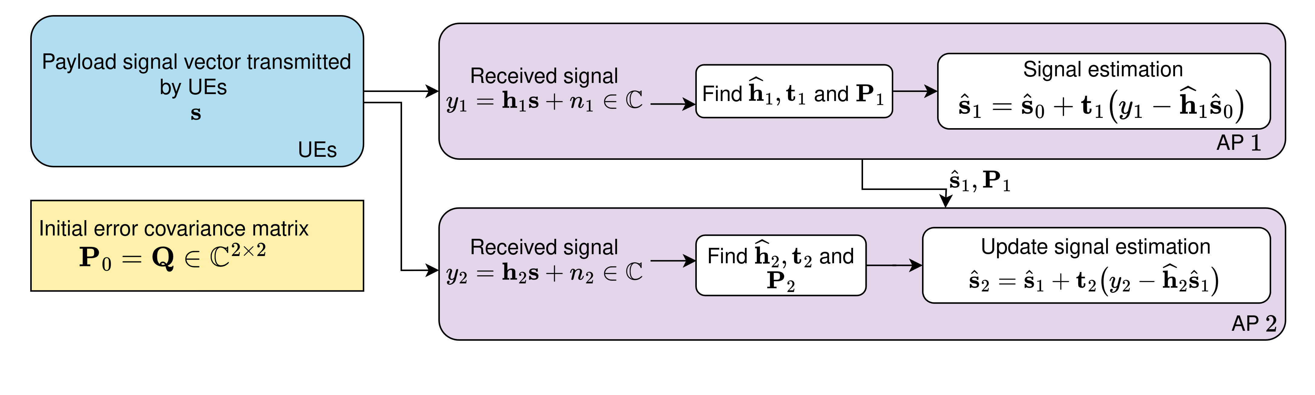
Sequential Processing

Slide 48
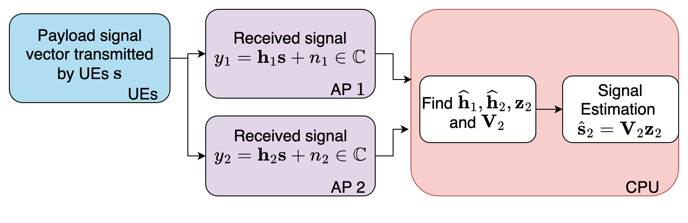
Centralised Processing

Slide 49
Measurements
Per UE-AP pair: change the OFDM index of the UE to change the used subcarriers
Do a measurement
Record received signal
Synchronise received signal
Add the signals together for the correct AP
Process

Slide 50
pk
No metric in GNU Radio -> extra challenge
Included transmitter gain
Not receiver gain => has to be included in the channel effect
Easier to just incorporate transmitter gain also there
p_k was for Gaussian distribution of signal also not the case as the p_k for a certain subcarriers was standard 1

Slide 51
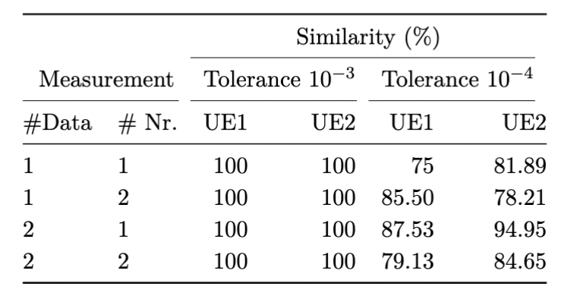
Results

Slide 52
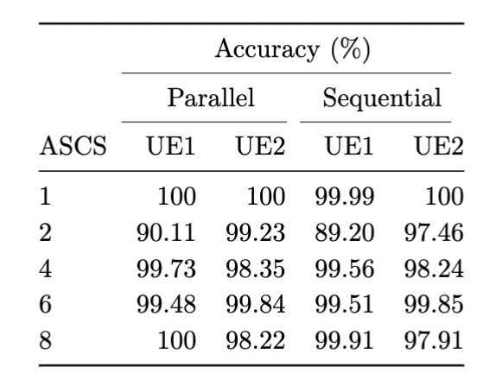
Result ASCS
Before error found in sequential

Slide 53
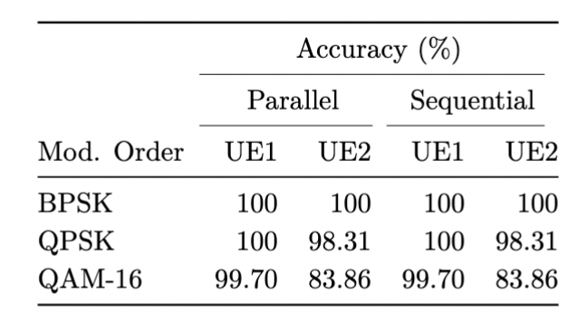
Result Modulation Order

Slide 54
Methodology
5. Channel Statistics Estimation
Noise statistics
Zero signal on all subcarriers
Sample mean and variance
Channel statistics
Unit signal on pilot subcarriers
Sample mean and variance, using noise statistics

Slide 55
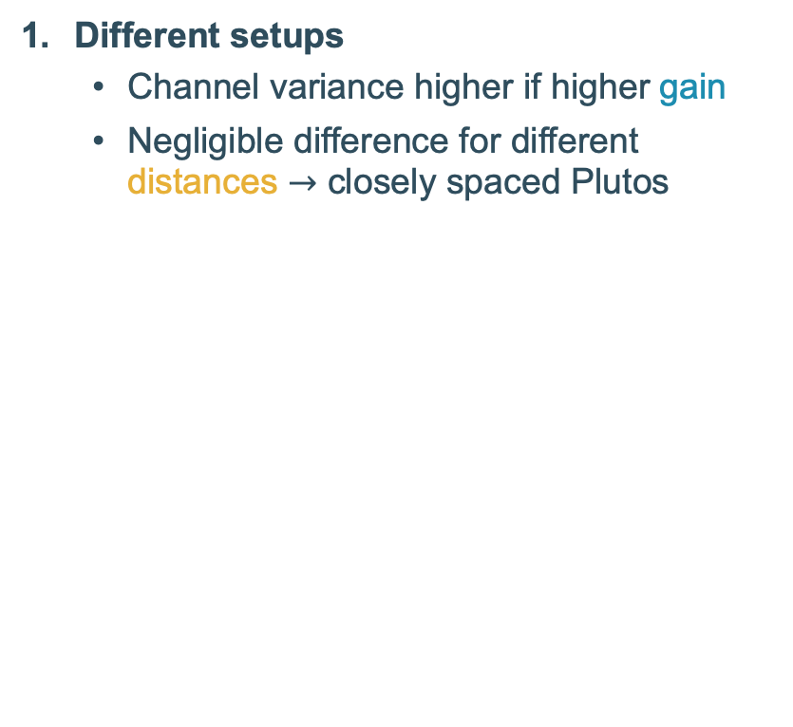
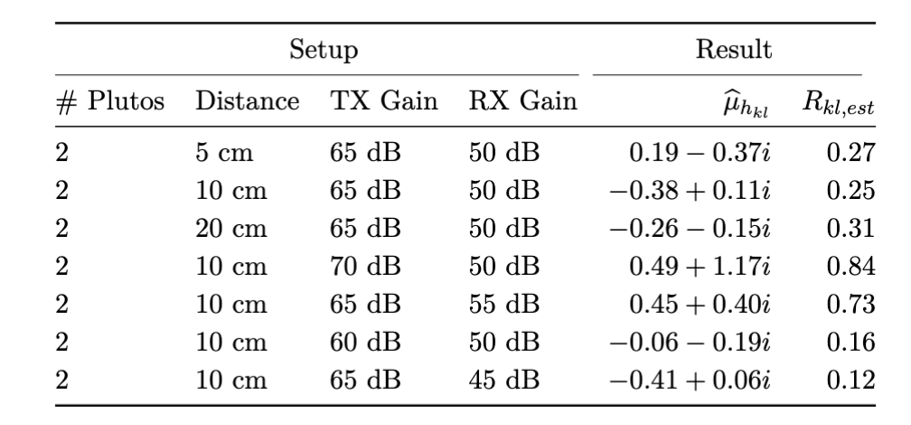
Measurement Results
5. Channel Statistics Estimation
v
Channel mean
Nonzero
Line-of-sight component
Closely spaced Plutos

Slide 56
Measurement Results
5. Channel Statistics Estimation
Channel mean
Nonzero
Line-of-sight component
Closely spaced Plutos

Slide 57
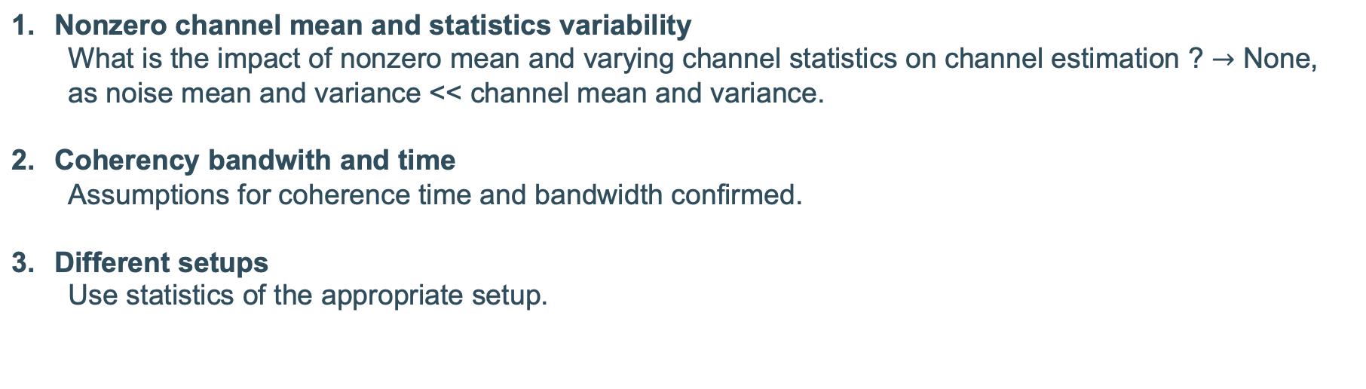
Effect on Channel Estimation
5. Channel Statistics Estimation

Slide 58
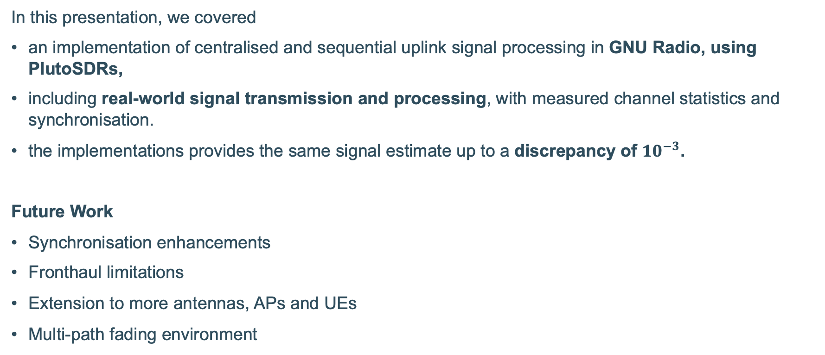
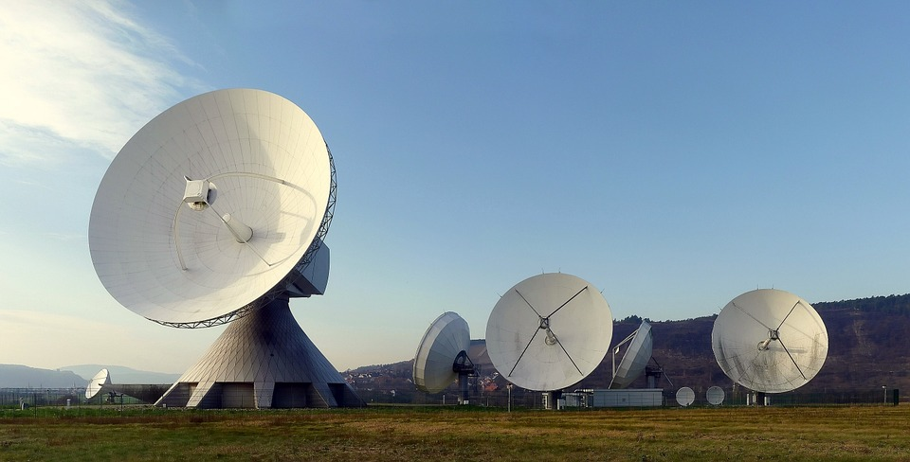
Conclusion
7. Conclusion
Notes:
https://jemengineering.com/blog-antennas-a-history/

Slide 59

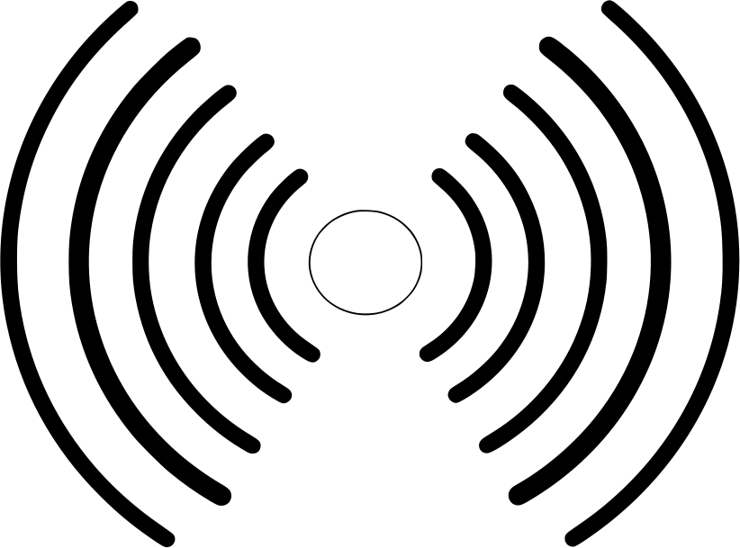
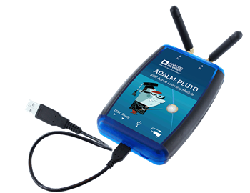

Additional Assumptions
3. Implementation Approach
Abstraction of transmission
Post-processing approach
Metricless signals in GNU Radio
Abstraction of power conversion
Multiple UE not supported by GNU Radio
Synchronisation of one AP-UE pair
Avoid multiple UE and AP synchronisation
10 cm
USB

Slide 60
Additional Assumptions
3. Implementation Approach
Environment
Abstraction of transmission
Post-processing
Fixed environment
Fixed Tx and Rx gain
Same two PlutoSDRs
Metricless signals in GNU Radio
Abstraction of power conversion
Synchronisation of one AP-UE pair
Avoid multiple UE and AP synchronisation
Notes:
Misschien er niet inzetten – vraag aan Vida, want gaat misschien vragen opwekken
DEZE is denk ik niet nodig

Slide 61
GNU Radio
3. Implementation Approach
Software Radio in GNU Radio
Predefined signal processing blocks
Possibility of custom blocks
Clear presentation of signal flow
Easy reconfiguration of network
Notes:
Eventueel eruit laten – vragen aan Vida of the implementation approach zelfs nodig is

Slide 62
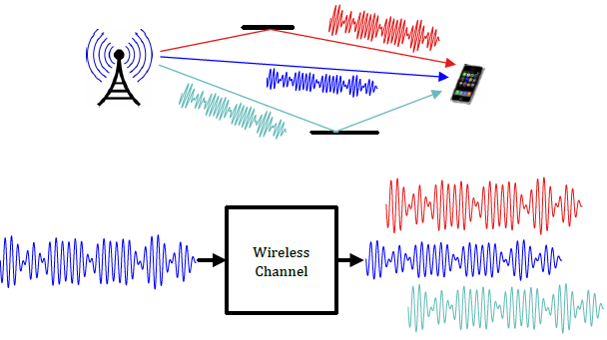
Additional Assumptions
3. Implementation Approach
Abstraction of transmission
Metricless signals in GNU Radio
Abstraction of power conversion
Incorporated in channel effect
Notes:
https://wirelesspi.com/small-scale-fading-in-a-wireless-channel/

Slide 63
PlutoSDR
3. Implementation Approach
Hardware Radio PlutoSDR
Portable
Affordable
User-friendly configuration in GNU Radio
Notes:
Eventueel eruit laten

Slide 64
3. Implementation Approach
Software Radio in GNU Radio
Predefined signal processing blocks
Possibility of custom blocks
Clear presentation of signal flow
Easy reconfiguration of network
Notes:
Eventueel eruit laten – vragen aan Vida of the implementation approach zelfs nodig is

