Slide 1
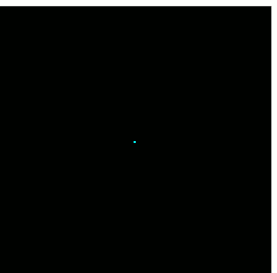
GRCon25
RF Recordings using SigMF and Project Update
Marc Lichtman

Slide 2
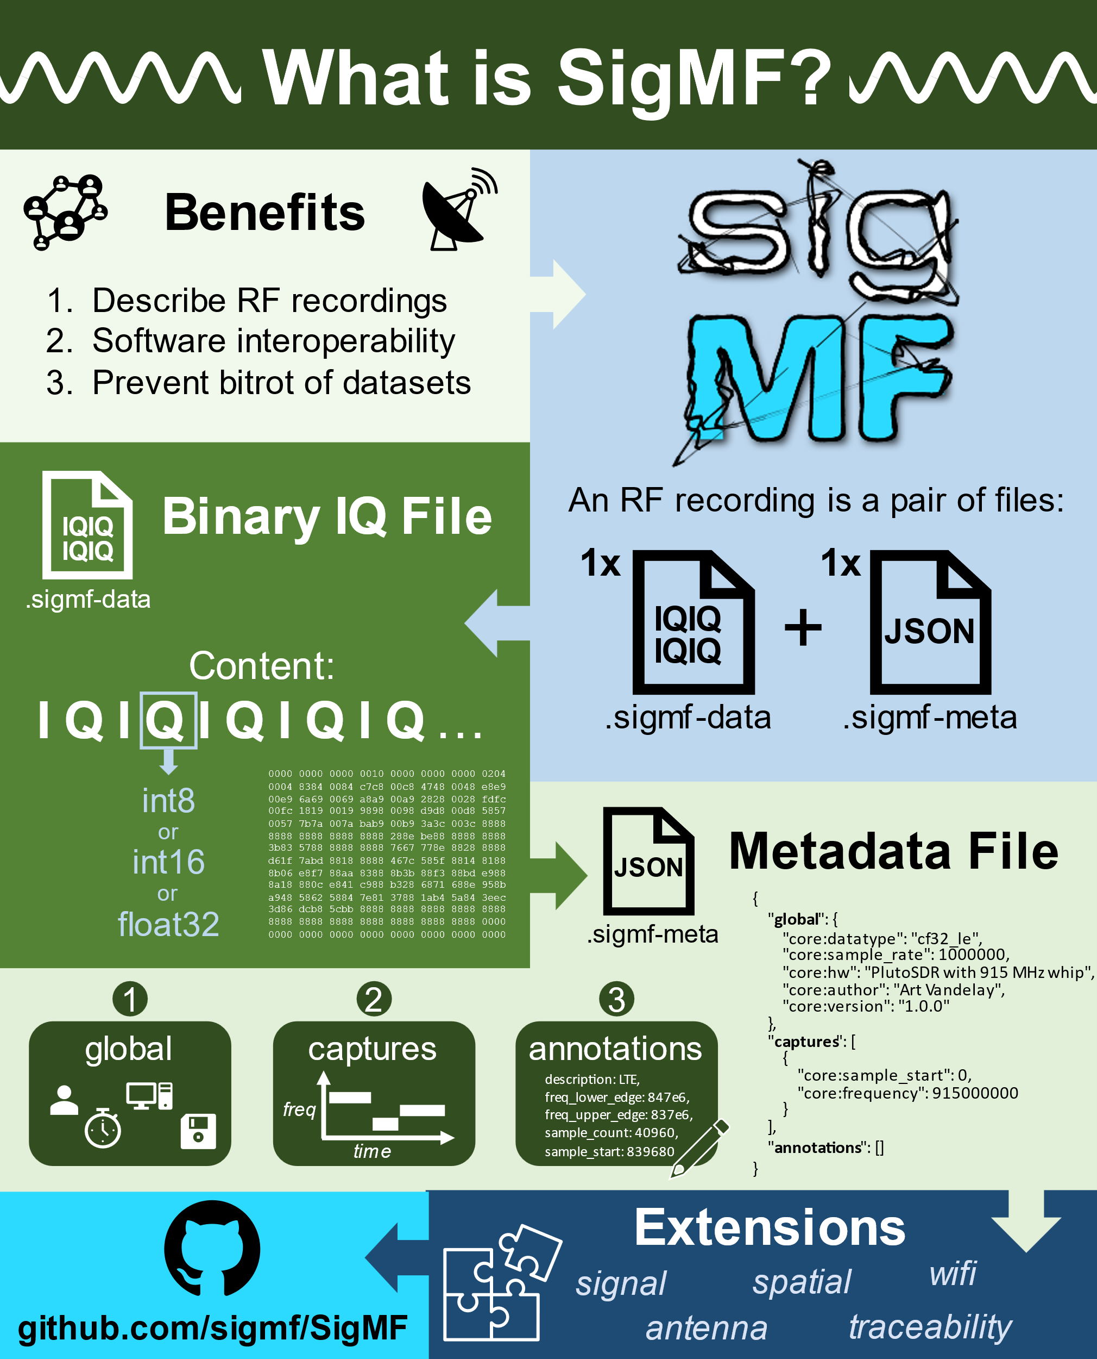
SigMF Overview
Open standard for storing RF to file
Binary IQ file + JSON file
SigMF specifies the JSON
Forces proper documenting of critical metadata easily lost when throwing tons of IQ files into a folder
Includes numerous optional fields specific to RF signals
Annotations can be used to mark interesting time-frequency bounding boxes
Extensions

Slide 3
{
"global": {
"core:datatype": "cf32_le",
"core:sample_rate": 40000000,
"core:hw": "PlutoSDR with whip antenna",
"core:author": "Art Vandelay",
"core:version": "1.0.0",
"core:description": "Describe your signal/recording here"
},
"captures": [
{
"core:sample_start": 0,
"core:frequency": 880000000,
"core:datetime": "2022-03-17T16:43:30Z"
}
],
"annotations": [
{
"core:sample_start": 100000,
"core:sample_count": 200000,
"core:freq_upper_edge": 884625000,
"core:freq_lower_edge": 883275000,
"core:label": "LTE"
},
…

Slide 4
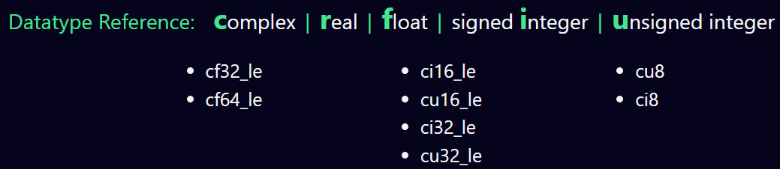
Datatype Reference
cf32_le is your typical 32-bit floats, e.g. GNU Radio File Sink w/ default complex (blue) stream
ci16_le are “shorts”, e.g. from BladeRF
ci8 – HackRF
cu8 – RTL-SDR

Slide 5
Why Use It?
Software interoperability
Avoid bitrot of datasets
Collaborative processing/analysis
Alternative to not using it is a bespoke method of storing metadata
Not much else out there specific to RF signals
Proprietary formats, eg test equipment vendors
HDF5 with ITU-R SM.2117-0 *very* specific to spectrum sensors
Packet captures of over-the-wire formats such as VITA 49
Old legacy formats that were too flexible, leading to variants

Slide 6
SigMF History
Started in 2017 at DARPA Hackfest in Brussels, by Ben Hilburn and others
Developed as a GNU Radio organization project
GRCon18 paper by Ben Hilburn, Nathan West, Tim O'Shea, Tamoghna Roy
Slowly refined the specs and added extensions, went into a stable state
2024 - changed from “The Signal Metadata Format (SigMF)” to just “SigMF” mainly for Wikipedia’s sake

Slide 7
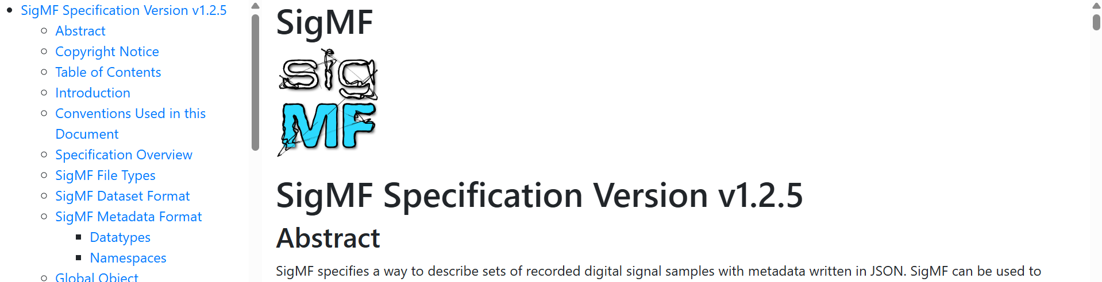
Where to find the Specs
Source of truth is the official JSON schema - sigmf-schema.json in root of main repo
We render HTML and PDF from the JSON schema and a .md file
https://sigmf.org/
PDF - https://sigmf.org/sigmf-spec.pdf

Slide 8
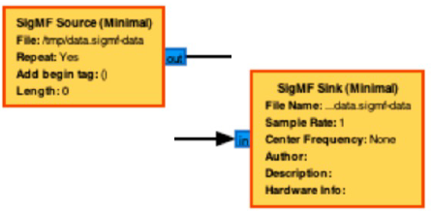
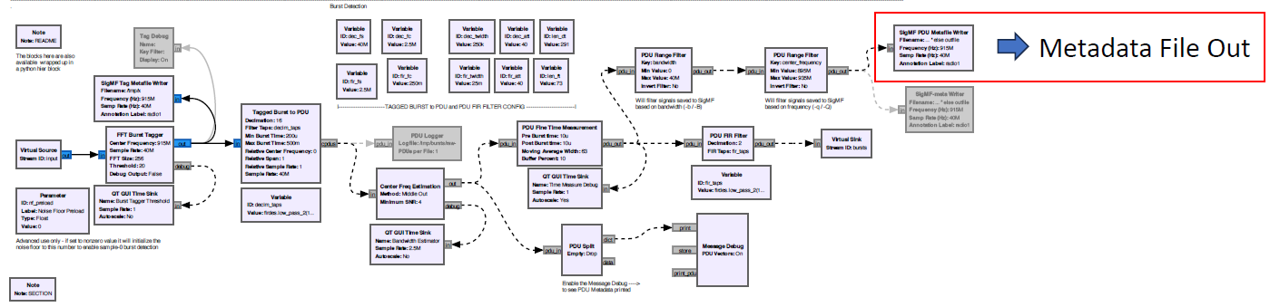
SigMF in GNU Radio
SigMF “Minimal” Blocks – basic functionality
https://github.com/jacobagilbert/gr-sigmf_utils
SigMF File Source – intelligent file specification, type conversion, etc
Add Tags From Metadata – adds annotation metadata as stream tags
Tag Meta Writer – produces metadata annotations from stream tags
PDU Meta Writer – produces metadata annotations from PDUs
Looking for someone or some group to lead an official gr-sigmf!

Slide 9
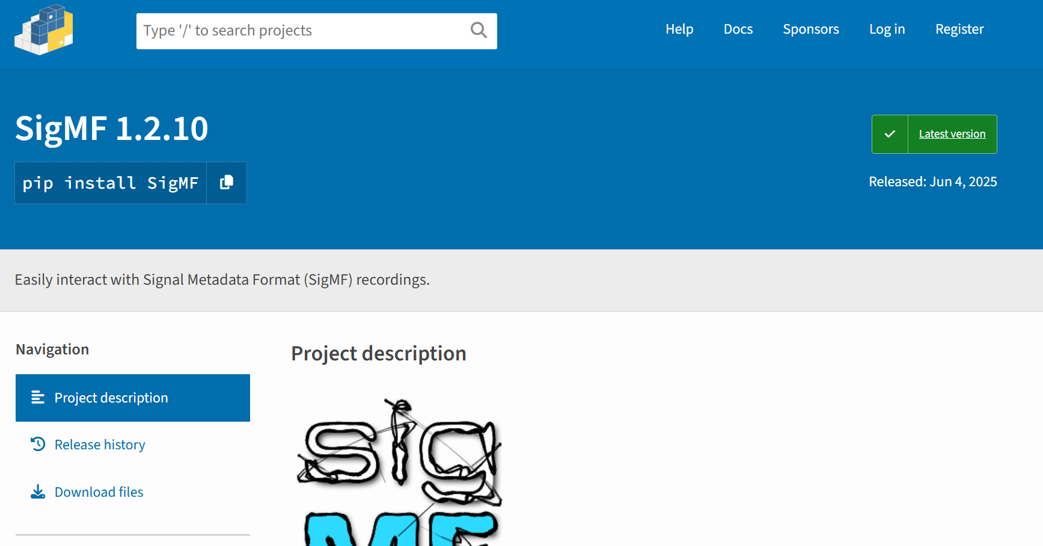
Python Package
pip install sigmf
Code lives https://github.com/sigmf/sigmf-python
Read, create, validate SigMF
Also includes support for Collections and Archives
Huge thanks to Kyle Logue (aka Teque5) for maintaining it, and the many contributors

Slide 10
Updates since GRCon24
v1.2.5 released a few months ago
Added Captures scope geolocation field
Global field is not being removed but Captures is preferred
The location of the recording system at the start of this Captures segment, as a GeoJSON point object
Some language improvements/clarifications
Still recommending Collections as the go-to method for multichannel recordings (avoid using num_channels!)

Slide 11
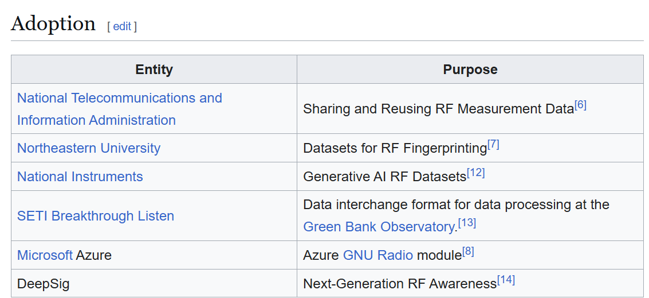
Updates since GRCon24
SigMF Wikipedia page was approved

Slide 12
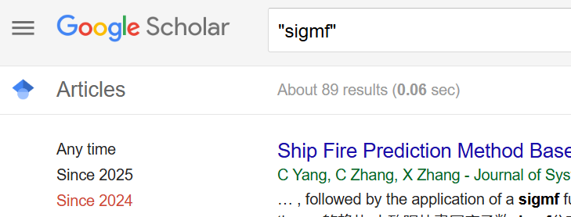
Used by Many
NTIA maintains their own set of Extensions https://github.com/NTIA/sigmf-ns-ntia
Basic support in lots of software (GNU Radio, Inspectrum, etc)
IQEngine.org is entirely built on top of the SigMF standard
Muon Space is using SigMF to bring raw RF from satellites to a data pipeline on the ground
DeepSig within OmniSIG and their datasets
Airbus, as part of internal software
MISP open source threat intelligence and sharing platform
MATLAB’s sigmf() function
Notes:
Sigmoidal membership function

Slide 13

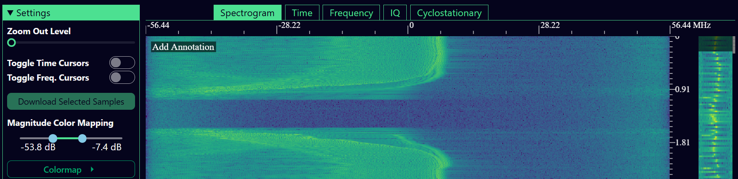
Web-based tool for managing and viewing your SigMF recordings
Public instance hosted at IQEngine.org
Lots of example SigMF recordings you can download, including CTF
You can even view your own (local) recordings
Has a mini tutorial for SigMF, including a SigMF JSON validator

Slide 14
Next steps
Further increasing adoption
Converters
We’re in a stable state at this point so we don’t want major spec changes
gr-sigmf?

