Slide 1
Automatic Python Bindings for GNU Radio 4 Blocks
Anthony Gravier
Carlos Del Valle Rivera

Slide 2
Project ATOM
R&D project focused on building a modular and extensible signal processing framework
We came from a proprietary SDR product, not very extensible or modular
No need to write the 100th “I can transmit a BPSK bro”…
Originally built prototype using GR3 flowgraphs as the backbone

Slide 3
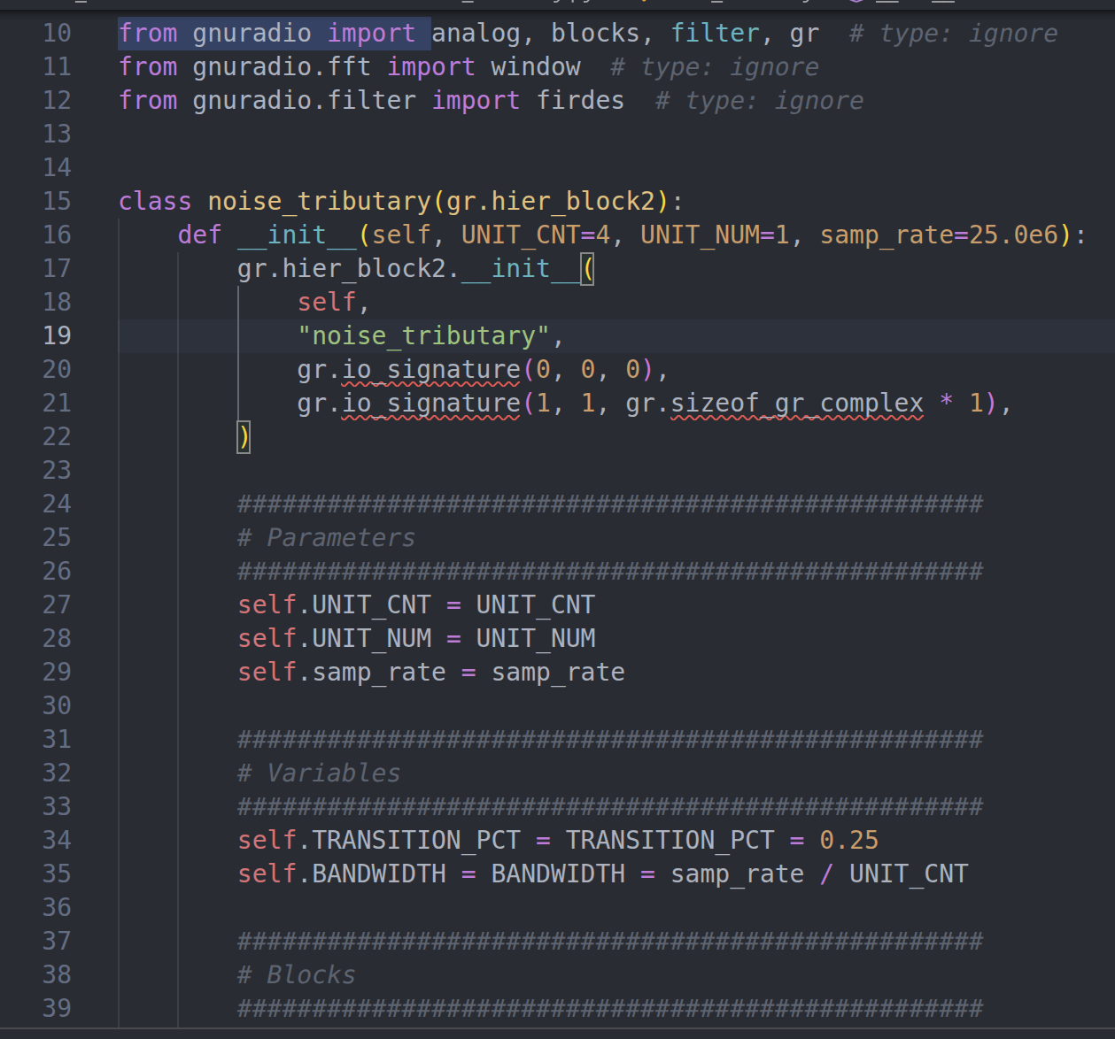
Developing flowgraphs in Python using GR3
Allows you to create flowgraphs and run them via Python!
Currently uses pybind11
Can even create blocks entirely in Python, and not C++
Very beginner friendly, kind of…

Slide 4
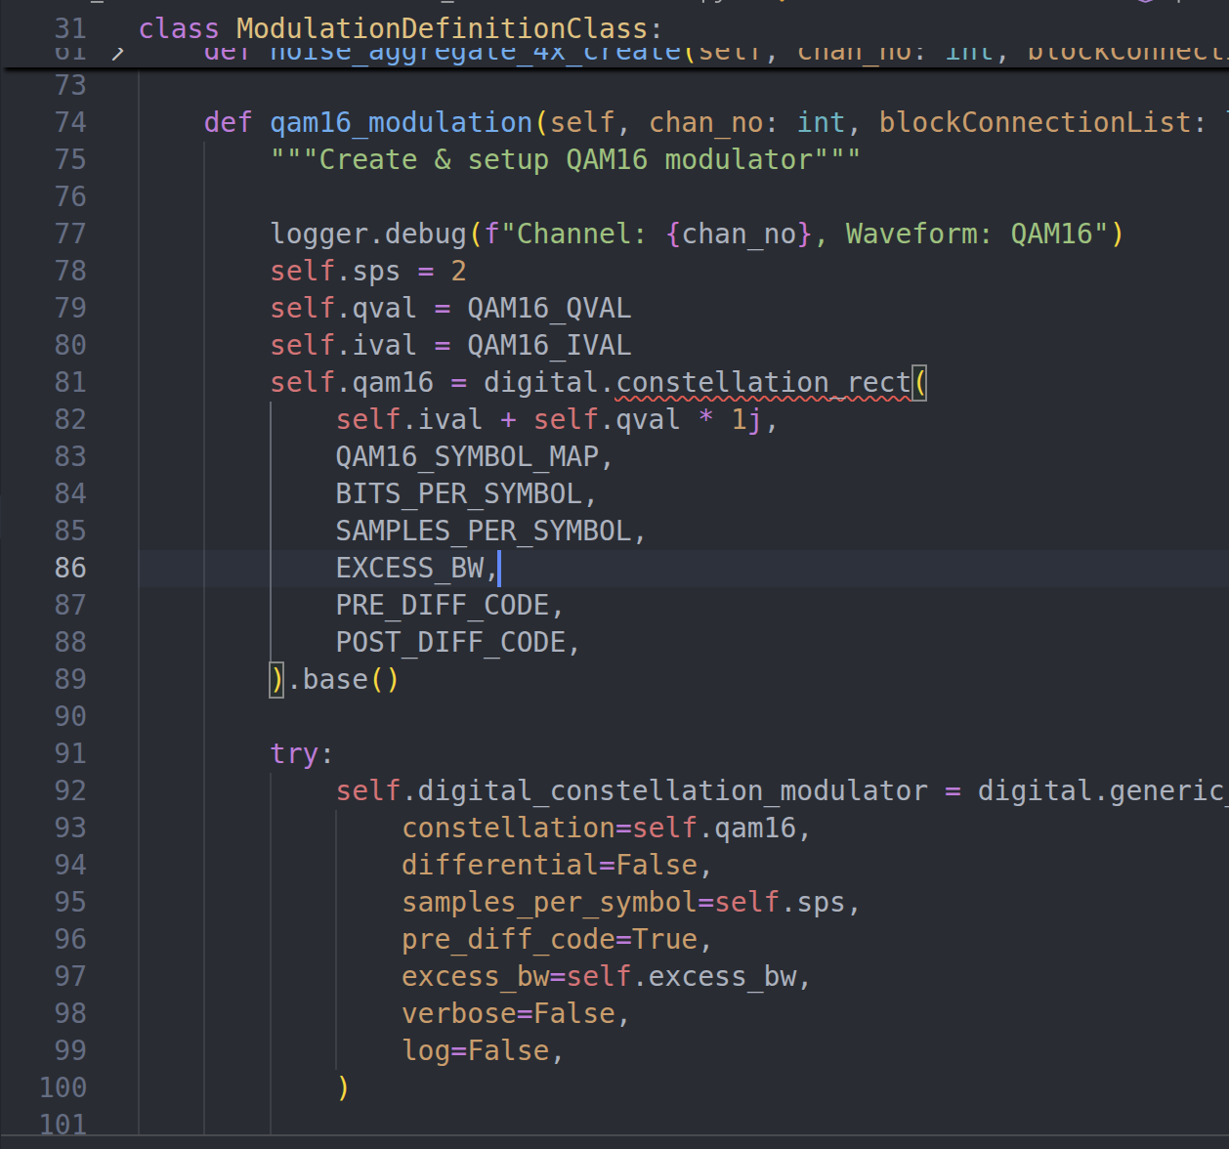
Short-comings of GR3 Python bindings
Poor support for multi-threaded workflows
Does not generate Python stubs
No linting or LSP support
Forces developers to reference the C++ and Python binding code to understand what functions are accessible in Python

Slide 5
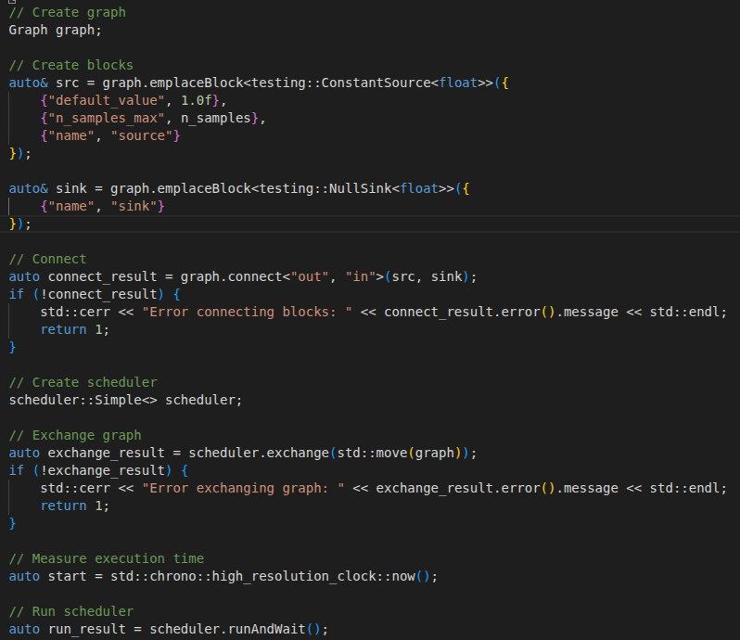
GNU Radio 4!
Began investigating GR4 after the RC1 release!
Plugin support for GR4 is amazing, try it out! No, seriously, please try it out…
Better support for multi-threading via the Scheduler
These improvements above are exactly what we were looking for with our R&D project
We realized that GR4 does not have any support for Python bindings
Started planning a migration
Built out a list of blocks we need to create for GR4
Began investigating how to create Python bindings

Slide 6
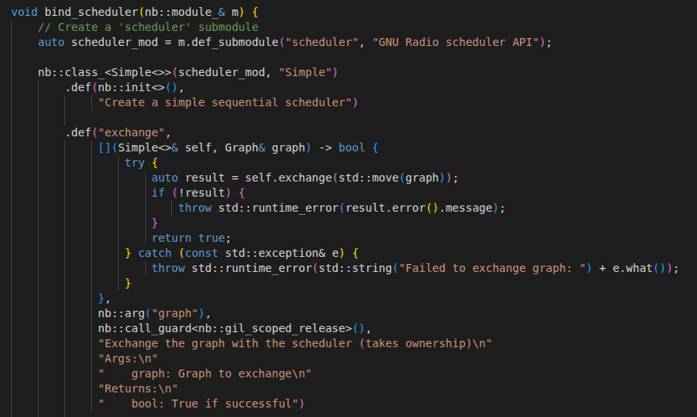
Introducing Nanobind!
After a week of investigating how to create bindings for modern C++ code, we came across Nanobind
Created by same maintainer as pybind11, seemed like a good successor
Syntactically like Pybind
Nanobind can generate py-stubs for your bindings
Support for ndarrays
Better multi-threading support
Modern C++ support (17)
We are in conversations with KBR to open-source python bindings for GR4
Enables anyone to run GR4 flowgraphs via Python

Slide 7
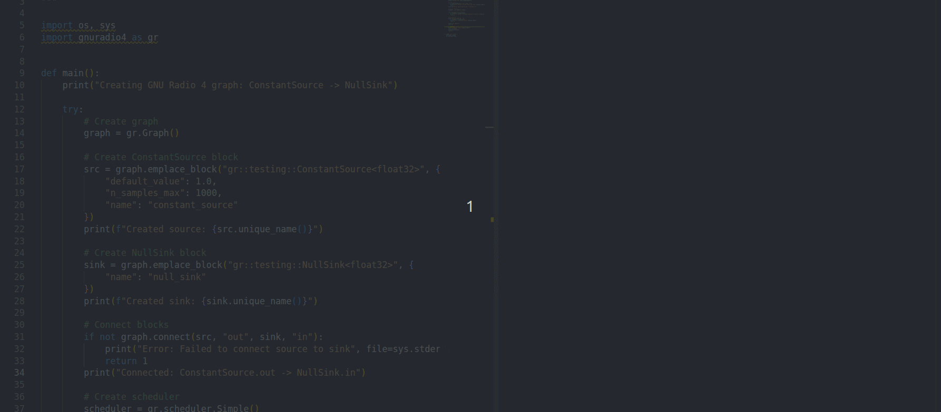
Running a graph in GR4 via Python!

Slide 8
Questions?

