Slide 1






gr-pocketsdr: Bringing PocketSDR Front-Ends to GNU Radio and GNSS-SDR Ecosystem
Minhaj Uddin Ahmad
Ph.D. Student | mahmad12@crimson.ua.edu
Connected and Automated Mobility Lab @ UA
GNU Radio Conference 2026

Slide 2
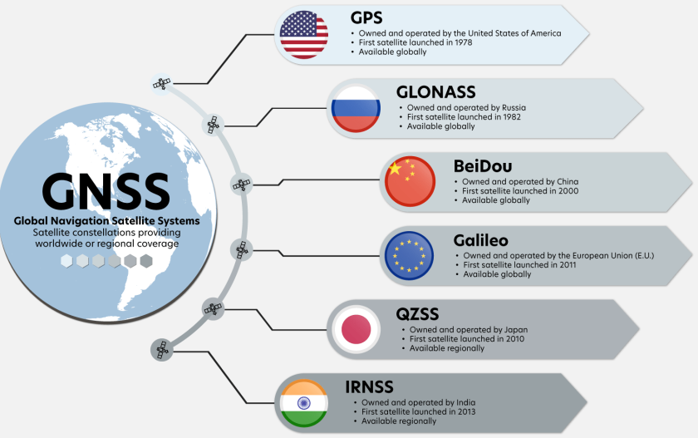

Global Navigation Satellite System
GNSS satellite signals are open for anyone / any device to receiver, for free, anywhere on earth.
With an SDR receiver, you can receiver the signals and process it in your laptop, turning your laptop into a GNSS receiver. This allows researchers to develop and test new algorithms and signal processing techniques.
Since GNSS signals are open, without any protection mechanism (mostly), there are safety and security concerns too, requiring active research in this area.
https://eos-gnss.com/wp-content/uploads/2023/04/GNSS-Infographic-1-1024x576.png

Slide 3
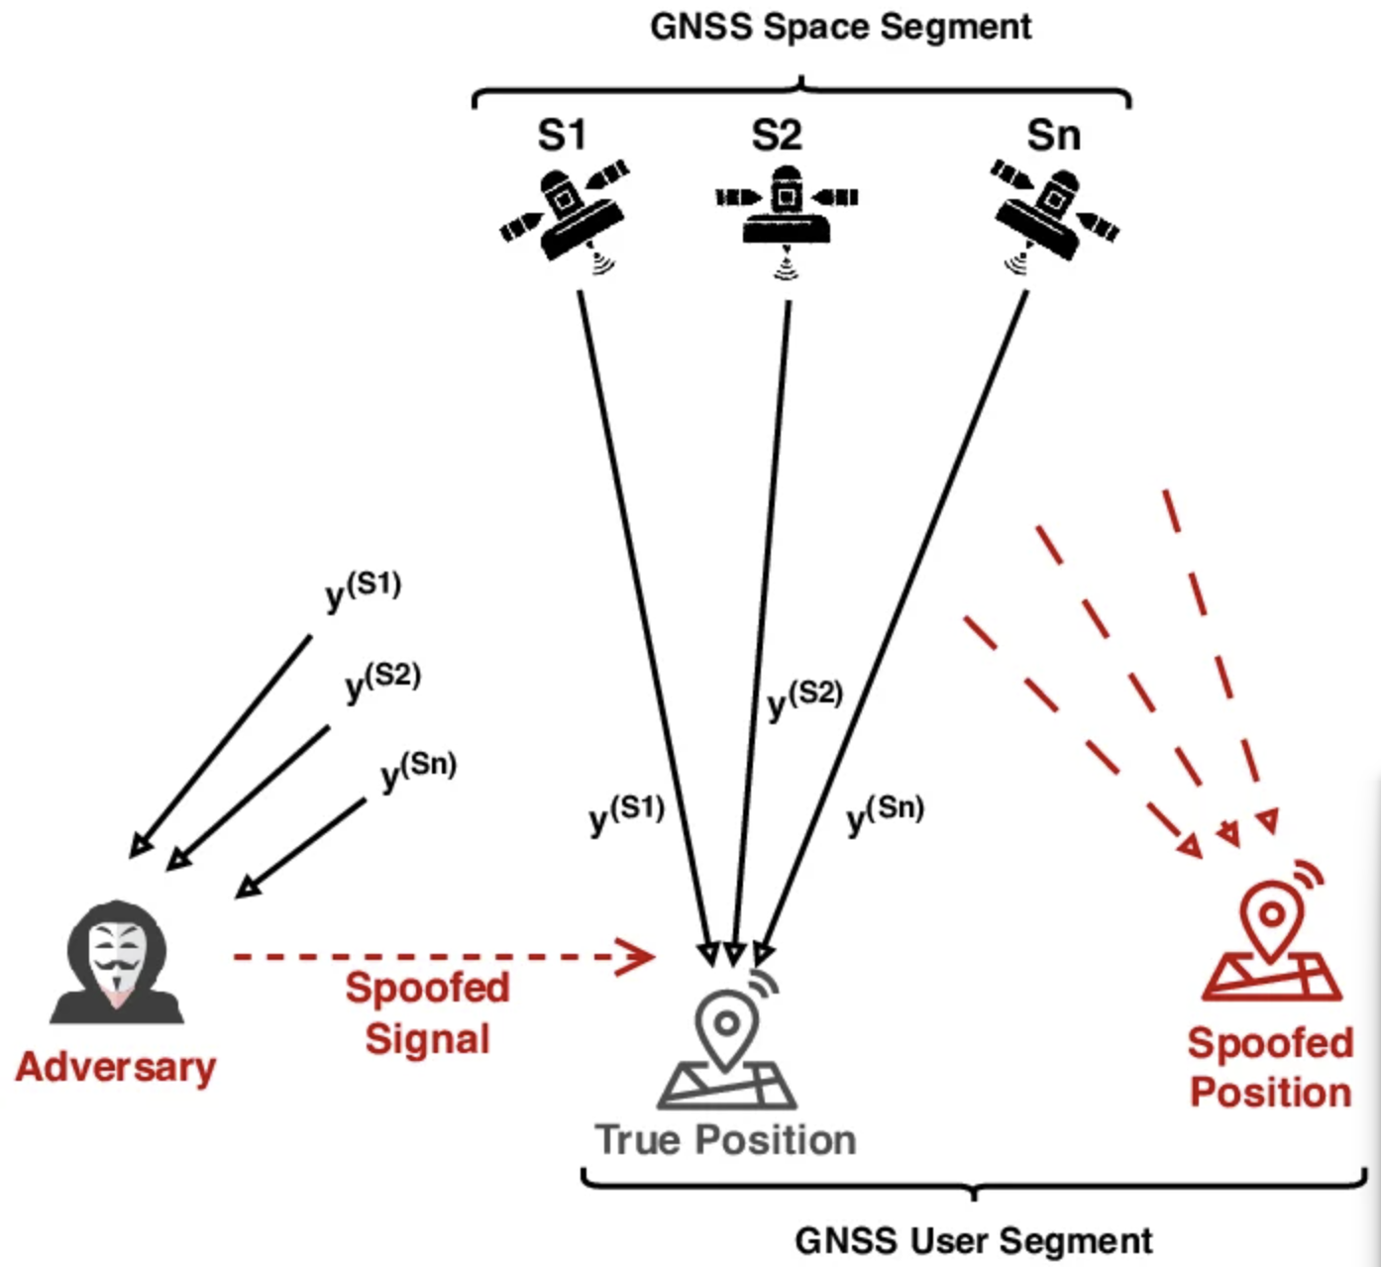
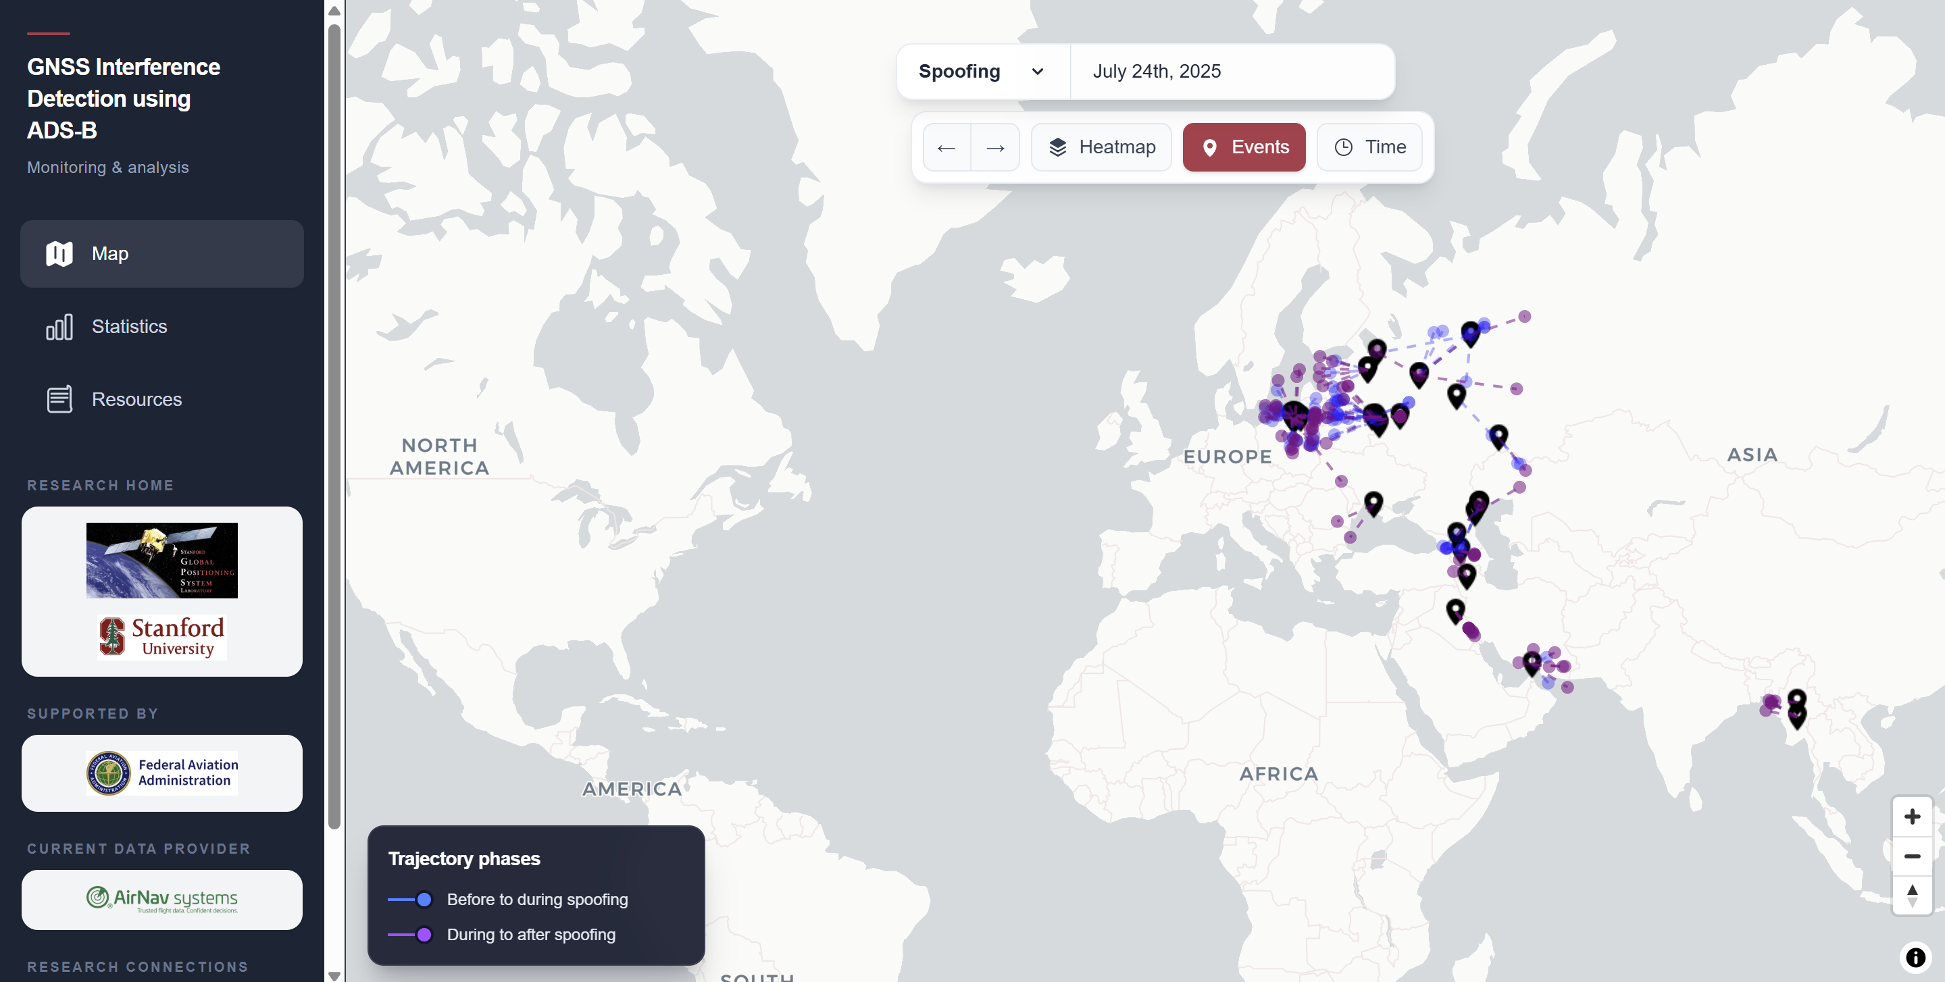
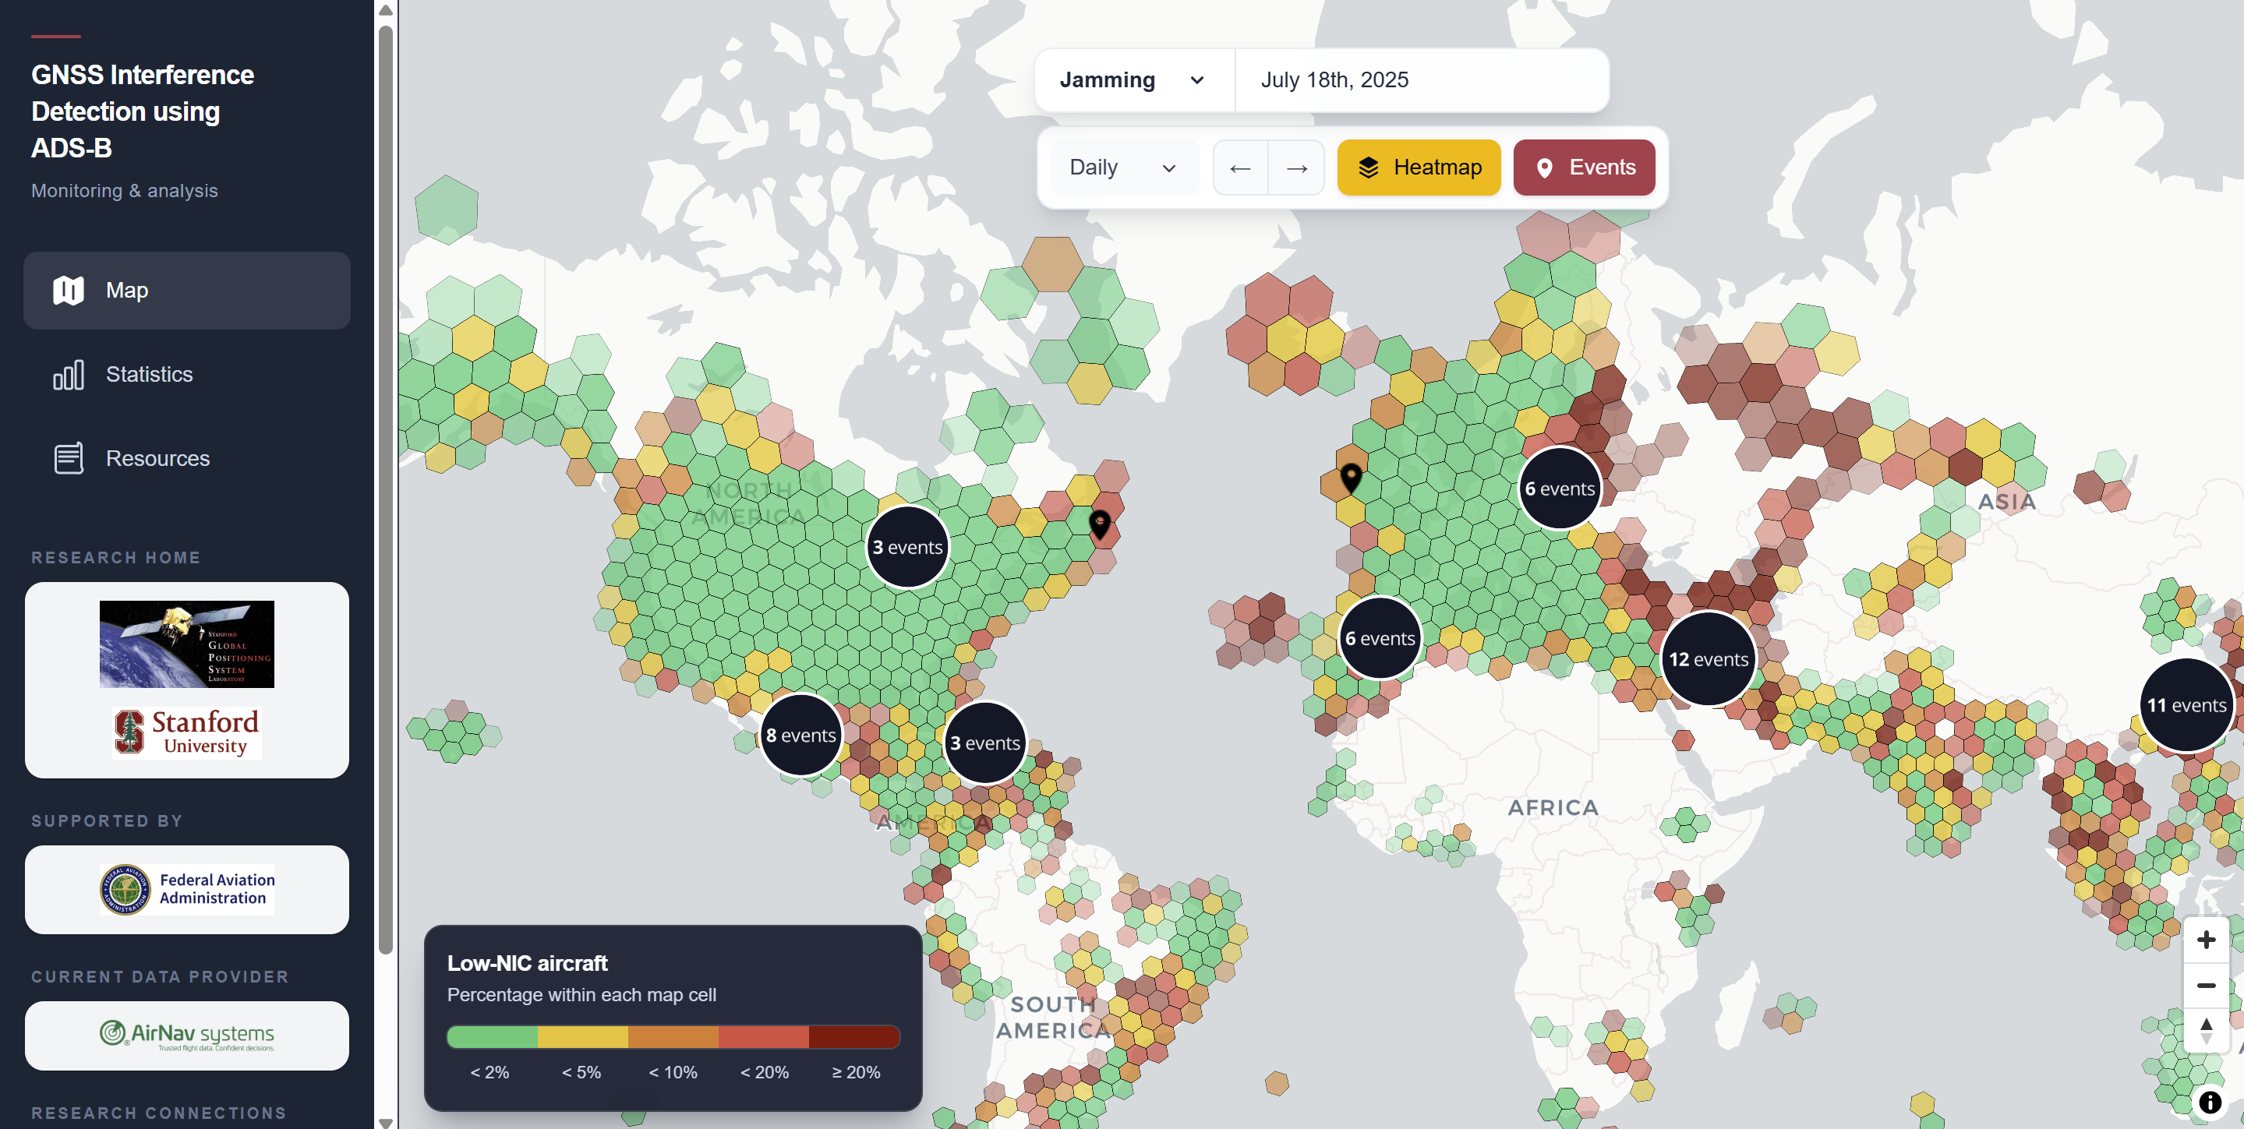
We need more research for GNSS resiliency
Spoofing concept
https://www.researchgate.net/publication/382288564_CLPDI-based_Fast_Secure_Code_Estimation_and_Replay_Attacks_on_GNSS_Signals
Connected and Automated Mobility Lab

Slide 4














Broad hardware support makes research accessible
Commodity SDR Hardware
Processing Software
PocketSDR
RTL-SDR
GNU Radio
Interface
HackRF
USRP
GNSS-SDR
LimeSDR
bladeRF
RTKLIB & Custom
PlutoSDR

Slide 5
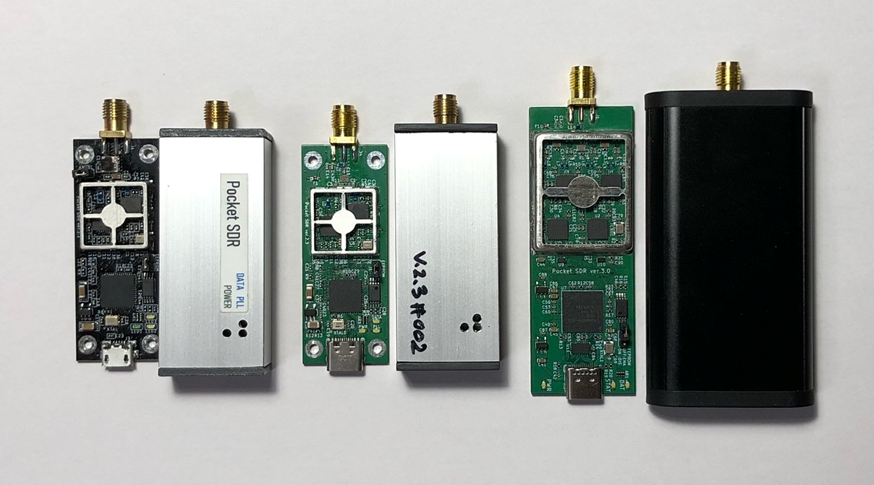
PocketSDR
MAX 2771
Cypress FX3
https://github.com/tomojitakasu/PocketSDR
https://www.datagnss.com/products/pocketsdr-gnss-receiver

Slide 6
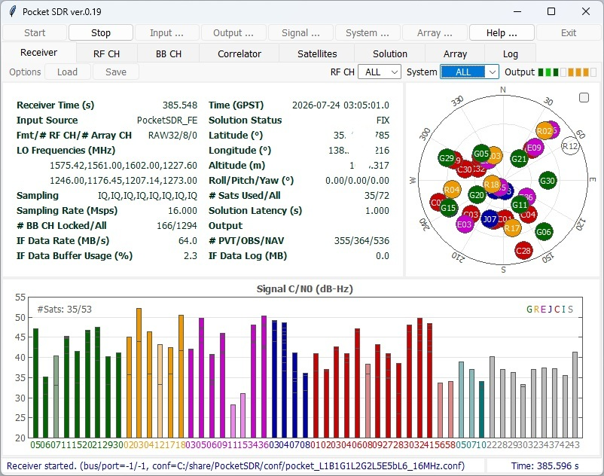
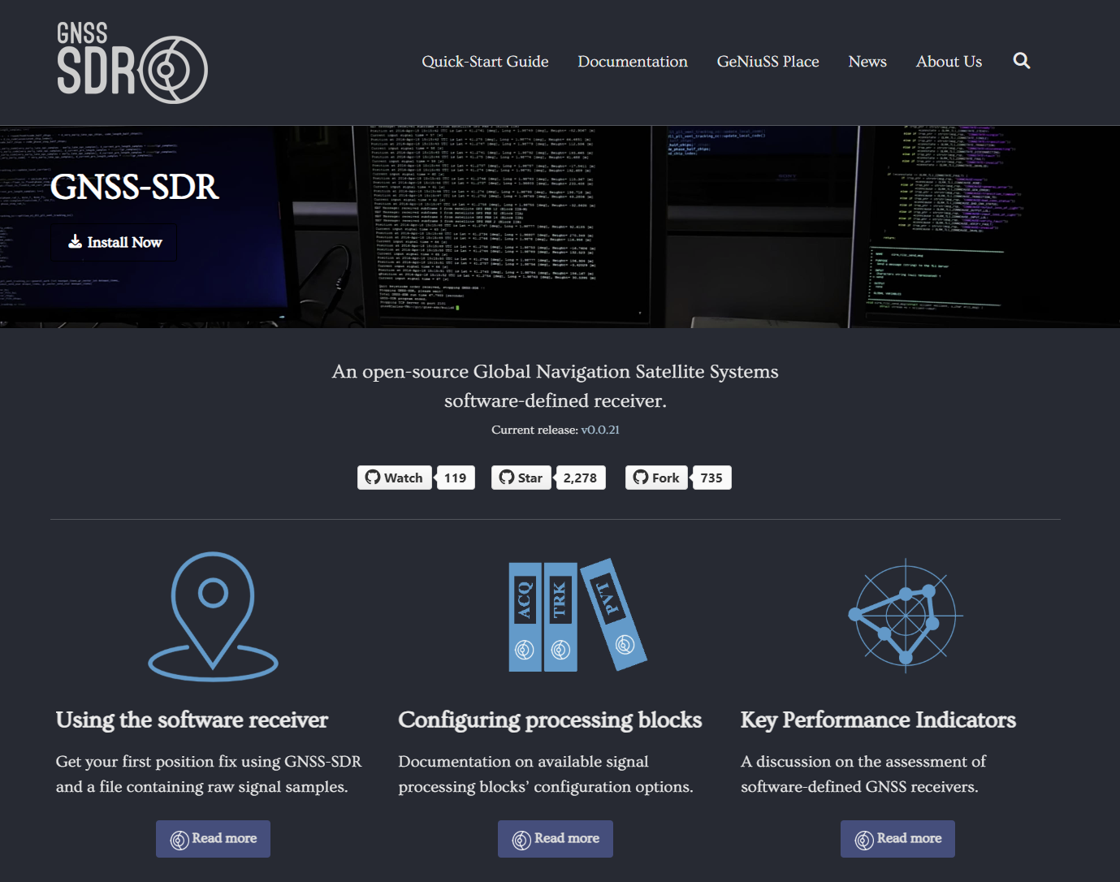
General Purpose GNSS Processing
https://github.com/tomojitakasu/PocketSDR
General Purpose - https://gnss-sdr.org/

Slide 7
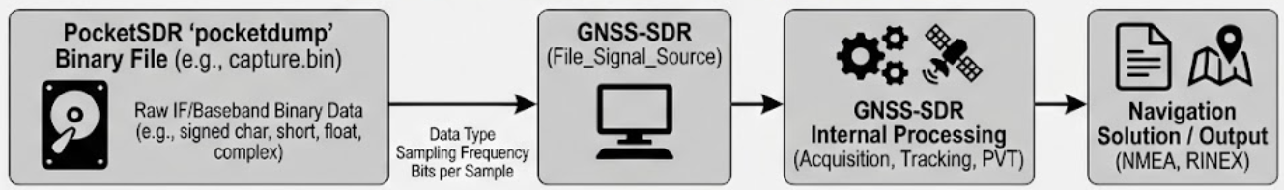
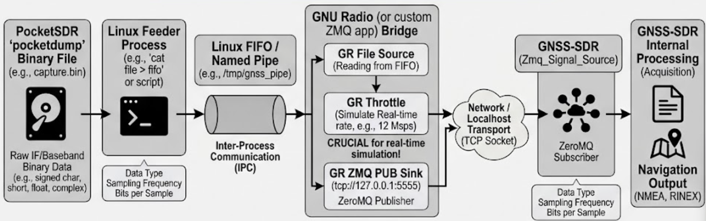
Traditional workflow
Offline file post-processing
Workaround for real-time processing

Slide 8


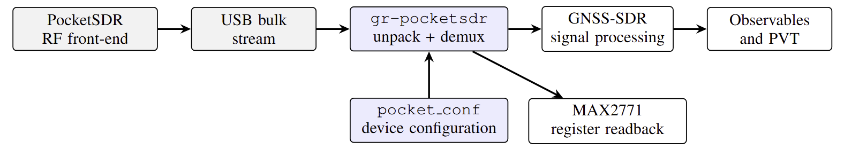
Building the bridge for live reception
Cypress FX3

Slide 9
Lets compare the gr-pocketsdr vs. ZMQ workaround
 | Pocket_SDR_Signal_Source | ZMQ_Signal_Source
Total CPU | 178.9 % | 205.1 %
Latency, median | 320.6 ms | 334.8 ms
Latency, worst case | 374.9 ms | 679.7 ms
Lag spread (jitter) | 58 ms | 236 ms
Wire rate, 1 channel | 16 MB/s | 64 MB/s
Reports lost samples | yes | no
Medians differ by 14 ms — worst cases differ by 305 ms

Slide 10
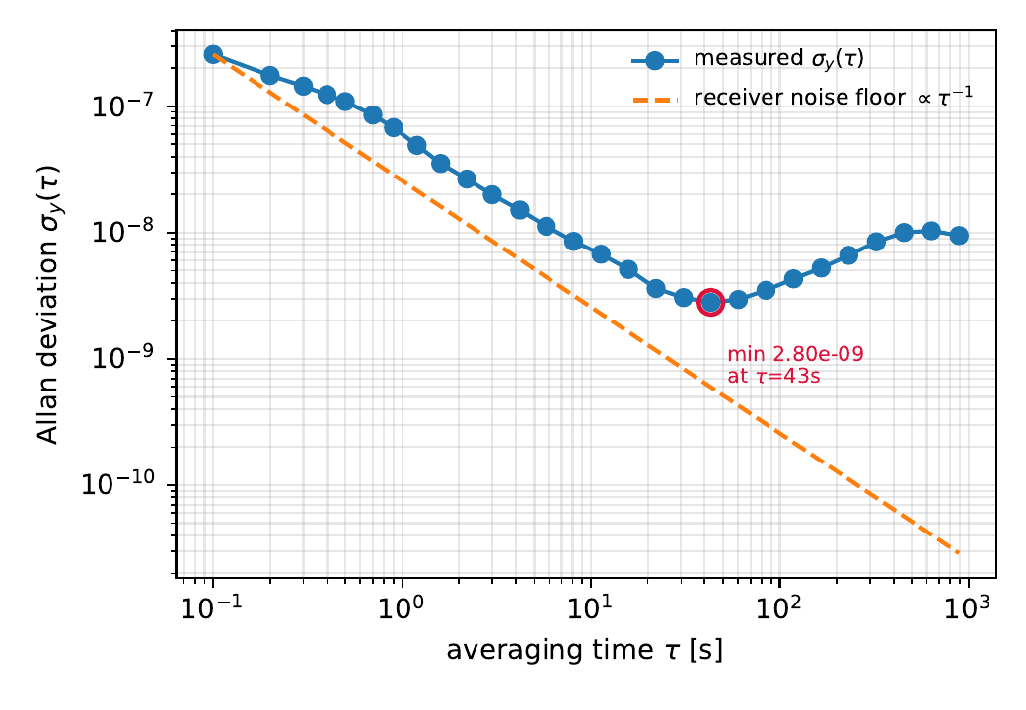
Application – Lets test the PocketSDR clock
Clock offset = TCXO phase error vs GPS time
37.6 min unbroken fix, 22 584 epochs at 10 Hz
Frequency offset: −0.265 ppm
Stability floor 2.8×10⁻⁹ at τ = 43 s
Above the receiver noise floor throughout

Slide 11
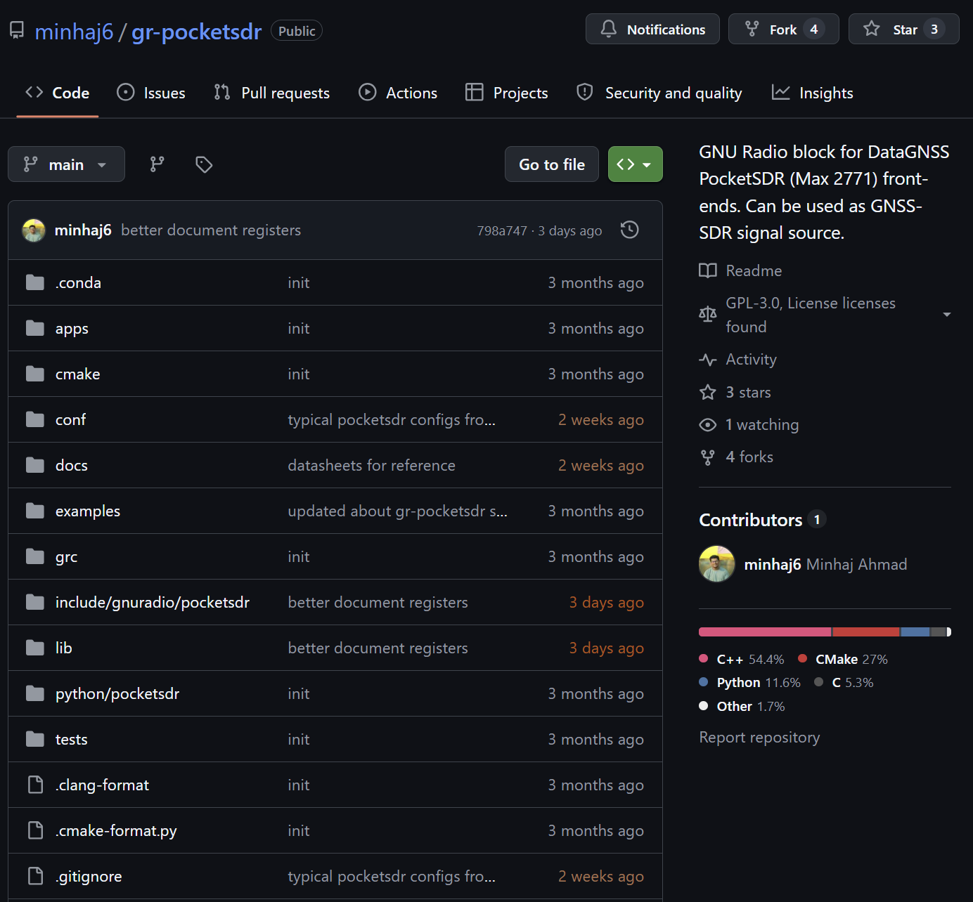
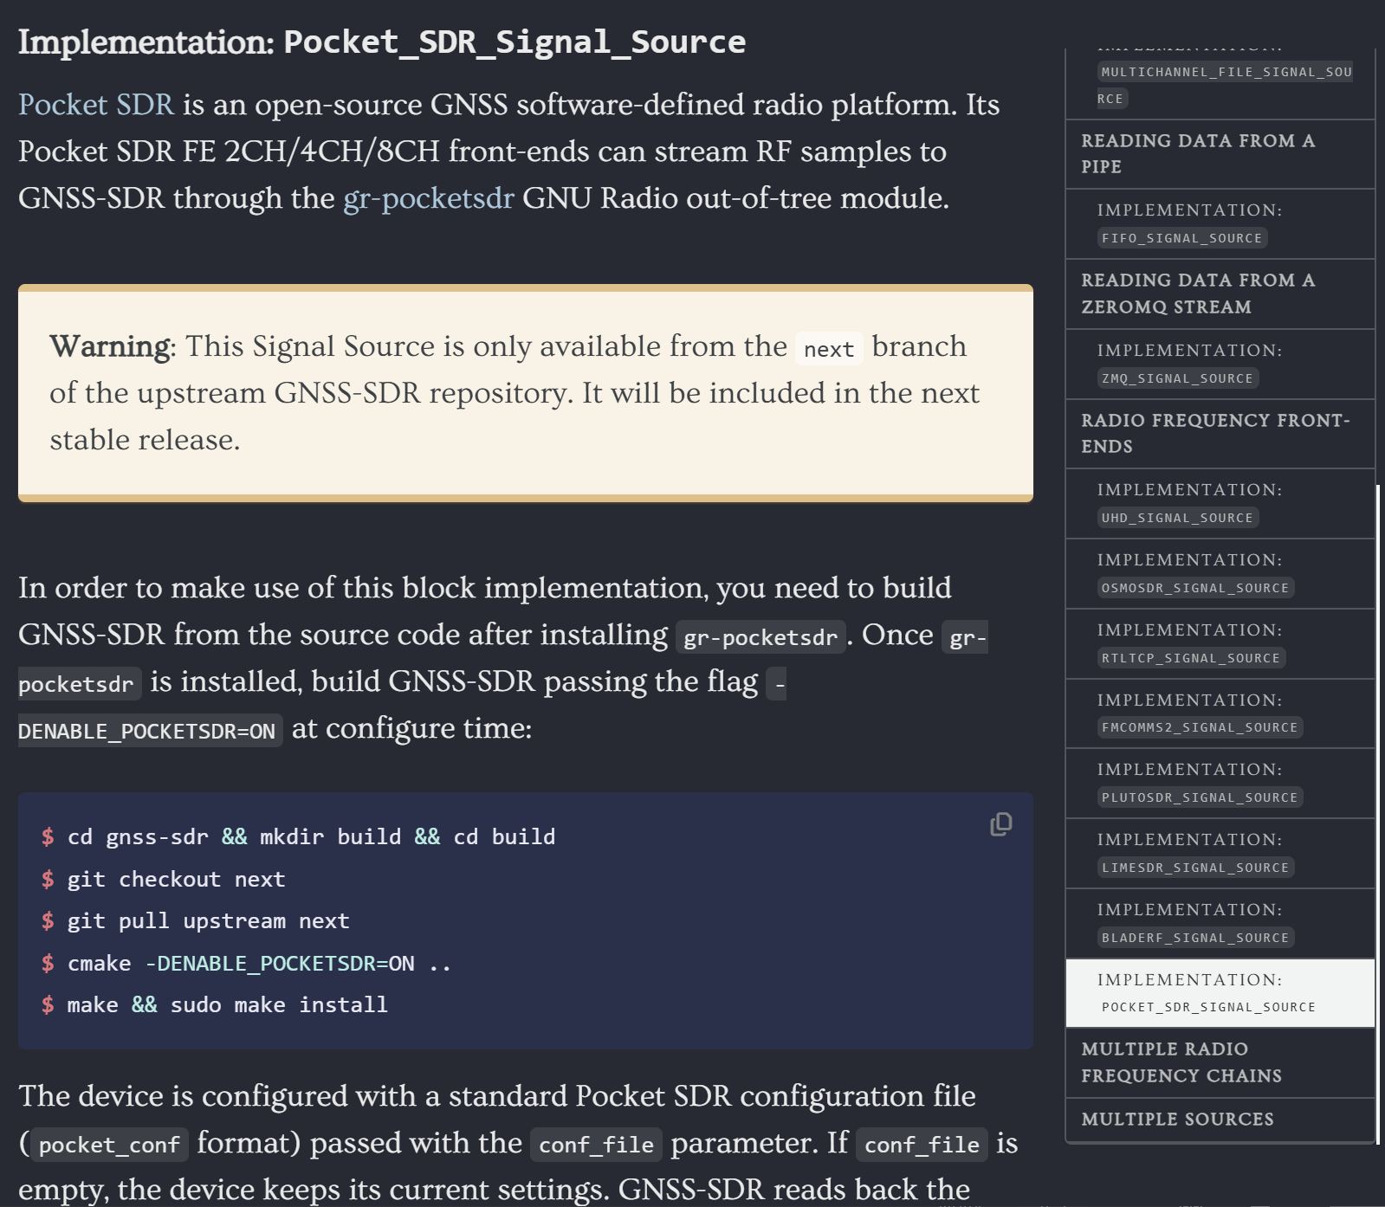
Open-source!
Source code available at GitHub
Merged with GNSS-SDR upstream, development branch

Slide 12
Conclusions and future work
It works! (few quirks to work out)
14.6 % less CPU than ZMQ workaround, 305 ms better at worst case jitter
4× less data transmission compared to ZMQ workaround
Get reports of ring-buffer overruns
Multi-frequency (GPS L1, L2, L5, Galileo) testing is open for future work

Slide 13

Thank You
Questions?
Supported by the National Center for Transportation Cybersecurity and Resiliency (TraCR), a U.S. DOT National University Transportation Center, and by NSF Award #2340456.
Contact: Minhaj Uddin Ahmad | mahmad12@crimson.ua.edu
Notes:
Happy to take questions.

