Slide 1

FISSURE:
Tactical RF Operations and Situational Awareness with GNU Radio
GNU Radio Conference 2026
Christopher Poore
Lead Developer
Assured Information Security, Inc.
poorec@ainfosec.com
github.com/ainfosec/FISSURE

Slide 2
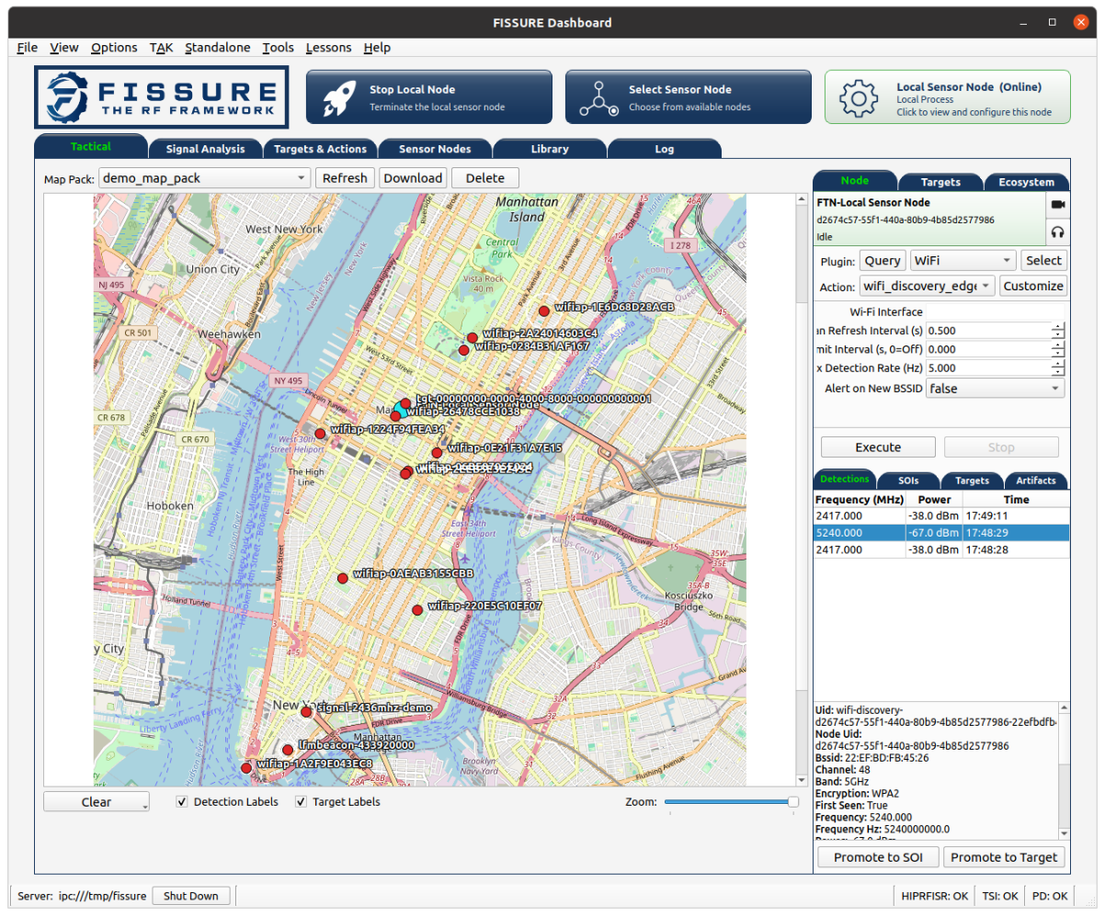
What is FISSURE?
An open-source framework for RF analysis, automation, and distributed operations
Brings signal processing, targeting, geolocation, and situational awareness into one environment
Coordinates SDRs, Sensor Nodes, software, and data across local and remote systems
Uses GNU Radio extensively for RF processing while FISSURE handles the surrounding workflow
Extensible through plugins, actions, and reusable operations
https://github.com/ainfosec/FISSURE
Chris Poore

Slide 3
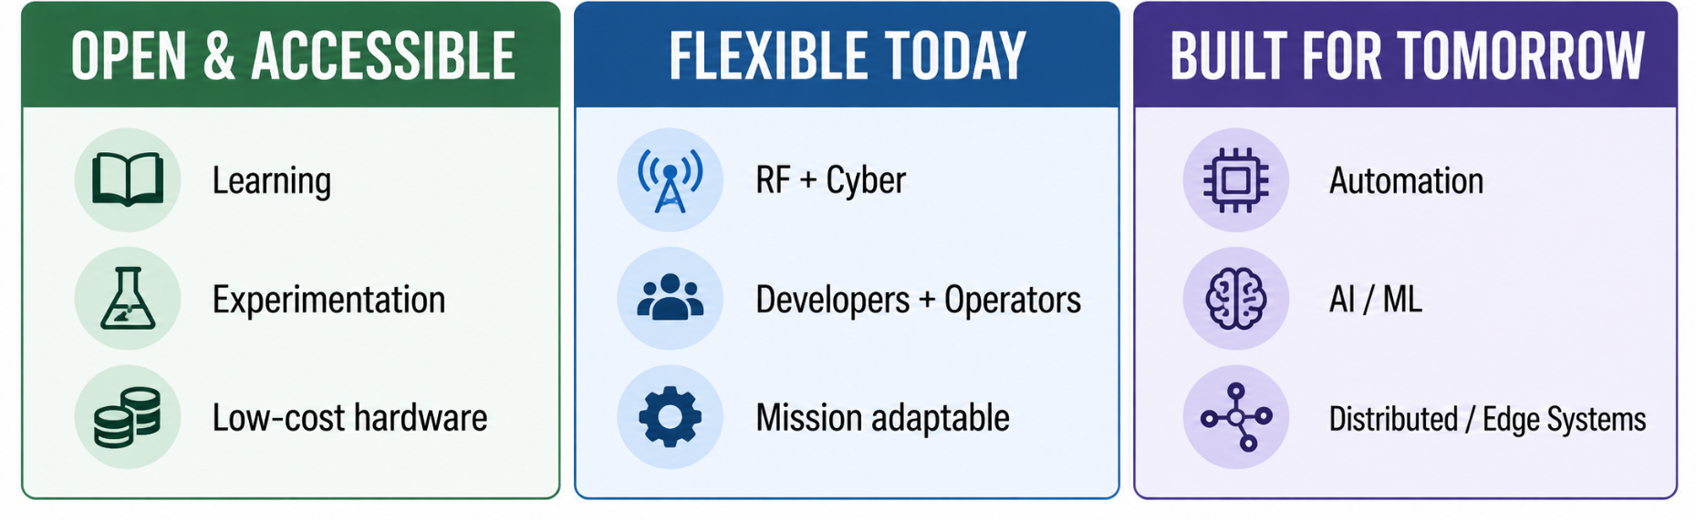
The Problem I am Trying to Solve
Open, flexible, affordable, and ready for what comes next
Create an open platform for learning, experimentation, development, and integration
Offer developers maximum flexibility while keeping operator workflows simple
Span RF and cyber without locking FISSURE to one protocol, sensor, platform, or use case
Build around automation, distributed systems, AI/ML, and affordable deployment
https://github.com/ainfosec/FISSURE
Chris Poore

Slide 4
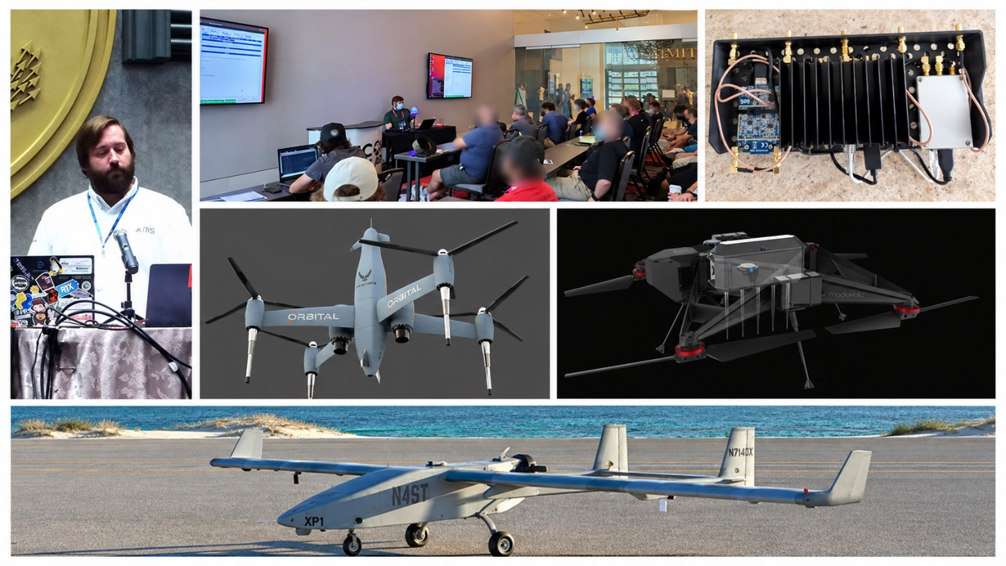
How We Got Here
From a collection of RF tools to connected operational workflows
Started as a broad RF/SDR toolbox with many independent capabilities
Early development added remote Sensor Nodes, distributed execution, and tactical features
Recent work has focused on connecting those pieces through clearer workflows, shared records, provenance, and automation
The goal now is to make FISSURE a stronger bridge between RF hardware, analysis, operators, and emerging AI/ML capabilities
https://github.com/ainfosec/FISSURE
Chris Poore

Slide 5
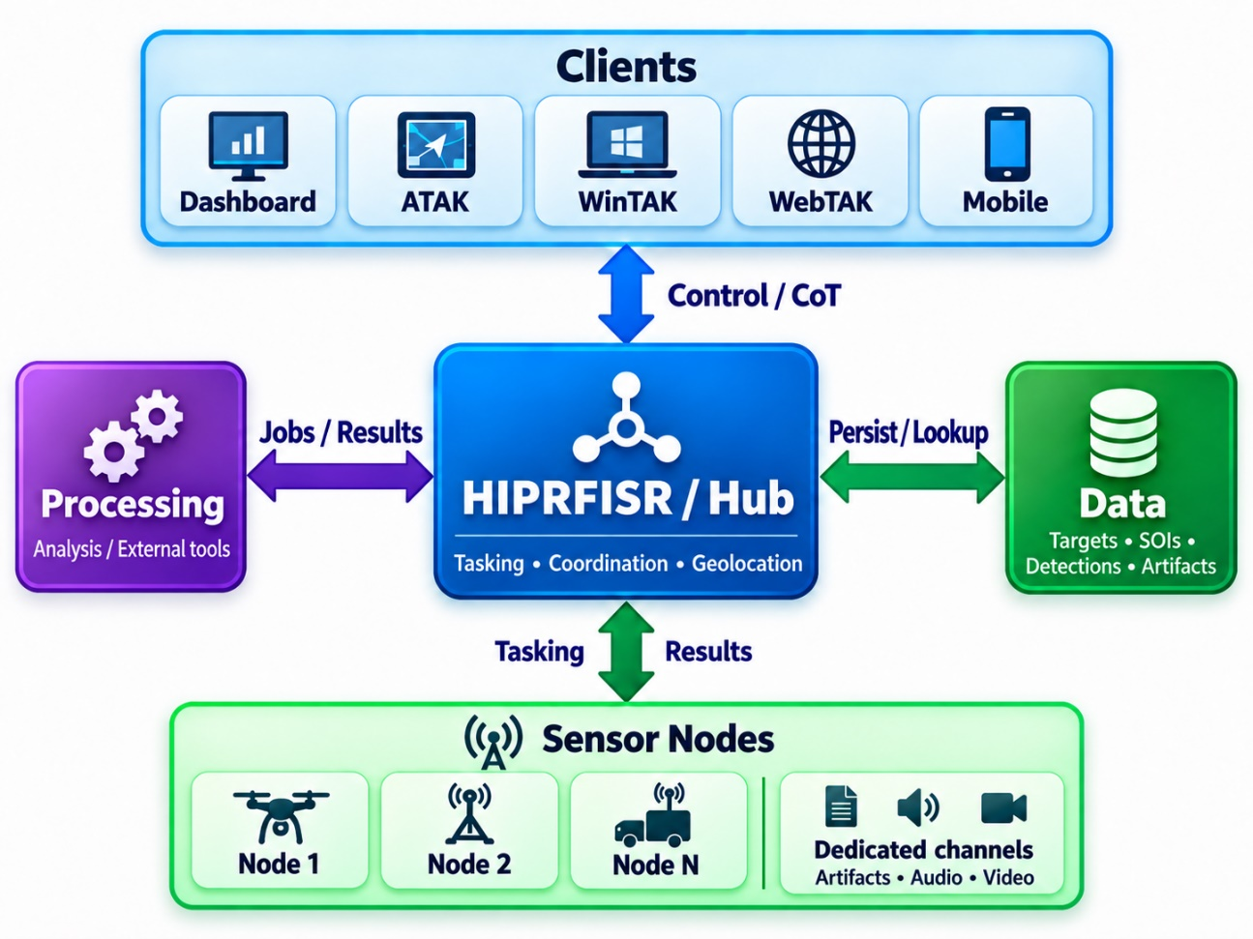
Distributed Architecture
A hub-and-node architecture connecting users, processing, sensors, and data
Clients access FISSURE through the Dashboard or through external systems such as TAK
HIPRFISR / Hub coordinates tasking, state, multi-node operations, geolocation, and persistent data
Processing Engines support heavier analysis, network-enabled capabilities, and integration with existing solutions
Sensor Nodes host SDRs, sensors, plugins, and other tools on distributed or platform-mounted systems
https://github.com/ainfosec/FISSURE
Chris Poore

Slide 6
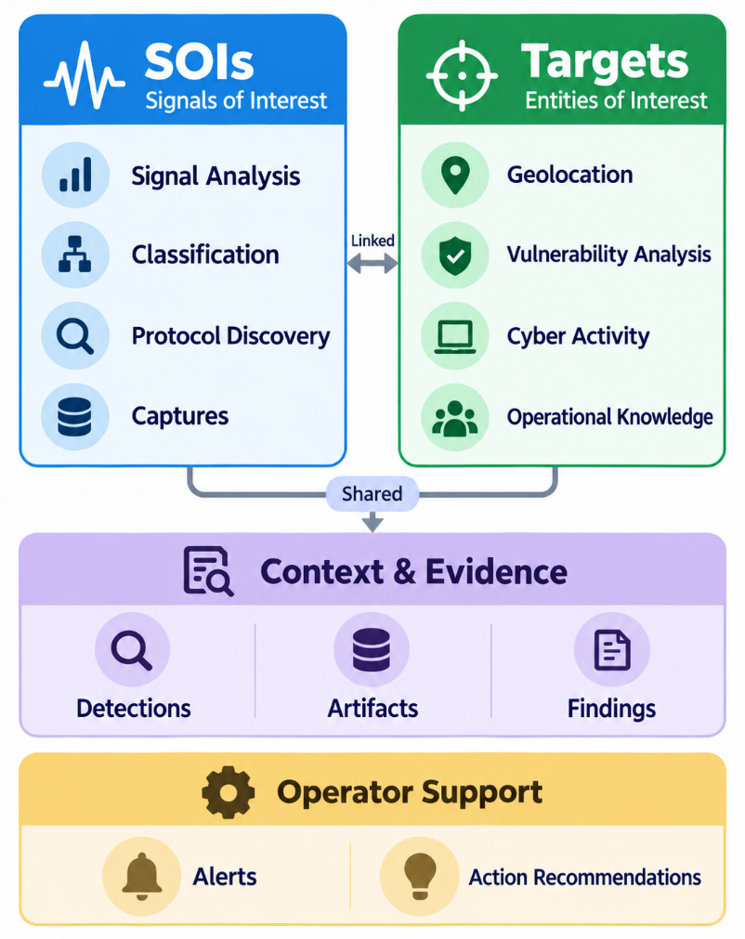
Core Information Model
Organizing signals, targets, and the context built around them
SOIs anchor signal analysis, classification, protocol discovery, and capture
Targets anchor geolocation, vulnerability analysis, cyber activity, and operational knowledge
Detections provide sensor observations and can drive awareness, geolocation, alerts, and triggers
Artifacts and Findings preserve evidence and analysis results, while Alerts and Action Recommendations surface what matters and what to do next
https://github.com/ainfosec/FISSURE
Chris Poore

Slide 7
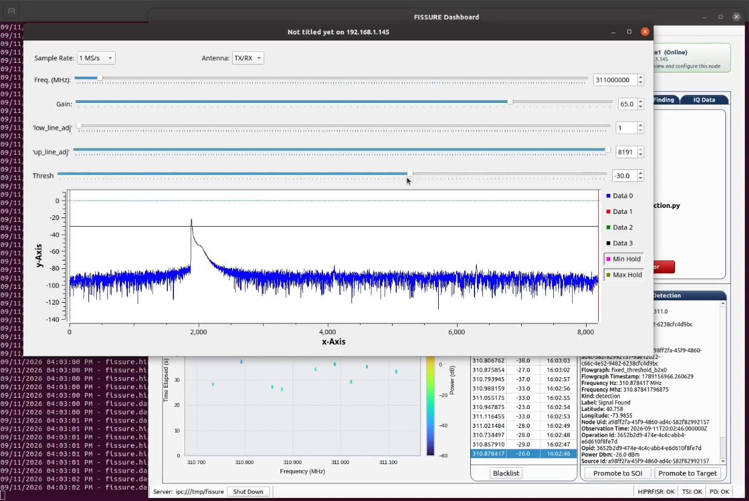
GNU Radio in the Workflow
Turning GNU Radio capabilities into local, remote, and automated operations
GNU Radio supports detection, capture, analysis, transmission, and other RF tasks throughout FISSURE
FISSURE supplies hardware, parameters, context, execution, and status, with values populated from SOIs, Targets, and other records when available
Capabilities can run locally or on remote Sensor Nodes, with Actions supporting parameterized flow graphs, custom launch logic, and remote GUI streaming through Xpra
https://github.com/ainfosec/FISSURE
Chris Poore

Slide 8
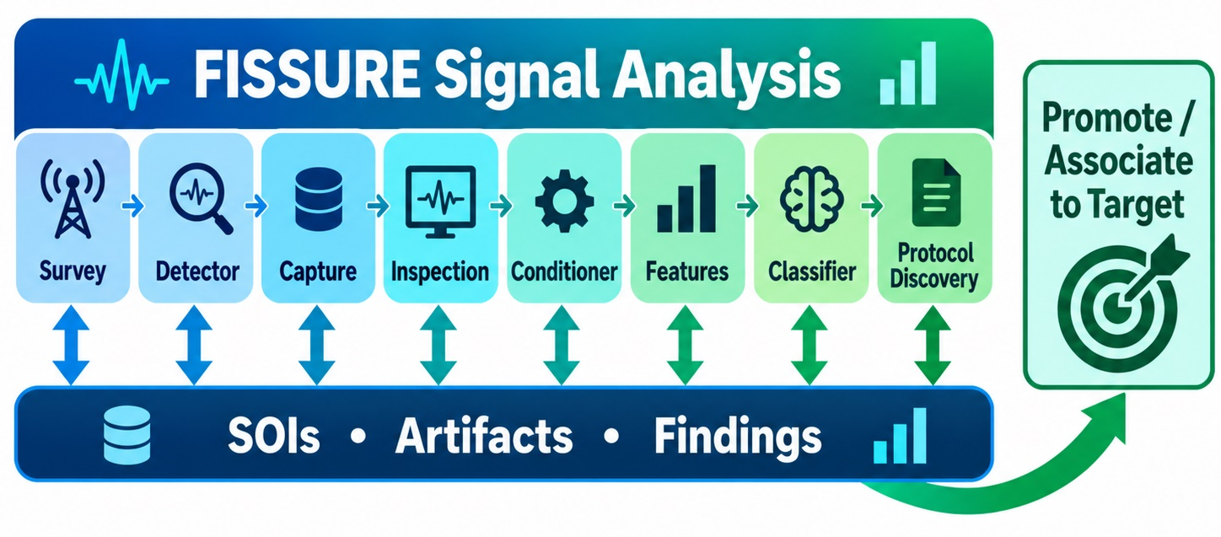
Signal Analysis as a Workflow
From discovery to understanding
Survey and detection help identify signals worth investigating
SOIs carry context through capture, inspection, conditioning, features, classification, and protocol discovery
Artifacts and findings preserve the data and results generated along the way
SOIs can be promoted to Targets when a signal becomes operationally relevant
https://github.com/ainfosec/FISSURE
Chris Poore

Slide 9
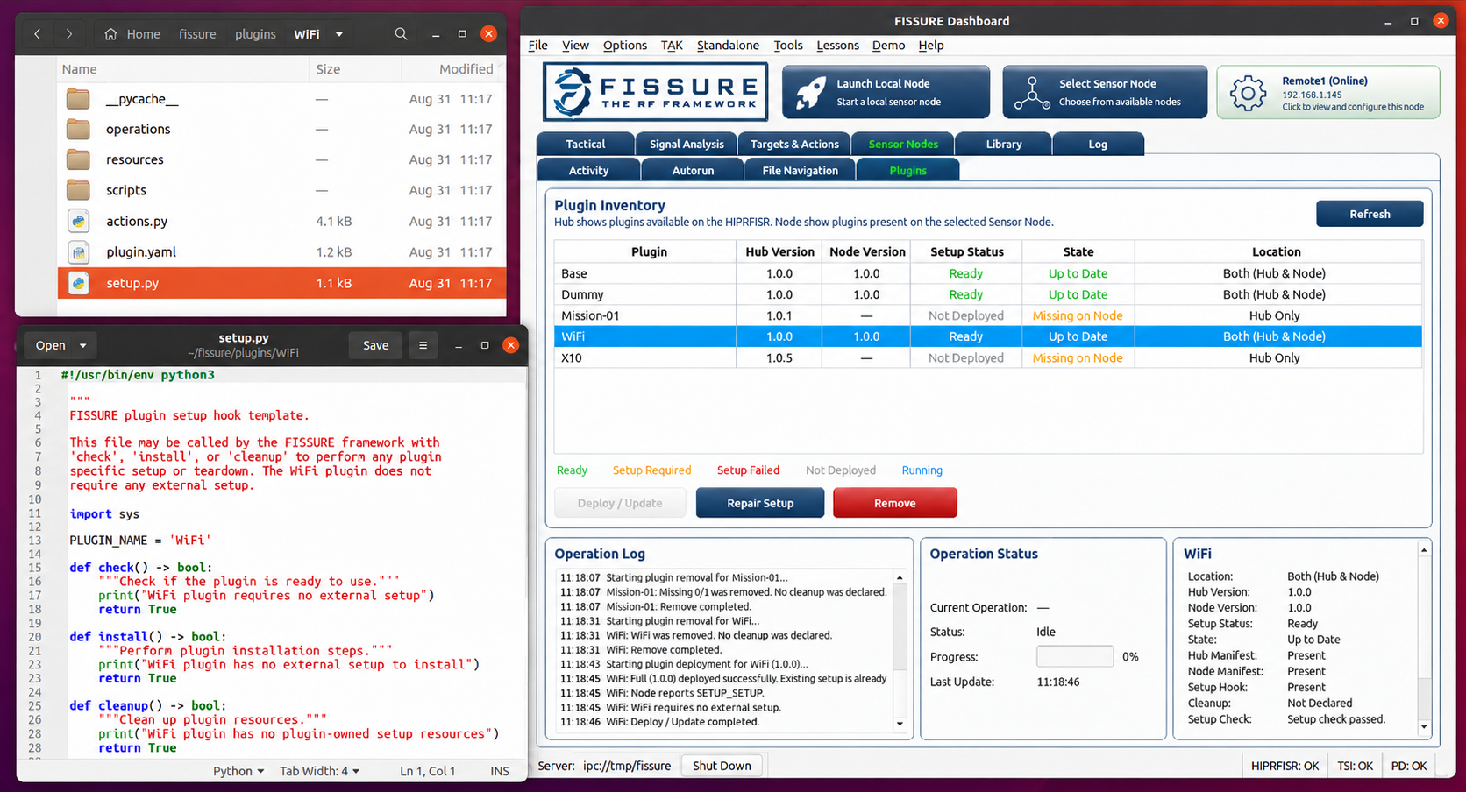
Plugins and Deployable Capabilities
Add and manage capabilities without changing the FISSURE core
Plugins can add GNU Radio, hardware, analysis, protocol, and other custom capabilities
Plugins can manage setup, dependencies, repair, updates, and cleanup
Capabilities can be deployed locally or to remote Sensor Nodes, while integrating third-party tools
Mission-specific plugins can reuse Actions and keep proprietary capabilities outside the public FISSURE core
https://github.com/ainfosec/FISSURE
Chris Poore

Slide 10
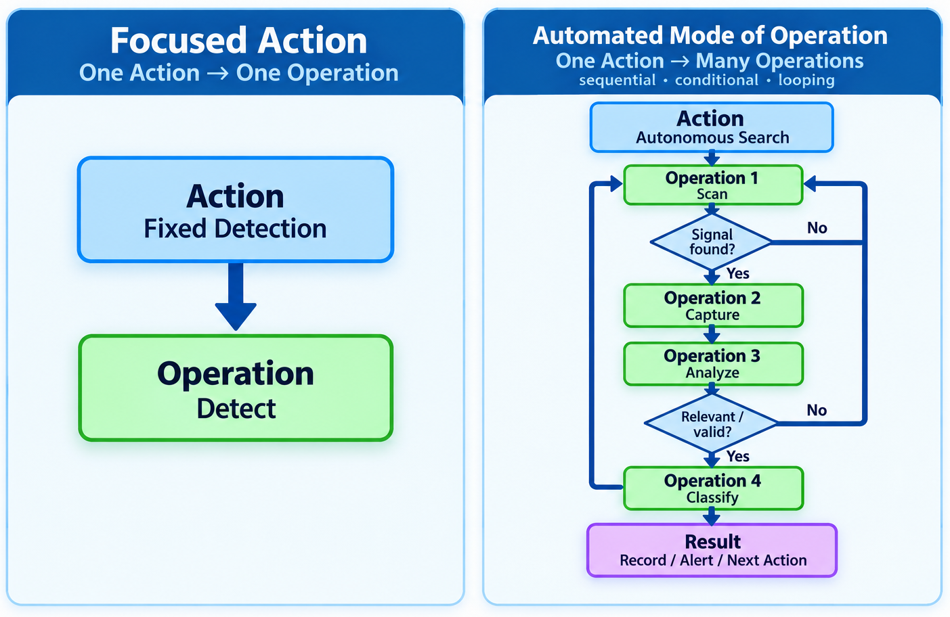
Actions and Operations
From focused one-off tasks to automated modes of operation
Operations are the programs that do the work, from GNU Radio and Python to external applications
Actions expose and configure those Operations for FISSURE, including inputs, parameters, context, and execution
An Action can call one Operation or orchestrate many sequentially, in parallel, or conditionally, supporting both focused tasks and automated modes of operation
https://github.com/ainfosec/FISSURE
Chris Poore

Slide 11
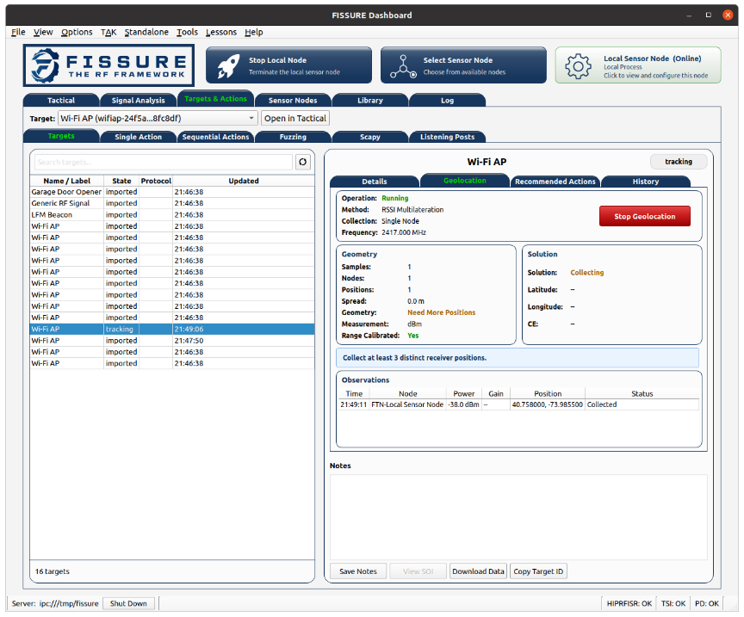
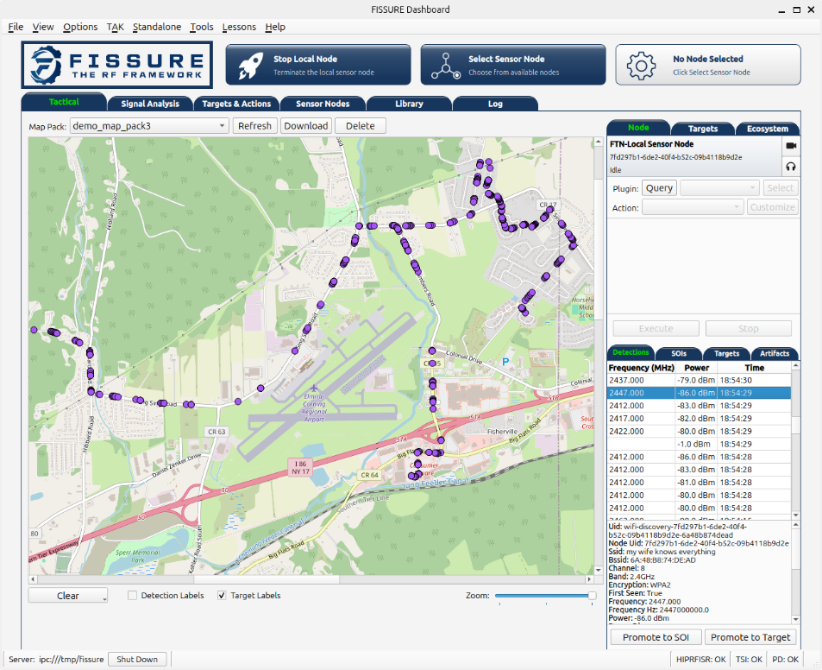
Geolocation and Target Awareness
Turning distributed observations into persistent operational context
Targets accumulate signals, locations, observations, and other knowledge about an entity
Sensor Nodes contribute detections and measurements for geolocation and tracking
HIPRFISR coordinates multi-node geolocation and feeds results back into Target and mapping workflows
Target context can recommend or pre-populate relevant Actions, while new observations continue building the record
https://github.com/ainfosec/FISSURE
Chris Poore

Slide 12
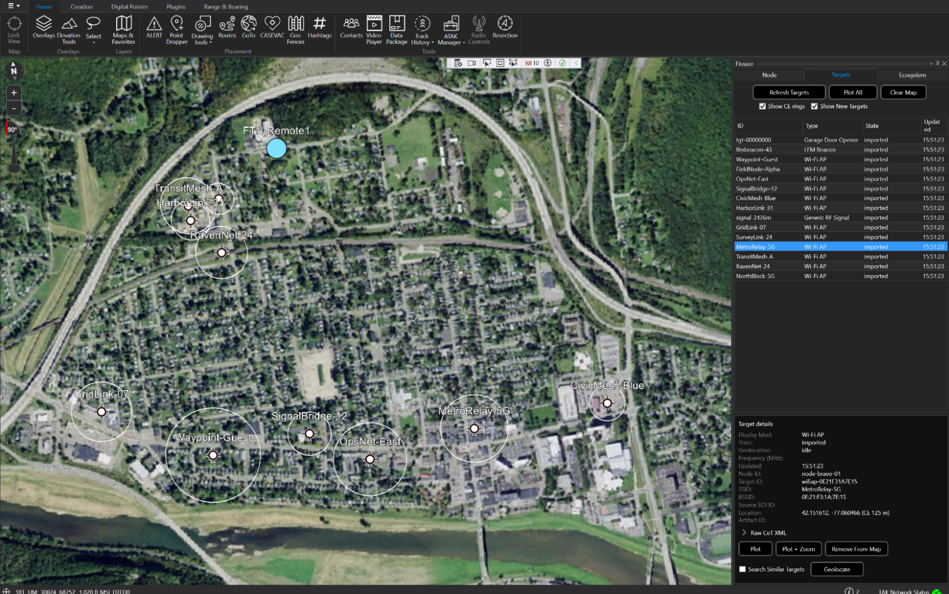
FISSURE + TAK
Sharing RF awareness through CoT while keeping FISSURE independent
FISSURE sends and receives CoT for Sensor Nodes, Targets, detections, geolocation, alerts, tracks, and events
ATAK and WinTAK extend RF-derived awareness to users outside the FISSURE Dashboard, including resources such as remote video
FISSURE can also provide its own operational map when a TAK client is not needed or available
https://github.com/ainfosec/FISSURE
Chris Poore

Slide 13
A Partial FISSURE Workflow (Video)
From tactical context to initial signal analysis
Tactical View
  Provides an operator-focused view of Sensor Nodes, detections, SOIs, and targets
  Connects distributed RF activity with persistent operational context
Signal Analysis Workflow
  Moves from RF discovery and detection into capture and analysis
  Associates collected data, artifacts, and findings back to SOIs
Distributed Operations
  Capabilities execute across local and remote Sensor Nodes
  Collected information can move between operational and analysis workflows
https://github.com/ainfosec/FISSURE
Chris Poore

Slide 14

A Partial FISSURE Workflow (Video)
From tactical context to initial signal analysis
https://github.com/ainfosec/FISSURE
Chris Poore

Slide 15
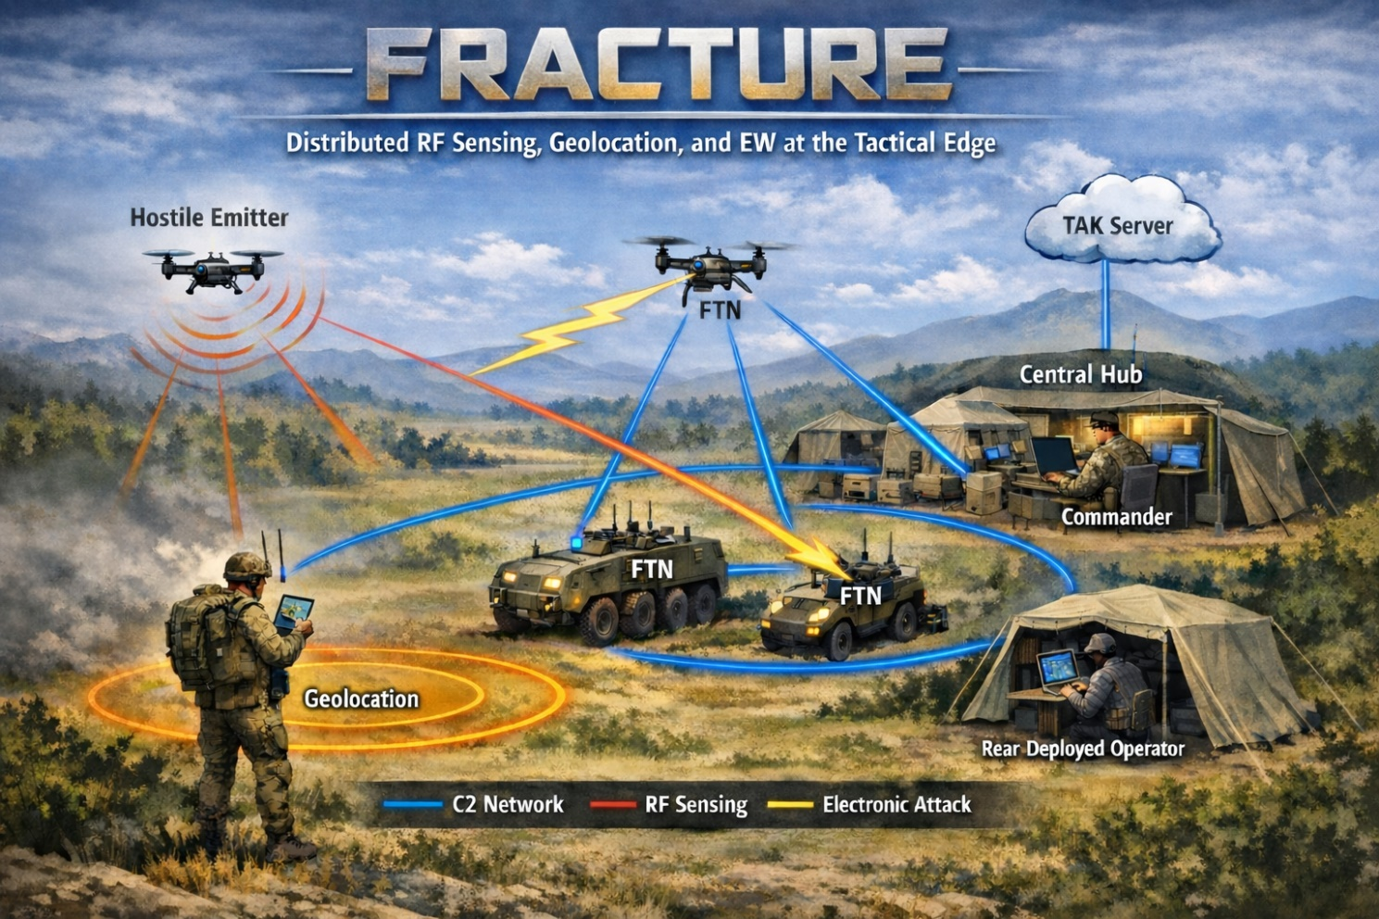
Fracture
Turning FISSURE capabilities into deployable systems
Fracture packages FISSURE into purpose-built hardware and software configurations
SDRs, compute, networking, plugins, and configuration are combined around a mission or use case
The goal is easier deployment, integration, support, and sustainment
Fracture can include deployment-specific integrations, including ATAK and WinTAK plugins not available in the public FISSURE release
https://github.com/ainfosec/FISSURE
Chris Poore

Slide 16
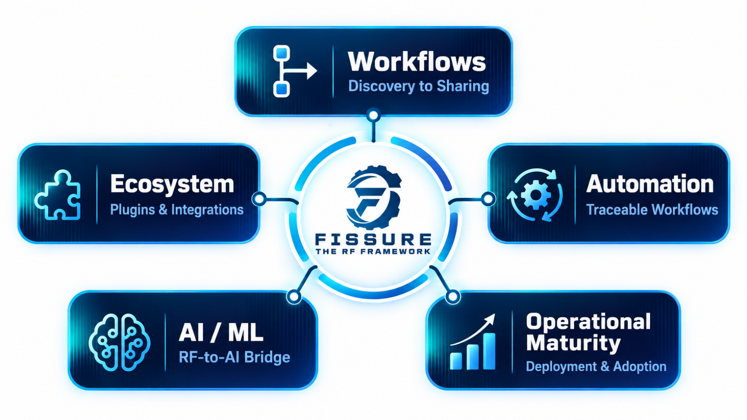
Where FISSURE Goes Next
Expanding capability, automation, AI integration, and operational maturity
Complete end-to-end workflows from discovery through sharing
Expand the plugin ecosystem across protocols, hardware, sensors, analysis, and integrations
Strengthen automation and provenance for repeatable, traceable workflows
Connect RF hardware and structured data more directly to AI/ML while hardening distributed deployment and adoption
https://github.com/ainfosec/FISSURE
Chris Poore

Slide 17






How You Can Help
There are plenty of ways to contribute
Use it: Try FISSURE with your own hardware, signals, workflows, and problems
Improve it: Report bugs, rough edges, missing capabilities, and workflow issues
Build with it: Contribute code, plugins, documentation, testing, hardware support, or existing RF/Cyber capabilities
Grow it: Share FISSURE with coworkers, students, professors, labs, and teams, or get involved more deeply in shaping the project
https://github.com/ainfosec/FISSURE
Chris Poore

Slide 18

Questions?
Chris Poore
Lead Developer
poorec@ainfosec.com
Assured Information Security, Inc.

