Slide 1

Real-Time Scheduling Support in GNU Radio 4
Tiancheng He¹ Joseph Goh² Syed Ali² Joel Isaacson¹ Nicholas Carter²
Samarjit Chakraborty² James Anderson² Bryan C. Ward¹
¹ Vanderbilt University ² University of North Carolina at Chapel Hill

Slide 2


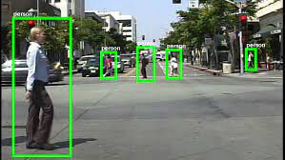

Real Time vs. Real Fast
Enterprise Systems
“Real Fast” Systems
Soft Real-Time System
Hard Real-Time System
Servers, desktops, web browsing, emails, etc.
Interactive processing, i.e., video games
Pedestrian Detection
Arc-Flash Relays: ~2ms to break circuit
Degree of Timing Requirements
Different systems have different performance objectives. Some favor higher throughput, others favor lower and/or predictable latency. This affects how you prioritize computations.

Slide 3
Priority Schemes and Scheduling Algorithms
A scheduling algorithm is defined by how it prioritizes the workload.
Linux historically used the Completely Fair Scheduler (CFS) to fairly schedule the workload.
Round Robin (RR) scheduling is a simple algorithm that gives fairness.
Fixed-priority (FP) scheduling allows you to choose which tasks to prioritize higher than others.
Earliest-Deadline First (EDF) prioritizes jobs that are more urgent to meet timing requirements.
Real-time scheduling theory provides analysis for latency and throughput guarantees

Slide 4
Exemplar Scheduling Algorithm: EDF
Let’s see EDF in action…
τ₁
5
10
15
τ₂
job release
5
10
15
job deadline
τ₃
5
10
15
EDF is…
Defined by a simple priority scheme: deadline = priority.
Provably optimal at meeting deadlines.

Slide 5
Scheduling in GR4 Today

Slide 6
Modular Scheduling Framework
Choose Your Scheduler! (Simple)
namespace gs = gr::scheduler;
gs::Simple<gs::ExecutionPolicy::multiThreaded> sched;
sched.exchange(std::move(graph));
blk_2
blk_4
Suppose you have a flowgraph and two CPU cores…
blk_1
blk_3
blk_6
blk_5

Slide 7
Modular Scheduling Framework
Choose Your Scheduler! (Simple)
namespace gs = gr::scheduler;
gs::Simple<gs::ExecutionPolicy::multiThreaded> sched;
sched.exchange(std::move(graph));
blk_1
blk_2
blk_3
blk_4
blk_5
blk_6
The graph is flattened by registration (emplace) order

Slide 8
Modular Scheduling Framework
Choose Your Scheduler! (Simple)
namespace gs = gr::scheduler;
gs::Simple<gs::ExecutionPolicy::multiThreaded> sched;
sched.exchange(std::move(graph));
Worker 1
runlist
blk_1
blk_3
blk_5
Blocks are distributed evenly to workers,
like dealing cards!
Worker 2
runlist
blk_2
blk_4
blk_6

Slide 9
Modular Scheduling Framework
Choose Your Scheduler! (DepthFirst)
namespace gs = gr::scheduler;
gs::DepthFirst<gs::ExecutionPolicy::multiThreaded> sched;
sched.exchange(std::move(graph));
blk_2
blk_4
Suppose you wanted to try the DepthFirst scheduler instead…
blk_1
blk_3
blk_6
blk_5

Slide 10
Modular Scheduling Framework
Choose Your Scheduler! (DepthFirst)
namespace gs = gr::scheduler;
gs::DepthFirst<gs::ExecutionPolicy::multiThreaded> sched;
sched.exchange(std::move(graph));
blk_1
blk_2
blk_4
blk_6
blk_3
blk_5
The graph is sorted by depth-first traversal order

Slide 11
Modular Scheduling Framework
Choose Your Scheduler! (DepthFirst)
namespace gs = gr::scheduler;
gs::DepthFirst<gs::ExecutionPolicy::multiThreaded> sched;
sched.exchange(std::move(graph));
Worker 1
runlist
blk_1
blk_4
blk_3
Blocks are distributed evenly to workers,
once again.
Worker 2
runlist
blk_2
blk_6
blk_5

Slide 12
What happens when you run them?
sched.runAndWait();
Blocks are executed Round Robin, regardless of scheduler!
DepthFirst
Simple
Worker 1
blk_1
blk_4
blk_3
Worker 1
blk_1
blk_3
blk_5
Worker 2
blk_2
blk_6
blk_5
Worker 2
blk_2
blk_4
blk_6

Slide 13
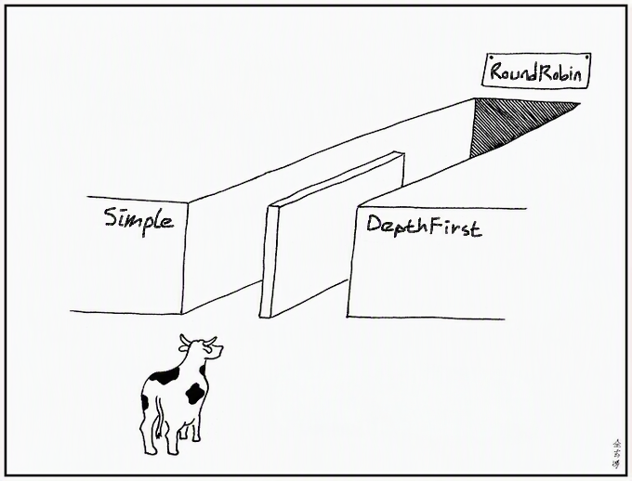
Modular, but Not Real-Time Scheduling
I’m latency sensitive and higher rate!
I’m not.
Wait your turn anyway!
blk_1
blk_3
blk_5
Today, schedulers differ mainly by block-to-thread distribution and runlist ordering.
Round Robin doesn’t consider urgency or ideal invocation rate of blocks.
The worker loop is not designed to be overridden by custom schedulers.

Slide 14
Modular, but Not Real-Time Scheduling
I’m latency sensitive and higher rate!
I’m not.
Wait your turn anyway!
blk_1
blk_3
blk_5
Can we apply tighter control over execution order and timing while keeping things modular?

Slide 15
Modular, Real-Time Scheduling in GR4

Slide 16
Blocks as Real-Time Tasks
GNU Radio Block
Input-batch size of N = 1,024
Sample arrival rate of 1 Msps
Each job must finish by next release
Real-Time Task
Each job processes 1,024 samples
Period: T = 1,024 / 1 Msps = 1,024 μs
Relative Deadline: D = T
JOB
One invocation of a block, i.e., batch of samples to be processed by a single work() call.
RELATIVE DEADLINE: D
Time from a job’s release (i.e., sample arrival) by which it should finish.
PERIOD: T
Inter-release time between jobs. lower period = higher invocation rate.

Slide 17
Scheduling Policies are a Template Argument
namespace gs = gr::scheduler;
gs::Simple<
gs::ExecutionPolicy::multiThreaded,
gr::profiling::null::Profiler,
gs::EdfPolicy> sched;
sched.exchange(std::move(graph));
sched.runAndWait();
Composable with any existing and custom scheduler.
Optional, defaults to existing behavior (Round-Robin execution) when omitted.
Selectively compiles (or compiles out) the corresponding worker-thread loop.

Slide 18
Scheduling Policies are Customizable
Don’t want EDF? Write your own priority-assignment policy!
struct CustomPriorityPolicy {
static constexpr std::string_view kName = "JobFixedPriority";
static constexpr PriorityClass kPriorityClass = PriorityClass::fixedJob;
std::int64_t key(const BlockModel&, const SchedState& state) const {
if (state.jobs.empty()) return kNeverSelected;
const Job& job = state.jobs.front();
// priority assigned from values fixed at release, e.g.
// EDF -> job.absoluteDeadline
// FIFO -> job.releaseTime
return assignPriority(job, state); // smallest key runs first
}
};
Notes:
Specifically, your scheduling policy must adhere to the SchedulingPolicyLike concept (C++20 feature).

Slide 19
Supported Scheduling-Policy Classes
Task-Level Fixed Priority
a.k.a. static priority
Block’s priority is
fixed at initialization.
Currently implemented:
  Rate Monotonic (RM) –
  Lowest-period tasks (i.e., highest-rate blocks) take priority.
  Fixed Priority –
  User assigns priority levels manually
Job-Level Fixed Priority
a.k.a. dynamic priority
Jobs’ priority levels are derived at runtime.
Currently implemented:
  Earliest Deadline First (EDF) –
  Job with earliest deadline takes priority
Round Robin
Identical to existing behavior.

Slide 20
A Peek Under the Hood
constexpr PriorityClass C = TPolicy::kPriorityClass;
// setup: on start, and after every graph change
applyStaticOrder<TPolicy>(blocks, states); // sort blocks by key once, only if hasStaticKey(C)
if constexpr (needsReleaseTracking(C)) { ... } // allocate job queues
// every pass
if constexpr (needsReleaseTracking(C)) { ... } // detect and release jobs from eligible blocks
if constexpr (!selectsByPriority(C)) { ... } // none (RR): run every block once, in list order
else if constexpr (hasStaticKey(C)) { ... } // fixedTask (FP, RM): try blocks in sorted order
else { ... } // fixedJob (EDF): run job with the smallest key
Worker-thread loop is chosen at compile time depending on desired level of priority expressivity.
Job-level prioritized policies also come with job tracking infrastructure.
Notes:
I want to add a “RR is behaviorally identical to vanilla claim,” but there’s a hiccup that makes it not true at the moment. I’ll fix it soon TM…

Slide 21
Fine-Grained, Lightweight Tracing

Slide 22
What’s taking so long?
We want to know a LOT:
Detailed timelines to verify scheduling and inspect timing anomalies.
Measure block/scheduler execution times and overheads in situ.
Track deadline misses, flowgraph end-to-end latency, and more!
The Solution:
A cheap, detailed, and fine-grained tracer.

Slide 23
Tracer Overview
 | GR4 built-in (Profiler.hpp) | Our tracer (Trace.hpp)
Trace Markers | Scheduler only | Scheduler + inside block work()
Clock | Wall clock, μs resolution | steady_clock, ns resolution
Trace Event Recording | std::string and vector ops, workers contend for shared buffer | 32-byte record into dedicated, per-thread buffer
Writing out | Writer thread interrupts workers to flush to disk every 100 ms | Only on dump, post-execution
Record categories | General scheduler events and open-ended fields | Work, lifecycle, job releases, deadlines, scheduling decisions, etc.
Notes:
23.6 to 46.6 ns/record at emission, write-to-disk deferred

Slide 24
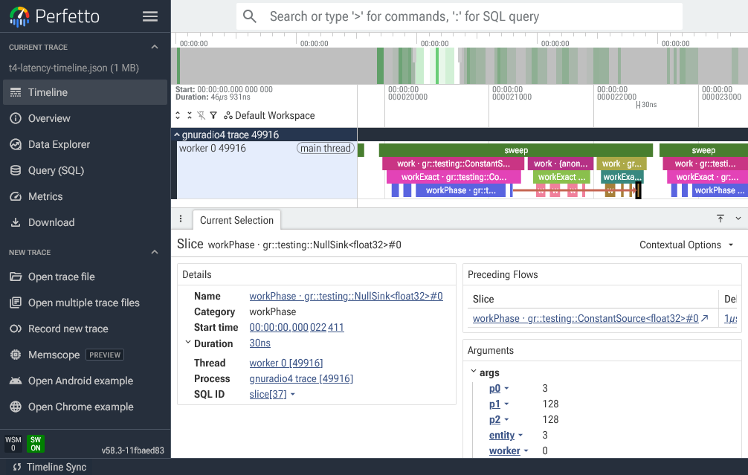
Analysis Tools and JSON Export
Work in progress:
Utility to analyze trace dumps natively or export to Catapult JSON format for UI browsing
$ gr4-trace summary <capture.gr4trace>
$ gr4-trace report <capture.gr4trace>
$ gr4-trace catapult <capture.gr4trace> <out.json>

Slide 25
Scheduling in Action

Slide 26

Exemplar Workload: IEEE 802.11p
What is IEEE 802.11p?
Wireless communications in
vehicular environments.
802.11p
Strict application-level timing requirement of 10 Hz.
►
If you want wireless transmission in a vehicle, you care about timeliness.
We evaluate our work on an 802.11p receiver in GNU Radio 4.0.

Slide 27
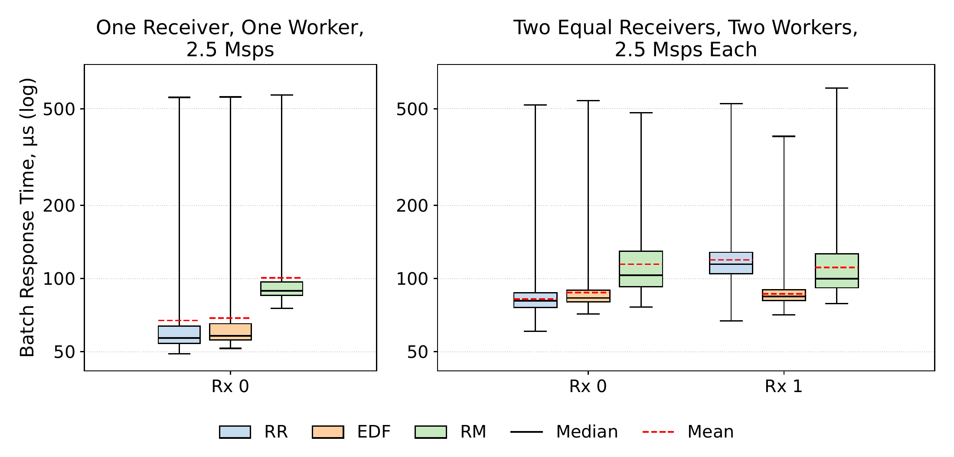
The Case for Round Robin (Baseline in GR4)
One 802.11p receiver at 2.5 Msps (million samples per second).
Baseline GR4 (RR) slightly outperforms EDF and RM on simple flowgraphs.
But what happens if you move beyond a single flowgraph?

Slide 28
The Case for Round Robin (Baseline in GR4)
Baseline (RR) performs significantly worse with multiple receivers.
It prioritizes the blocks of earlier receivers before the next.
If you have more than just a single flowgraph, then which scheduling
policy is applied has consequences.

Slide 29
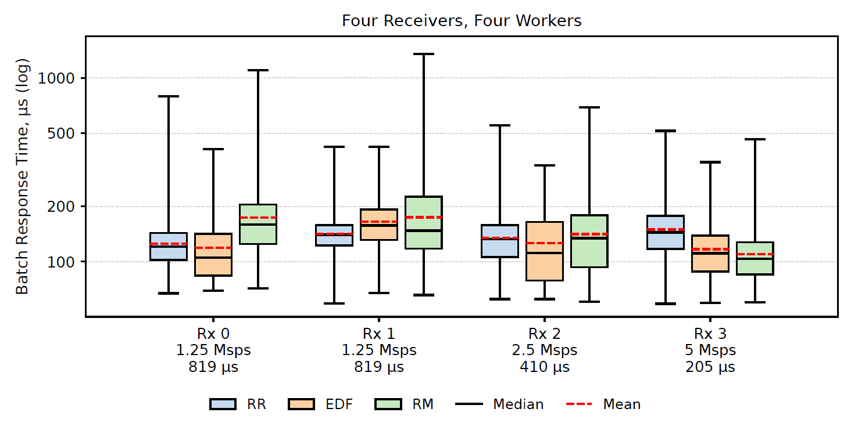
How about Earliest Deadline First (EDF)?
We up the dynamicity of the system. Four receivers, differing input batch arrival frequencies.
Trend: Baseline (RR) mean/median increases with each additional receiver.
EDF mean/median remain very consistent, with better response times in 3 of 4 receivers.

Slide 30
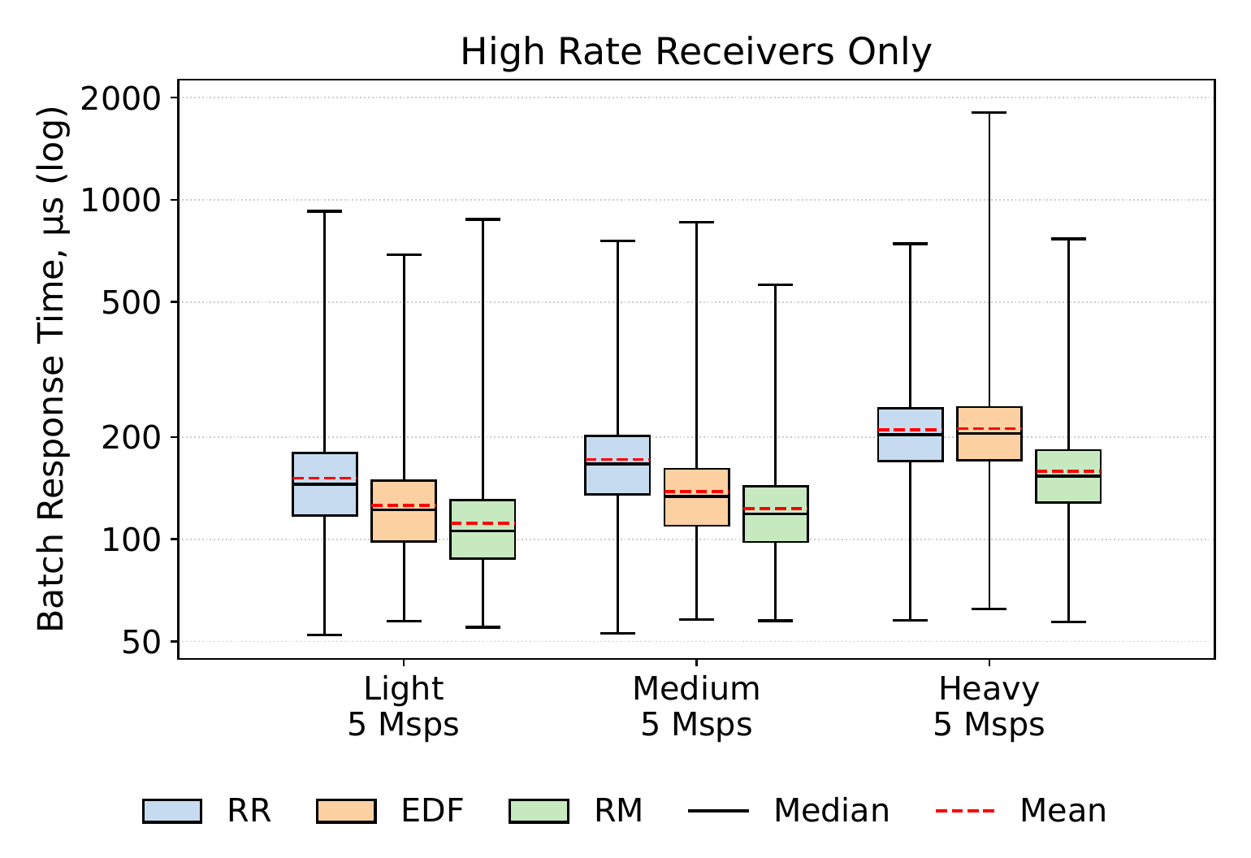
The case for Rate Monotonic scheduling
In this experiment, we plot only the response times for the highest batch input rate receiver (5 Msps) in a ‘Light’, ‘Medium’, and ‘Heavy’ utilization systems.
Rate Monotonic has great response times for the high-rate receiver.
All other receivers (not pictured) have
worse response times, but if strict prioritization of high-rate receivers is needed, RM works best.

Slide 31
Conclusion

Slide 32
Ongoing and Future Work
In progress:
Reduction of scheduling-operation overheads, especially for job-release tracking.
Tools for automatic timing- and scheduling-parameter derivation.
Further reduction of our tracer’s overheads.
Future work:
Scheduling policies that explicitly account for dynamic batch sizes.
Timing-property aware block-to-worker assignment.
Tighter integration with OS schedulers (e.g., SCHED_DEADLINE).

Slide 33

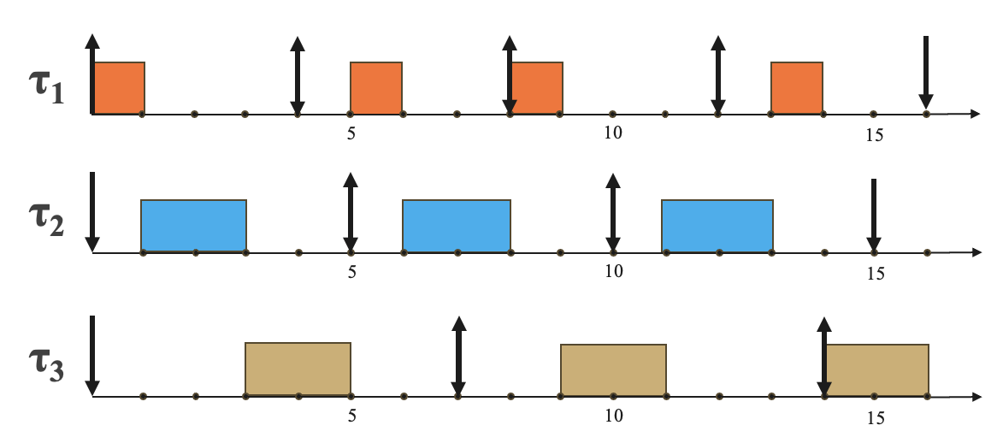

Conclusion
gs::Simple<gs::EdfPolicy> sched;
Code available at:
https://github.com/gosephjoh/gnuradio4/tree/modular-scheduling
Support for real-time scheduling and modular, customizable priority schemes in GR4
EDF and RM implementations
Lightweight tracer for fine-grained scheduling and timing inspection
Benchmarks show utility in freedom of scheduling-policy choice
Work supported by ARDC.

Slide 34

Real-Time Scheduling
Real-time systems have timing requirements
Often found in safety-critical systems where timing violations can cause critical failures
Real-time analysis provably guarantees correct temporal behavior
  Requires models of workload
  Analysis techniques applied to mathematical model of workload
Designed for worst-case or near worst-case performance to guarantee timing, instead of merely providing best effort
Our Thesis: Real-time models, schedulers, and analysis can be extended to support Software-Defined Radio (SDR) workloads and provide
predictable and bounded latency with guaranteed throughput.

Slide 35
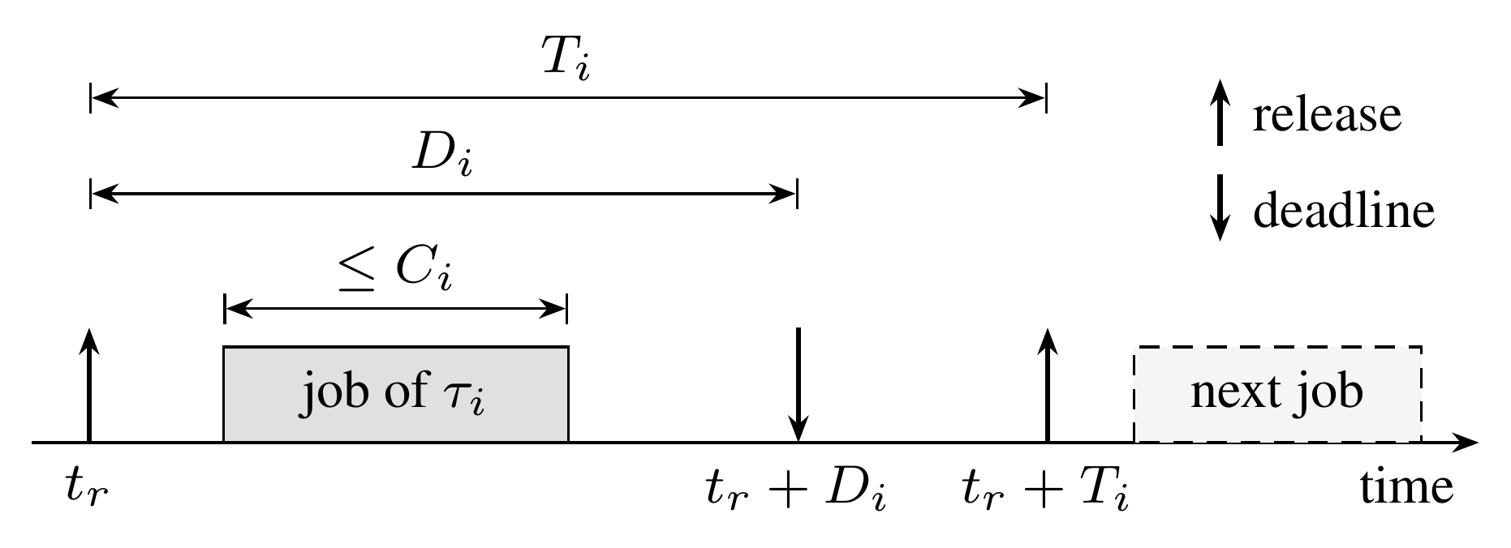
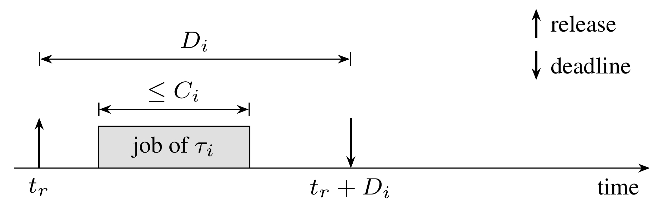
Blocks as Real-Time Tasks
JOB
One invocation of a block, i.e., batch of samples to be processed by a single work() call.
RELATIVE DEADLINE: D_{i}
Time from a job’s release (i.e., sample arrival) by which it should finish.
PERIOD: T_{i}
Inter-release time between jobs. lower period = higher invocation rate.

Slide 36
Real-Time Scheduling Policies
Static priority and Rate Monotonic (RM)
RM sort the list by priority once, at start.
RM scan from the top; run the first block that has input.
After any call that did work, RM restart from the top.
RM stop after a bounded number of selections, then do housekeeping.
RATE MONOTONIC
Priority by period: a 5 Msps receiver's blocks outrank a 1.25 Msps receiver's. No job tracking needed.

Slide 37
Scheduling Overheads
Preliminary results show minor to negligible added overhead per message phase (“bookkeeping”): ~0.5 μs added work.
 | Baseline (RR) | RM | EDF
Message phase (total, μs) | 6.49 | 6.92 | 6.64
stateSync (incl. job release tracking, μs) | 4.53 | 4.80 | 5.02
Notes:
I need to make sure these figures are solid. The experiment setup is too jank to make definitive claims about anything.

Slide 38
The fastest receiver
BATCHES LATER THAN 204.8 µs
period = batch size ÷ sample rate = 1,024 samples ÷ 5M samples/s = 204.8 µs
Scenario | RR | EDF | RM
Light | 13.3 % | 2.7 % | 0.8 %
Medium | 23.1 % | 5.8 % | 2.0 %
Heavy | 48.8 % | 50.2 % | 13.1 %

Slide 39
Five scenarios, three policies
Scenario | Receivers (Msps) | Total
One Rx | 2.5 | 2.5
Two equal Rx | 2.5, 2.5 | 5
Light | 1.25, 1.25, 2.5, 5 | 10
Medium | 1.25, 2.5, 2.5, 5 | 11.25
Heavy | 2.5, 2.5, 5, 5 | 15
METRIC
Response time of each batch, from its arrival at the throttle to its use by the receiver's sync gate. Late: past its period.
RUNS
10 × 30 s per scenario and policy. VM stalls removed: 0.007 % of batches.

Slide 40
Evaluated Scheduling Policies
Round Robin (Baseline GR4) | Earliest Deadline First (EDF) | Rate Monotonic (RM)
Selects blocks in a round-robin fashion for invoking work(). Low overheads- simple to decide which block is worked upon next. The default scheduling policy in GR4. | Invokes work() on the blocks with the earliest deadlines. | Blocks are given an invocation frequency. The system prioritizes the highest-frequency blocks. E.g., when there is work to be done, the blocks of a 5 MHz graph will always be prioritized over the blocks of a 1.25 MHz graph.
In our experimental evaluation, block deadlines are set so that work() must complete before the next batch of inputs arrive at the source block.

Slide 41
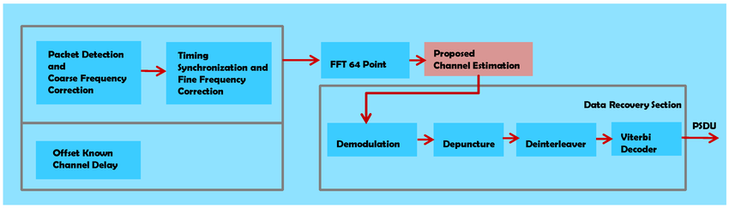

Workload: IEEE 802.11p receivers
gr-ieee802-11's receiver, ported to GR4 block for block: 18 blocks per receiver
Cheap blocks (multiply, delay, average) and costly ones (FFT, decoding, parsing)
1,024 samples per call; deadline = period, 204.8 µs at 5 Msps
Source and throttle run first; one worker thread per receiver

Slide 42
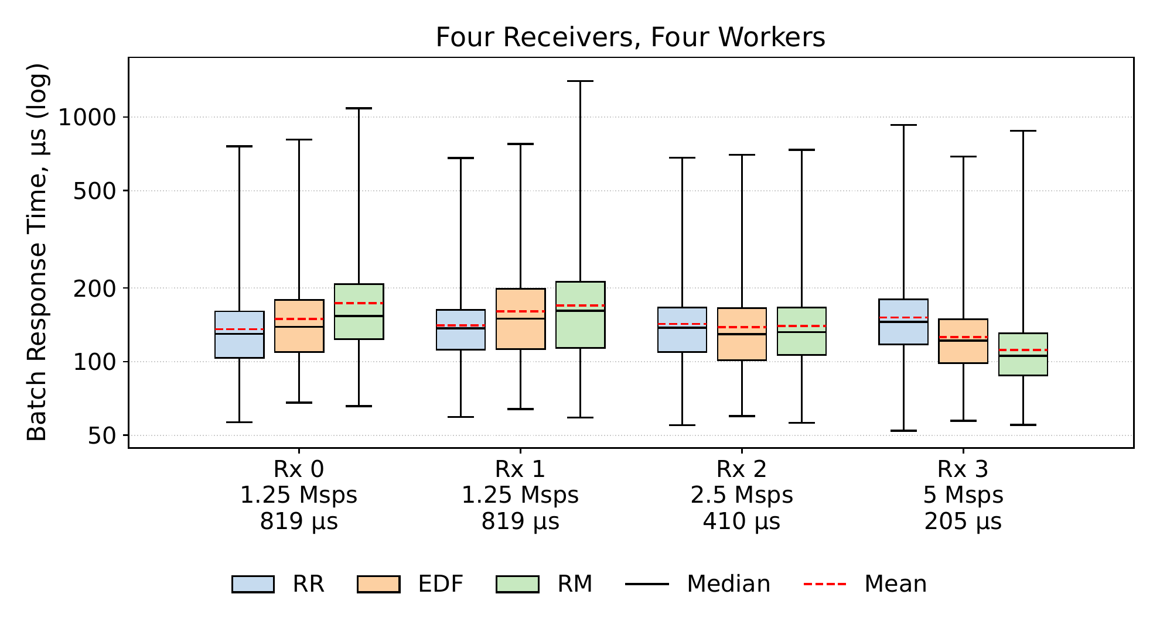
Receivers at different rates
LIGHT SCENARIO, MEAN ΜS
Rx | RR | EDF | RM
0 · 1.25 | 136 | 149 | 173
1 · 1.25 | 141 | 161 | 169
2 · 2.5 | 143 | 138 | 140
3 · 5 | 151 | 126 | 112

Slide 43
One receiver, or two equal ones
Rx | Metric | RR | EDF | RM
One RX | Mean | 67 | 69 | 101
One RX | Max | 557 | 560 | 570
Two Equal | RX 0 Mean | 82 | 87 | 115
Two Equal | RX 1 Mean | 119 | 86 | 111

Slide 44
τ₁
τ₂
τ₃
τ₁
5
10
15
τ₂
5
10
15
τ₃
5
10
15
τ₁
5
10
15
τ₂
5
10
15
τ₃
5
10
15

Slide 45
The case for Rate Monotonic scheduling
In this experiment, we plot only the response times for the highest batch input rate receiver (5 Msps) in a ‘Light’, ‘Medium’, and ‘Heavy’ utilization systems.
Scenario | Baseline (RR) | EDF | RM
Light | 13.3 % | 2.7 % | 0.8 %
Medium | 23.1 % | 5.8 % | 2.0 %
Heavy | 48.8 % | 50.2 % | 13.1 %
Rate Monotonic is the only scheduling
policy with a low deadline-miss rate.
All other receivers (not pictured)
have worse response times
under RM, but they don’t
miss deadlines.

Slide 46
Scheduling 101
How would you schedule these jobs to meet all deadlines?
Round Robin – Take turns in any order!
τ₁
τ₂
τ₃
τ₁
5
10
15
job release
τ₂
job deadline
5
10
15
job finish
τ₃
5
10
15

Slide 47

Scheduling 101
How would you schedule these jobs to meet all deadlines?
Round Robin – Take turns in any order!
τ₁
τ₂
τ₃
τ₁
5
10
15
job release
τ₂
job deadline
5
10
15
job finish
τ₃
5
10
15

Slide 48
Scheduling 101
How would you schedule these jobs to meet all deadlines?
Round Robin – Take turns in any order!
τ₁
τ₂
τ₃
τ₁
5
10
15
job release
τ₂
job deadline
5
10
15
job finish
τ₃
5
10
15

Slide 49
Scheduling Policies – Which would you pick?
Quick peek at results
Which policy would you prefer for your workload? Policy 1, 2, or 3?
Response time (μs)
Policy 1 is the current baseline RR in GR4 as of today.
Policy 2 works quite well, and we show later that Policy 3 is best for high-rate receivers.
► Scheduling policies deserve a close look.

Slide 50
Takeaways
No one best scheduling policy.
Rate Monotonic had the worst average response times but also best prioritized high-rate receivers.
Earliest deadline first remained very consistent, even in heavily utilized systems.
Round robin (current default in GR4) is very effective at
simple flowgraphs.

