Slide 1
Open-Source RF Environment Generator for Procedurally-Generated Over-the-Air Datasets Using GNU Radio
September 22, 2026
Presenters:
Samuel Brosh
Kathleen De Key

Slide 2
Background
RadioML.2016
  The first time that researchers attempted building upon the successful strategies from image and voice recognition domains in ML
  Researchers used a CNN on 2x128 input
  Achieved 90%+ accuracy
  Released dataset RadioML.2016, which was considered the benchmark at the time
  Researchers conceded that a generalizable network will need to be trained and tested against more perturbations than AWGN
TorchSig
  Researchers asserted that models trained from RadioML datasets were overfit– Not enough complexity
  Therefore, researchers introduced a new dataset, Sig53 with significantly more channel impairments
    Phase shift, time shift, frequency shift, Rayleigh fading channel, IQ imbalance and random resample
    53 Modulation schemes
  Researchers introduced Cross-Covariance Image Transformers (XCiT) to the Narrowband Inference

Slide 3
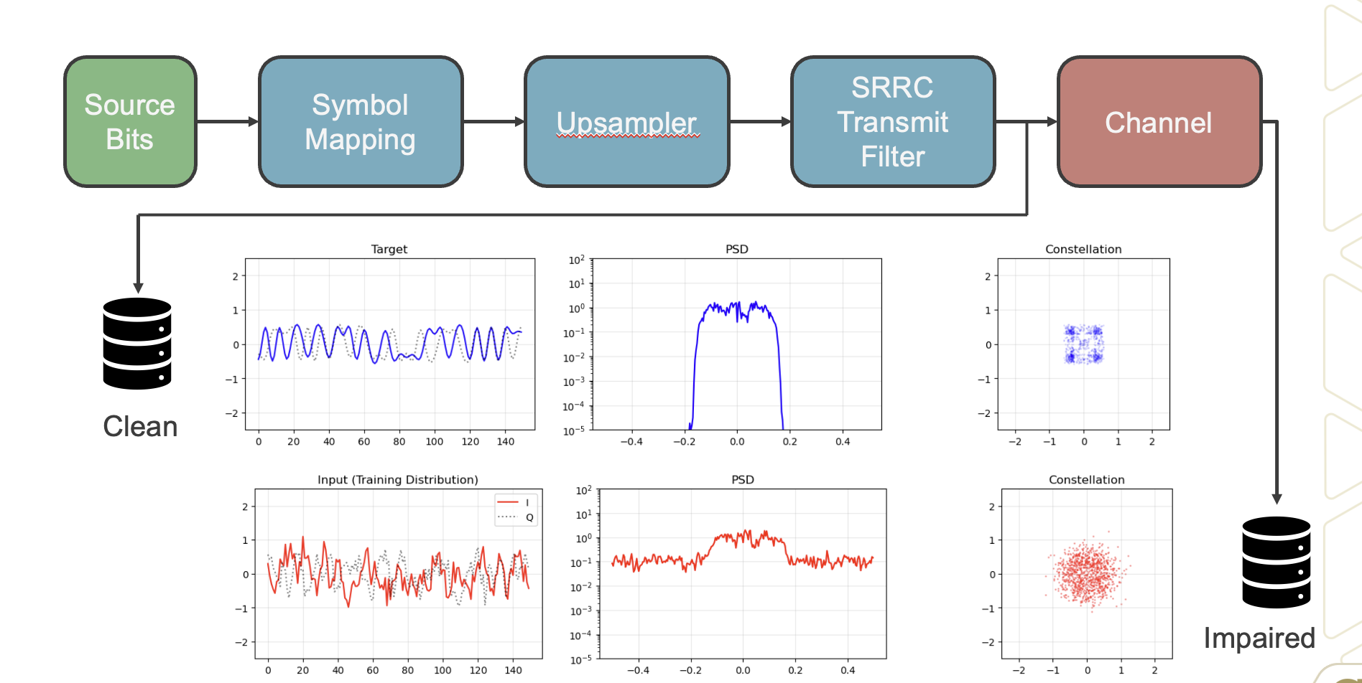
The Synthetic Approach
Could we model the channel better than guessing?

Slide 4

Drawbacks of Synthetic Approach
Could we model the channel better than guessing?

Slide 5
Proposed Area of Research
We believe that there are significant progress to be made when focusing on the intersection between large-scale training (procedurally generated datasets such as Sig53), OTA-native datasets and neural network architectural decisions, and spatial processing
How do we facilitate this?
Foundation Modeling
Spatial Processing
Agentic or other Solution?
OTA Native

Slide 6
What is Radio Frequency Environment Generator (RFEG)?
An open-source system that procedurally generates labeled, over-the-air RF datasets by orchestrating distributed software-defined radios to realize a user-specified scene in the real electromagnetic environment
What problem does it solve?
  Data realism
  Data scarcity
How it works?
  A central node randomizes signal parameters and writes a JSON scene description per signal, sent over TCP to emitter nodes main.py.
  Distributed emitter nodes (USRPs on SBCs) transmit the specified waveforms; a receiver captures the aggregate signal
  Every capture is saved with the exact transmit parameters as labels

Slide 7
RFEG: The Middle Ground for OTA RFML Data
 | Synthetic Datasets | Large Industrial Testbeds
Examples | RadioML, Torchsig | POWDER, Colosseum
Channel realism | Modeled | Real or has hardware impairments
Labels | Perfect | Available, but requires configuration
Cost | None | Constrained by shared scheduling
Reflects your operational EM environment | No | Rarely
The development path using RFEG:
Identify your need–
  e.g. identifying LPI/LPD signals in your operational environment
Model the signals of interest in GNU Radio
Configure RFEG, and collect lots of data

Slide 8
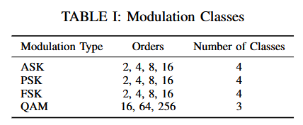
Narrowband Implementation
1 Receiver + 1 Transmitter on the same frequency
Modulation Classes: 15 types across 4 families
Random parameter selection:
  Symbol rate
  samples/symbol
  TX gain
  Root raised cosine filter (filter span & roll-off factor)
  Random seed for reproducibility
GNU Radio flowgraph generates modulated signals, transmitter and receiver starts at the same time
Aligned clean signals with received signals using autocorrelation property of Barker code

Slide 9
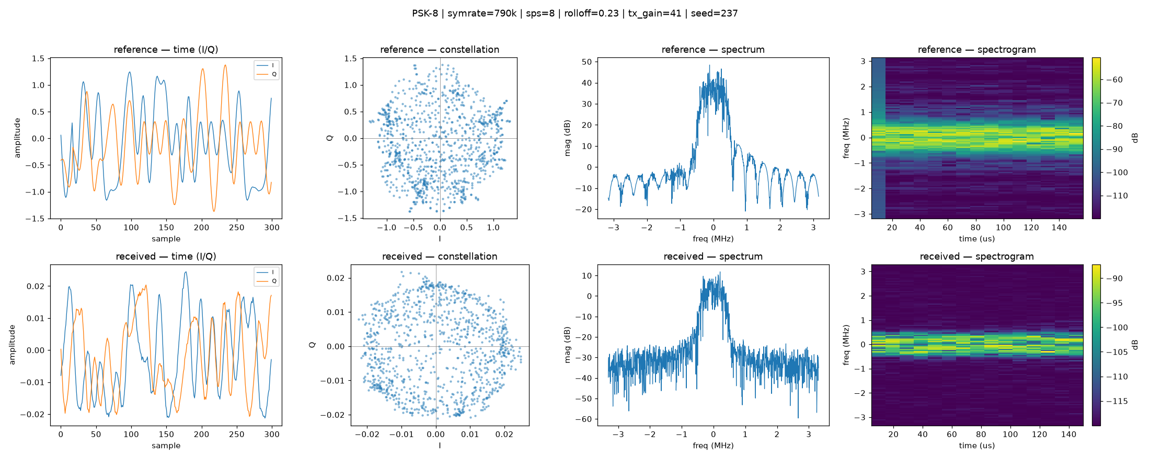
Narrowband Implementation
Output File: python pickle file
  Data: Aligned clean/received IQ signal
  Labels: Modulation type/order, signal parameters, hardware settings, random seed
Why align clean & received signal?
  Enables AI/ML the ability to solve a greater class of problems, including symbol-level recovery tasks, interference mitigation, LPI/LPD signal detection, and carrier frequency offset estimation

Slide 10
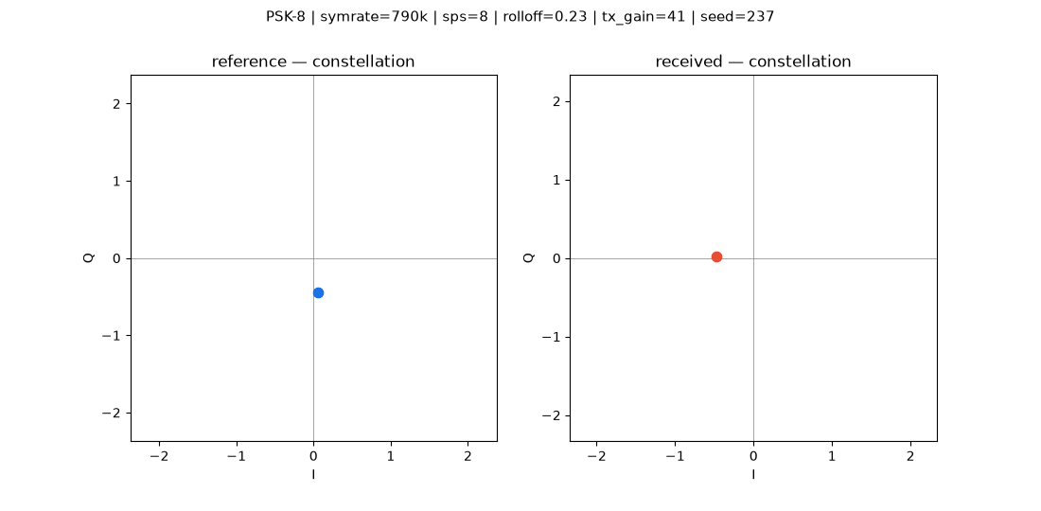
Received Signal Example

Slide 11
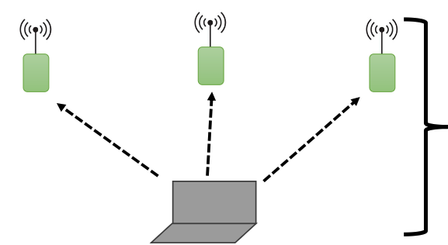
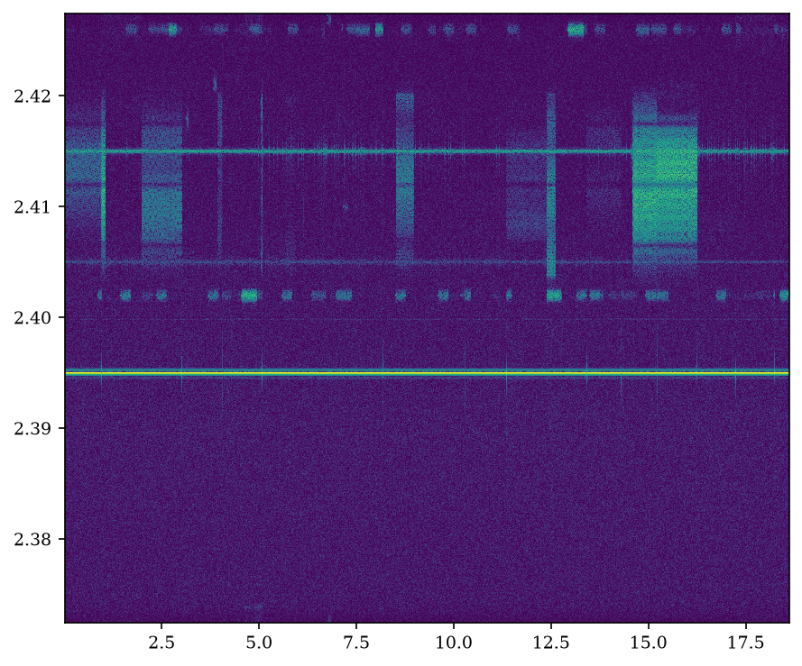
Wideband Implementation
A Central Node (CN), acting as a scheduler, sends commands to multiple Distributed Nodes (DN) to generate OTA RF scenes
  Ability to transmit the same modulation class, orders and random parameters
  Each DN can transmit different signals on different frequencies
Output File: Python pickle file
  Data: Received wideband signal only
  Labels: random parameters of each node
DN
DN
DN
Signals generated with RFEG
CN
Notes:
Users can use their own equipment (when architecture is built out), in their own environment, with their own sensing platform.

Slide 12
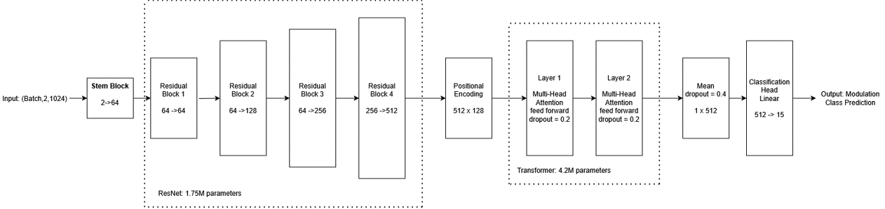
Neural Network Training
ResNet Feature Extractor + Transformer Encoder + Classification Head
Trained on narrowband data collected over multiple days on 2.4GHz
Test Dataset -> Indoor Environment 1
Validation Dataset 1 -> Indoor Environment 1
Validation Dataset 2 -> Indoor Environment 2

Slide 13
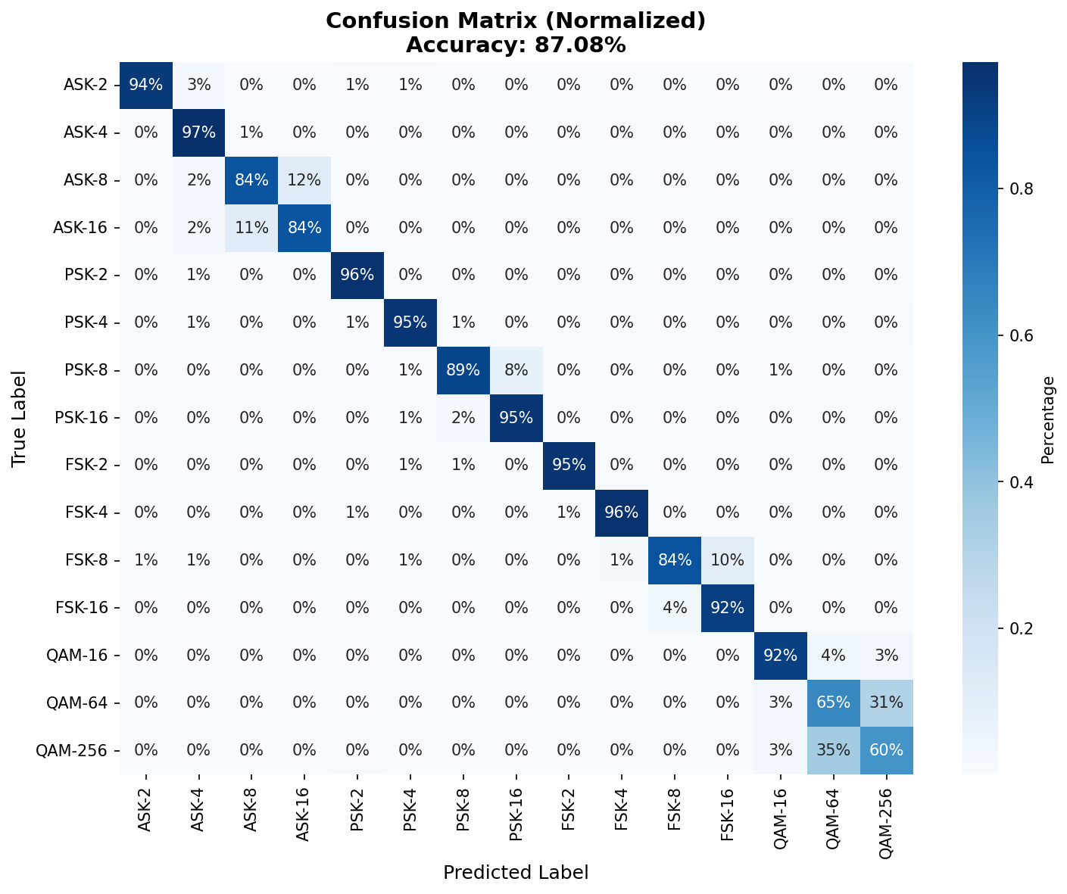
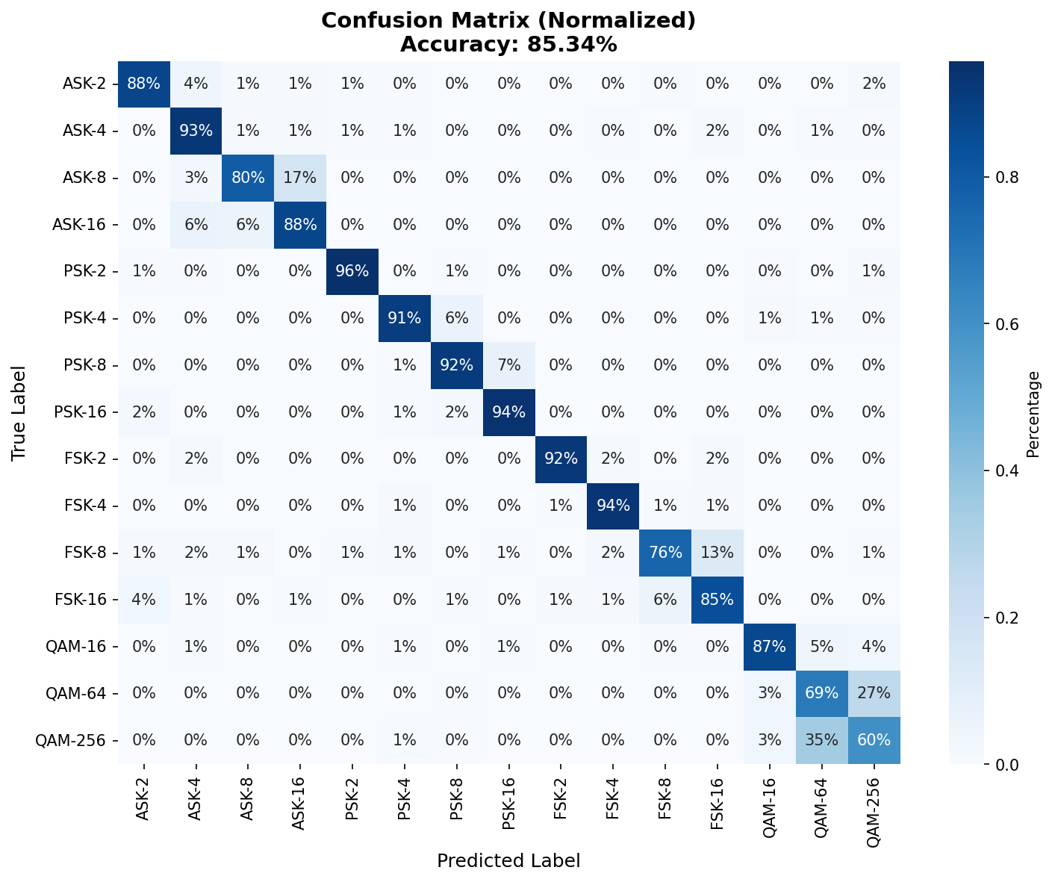
Results
Validation Confusion Matrix on Environment 1 (same as training environment)
Validation Confusion Matrix on Environment 2 (different from training environment)

Slide 14
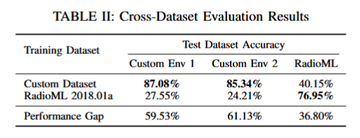
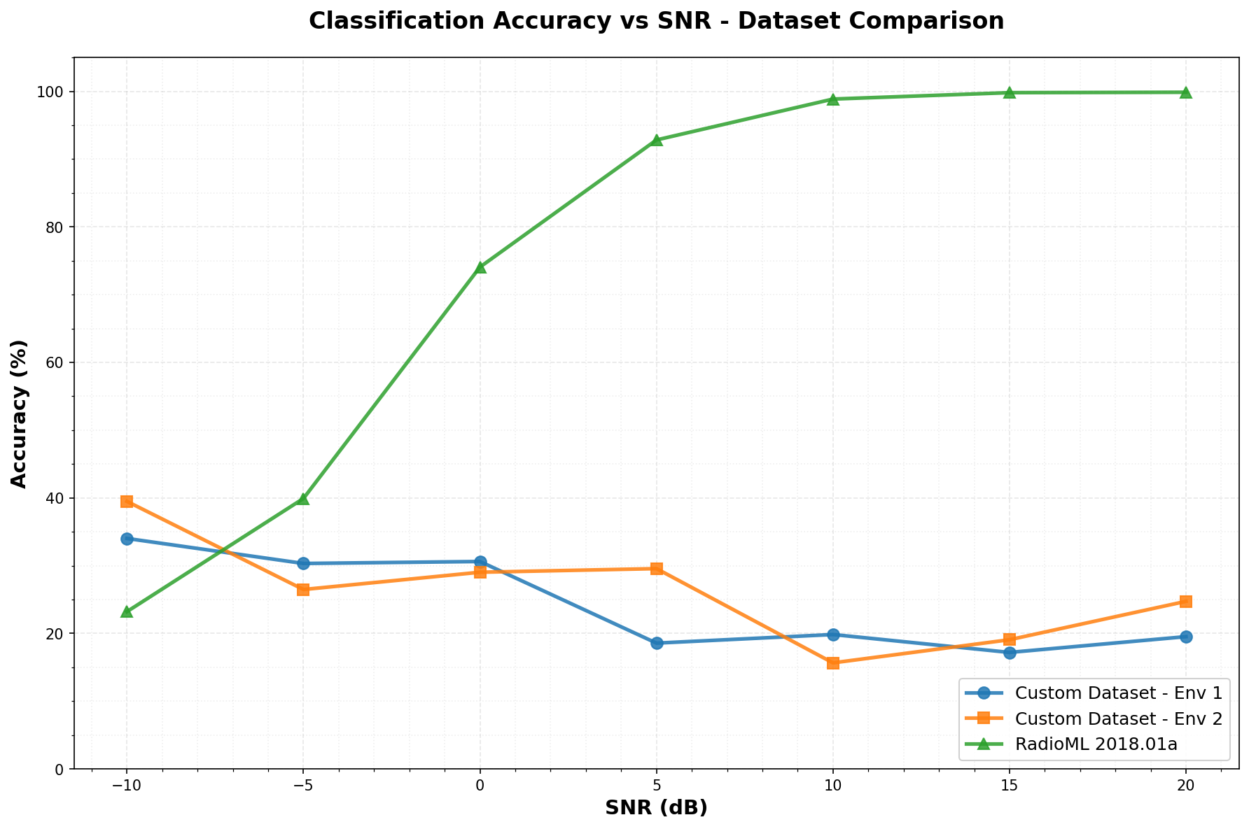
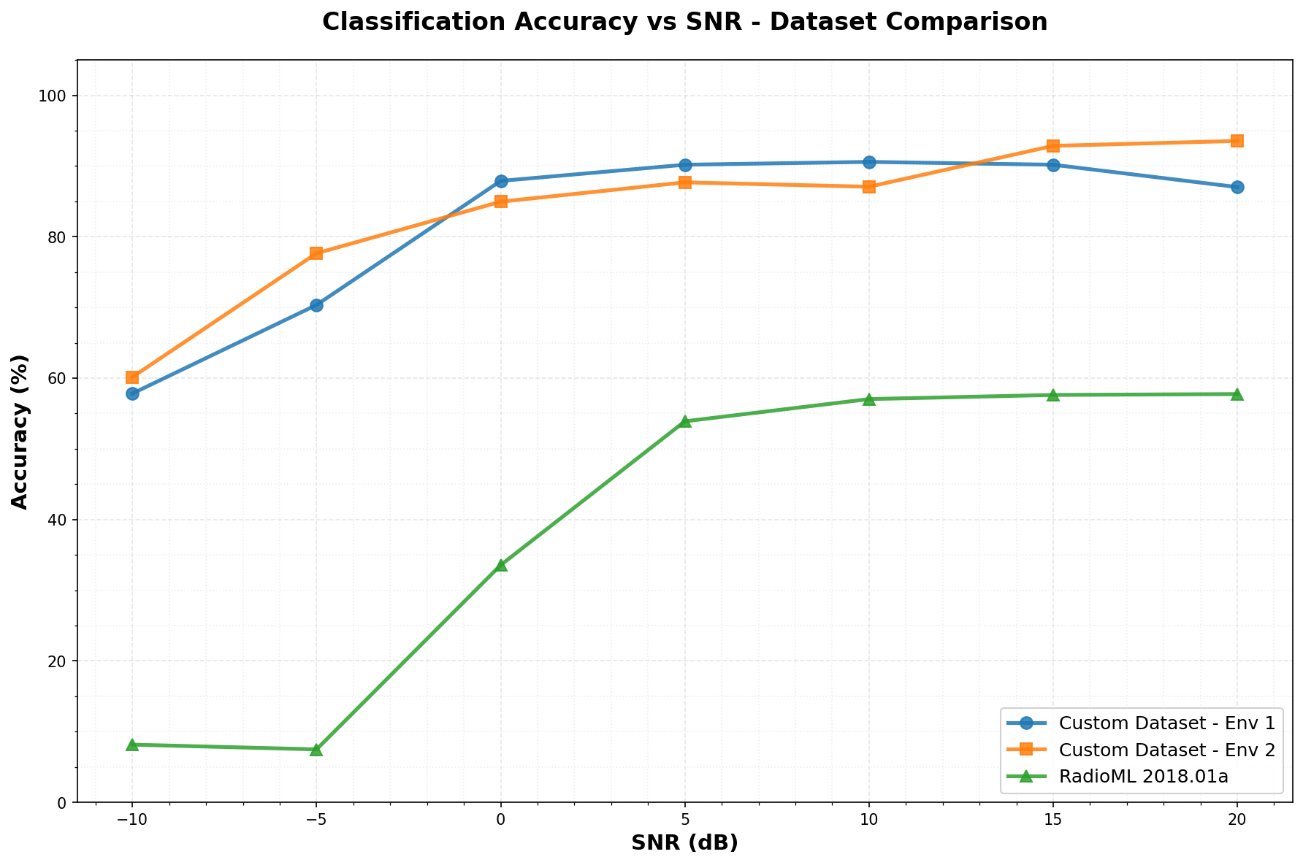
Comparison with RadioML2018.01a
Model trained on RadioML2018 Dataset
Model trained on RFEG Dataset

Slide 15
Conclusion
We have presented the RFEG that operationalizes the process of generating, collecting, and labeling OTA RF data at scale
We have introduced two distinct implementations of RFEG: narrowband and wideband
We presented results to a simple 15-modulation classification task using RFEG generated data
Next steps:
  Present a GUI that simplifies interacting with RFEG
  Time synchronization of wideband distributed nodes
  Configuration and testing of interfering nodes, larger scale problem sets

