Slide 1



gr-autopilot: An Agentic Framework for Closed-Loop
Flowgraph Synthesis with Hardware-in-the-Loop Feedback
Stepan Mazokha
Gabriel Garcia
George Sklivanitis
Center for Connected Autonomy and AI (CA-AI.fau.edu)
Florida Atlantic University, Boca Raton, FL, USA
September 2026

Slide 2
Motivation
2
RF experimentation is challenging: time-consuming, requires DSP knowledge, long engineering iterations, hardware challenges, etc;
Agentic workflows are promising: significant advancements in AI motivate the exploration of adopting AI to accelerate RF experimentation objectives;
Great progress, but still a great research opportunity: the existing agentic tools for GNUradio demonstrate great potential, yet do not offer closed hardware-in-the-loop experimentation functionality.

Slide 3
Existing GNU Radio Agentic Frameworks
3
 | dollarhyde/gr-mcp | yoelbassin/gr-mcp (Marconi) | gr-autopilot
Build flowgraph | Yes | Yes | Yes
Execute flowgraph | No (only export .grc) | Yes | Yes
Real radios? | Only detection, not running | Simulation Only | Yes
Scoring? | No | Spectrum Stats Only | Yes
Scoring-based Design? | No | Only Simulation | Yes
Notes:
gr-mcp: An MCP server that exposes GNU Radio's block library so a model can assemble, validate and export a flowgraph, and auto-detect attached SDRs; it generates the Python but hands you back a .grc file to run yourself
marconi: An LLM-driven RF assistant that surveys a spectrum, builds a receiver, runs it and leaves behind a reproducible project (SigMF captures, YAML pipelines, .grc), scoring what it built from signal statistics (sim only now, hardware is in their roadmap)
iot-mcp: Edge-deployed MCP servers that let a model query 22 sensor types and drive 6 microcontroller families in natural language, benchmarked on whether it emits the correct tool call (100% success, 205 ms, 74 KB) rather than on whether anything it designed performs well.
6G orchestrator agent: A two-stage fine-tuned telecom model that decomposes a physical-layer intent into a sequence of existing network API calls, validated on 3GPP Q&A, API retrieval and task decomposition over generated query sets
SignalLLM: A hierarchical agent that decomposes a signal-processing goal into subtasks and solves them by code synthesis, model invocation or an alternating loop with a classical optimizer (differential evolution), demonstrated on five tasks that all run against stored public datasets

Slide 4
gr-autopilot System Architecture
4
LLM Agent
(outer tool)
Bayesian Optimizer
(inner loop)
Strategy, Experiment Orchestration
Optimization
MCP tool surface — 38 tools
Trials
Registries
603 blocks · 18 DSP skills
hardware (Pluto, HackRF) · experiments (logs, flowcharts)
Grader
BER · EVM · SNR
Bench Declaration
identity check
device claims
operator only
pluto2
transmitter
HackRF One
interferer
pluto3
receiver + grader
contained RF path

Slide 5
Division of Responsibilities
5
THE AGENT
THE IMMUTABLE INTERNAL FRAMEWORK
in simulation: TX & RX chain building;
over the air: only TX chain building;
claims device roles, retunes the link, sets a hop plan;
senses the band while the link is silent;
runs trials and reads BER / EVM / SNR;
sees the constellation (for diagnosis only);
opens a named experiment and reads its edit ledger.
the known pseudorandom payload and the synchronization preamble;
over the air, the RX chain: matched filter, Zadoff-Chu acquisition, carrier frequency tracker, grader;
the interferer (armed only over the operator channel);
the scoring code (can’t be agent-modified).

Slide 6
MCP Tools, Registries & Their Roles
6
Blocks
auto-introspected from GNU Radio’s installed block descriptors
603 blocks
Skills
modems BPSK–256-QAM, RRC shaping and matched filtering, timing and Costas recovery, AGC
18 DSP skills
Hardware
a capability manifest per radio (tuning range, gain ranges, quirks; identity read live over libiio)
manifest per radio
Experiments
the runnable scenarios and their success criteria (every measuring tool refuses until an experiment is open)
edit ledger per run
The hardware settings aren’t hardcoded. Registries are queried at runtime; the flowcharts are built based on the results of these queries;
38 MCP tools in seven groups: experiment, discovery, construction, measurement, adaptation, learning, optimization, memory;
One surface. The framework’s Bayesian optimizer and the LLM agents drive exactly the same MCP tools; the daemon stays up across agent sessions, so the radios are not re-acquired for every conversation.

Slide 7
Two Operational Timescales
7
Overall strategy: maximizing spectral efficiency (bits/symbol)
subject to BER ≤ 10⁻² (10⁻³ over the air)
LLM Outer Loop (slow)
Overall strategy:
modulation order
transmit chain, receive chain (simulation)
retune once interference affects the link
decide when to stop
Bayesian Inner Loop (fast)
The aim is to minimize loss (BER + EVM)
Runs a fixed number of trials and attempts to optimize configurations of the built flowgraph:
carrier-phase correction
RRC roll-off
The agent is never given the answer. The agent must identify the right policy from the BER and the EVM (grader output);
Every winner is re-measured before it is reported, and the agent may stop a run early once the target is met.
Notes:
RRC rolloff – root-raised-cosine roloff (which defines the shape of the pulse via which each symbol is transmitted through the link).
Rolloff 0.05: nearly the theoretical minimum bandwidth
Rolloff 0.95: almost double the bandwidth to send the symbol (wasteful)
bits_per_hz = bits_per_symbol / (1 + rolloff)
Carrier phase correction – to address the lack of sync between the TX/RX oscillators. However, the receiver estimates it from the preamble, so this argument is rarely used by the agent.

Slide 8
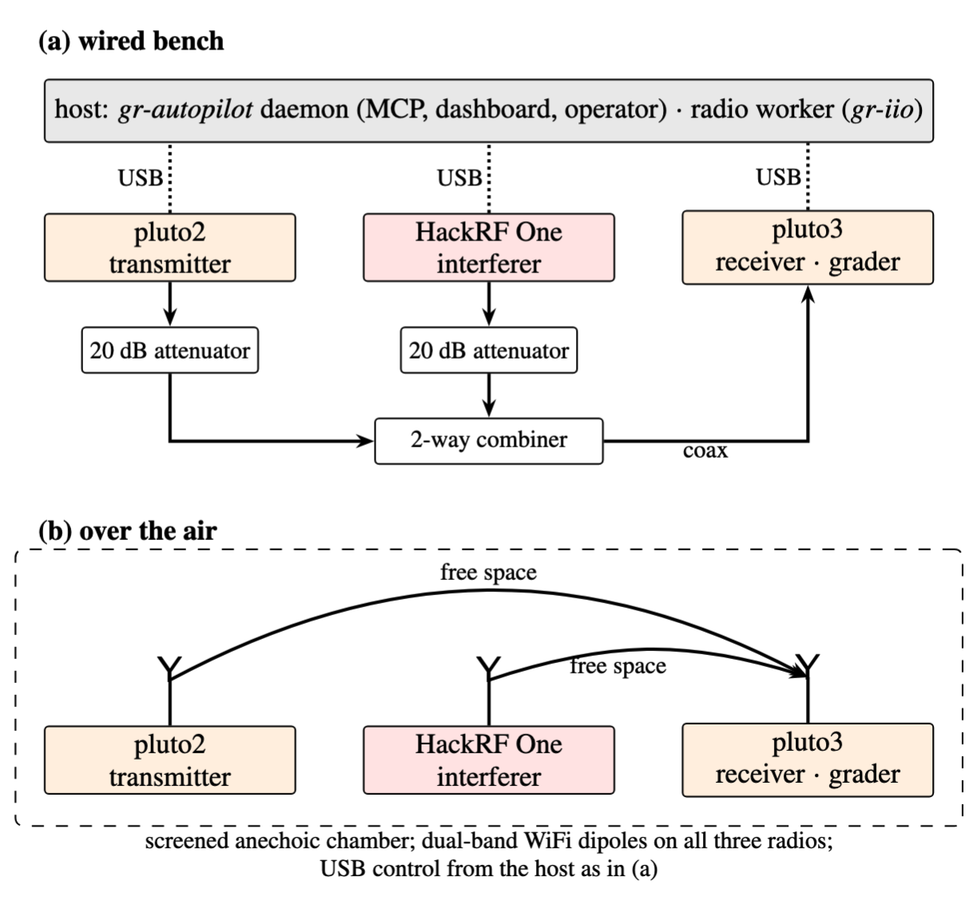
Experimental Setup: Wired Bench and Over the Air
8
unit | role | chip | tuning
pluto2 | transmitter | AD9364 (reconfigured) | 70 MHz – 6 GHz
pluto3 | receiver, grader | AD9363A | 325 MHz – 3.8 GHz
HackRF One | interferer | MAX2837 | 1 MHz – 6 GHz
RF Link Configurations
Waveform: 2.084 Msps, 8 samples/symbol (260.5 ksym/s);
Wired: 2400 MHz, frequency hopping limited by SDR hardware limits; 20 dB attenuators into a ZN2PD-63-S+ splitter used as a combiner.
Over the air: initial frequency set to 2370 MHz, frequency hopping limited by SDR hardware limits; dual-band WiFi dipoles (2–3 dBi); receive gain 45 dB.
Channel condition: set by the operator via pluto2’s transmit attenuation (never reported to the agent)
Host: Ubuntu 22.04, GNU Radio 3.10; libiio / gr-iio for the Plutos, hackrf_transfer for the HackRF; identity checked against the bench declaration.

Slide 9
Example of an Iteration
9
1 · open
start_experiment opens the run’s record
list_devices · list_skills · list_blocks read the registries
2 · build
build_flowgraph: modulation, code, pulse shape, TX chain
claim_device: the TX and RX roles
3 · run and grade
run_flowgraph: preamble + known payload sent, captured, graded
get_metrics → BER · EVM · SNR
capture_constellation · diagnose_signal
4 · adapt
rebuild the structure, or
start_bo_run tunes the knobs
sense_spectrum · set_center_freq
set_hop_plan
5 · record
every trial and decision → the edit ledger
read_edit_ledger · annotate_ledger
finish_experiment closes the run; the dashboard raises the report
repeat until the goal is met — then finish the experiment
Everything is on the record. Every trial and every decision is appended to the edit ledger; the run report on the dashboard is built from the same ledger the agent reports from.
Headless by design. The daemon serves the MCP endpoint, the telemetry dashboard and the operator channel from one loopback port; a client on another machine presents a bearer token.

Slide 10
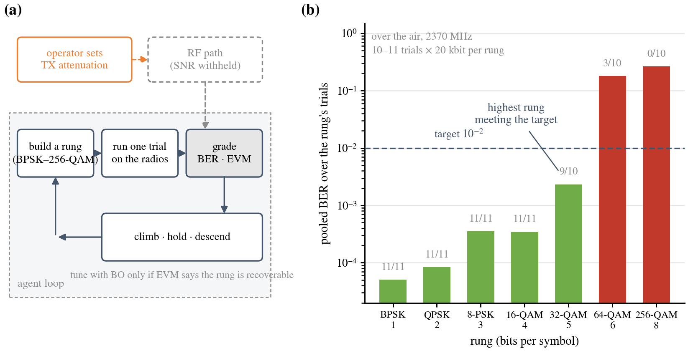
Experiment 1: Modulation Staircase
10
Setup: 1 Pluto TX, 1 Pluto RX, 2370 MHz over the air;
Goal: identify and hold the highest modulation (BPSM – 256 QAM) that meets BER target of 10⁻²), maximize bits per symbol;
Challenge: the agent isn’t directly aware of channel conditions, must decide based on link grader performance.

Slide 11
Experiment 1: Modulation Staircase
11
Modulation Staircase Experiment Recording

Slide 12
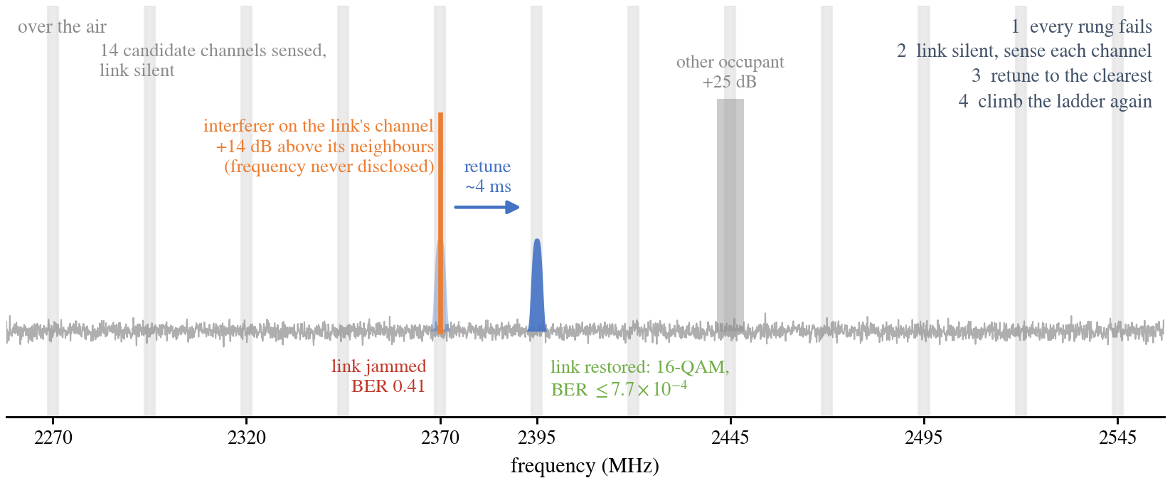
Experiment 2: Fixed Jammer
12
Setup: 1 Pluto TX, 1 Pluto RX, start: 2370 MHz OTA, introduced HackRF jammer;
Goal: same as Experiment 1, but with the introduction of the jammer which forces the agent to find a “quiet” channel;
Challenge: the agent isn’t aware of the channel conditions, and of the presence of the jammer, which can be enabled/disabled at any point throughout the experiment;

Slide 13
Experiment 2: Fixed Jammer
13
Fixed Jammer Experiment Recording

Slide 14
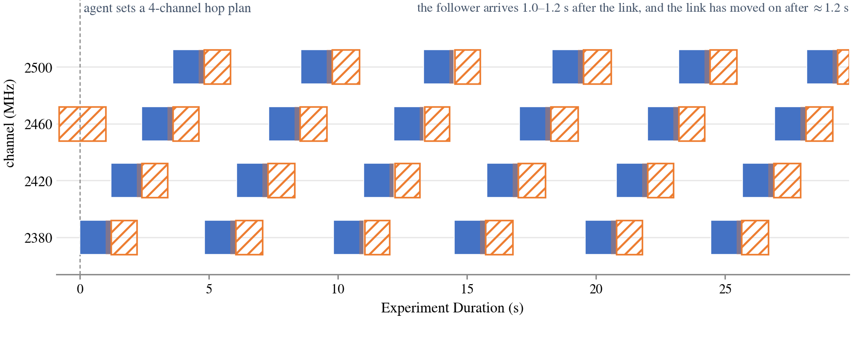
Experiment 3: Smart Jammer
14
Setup: 1 Pluto TX, 1 Pluto RX, start: 2370 MHz OTA, “smart” HackRF jammer;
Goal: same as Experiment 1 & 2, but the jammer follows the link after a programmable delay;
Challenge: the agent isn’t aware of the channel conditions, and of the presence of the jammer, or the time when it might re-tune to the channel;

Slide 15
Experiment 3: Smart Jammer
15
Smart Jammer Experiment Recording

Slide 16
Future Work
16
Grader Enhancements: generalize the grader functionality to include compatibility of additional metrics & support of OFDM;
Expand Hardware Support: add built-in support for USRPs and other SDRs on the market;
Security Guardrails: introduce LLM and algorithmic guardrails to protect against AI risks in over-the-air experimentation scenarios;
Multi-jammer Support: expand the support of interference mitigation beyond a single tone-shaped source.

Slide 17
Let’s Collaborate!
17
Project Code
https://github.com/C2A2-at-Florida-Atlantic-University/gr-autopilot
Any Questions
smazokha2016@fau.edu
Supported by the NSF ERC for Smart Streetscapes, award EEC-2133516.
fau.edu/smart
ca-ai.fau.edu
cs3-erc.org

