Slide 1


Universal High-Bandwidth SDR Transceiver for RFSoC4x2 and GNU Radio
Marius Šiaučiulis, Louise H. Crockett and Robert W. Stewart
github.com/marsiau
marius.siauciulis@strath.ac.uk
github.com/strath-sdr/rfsoc_qsfp_offload

Slide 2

Contents
Introduction
RFSoC 4x2 Platform
Hardware Setup Overview
Hardware architecture
Software Architecture
  RFSoC board
  GNU Radio client
Updated design
  Hardware architecture
  MTS
  Additional rates
Notes:
Intro
RFSoC 4x2 refresher
HW Arch
MTS
PYNQ remote

Slide 3

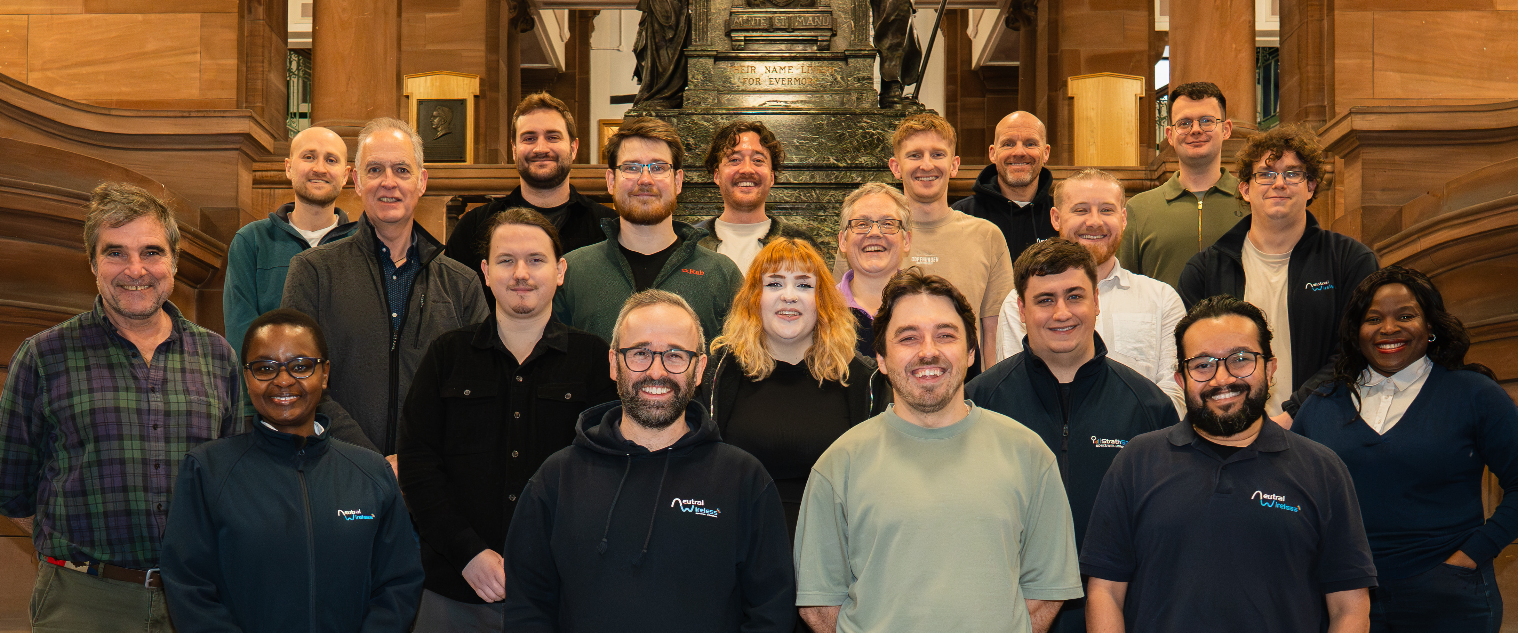
StrathSDR (and Neutral Wireless)
StrathSDR = University of Strathclyde Software Defined Radio
StrathSDR is composed of around 20 staff, including:
  4 senior academics and academic-related staff
  8 research staff
  10 PhD students
  Interns and project students
Our spin-out company, Neutral Wireless, also has additional staff.
Neutral Wireless is a technology company specialising in 5G private networks, broadcast connectivity, SDR, consulting and training.
(some of!) the StrathSDR team, Dec 25.​

Slide 4
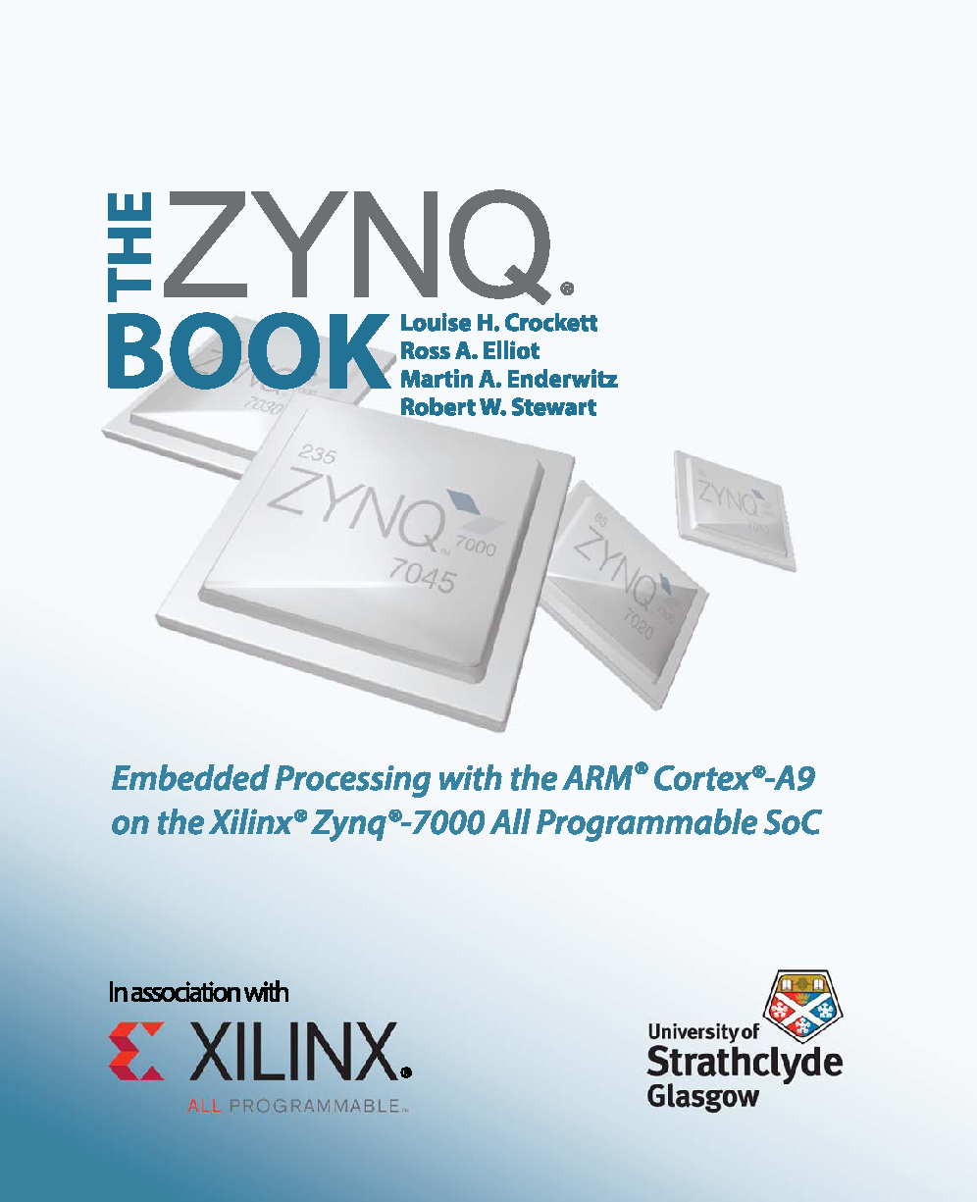
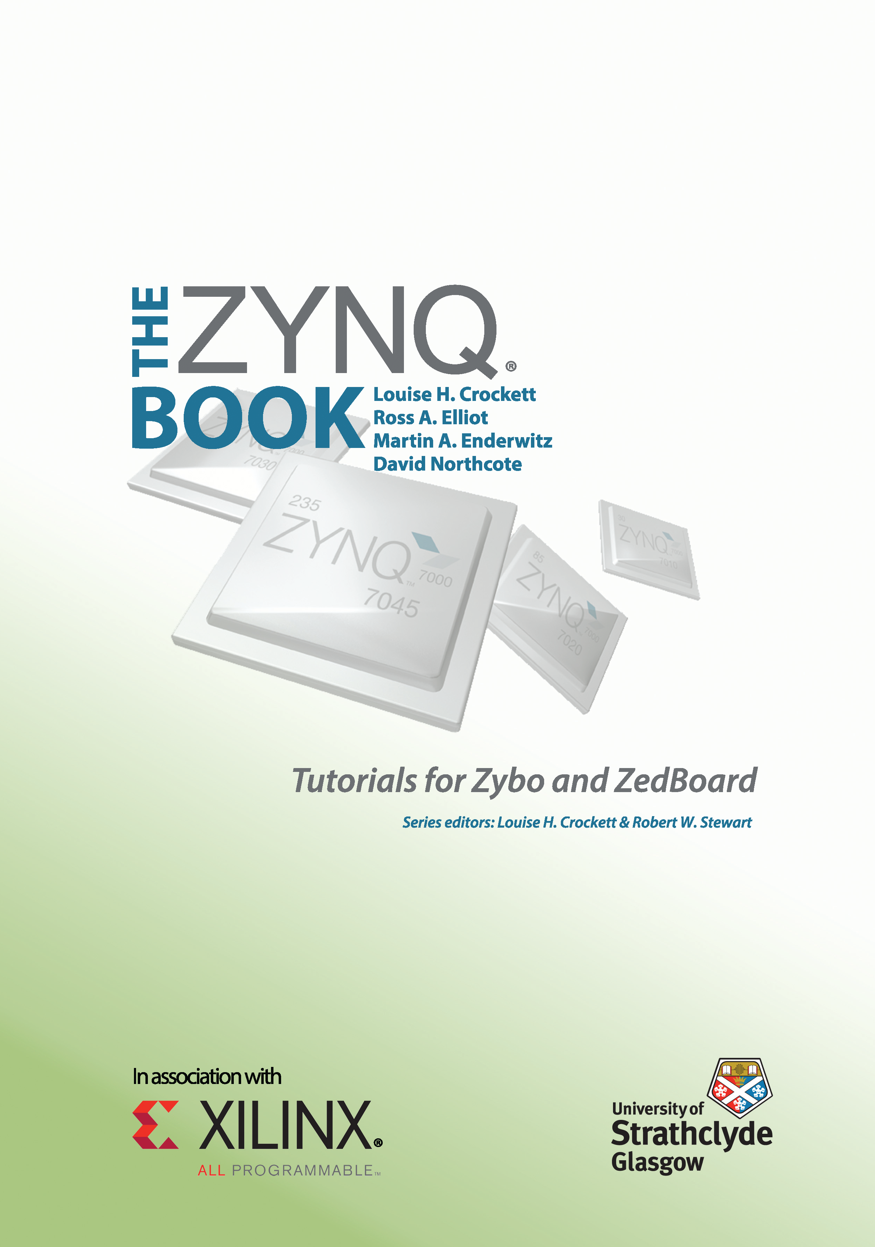
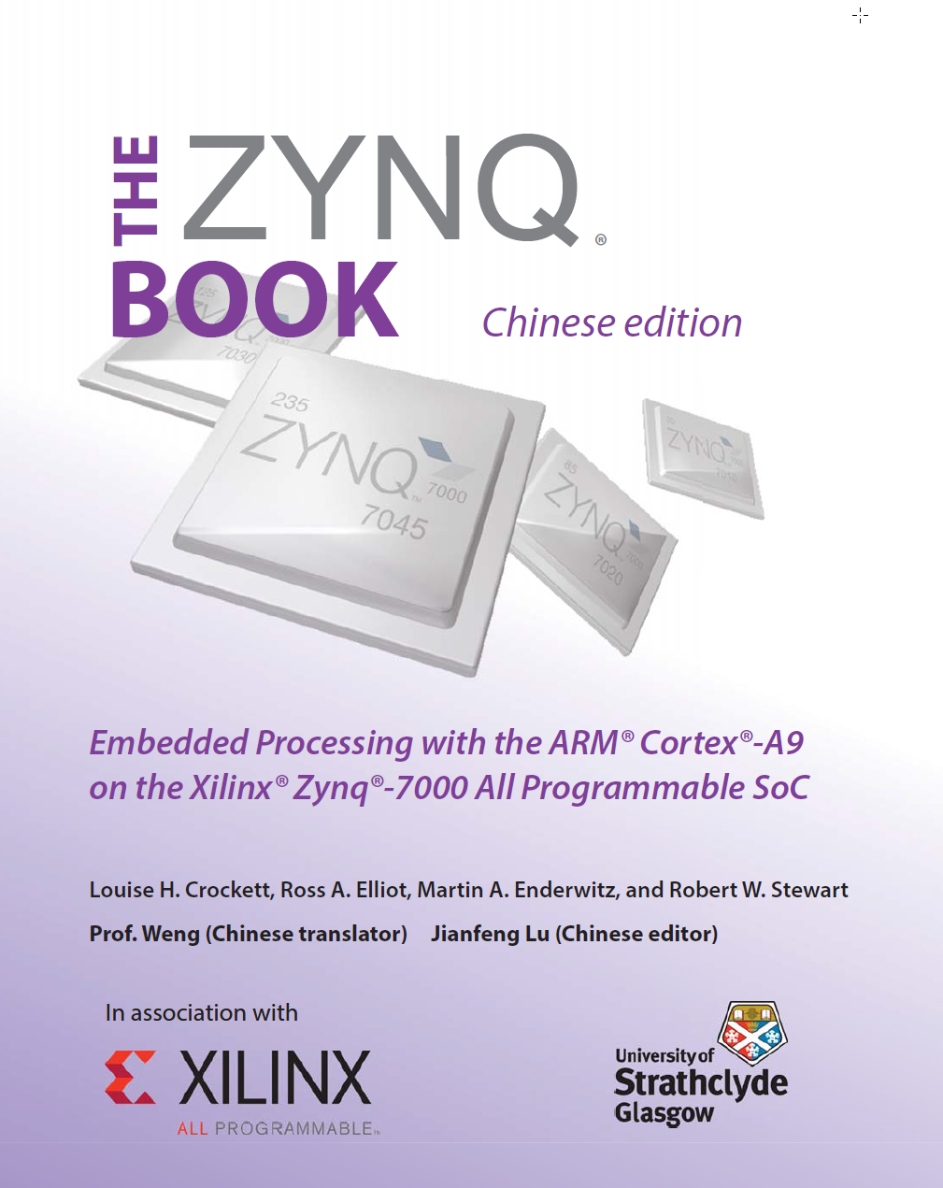
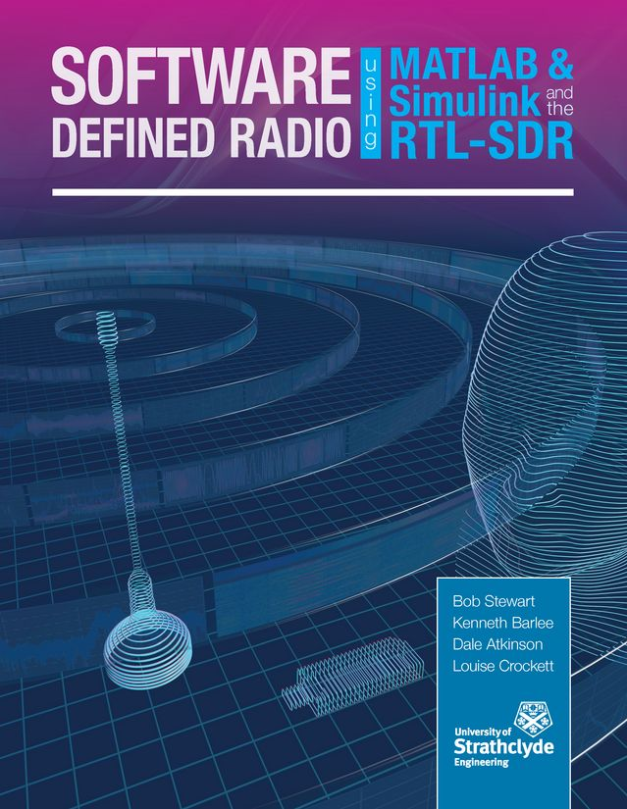
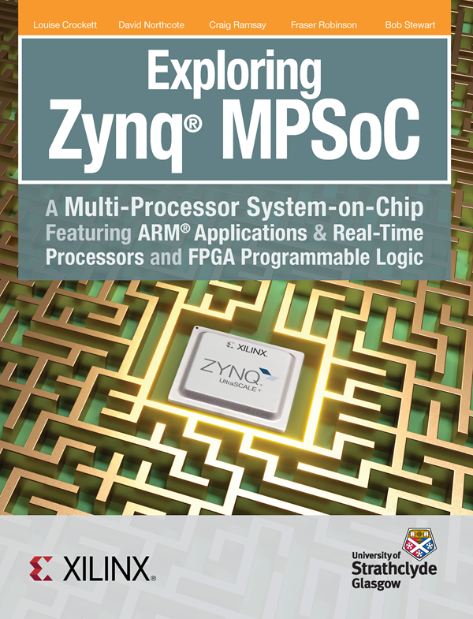
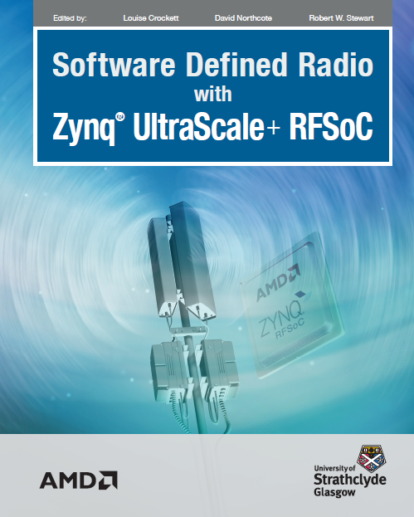
Book Development…
With Xilinx then AMD:
The Zynq Book (2014)
  The Zynq Book Tutorials
  The Zynq Book Chinese Edition
Exploring Zynq MPSoC (2019)
Software Defined Radio with Zynq UltraScale+ RFSoC (2023)
Also:
Software Defined Radio with MATLAB, Simulink and the RTL-SDR (2015)

Slide 5
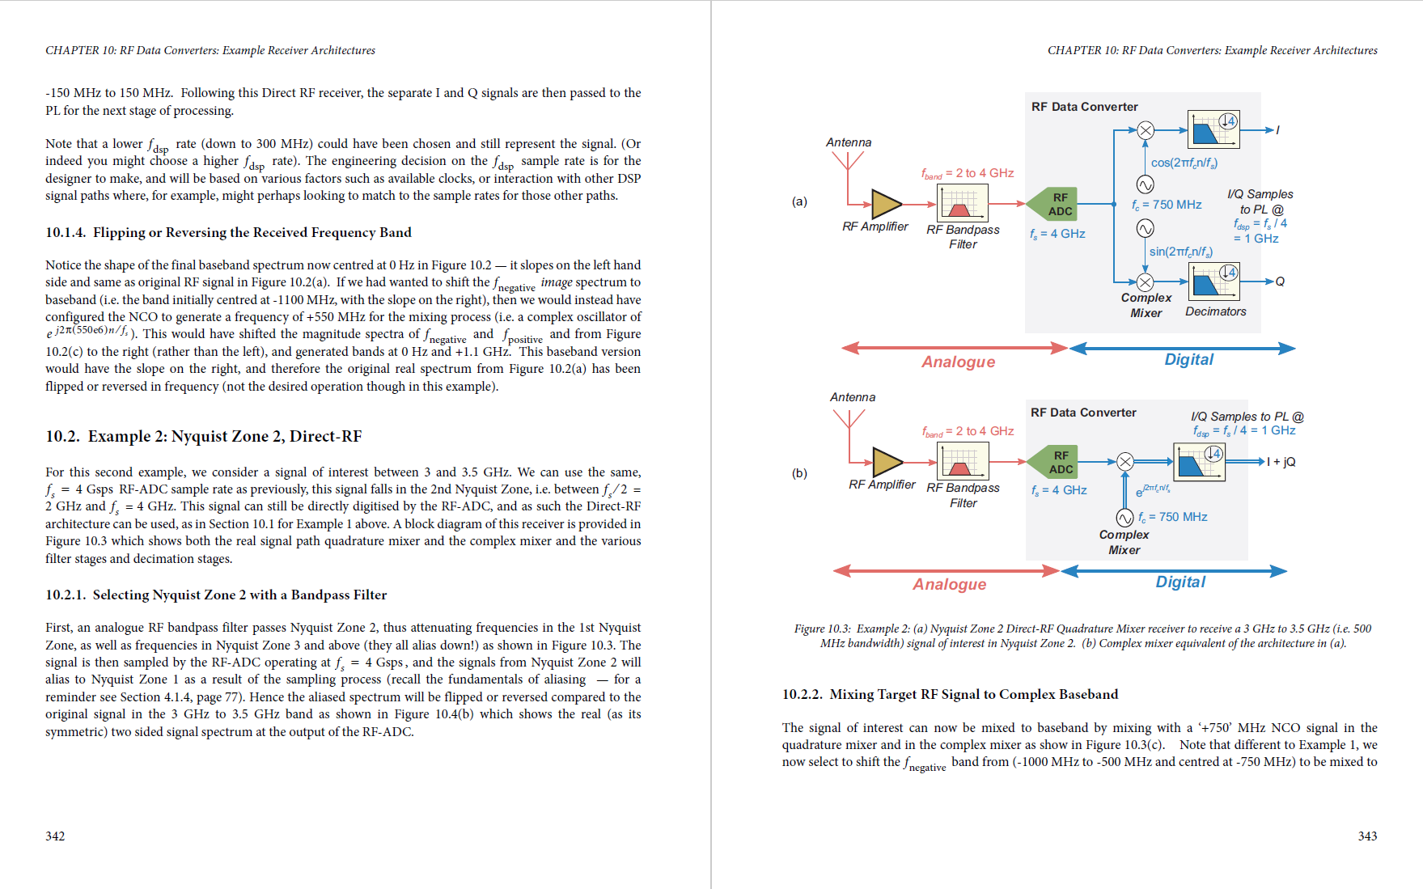
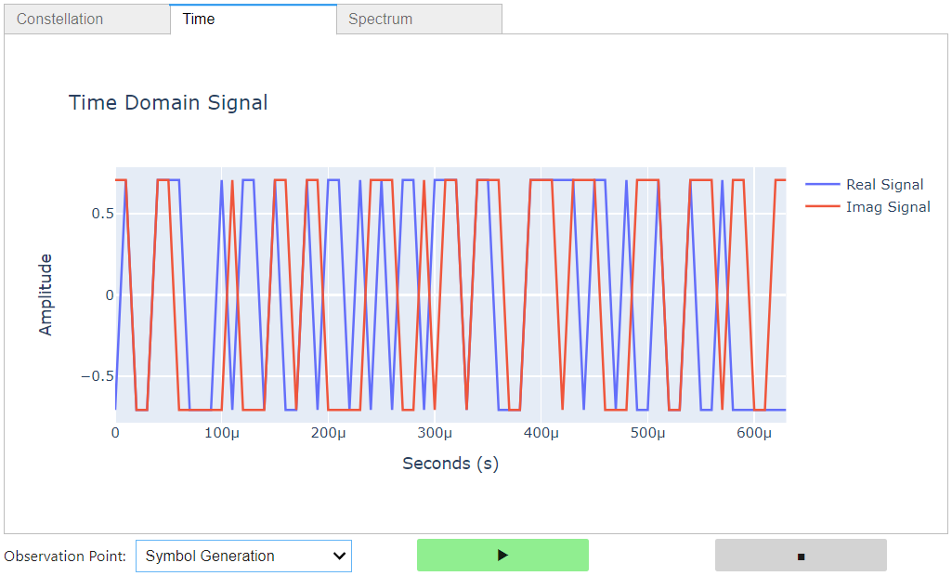
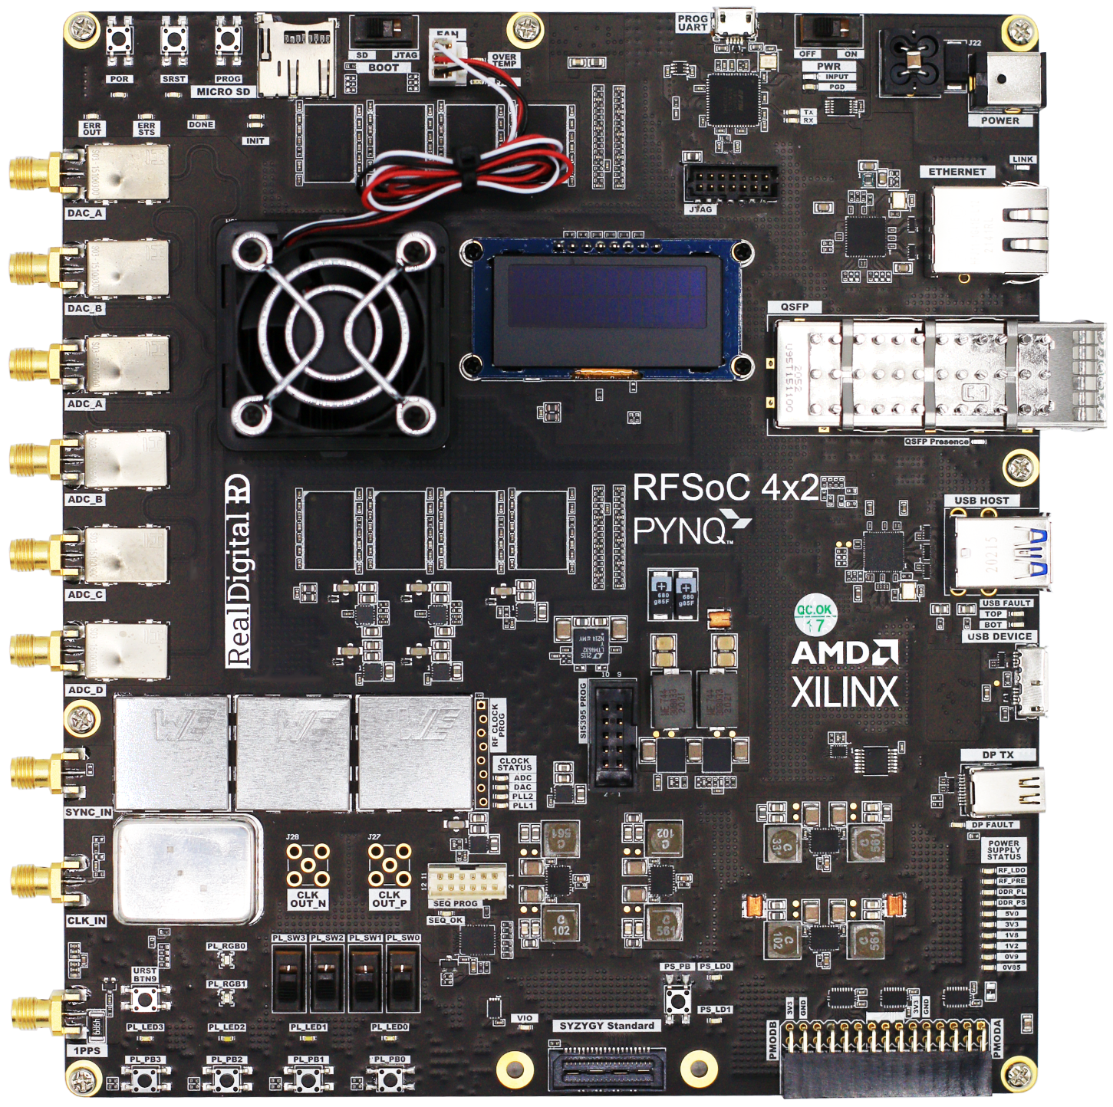
RFSoC Learning and Development Resources
For anyone interested in Zynq RFSoC and SDR implementation, we have recently published a book on this topic with AMD.
The book is available as a free PDF download as well as in hardback and softback from Amazon and other retailers.
It is accompanied by a GitHub repository with Jupyter notebook tutorials, examples, and open-source reference designs for supported development boards, including:
  Signal processing and comms principles
  Radio transmitter and receiver designs
  Frequency planning
  Forward error correction … and more.
www.rfsocbook.com

Slide 6
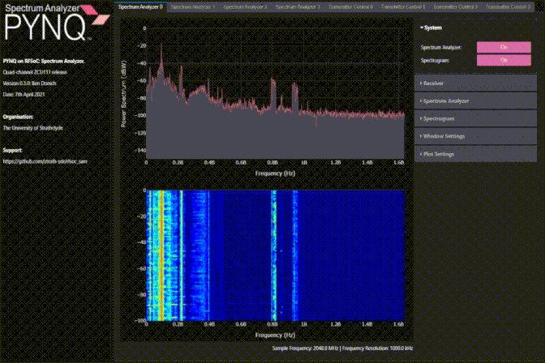

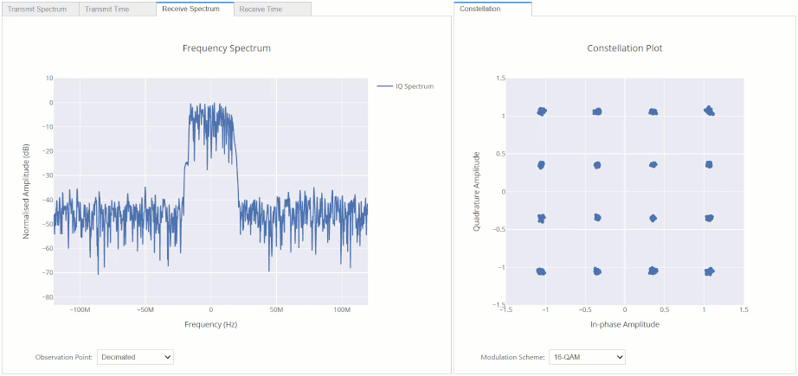
Open source examples
Open Source PYNQ Spectrum Analyzer
https://github.com/strath-sdr/rfsoc_sam
Open Source RFSoC OFDM Transceiver
https://github.com/strath-sdr/rfsoc_ofdm
Notes:
Processing such data rates locally in real-time can be challenging.
For applications like machine learning algorithms for cognitive radio, and spectrum monitoring, it is often necessary to offload the collected data to a robust server for processing and analysis.

Slide 7
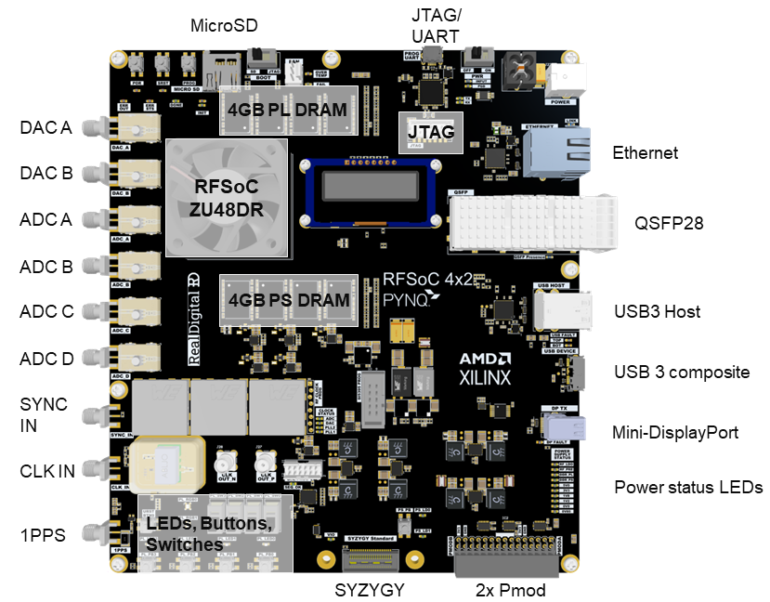
RFSoC 4x2 platform
RF Digital to Analog Converters (RF-DACs)
  2x
  14-bit
  9.85 GSPS
RF Analog to Digital Converters (RF-ADCs)
  4x
  14-bit
  5 GSPS
100Gbit/s QSFP network interface
64-bit Quad core Arm CPU running PYNQ Linux
Programmable Logic (PL / FPGA)
Supported by PYNQ open-source framework with Python & Jupyter notebooks
RFSoC 4x2 http://www.rfsoc-pynq.io/rfsoc_4x2_overview.html
Notes:
A high-level productivity language (Python in this case)
FPGA overlays with extensive APIs exposed as Python libraries
A web-based architecture served from the embedded processors, and
The Jupyter Notebook framework deployed in an embedded context

Slide 8
RFSoC offload
Modern Software Defined Radio (SDR) systems are capable of multi-gigabit-per-second sampling rates, generating massive amounts of digitized RF data.
It is often necessary to offload the collected data to a robust server for processing and analysis
  Spectrum monitoring
  Disaggregated radio
  Machine learning
  Test equipment
We present an RFSoC offload design capable of 80GBit/s offload in a 100GBit/s network channel with minimum latency.
  0 to 2,457.6MHz & 2,457.6MHz to 4915.2MHz Fc
  Runtime configurable bandwidth

Slide 9
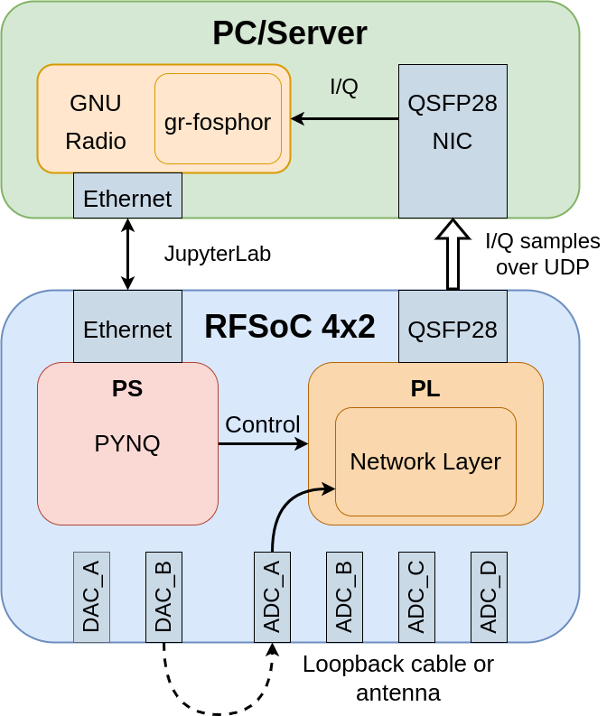
RFSoC Offload Hardware Setup Overview
RFSoC 4x2 board samples RF spectrum from an antenna or via a loopback cable.
I/Q samples are sent over a 100Gbit network to a PC equipped with a QSFP Network Interface Card (NIC).
GNU Radio with gr-fosphor is utilized for Graphics Processing Unit (GPU) accelerated, real-time spectrum plotting.
An Ethernet connection is used to access a JupyterLab interface running on the board and remotely control the RF-DC parameters.
Design overview diagram.

Slide 10
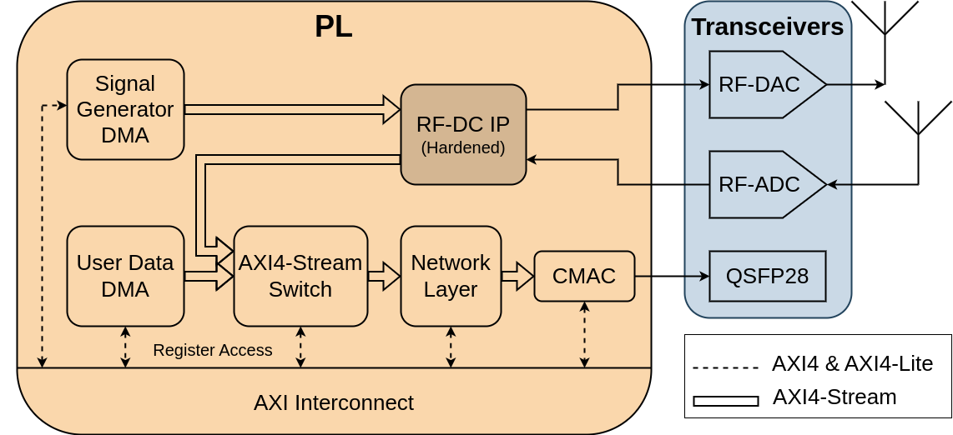
Hardware Architecture
The high-speed network architecture is implemented entirely on the Programmable Logic (PL), enabling maximum network bandwidth and minimum latency.
Arbitrary test signals can be generated using Python and transmitted via the RF-DAC using the Signal Generator module.
Network layer can be driven by either the User Data Direct Memory Access (DMA) or RF-ADC source.
User Datagram Protocol (UDP) is used for data transfer over the QSFP28 network.
High level overview of the hardware system.
Notes:
CMAC IP - requires a no-charge licence, encapsulates the UltraScale+ Integrated 100G Ethernet Subsystem, and is used to provide Ethernet Media Access Controller (MAC), Physical Coding Sublayer (PCS) and Reed-Solomon Forward Error Correction (RS-FEC) functionality.
Network Layer kernel is a collection of HLS modules that implement the network layer functionality including:
translation between
Internet Protocol (IP)
Media Access Control (MAC) addresses
ping capability
UDP transport layer functionality
Minimal overhead, as it does not require establishing and maintaining a connection.
Prioritize low latency and can tolerate potential data loss.
Used for real-time streaming

Slide 11
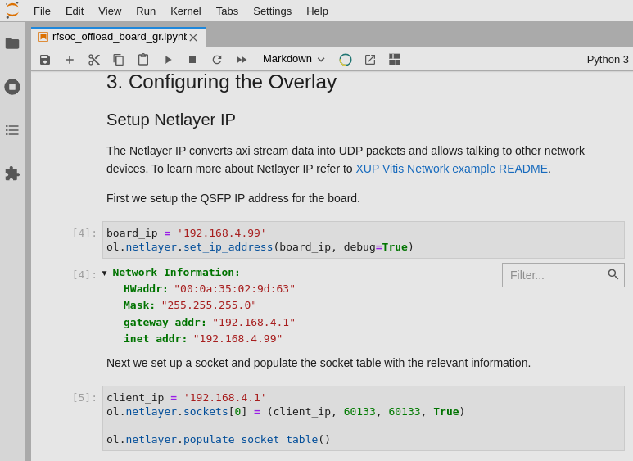
Software Architecture - Board
JupyterLab provides an interactive Python session for dynamic adjustment of software and hardware parameters.
PYNQ framework provides Python APIs for interacting with the Programmable Logic (PL), controlling parameters of the RF-ADCs, RF-DACs, and programming the internal reference clocks.
Custom network payloads and signals can be generated in Python and transmitted over the network or through RF-DAC.
JupyterLab interface

Slide 12
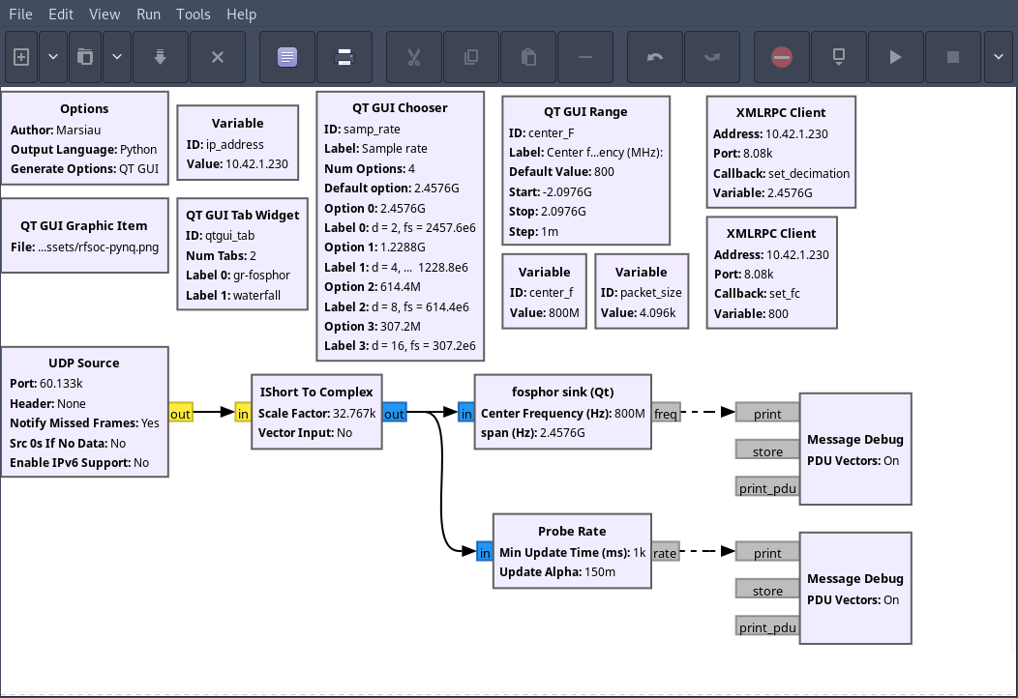
Software Architecture – GR Client
XMLRPC blocks enable adjustment of remote board parameters.
Variable Blocks are used to make the design parametric.
QT GUI Blocks facilitate the user input options.
Full GNU Radio flowgraph

Slide 13
PYNQ: How it works
MAC/WIN/Linux
Think Raspberry Pi + Programmable Logic
Users bring their FPGA designs
PYNQ provides everything you need to get started
  Ubuntu-based OS image
  Libraries, drivers, etc.
  Lots of compatible software
Run code on-target from a host web browser
Host
Browser
Ubuntu-based Arm64 OS
PYNQ
Jupyter
Python
Debian pkgs
Target Device
Linux Kernel
fpga
manager
uio
devmem
xrt
axi_intc
FPGA
PYNQ overlays
user designs
PYNQ IPs
Notes:
So how does PYNQ work then?
Simplifying this a bit, SoC devices are split between the Programmable Logic (PL), containing the FPGA, and the Processing System (PS), which contains an embedded Arm processor.
Users create custom hardware components (called IPs) and complete FPGA designs (called overlays), which users make using AMD EDA tools, such as Vitis and Vivado. These designs sit on the PL
PYNQ provides everything you need for the PS side, this includes an Ubuntu-based OS, with libraries, drivers, and lots of pre-installed software to get you started
The user can then interface with the device on a host machine within a standard web browser using the Jupyter IDE.
Now, to understand the updates we are making to PYNQ, it is important to note that, when users write and execute code from within Jupyter, they are actually writing and running this code from the Arm processor on the PS.

Slide 14
Introducing PYNQ.remote
Classic PYNQ
PYNQ.remote
MAC/WIN/Linux
MAC/WIN/Linux
Identical PYNQ UX
Minimal Petalinux image
PYNQ low-level functionality in C++
  PYNQ.cpp
Python API on the host
User interface remains the same!
Host
Jupyter
Browser
Browser
PYNQ Package
Python
gRPC
Ubuntu-based Arm64 OS
OS pkgs
PYNQ
Petalinux-based OS
Jupyter
Python
gRPC
PYNQ.cpp
Debian pkgs
meta-layers
Target Device
Linux Kernel
fpga
manager
uio
devmem
xrt
axi_intc
FPGA
PYNQ overlays
user designs
PYNQ IPs
Notes:
So following this feedback, we’re adding some new features to PYNQ, called PYNQ.remote
First off, the FPGA and kernel parts of PYNQ will remain the same.
However, we’re now reducing the operating system from an Ubuntu-based image to a Petalinux-based one.
To further reduce the on-target software, we’re rewriting the low-level API of PYNQ in C++, which we’re calling PYNQ.cpp.
This means that we’re now moving the Python side of PYNQ to the host. So users will now be running and executing PYNQ code from the host computer, as opposed to on the target device as before.
Because users still interact PYNQ’s Python API, the user interface remains the same. This means users can still use PYNQ in exactly the same way as before
Finally, I want to clarify here that classic PYNQ still exists. We’re just adding a new way of using PYNQ with PYNQ.remote and PYNQ.cpp

Slide 15
How PYNQ.remote Works: Protocol Buffers
Compact serialization format
  think JSON but smaller + faster
Define schemas for structured data
Protobuf compiler provides cross-language support
PYNQ.remote and PYNQ.cpp connect the APIs
Host
PYNQ APIs
gRPC client
*_grpc.py
*.proto
serialisation
Protobuf
Compiler
gRPC channel
Target
*_grpc.cc
PYNQ.cpp
gRPC server
Notes:
What makes gRPC language-agnostic is its use of Protocol buffers (or Protobufs)
Protobufs are a serialisation format. Kind of like JSON, but smaller and faster
You define schemas for your data structures using the .proto format.
The protobuf compiler then takes these schemas and compiles them into gRPC code in whatever your target language is.
For PYNQ.remote on the host this is Python, and for PYNQ.cpp on the target device it’s C++
We then bridge the gRPC code to the PYNQ Python libraries and PYNQ.cpp, which allows the host and target to communicate.

Slide 16
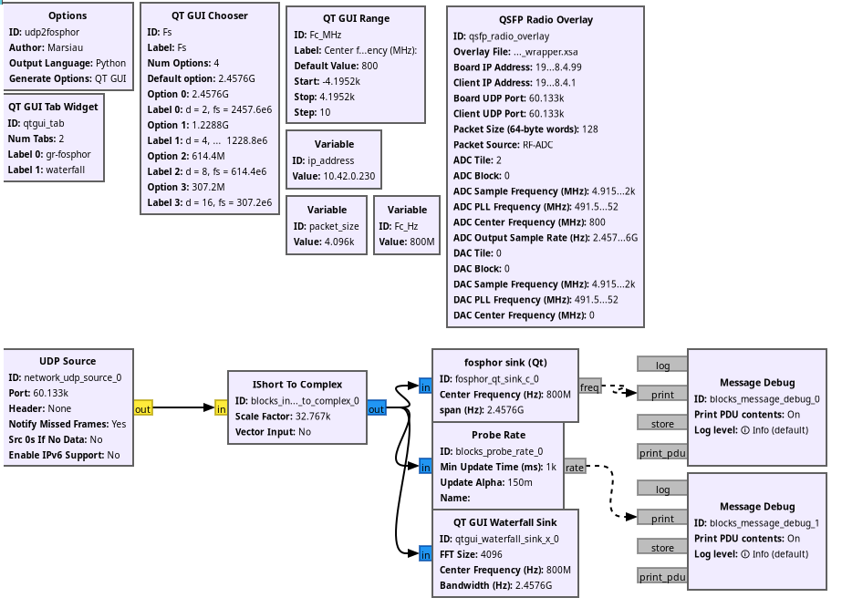
Updated GR flowgraph
Notes:
What makes gRPC language-agnostic is its use of Protocol buffers (or Protobufs)
Protobufs are a serialisation format. Kind of like JSON, but smaller and faster
You define schemas for your data structures using the .proto format.
The protobuf compiler then takes these schemas and compiles them into gRPC code in whatever your target language is.
For PYNQ.remote on the host this is Python, and for PYNQ.cpp on the target device it’s C++
We then bridge the gRPC code to the PYNQ Python libraries and PYNQ.cpp, which allows the host and target to communicate.

Slide 17
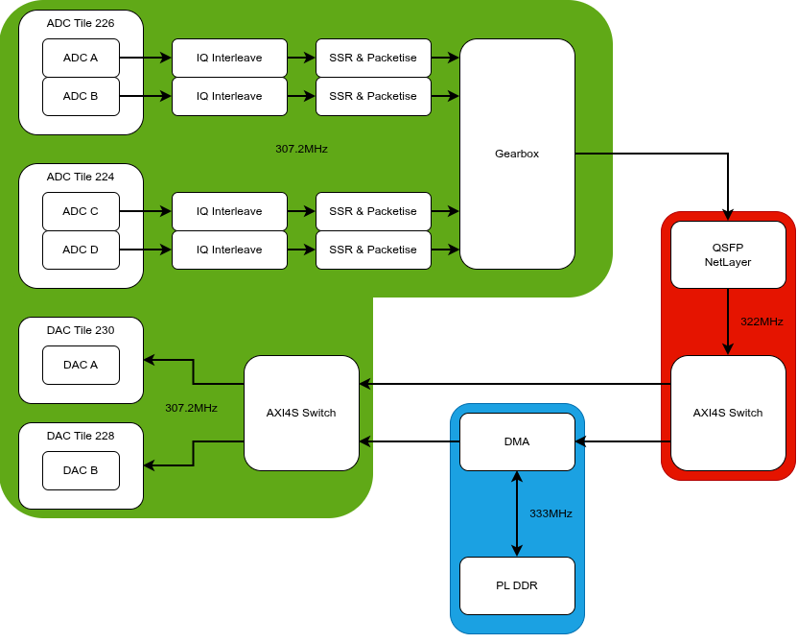
Updated Hardware Architecture
Notes:
CMAC IP - requires a no-charge licence, encapsulates the UltraScale+ Integrated 100G Ethernet Subsystem, and is used to provide Ethernet Media Access Controller (MAC), Physical Coding Sublayer (PCS) and Reed-Solomon Forward Error Correction (RS-FEC) functionality.
Network Layer kernel is a collection of HLS modules that implement the network layer functionality including:
translation between
Internet Protocol (IP)
Media Access Control (MAC) addresses
ping capability
UDP transport layer functionality
Minimal overhead, as it does not require establishing and maintaining a connection.
Prioritize low latency and can tolerate potential data loss.
Used for real-time streaming

Slide 18
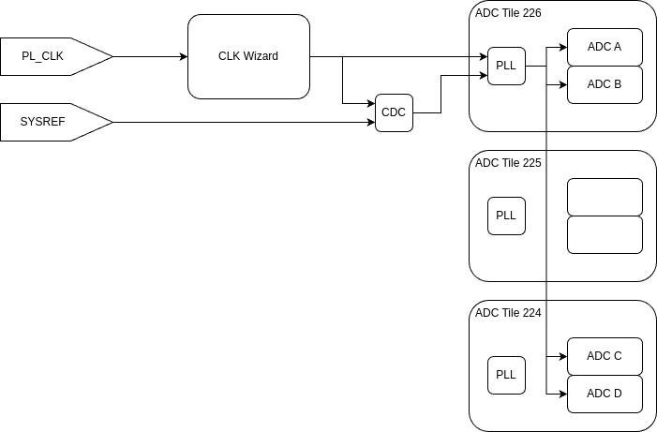
Multi Tile Sync (MTS)
PL_CLK & SYSREF from TI LMK04828
PL_CLK is used as PLL reference
SYSREF for phase synchronization
Tile 225 required to pass the CLK
DAC subsystem follows the same rules
Notes:
CMAC IP - requires a no-charge licence, encapsulates the UltraScale+ Integrated 100G Ethernet Subsystem, and is used to provide Ethernet Media Access Controller (MAC), Physical Coding Sublayer (PCS) and Reed-Solomon Forward Error Correction (RS-FEC) functionality.
Network Layer kernel is a collection of HLS modules that implement the network layer functionality including:
translation between
Internet Protocol (IP)
Media Access Control (MAC) addresses
ping capability
UDP transport layer functionality
Minimal overhead, as it does not require establishing and maintaining a connection.
Prioritize low latency and can tolerate potential data loss.
Used for real-time streaming

Slide 19
Network Throughput Test Results
To maximize network throughput, Jumbo Frames (up to 9000 bytes of payload) are enabled in the network.
Experimental results closely align with the calculated ideal throughput.
RF-ADC data output rate is calculated using:
RRF−ADC = B × C × Q
  B is the bandwidth (RF-ADC sampling rate)
  C is channels (2 for complex data)
  Q is the RF-ADC resolution (14 bits with 2-bit padding, total 16 bits)
Decimation | Bandwidth (MHz) | RF-ADC Data Output Rate (GBit/s) | Measured Avg. Throughput (GBit/s)
2 | 2,457.6 | 78.6432 | 73.40
4 | 1,228.8 | 39.3216 | 36.81
8 | 614.4 | 19.6608 | 18.41
16 | 307.2 | 9.8304 | 9.20
Notes:
around 6% of the incoming packets are dropped when 2457.6MHz bandwidth is selected, due to the receiving system being unable to keep up with the traffic.
The relatively small error between the experimental results and calculated throughput could be related to:
packet forming latency
UDP network overhead
PCIe lane throughput limitations of the client PC
this indicates the limits of the current design's performance

Slide 20
Additional rates
DDC | Fs(MHz) | x1 Gbits/s | x2 Gbits/s | x4 Gbits/s
1 | 4915.2 | 146.48 | 292.97 | 585.94
2 | 2457.6 | 78.64 | 157.29 | 314.57
4 | 1228.8 | 39.32 | 78.64 | 157.29
6 | 819.2 | 26.21 | 52.43 | 104.86
8 | 614.4 | 19.66 | 39.32 | 78.64
10 | 491.52 | 15.73 | 31.46 | 62.91
12 | 409.6 | 13.11 | 26.21 | 52.43
16 | 307.2 | 9.83 | 19.66 | 39.32
20 | 245.76 | 7.86 | 15.73 | 31.46
24 | 204.8 | 6.55 | 13.11 | 26.21
40 | 122.88 | 3.93 | 7.86 | 15.73
Decimation | Bandwidth (MHz) | RF-ADC Data Output Rate (GBit/s)
2 | 2,457.6 | 78.643
4 | 1,228.8 | 39.322
8 | 614.4 | 19.661
16 | 307.2 | 9.83
Notes:
CMAC IP - requires a no-charge licence, encapsulates the UltraScale+ Integrated 100G Ethernet Subsystem, and is used to provide Ethernet Media Access Controller (MAC), Physical Coding Sublayer (PCS) and Reed-Solomon Forward Error Correction (RS-FEC) functionality.
Network Layer kernel is a collection of HLS modules that implement the network layer functionality including:
translation between
Internet Protocol (IP)
Media Access Control (MAC) addresses
ping capability
UDP transport layer functionality
Minimal overhead, as it does not require establishing and maintaining a connection.
Prioritize low latency and can tolerate potential data loss.
Used for real-time streaming

Slide 21
github.com/strath-sdr/rfsoc_qsfp_offload

