Slide 1


Cross-SDR Assessment for Spectrum Sensing
Parker Trzebunia, Wahab Khwaja, Ali Gurbuz

Slide 2
Motivation
Spectrum sensing and detection
RF data for intelligent systems
Reliable, cost-effective sensing supports wireless communication and other applications.
Demand for RF training data continues to grow.
- Dynamic spectrum access
- Passive UAV detection
- Modulation recognition
- Cognitive radio
- Enhanced radar
02

Slide 3
Problem formulation
Five commercial software-defined radios
Different datasheet specifications require different parameter profiles.
Comparison within each profile
Live-band detections, scan time, and false-detections
Profiles vary sampling rate and frequency band. Receiver front-end configurations remain fixed.
03

Slide 4
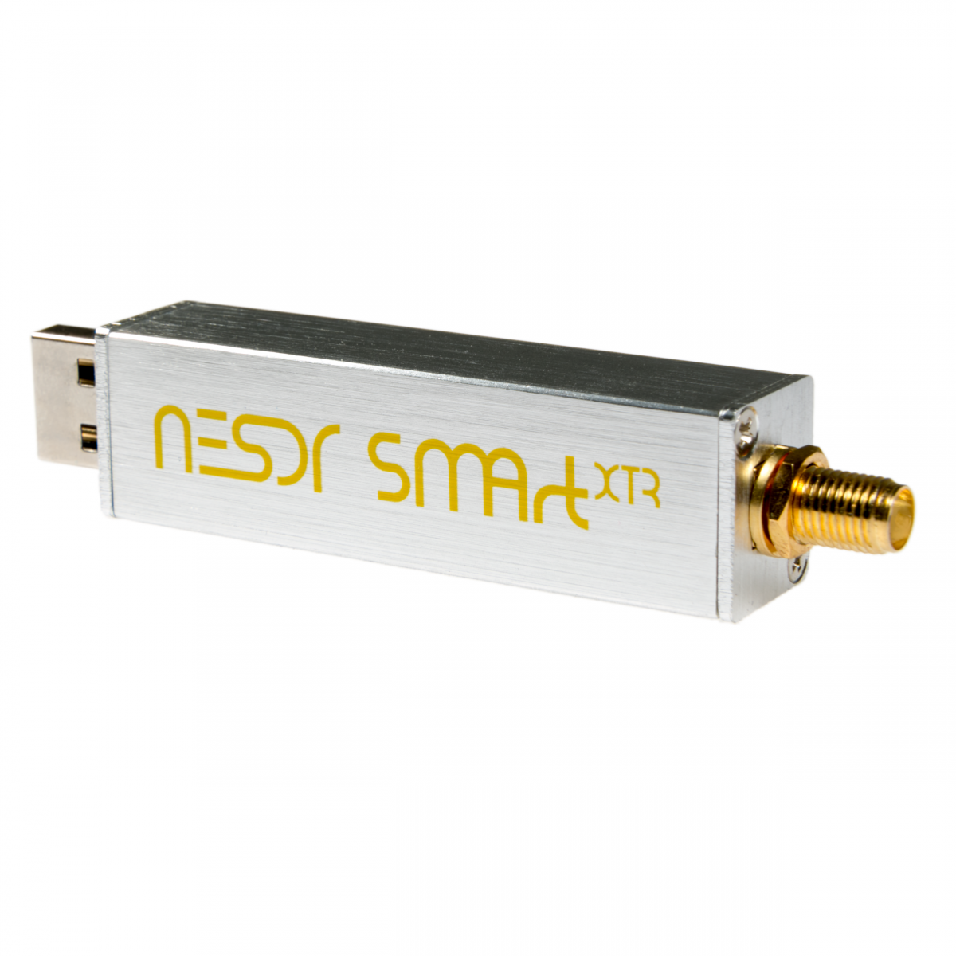
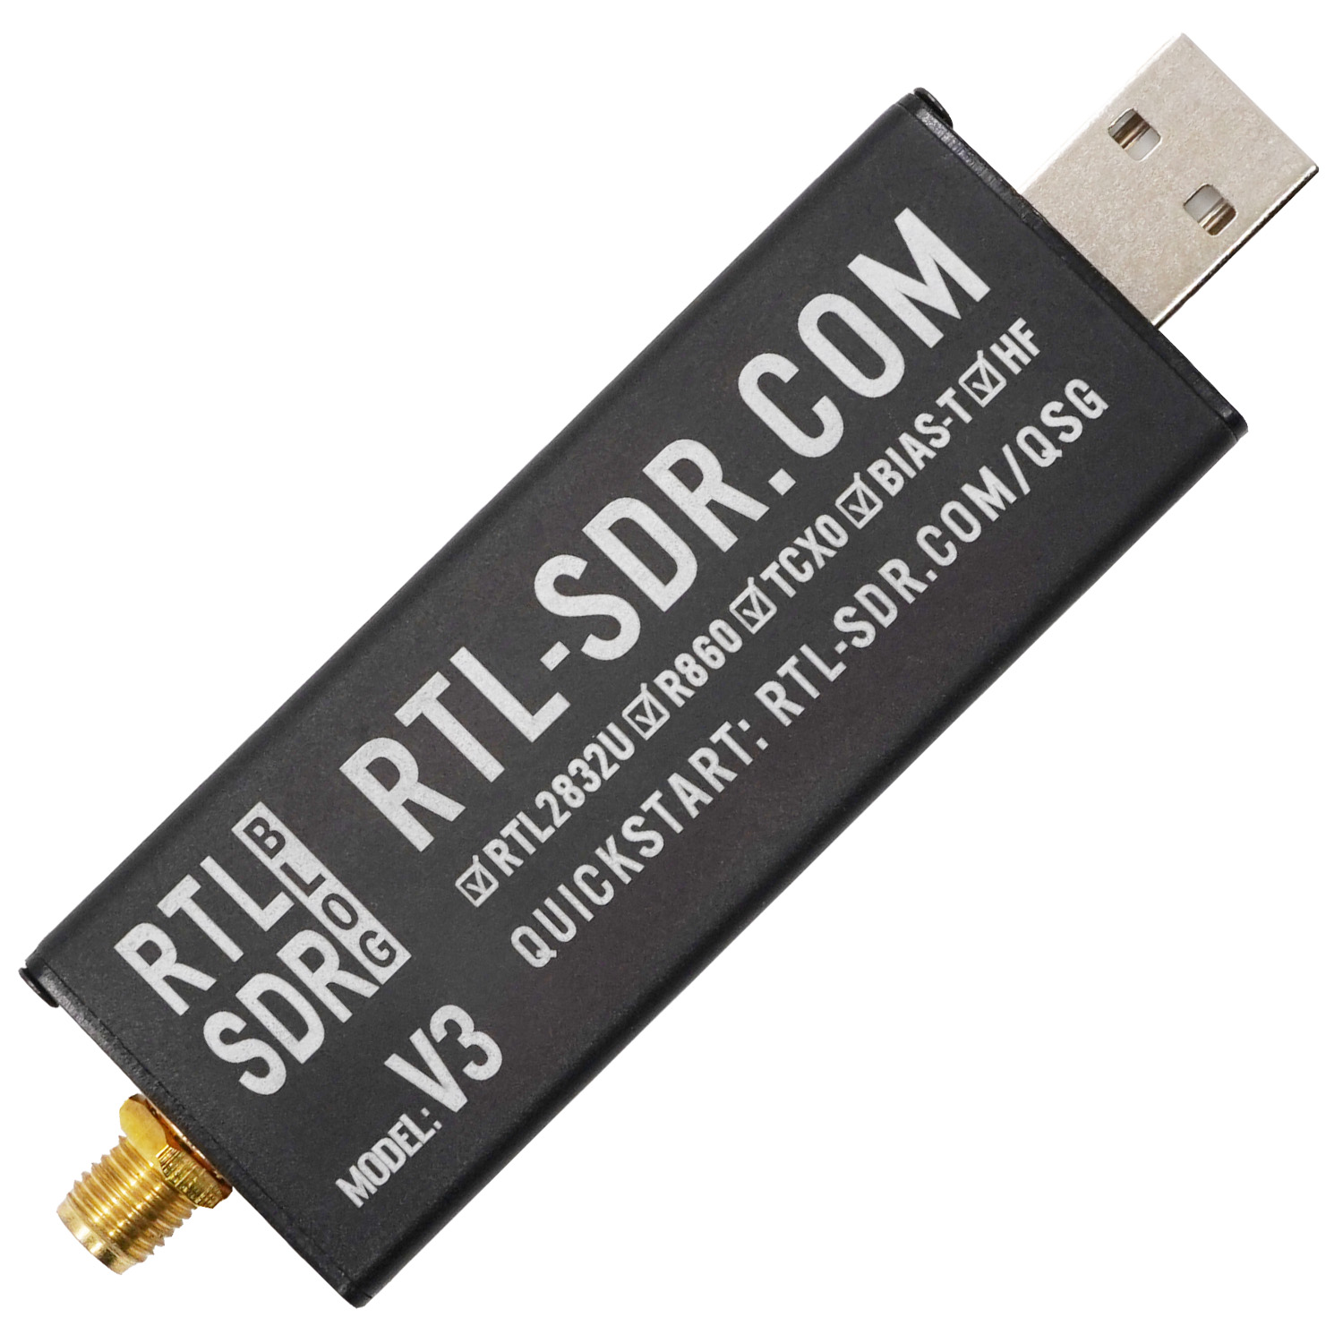
Hardware: small-scale SDRs
Maximum stable sampling rate: 2.4 MS/s
Nooelec NESDR SMArt XTR
RTL-SDR Blog V3
Tuning range to 55-2300 MHz
Tuning range to 0.5-1766 MHz
04

Slide 5
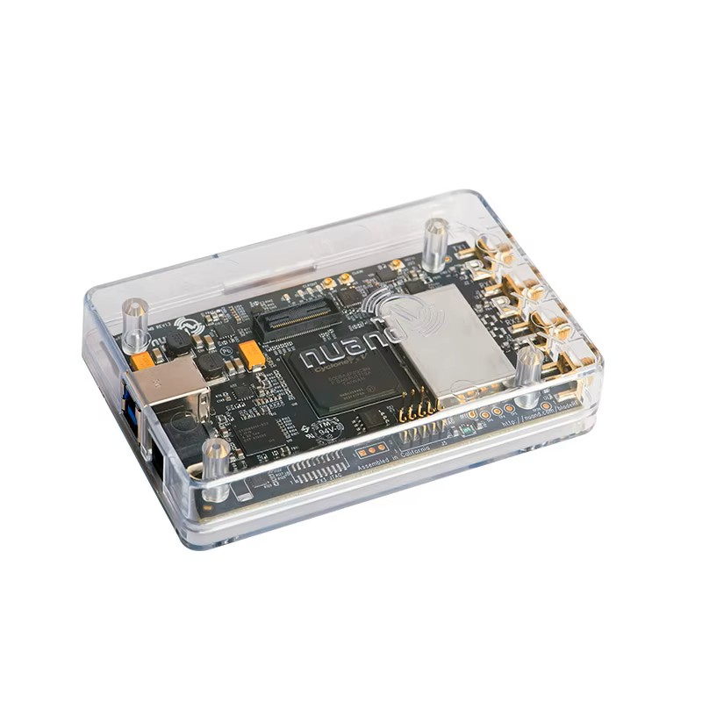
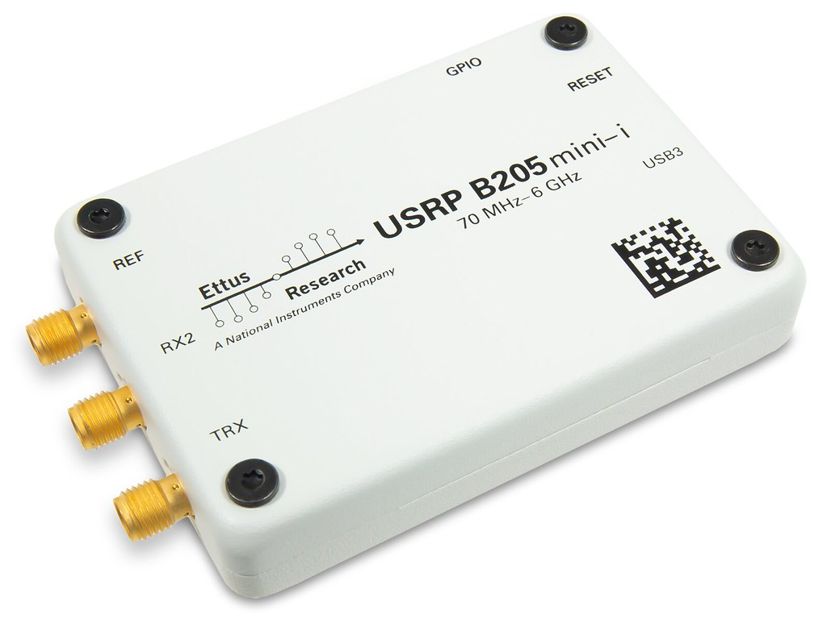
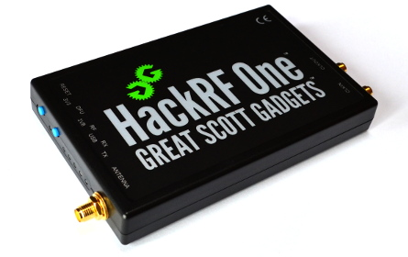
Hardware: wideband SDRs
Tuning range up to 6 GHz
GSG HackRF One
Ettus USRP B205mini
Nuand bladeRF 2.0 Micro xA9
Max. 20 MS/s
Max. 61.44 MS/s
Max. 61.44 MS/s
05

Slide 6
Profile selection
RTL-SDR V3 and SMArt XTR
Limited frequency range and maximum sampling rate
HackRF One and bladeRF xA9
Lower sampling rates pose challenges due to analog-to-digital converter and bandpass filter limitations.
B205mini
Shared reference for the other four SDRs, with low and high sampling rates and a wide frequency range
06

Slide 7
Measurement profiles
Center-frequency range | Sampling rate | Subband bandwidth | Participating SDRs
902—928 MHz | 2.4 MS/s | 2 MHz | B205mini RTL-SDR V3 SMArt XTR
902—928 MHz | 10 MS/s | 5 MHz | B205mini HackRF One bladeRF xA9
2402—2480 MHz | 10 MS/s | 5 MHz | B205mini HackRF One bladeRF xA9
07

Slide 8
Sensing & detection framework
Wideband sensing through sequential scanning of subbands
Processing chain
Windowing, FFT, frequency response normalization,
energy detection, and subband stitching
Detector settings
Settling after retune
N = 1024 Pf = 10⁻⁵
0–30 ms between the five receivers
08

Slide 9
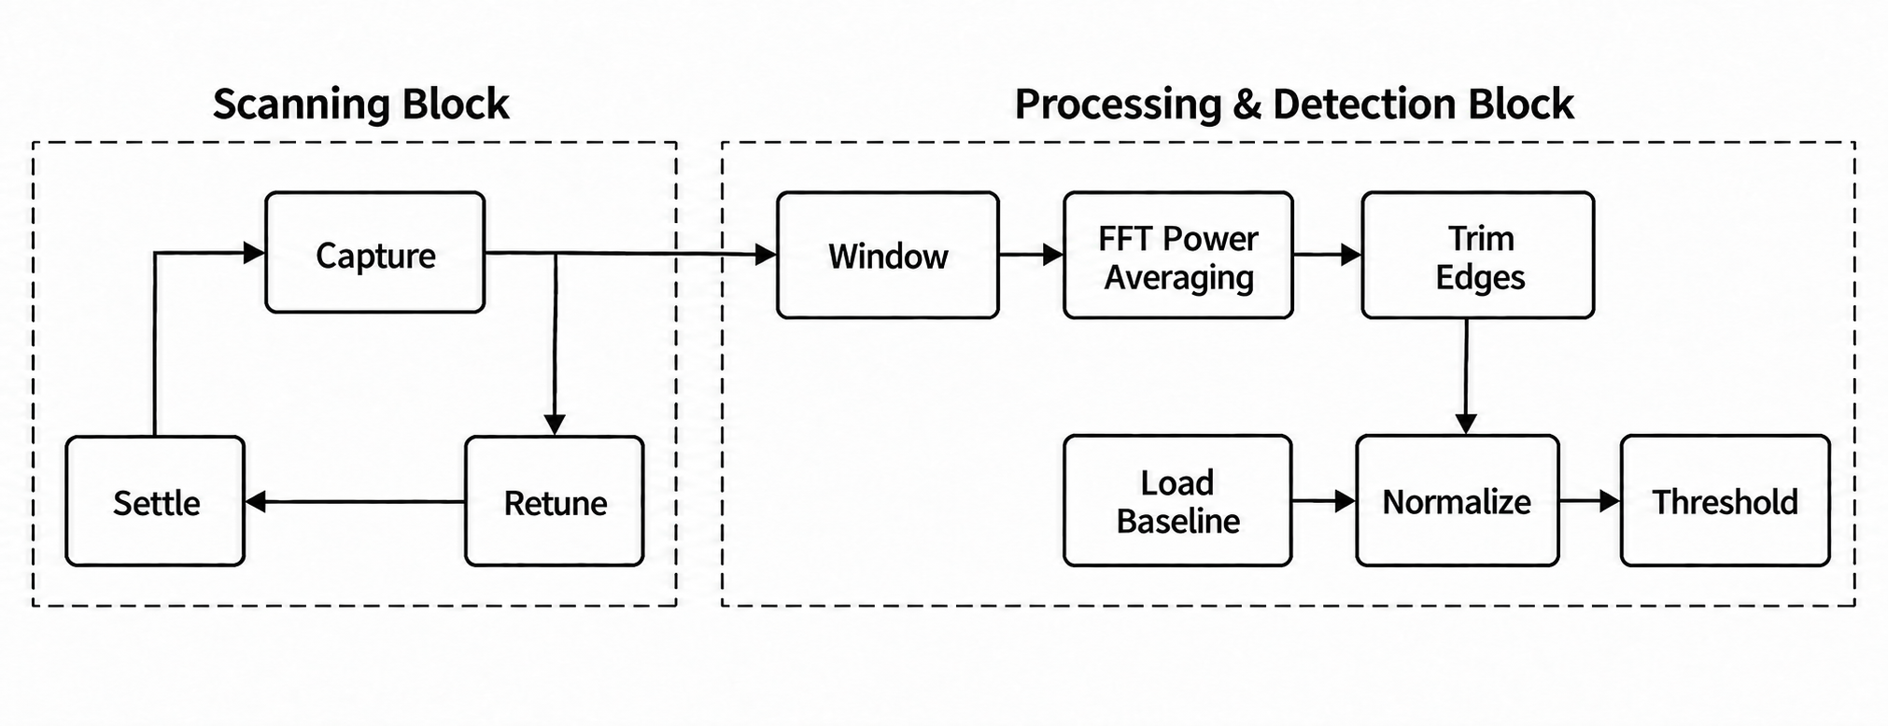
Scanning & processing workflow
09

Slide 10
Detection performance
Live-band observations
Across the trials, all SDRs detect nearly 100% of signals that can be visually distinguished from the noise floor.
Evaluation limits
No overall detection rule is yet implemented.
Detection probability is not numerically evaluated.
10

Slide 11
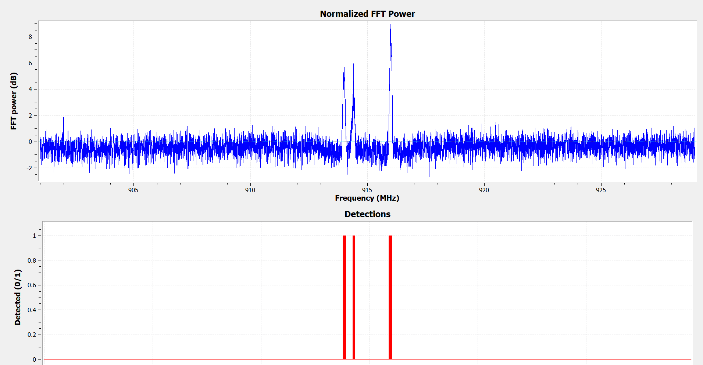
Detection in the 915 MHz ISM band
RTL-SDR V3 at 2.4 MS/s
11

Slide 12
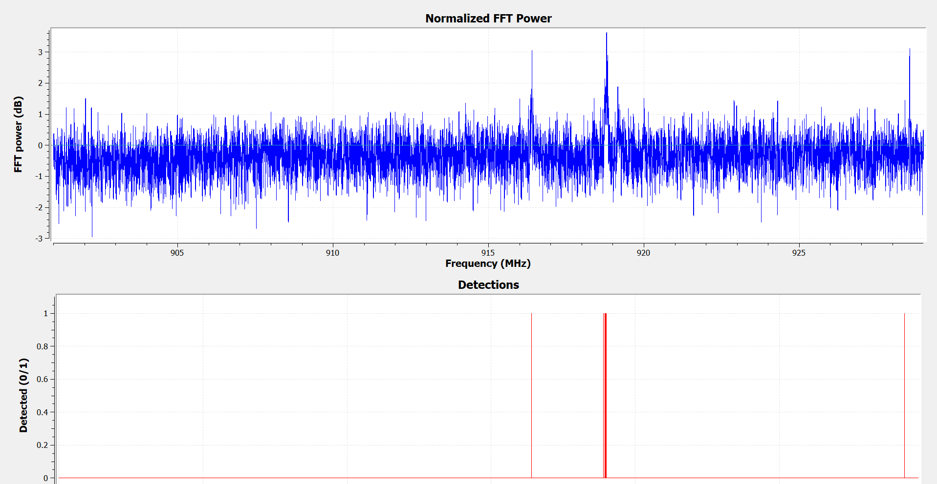
Detection near the noise floor
Robust to low-power spurs just 3 dB above baseline
12

Slide 13
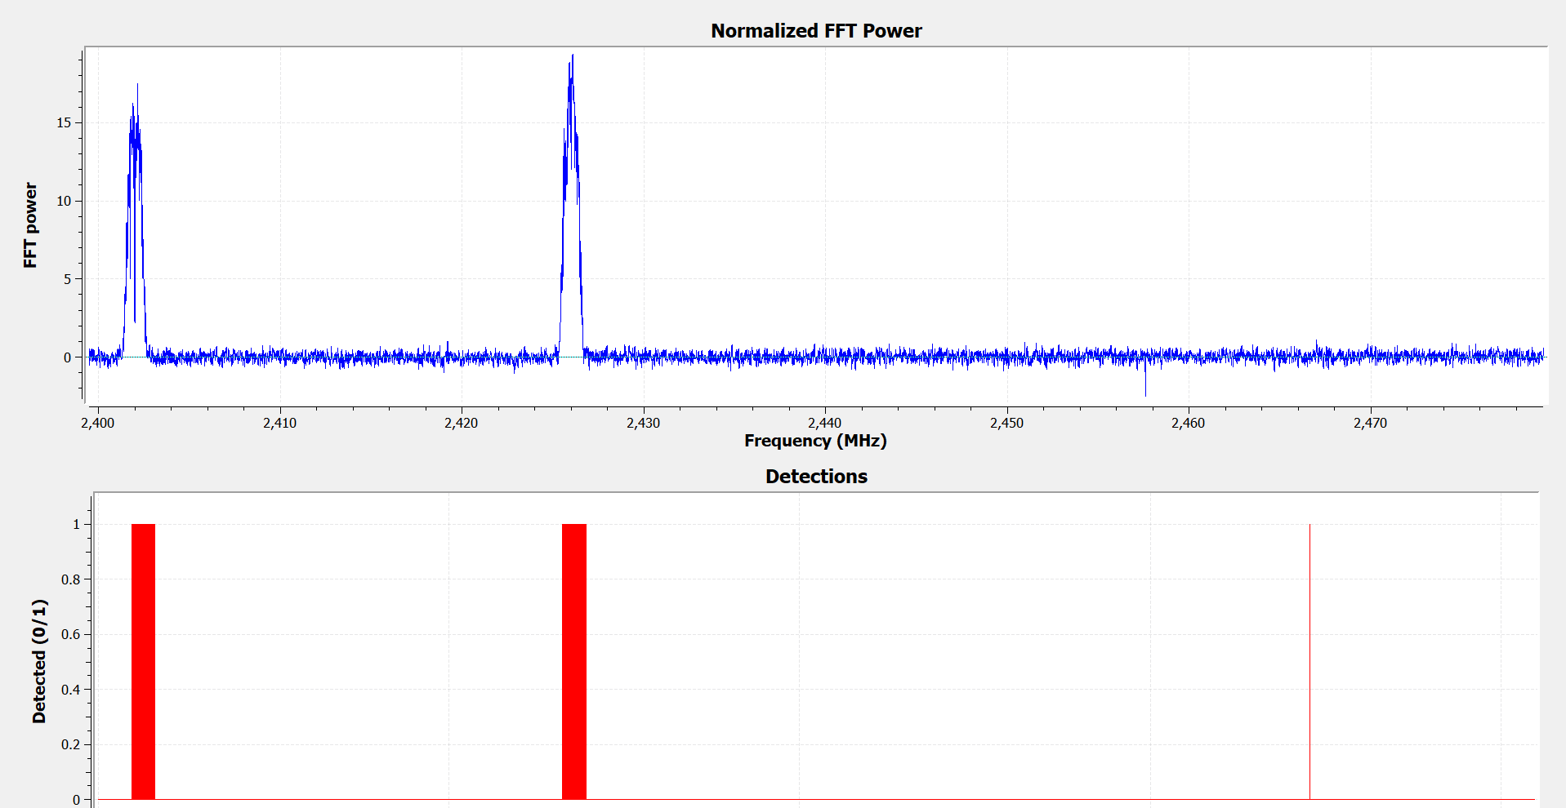
Detection in the 2.4 GHz Bluetooth band
bladeRF xA9 at 10 MS/s
13

Slide 14
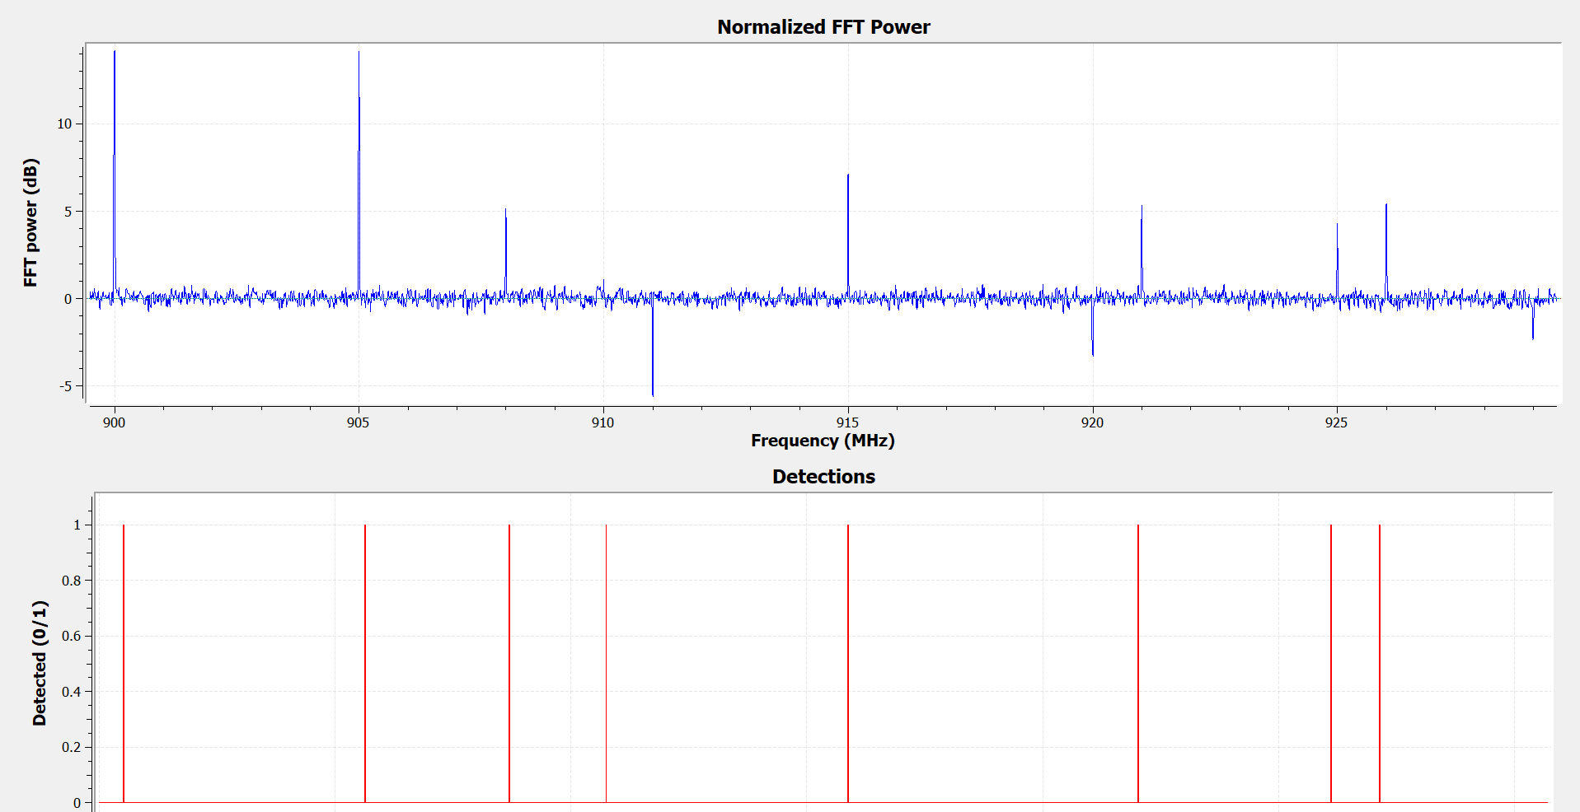
Receiver artifacts
HackRF One and SMArt XTR show stochastic artifacts. A few frequencies consistently trigger false detections, attributed to the local oscillator and other device harmonics.
14

Slide 15
Timing analysis
Receiver | Frequency range | Sampling rate | Total time (s) | Scan time (ms) | Detection time (ms)
RTL-SDR V3 | 902—928 MHz | 2.4 MS/s | 0.707 | 45.3 | 8.3
SMArt XTR | 902—928 MHz | 2.4 MS/s | 1.091 | 72.7 | 8.2
B205mini | 902—928 MHz | 2.4 MS/s | 1.038 | 73.5 | 11.9
HackRF One | 902—928 MHz | 10 MS/s | 0.480 | 77.5 | 16.3
bladeRF xA9 | 902—928 MHz | 10 MS/s | 0.522 | 82.7 | 16.9
B205mini | 902—928 MHz | 10 MS/s | 0.931 | 153.9 | 17.1
HackRF One | 2402—2480 MHz | 10 MS/s | 1.344 | 83.0 | 16.5
bladeRF xA9 | 2402—2480 MHz | 10 MS/s | 1.570 | 96.5 | 17.2
B205mini | 2402—2480 MHz | 10 MS/s | 2.223 | 138.4 | 18.3
15

Slide 16
False detections
Mean number of false detections per subband at 30 ms and 10 ms dwell times
Receiver | Sampling rate | Expected false detections | False detections 30 ms | False detections 10 ms
RTL-SDR V3 | 2.4 MS/s | 0.00852 | 0.0143 | 0.0143
SMArt XTR | 2.4 MS/s | 0.00852 | 6.7586 | 2.3329
B205mini | 2.4 MS/s | 0.00852 | 0.0743 | 0.0143
B205mini | 10 MS/s | 0.00512 | 0.0100 | 0.0100
HackRF One | 10 MS/s | 0.00512 | 1.9000 | 2.3100
bladeRF xA9 | 10 MS/s | 0.00512 | 0.0133 | 0.0233
The 2.4 GHz band was excluded because high-power signals leaked through the terminating cap.
16

Slide 17
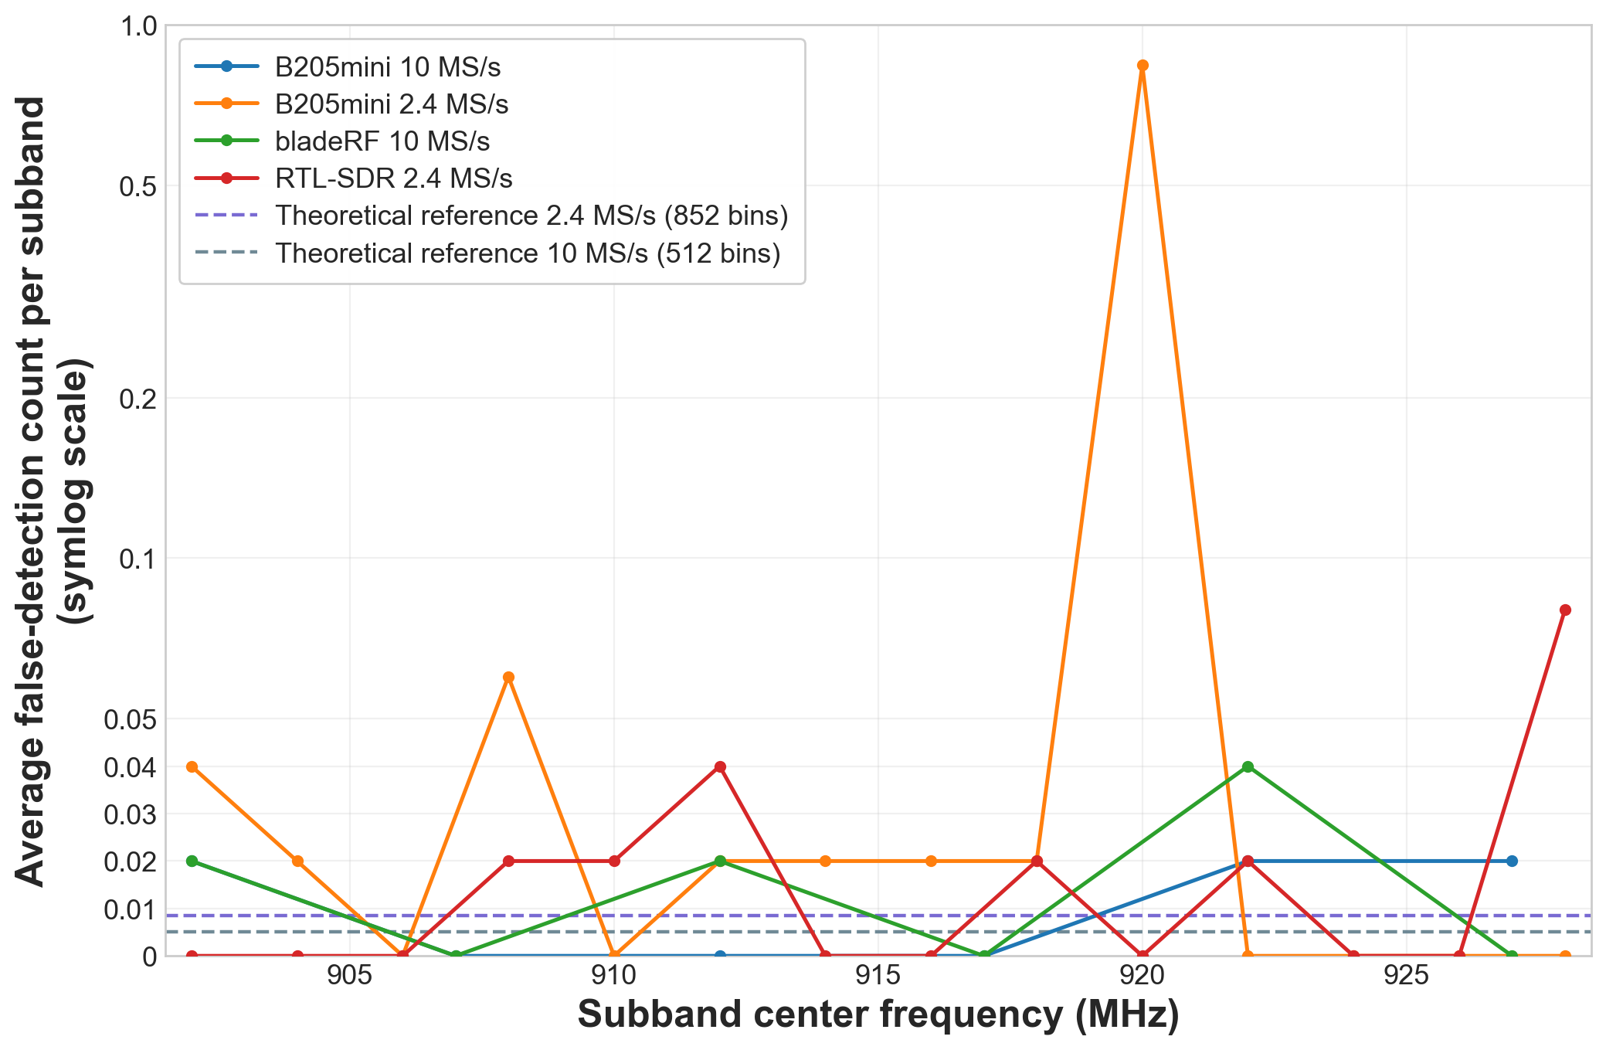
False detections by subband
17

Slide 18
Additional observations
RTL-SDR V3
Only receiver accurate with a 0 ms settling interval
HackRF One
Additional settling time observed only for the first subband after startup
NESDR SMArt XTR
Far less stable for detection, with many spurious tones and harmonics, despite sharing the RTL2832U demodulator with RTL-SDR V3
bladeRF
Relatively weak passband filtering prompted aggressive oversampling: 10 MS/s for 5 MHz windows
18

Slide 19
Concluding remarks
All five SDRs support simultaneous sensing and detection at resolutions as low as 10 ms with the tested sampling configurations.
B205mini, RTL-SDR, and bladeRF
Consistent baselines and clean scans
HackRF
Fastest scans of its bands, but robust detection requires correction for device artifacts
SMArt XTR
Greater instability from a highly stochastic receiver response
19

Slide 20
Further work
A robust overall detection rule for each subband
01
Group adjacent detected bins into one signal
02
Separate narrowband tones from random false detections
03
Recognize low-SNR signals with sparsely detected bins
20

