Slide 1



Detect, Extract, Recognize
Wideband RF Signal Detection and Modulation Recognition with Over-the-Air Validation
Sultan Mohammad Manjur, Wahab Ali Gulzar Khawaja, Cemre Omer Ayna, Ali Cafer Gurbuz
IMPRESS Lab, Department of Electrical & Computer Engineering
North Carolina State University
Koch Hall, 890 Oval Dr, Raleigh, NC 27606
{smanjur,wkhawaj,cayna,acgurbuz}@ncsu.edu
This work was supported by the National Science Foundation under Grant No. 2534621 and by the Laboratory for Analytic Sciences.

Slide 2

Presentation Flow
Motivation
2. Method
3. Evaluation
& Validation
4. Conclusion

Slide 3
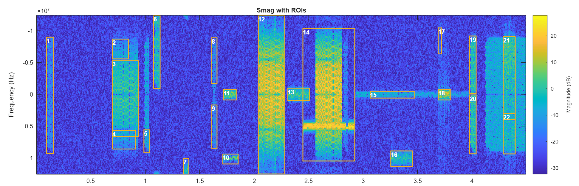
Motivation
1
Automatic Modulation Recognition (AMR) provides waveform-level characterization by identifying the modulation type or modulation family of an over-the-air (OTA) transmission.
AMR is an important component of RF spectrum sensing capability for signal identification, receiver configuration, interference analysis, and downstream demodulation.
Radio Dynamic Zone (RDZ): A dynamic spectrum-sharing environment or regime designed for flexible, automated spectrum management .

Slide 4
Motivation
2
Problem
Effective spectrum use requires sensing systems to determine the present signal’s type, along with its time, band, and frequency.
Most AMR frameworks assume that the signal of interest has already been detected and isolated.
Spectrum sharing is prone to detection and isolation errors, which can degrade downstream raw-I/Q classification accuracy.
Solution
Integrated wideband sensing pipeline for RF activity detection, signal extraction, and modulation recognition.
A class agnostic detection model to estimate temporal and spectral boundaries.
A lightweight one-dimensional classifier that learns modulation-dependent characteristics directly from I/Q samples.

Slide 5
Method
3
System Pipeline
RF Activity Detection
I/Q Signal Extraction
Modulation Recognition
Single-class YOLOv11 detector on STFT spectrogram images for detecting signal time-frequency bounding boxes.
Cropping, frequency translation to baseband, and zero-phase Butterworth filtering.
Lightweight 1D attention model (XCiT) with 57 complex I/Q waveform classes working in real time.

Slide 6
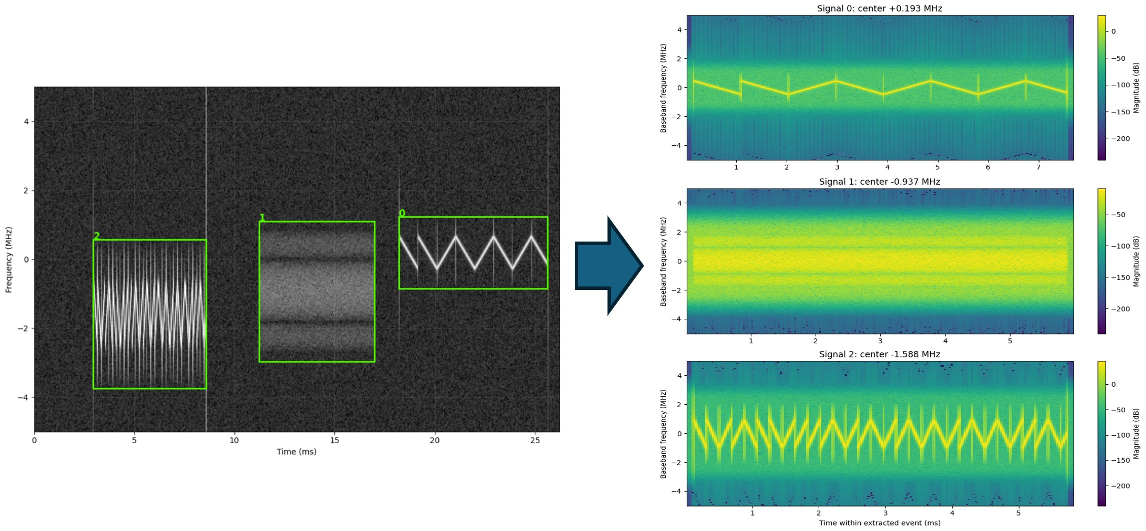
Method
4
Detection & Baseband Isolation
Bounding box dimensions yield center frequency, occupied bandwidth, and duration estimates.
Extracted complex I/Q is frequency shifted and filtered with a Butterworth filter to suppress out-of-band noise.
The detection dataset is wideband TorchSig observations across 0–30 dB SNR, containing 250,000 training samples, with 10,000 samples each for validation and testing.
Single-class YOLOv11 achieves 99.2% mAP@0.5
Sample I/Q signal extraction from a wideband observation using the detected time-frequency regions.

Slide 7
Method
5
1D Cross-Covariance Attention Network
Cross-Covariance Image Transformer (XCiT) is a lightweight one-dimensional attention-based architecture, chosen as the fine-grained modulation recognition model following the RF adaptation.
Cross-Covariance Attention (XCA) operates across feature channels rather than tokens, where the interactions are based on the cross-covariance matrix between keys and queries.
1D Convolutional embeddings (kernel 8, stride 4) convert 4,096 complex I/Q samples into a 192-dim sequence.
The resulting sequence is processed by 12 XCA blocks with four attention heads. Cross-covariance attention is applied across feature channels, combined with depthwise 1D Convolutional local patch interactions.
Modulation training dataset consists of 4096 complex I/Q samples generated at 10 MHz sampling rate. In total ~50M TorchSig realizations generated online with impairments such as Rayleigh fading, phase noise, clock drift, and I/Q imbalance.

Slide 8
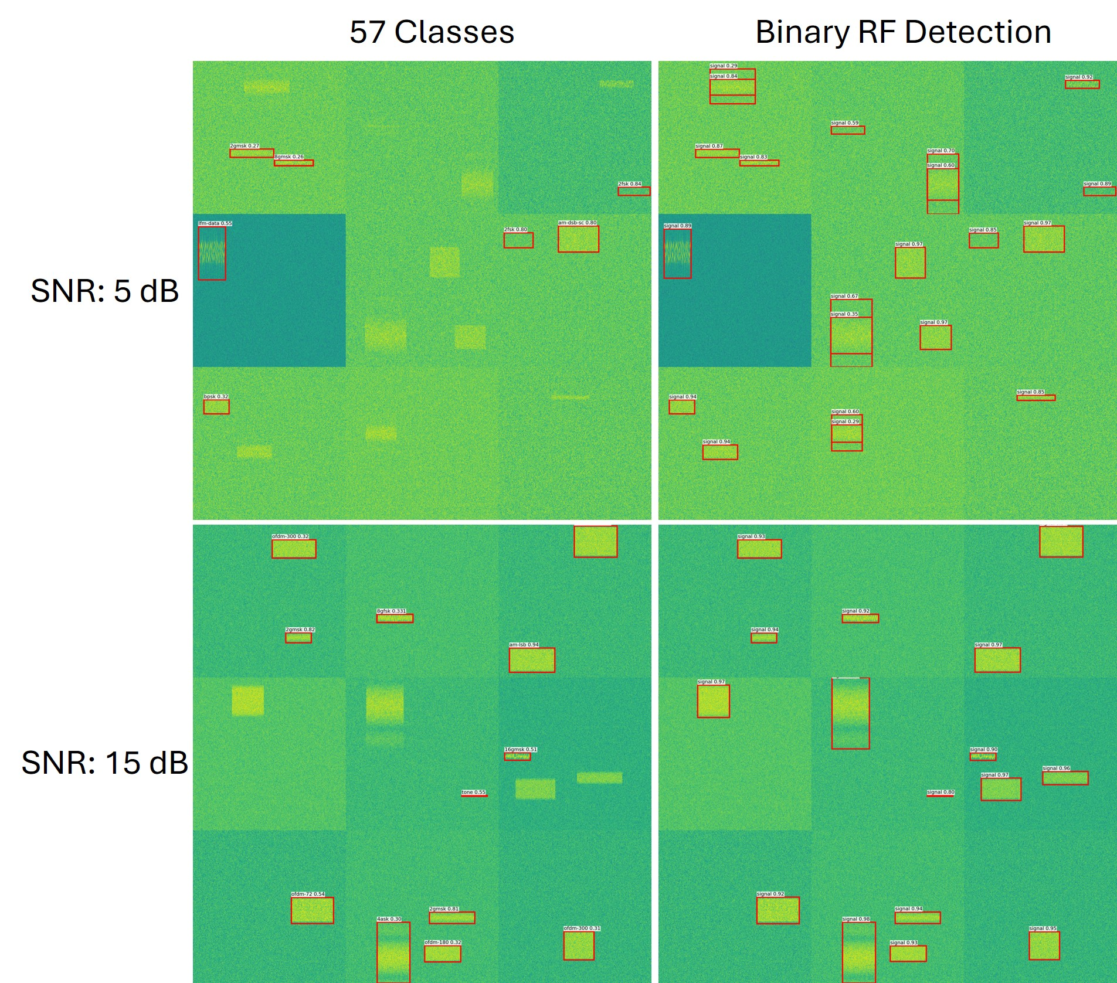
Method
6
SNR: 15 dB
SNR: 5 dB
Wideband STFT Detection Performance
Multi-class and single-class YOLOv11 models were trained and tested separately on the 10000 samples across 0-30 dB range.
Multi-class detector produces low-confidence predictions and fails to detect multiple signal instances,
The single-class detector identifies a larger number of the same signals with higher confidence. Single-class YOLOv11 achieves 99.2% mAP@0.5, compared to 58.8% mAP@0.5 for multi-class model.
Sample RF signal detection results with multi-class (top) and single-class (bottom) YOLOv11 detector

Slide 9
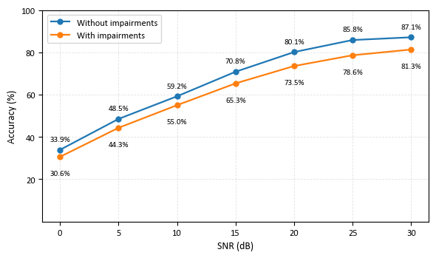
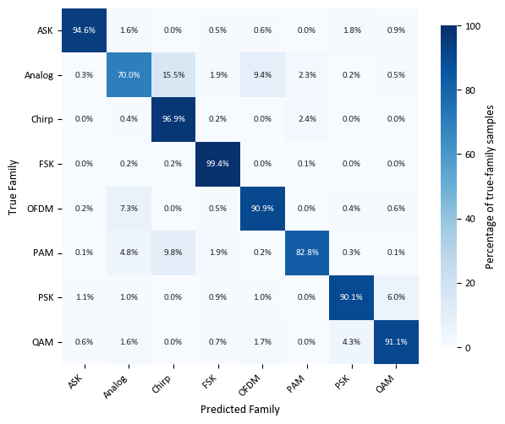
Evaluation & Validation
7
Simulated Data Classification Results
A total of 57 modulation and waveform classes were grouped into 8 families: ASK, Analog, Chirp, FSK, OFDM, PAM, PSK, and QAM.
The modulation-recognition stage was evaluated independently using the fixed test set of 114,000 unseen signals spanning the 57 waveform classes.
The overall 57-class top-1 fine-grained accuracy across the 0–30 dB SNR range is 62.1%, and family-level accuracy of approximately 92.0%.
Strong discrimination for families such as FSK and chirp-based waveforms, while relatively greater confusion remains for some analog and PAM signals.
Modulation classification accuracy across SNR levels with and without additional channel and impairments.
Modulation classification accuracy confusion matrix across the eight modulation families

Slide 10
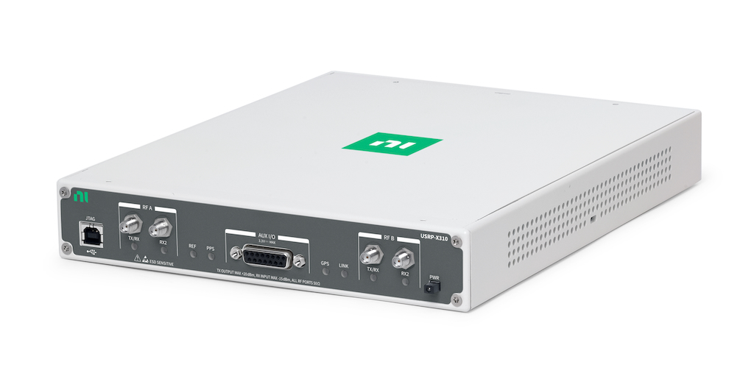
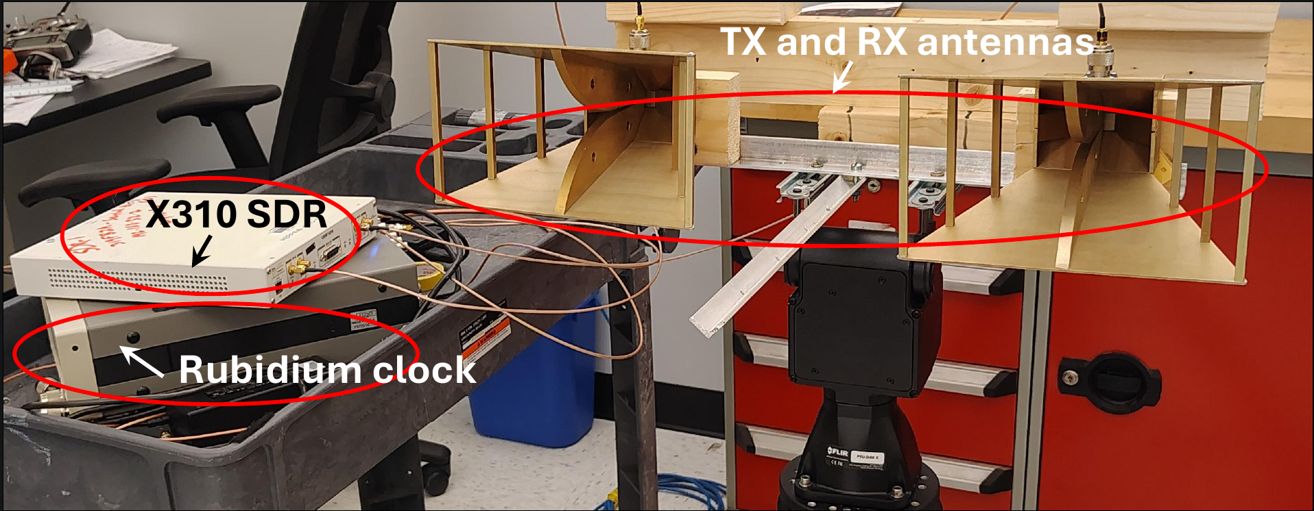
Evaluation & Validation
8
The AMR pipeline was further evaluated with RF signals physically transmitted and received through the SDR-based OTA setup.
Hardware: Ettus USRP X310 SDR.
Both TX and RX operated at a carrier frequency of 3.2 GHz and a sampling rate of 1 MS/s.
An external Rubidium frequency standard provided a 10 MHz reference and pulse-per-second signal to maintain frequency and timing coherence.
Double ridge horn antennas were used placed on a horizontal platform at a distance of 0.5 m apart.
The operating SNR was controlled by transmit and receive gains.
Over-the-Air Evaluation Setup

Slide 11
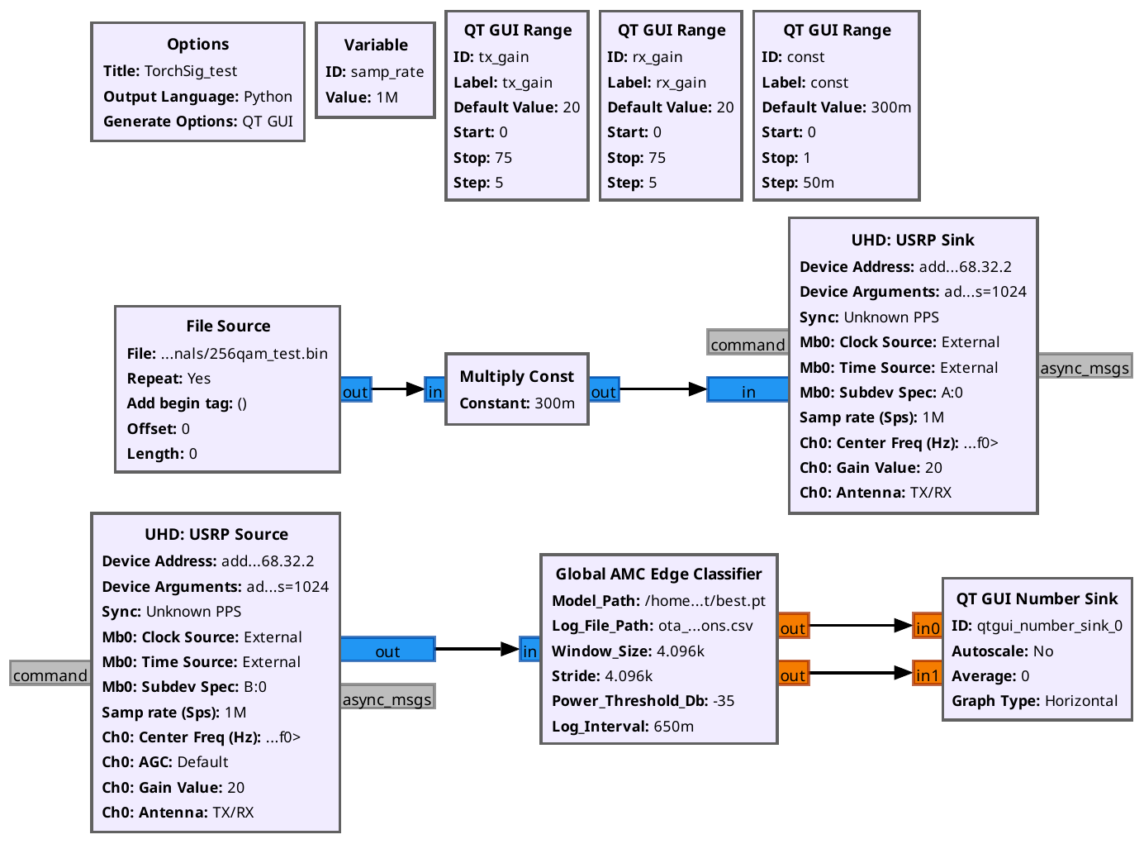
Evaluation & Validation
9
GNU Radio Flowgraph

Slide 12
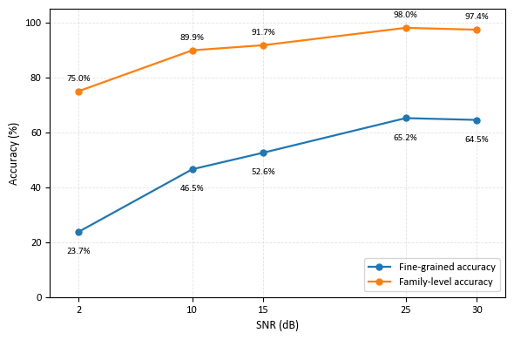
Evaluation & Validation
10
Over-the-Air Evaluation
The OTA evaluation includes 48 digital modulation classes at measured SNR levels of 2, 10, 15, 25, and 30 dB.
Fine-grained classification accuracy increases from 23.7% at 2 dB to
65.2% at 25 dB, while the corresponding family-level accuracy increases from 75.0% to 98.0%.
Fine-grained and family-level top-1 accuracy across SNR range.

Slide 13
Conclusion
11
Real-Time Wideband RF Sensing
A validated unified pipeline connecting time-frequency signal localization with efficient signal detection and modulation classification for real-world spectrum processing.
Unified Pipeline
Robust OTA Reception
Future Work
Eliminates unrealistic pre-isolation assumptions for signal AMR. The high family-level performance suggests a hierarchical recognition strategy may be beneficial.
Detection stage reliably identifies signal regions over a broad SNR range, the
AMR model provides strong discrimination at the broader modulation-family level.
Evaluating the AMR pipeline on outdoor environments with independent radios, longer links, and under more diverse channel, interference, and hardware conditions.

Slide 14
Thank you for listening!
Questions?

Slide 15
Bibliography
Johner, Glen, and Qiu, Jing. “Ultralytics YOLO v11”, URL: https://github.com/ultralytics/yolo11,
Boegner, Luke, Gulati, Manbir, Vanhoy, Garrett, Vallance, Phillip, Comar, Bradley, Kokalj-Filipovic, Silvija, Lennon, Craig, and Miller, Robert D. “Large scale radio frequency signal classification”, 2022a. URL: https://arxiv.org/abs/2207.09918
Boegner, Luke, Vanhoy, Garrett, Vallance, Phillip, Gulati, Manbir, Feitzinger, Dresden, Comar, Bradley, and Miller, Robert D. “Large scale radio frequency wideband
signal detection recognition”, 2022b. URL: https: //arxiv.org/abs/2211.10335
Ali, Alaaeldin, Touvron, Hugo, Caron, Mathilde, Bojanowski, Piotr, Douze, Matthijs, Joulin, Armand, Laptev, Ivan, Neverova, Natalia, Synnaeve, Gabriel, Ver-
beek, Jakob, et al. “Xcit: Cross-covariance image transformers”, Advances in neural information processing systems, 34:20014–20027, 2021.

Slide 16
Figure References
Source: Automated Labeling of Time-Frequency Regions for AI-Based Spectrum Sensing Applications, MATLAB.
https://www.mathworks.com/help/signal/ug/automated-labeling-of-time-frequency-regions-for-ai-based-spectrum-sensing-applications.html
Source: USRP X310, Ettus Research.
https://www.ettus.com/wp-content/uploads/2024/10/NI-Ettus-X310.jpeg

Slide 17
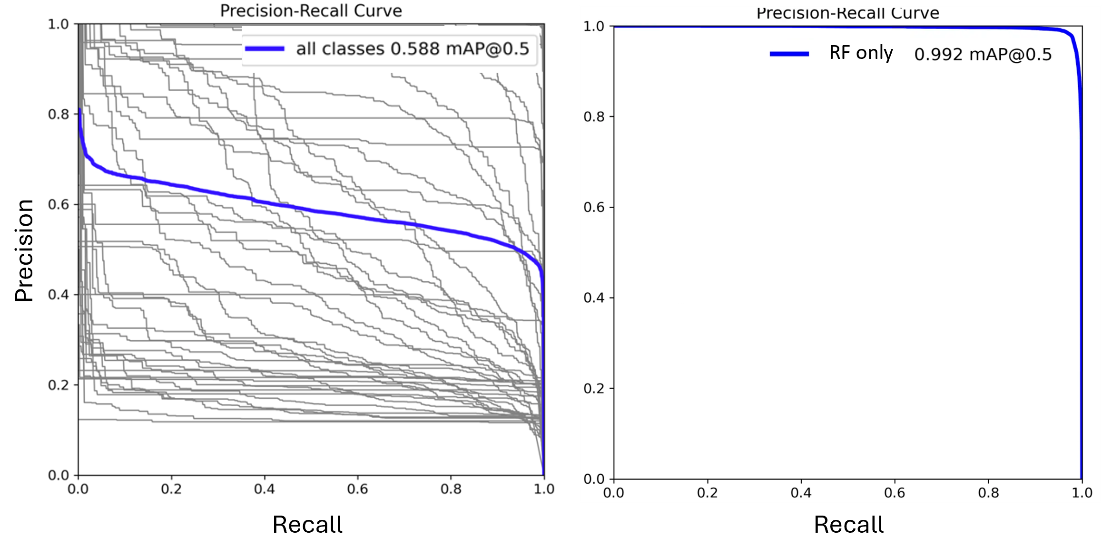
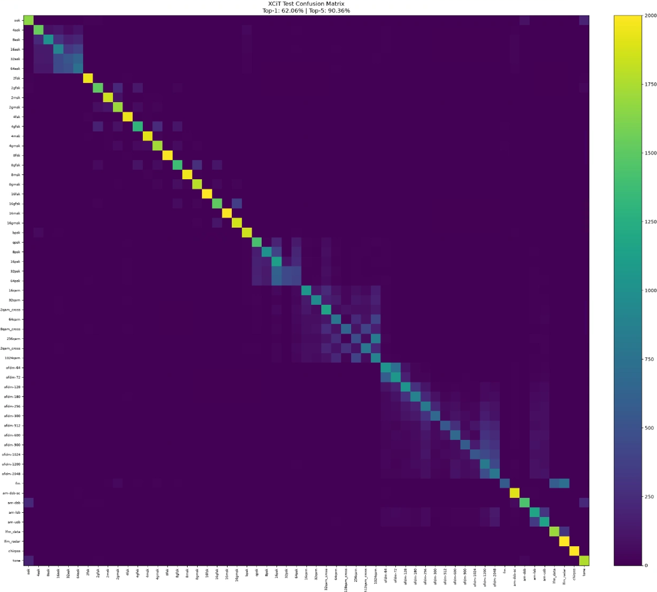
Extra Figures
Precision-Recall Curve of single-class and multi-class YOLOv11 models
Confusion matrix showing modulation fine-grain classification accuracy across the 57-modulations

