Slide 1
How To Share Clocks For Phase Coherency
(That suits your Needs)
Jan Schirok
Chief Engineer

Slide 2

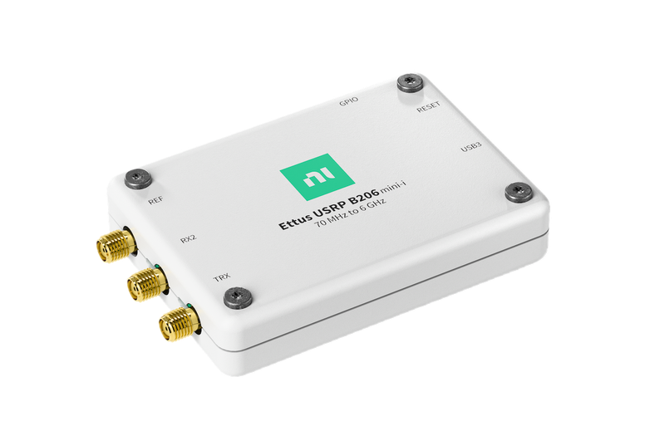


Enter to Win a USRP B206mini-i!
Scan the QR code to enter for your chance to win.
NI Ettus USRP B206mini-i
Visit the NI booth in the exhibit area to learn more!
No purchase necessary. One entry per person.
Winner will be selected at random and notified after the event.

Slide 3
Introduction to Phase Coherency
Super Short, Super Brief

Slide 4


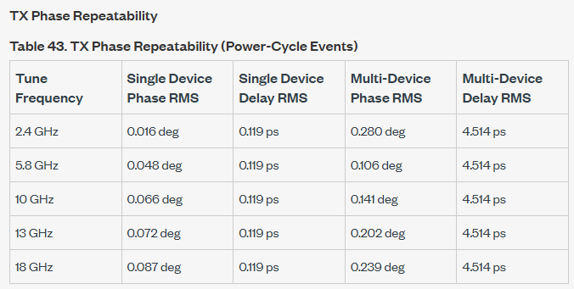
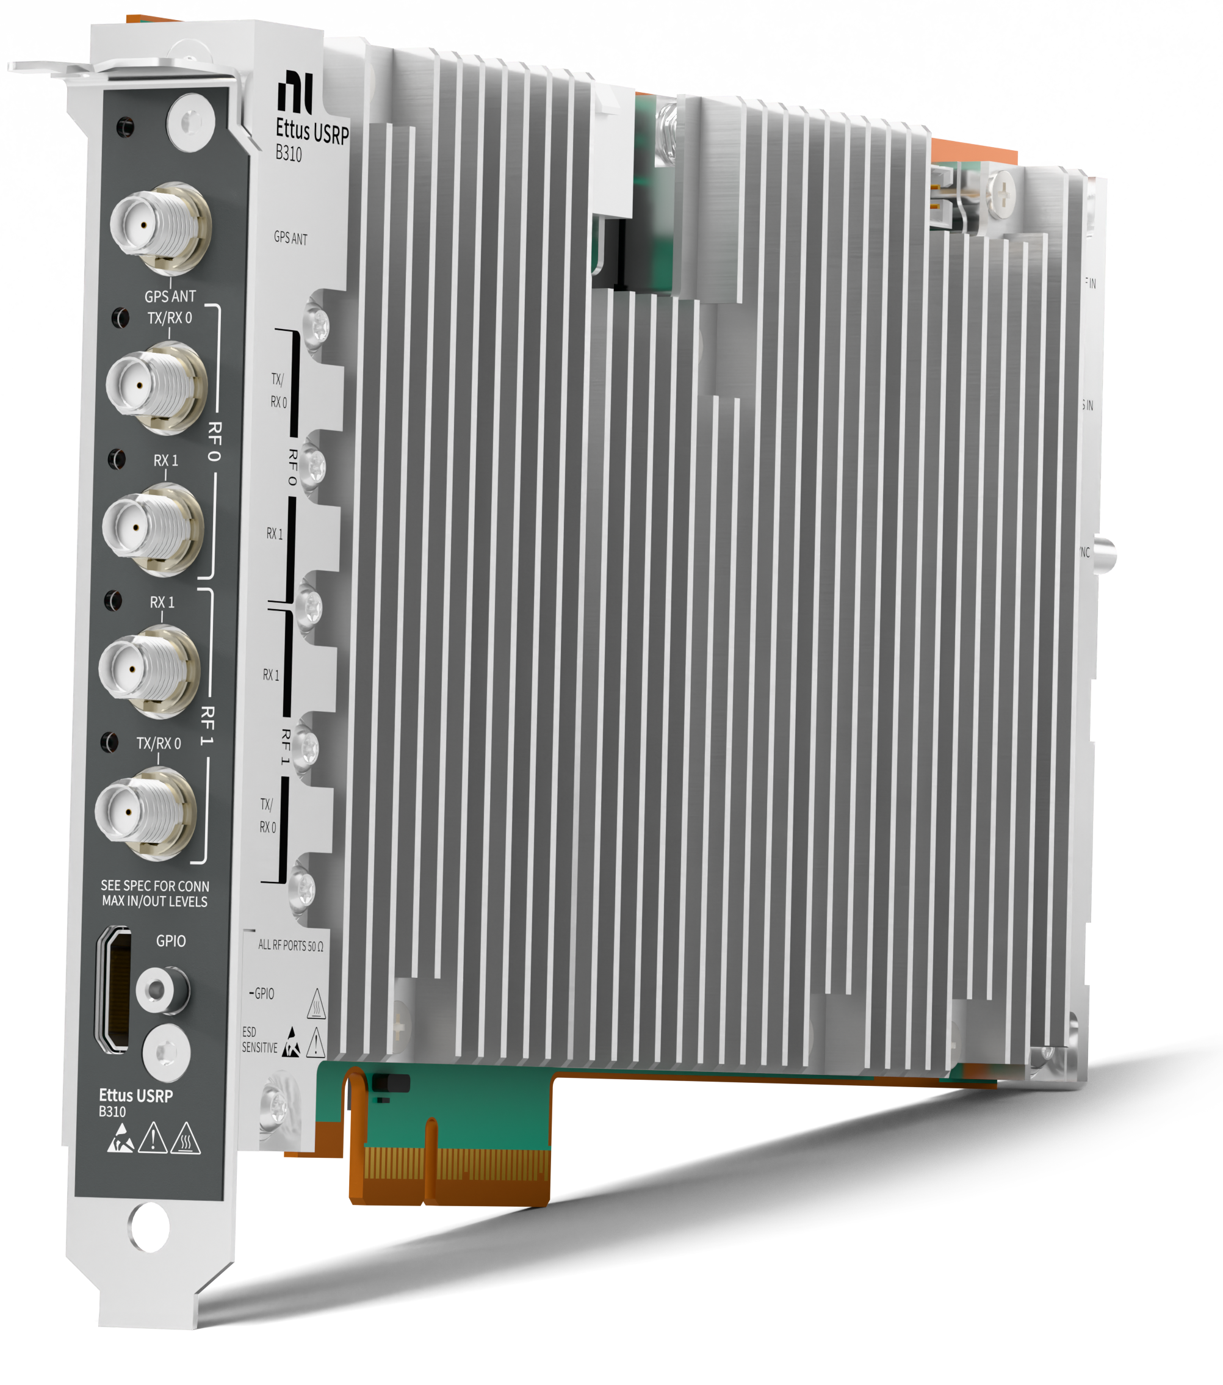
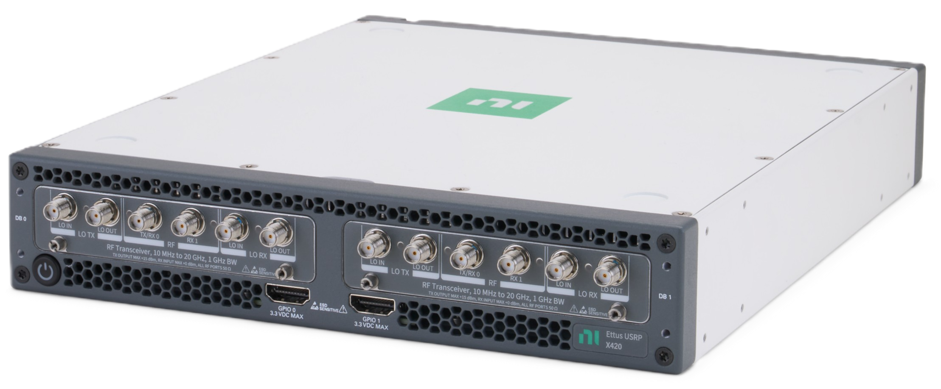
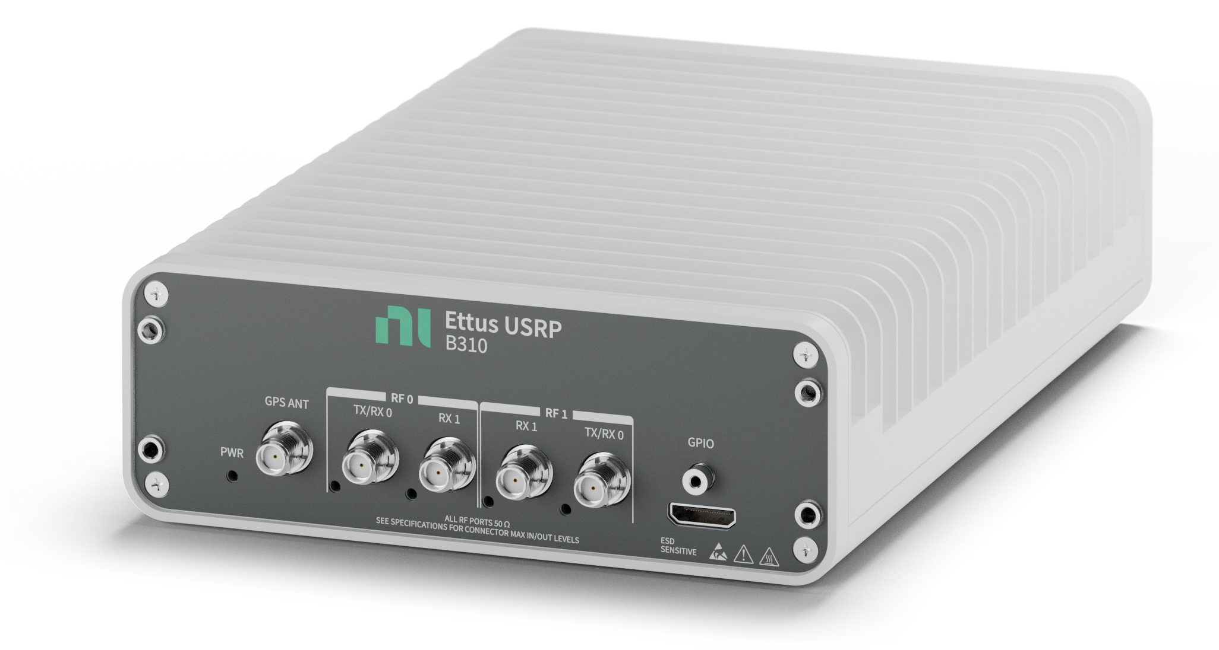

Multi-Antenna Systems
– Care about Synchronization
Applications involving multiple antennas require
Systematic phase relations between channels (“Phase Coherence”)
Beamforming –
Tx-Tx / Rx-Rx coherence
Direction Finding –
Tx-Tx / Rx-Rx coherence
Modelling helps with
understanding requirements:
Phase errors
Time offsets
Stability
Repeatability
Beamformer
Ant. array
…
…
$$Δφ$$
Rx
Rx
Many SDRs (like the USRP) are designed with these applications in mind
High End SDRs with LO Sharing
(like the USRP X420)
SDRs with Phase Repeatability using
Reference Sharing (like the USRP B310)
Based on the needs, SDRs scale in:
Frequency range
Bandwidth
…
Method/Level of Synchronization

Slide 5
Application Requirements
What Level of Coherency will you need?

Slide 6
Phase Coherency Requirements…
Mapping Phase, Time, Stability, Repeatability
I want to do RF Direction Finding.
What’s the right device for the job?
What do you care about?
Coherency
Connoisseur
Coverage of new WIFI bands
Scaling from 2 to 8 antennas
Signals with medium bandwidth
Consistency over a longer time
And, I want to rerun the measurement after a reboot with the same phase weights
Synchronization
Supplier
Direction is based on RF Phase accuracy
Wider Bandwidths turn into Time accuracy
For long durations we specify stability
Restarts are captured in repeatability
How accurate does the phase need to be?
A couple degree – maybe up to 10 degree offsets is usually good enough for me
You should consider a device with repeatable phase – e.g. something that scales well to 8 channels using a Multi-Device-Synchronization cable…

Slide 7
Map Applications
It’s not the application alone…
The used algorithm matters as well!
Phase
Accuracy
General Themes – Your Application needs may differ!
Direction Finding (AoA)
+ Beam Forming
Distributed MIMO
Direction Finding (TDoA)
Repeatable
ISAC Research
Stable
Multi-User MIMO (Cooperative)
Teaching RF
Simpler RF
Spectral Monitoring
Drifting
Time
Accuracy
Drifting
Stable
Repeatable
Notes:
“Starting points” – but your application needs may differ

Slide 8
Synchronization Methods
And accuracies…

Slide 9
A little experiment…
Just clap along…
We’ll try a song…

Slide 10
What does clapping tell us for synchronization?
Clapping = Matches your beat to my beat
Synchronization of Software Defined Radios is similar
  Your internal reference is pulled by an external reference
  The reference can be slow / or fast
  Faster usually has more accuracy (and We Will Rock You is fun to clap along)
    From 1 PPS, 10 MHz, 125 MHz to Shared LO – things increase accuracies
Note - following a beat is “over the air synchronization” – with some similarities to GPS ☺

Slide 11

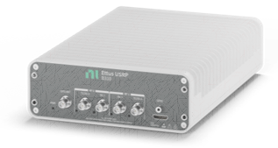
What about Single Device / Within a device?
Device Internal Channels
Time: Repeatable
Phase: Stable,
some repeatable
Last Seen: Multi Channel Devices
Most of this presentation is BETWEEN DEVICES
What about – WITHIN A DEVICE?
…The easy choice…
Time alignment likely repeatable & stable
Phase Accuracy is Device Specific
  Usually highly stable phase between channels
    Separate synthesizers (on different daughterboards) may decrease stability
  Repeatability depends on the architecture
    A list of USRPS
    with repeatable phase within the device:
    Specified: B310, X420, X440
    Shared internal LO: B210, E320, TwinRX, N32x
    Seen working: UBX/OBX …

Slide 12

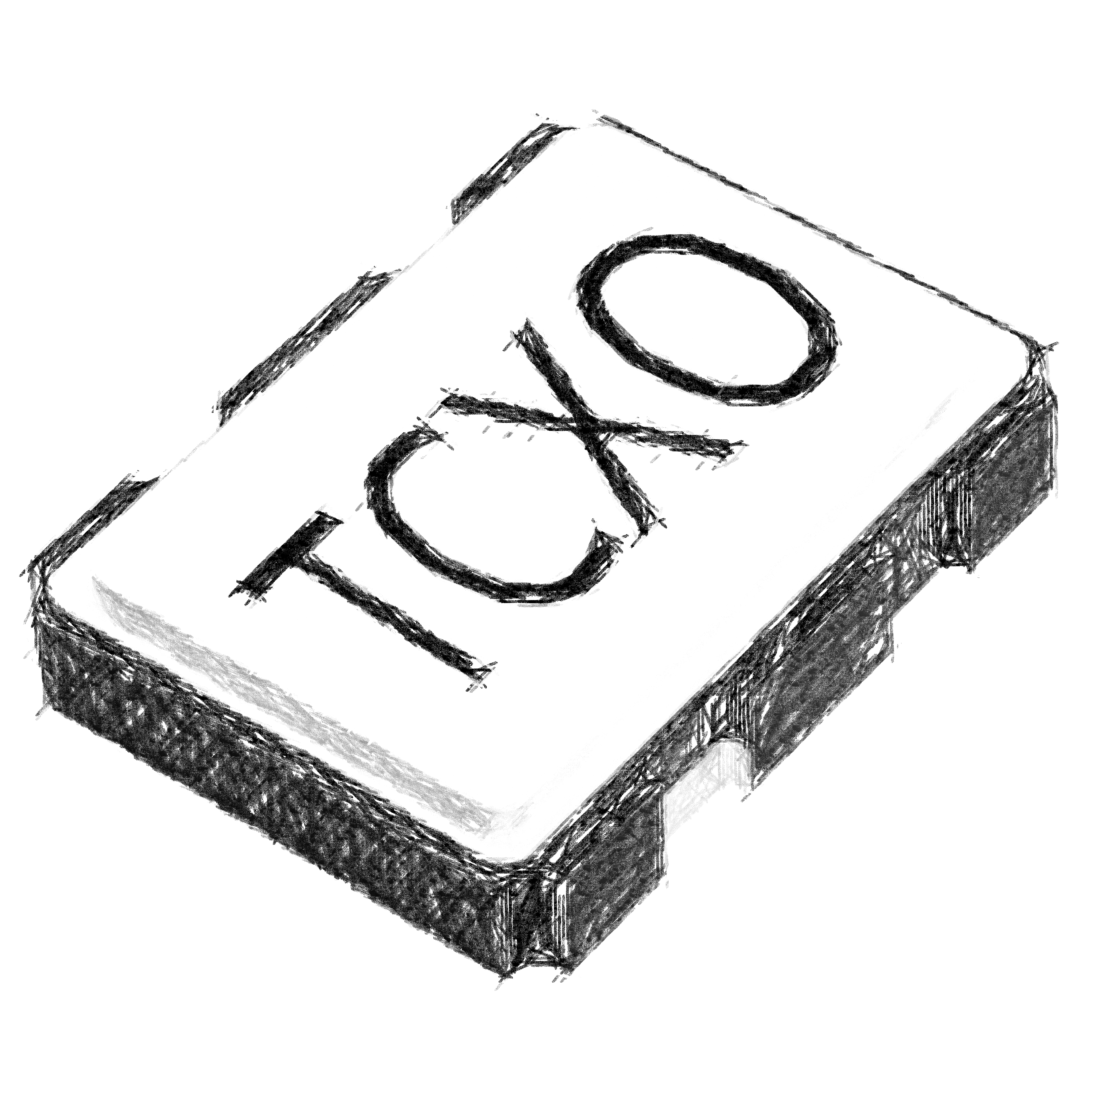
Synchronization: Internal Reference between devices
(aka – no synchronization)
Internal Reference
Time: Drifting
Phase: Drifting
Last Seen: Any SDR
Internal reference – SDR running “on its own”
(almost) Any SDR has this
Related specification: Reference/Frequency Accuracy
  Usually in PPM / PPB (# of 1E-6 or 1E-9)
  Reference frequency turns into – an RF frequency offset
  +1 ppm (1E-6) reference accuracy turns into 1kHz offset at 1 GHz RF (360 degrees phase in 1 ms!)
Time and Phase are drifting between devices
  Both based on reference accuracy
  Drift can be described with: Allan Variance / Allan deviation or Phase noise
Properties between Multiple Devices

Slide 13
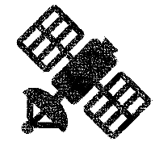
Synchronization: GPS / GNSS
GPS-based Synchronization
Time: Repeatable
Phase: Low stability
Last Seen: Mid/high end
GPS based synchronization uses an antenna (accessory) hooked up to the SDR … or to a Clock distribution like CDA-2990G
  Antenna requires direct view of the sky
  Receives signals from GPS satellites over the air
GPS data contains position (coordinates) and time/date
Time information is turned into high Frequency accuracy
  1E-9 (1ppb) or better can be achieved
  Stabilization will take some time (5..10 minutes, sometimes more)
Time is repeatable over many SDRs across the globe
  Time accuracy depends on many factors (model, clocking, weather conditions, antenna …) – expect roughly 2-digit nanoseconds
This is a uni-directional over-the-air synchronization with 20000..26000km distance (77ms worth of propagation time)
  Don’t expect a repeatable phase
Properties between Multiple Devices

Slide 14
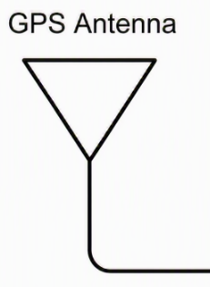
GPS-Based Synchronization
SDR
SDR
GPS Ant
GPS chip
GPS Ant
GPS chip
SDR
TX0
TX0
GPS Ant
GPS chip
RX0
RF
PLL
RX0
RF
PLL
TX0
TX1
TX1
RX0
RF
PLL
RX1
RX1
SDR
TX1
GPS Ant
GPS chip
TX0
RX1
RX0
RF
PLL
Any number of SDRs with
GPS antenna
TX1
SDR
RX1
GPS Ant
GPS chip
TX0
RX0
RF
PLL
TX1
RX1

Slide 15
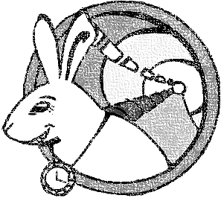
Network Based Synchronization
Network Based Synchronization
Time: Repeatable
Phase: Low stability
Last Seen: USRP N3xx
Fewer SDRs out there directly supporting network-based synchronization – e.g. USRP N3xx
Clock distribution devices available to also create PPS/10 MHz → can be used by many standard SDRs
1588 High Accuracy profile / White Rabbit: Time accuracy of << 1ns (down to picoseconds)
  Requires specific Ethernet infrastructure
  (White Rabbit Switches)
  Accuracy and effort/system complexity scale together
Works over fiber with long distances
Phase coherency – not repeatable but provides stability
Properties between Multiple Devices

Slide 16
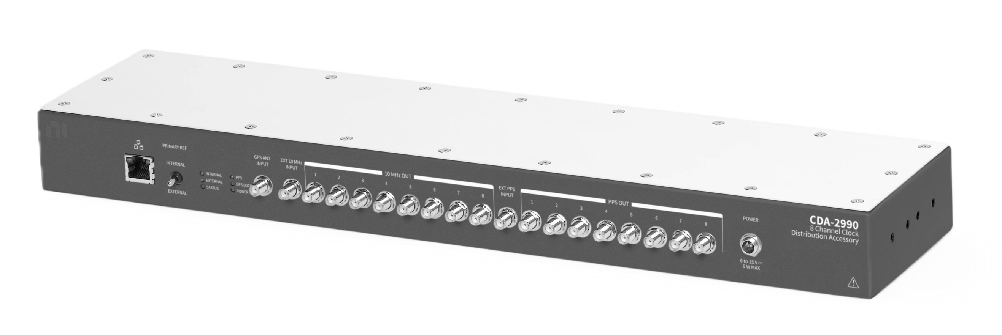
External Reference (10M+PPS)
External Reference
(10 MHz + PPS)
Time: Repeatable
Phase: Some Repeatability
Last Seen: Most SDRs
Most SDRs and RF instruments support 10 MHz as reference clock
PPS in addition provides accurate timing
Distribution devices help to synchronize multiple devices – like Octoclock CDA-2990
Device-dependent accuracies – but timing repeatability can get to very low levels,
e.g. < 10 ps
Phase repeatability heavily depends on RF clocking – but can get down to 10s of degrees at RF (high temperature dependencies, settling times)

Slide 17
Shared 10 MHz and PPS sync
SDR
SDR
TX0
TX0
RX0
Transceiver
Transceiver
RX0
TX1
PLL
Clock in
10MHz
10MHz
Clock in
PLL
TX1
RX1
PPS in
PPS in
RX1
# of devices based on distribution device (some allow being cascaded)
SDR
SDR
TX0
Distribution
(e.g. OctoClock CDA-2990)
TX0
RX0
Transceiver
Transceiver
RX0
TX1
PLL
Clock in
10MHz
10MHz
Clock in
PLL
TX1
RX1
PPS in
PPS in
RX1
SDR
SDR
TX0
TX0
RX0
Transceiver
Transceiver
RX0
TX1
PLL
Clock in
10MHz
10MHz
Clock in
PLL
TX1
RX1
PPS in
PPS in
RX1
SDR
SDR
TX0
TX0
RX0
Transceiver
Transceiver
RX0
TX1
PLL
Clock in
10MHz
10MHz
Clock in
PLL
TX1
RX1
PPS in
PPS in
RX1

Slide 18
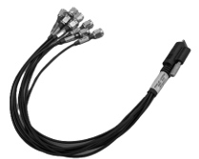
Multi Device Sync Cable
A couple SDRs are providing multi-device synchronization via extra cabling
  B310 is the latest USRP with that method
B310 specifically
  Shares higher reference frequency
  (“High Frequency Reference”)
  Still closes timing for 1 PPS
  Achieves higher accuracies for Time + Phase Repeatability & Stability than 10 MHz
  Star distribution for high symmetry
  (1 device shares clocks to 3 more + itself)
High synchronization accuracy
  A couple degrees of phase repeatability
  A couple picoseconds time repeatability
Multi Device Sync Cable
Time: Repeatable
Phase: Good Repeatability
Last Seen: USRP B310, N210
Properties between Multiple Devices

Slide 19
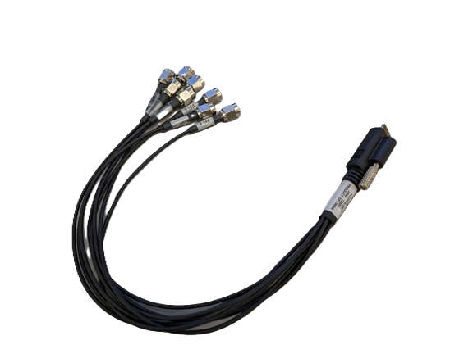
Multi-Device Sync
B310
High frequency reference
TX0
Clock out
RX0
PPS out
TX1
Clock in
RX1
PPS in
Specific method for B310
First device shares reference
Wraps back to itself as well
B310
TX0
Clock out
RX0
PPS out
TX1
Clock in
RX1
PPS in
B310
TX0
Clock out
RX0
PPS out
TX1
Clock in
RX1
PPS in
B310
TX0
Clock out
RX0
PPS out
TX1
Clock in
RX1
PPS in

Slide 20
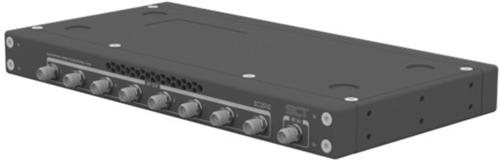
LO Sharing
LO Sharing
Time: - (not shared)
Phase: Best repeatability
Last Seen: USRP X420,
USRP N32x,TwinRX
LO Sharing helps with very accurate phase repeatability / stability between devices
  E.g. much better than 1 degree RMS at 18 GHz
Make sure the cabling is suitable
(phase can be very temperature dependent)
New LO Sharing accessory for X420
– SignalCraft SC2510
  Distributes LO beyond 2 channel configurations
  Allows Cascading for > 8 channels
LO Sharing doesn’t help with accurate time
→ Still relies on another method like 10MHz+PPS reference for that
Properties between Multiple Devices

Slide 21
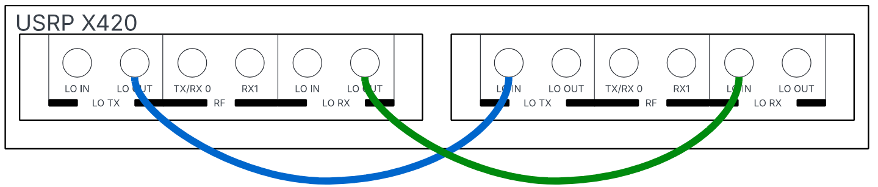
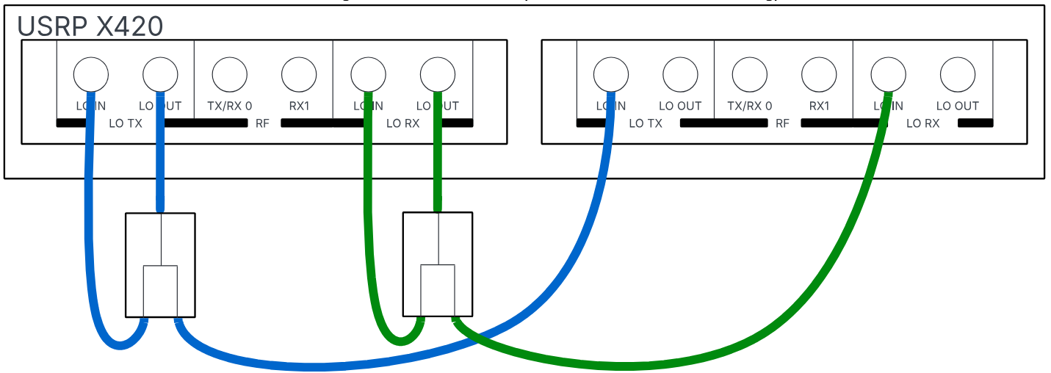
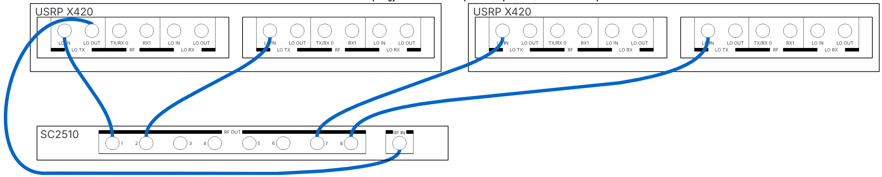
X420 LO Sharing options
Simple 2x2 coherent system
Recommended 2x2 coherent system
(symmetric using passive splitter)
Multi-Device (4x4 and higher) via
SignalCraft SC2510 (cascadable for > 8x8)

Slide 22
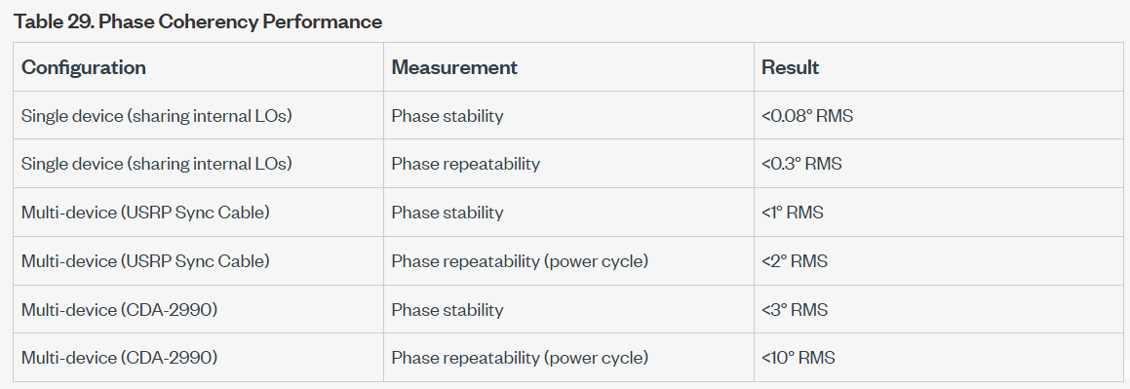
Example Spec – Phase Accuracy
https://www.ni.com/docs/en-US/bundle/usrp-b310-enclosed-specs/page/specs.html

Slide 23
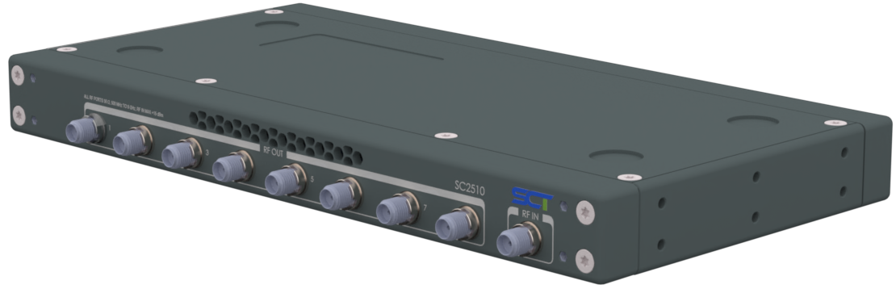
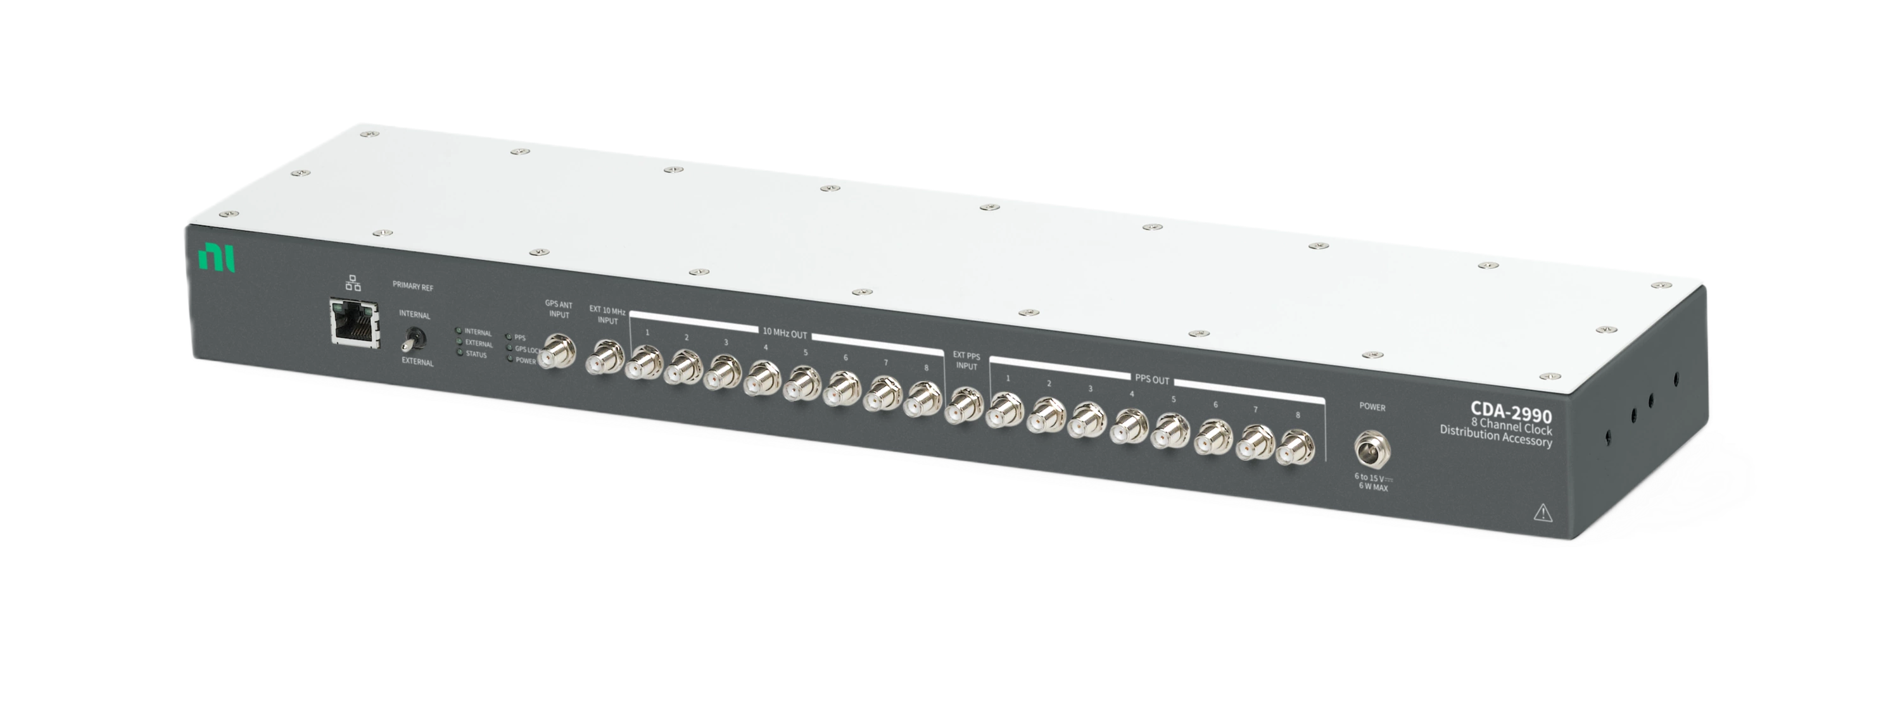
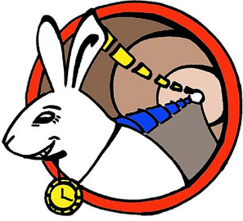
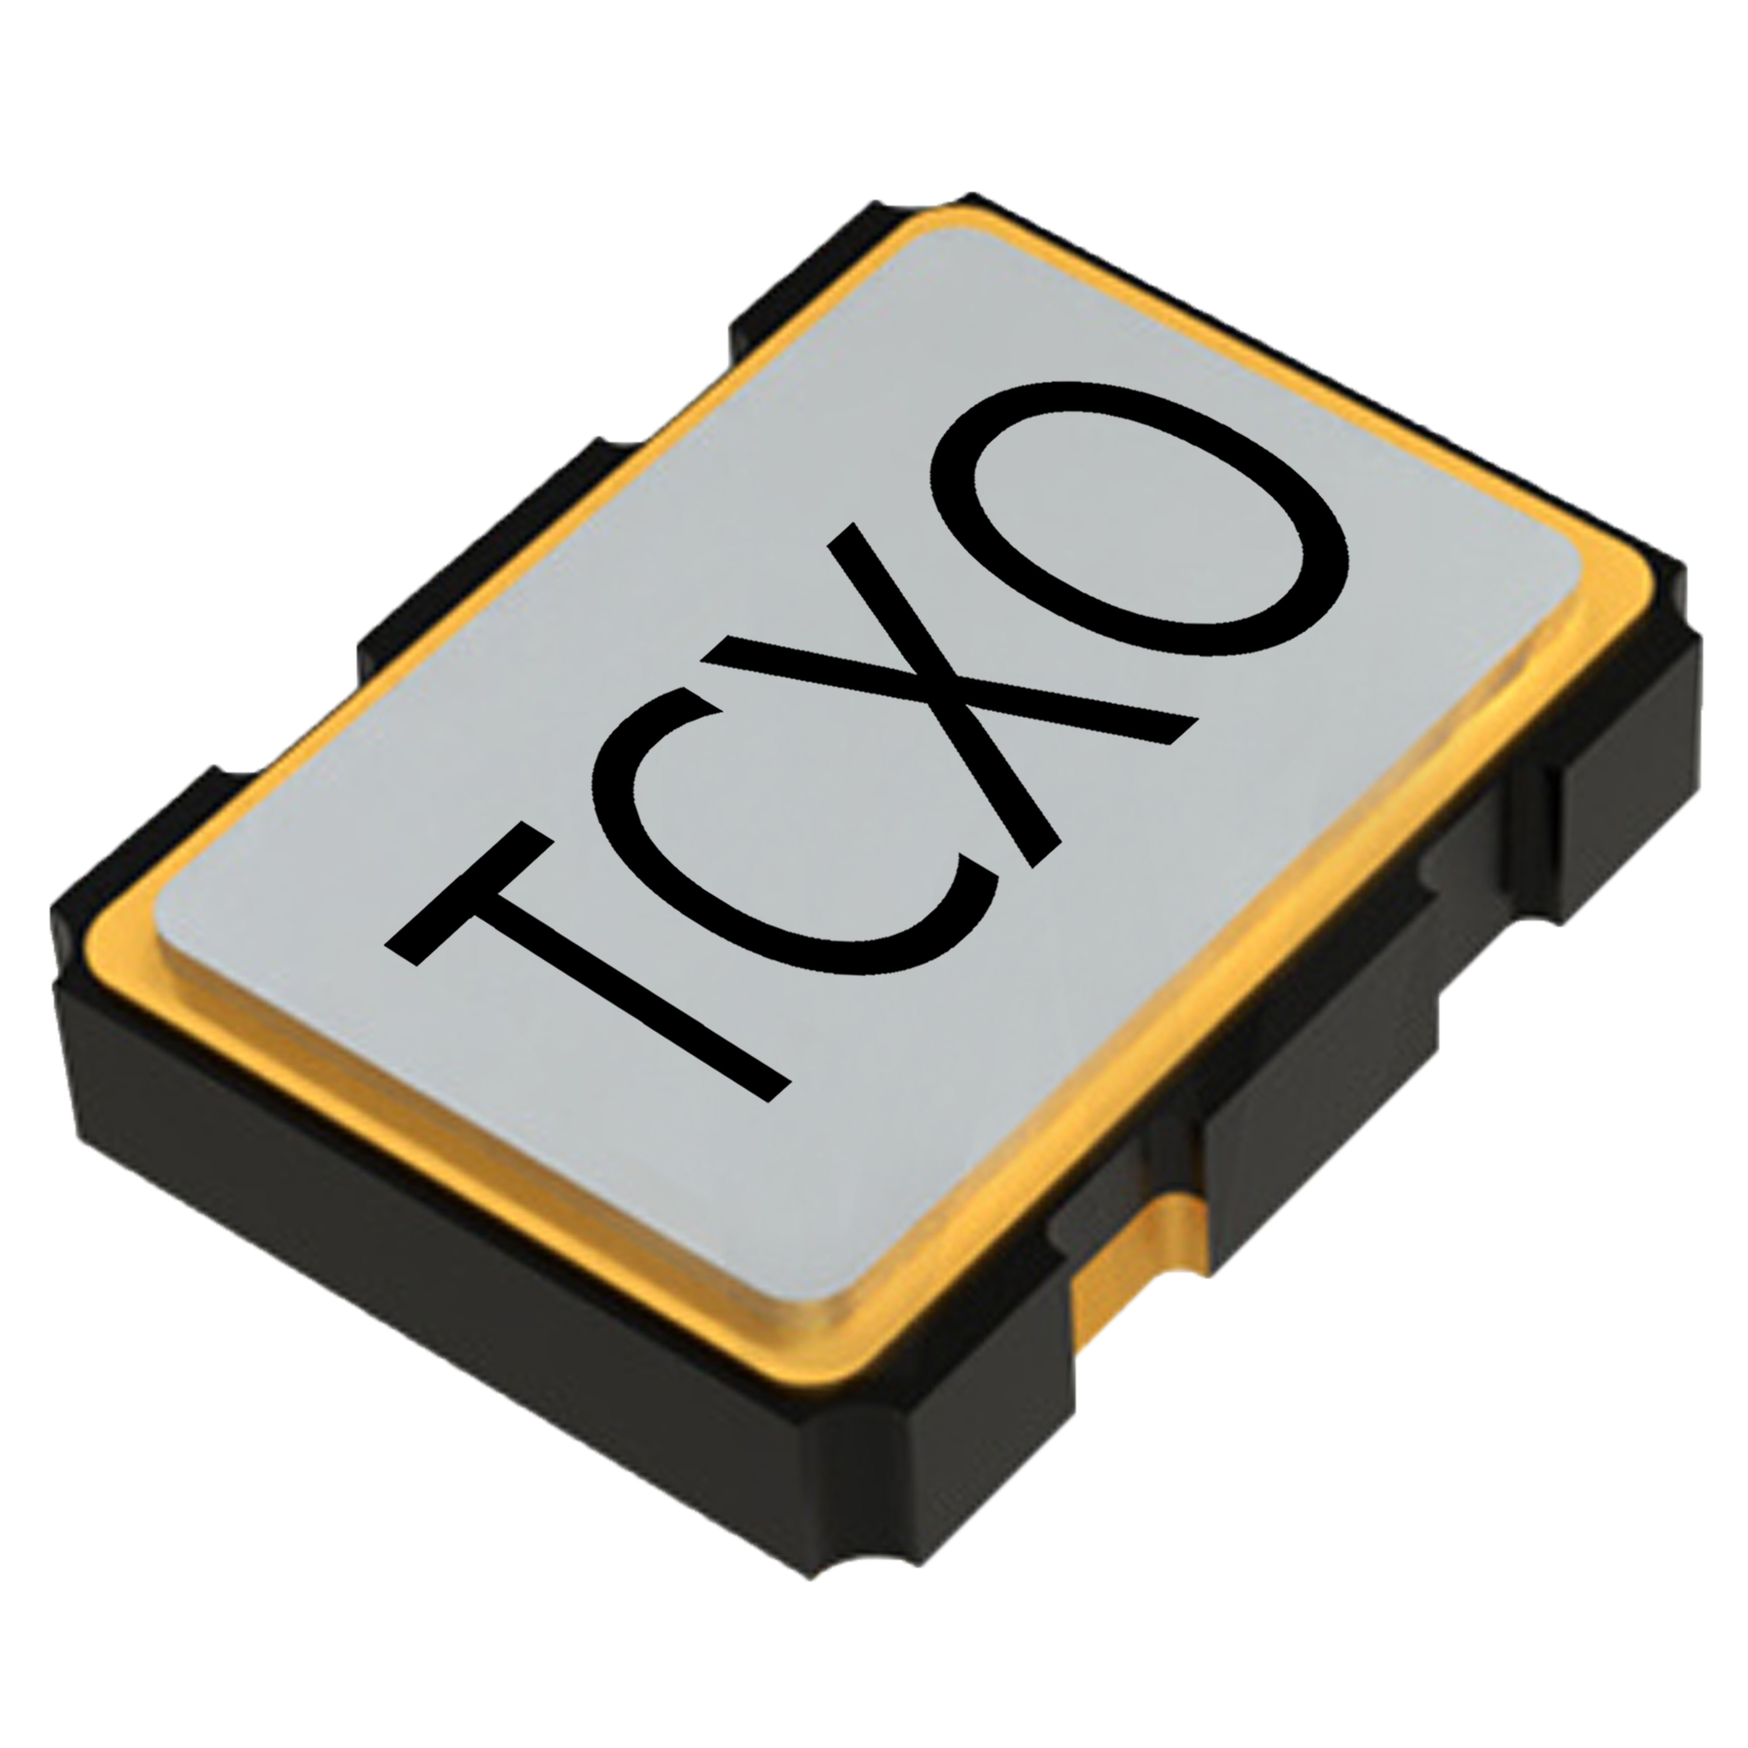
Accuracy of Synchronization Methods between devices
Phase
Accuracy
LO Sharing (X420, N32x, TwinRX)
Repeatable
Multi Device Sync (B310)
External Reference (1PPS+10M)
Stable
Network Sync (N3xx)
GPS
Drifting
Internal Reference
Time
Accuracy
Drifting
Stable
Repeatable

Slide 24
Summary

Slide 25
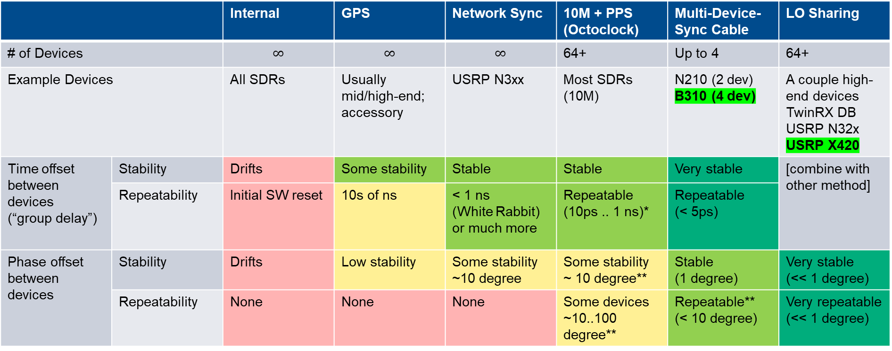
Summary of synchronization methods – between devices
 |  | Internal | GPS | Network Sync | 10M + PPS (Octoclock) | Multi-Device-Sync Cable | LO Sharing
# of Devices |  | $$∞$$ | $$∞$$ | $$∞$$ | 64+ | Up to 4 | 64+
Example Devices |  | All SDRs | Usually mid/high-end; accessory | USRP N3xx | Most SDRs (10M) | N210 (2 dev) B310 (4 dev) | A couple high-end devices TwinRX DB USRP N32x USRP X420
Time offset between devices (“group delay”) | Stability | Drifts | Some stability | Stable | Stable | Very stable | [combine with other method]
 | Repeatability | Initial SW reset | 10s of ns | < 1 ns (White Rabbit) or much more | Repeatable (10ps .. 1 ns)* | Repeatable (< 5ps)
Phase offset between devices | Stability | Drifts | Low stability | Some stability ~10 degree | Some stability ~ 10 degree** | Stable (1 degree) | Very stable (<< 1 degree)
 | Repeatability | None | None | None | Some devices ~10..100 degree** | Repeatable** (< 10 degree) | Very repeatable (<< 1 degree)
* Device dependent
** Device and frequency dependent

Slide 26
Q&A

