Slide 1
Holoscan and USRP:
A GPU and SDR Case Study
Martin Braun
Ettus Research / NI / Emerson
Sage Trudeau
UT Austin

Slide 2
Holoscan and DAQIRI
What’s a Daqiri? Is it already that time of day?

Slide 3
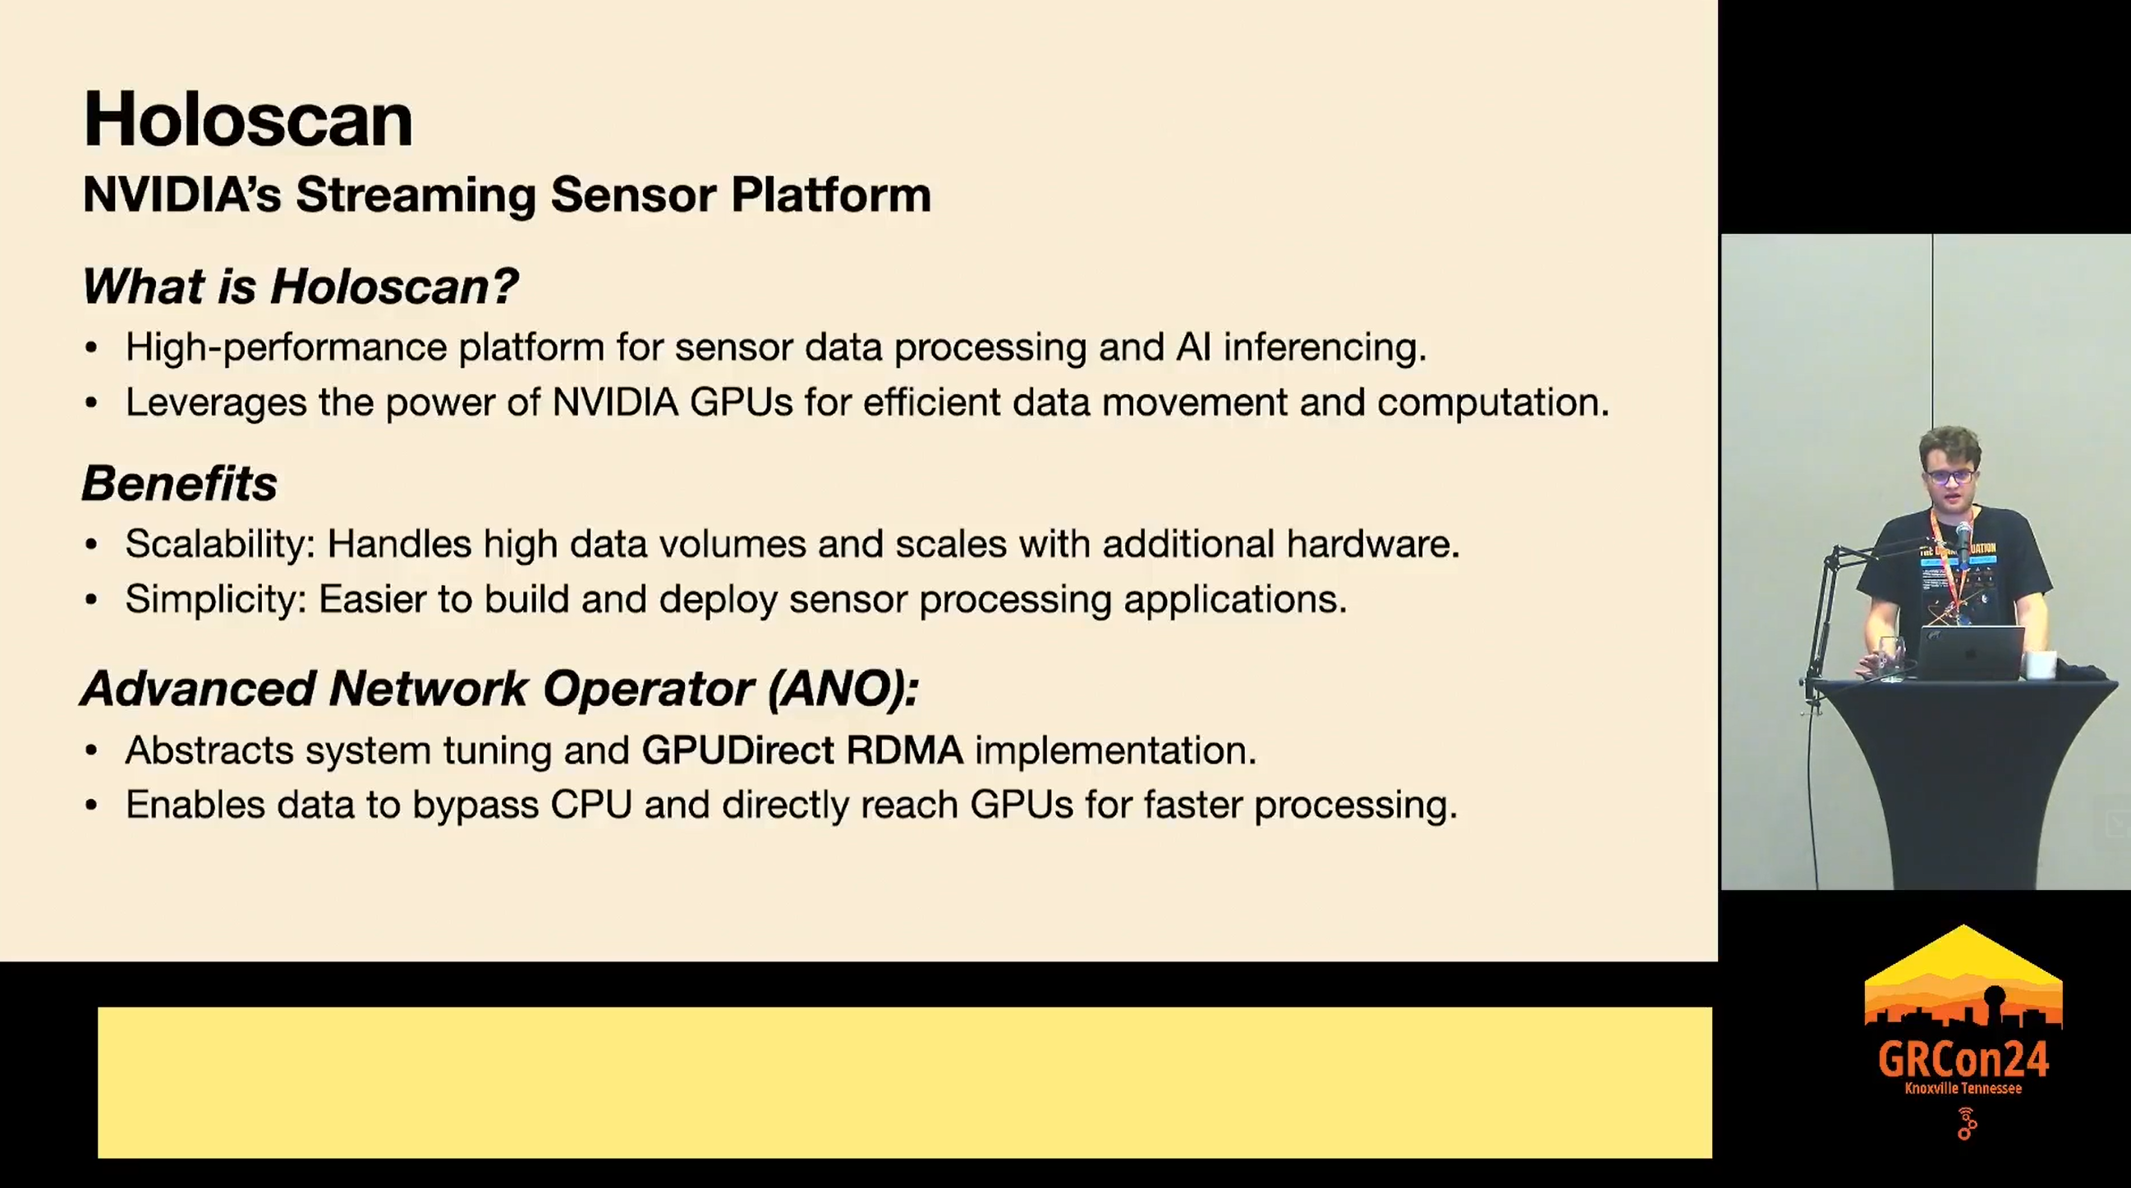

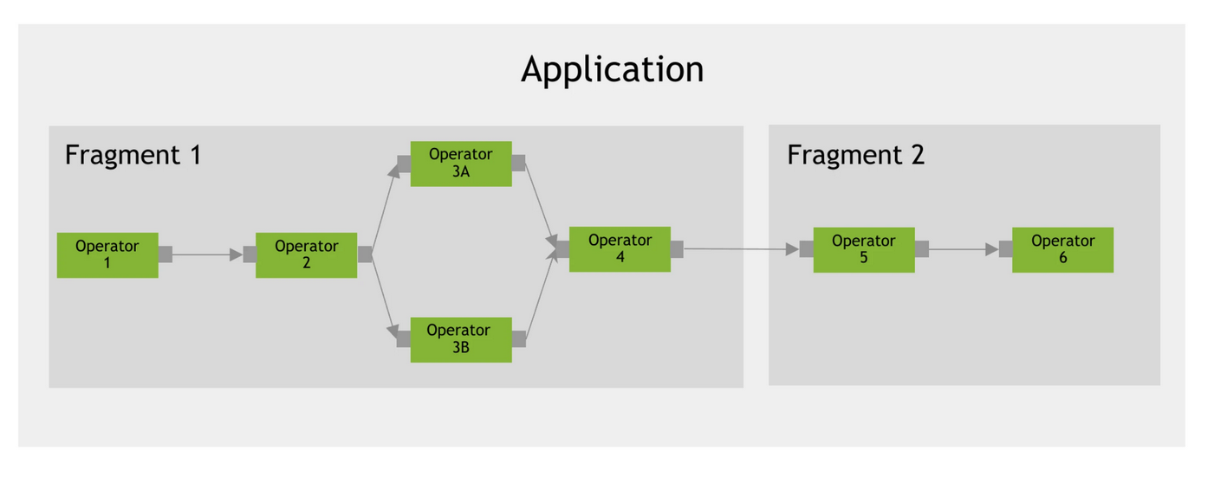
What are Holoscan and DAQIRI?
Holoscan: A data movement and GPU processing framework by Nvidia
  Open Source, Permissively Licensed
  Composable architecture, block-based design (“one block per function”)
  All right, let’s be real, this is GNU Radio for GPUs
  Ideal for Ethernet-based I/O, good for streaming applications
  Developers focus on building IP blocks (GPU algorithms), data movement and
  memory management is handled by the framework
  Can be used with Ethernet-capable devices, USRP is a great candidate for
  interoperability
  Has a Python and a C++ API, those are not (yet?) interoperable
Daqiri: The I/O library that handles data movement
  “Data Acquisition for Integrated Real-time Instruments”
  Was originally part of Holoscan, and they connect well
Your Device
I/O Library
NEW: Daqiri
[Luigi Cruz, GRCon ‘24]
Nvidia Holoscan

Slide 4
GNU Radio <-> Holoscan Comparison
GNU Radio
Holoscan
Scheduler stems from the early 2000s, but very stable API
CPU focused, very portable
Focus on radio/DSP
Switch between C++ API / Python API / GRC, combine components from all language domains
Very mature and comprehensive block library, both in-tree and out-of-tree
Between CGRAN and github: Easy to find out-of-tree modules
Modern architecture, but APIs change frequently
Made for use with Nvidia GPUs
Comes from medical imaging (?), applications very varied
No GUI whatsoever, even visualizations are highly limited, C++/Python not interoperable
Extension community not well established, Nvidia not focused on building out open-source block library
Holohub is the main extension repository, where all users upstream their extensions/applications/examples

Slide 5
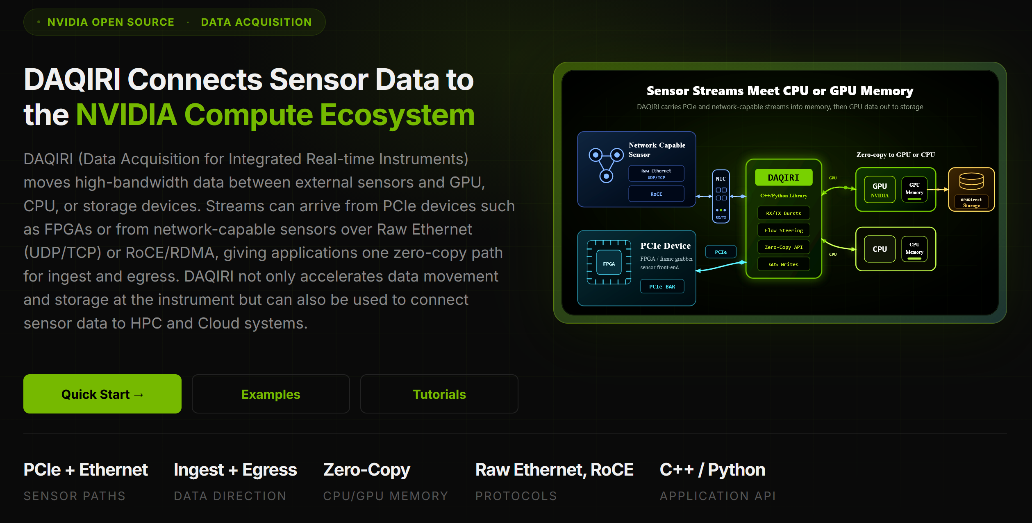
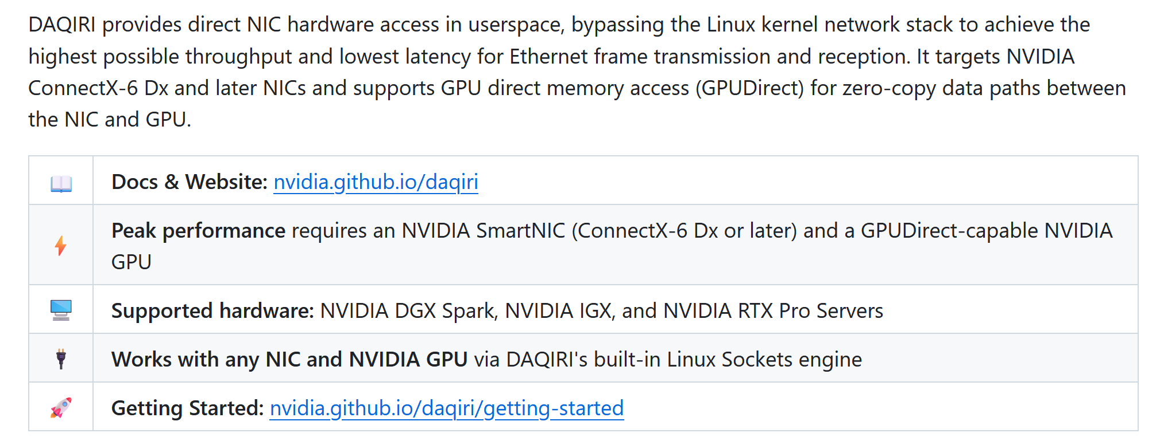
Daqiri: Abstracting the I/O
Assumption: You are using lots of Nvidia-compatible hardware (GPU, ConnectX NIC, ideally DGX/IGX/RTX machines)
Daqiri abstracts different transport modes (e.g., RDMA, raw UDP + DPDK, …) to easily enable GPUDirect support for your external sensor (e.g., your SDR)
If you get it installed on your system, and the hardware allows it, then you can easily stream data rates of 2000 Msps (8 Gbyte/s) or more directly into your GPU memory space
Runtime configuration options are provided through a YAML file

Slide 6
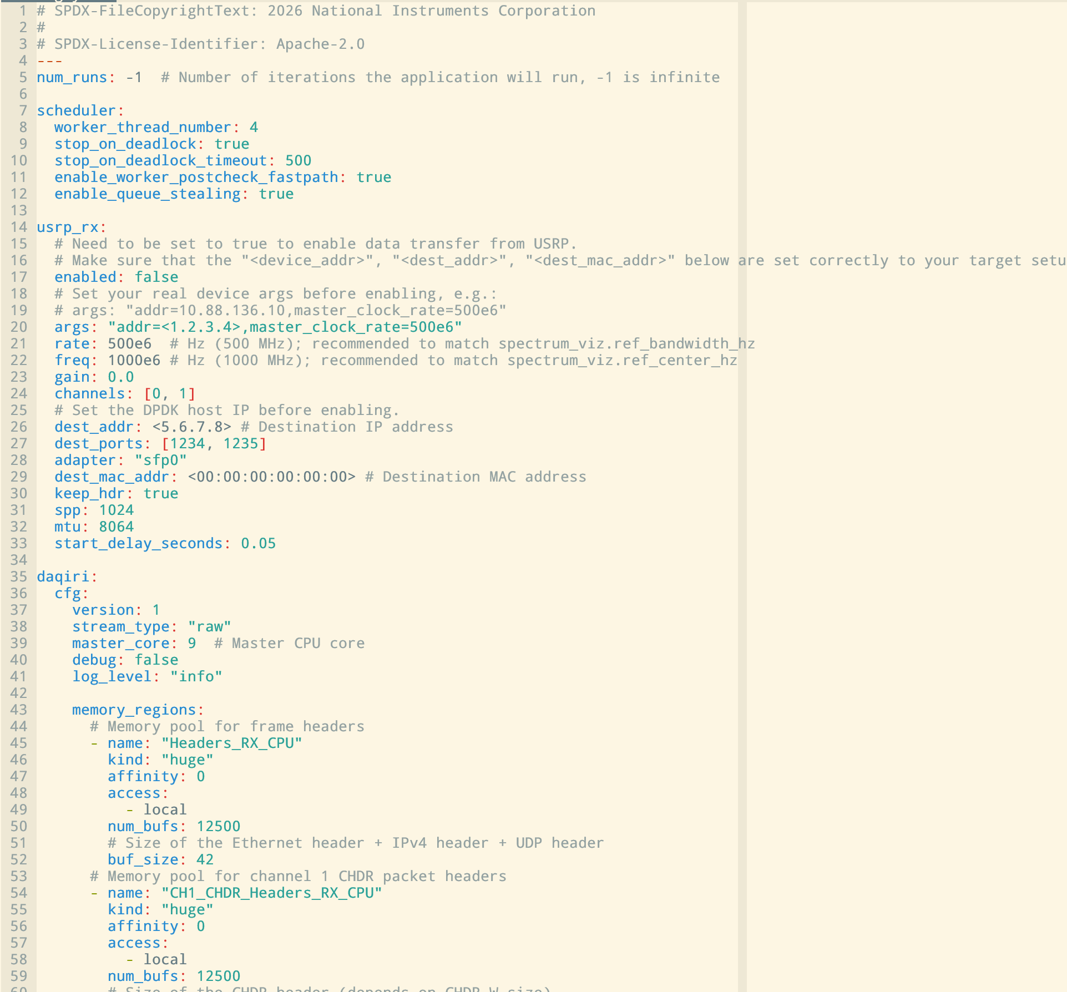
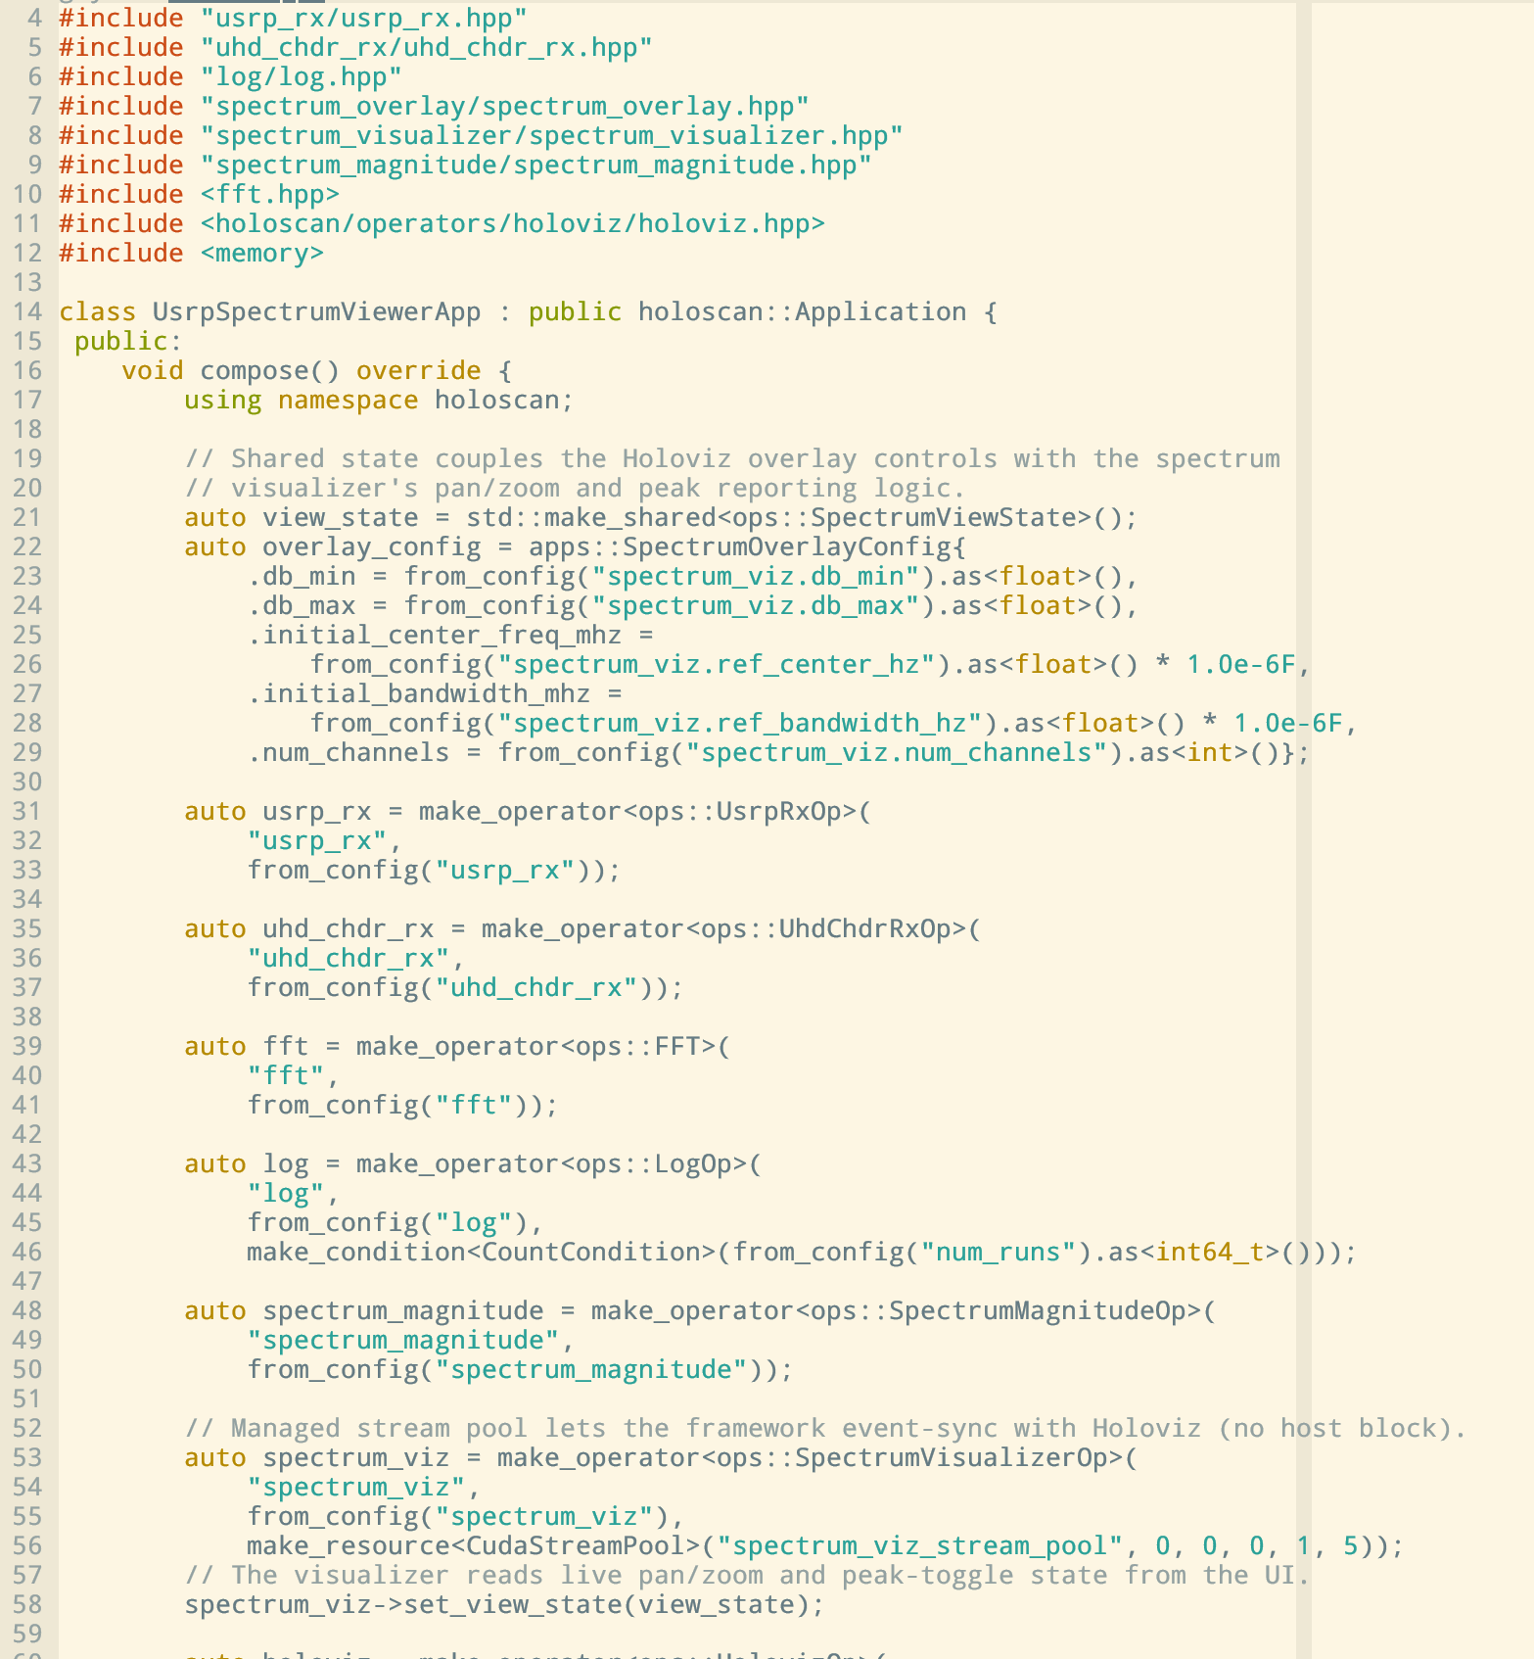
Examples: config.yml and main app

Slide 7
Holoscan-Based Applications

Slide 8
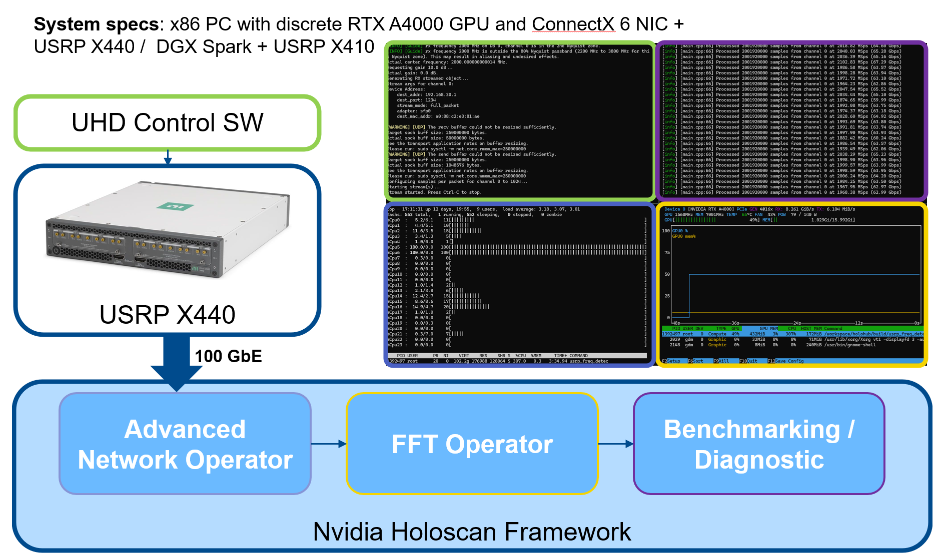
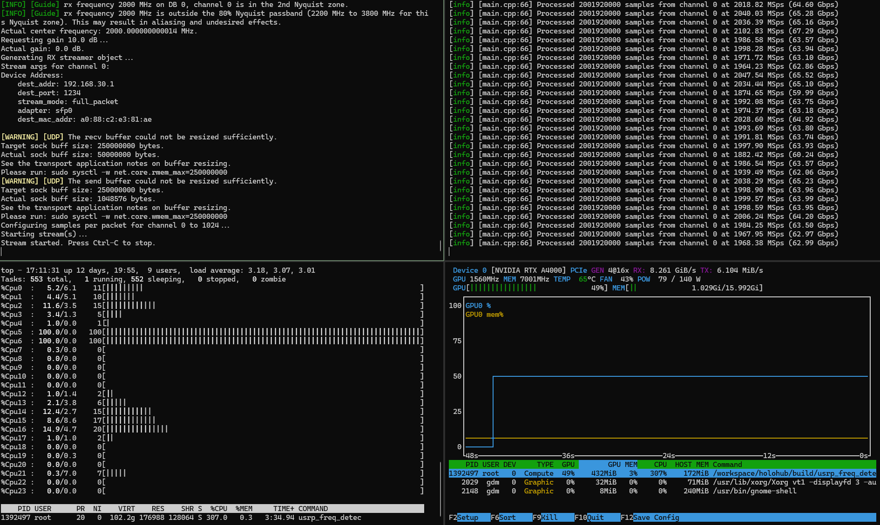
It all started with a PoC…
We wanted to see if Holoscan gives us anything useful
We used the raw UDP streaming feature of the USRP to
produce a high-rate output that could be ingested by
Holoscan
Various platforms were tested
As a stand-in for an SDR app, we simply ran a 20k FFT
Full rate of X440 (2000 Msps) could be streamed without
losing data
Uses DPDK for data transfer, blocks CPU cores
This could be useful!

Slide 9
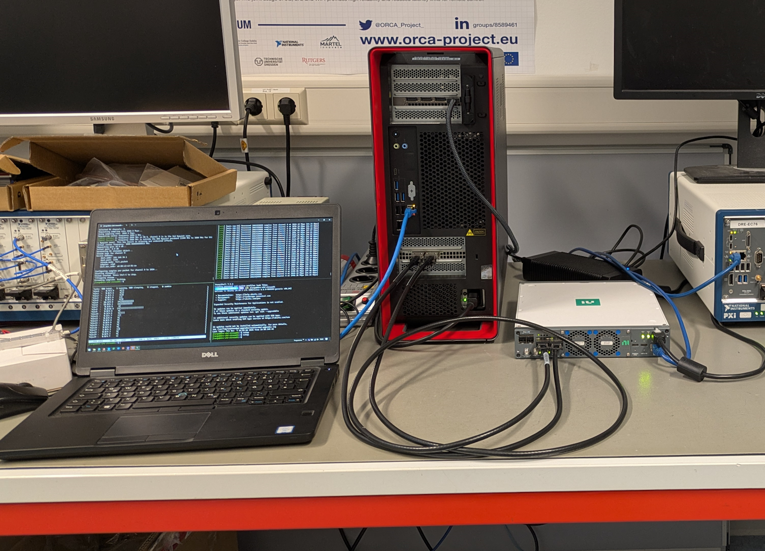
System Setup
Direct connection between USRP and GPU system
(Dell desktop, or DGX Spark)
Sometimes use separate computer for command & control
Always use ConnectX NIC (either built-in with DGX Spark, or
we have discrete GPU & NIC in the Dell system)
Getting everything to work can be a bit of a struggle; it’s a lot
easier on a DGX Spark than on a custom PC

Slide 10
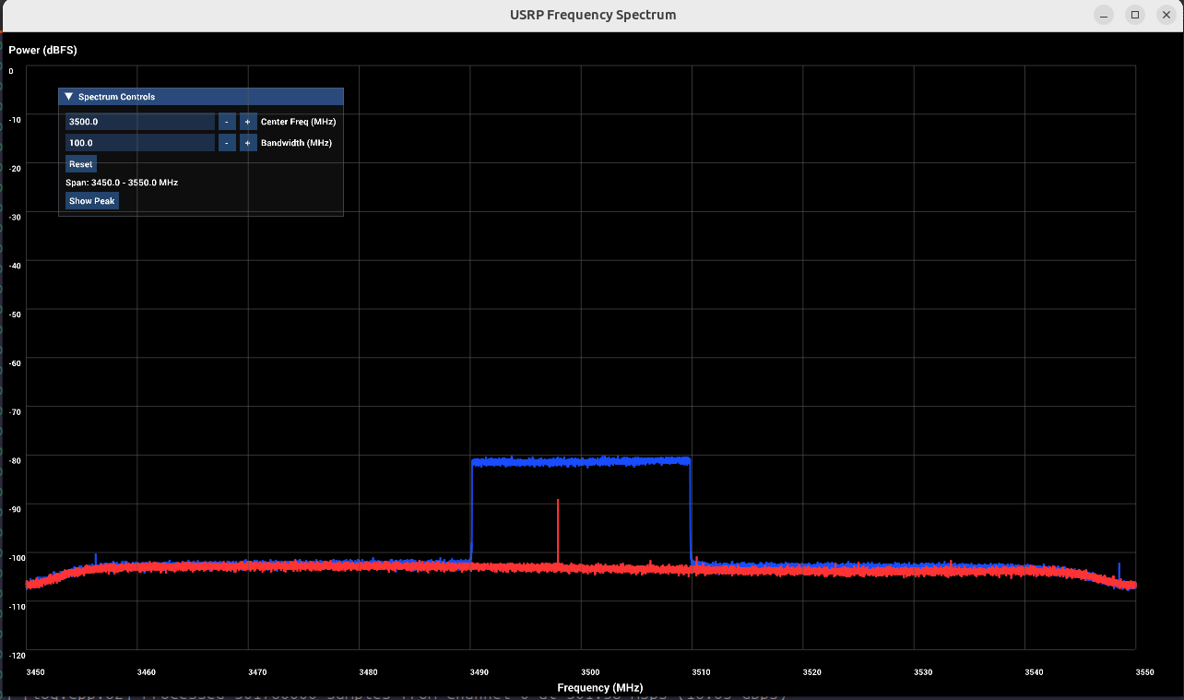
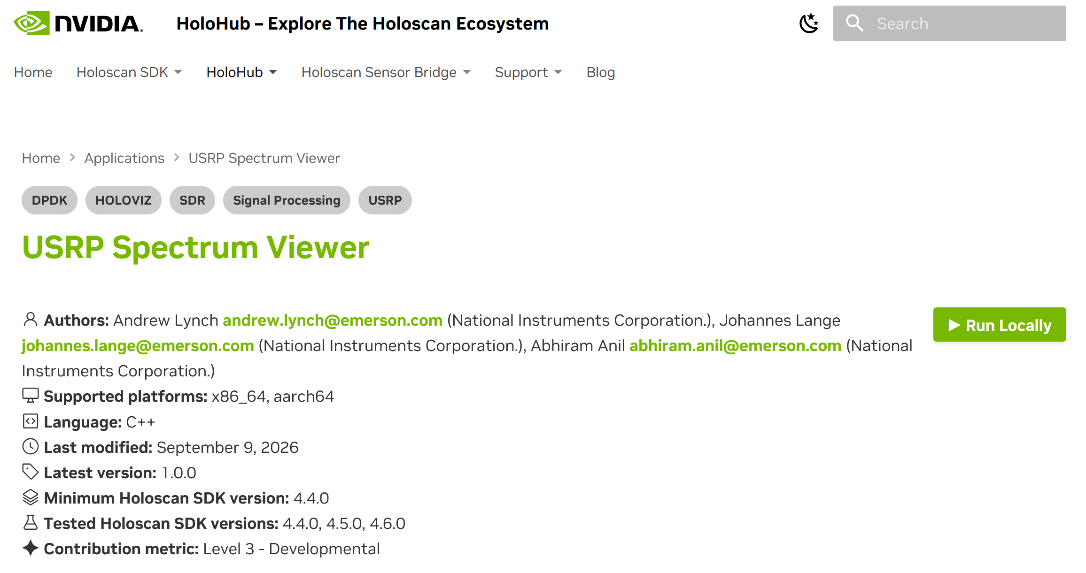
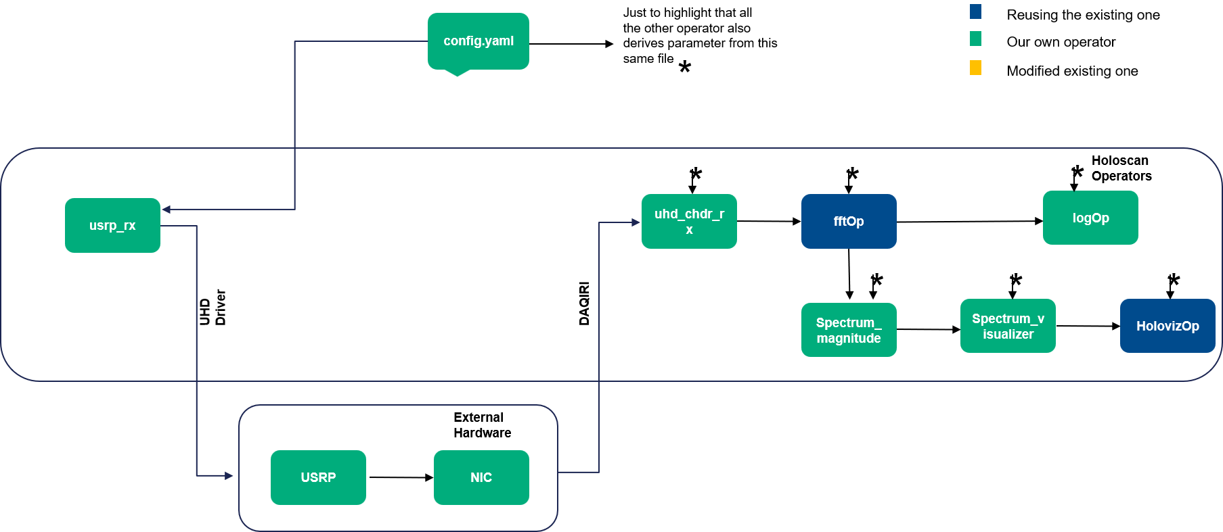
USRP Spectrum Viewer
Spectrum Viewer: Super-simple demo that enables SDR users to get started with Holoscan
Uses Holoviz for visualization
No sample ever leaves GPU memory!
Available on Github/Holohub! (Thanks to our intern Abhiram!)

Slide 11
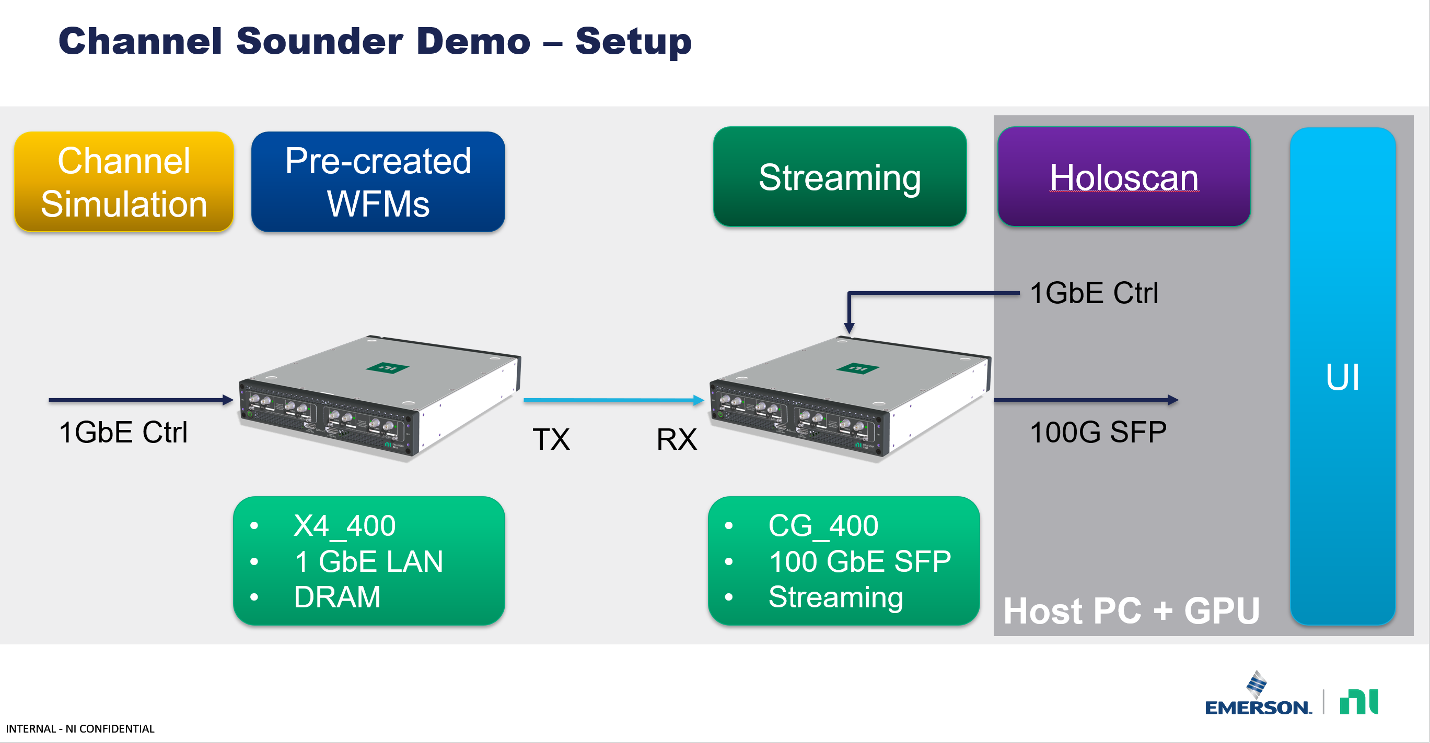
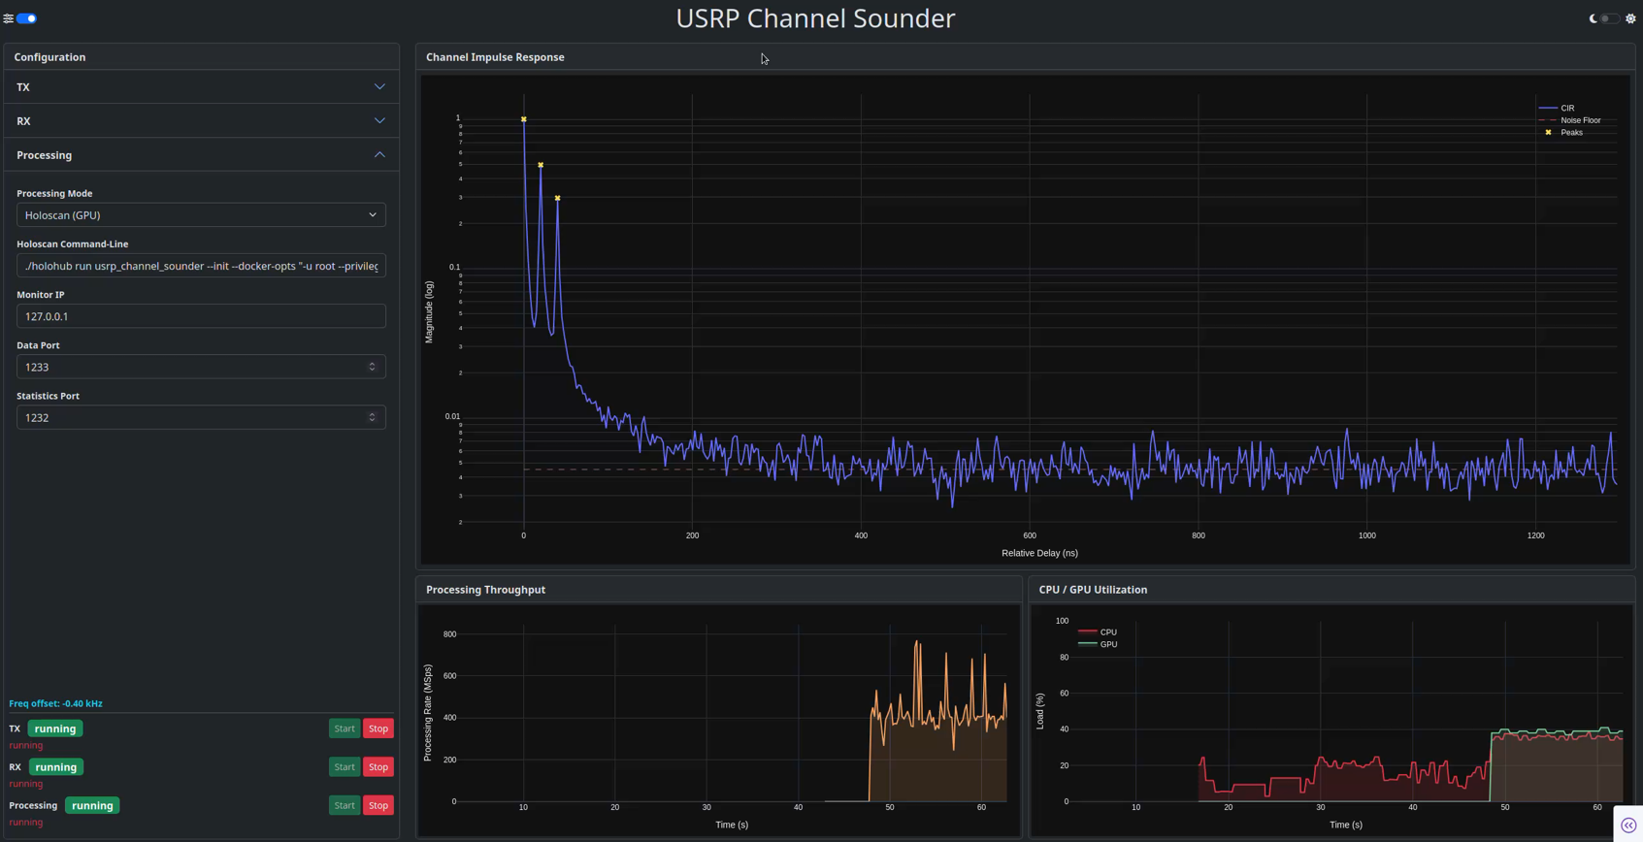
Channel Sounder
Generate Zhadoff-Chu sequences and transmits them with one USRP, receives them on a second USRP to get channel sounding response
Alternatively processes signals in pure Python or on GPU, with an approx. 100x improvement when using the GPU
When using GPU, we can process the full rate of a USRP X410 with processing capabilities to spare
Demo is designed with the goal to make it portable and easy to reproduce at events (emphasis on visuals), but in principle we could be sounding real channels this way

Slide 12
Limitations
Currently, lots of limitations:
  No flow control support: You must make sure the GPU algorithms can handle all incoming data, or data is lost and bad things happen
  No Tx support: Consequence of no flow control

Slide 13


ARGUS
Sage Trudeau, Brandon Nguyen, Divyadharshini Muruganandham, Kaushik Chowdhury

Slide 14
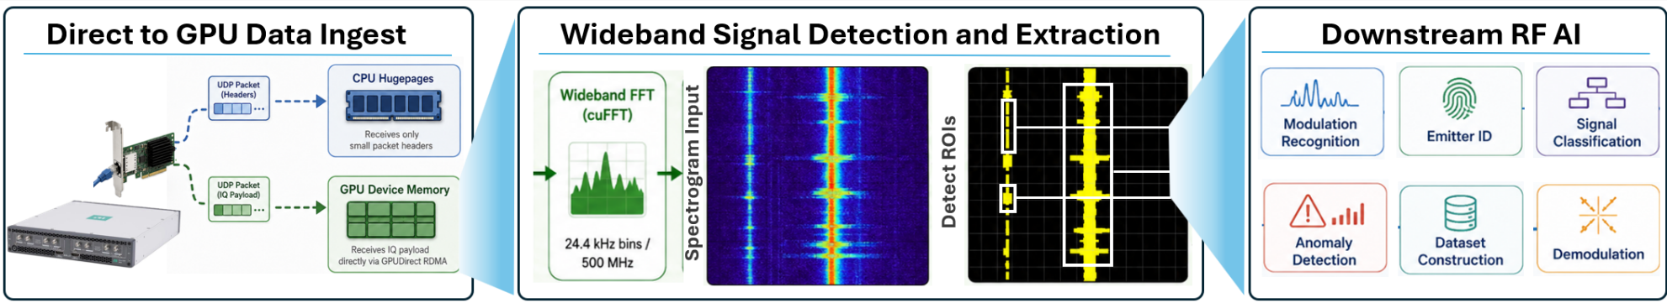
How do we deploy real time RF-AI models in the wild?
ARGUS addresses whether the end-to-end wideband system can keep
up with data delivery to RF AI models at all
Notes:
The previous studies focus on whether a learned RF model remains accurate after deployment and how to mitigate that. ARGUS [4] addresses a complementary problem: whether the end-to-end wideband system can keepup with data delivery to RF AI models at all.
A dual-channel receiver sampling complex int16 IQat 500 MS/s per channel produces approximately 4 GB/s, exceeding 14 TB per hour. Continuouslystoring the entire stream and performing expensive downstream inference over every sample doesnot scale.ARGUS performs generic signal localization before archival or expensive interpretation. If onlyregion R of an observed bandwidth–time product BT contains useful signal support, the retainedfraction isρ = |R|BT , Rout ≈ ρRraw + Rmeta. (7)The system goal is to expose this retained-volume tradeoff subject to downstream application-13defined detection, false-positive, and real-time constraints.

Slide 15
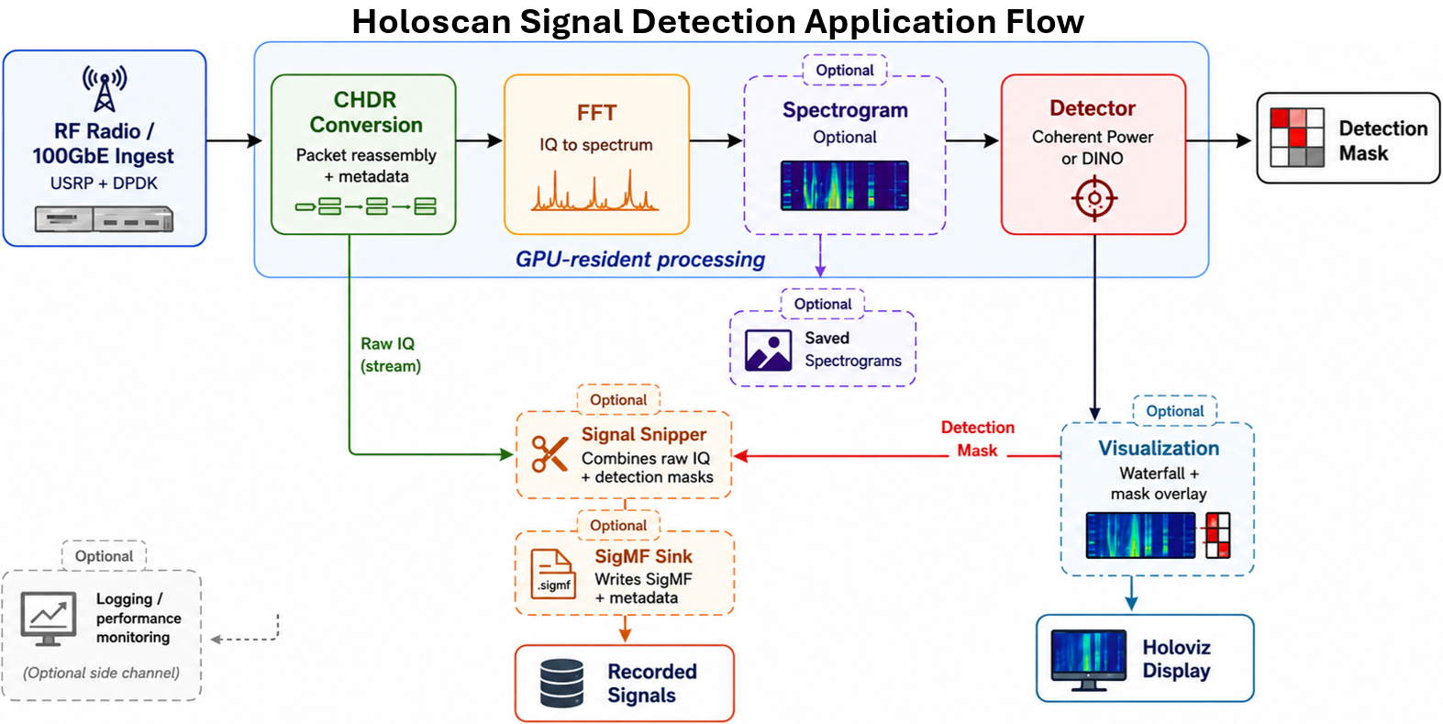
Notes:
We then create an application flow around this new ingest capability.
Our application converts the IQ to a spectrogram via a FFT, and then performs signal detection followed by signal extraction. This serves as the key upfront down selection process to prevent expensive downstream AI from being required to operate on every sample.

Slide 16
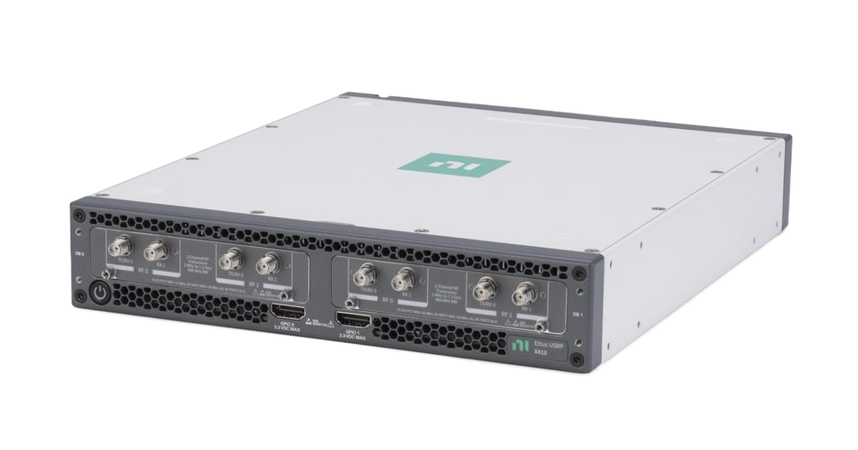
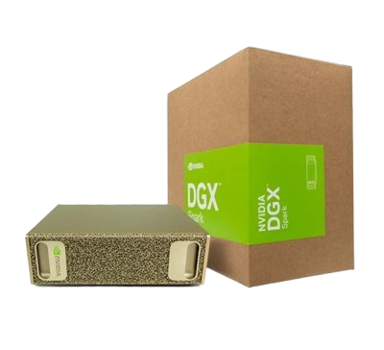
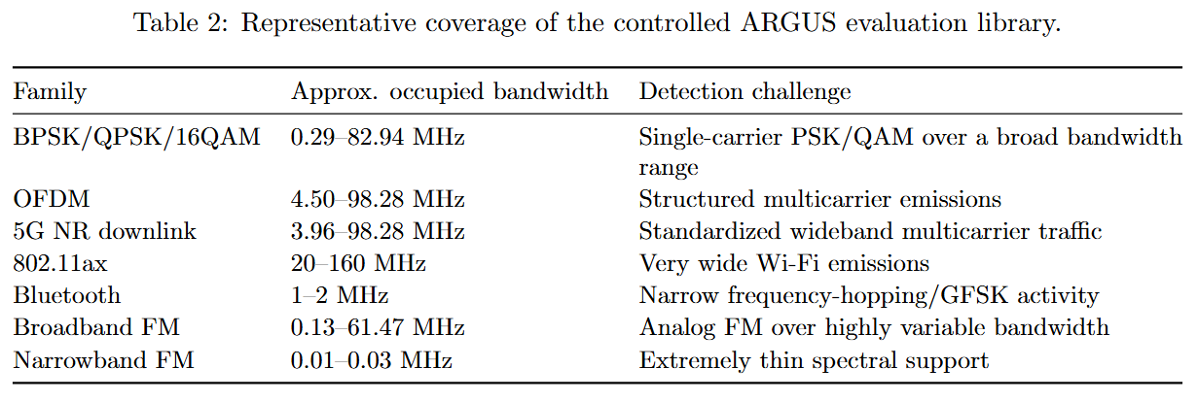

Control Setup
RF Coax
USRP X410
USRP X410
QSFP+ 100GE
Waveform Library
DGX Spark
ARGUS Framework

Slide 17
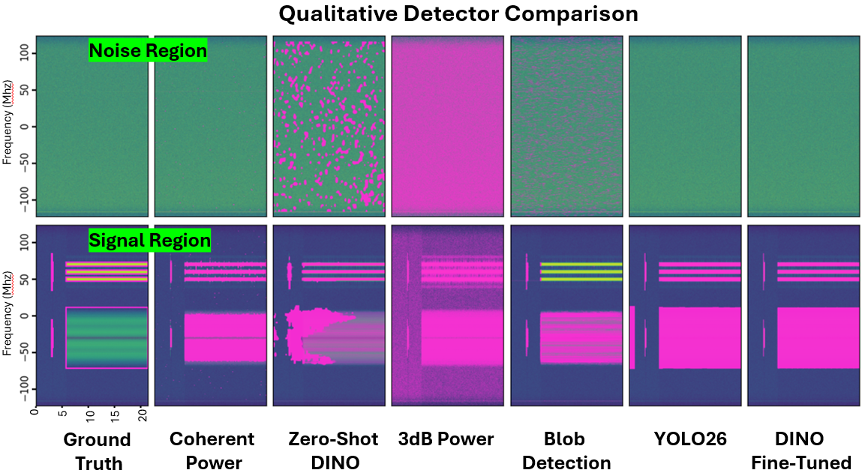
Notes:
To begin to get a feel for different detectors ranging from traditional signal processing approaches to computer vision to AI semantic segmentation, we qualitatively view different detector masks produced on the same input signal. We initially pick a non challenging high SNR capture, and provide ground truth for comparison.
We immediately notice some interesting observations:
The cleanest masks are produced by Yolo26, Dino fine tuned, and coherent power
Zero shot dino, 3db power, and blob detection also provide some potentially promising aspects and reasonable detection capabilities but all share a fatal flaw in that they produce an extremely high number of false positive detections. This is problematic for ARGUS as each false positive wasts those same downstream resources that we are utilizing ARGUS to attempt to preserve.

Slide 18
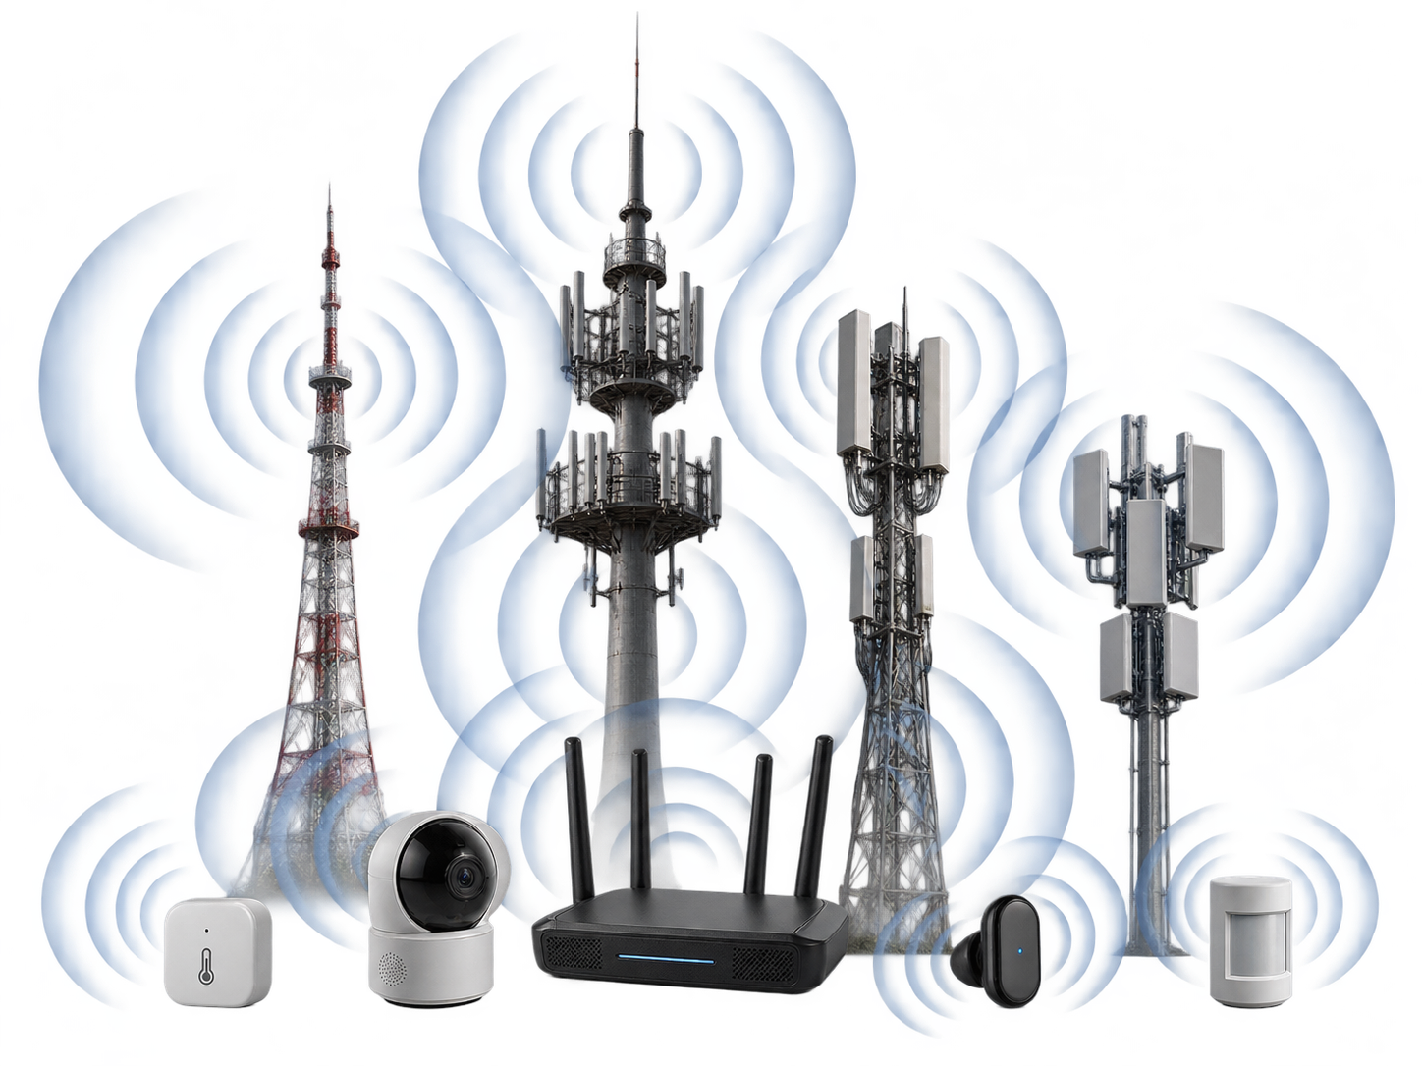
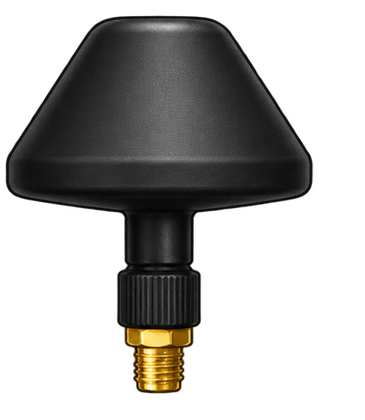
Deployment Setup
Wideband Antenna
USRP X410
QSFP+ 100GE
DGX Spark
ARGUS Framework
Notes:
After those evaluations we down selected to our most promising detectors and began stress testing them in unseen environments.
Here is what that setup looks like

Slide 19
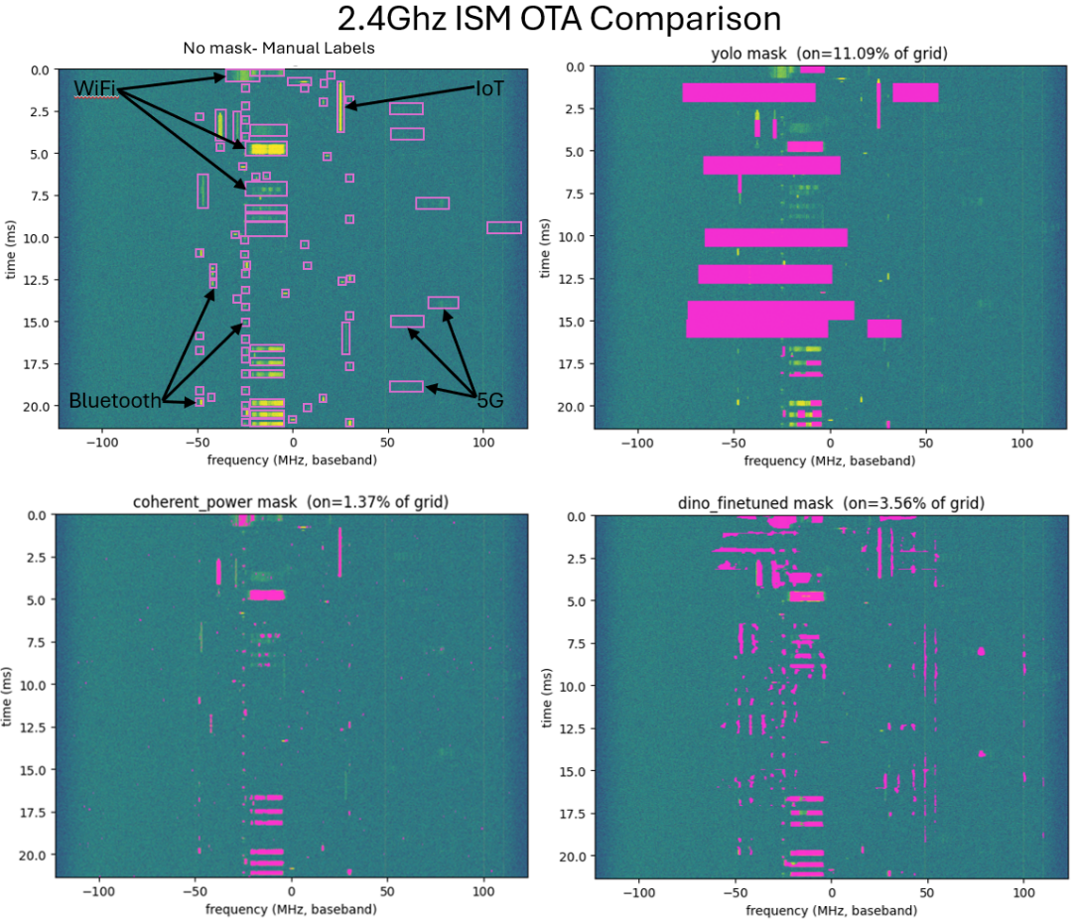
Stress Testing Detectors
Out of Distribution Environment
Fine-tuned DINO localizes several weaker structures near the visible noise floor
Coherent power primarily captures strong emissions
YOLO produces larger box-shaped regions and misses several narrowband structures.
Notes:
Now that we have our top 3 contenders, we importantly want to see how they do in an out of distribution environment. To do this we captured a frame from the 2.4GHz ISM band, and I manually labeled the signals in that environment.
coherent power primarily captures strong emissions, Fine-tuned DINO sees those and additionally localizes several weaker structures near the visible noise floor;
while YOLO produces larger box-shaped regions and misses several narrowband structures.
One plausible explanation is that YOLO’s box-regression objective imposes stronger assumptions regarding region shape, bandwidth, and object extent. In contrast, DINOv3 provides dense features obtained through broad self-supervised pretraining and is adapted using a per-pixel segmentation objective. These properties may make fine-tuned DINO less dependent on the specific box geometries represented in the supervised training set. However, the present experiment does not independently control for pretraining, architecture, output representation, loss function, and fine-tuning strategy. We therefore treat this interpretation as a hypothesis rather than a demonstrated causal explanation.

Slide 20
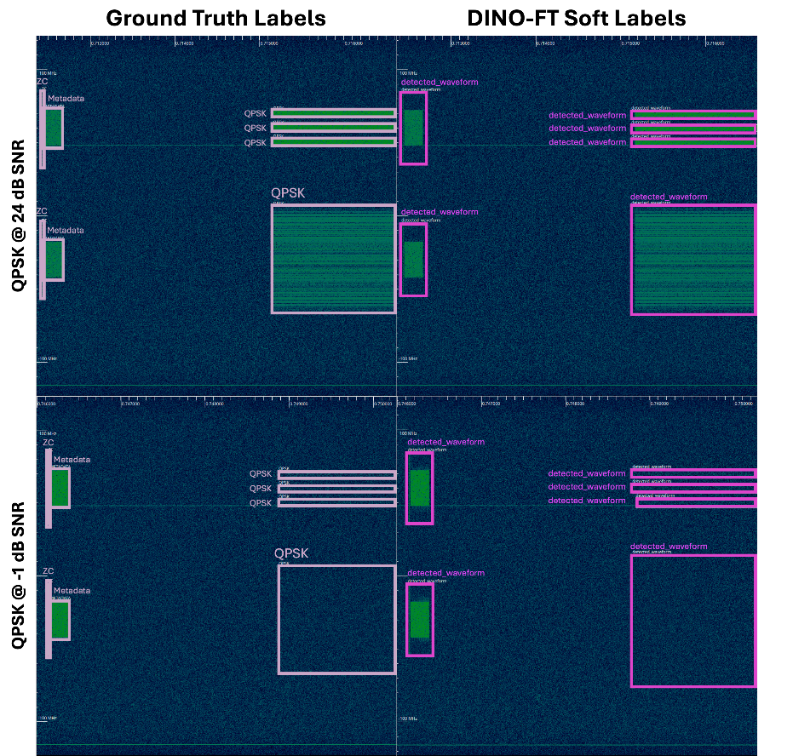
Stress Testing Detectors
Low SNR Conditions
Can you see the QPSK signal in the orange region?
DINO can!
DINO-FT shows impressive capability to localize signal region below the noise

Slide 21
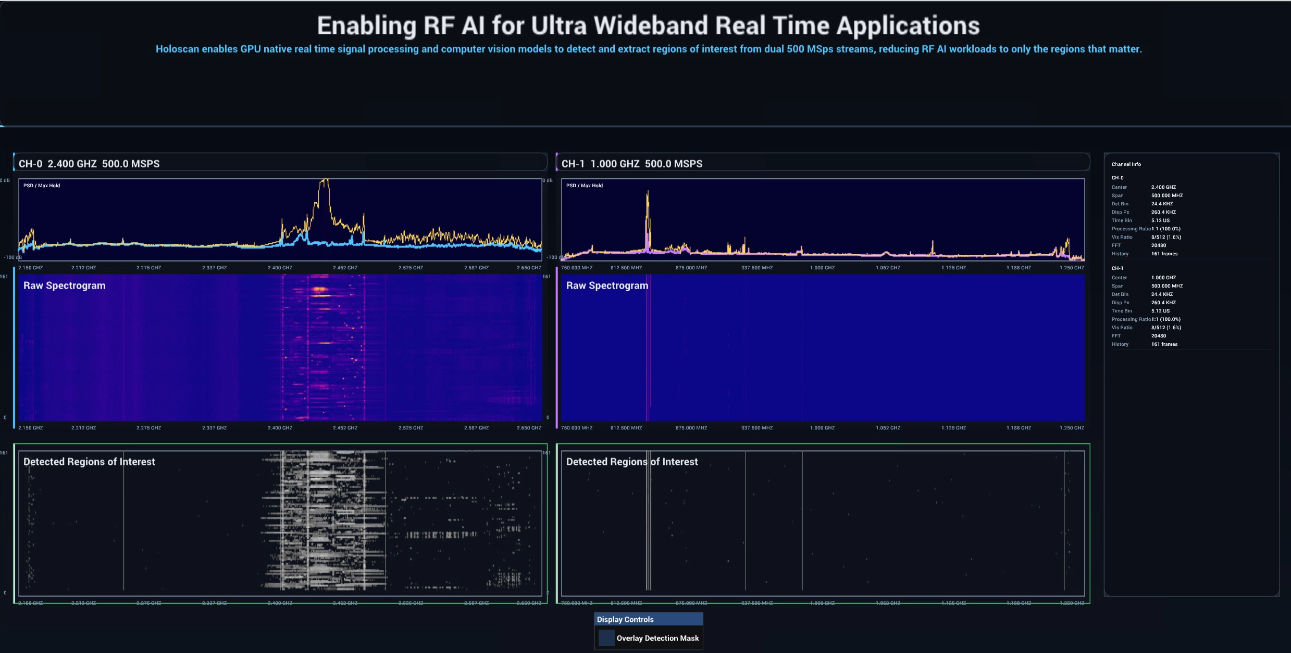
Demo
Notes:
And finally here is a live demo of the system in action. We gave this demo as part of the NI connect keynote this year, and have the updated version of it scheduled to appear at GRCon in September running off of a DGX spark.
In this demo you can see ARGUS operating using the fast coherent power implementation on two simultaneous 500Msps channels.

Slide 22
GNU Radio and GPUs

Slide 23
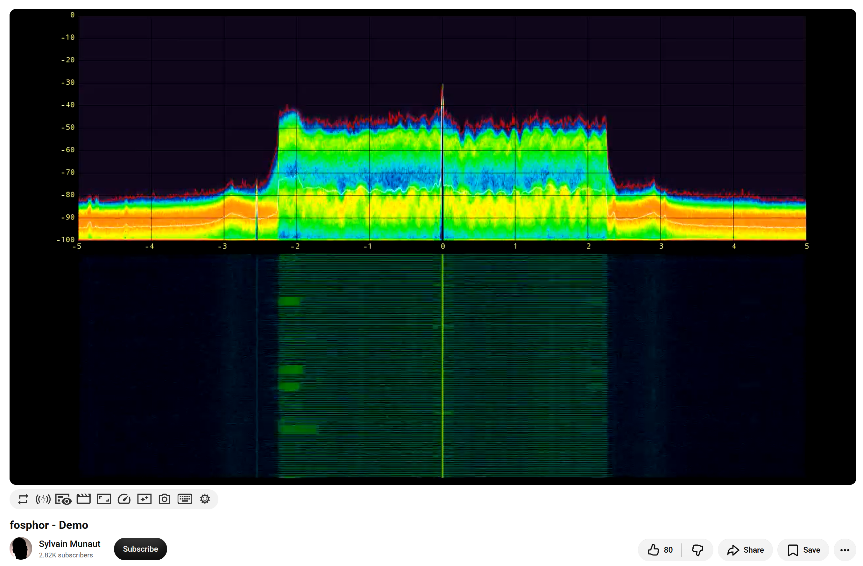
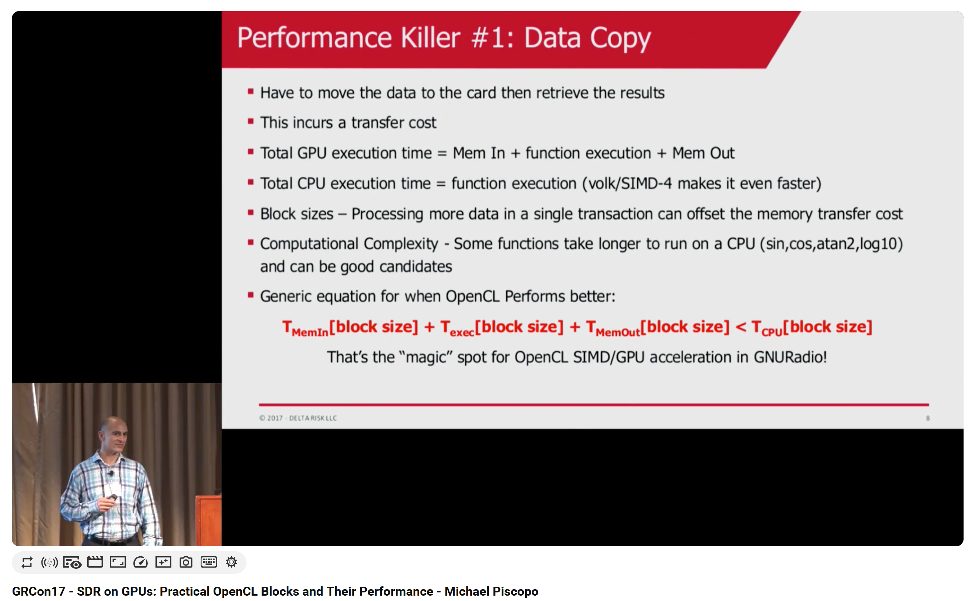
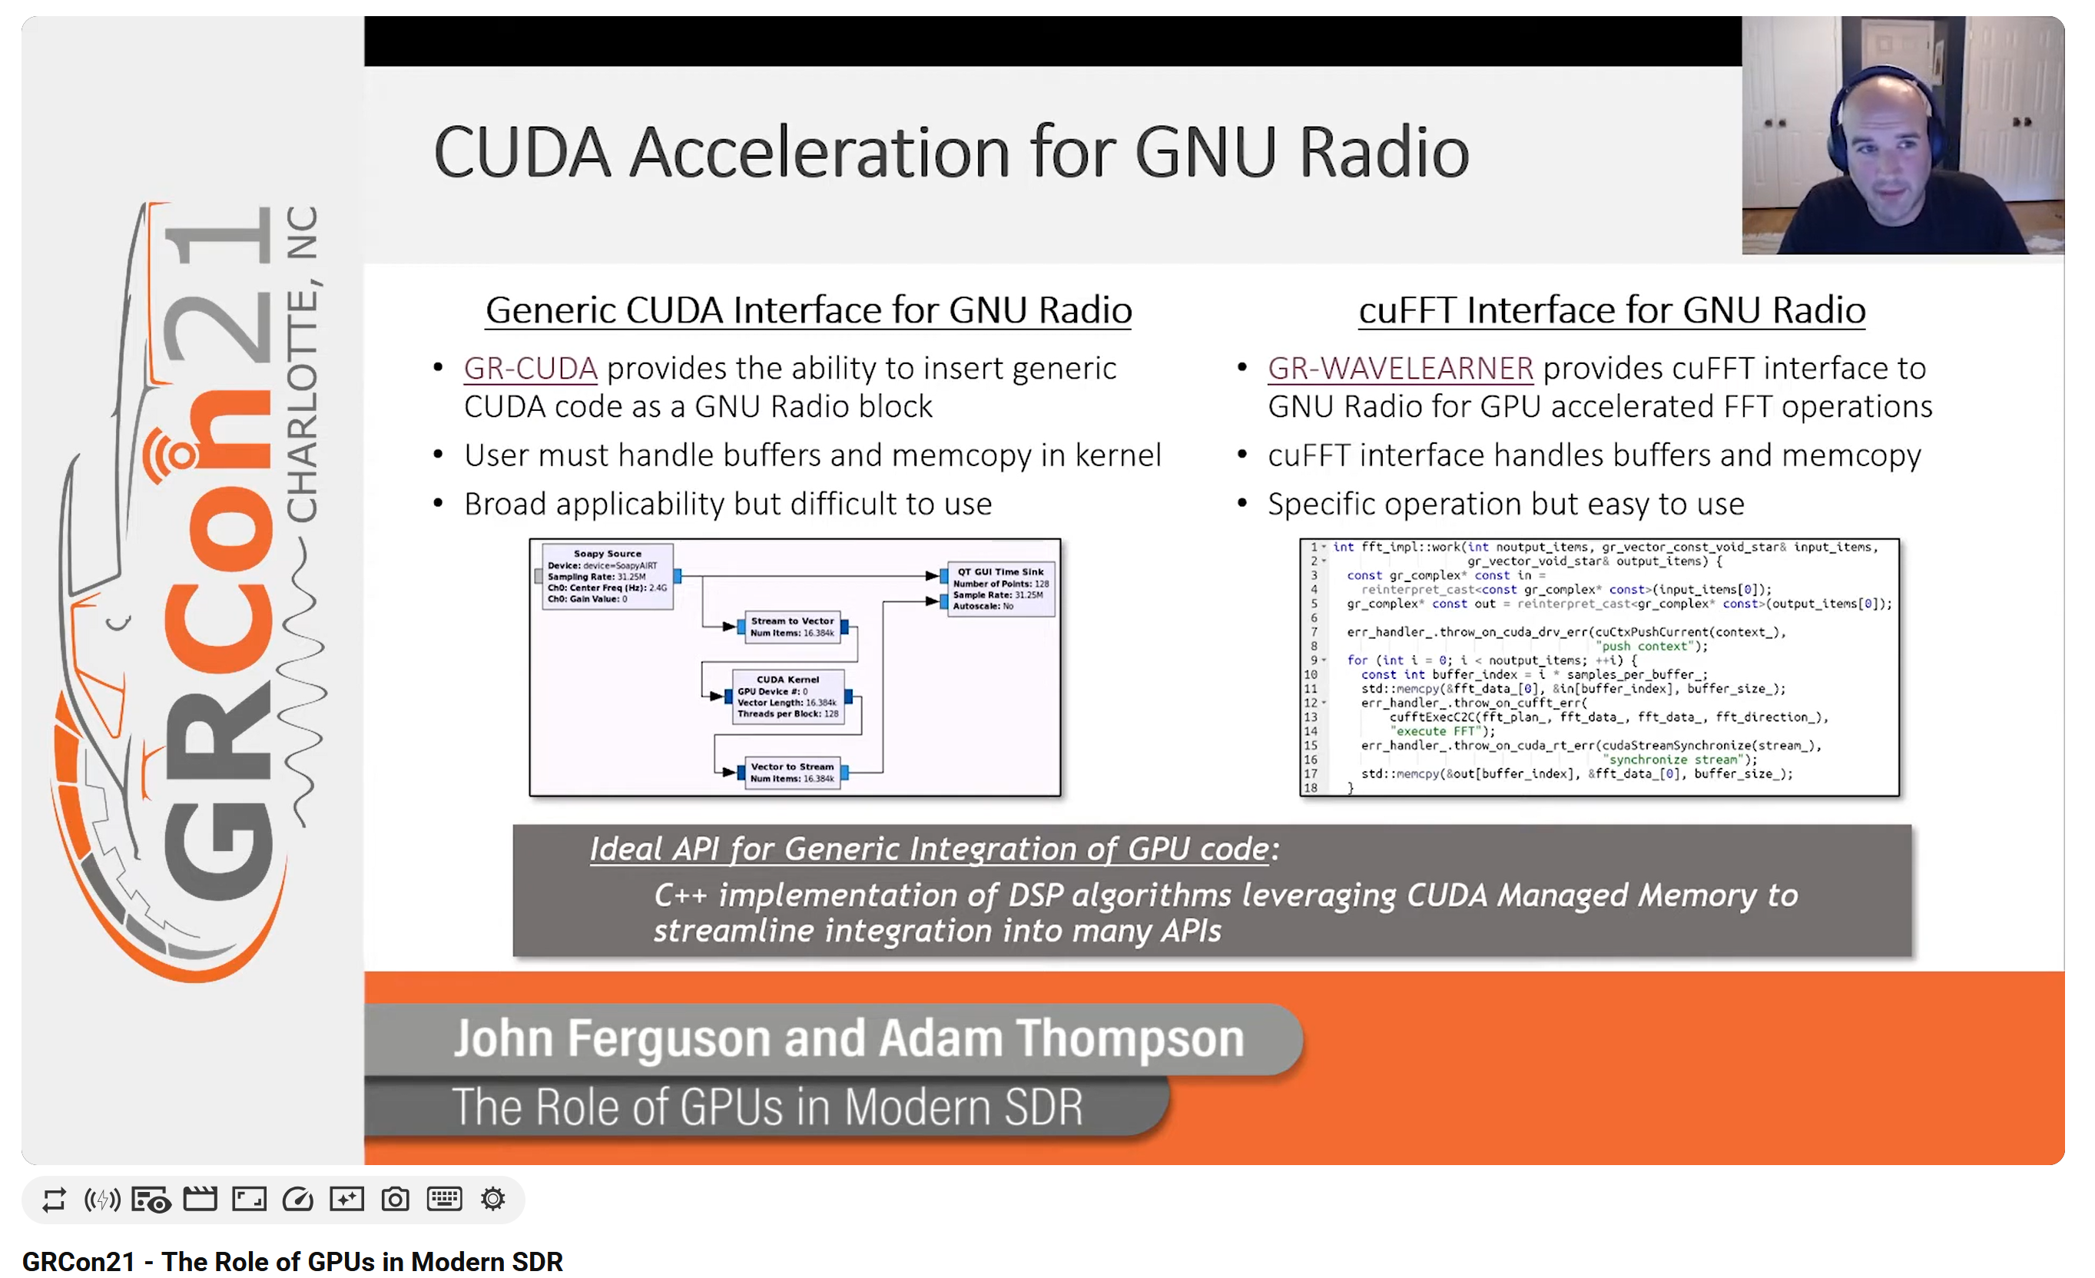
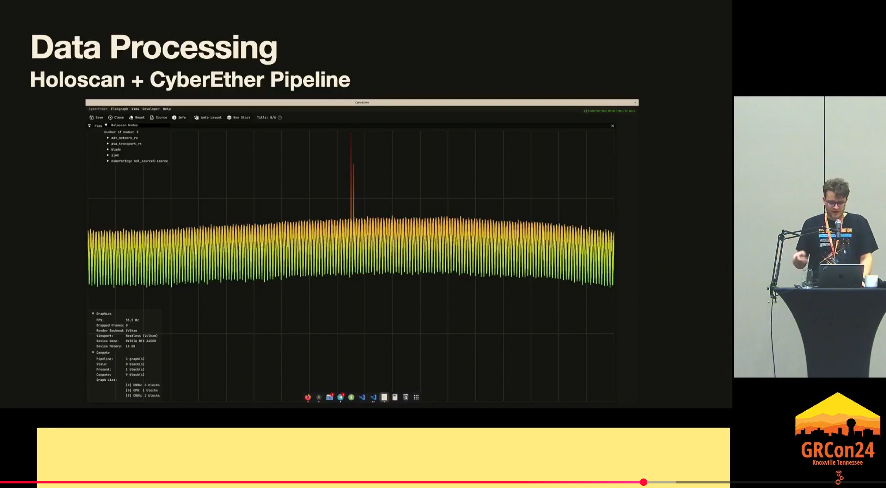
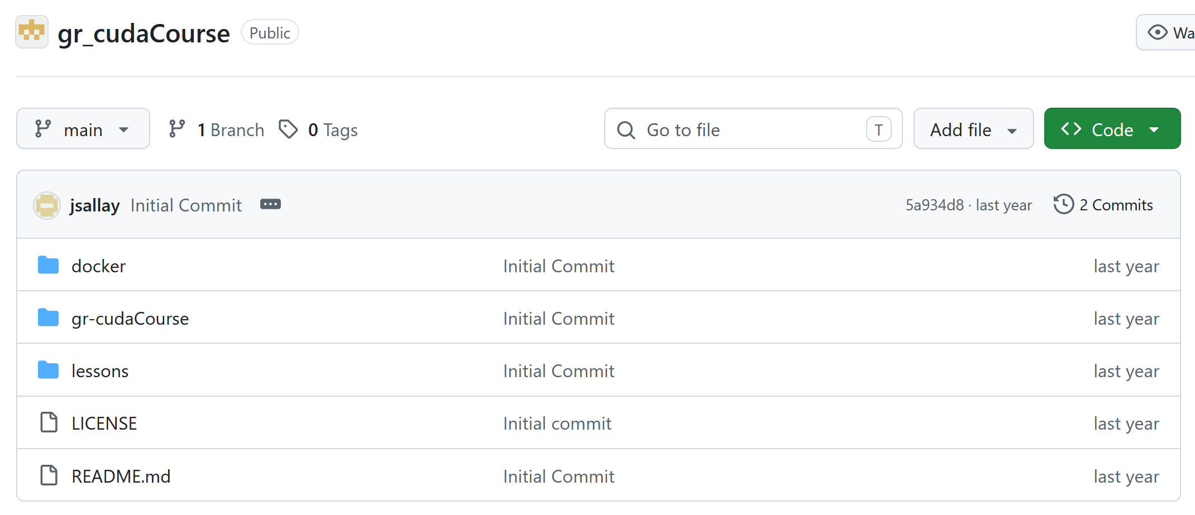
A brief history…
GPUs and SDRs go way back, but the first “big bang” was probably
fosphor (and gr-fosphor) by Sylvain (OpenCL-based)
Mike P. (among others!) talked about accelerating blocks with GPUs as early as 2017
DARPA + BlackLynx bring us custom buffers, and with that comes gr-cuda
Adam T. and his gang have been coming to GRCon for a while now, showing off new tools for use with SDRs
Luigi keeps building crazy cool apps that build on GPUs (among other things)
JohnS and Beecubed provide tutorials for gr-cuda
I probably forgot loads of people
Kudos, shoutouts, respect, and all the appropriate credit to all these folks!

Slide 24
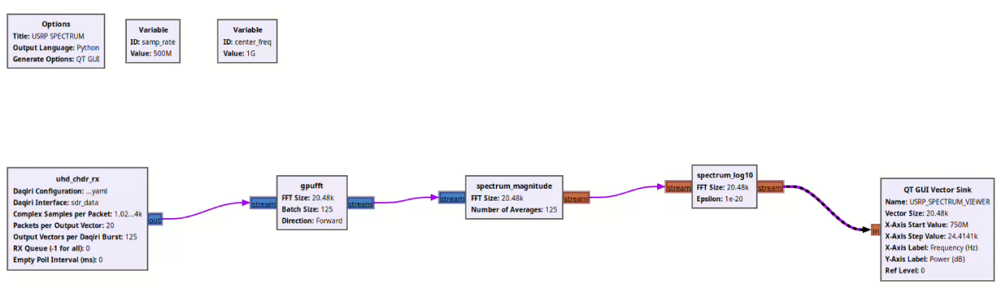


gr-cuda ❤️ Daqiri
CPU
https://github.com/gnuradio/gr-cuda
GPU
CUDA Interoperability
Goal
Move, process and visualize I/Q data (500 Msps). All on GPU!
Current State
Integrated DAQIRI into GNU Radio ecosystem
Created FFT, magnitude and log conversion blocks (similar to Holoscan)
Able to achieve 90% full functional GPU pipeline, “only” visualization missing
What’s missing?
Idea: visualization using CUDA interop (CUDA + openGL)
Add remote streaming configuration as GNU radio block
Notes:
What other frameworks do we have which are working seamlessly with USRP? -> GNU Radio + CUDA? -> gr-cuda
Goal
Move, process and visualize I/Q data. All on GPU!
Current State
Integrated DAQIRI into GNU Radio ecosystem
Created FFT, magnitude and log conversion blocks (similar to Holoscan)
Able to achieve 90% full functional GPU pipeline, “only” visualization missing
Next
Idea: visualization using CUDA interop (CUDA + openGL)
Add remote streaming configuration as GNU radio block

Slide 25
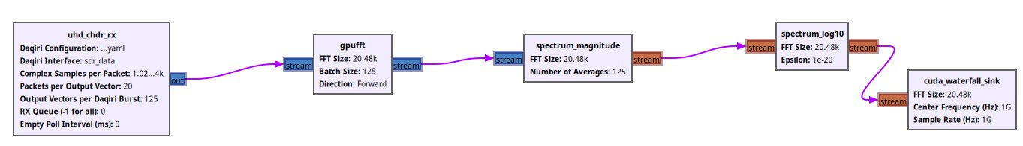
gr-cuda ❤️ Daqiri
https://github.com/gnuradio/gr-cuda
CUDA Interoperability
Goal
Move, process and visualize I/Q data (500 Msps). All on GPU!
Current State
Integrated DAQIRI into GNU Radio ecosystem
Created FFT, magnitude , log conversion and visualization blocks (similar to Holoscan)
Able to achieve 100% full functional GPU pipeline with maximum I/Q data (1500Msps)
What’s missing?
Add remote streaming configuration as GNU radio block
Notes:
What other frameworks do we have which are working seamlessly with USRP? -> GNU Radio + CUDA? -> gr-cuda
Goal
Move, process and visualize I/Q data. All on GPU!
Current State
Integrated DAQIRI into GNU Radio ecosystem
Created FFT, magnitude and log conversion blocks (similar to Holoscan)
Able to achieve 90% full functional GPU pipeline, “only” visualization missing
Next
Idea: visualization using CUDA interop (CUDA + openGL)
Add remote streaming configuration as GNU radio block

Slide 26
That’s all for now
Bottom line: There are great ways for SDR/GPU integration
This is all pretty new
gr-cuda blocks: We still need to figure out open-sourcing mechanics
Please pester us with questions!

