Slide 1
Lllama and the Lake Monster
SDR in Neutral Atom Quantum Computing
Robin Coxe (AB1WM)
rcoxe@atom-computing.com
Chief Control Systems Engineer
Atom Computing Inc.
GNU Radio Conference 2021
23 September 2021

Slide 2
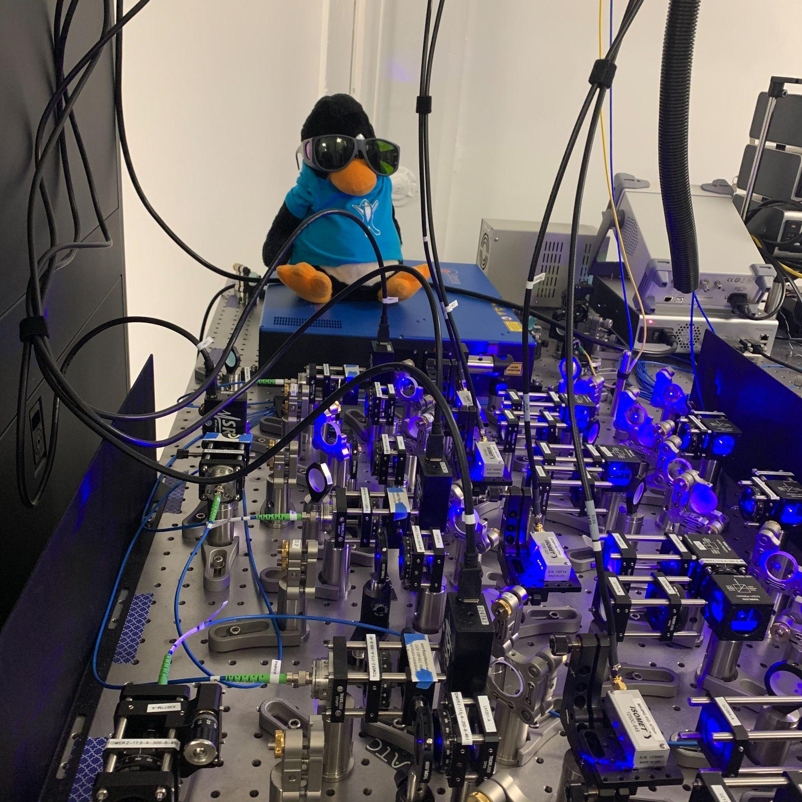
Outline
What is a Quantum Computer?
Why use Neutral Atoms for Quantum Computing?
How? Lasers!
(Classical) Control System Electronics
SDR and GNU Radio in Quantum Computing
Hapyxelor the Canadian Lake Monster (RAWR!): Custom RF Waveform Generator
Lllama: GNU Radio in Action
Atom Computing: Who are we?

Slide 3
What is a Quantum Computer?
Quantum Computers employ a computational model based on the principles of quantum mechanics
Quantum Strong Church-Turing Thesis: any physical computing device can be simulated efficiently by a fault-tolerant quantum computer
Extension to SCTT: any algorithmic process can be simulated efficiently by a probabilistic Turing Machine
Processes dictated by classical physics cannot simulate quantum mechanics in tractable timeframes (pointed out by Feynman, Deutsch, and others in the 1970s and 1980s).
Both classical and quantum computers can be expressed in terms of a uniform set of reversible circuits
Classical Computer: Binary Bits (0 or 1) and, e.g. {NAND, FANOUT}
Quantum Computer: Qubits and, e.g. {Rotation Operators, Phase Shift, CNOT <-> 1 and 2 qubit gates}
Rotation by angle 𝛳 about x, y, z axis of the Bloch sphere
Phase shift: trace a horizontal circle on the Bloch sphere by ɸ radians.
CNOT: acts on 2 qubits, and performs the NOT operation on the second qubit only when the first qubit is |1>

Slide 4
Qubit? Bloch Sphere? Eh?
Qubit: the fundamental unit of quantum computation
The physical realization of a qubit is a two-state quantum mechanical system.
Mind-bending Oddity of Quantum Mechanics: a qubit is a coherent superposition of both states
Superposition = complex linear combination not “in both states at the same time”
Probability amplitudes represented by complex numbers: 𝜶|0> + 𝜷|1>
Probability amplitudes can both constructively & destructively interfere (quantified by relative phase of 𝜶 and 𝜷)
Qubit collapses to one of the two states only upon measurement
Decoherence introduced by external perturbations to a quantum system can mimic erroneous measurements, hence the need for fault-tolerance.
Bloch Sphere: Geometrical representation of a qubit
State probabilities determined by θ
Operations on qubits can be represented by rotations on the Bloch sphere.
By Smite-Meister - Own work, CC BY-SA 3.0,
https://commons.wikimedia.org/w/index.php?curid=5829358

Slide 5
Quantum Computation
The inputs to a quantum computer are registers of qubits in an initial state.
A quantum circuit selectively interferes the components of the input according to a predetermined algorithm.
The magic of quantum interference results in the cancellation of all possibilities except the solution to the algorithm.
For operations with multiple entangled qubits, the combined state contains more information than each qubit individually.
Quantum computers must support at least 2-qubit gates to take advantage of entanglement.
Quantum Teleportation: impart information from one entangled qubit to another regardless of physical separation!
Entangled qubits enable the generation of the most random of random numbers.
Sampling from Probability Distributions: pattern recognition, probabilistic inference, better Monte Carlos
Simulation of Quantum Systems and Quantum Chemistry Computations
Linear algebra on steroids! Optimization problems! Deep learning tensor networks! Break the blockchain!
Some Examples: https://www.ibm.com/quantum-computing/business/
Quantum Entanglement
Applications for Quantum Computers

Slide 6
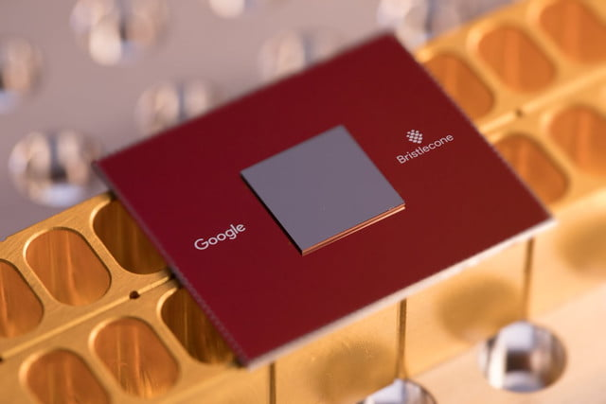
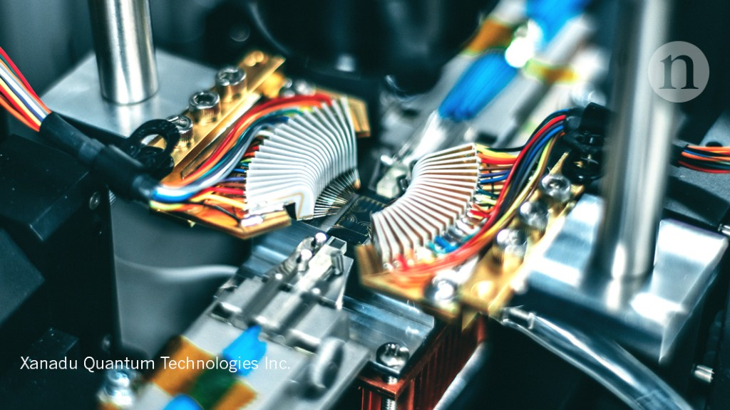
Why Neutral Atoms for Quantum Computing?
Alternative Approaches:
Superconducting transmon qubits made from Josephson junctions (IBM, Google)
Trapped ions (Honeywell, IonQ) and Photonics (PsiQuantum, Xanadu)
Advantages of Neutral Atoms:
Long qubit coherence times (>10s) compared to <10⁻⁴ s for transmons & <0.1 s for trapped ions
Arrays of identical atoms that can be trapped and cooled with lasers.
No semiconductor process variations across qubits.
Alkaline-earth elements: have atomic level structures conducive to qubit operations
Can operate at room temperature without bulky dilution refrigerators.
Low-loss readout by taking images. No need for dedicated readout electronics for each qubit.
Smaller than semiconductor qubits. Attainable array size scales with laser power.
Notes:
Skip over alternative approaches to save time.

Slide 7
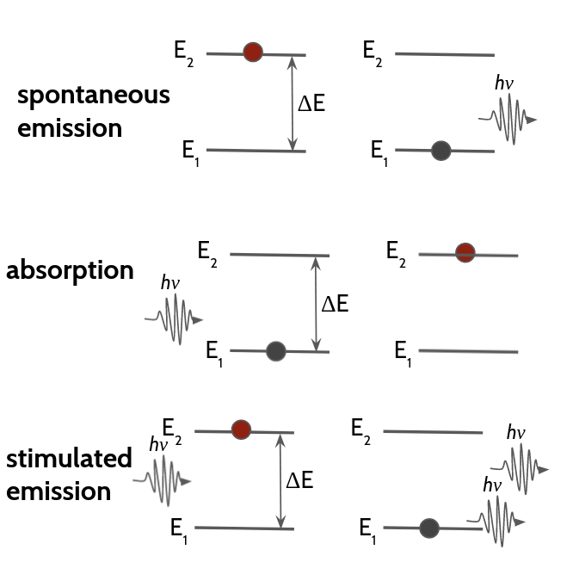
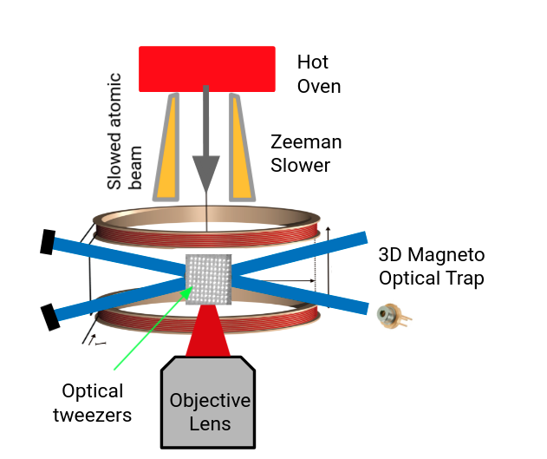
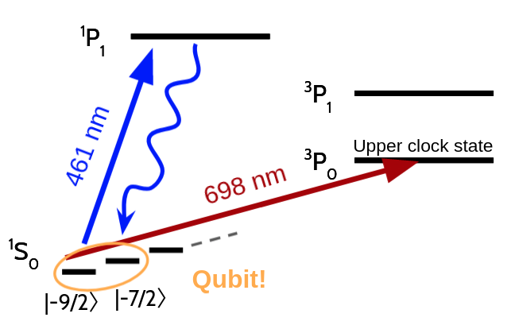
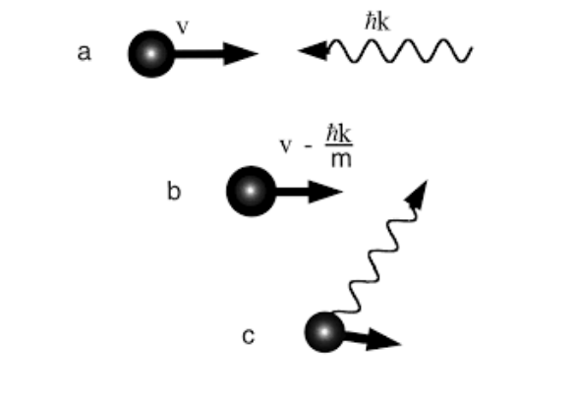
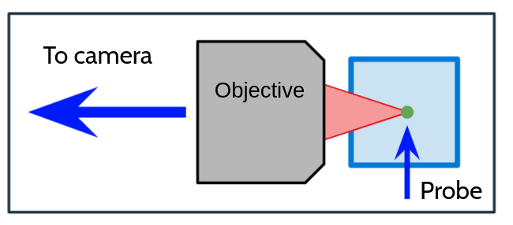
Lasers, Magnets, and the Magic of Atomic Physics
Laser Cooling
Atoms + Lasers
Optically Trapped Neutral Atoms
Shelving & Imaging
Use lasers and magnetic fields to cool atoms down to μK and compensate for the Doppler effect (1997 Nobel Prize in Physics)
Use magnetic fields to split atomic energy levels into closely packed sub-states that can be individually addressed with lasers
Use lasers to prepare atoms in state configurations conducive to quantum computation
Use lasers for state-specific qubit readout with a CCD imager: count photons emitted when atom decays back to ground state
In order to orchestrate these interactions, we need to precisely control the duration, frequency, amplitude, and phase of the suite of lasers in the control system at ns timescales→ use RF pulses to control lasers → SDR!

Slide 8
Quantum Control of Neutral Atoms
Make a single qubit
Start with a cloud of Strontium-87 atoms boiled off of a block of Sr in an oven
Cool the atoms
Isolate a single atom in an optical dipole trap formed by focused laser beams
Scale to many qubits
Make an array of traps
Cool the atoms some more
Completely fill the portion of the array dedicated to quantum computation
Perform gate operations on qubits
Address individual atoms
Construct and 1-qubit and 2-qubit gates with sequences of laser pulses
𝜋-pulse is a 180 degree rotation on the Bloch sphere (translates from |0> to |1> and vice versa).
𝜋/2-pulse creates an equal superposition of |0> and |1> states

Slide 9
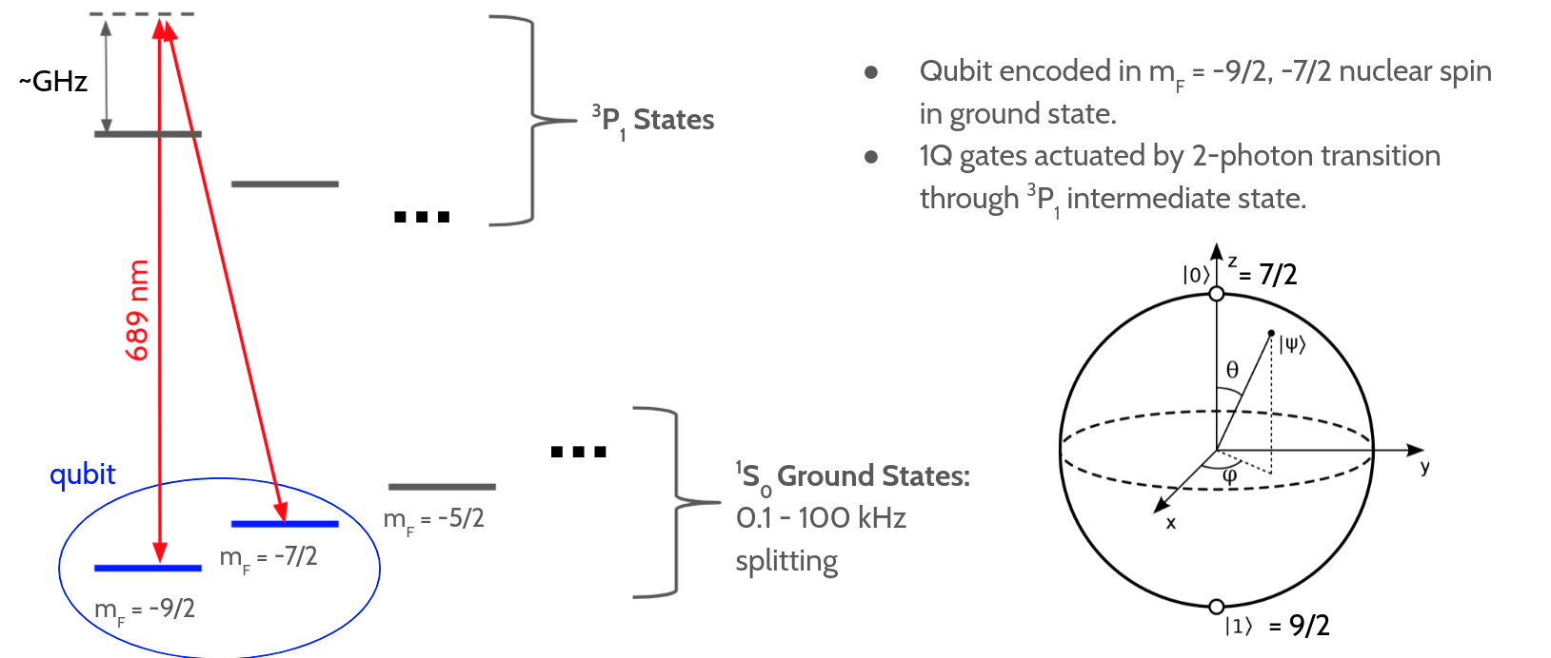
One-Qubit ⁸⁷Sr Gates
Notes:
We’re using the off-resonant coupling to coherently rotate from -9/2 to -7/2 because we actually never want any population in the 3P1 state (which would lead to decoherence).
1Q gates actuated by 2-photon transition mediated by the off-resonant 3P1 state.
Zeeman effect: hyperfine splitting of ground state energy levels in the presence of a B field

Slide 10
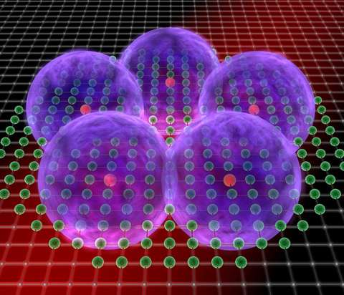
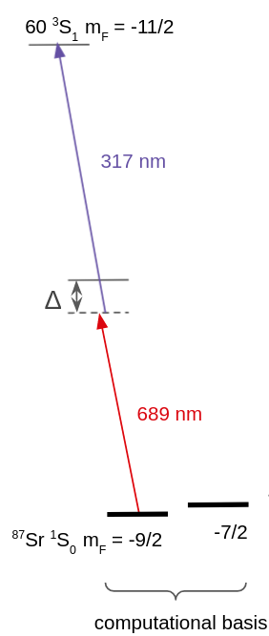
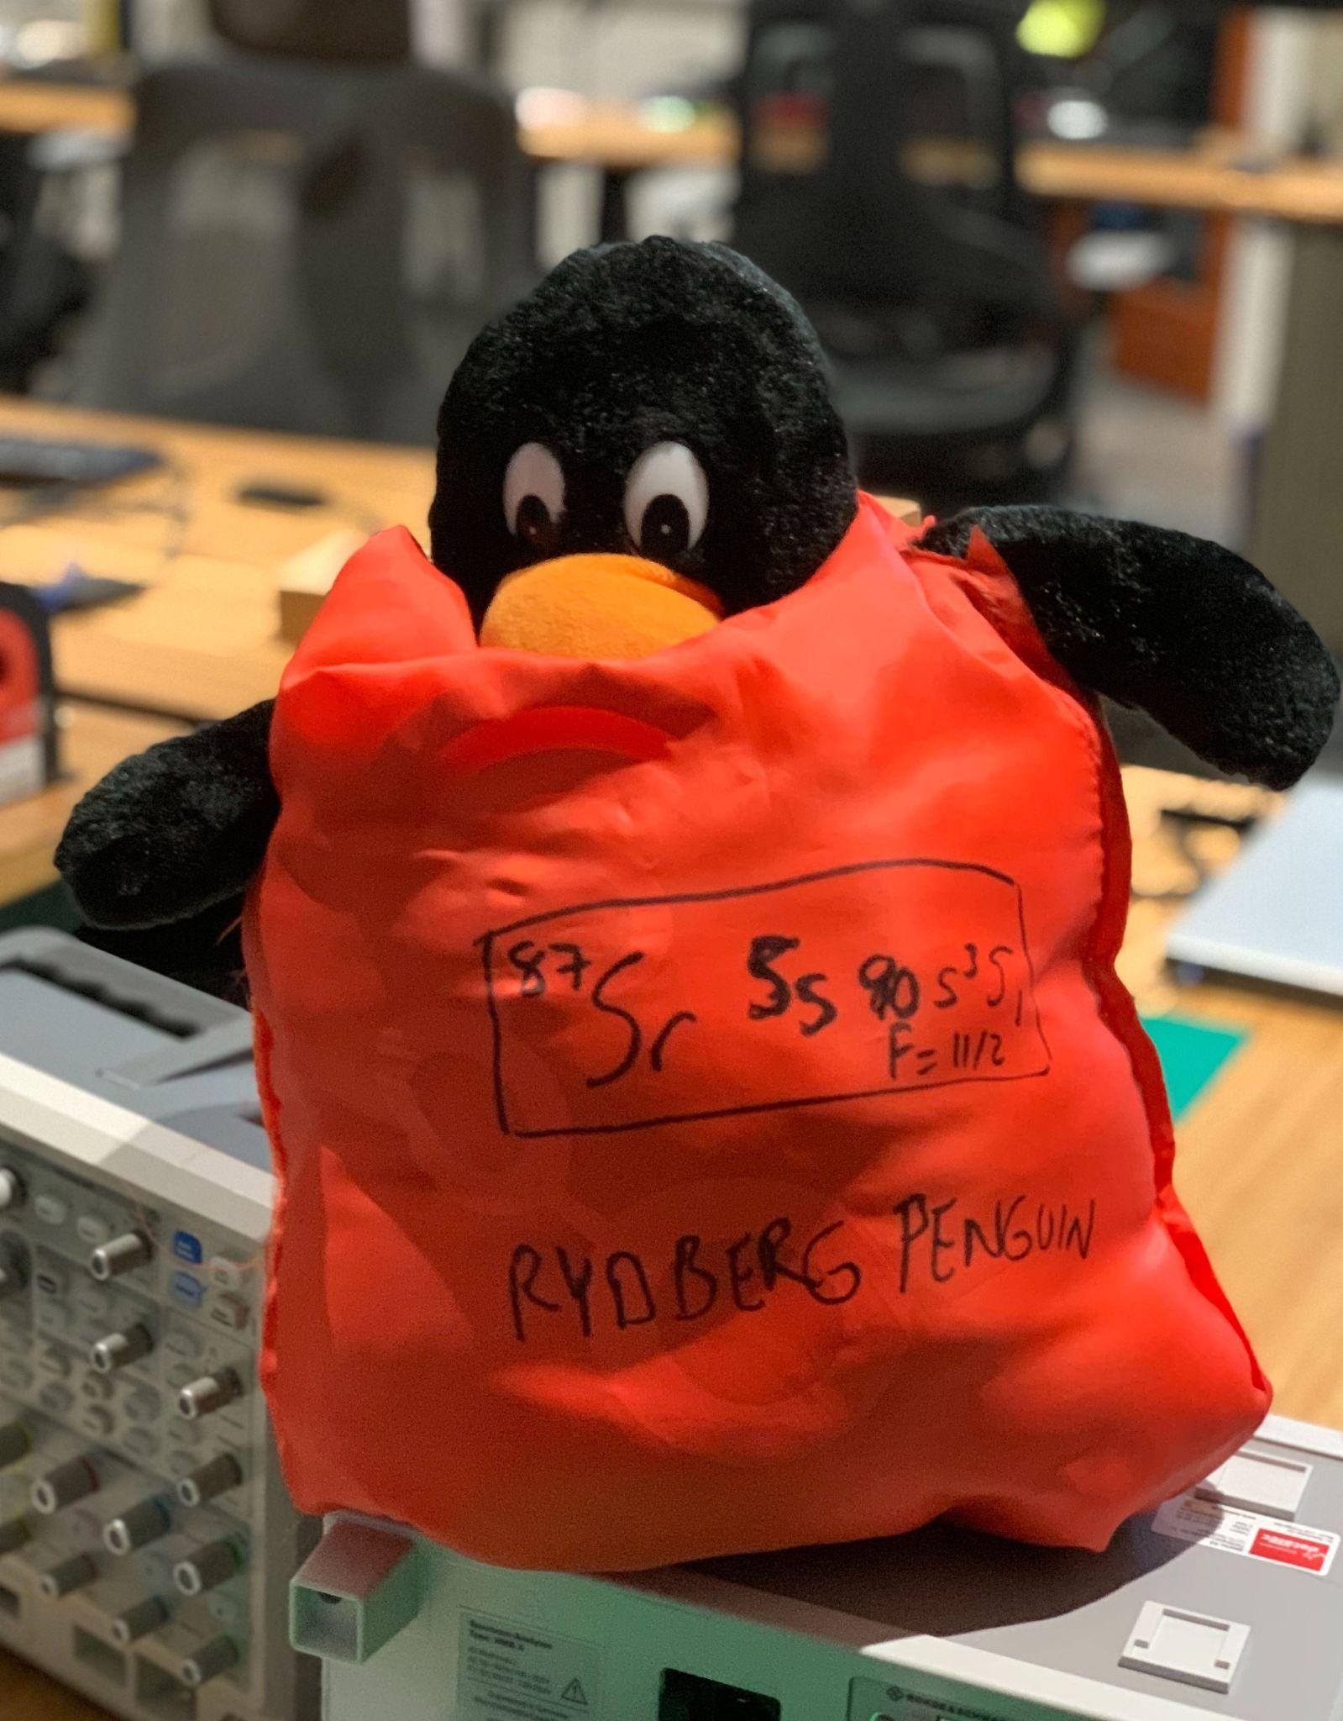
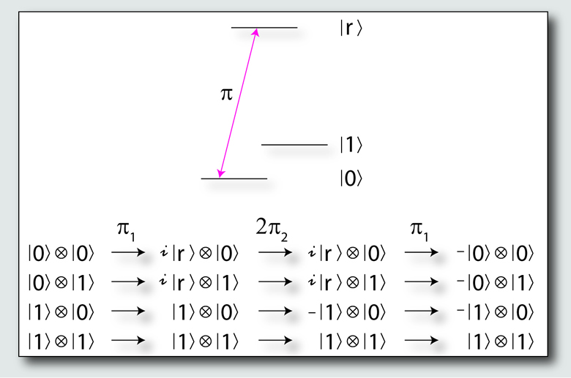
Two-Qubit ⁸⁷Sr Gates
Rydberg Atoms
Use two neighboring atoms and the Rydberg Blockade effect to create a 2-qubit gate equivalent to a CNOT or C-Phase gate (i.e., target atom can only be excited if control atom is in the ground state)
Rydberg Atom: an atom in an excited state with a large principal quantum number resulting in a bloated electron cloud
Use a UV laser (ƛ= 317 nm) to create Rydberg states
Rydberg Blockade: if atom #1 is in a Rydberg state, atom #2 in a neighboring trap few ㎛ away is prohibited from entering the Rydberg state due to dipole forces exerted by the atom #1 on atom #2, since the UV laser is no longer resonant with the shifted energy level of atom #2.
Rydberg Penguin
C-PHASE Gate
Reference: https://cold-atoms.physics.lsa.umich.edu/projects/dipoleblockade/motivation.html
Notes:
C-gates or “Controlled” Gates are 2-qubit gates and are only actually iff control qubit is in a specific state.
CNOT gate can be used to entangle/disentangle Bell State: 1/sqrt(2)[ |0>_a + |1>_a + |0>_b → 1/sqrt(2) [ |00> + |01>]

Slide 11
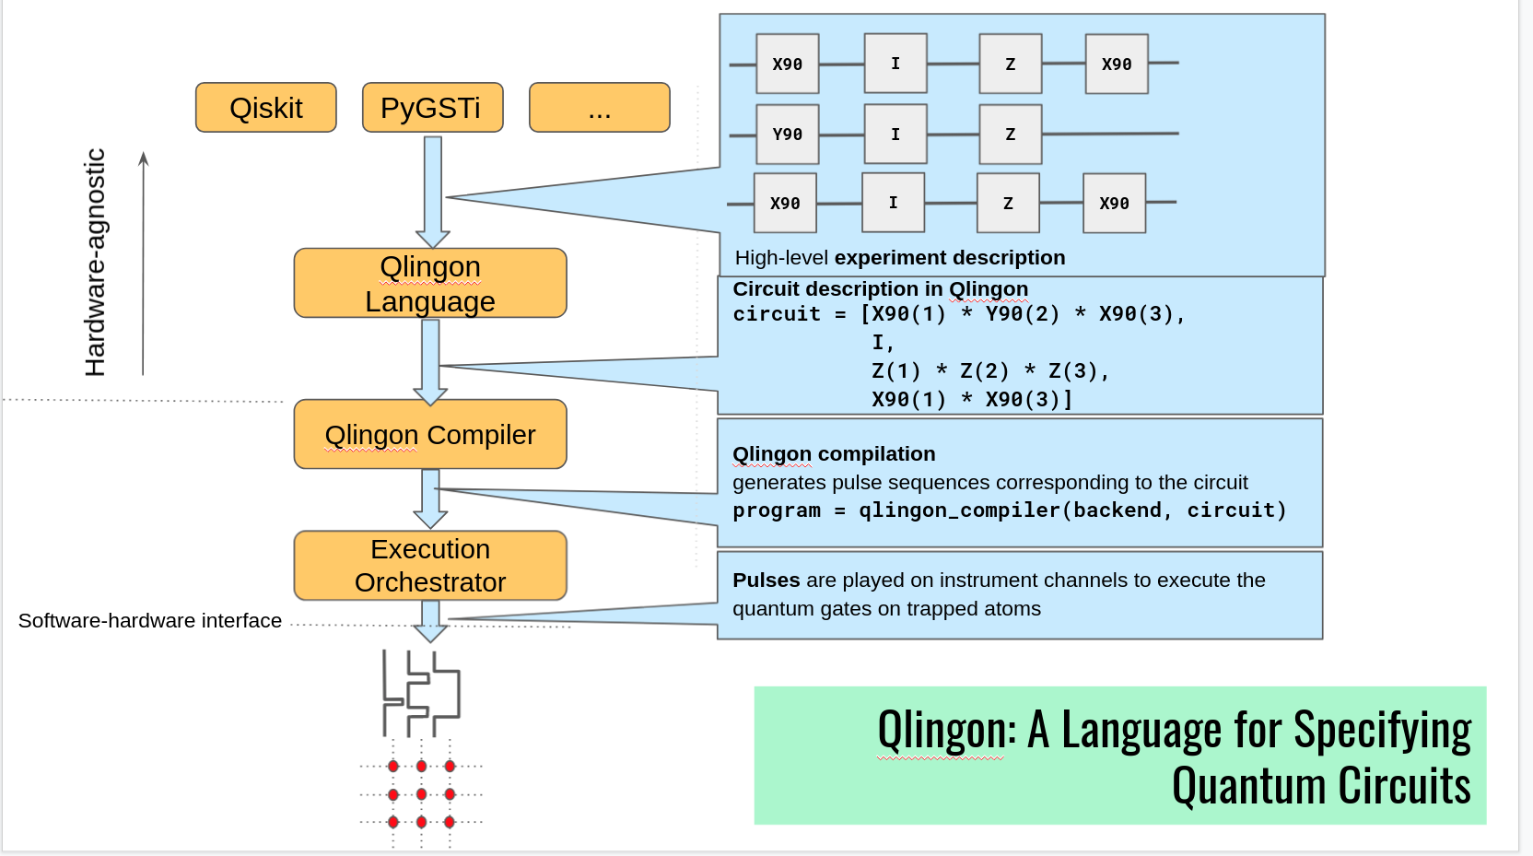
Neutral Atom Quantum Computing: The Stack
Lower Level Sequence Description
Public API
Internal Quantum Information UI
High-level Quantum Language
In-house Quantum Gate DSL
Sequence Pipeline Compiler
Job Queue
Control Systems Group:
Basement Troglodytes of the Stack
Digital and Analog Sequencer
Laser Cooling & Trapping
Readout Hardware
Laser Actuators
Optically Trapped Strontium Atoms

Slide 12
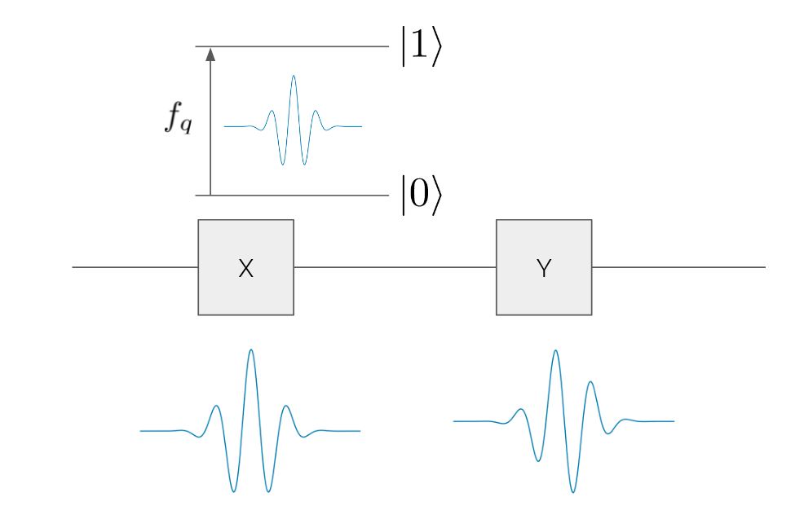
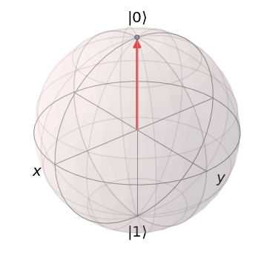
Represent Quantum Circuits as RF Pulses
𝜋-pulse
Image Credits: Prasahnt Sivarajah
Phase-Coherent Pulses at ~10 ns Timescales
Notes:
Rotation by pi radians about an axis of Bloch sphere: X gate: |0> to |1> and vice versa;Y gate: |0> to i|1> and |1> to -i|0>; Z gate: |0> to |0> and |1> to -1|1> (phase flip)
Area under the pulse determines exactly how much of the population we transfer from one state to the other.
The shape of the pulse can also have a huge effect on the performance of the gate.

Slide 13
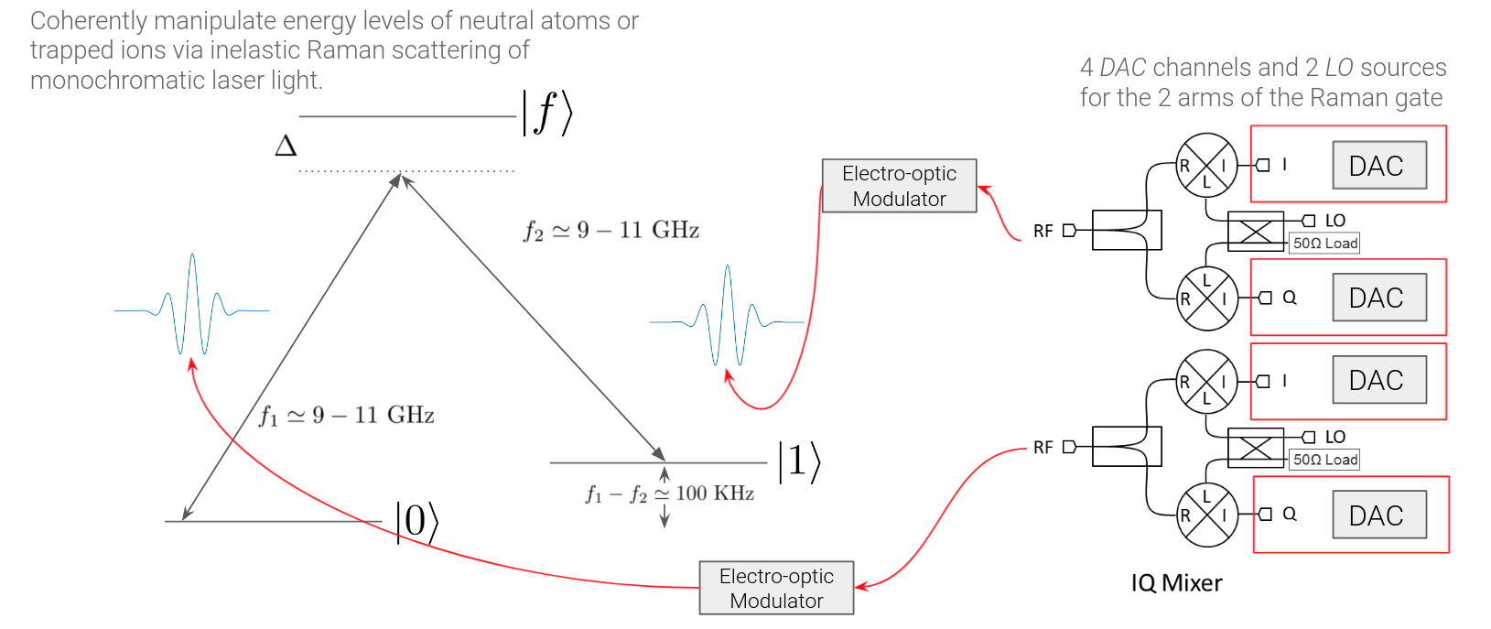
Use an SDR to Create a 1-Qubit Gate
Notes:
Separation of the 2 states is ~100s of kHz and matches the qubit frequency

Slide 14
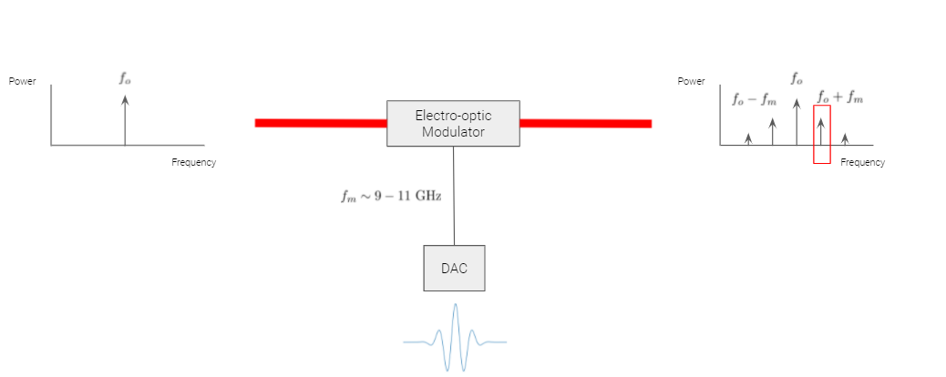
Actuate Stimulated Raman Transitions for 1Q gates with EOMs
Notes:
EOM enables microwave RF pulse to be “imprinted” on the laser beam to induce the stimulated Raman transition by adding a time-dependent phase to the laser beam, resulting in a sideband a fo+fm.

Slide 15
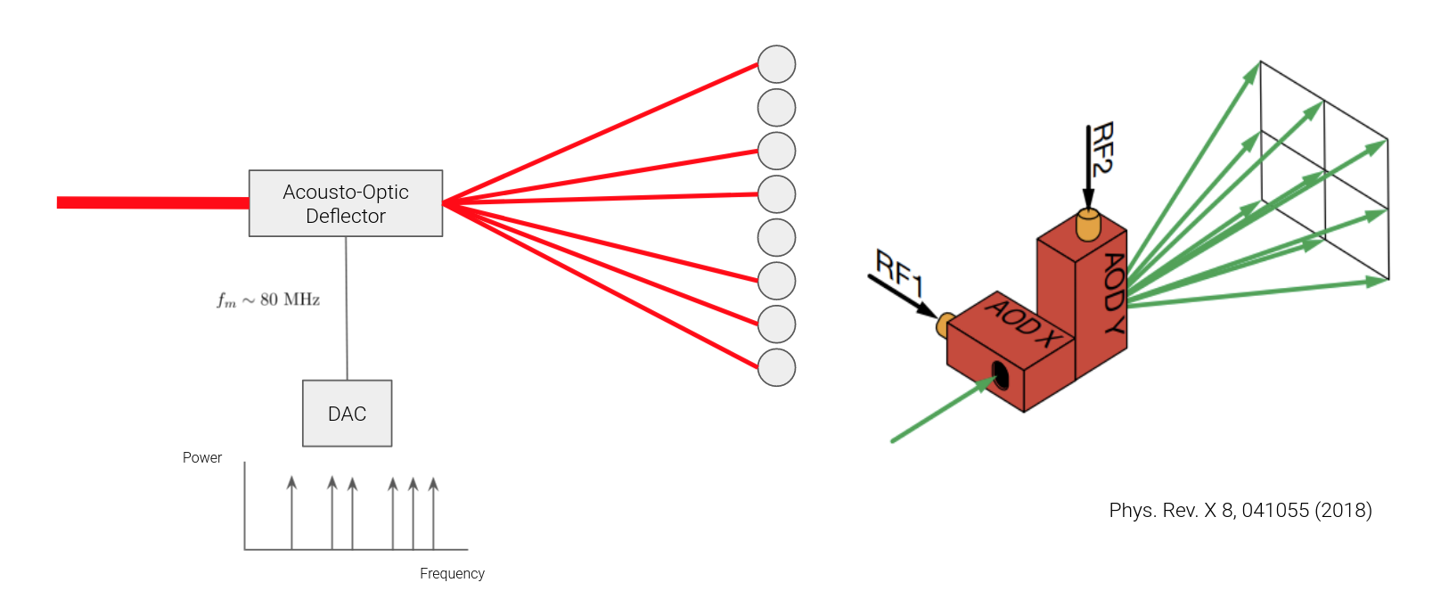
Selectively Address Trapped Atoms with RF Tones
Notes:
frequency of AOD tone → deflection angle of laser light

Slide 16
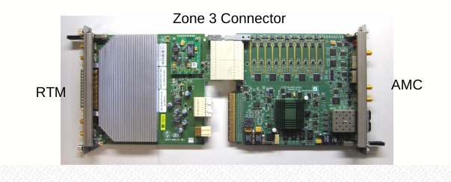
Enabling Technologies
Software Defined Radio:
Programmable RF Pulser is essentially a wired SDR
SDRs can be used for monitoring laser frequency locks and controlling AODs and EOMs
RF DACs/ADCs, RF integrated transceivers and components, and FPGA IP
But no cost-effective commercially available SDRs can transmit >8 GHz, so we’re making our own
Particle and Atomic, Molecular, and Optical (AMO) Physics:
Open source electronics developed for particle accelerator control using the MicroTCA standard
Commercially-available instrumentation developed by academic/national labs: e.g., CERN, DESY, NIST
emCCD cameras for imaging

Slide 17
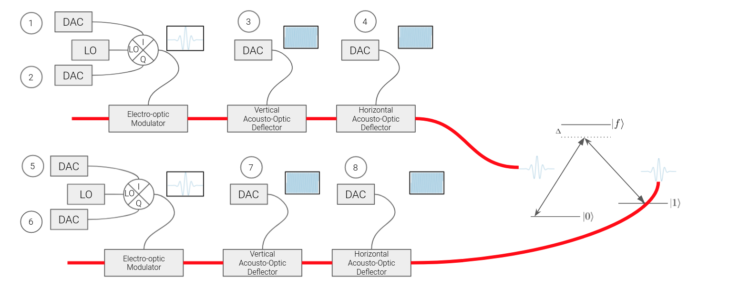
Address 1-Qubit Gates with 8 DAC Channels

Slide 18
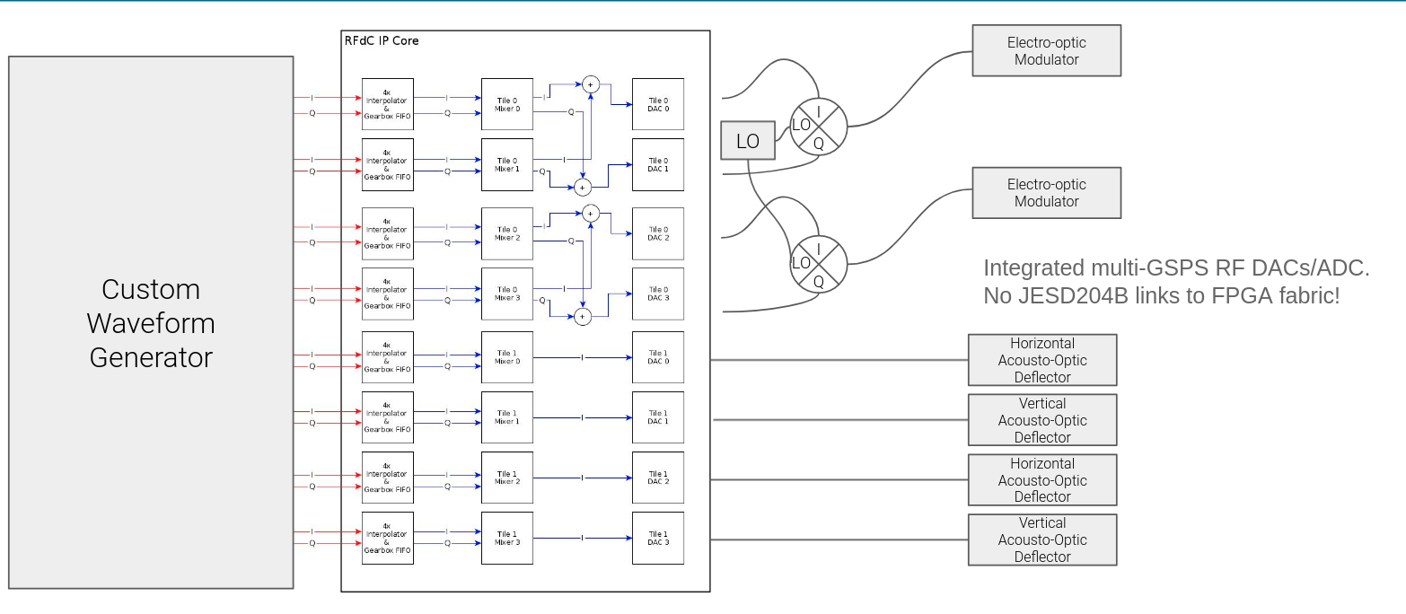
Hapyxelor: Xilinx RFSoC-based Custom Waveform Generator
(and Canadian Lake Monster)
CPU + FPGA LAND
RF LAND
LAND
Monster Reference: https://itsmth.fandom.com/wiki/Hapyxelor

Slide 19
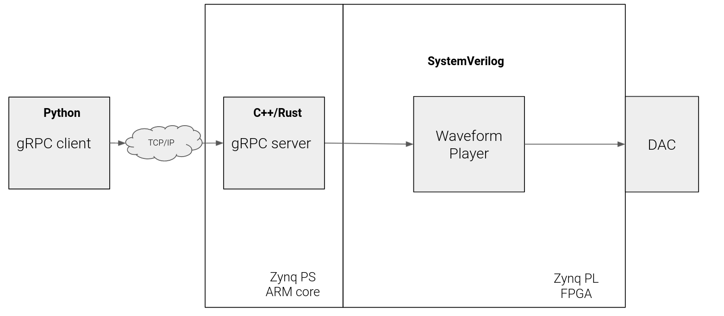
Hapyxelor FPGA and Software Architecture

Slide 20
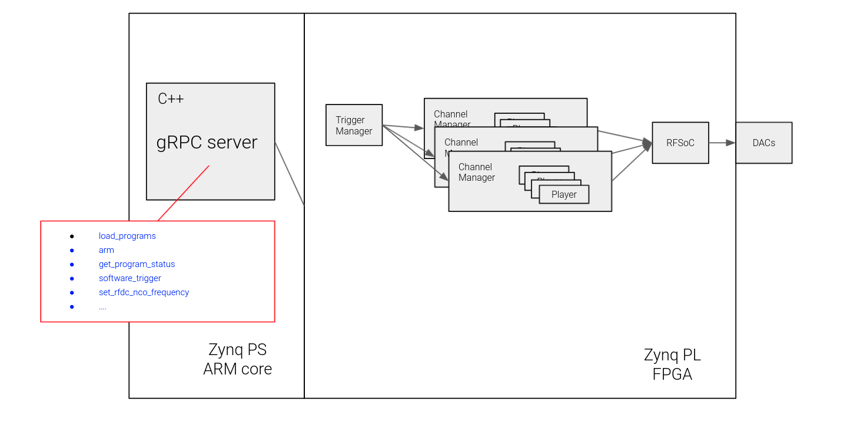
Hapyxelor Server & FPGA Gateware
set_rfdc_nco_frequency
software_trigger
get_program_status
arm
load_programs
...
Channel Manager <-> DAC channel
Multiple Waveform Players can be associated with one Channel Manager

Slide 21
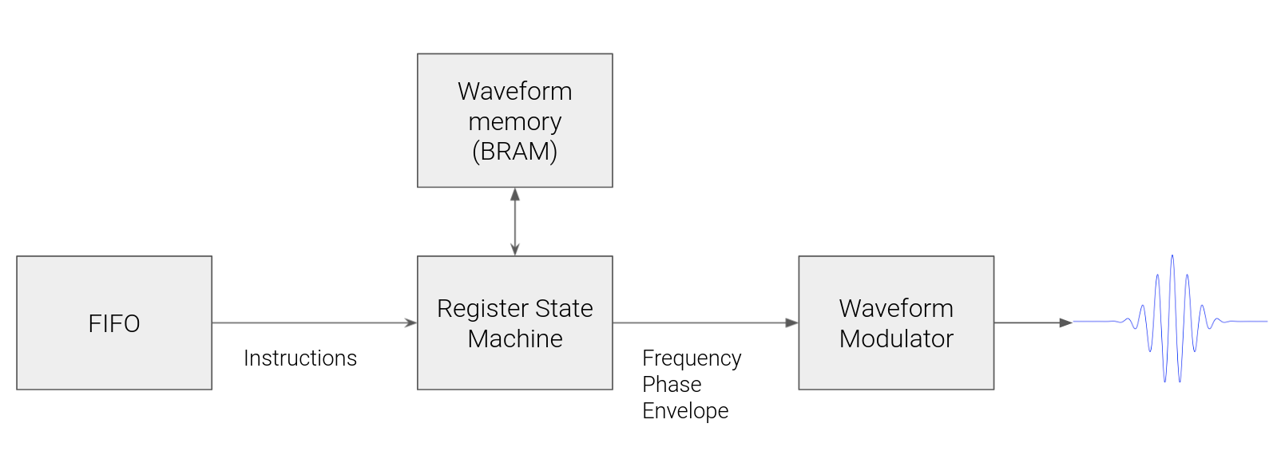
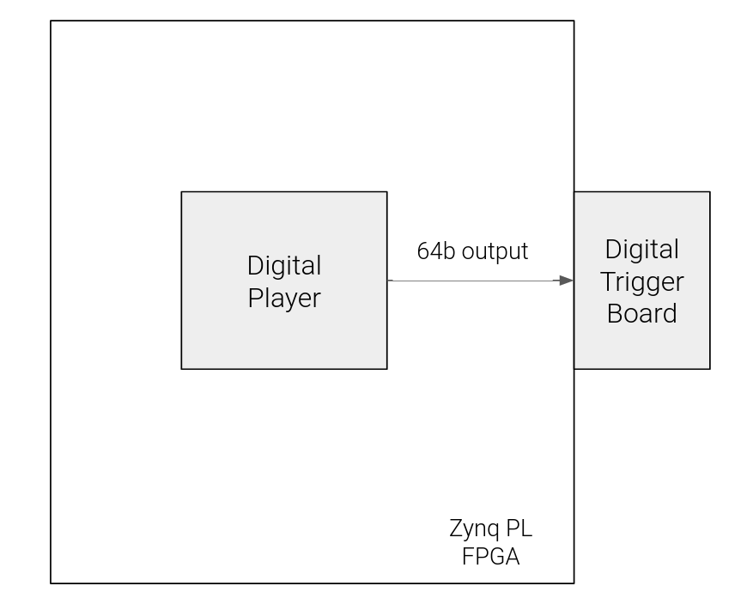
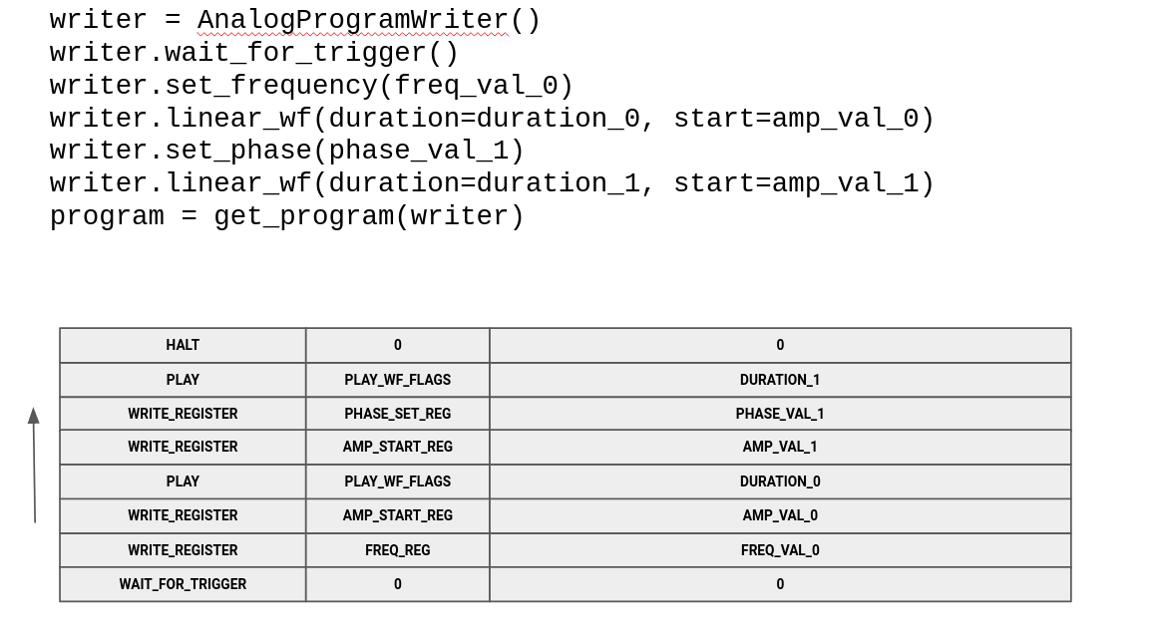
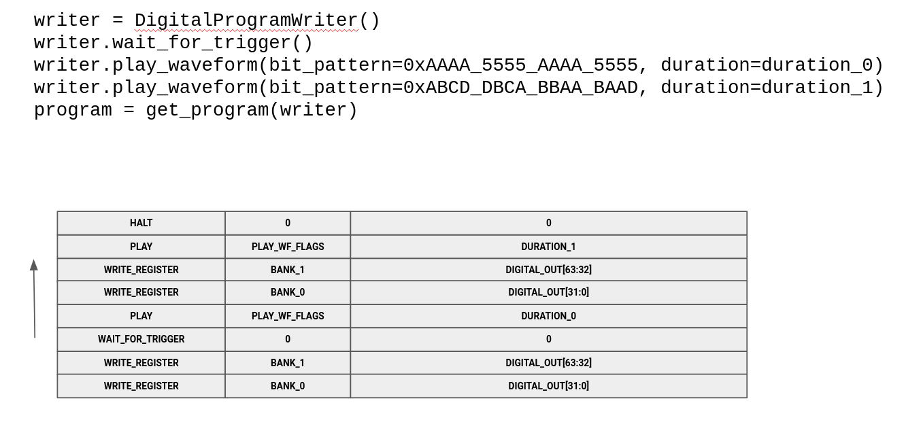
Hapyxelor Waveform and Digital Players

Slide 22
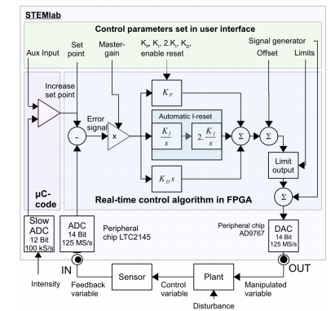
Use RFSoC ADCs as inputs to digital PID controllers
DC-couple the RFSoC ADCs to measure photodiode voltage outputs that scale with laser intensity
Digital PID implemented as an FIR or IIR filter in the FPGA
Integrator Windup is an issue for Analog PID controllers
Easy for a digital PID: reset the integrator
Amplitude Modulate the RF DAC outputs
Bandwidth of digital servos limited by the latency of ADC/FPGA/DAC path (typically 100s of KHz to a few MHz)
Typical Digital PID Implementation
Reference: https://arxiv.org/pdf/1709.07188.pdf
Notes:
RFSoC ADCs are total overkill, but hey, we get 8 of them for free, so we might as well use them.

Slide 23
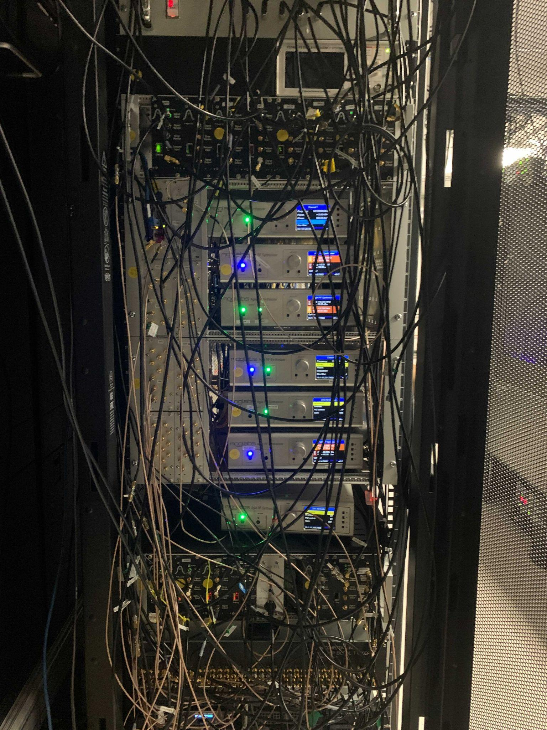
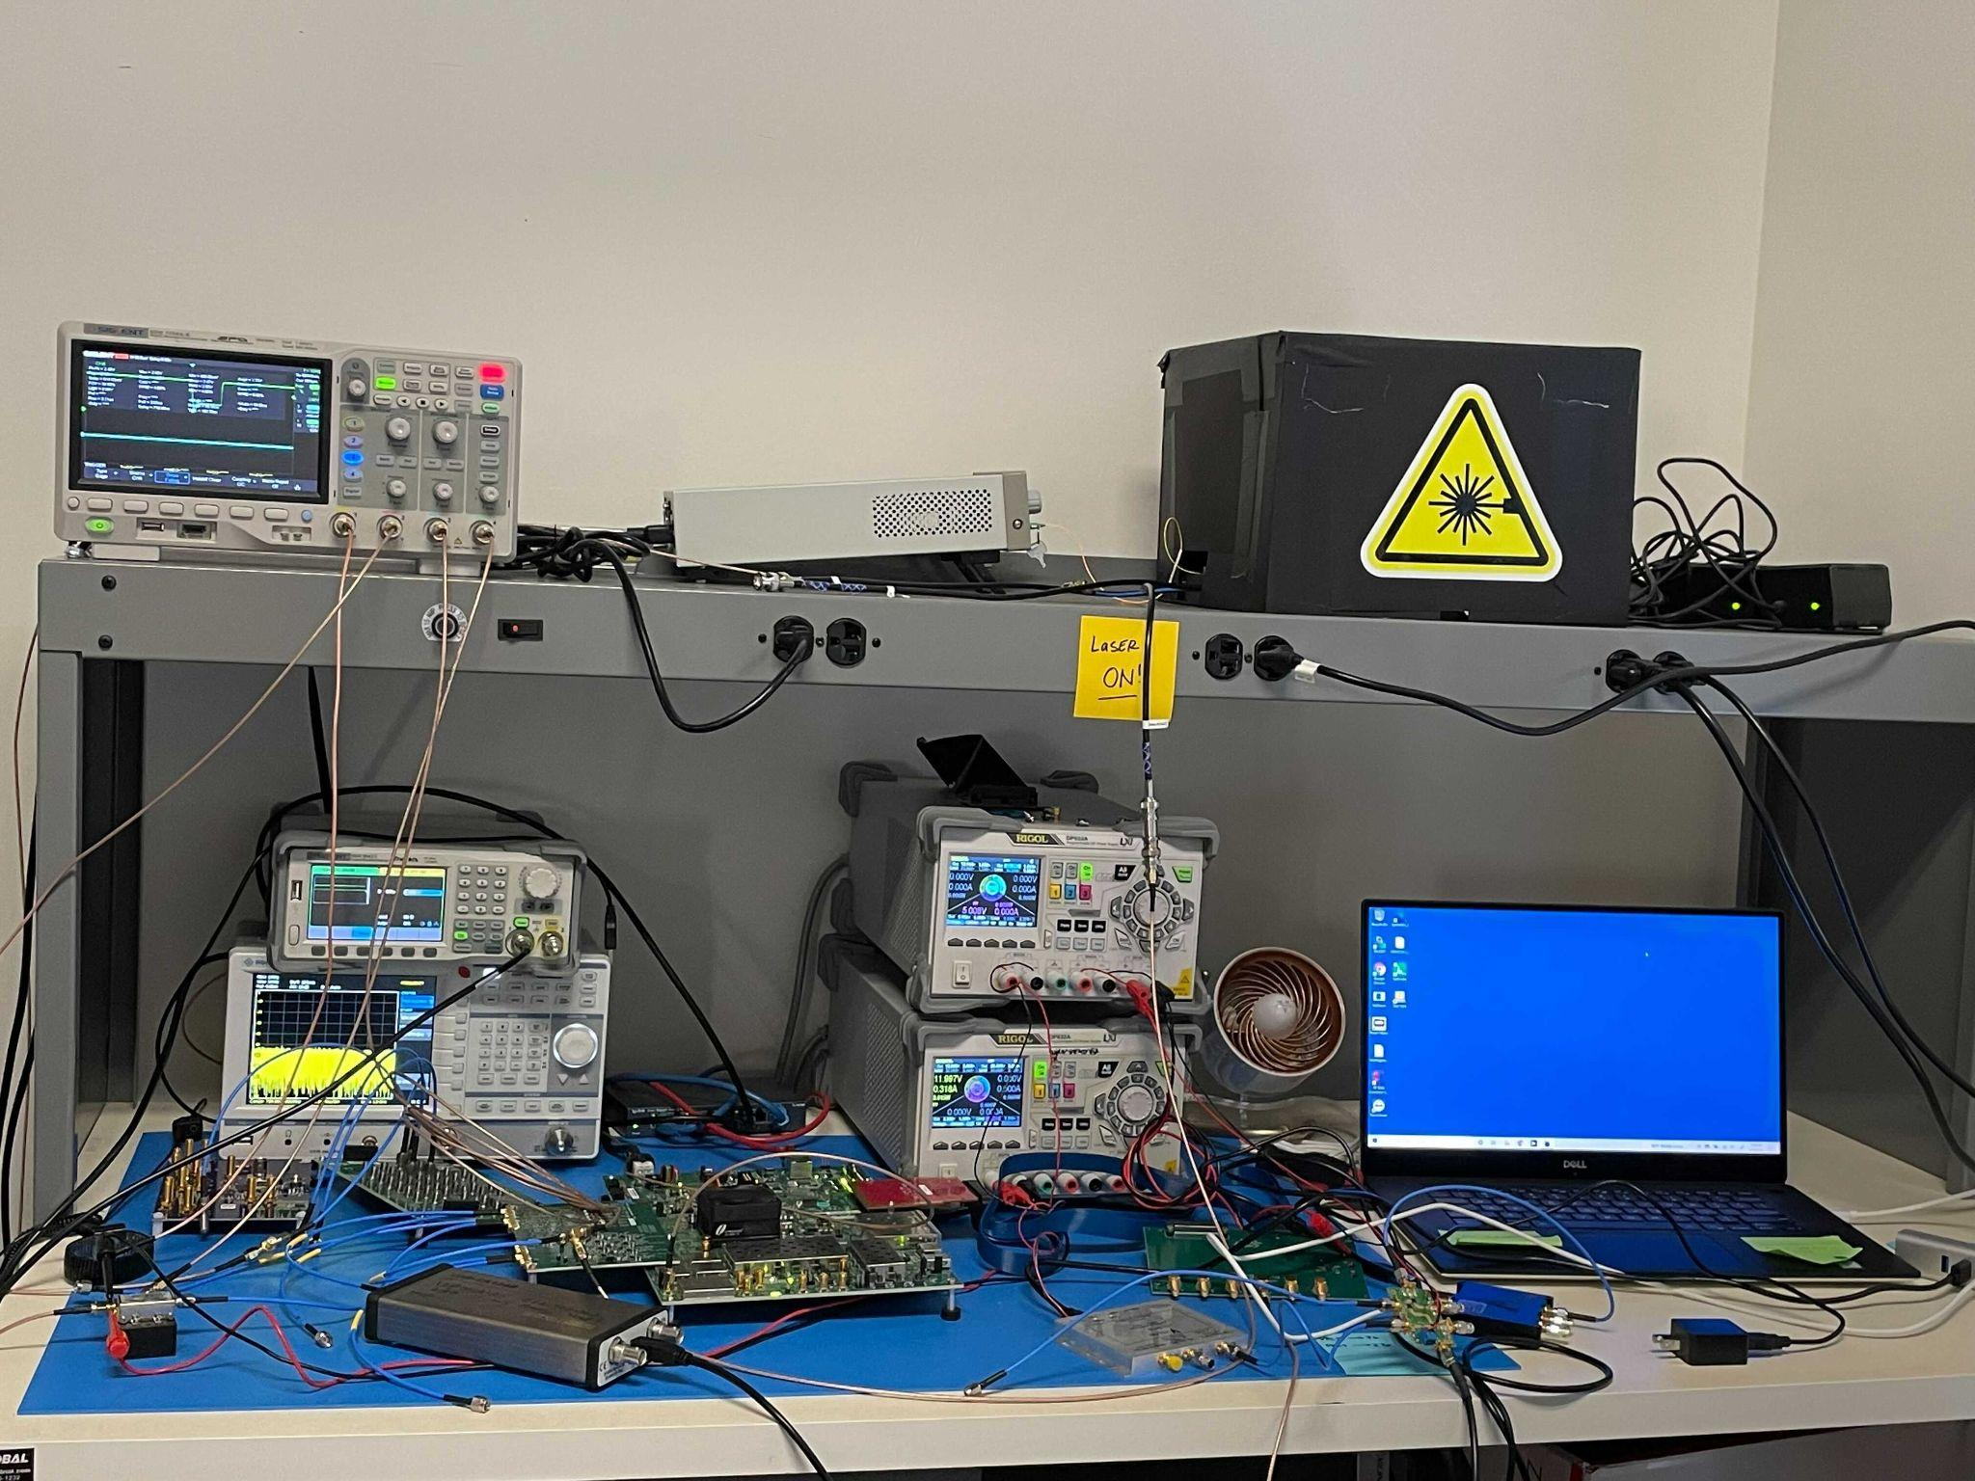
The “Before” Times
Hapyxelor Frankenboard Benchtop Prototype

Slide 24
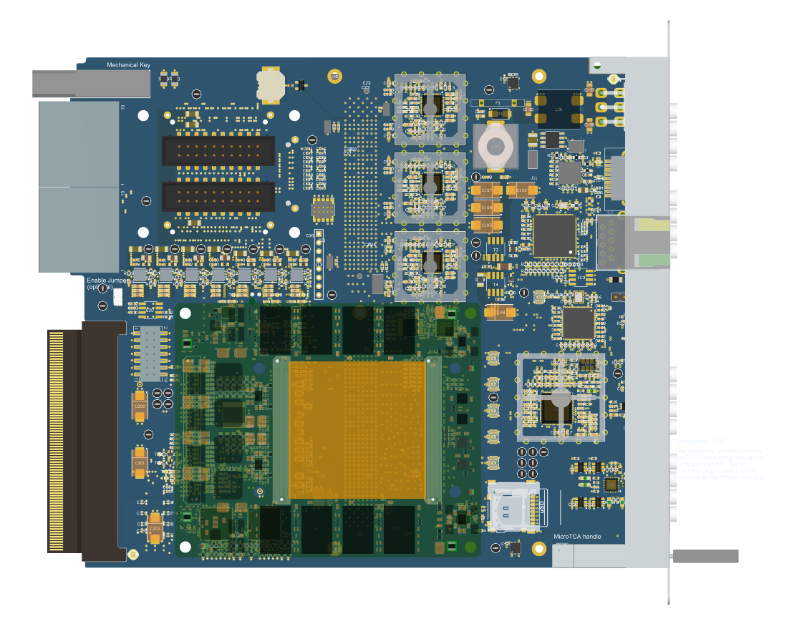
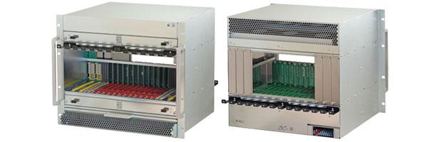
Custom MicroTCA SDR Hardware
SKIPPER REAR TRANSITION MODULE (RTM): DIGITAL TRIGGERS
KOWALSKI ADVANCED MEZZANINE CARD (AMC): RFSoC SDR
MicroTCA: Standard, scaleable, replicable form factor for Atom Computing’s control system electronics
https://www.picmg.org/openstandards/microtca/

Slide 25
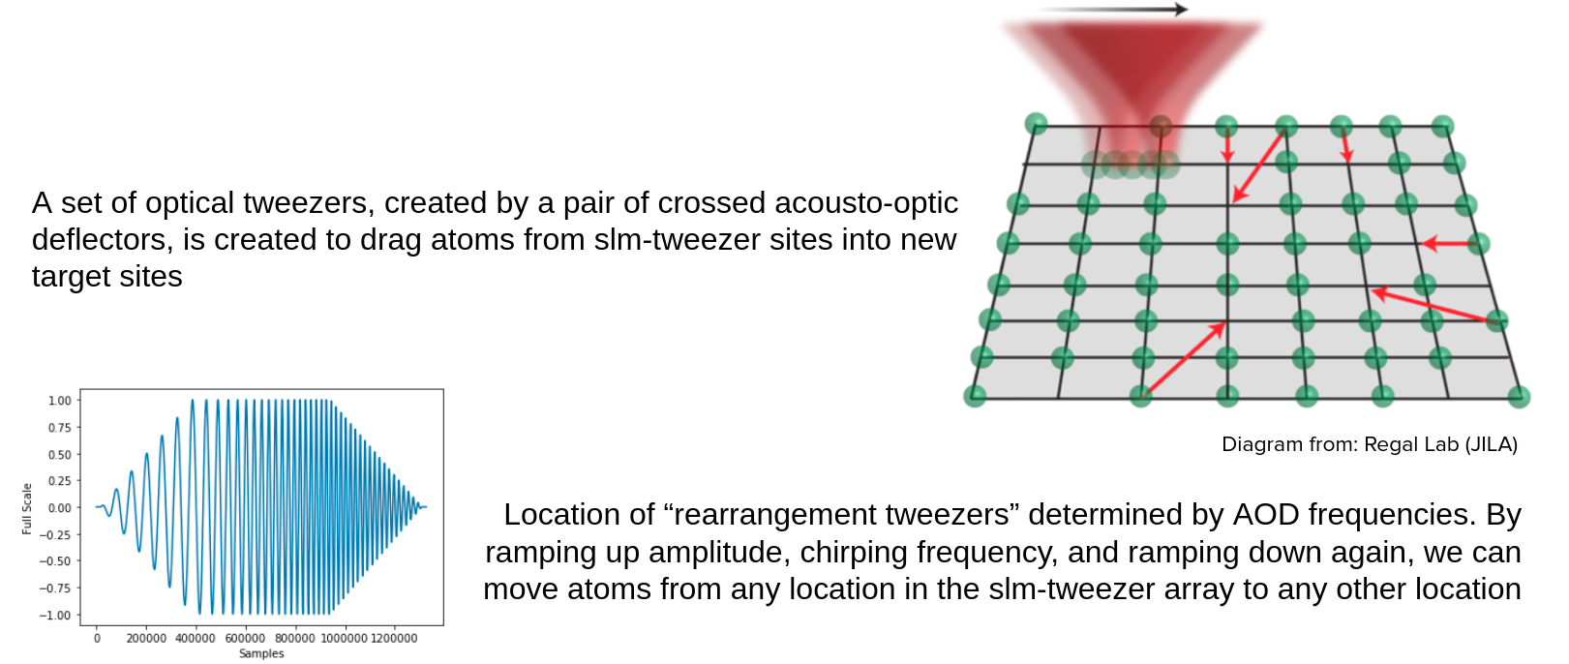
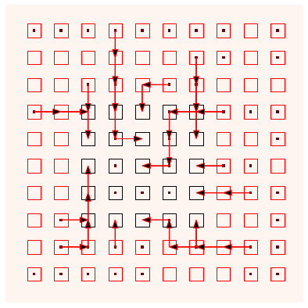
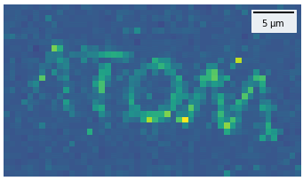
Hapyxelor in Action: Rearrangement

Slide 26
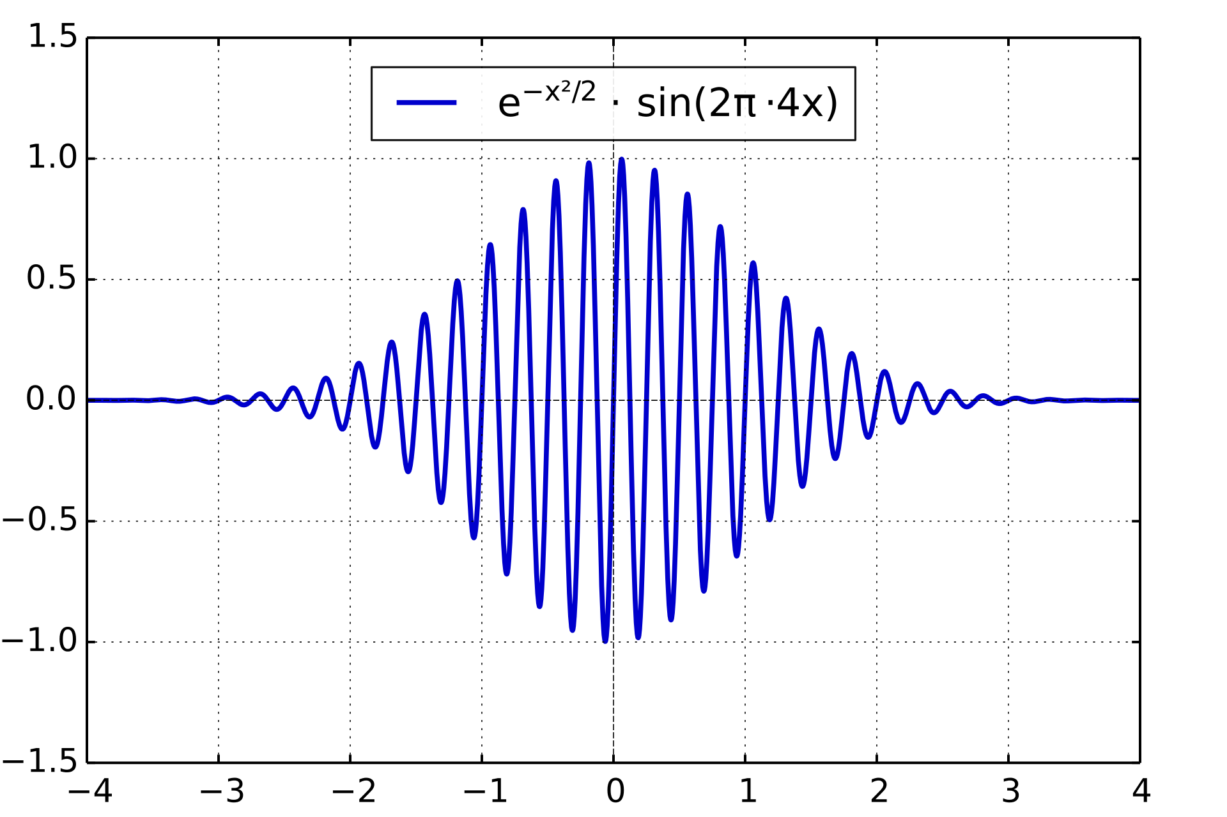
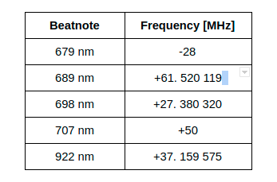
Optical Frequency Comb
Erbium-doped fiber mode-locked laser with a spectrum made up of discrete, equidistant frequency components
Mode Locking: laser outputs femtosecond-scale optical pulses in the time domain separated by the round-trip propagation time in the laser cavity.
Pulse train approximates a Dirac Delta function in the time domain and a Dirac Comb in the frequency domain defined by offset & repetition rate
The Ultimate Frequency Reference!
Maps RF frequencies (10-300 MHz) onto THz-scale optical frequencies
Jan Hall and Theodore Hänsch: Nobel Prize in Physics 2005
Hall’s student, Prof. Jun Ye of CU Boulder, won the 2022 Breakthrough Prize in Fundamental Physics and is a scientific advisor to Atom Computing
Keeps our veritable plethora of CW lasers frequency locked.
Beat frequencies are in the sweet spot for an Ettus SDR (yes, I’m biased).
Electric Field vs. Time of an ultrashort laser pulse
Frequency Comb References:
https://en.wikipedia.org/wiki/Frequency_comb
https://www.nist.gov/topics/physics/optical-frequency-combs

Slide 27
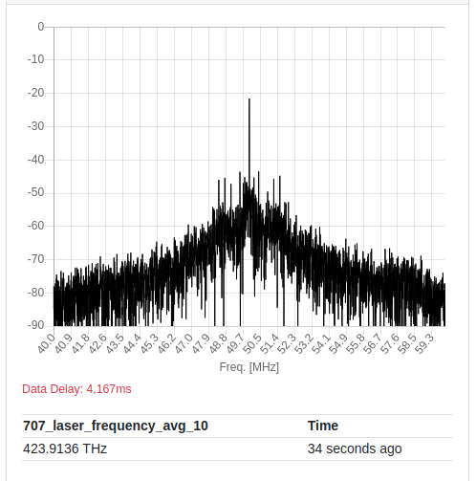
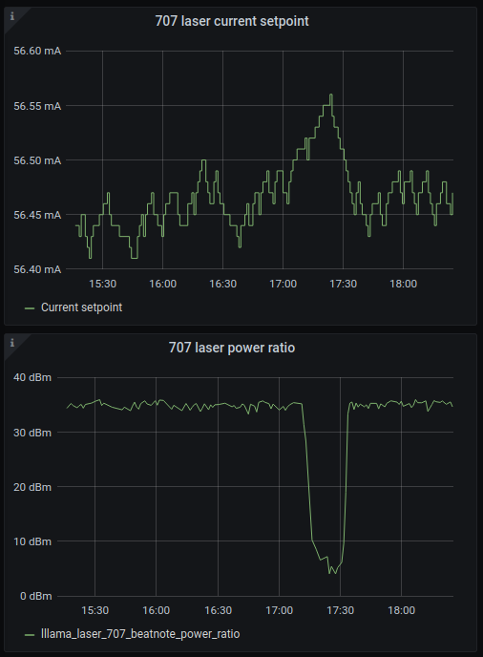
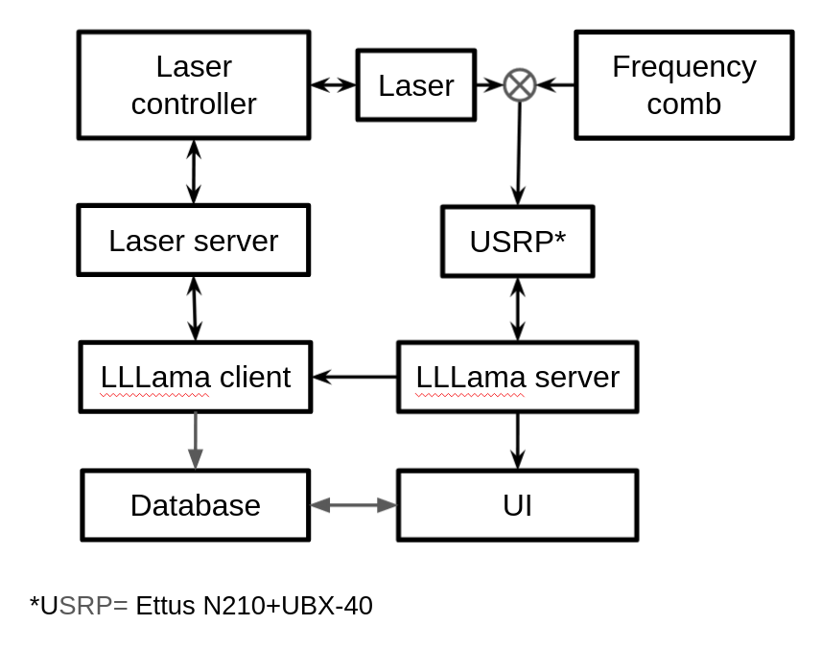
LLLama: Long-term Laser Locking and Monitoring Apparatus
Measure beatnote RF FFT spectrum with Ettus USRP N210 + UBX-40
Integrate PSD in band at carrier and a few MHz away
Calculate ratio of integrated powers
See if power ratio has decreased, if so, change the current setpoint
Periodically monitor beatnotes of all lasers in the system with an RF switch

Slide 28
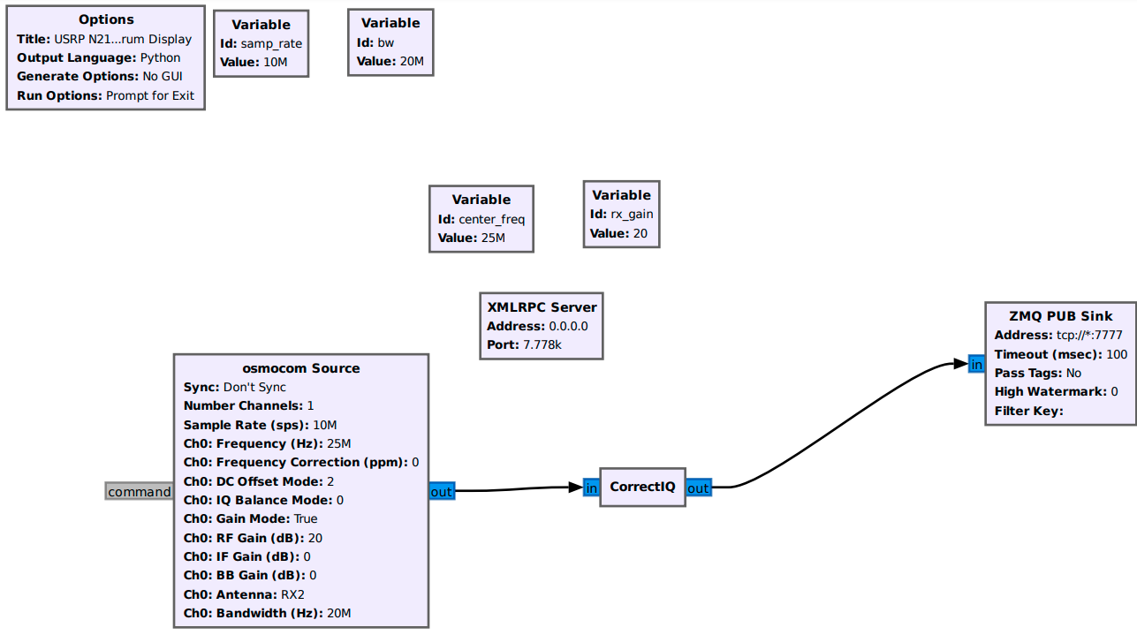
LLLama GNU Radio Flowgraph: 1 μBalint?
This underwhelming GNU Radio Flowgraph has increased the uptime of our lasers from O(days) to O(weeks)!
Laser lock status is displayed in a real-time environmental monitoring display
Notes:
We were originally using a HackRF, hence the osmocom source, but needed a better receiver, so upgraded to a USRP N210.

Slide 29
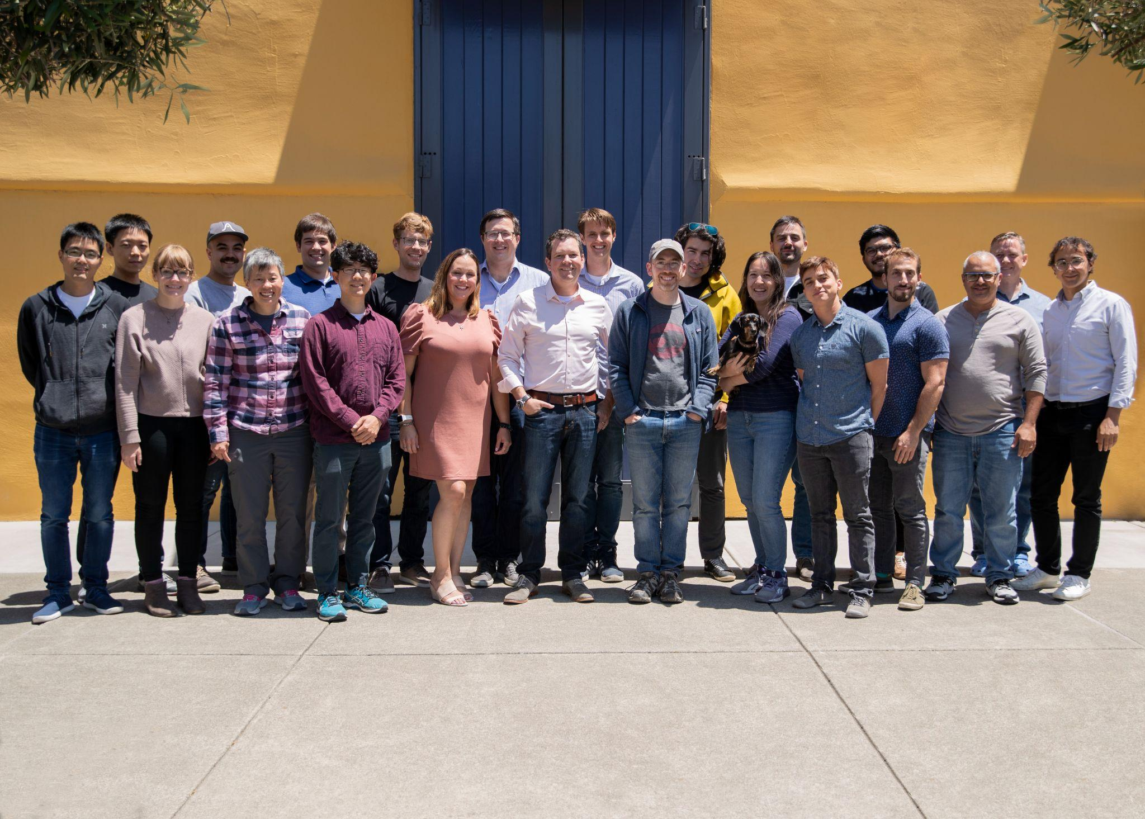
ATOM COMPUTING
WE’RE HIRING SOFTWARE AND FPGA ENGINEERS
www.atom-computing.com/careers
We build quantum computers using optically-trapped neutral atoms.
Founded in 2018 by Ben Bloom and Jonathan King
Funded by VC and U.S. Government grants
30+ people and growing
HQ in Berkeley, CA
Offices in Boulder, CO, Austin, TX, and Cary, NC

